Slide 1

Direct dark matter searches with XMASS
S. Moriyama, ICRR, University of Tokyo
December 17, 2015 @ Kyoto, DSU 2015

Slide 2
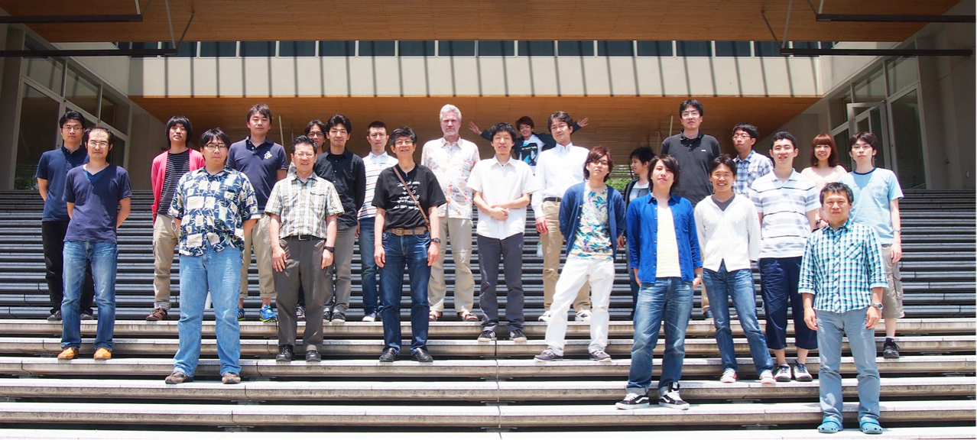
The XMASS collaboration:
Institute for Cosmic Ray Research, the University of Tokyo
Kavli Institute for the Physics and Mathematics of the Universe, the University of Tokyo
Kobe University
Tokai University
Yokohama National University
Miyagi Educational University
STE lab., Nagoya University
Tokushima University
Center for Underground Physics, Institute for Basic Science
KRISS
10 institutes 41 researchers.

Slide 3
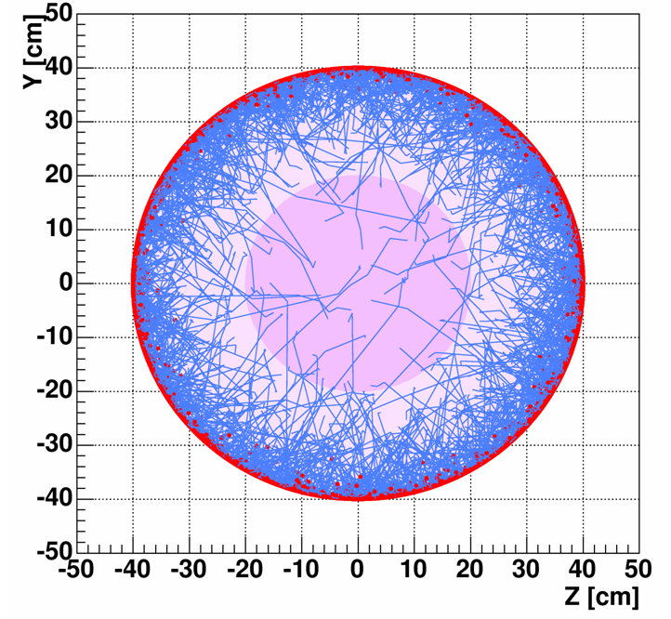
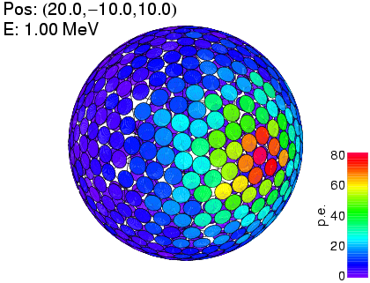
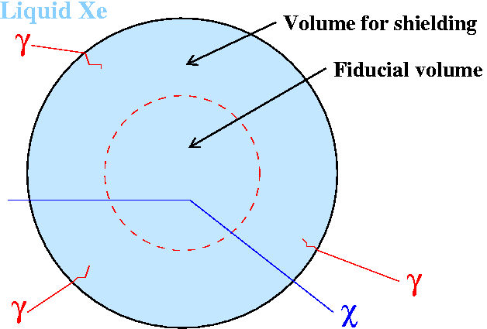
Self-shielding and event reconstruction
liquid xenon for self-shielding
low BG for DM search
Liquid Xe
Densely packed
photomultipliers
detect scintillation
lights!
trajectories of γ rays

Slide 4
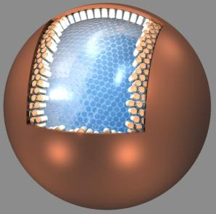
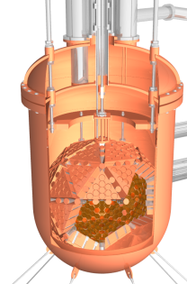
1 phase LXe: XMASS project
XMASS-I
XMASS-1.5
XMASS-II
DM
1ton fid. (5ton)
1.5mφ, ~1000 PMTs
pp solar ν limited
Ultimate BG for elec.
WIMPs <10⁻⁴⁶cm²
various types of DM
DM, solar, ββ
10ton fid. (25ton)
Detailed study of DM
including e channel
pp Solar nu
ββ ~30meV(IH)
DM
100kg fid. (830kg)
0.8mφ, 642 PMTs
2010-
DM search

Slide 5
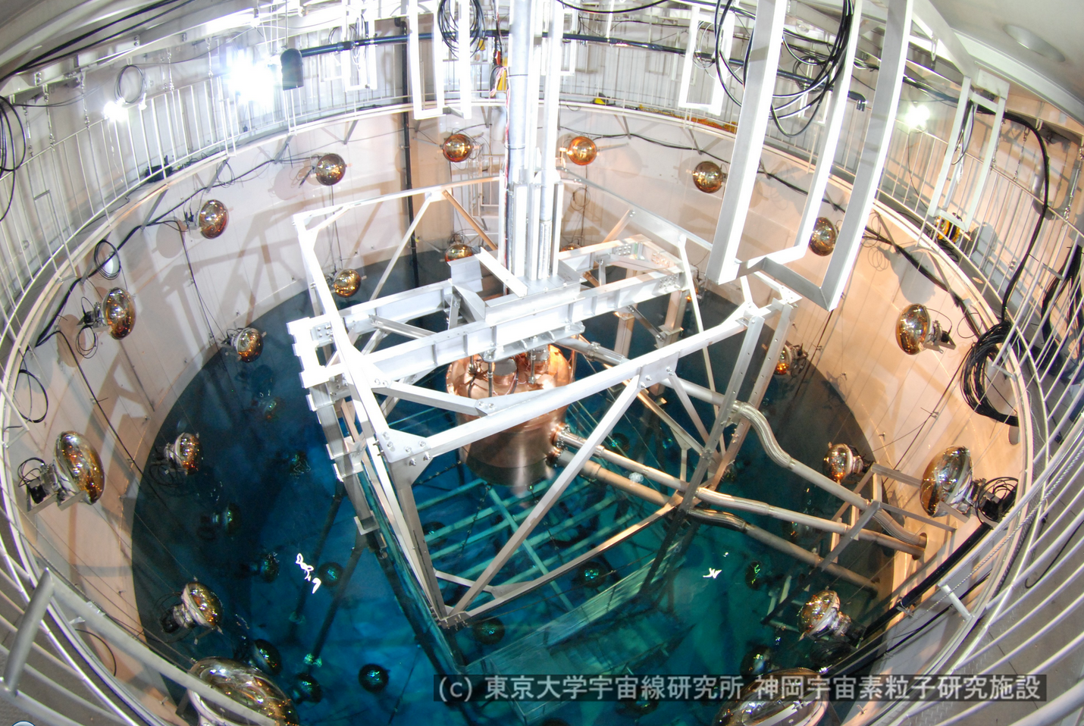
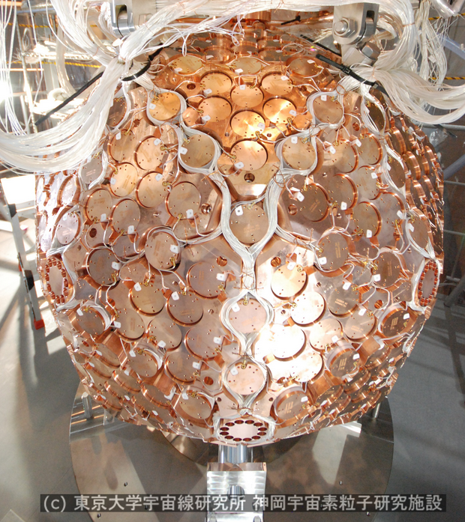
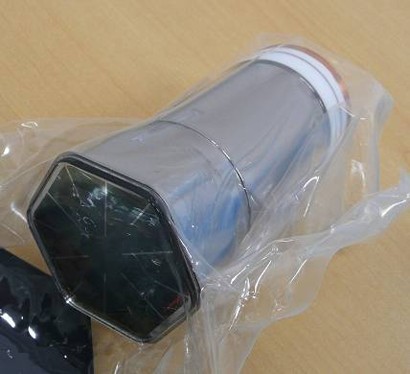
XMASS-I detector
Single phase liquid xenon detector.
~830kg of LXe for sensitive region.
642 low background PMTs.
10m x 10m water tank with 70 PMTs (20 inch ) for muon veto.
High photoelectron yield ~14pe/keV.
Eth <1keVee & <3keVnr for full volume analysis.

Slide 6
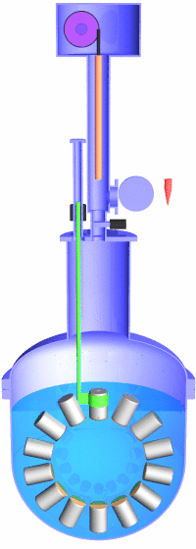
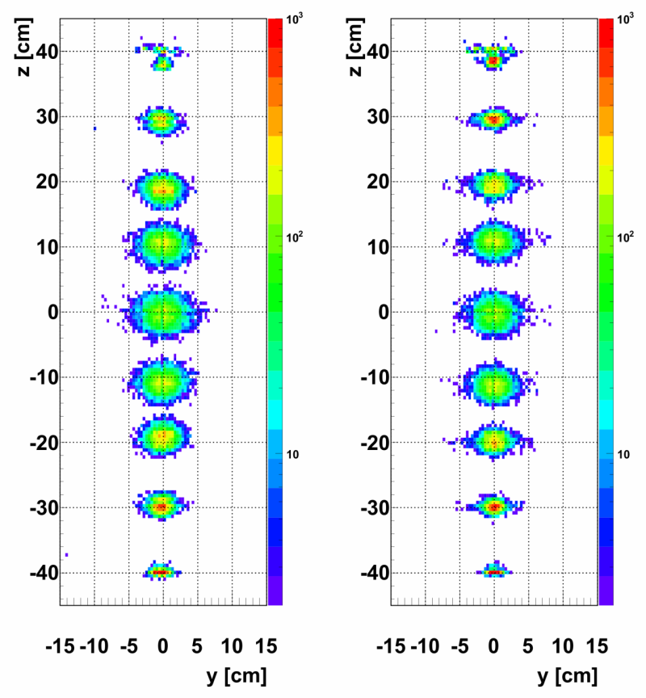
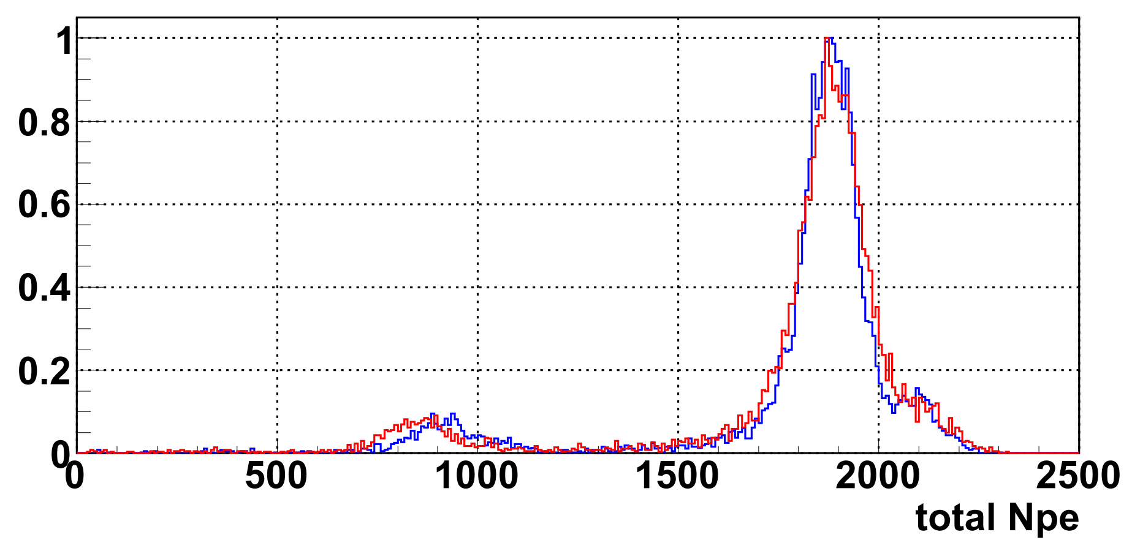
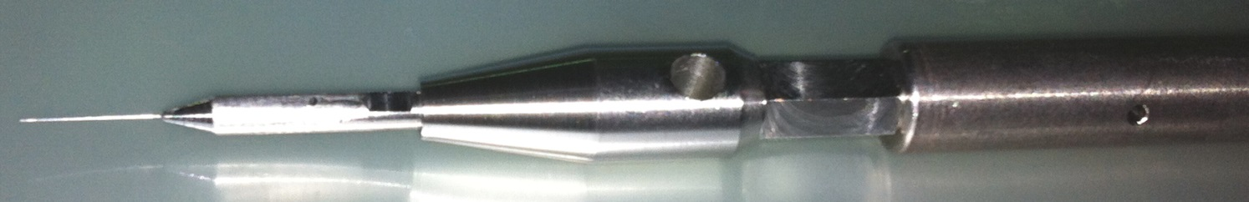
XMASS Inner Calibration
Stepping
motor
Calibration data every week.
Reconstructed position distributions were reproduced by Monte Carlo samples.
Optical parameters were tuned by these data sets.
data
MC
Z [cm]
Z [cm]
data
MC
122keV
~4% rms
~5m
Gate
valve
136keV
59.3keV of W
Top
photo
Tube
can be
removed
Φ0.21 mm for ⁵⁷Co source
Source rod
6
Notes:
Want to explain just one thing related to actual detector operataion.

Slide 7
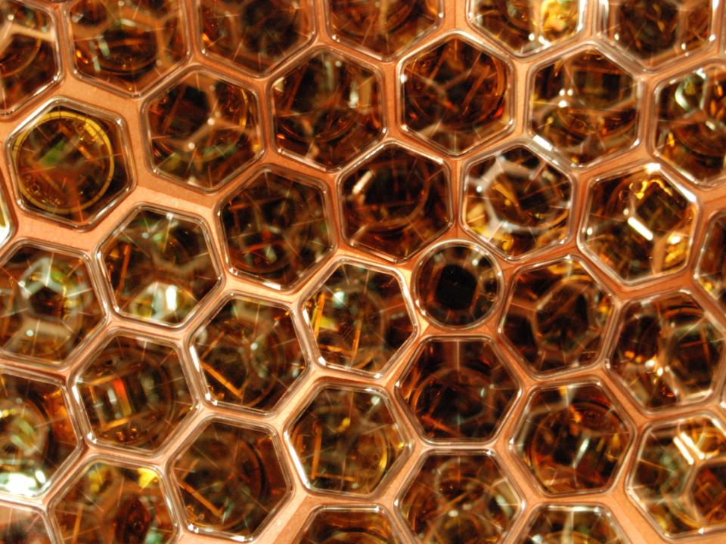
Advantages of the XMASS-I (1)
Large photoelectron yield
  Densely packed photomultipliers directly surround the liquid xenon target.
  No electric field which reduces scintillation signal. (necessary in 2-phase detectors)
  Low energy threshold can be realized.
Impact of photo coverage differences among LXe detectors
XENON100
2.3/3.8
Effect of electric field for e signals
LUX
6.7/8.8
XMASS-I
14 photoelectrons/keV
Notes:
LUX with field was obtained by NEST, @122keV 0 field = 63photons/keV, 200V/cm = 48photons/keV.
They use 181V/cm for LUX first paper.
As for the XENON100, I refer arXiv:1402.3731, page 5, evaluation by NEST(38/63), I got similar number, 3.7.
➔ xenon solar axion paper, 3.76p.e./keV is written.
LUX nr, from paper figure, 7keVnrで90% efficiency after S1+S2 or S1 only

Slide 8
Search for low mass WIMPs
DAMA
PLB 719 (2013) 78
XMASS
CDMS-Si
~full efficiency @3keV nuclear recoil
No position information was used.
➔ Energy threshold can be minimized for the analysis.
Our observed spectrum excluded majority of DAMA region.
Efforts to lower the threshold are being made.

Slide 9
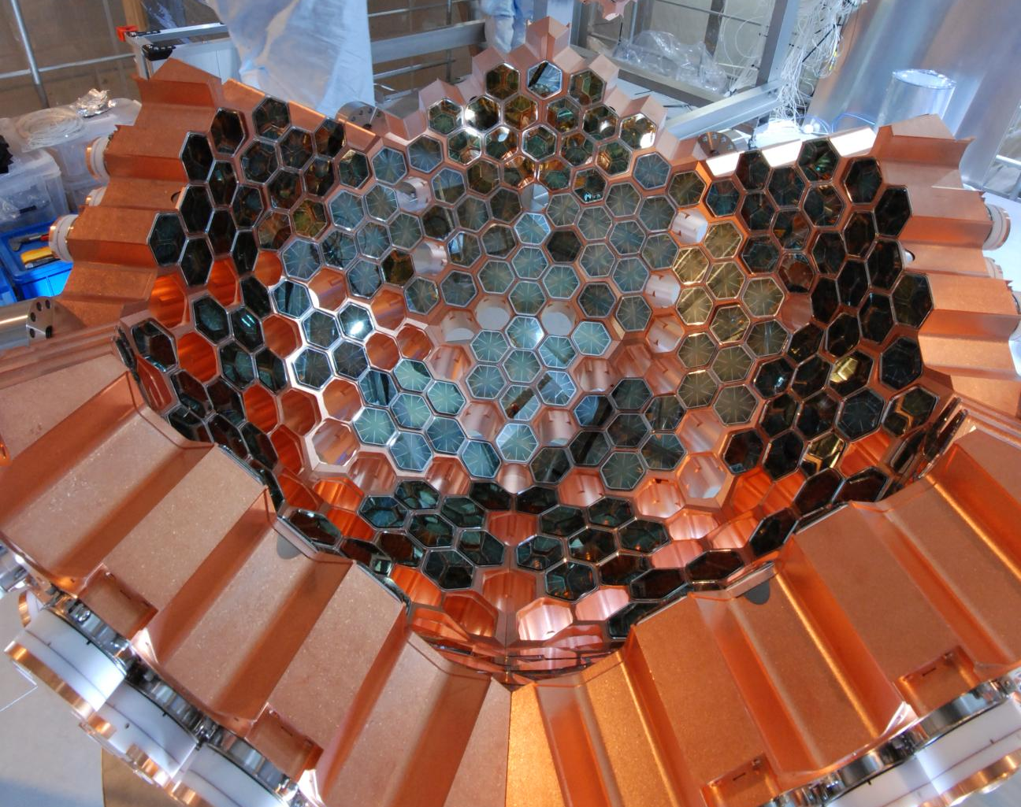
Advantages of the XMASS-I (2)
Large mass
  ~830 kg sensitive mass (XMASS-I), the largest size among DM detectors
  >1.5yrs of data taking continuing, the longest running time among LXe detectors
  Large exposure data set comparable to the DAMA/LIBRA modulation data 1.33ton year is available.
∼ 84 cm
Bottom half of the detector while construction

Slide 10
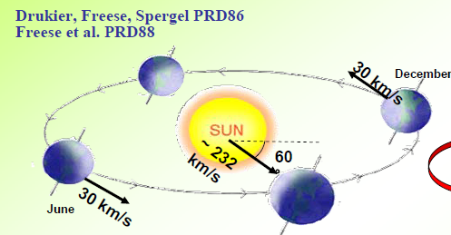
Search for annual modulation
DAMA/LIBRA
Modulated signal in DAMA/LIBRA data set:
  No experiments have confirmed, still no explanation.
A direct verification by comparable exposure is necessary. Electron signals must be examined as well because DAMA data include electron signals.
low threshold: 1.1keVee threshold ⬄ 2keVee DAMA
XMASS-I is suitable to cross check their data!

Slide 11
Search for annual modulation
NEW! arXiv: 1511.04870
  Two analyses
    Independent of a specific DM model. ➔ No significant modulation.
    Applicable to both of electron/nuclear recoils.
90% C.L.
upper limits
for positive/negative
amplitude

Slide 12
Results from XMASS-I
NEW! arXiv: 1511.04870
8GeV WIMP (2x10⁻⁴⁰cm²)
  Assuming energy spectra for standard WIMPs.
1.1-1.8keVee
7GeV
We exclude almost all the DAMA/LIBRA allowed region solely with the modulation analysis.

Slide 13
Advantages of the XMASS-I (3)
Two interaction channels to search for dark matter
  No discrimination between nuclear recoils and e recoils.
  This forces us to realize low BG including e/γ events. ➔ the world lowest BG >40keV. (~x30 of pp solar ν)
  Enables us to search for DM signatures through electron-interaction channels.
    Particles beyond WIMPs
    Other physics (ν phys., solar axions, etc.)

Slide 14
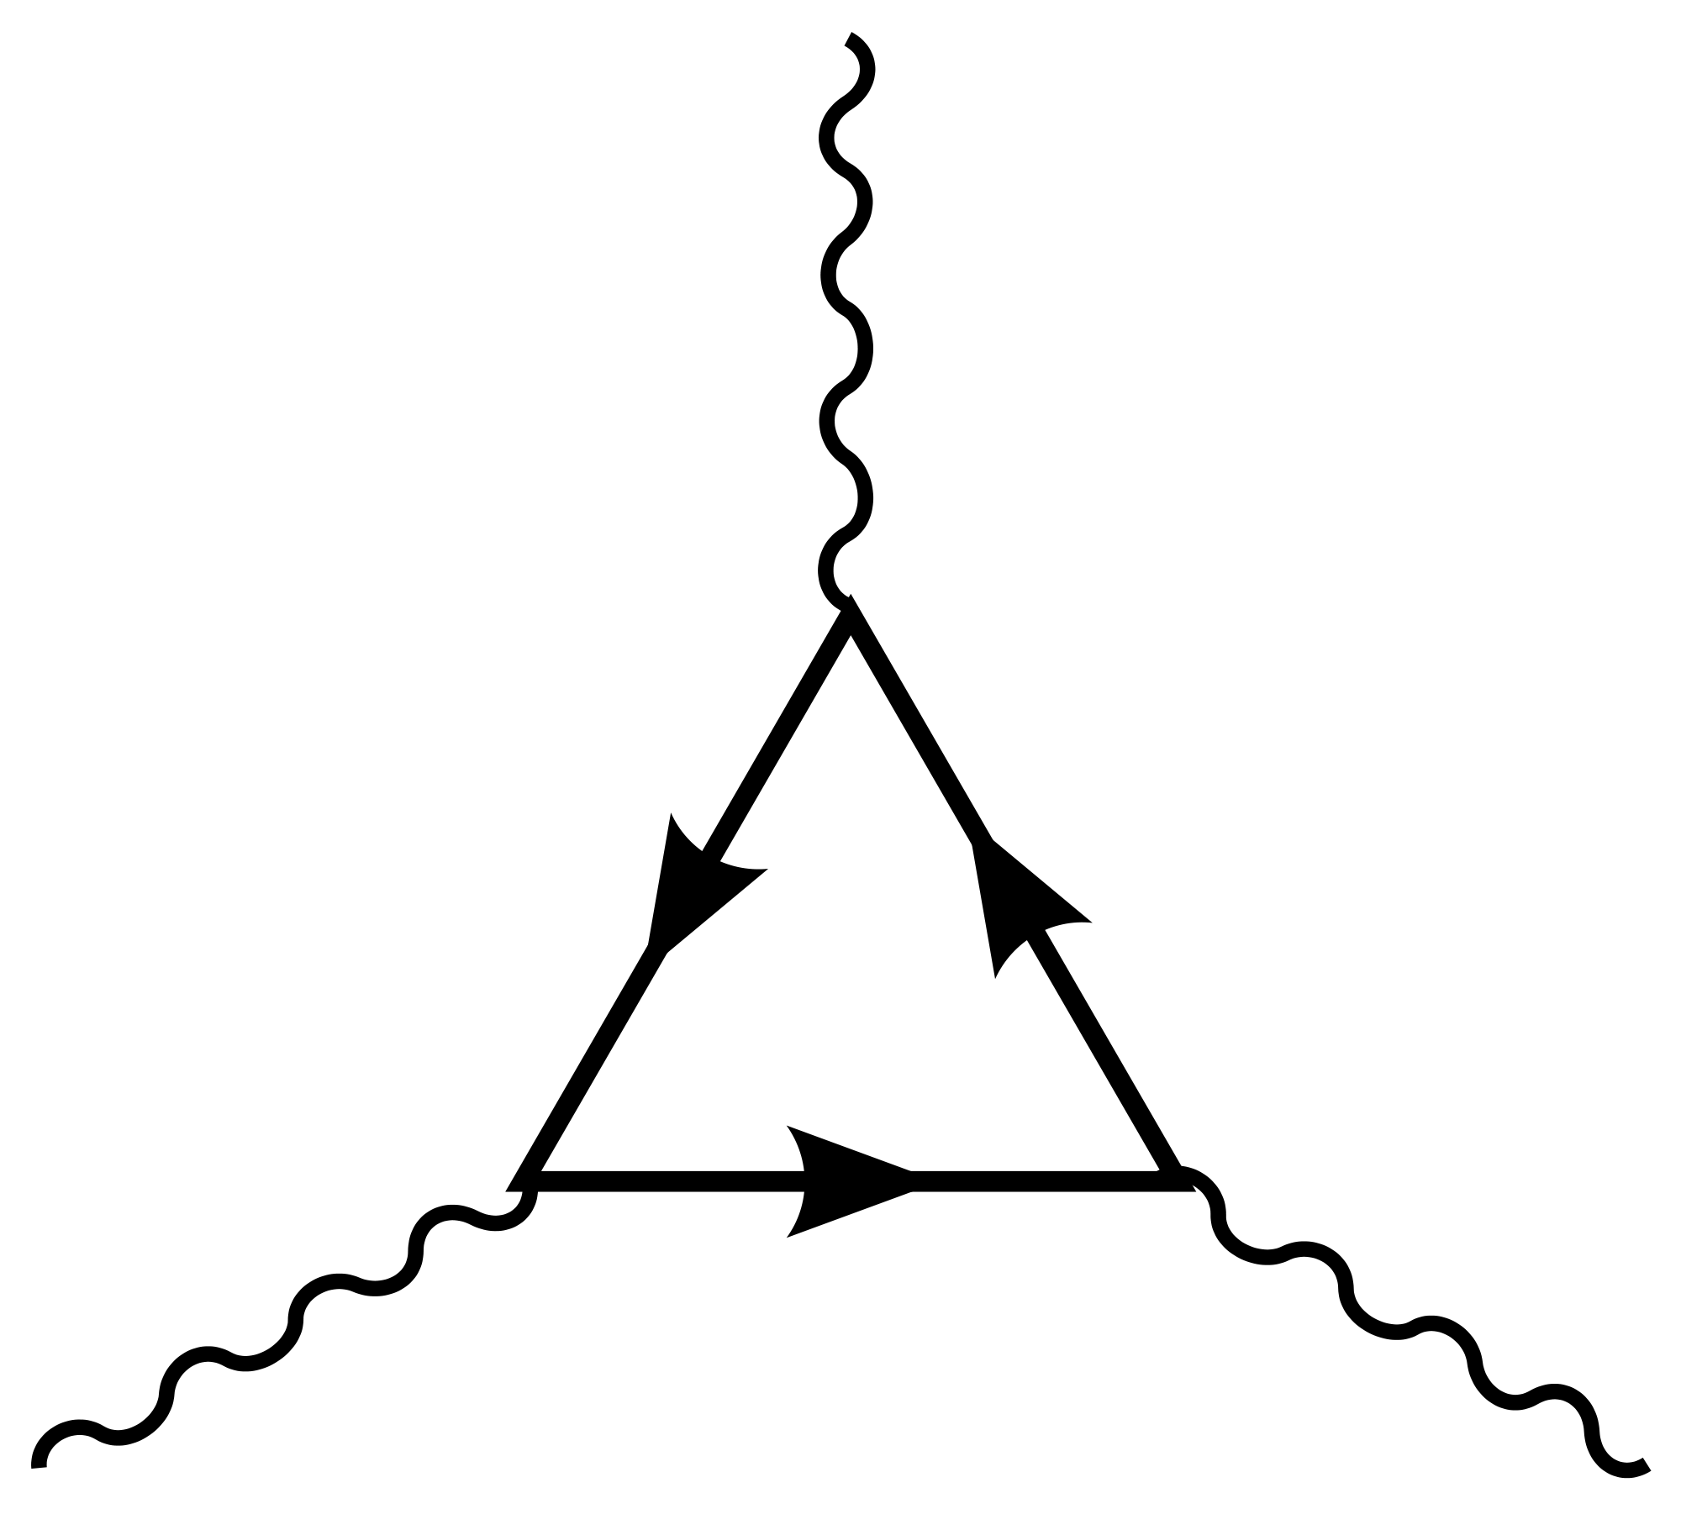
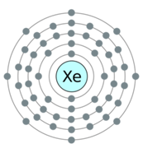
Physics results with the world
lowest BG >40keV (1)
Double electron capture +2ν decay of ¹²⁴Xe
  “peak search” @ 64keV (=two K-shell X-rays)
  World best lower limit of half-life >2.0x10²¹ yr.
NEW! arXiv: 1510.00754
ν
K-shell X-ray
Upper limit of the signal
K-shell X-ray
ν

Slide 15
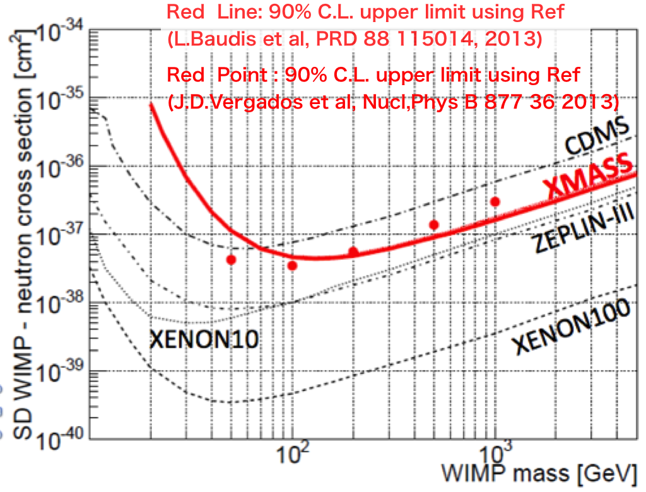
Physics results with the world
lowest BG >40keV (2)
¹²⁹Xe, inelastic scattering by WIMPs
  “peak search” @ 40keV (=40keV γ + nucl. recoil.)
  World best upper limit via the inelastic channel.
Spin dependent cross section
XMASS collaboration
PTEP, 2014, 063C01
keV
Table of Isotopes

Slide 16
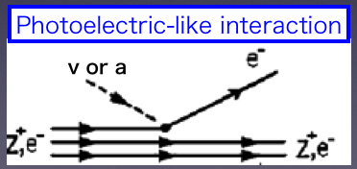
Physics results with the world
lowest BG >40keV (3)
Bosonic super-WIMPs
  Coupling and mass to produce the observed DM density had not been directly tested.
  Convert their rest mass into kinetic energy of electrons.
  “peak search” @ rest mass
  Excluded the model in 40-120 keV mass range.
pseudoscalar:
axion-like particles
90% C.L.
vector
XMASS collaboration
Phys. Rev. Lett, 113, 121301 (2014)

Slide 17
Future of XMASS

Slide 18
Next stage: XMASS-1.5
XMASS-I
XMASS-1.5
XMASS-II
DM
1ton fid. (5ton)
1.5mφ, ~1000 PMTs
pp solar ν limited
Ultimate BG for elec.
WIMPs <10⁻⁴⁶cm²
various types of DM
DM, solar, ββ
10ton fid. (25ton)
Detailed study of DM
including e channel
pp Solar nu
ββ ~30meV(IH)
DM
100kg fid. (800kg)
0.8mφ, 642 PMTs
2010-
DM search

Slide 19
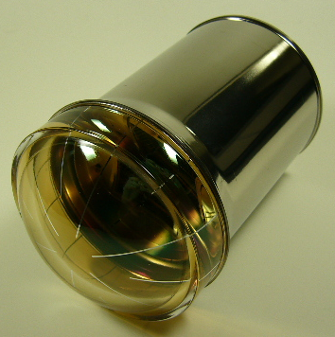
1. Reduction of RI @ inner surface: done!
2. Improvement to id surface BG: done!
XMASS-I, flat photocathode
XMASS-1.5, dome-shape photocathode
scintillation photons
scintillation photons
event vertex
event vertex
photocathode
photocathode
With these new PMTs, we can fully exploit the self-shielding effect.

Slide 20
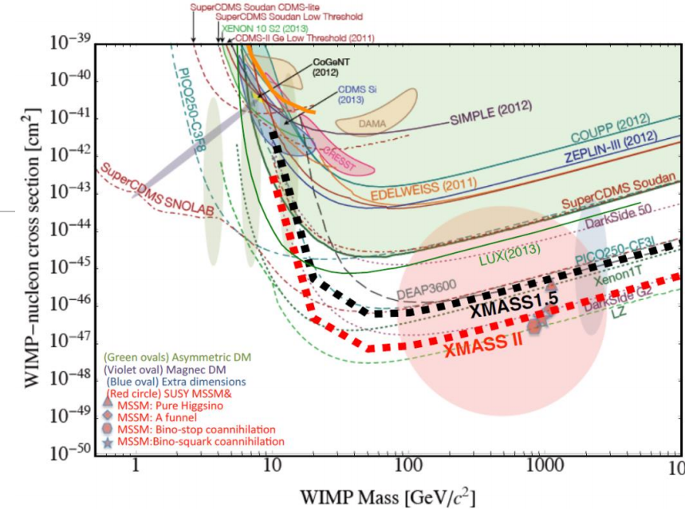
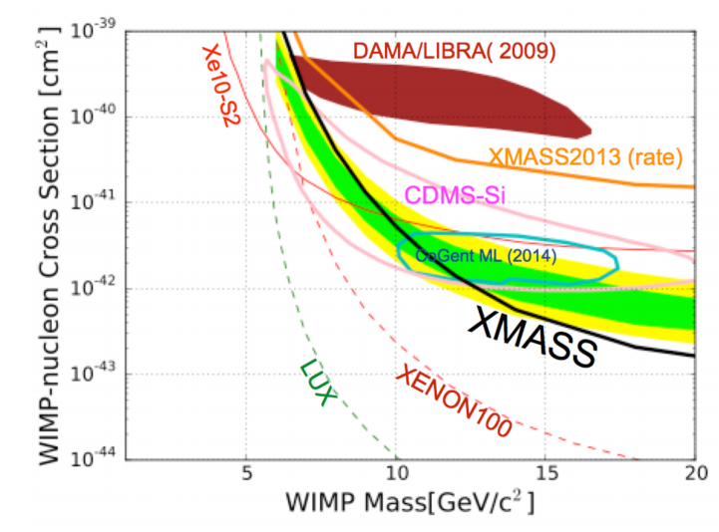
XMASS-1.5&II
bosonic super-WIMPs in XMASS-1.5
pseudoscalar: ALP
Total 5ton/fiducial 1ton
Total 25ton/fiducial 10ton
9x10⁻⁴⁷cm² & 2x10⁻⁴⁷ cm² @100GeV
~1x10⁻⁵/keV/kg/d (~pp solar ν)
Realize ultimate sensitivity for e recoil.
vector
Nuclear recoil
modulation analysis
XMASS1.5

Slide 21

Summary
XMASS has a unique advantages to search for dark matter particles: low threshold, large mass, and low BG for electron signals.
With them, various attempts to see signals from DM and other physics were conducted: low mass WIMPs, annual modulation, super-WIMPs, DEC, etc.
The best sensitivity to “electron recoils”. Any interesting dark matter models?
Planning to build detectors with much lower BG and larger targets. New PMTs are essential to detect dark matter and developed successfully.

