Slide 1


Observing GWs from CCSNe /
Stability of magnetar magnetospheres
Pablo Cerdá-Durán
University of Valencia
Multi-Messenger Astrophysics in the Gravitational Wave Era – YITP, Kyoto, 27 Sept. 2019

Slide 2

Outline
Part 1 – Observing gravitational waves from core collapse supernovae
Part 2 - Stability of twisted magnetar magnetospheres

Slide 3
Part 1 – Observing gravitational waves from core collapse supernovae
Collaborators:
A. Torres-Forné (AEI)
M. Obergaulinger (TU Darmstadt/UV)
J. A. Font (UV)
A. Passamonti (U. Alicante)
B. Müller (Monash University)
P. Astone, I. di Palma, F. Ricci, F. Muciaccia (INFN, Roma)
Marco Drago (GSSI)
Publications:
Torres-Forné et al 2018a,b, 2019, Astone et al 2018

Slide 4
GW emission in CCSN
Collapse of the core of massive stars (8-100 M☉)
Non-rotating progenitors (>99%) (Li et al 2011, Chapman et al 2007)
Observable within ~10 kpc (Gossan et al 2015, Powell & Müller 2018)
Rare events (1/ 30 year in our galaxy) (Adams et al 2013)
1. Collapse
4. Neutrino-driven
explosion
3. PNS excitation
2. PNS formation
MPA

Slide 5
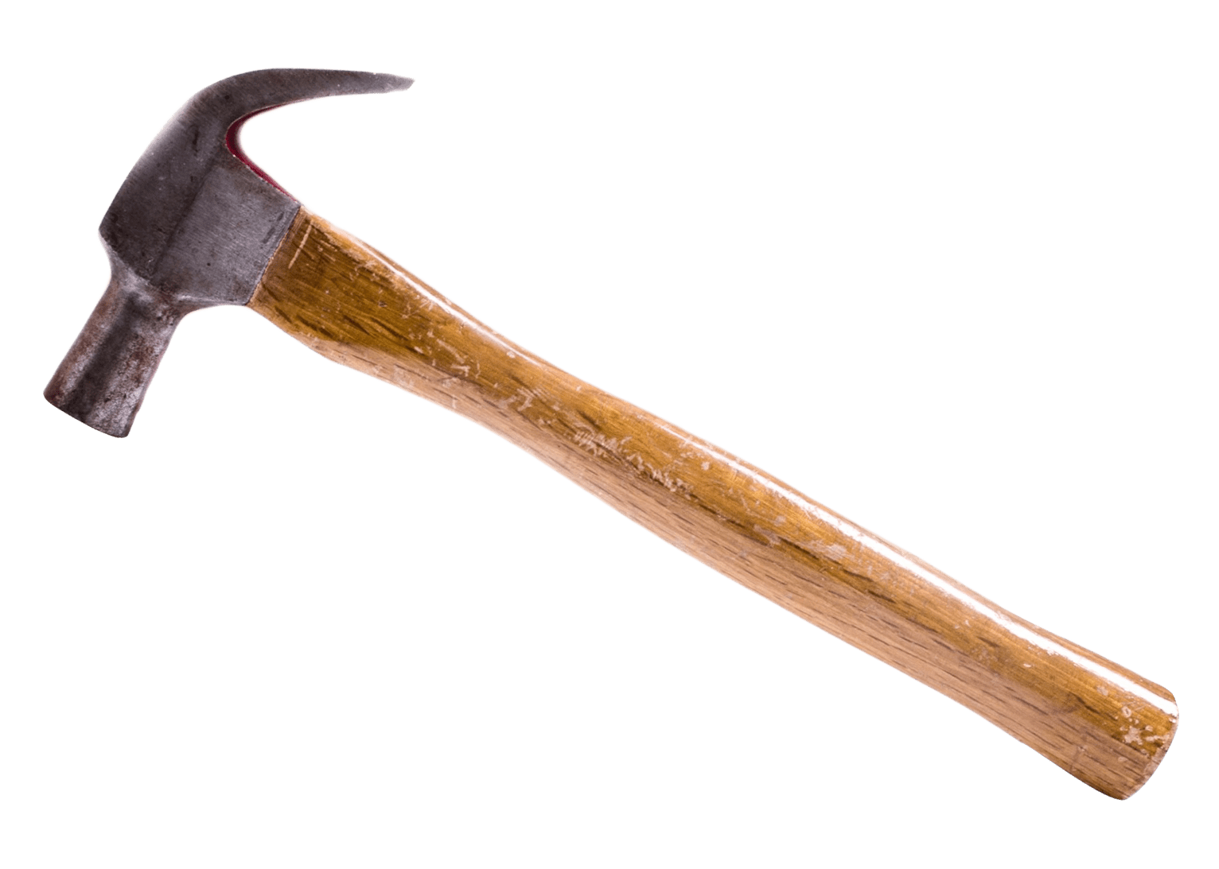

GW emission in CCSN
PNS phase (before explosion):
Duration: ~ 0.1 – 1 s
PNS mass grows: ~0.5 M☉ → 1.4 – 2 M☉
PNS shrinks: ~30 km → ~10 km
PNS cools down
PNS excitation
The “hammer”: convection, SASI
The “bell”: proto-neutron star
The “ring”: PNS normal modes
2. PNS formation
MPA

Slide 6
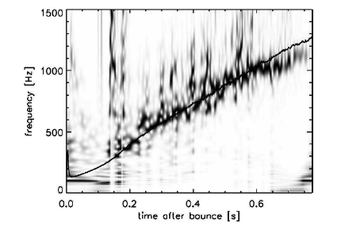
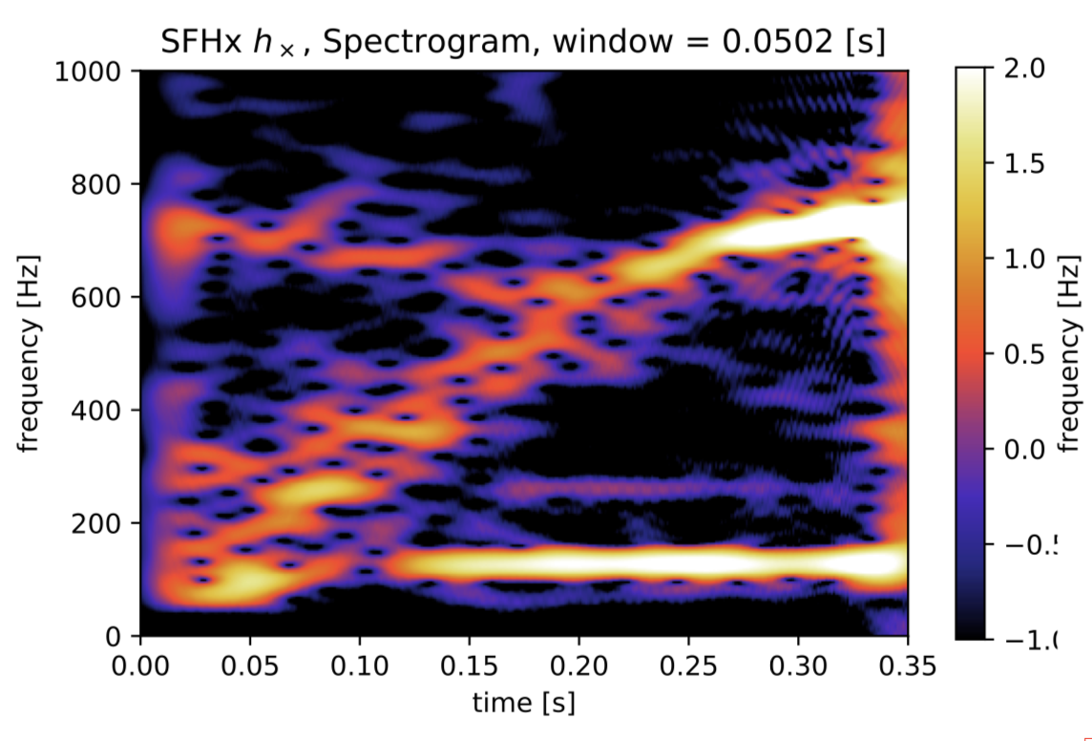
GW emission from PNS oscillations
Powell et al 2019
Müller et al 2013
Highly stochastic
Torres-Forné et al 2019
Kawahara et al 2018
Time evolving frequencies (g-modes, SASI)

Slide 7
PNS asteroseismology
Which modes are observed?→ mode identification (this talk)
How do mode frequencies depend of PNS properties? → universal relations
(A. Torres-Forné’s talk, next week)
f (M,R,…)
?
?
Torres-Forné et al 2019

Slide 8
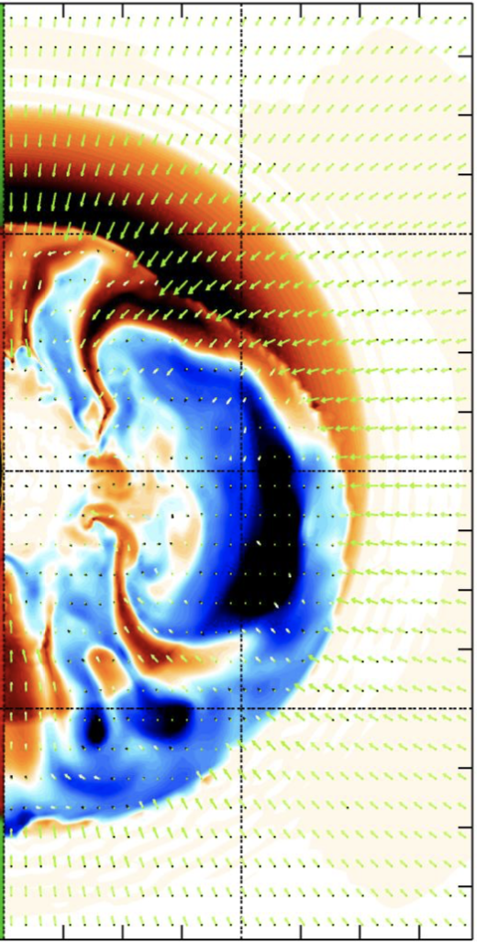
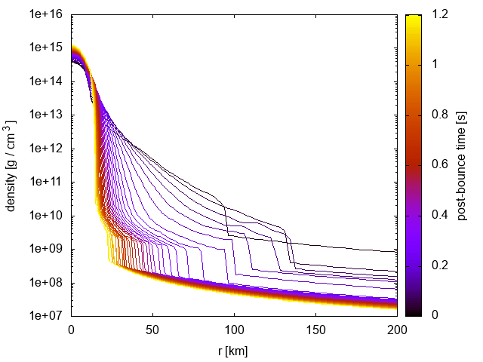
Proto-neutron star oscillations
Torres-Forné et al 2019
Multi-dimensional numerical simulation
waveform
spectrogram
?
1D angular average
l=2 eigenmodes
Obergaulinger et al 2013
Torres-Forné et al 2018

Slide 9
Proto-neutron star oscillations
Linear perturbations of a spherical background → eigenvalue problem
Simplified background (TOV, polynomials…)
Reisenegger & Goldreich 1992
Ferrari et al 2003, 2004
Passamonti et al 2005
Krüger et al 2015
Camelio et al 2017
Sotani et al 2017
Background from simulations
Torres-Forné et al 2018, 2019a,b
Morozova et al 2018
Sotani et al 2019
Westernacher-Schneider 2019
Our contribution:
Background from simulations
GR formalism including space-time perturbations (lapse and conformal factor)
Global treatment (PNS + shock)
GREAT = General Relativistic Eigenmode Analysis Tool
https://www.uv.es/cerdupa/codes/GREAT/

Slide 10
Classified modes
p-modes
f-mode
g-modes
Torres-Forné et a 2018b
s20, SFHo EOS

Slide 11
Comparison with GWs
Most of the GW signal in CCSN can be modelled as PNS oscillations
It is possible to identify PNS modes in GW data
Asteroseismology
(see A. Torres-Forné talk, next week)
₃
²g₁
²g₃
²f

Slide 12
Can we use this to help with GW detection?
MPA

Slide 13
SNe GW detection in LIGO/Virgo
Current methods: unmodelled burst searches
Can we improve these by adding information about the SN signal (g-modes)?
Train a convolutional neural network (CNN) to recognize GW patterns

Slide 14
SNe GW detection in LIGO/Virgo
Train CNN with SN-like waveforms → phenomenological templates
Modify coherent waveburst pipeline (CWB, Klimenko et al 2008, 2016) to include the CNN
Compare results with original CWB

Slide 15
Parametrized phenomenological templates
Mimics PNS modes
Model: damped harmonic oscillator
7 free parameters (ccphenv2)
Stochastic excitation: different realizations possible
Astone et al 2018
Automatic generation of templates to train CNN (800 in this work)

Slide 16

Pipeline
time-freq. likelihood
waveform
CWB
CWB
SIGNAL / NOISE
+ Detector Gaussian noise
CNN
SIGNAL / NOISE

Slide 17
Detection efficiency
Astone et al 2018
10000 signal images & 10000 noise images
Improved efficiency over CWB
Proof-of-concept: more realistic setup needed.
It is possible to improve detectability using CNN and phenomenological templates

Slide 18
Part 2 - Stability of twisted magnetar magnetospheres
Collaborators:
T. Akgün, J.A. Miralles, J.A. Pons (U. Alicante)
J. Mahlmann, M.A. Aloy (U. Valencia)
Publications:
Akün et al 2016, 2017, 2018a,b, Mahlmann et al 2019.

Slide 19
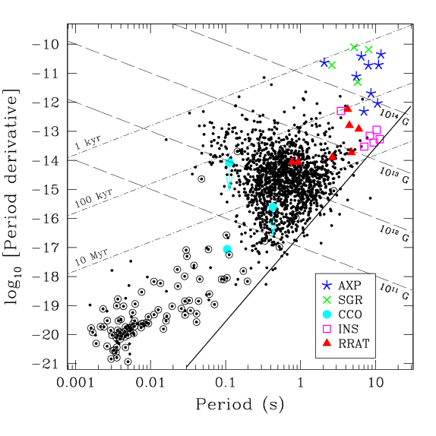
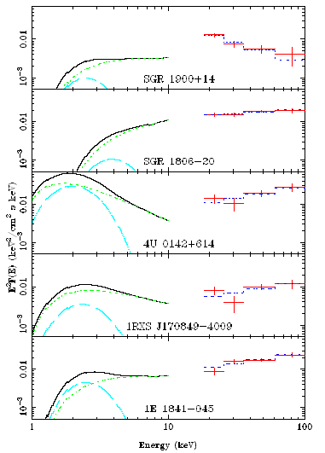
What are magnetars?
Detected as SGRs and AXPs
Large inferred magnetic field (10¹⁴-10¹⁵ G)
Long rotation period: 2-12 s
Quiescence emission properties:
  X-ray luminosity ~10³⁴-10³⁶ erg/s
  Thermal black body (~0.5 keV)
  Soft X-ray tail (2-10 keV)
  Hard X-ray component (15-100 keV)
Götz et al 2006
  Kaspi 2010
Magnetically powered emission
Part of the emission comes from the magnetosphere

Slide 20
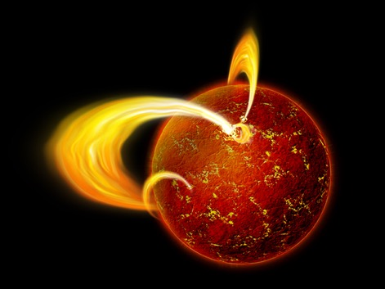
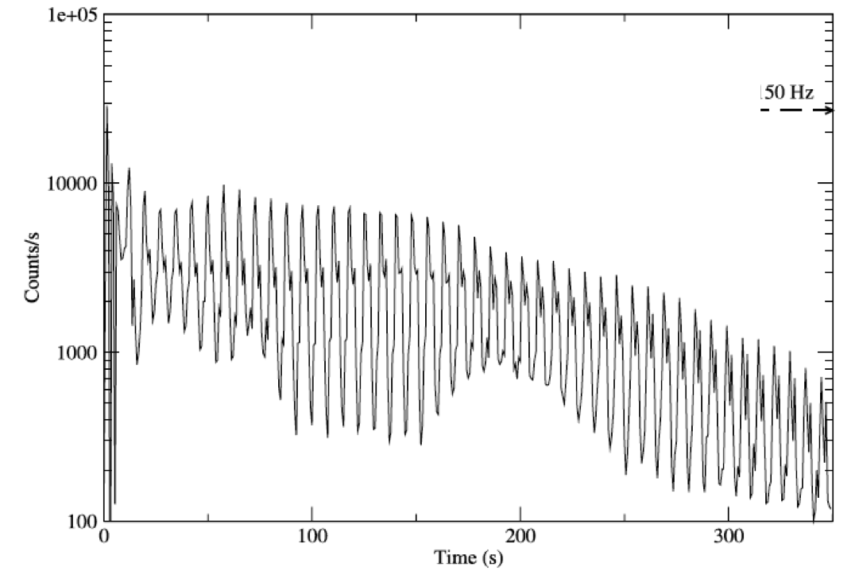
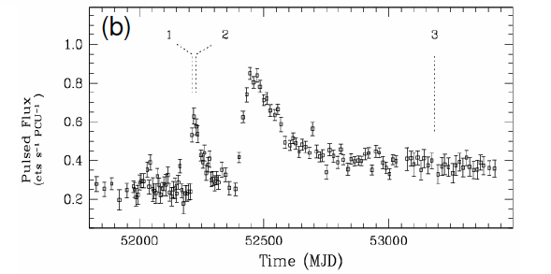
Magnetar activity
Type of activity:
  Short duration bursts: 10³⁶-10⁴³ erg/s in ~0.1 s
  Long duration outbursts: 10³⁶ erg/s in hours
  Giant flares: 10⁴⁴-10⁴⁷ erg/s in 0.1 s (3 observations)
Extended X-ray decay lasting for 10³-10⁴ the event duration
Strohmayer & Watts 2006
1E 1048-59, Woods et al 2004

Slide 21
Energetics driving the evolution
Magnetosphere energy (dipole energy)
Magnetic field energy
Magneto-thermal evolution
  For T~10⁸ K (10³-10⁵ yr) and B>10¹⁴G → Crustal Hall evolution dominant
  Pons & Geppert 2007, Aguilera et al 2008, Pons et al 2009, Kojima & Kisaka 2012, Viganò et al 2012,2013, Gourgouliatos & Cumming 2014, Wood & Hollerbach 2015.
  Hall timescale:
  Building of mechanical stresses in the crust (Perna & Pons 2011) and twists in the magnetosphere (Akgün et al 2017)
( )
( )
L 10¹⁵ G
τ_{Hall} ~ 600 yr
1 km B

Slide 22
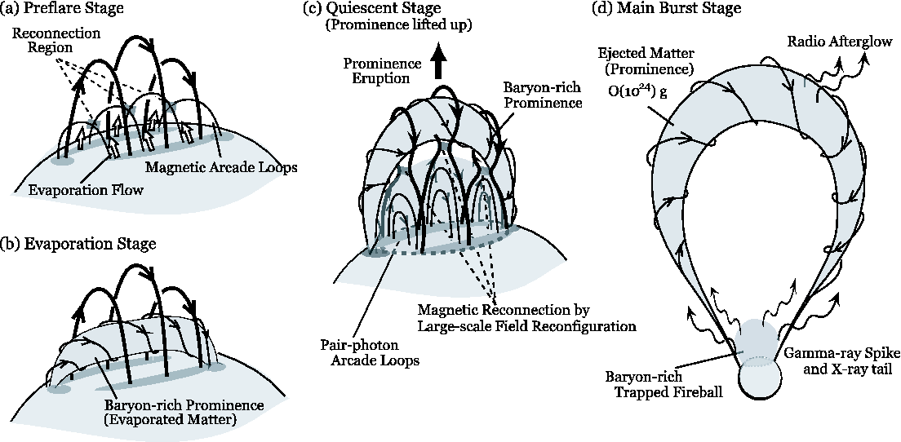
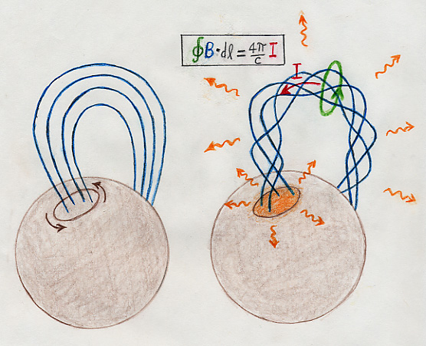
Two burst models
Crust-quake model (internal mechanism)
Magnetospheric instability (external mechanism)
Thompson & Duncan 1995
Stress builds in the crust
Mechanical failure at the breaking strain (Horowitz & Kadau 2009)
Generation of thermo-plastic waves (Levin & Lyutikov 2012, Belovodorov & Levin 2014, Li et al 2016)
Alfvén waves propagate into the magnetosphere (Thompson & Duncan 1995, Li et al 2016) → thermalisation → emission.
Lyutikov 2003
Twist builds in the magnetosphere
Critical twist → Magnetospheric instability
MS reconnection → emission (Lyutikov 2003; Gill & Heyl 2010; Elenbaas et al. 2016)
Masada et al 2010

Slide 23
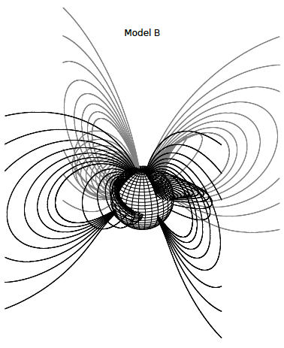
Force-free twisted magnetospheres
Grad-Shafranov equation:
P: poloidal flux function, T: toroidal function
Magnetospheric currents ←→ twist
Boundary condition problem (non-linear elliptic equation):
  Magnetic field at the NS surface
  Vacuum at long distances
Glampedakis et al. 2014; Fujisawa & Kisaka 2014; Pili et al. 2015; Akgün et al. 2016; Kojima 2017, 2018; Kojima & Okamoto 2018; Akgün et al. 2018a)

Slide 24

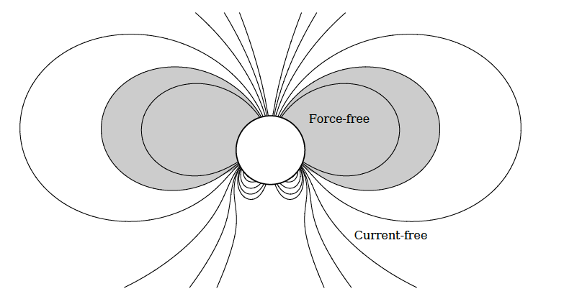
Parametrized configurations
Boundary condition at the NS surface:
  Poloidal field (e.g. dipole)
  Parametrised Toroidal function: 3 parameters (s, σ, P_{c})
s ~ strength of the toroidal field
(s=0 → no twist or currents)
P_{c} ~ extent of region with currents
σ ~ slope
Akgün et al 2018

Slide 25
Energy stored in the twist
Parameter space is limited (no solutions for certain values of the parameters):
Not every surface field has a possible FF configuration (maximum twist ~ 1 rad).
Solution is not unique:
Several degenerate solutions for the same boundary condition.
Akgün et al 2018
σ=1
(ε−ε_{d})/ε_{d}

Slide 26
Degenerate solutions
Akgün et al 2018
Example: s=1.5, P_{c}=0.57, σ=1
3 degenerate solutions
3
Are the configurations stable?
It is possible to reach these configurations during the magnetar evolution?

Slide 27
Magneto-thermal evolution with force-free magnetospheres
Magneto-thermal evolution + external force-free magnetosphere
Hall evolution in the crust → twist in the magnetosphere
Maximum twist reached in timescales of 1-10 kyr
Akgün et al 2017

Slide 28
Observational signatures (quiescence emission)
Enhanced spin-down → breaking index <3
Temperature increase (current dissipation at the surface)
Akgün et al 2017
Akgün et al 2018

Slide 29
Stability of dynamically twisted magnetospheres
Parfrey et al 2012
Dynamical twisting simulations: Mikic & Linker 1994, Parfrey et al. 2012, 2013, Carrasco et al. 2019.
Start with a vacuum solution (dipole) and apply a twist at the NS surface.
Instability for twists~1 rad
Twisting timescale ~10 ms << magneto-thermal evolution timescale (10³-10⁴ yr).
During crustquakes?
Mikic & Linker 1994

Slide 30
Stability of twisted magnetospheres in equilibrium
Initial data are force-free equilibrium solutions
Degenerate models
Hypothesis:
  Lowest energy model stable
  Higher energy models unstable
Numerical simulations:
  Force-free electrodynamics implementation in the Einstein Toolkit
  Mahlman et al (in prep.)
Mahlmann et al 2019

Slide 31
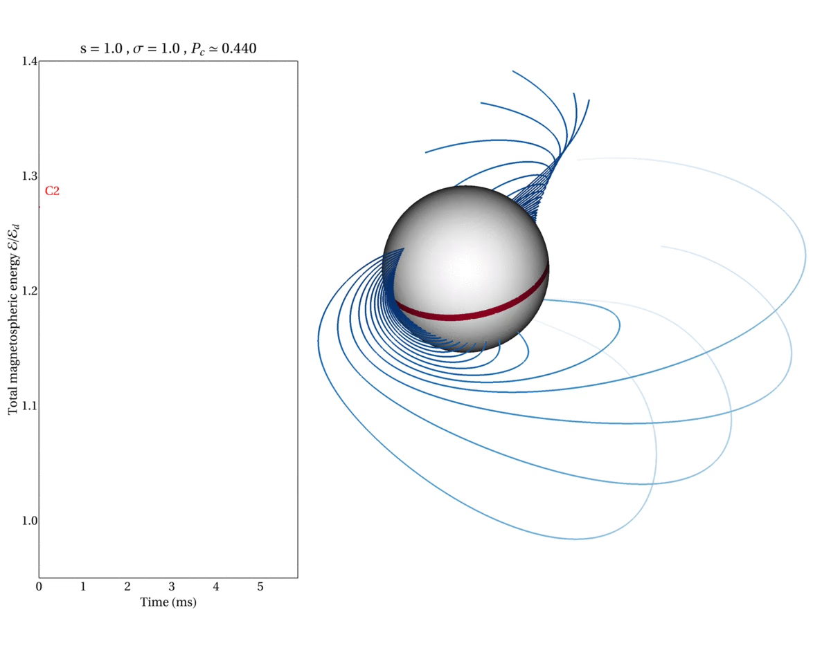
Evolution of a “high-energy” model
Stability hypothesis confirmed
Axisymmetric instability → Interchange instability? (Tayler 1973)

Slide 32
Magnetic field structure evolution
Final configuration is close to the low energy solution

Slide 33
Energetics
Fraction of the energy released: 0.1-0.2 x ε_{d}
Instability timescale ~ few ms
Emission timescale ~0.1 s
Luminosity ~ 10⁴⁶ erg/s ~ giant flare
These are upper limits
Mahlmann et al 2019

Slide 34
Mechanical stress on the crust
Mechanical stress applied to the crust:
Crustal failures at B~10¹⁵-10¹⁶ G
Crustal displacement:
These are upper limits
  T^{ij}_{crust} 2δB
  T^{ij}_{B} B
~ ~0.03-0.1

Slide 35
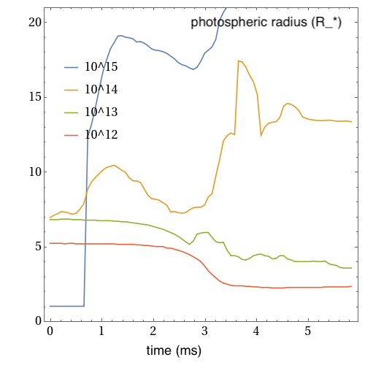
Emission properties
Magnetosphere becomes optically thick to resonant cyclotron scattering
Photospheric radius up to 10-20 R*
This region is expected to be filled by pair plasma (confined fireball) and emit thermally → extended X-ray emission.
photosphere

Slide 36
Conclusions (part 2)
Over-twisted magnetosphere can become unstable and lead to catastrophic highly energetic events.
Magnetospheric instability model explains phenomenology of burst and flare activity in magnetars.
Possible issues:
  Instability timescale ~ ms but flare duration ~0.1 s → What sets the dissipation timescale? (see e.g. Li et al 2018)
  How to reach the unstable branch during magneto-thermal evolution → rapid evolution needed.

Slide 37
Thank you

