Slide 1
The Method of Comparing BNS Merger Rate Estimated from Radio Afterglows from Short Gamma Ray Bursts and by Gravitational Waves
Minori Shikauchi
Research Center for the Early Universe (RESCEU),
the University of Tokyo, Japan
Notes:
my new research plan

Slide 2
Dawn of multi-messenger astronomy
Abbott et al. (2017)
Tanaka et al. (2017)
Abbott et al. (2017)
Notes:
GW from BNS merger
after that, short gamma ray burst, kilonova/macronova and afterglow in multi-wavelengths
a dawn of multi-messenger astronomy including GW astronomy

Slide 3
Today’s talk
Two independent ways to estimate BNS merger rate;
1. radio afterglow from SGRBs
2. gravitational waves
How to detect radio transients?
How to estimate BNS merger rates?
Goal
compare BNS merger rate estimated from radio afterglows
with one LIGO estimates
Notes:
consists of three parts
first, a brief summary of short gamma ray bursts and radio afterglows vital for my detection method of radio transients
second, how to detect a radio transient ; similar way to detect GW signal using matched filtering method
finally, how to estimate BNS merger from each observation

Slide 4
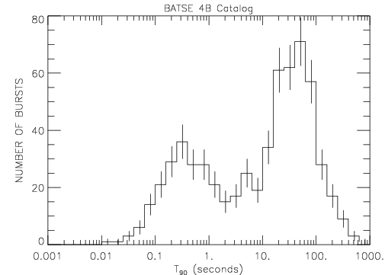
Short Gamma Ray Bursts (SGRBs)
soft gamma-ray pulse
non-thermal
short period : ≲ 2 sec
progenitor
- related to compact objects?
- NS-NS, NS-BH, WD-BH merger
https://gammaray.nsstc.nasa.gov/batse/grb/duration/
Notes:
distribution : bimodal
focused on BNS merger model

Slide 5
Short Gamma Ray Bursts (SGRBs)
afterglow in multi wavelengths
- optical, radio, and X-ray
- observed longer (~ weeks to years)
Frail et al. (1997)
Notes:
help us to localize them very accurately in ~arcsec

Slide 6
Afterglow from SGRBs
emission process
- synchrotron radiation
(Waxman 1997a,b, Wijers et al. 1997, Katz and Piran 1997)
- power-law spectrum
Sari et al. (1998)
Notes:
synchrotron radiation from accelerated electrons
when a relativistic shell collides with surrounding medium

Slide 7
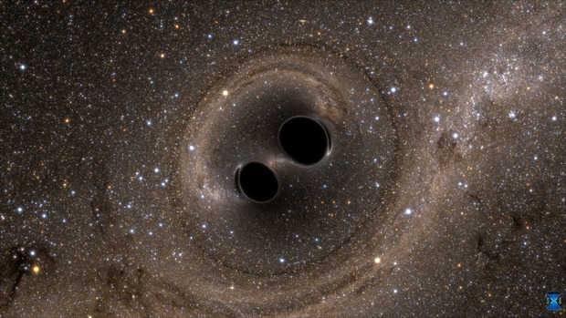
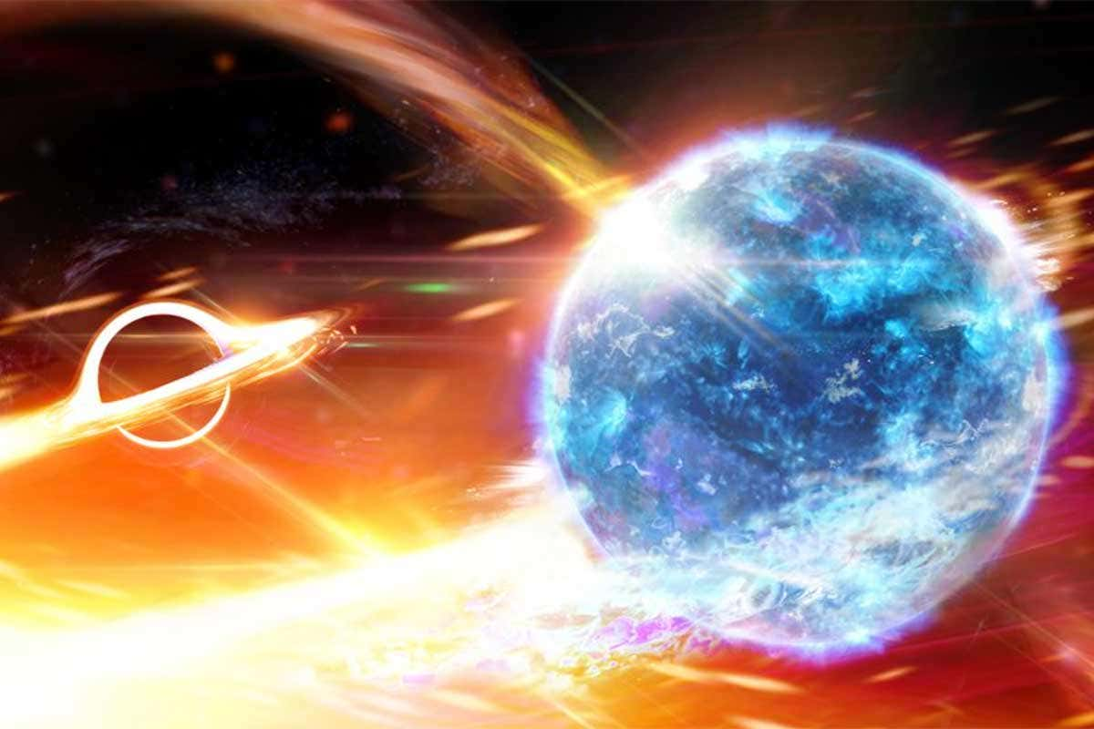
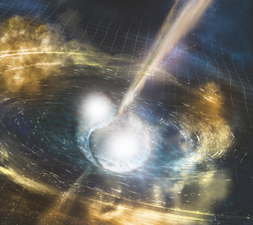
Observation of Gravitational Wave
LIGO observed …
Binary black hole merger
Neutron star - black hole merger
Binary neutron star merger
BBH, BNS : https://www.ligo.caltech.edu/
BHNS : https://greatlakesledger.com/2019/08/26/neutron-star-eaten-by-black-hole-new-ligo-discoveries/

Slide 8
How We can Detect GW signals and radio transient

Slide 9
Method : Matched Filtering
Data
templates
Strain h
Brightness
Evaluate How Much They are Alike
Signal-to-Noise Ratio(SNR) / ranking statistic
Notes:
ranking statistic : a statistic to rank GW candidates
my detection method of radio transients is similar to GW signal search
I’d like to summarize how to detect GW signals to understand why I’m going to use this method to detect radio transients

Slide 10
How We can Detect GW Signals
both images : Abbott et al. (2016)
We have to detect a signal
- with various shapes
- very small change
- including a lot of noise
Time
strain h ~ (change in optical path length)
/ (optical path length)
Notes:
strain is very very small
LIGO detects GW by observing the change of optical path length in laser interferometer

Slide 11
How We can Detect GW Signals
Abbott et al. (2017)
We have to detect a signal
- with various shapes
- very small change
- including a lot of noise
Glitch
strain h ~ (change in optical path length)
/ (optical path length)

Slide 12
How We can Detect GW Signals
red…whitened
blue…best-matched waveform
Reducing some noise
- by “whitening”
- by subtracting glitch model
whitening
$$\tilde{d}(f)→\tilde{d}(f)/\sqrt{S_{n}(f)}$$
$$<\tilde{n}\left(f\right){\tilde{n}}^{∗}\left(f^{′}\right)> = \frac{1}{2}S_{n}\left(f\right)δ\left(f−f^{′}\right) ,f>0$$
Credit : LIGO/Caltech/MIT/LSC

Slide 13
How We can Detect GW Signals
Reducing some noise
- by “whitening”
- by subtracting glitch model
Abbott et al. (2017)

Slide 14
How We can Detect GW Signals
Prepare some templates
- mass
chirp mass M = (m₁m₂)^{3/5}/(m₁+m₂)^{1/5}
mass ratio q = m₁/m₂
- spin
effective spin χ_{eff} = (m₁χ₁+m₂χ₂)/(m₁+m₂)
Abbott et al. (2016)
so many templates!

Slide 15
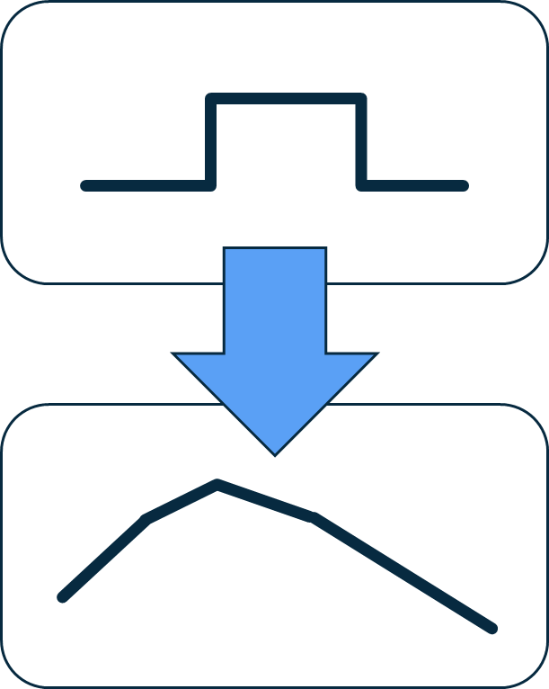
Matched filter applied to time-series of radio images
Reducing non-Gaussian noise
- randomly switching on and off a radio telescope
Operated in image pixel level
More precise templates : power-law type
cf. top-hat type in previous research (Feng et al. 2017)
advantage
- reducing time-independent classical confusion noise
- reducing false detection
→ detectable of fainter transient such as radio afterglows
Notes:
typically, search for a transient luminous enough to distinguish from noise of each image
target : radio transients less faint than ~mJy, too faint
by using matched filtering method, there are three advantages

Slide 16
Estimate BNS merger rate from observation of radio afterglows
Notes:
from next part, I’d like to introduce the way to estimate BNS merger by observing radio afterglows
consisting of two parts : first calculate signal-to-noise ratio and then calculate upper limit of BNS merger rate at the maximum SNR

Slide 17
Calculate SNR
Based on Feng et al. (2017)
Hypothesis H₀ and H₁
H₀ : a radio transient is absent. Include random noise + constant background.
(added classical confusion noise)
H₁ : the transient exists.
Assumption : noise on each image is Gaussian noise
- average = 0
- the deviation of each pixel σ_{i}

Slide 18
Calculate SNR
for i th data point (i = 0 … N) for each pixel, the observed brightness x_{i} ;
H₀ : x_{i} = c + σ_{i}
H₁ : x_{i} = c + Af_{i} + σ_{i}
$p\left(x | H_{0}\right)=\int{𝒩_{0}exp\left(−\sum_{i=1}^{N}{\frac{{b_{i}}^{2}{\left(x_{i} −c\right)}^{2}}{2{σ_{i}}^{2}}}\right)p\left(c | H_{0}\right)dc}$
$p\left(x | H_{1}\right)=\int{𝒩_{1}exp\left(−\sum_{i=1}^{N}{\frac{{b_{i}}^{2}{\left(x_{i} −c−Af_{i}\right)}^{2}}{2{σ_{i}}^{2}}}\right)p\left(c | H_{1}\right)p\left(A | H_{1}\right)dcdA}$
Assumption : c and A are independent and uniformly distributed
→ least-squares approach, calculate their extremum χ_{min}
Notes:
N₀, N₁ : normalization factor
b_{i} : the value of the i th primary beam for each pixel
f_{i} : light curve template
(top hat with a duration of 15 days and a brightness of 1Jy beam⁻¹)

Slide 19
Calculate SNR
for $H_{0}, c= c_{0}=<x> =\frac{\sum{b_{i}^{2}x_{i}/σ_{i}^{2}}}{\sum{b_{i}^{2}/σ_{i}^{2}}}$
for $H_{1}, c= c_{1}=<x>−A_{1}<f> =\frac{(x,f− <f>)}{(f− <f>,f− <f>)}$
$ρ=(x,f− <f>)$
$$σ_{ρ}=\sqrt{(f− <f>,f− <f>)}$$
SNR $\tilde{ρ}≡$ ρ/σ_{ρ}

Slide 20
Calculate Upper Limit of Astrophysical Rate of Radio Afterglows
Assumption :
the number of astrophysical transients with a certain flux density can be described by Poisson distribution
m = RVT
R : astrophysical rate of radio afterglows
V : the volume searched for each image
T : the period searched for each image
$ε(\tilde{ρ})$ : the search efficiency as a function of flux density evaluated at $\tilde{ρ}$
The probability that we detect no events at SNR above $\tilde{ρ} P(\tilde{ρ})$ ;
$$P\left(\tilde{ρ}\right)= e^{−mε(\tilde{ρ})}$$

Slide 21
Calculate Upper Limit of Astrophysical Rate of Radio Afterglows
The upper limit of R at a confidence level p is determined by $P\left({\tilde{ρ}}_{m}\right)$=1 – p ;
${\text{R}}_{p}=−\frac{\ln{(1−p)}}{VTε({\tilde{ρ}}_{m})}$ (${\tilde{ρ}}_{m}$ : max $\tilde{ρ}$ in the loudest event statistic)

Slide 22
Estimate BNS merger rate from observation of gravitational waves
Notes:
Finally I’d like to summarize how LIGO calculate BNS merger rate from GW observation

Slide 23
Calculate Astrophysical Rate of GW transients
Based on Abbott et al. (2016)
Assumption :
All populations are distributed uniformly in comoving volume
Λ_{i} : astrophysical origins (BBH, BNS, NS-BH)
Λ₀ : terrestrial (i.e. instrumental / environmental effects from GW detector)
Based on a detection statistic x,
$$\frac{dN}{dx}=Λ_{i}p_{i}\left(x\right)+Λ_{0}p_{0}(x)$$
(N : the number of triggers, Λ_{i} : Poisson mean numbers of triggers of each origin)

Slide 24
Calculate Astrophysical Rate of GW transients
$$Λ_{i}=R_{i}<VT>$$
<VT> : population-averaged sensitive space-time volume
R_{i} : astrophysical rate of each origin
$$<VT> =T\int{dzdθ}\frac{dV_{c}}{dz}\frac{1}{1+z}s\left(θ\right)f(z,θ)$$
V_{c} : comoving volume
s(θ) : distribution function for the astrophysical population
f(z, θ) : selection function for the probability of detecting a source with parameters θ at redshift z

Slide 25
Calculate $Λ_{i}$
Prior distribution of $Λ_{i}$ and $Λ_{0}$ p({$Λ_{i}$}, $Λ_{0}$) ;
$$p(\left\{Λ_{i}\right\},Λ_{0})∝{\left(\sum_{i}^{N_{c}}{Λ_{i}}\right)}^{−N_{c}+1/2}{Λ_{0}}^{−1/2}$$
N_{c} : the number of different classes of astrophysical triggers
Likelihood ratio including M triggers with detection statistic {x_{j} | j = 1, …, M} ;
$$ℒ\left(\left\{x_{j} | j=1,…,M\right\} | \left\{Λ_{i}\right\},Λ_{0}\right)= \left\{\prod_{j=1}^{M}{[Λ_{i}p_{i}\left(x_{j}\right)+Λ_{0}p_{0}\left(x_{j}\right)]}\right\}exp⁡(−Λ_{i}−Λ_{0})$$
Posterior distribution of $Λ_{i}$ = $p(\left\{Λ_{i}\right\},Λ_{0})×ℒ\left(\left\{x_{j} | j=1,…,M\right\} | \left\{Λ_{i}\right\},Λ_{0}\right)$
Notes:
based on Beyes’ theorem, posterior distribution

Slide 26
Conclusion
Short gamma ray bursts (SGRBs) are thought to be related to compact binary coalescence
Focused on one of the scenarios ; binary neutron star merger (BNS merger)
By observing radio afterglow from SGRBs, we can get an upper limit of BNS merger rate
We can detect radio transients in the similar way to detect GW transients;
- prepare some templates “tuned” to a targeted object
- compare the data with them
- evaluate the similarity : Signal-to-Noise Ratio (SNR)
Estimate an upper limit of radio afterglow rate ≅ an upper limit of BNS merger rate
Estimate BNS merger rate from GW triggers

Slide 28
Calculate SNR
Computing the likelihood ratio Λ(x):
Λ(x) = p(x|H₁)/p(x|H₀)
(p(x|H_{i}) : the probability of observing x given the hypothesis H_{i} (i = 0,1) is true)
Assumption : image noise is Gaussian noise,
- average = 0
- the deviation of each pixel σ_{i} (This is not so important.)

