Slide 1
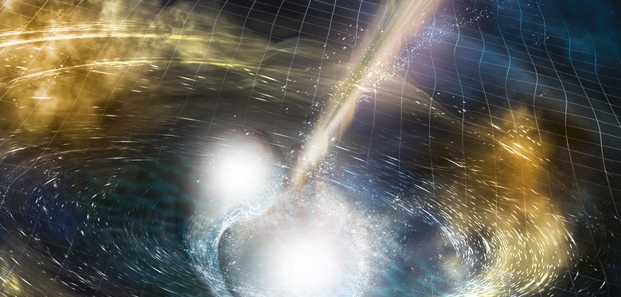
Gravitational Wave Astronomy with LIGO and Virgo
Chad Hanna - Penn State
Black Holes and Neutron Stars with Gravitational Waves - October 7, 2019

Slide 2
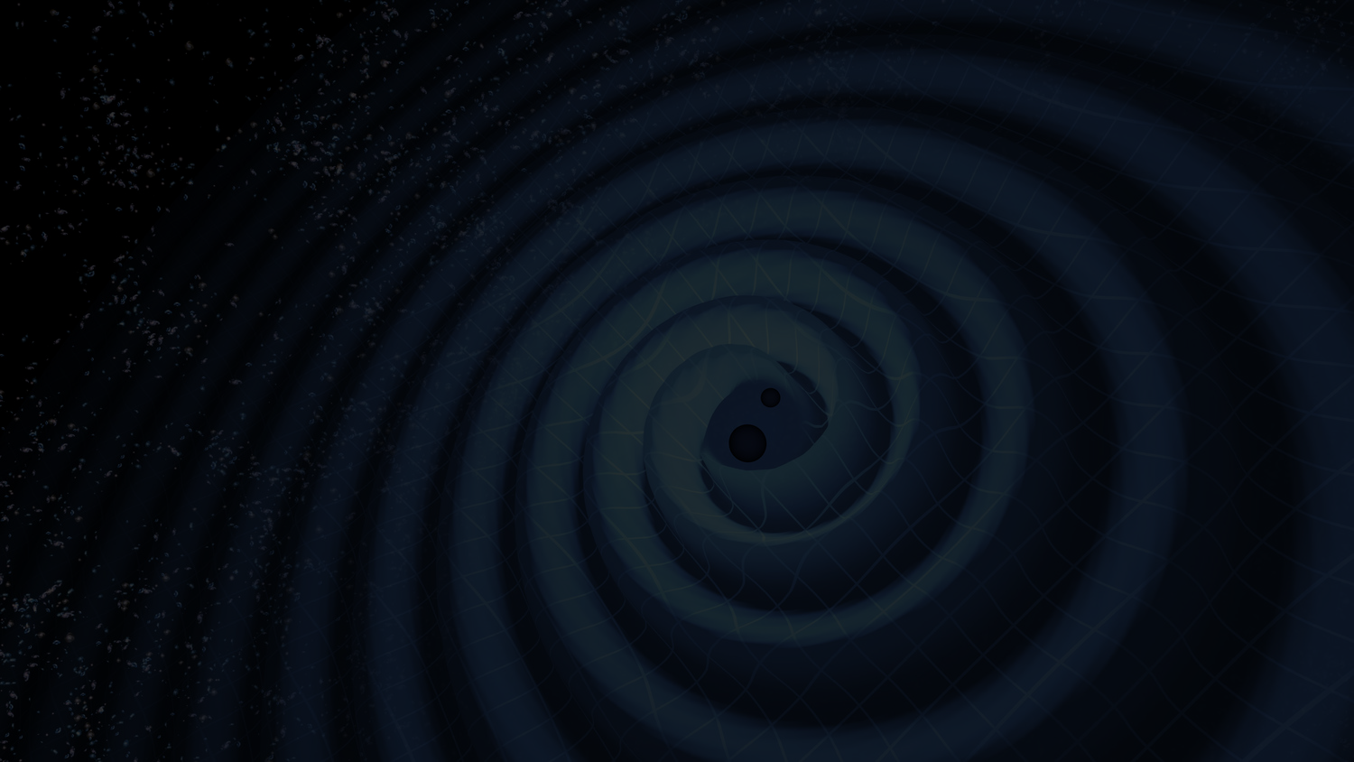
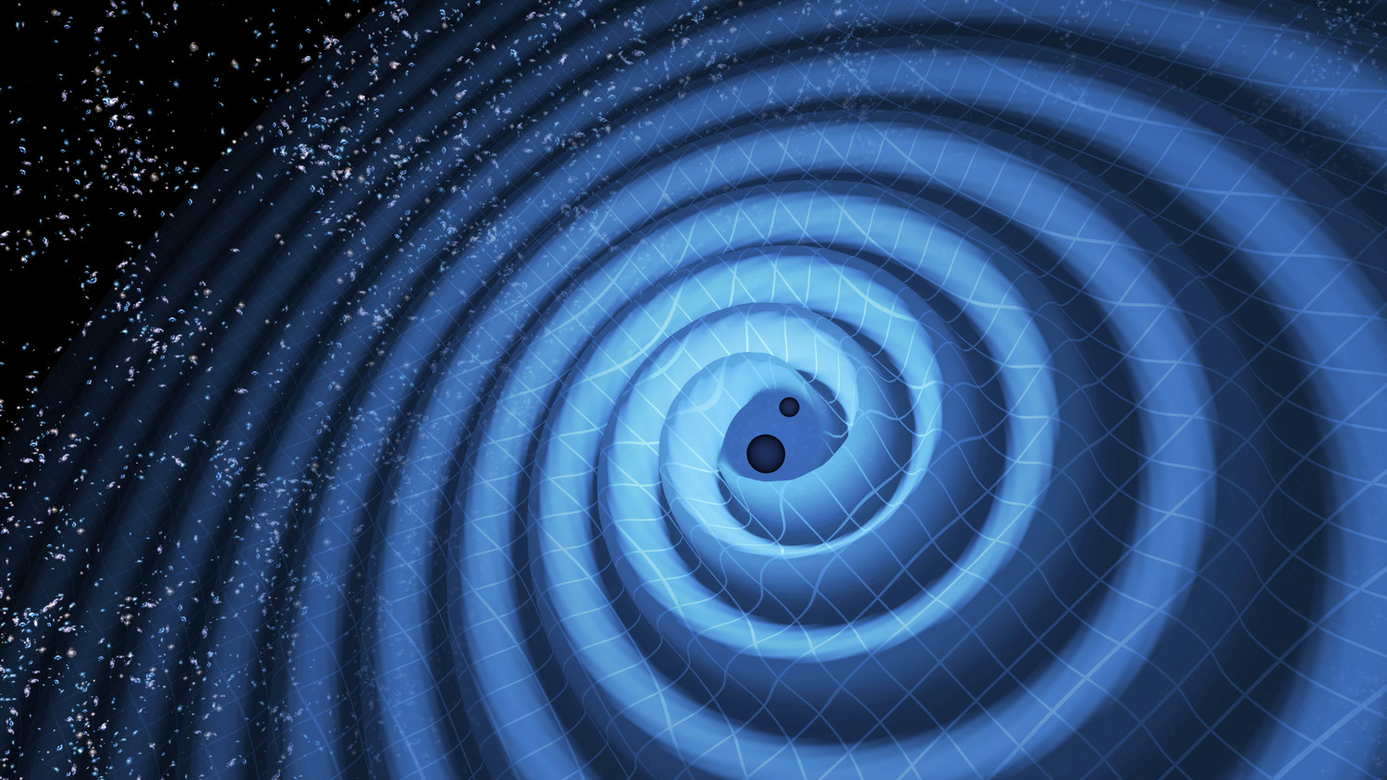
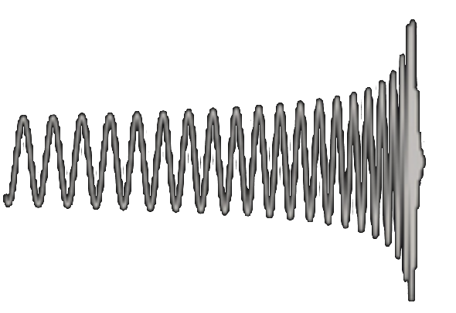
Distant observers see changes in length: strain = ΔL/L
Energy loss drives the binary to merge. Peak strain on Earth: 10⁻²¹
Waveform depends on
M₁,m₂,s₁s₂,position, orientation,...
strain
time
Credit: NASA & LIGO

Slide 3
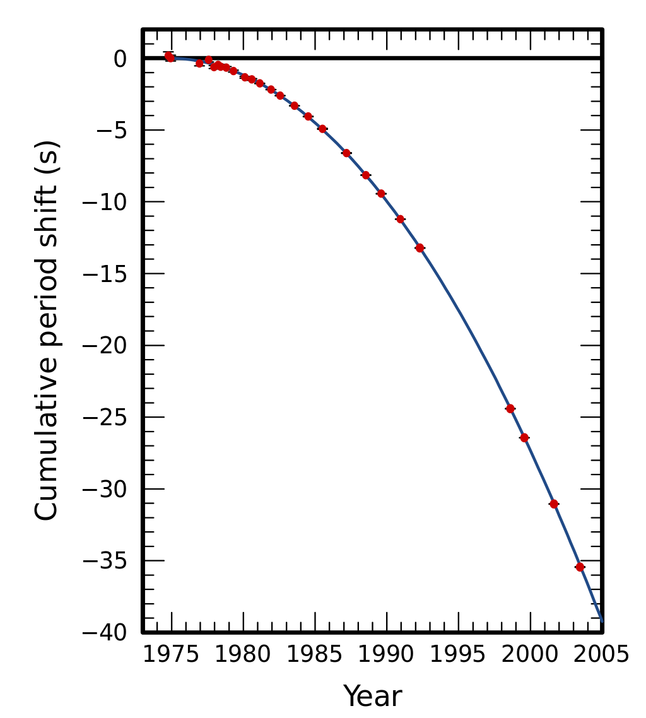
The Hulse-Taylor Pulsar PSR B1913+16 provided conclusive evidence that double compact objects would be gravitational wave sources
en.wikipedia.org

Slide 4
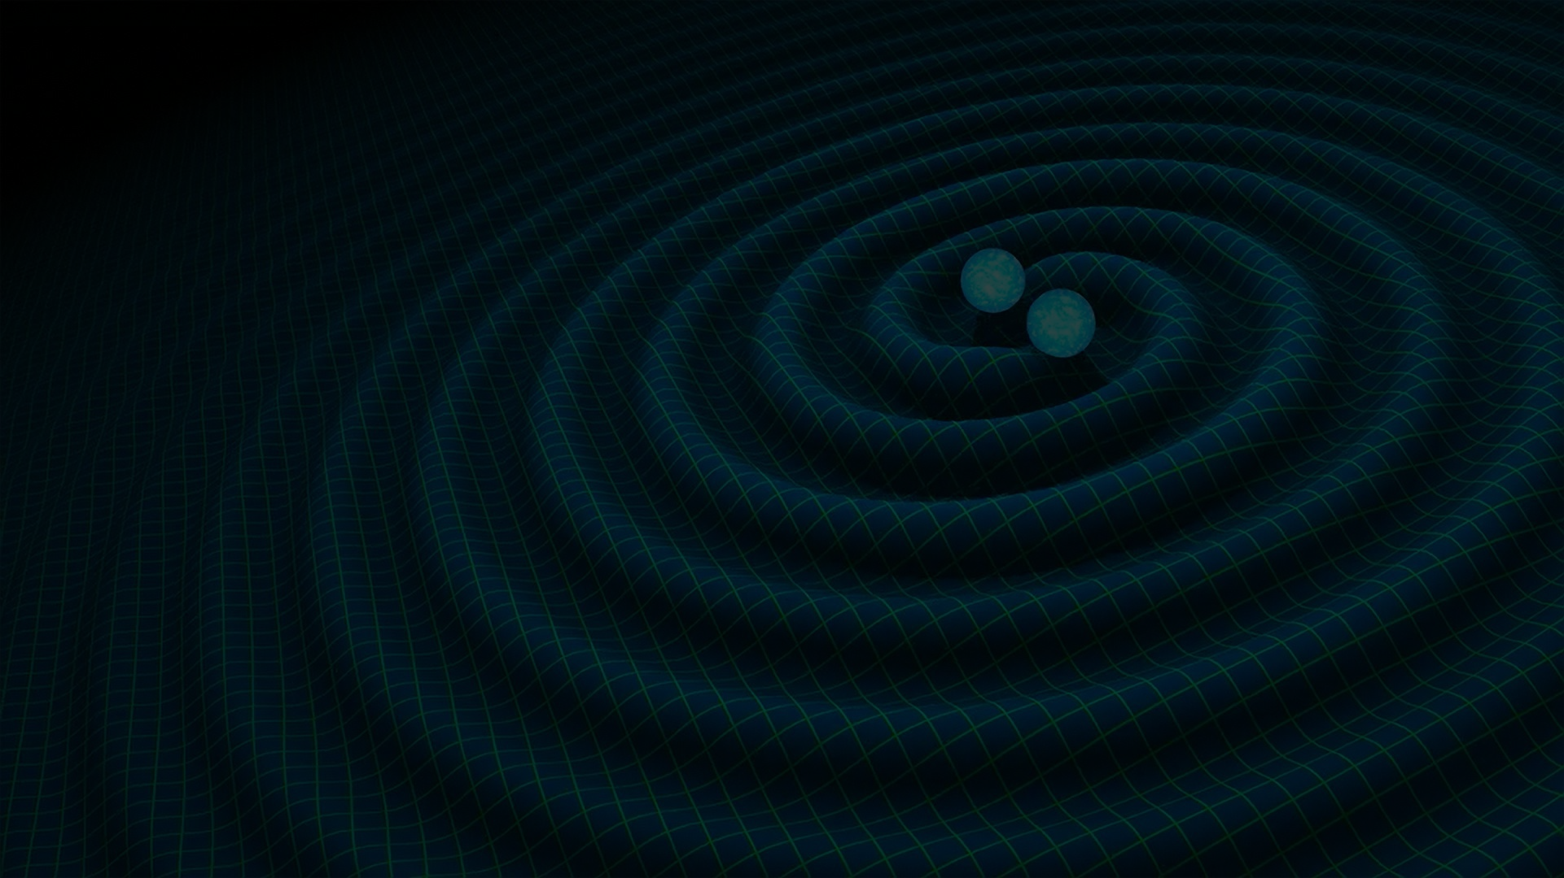
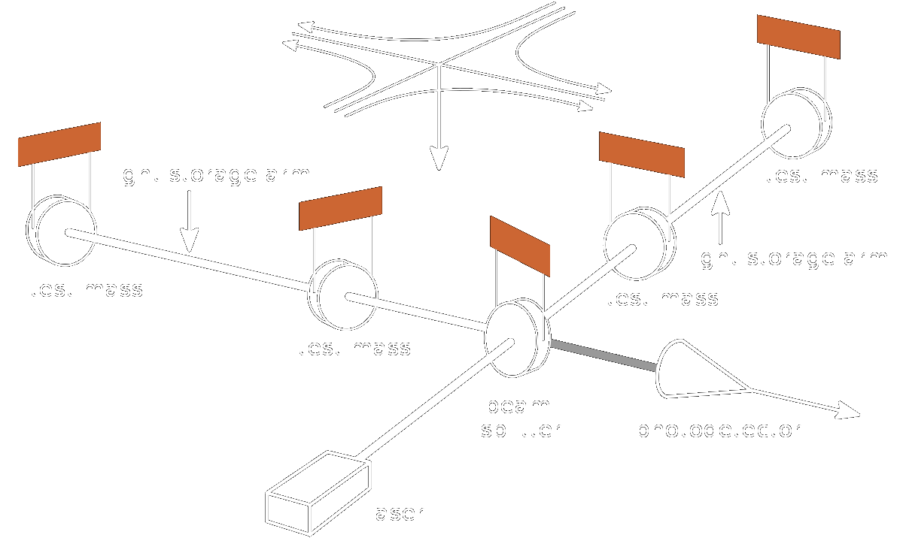
Credit: NASA & LIGO

Slide 5
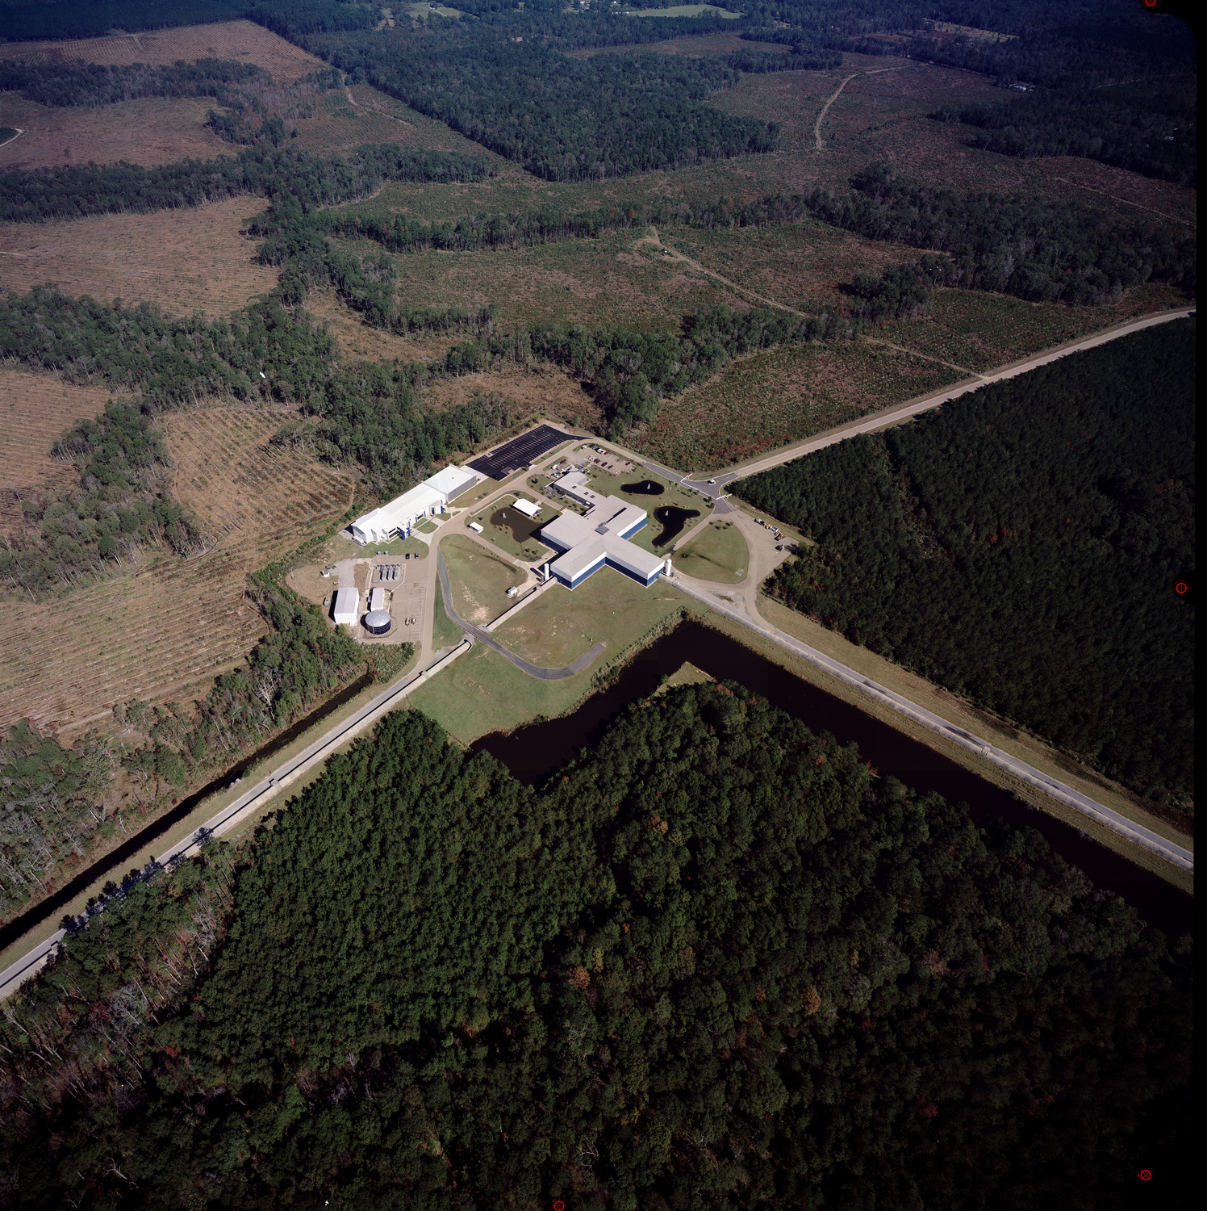
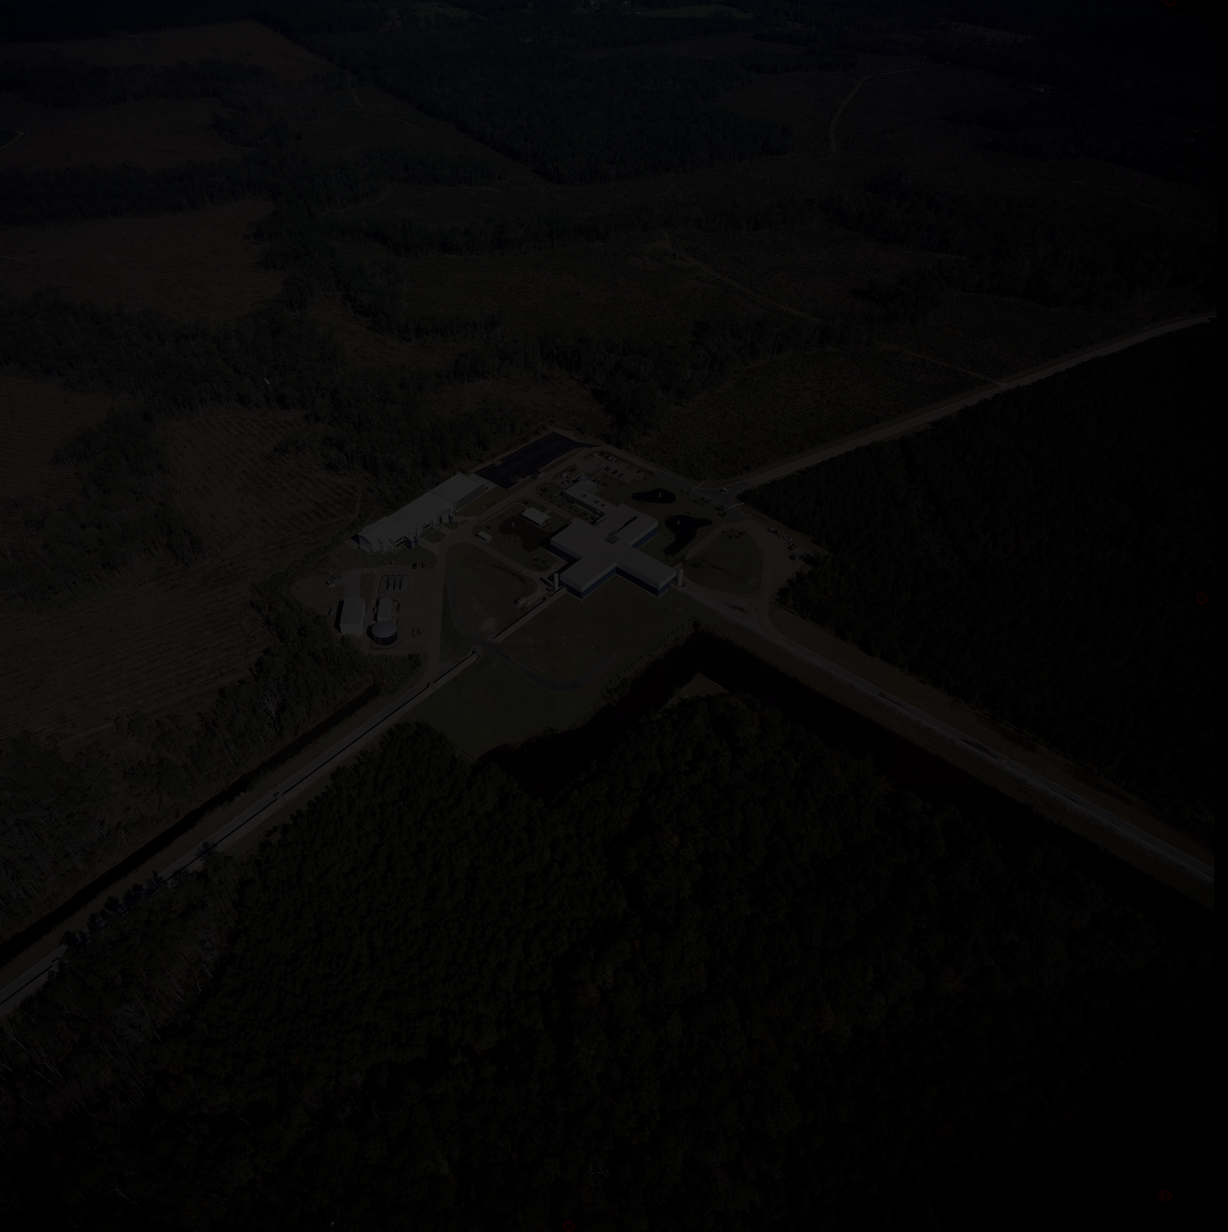
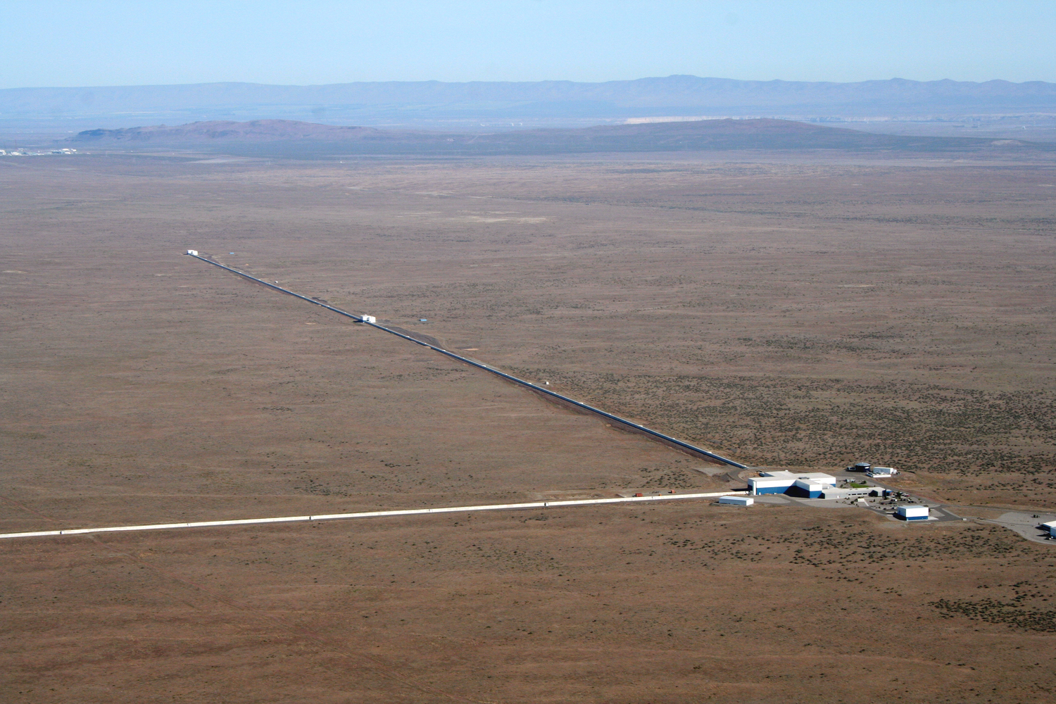
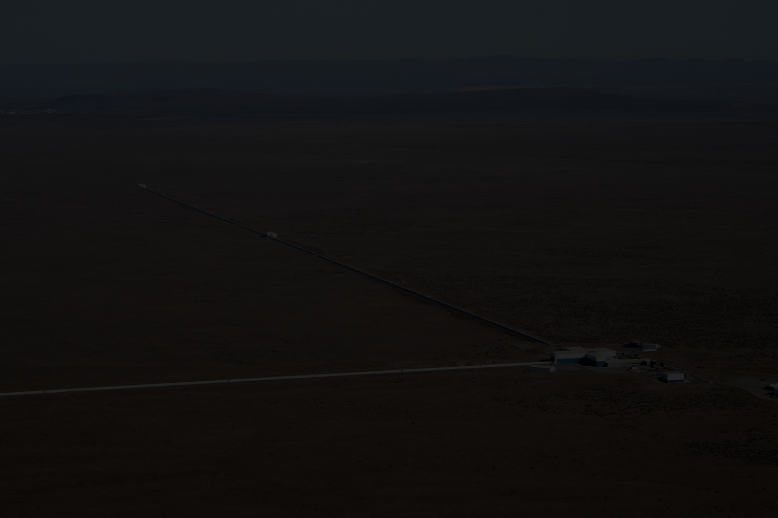
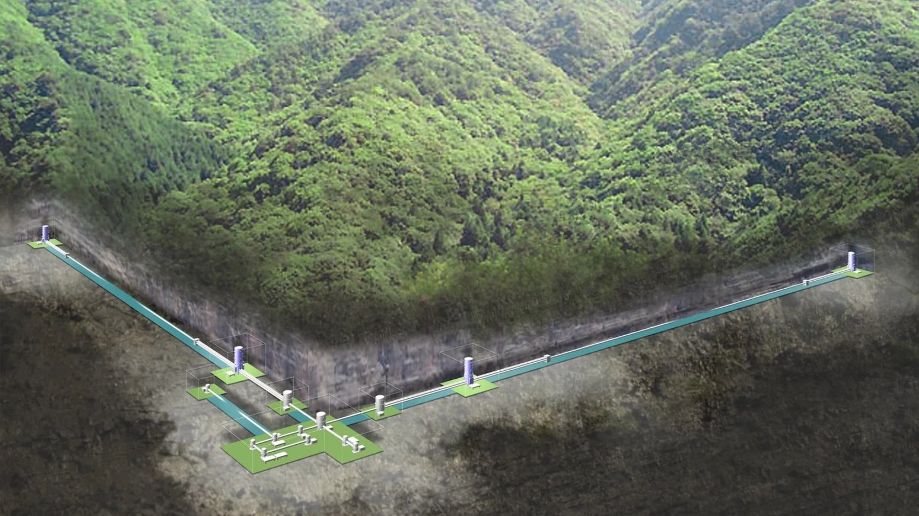
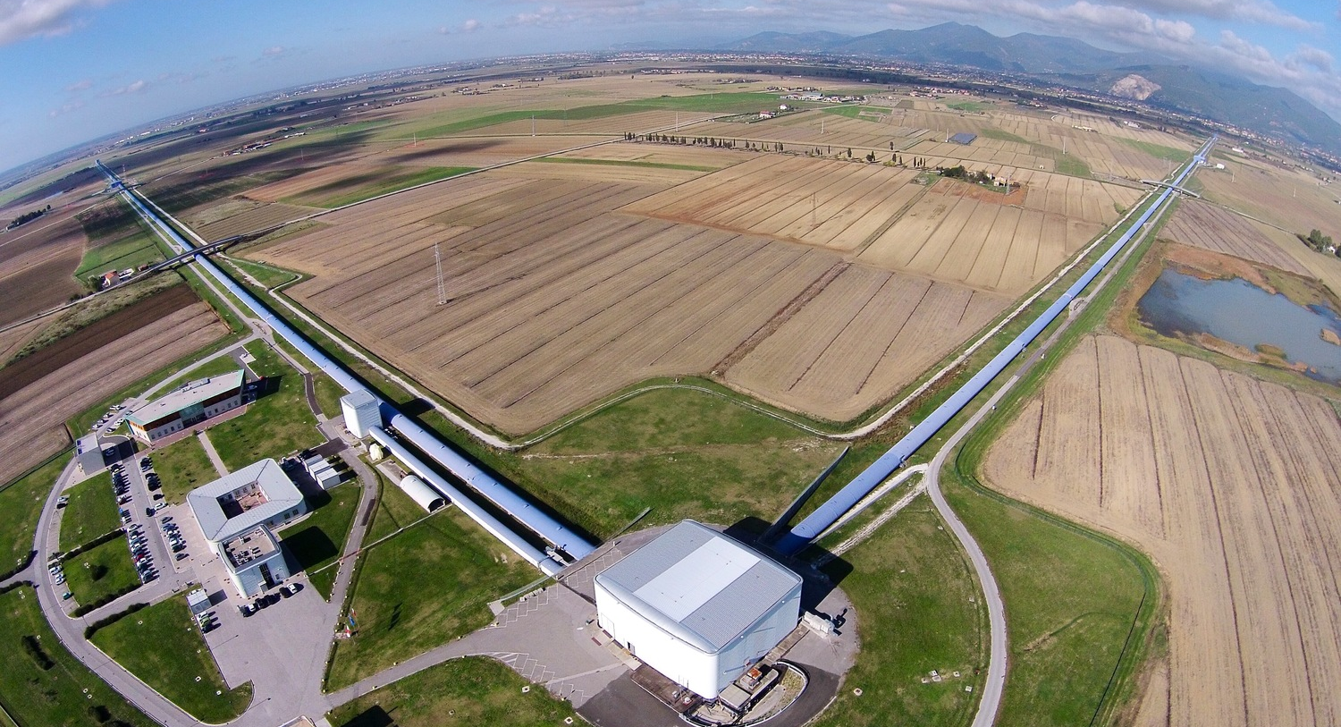
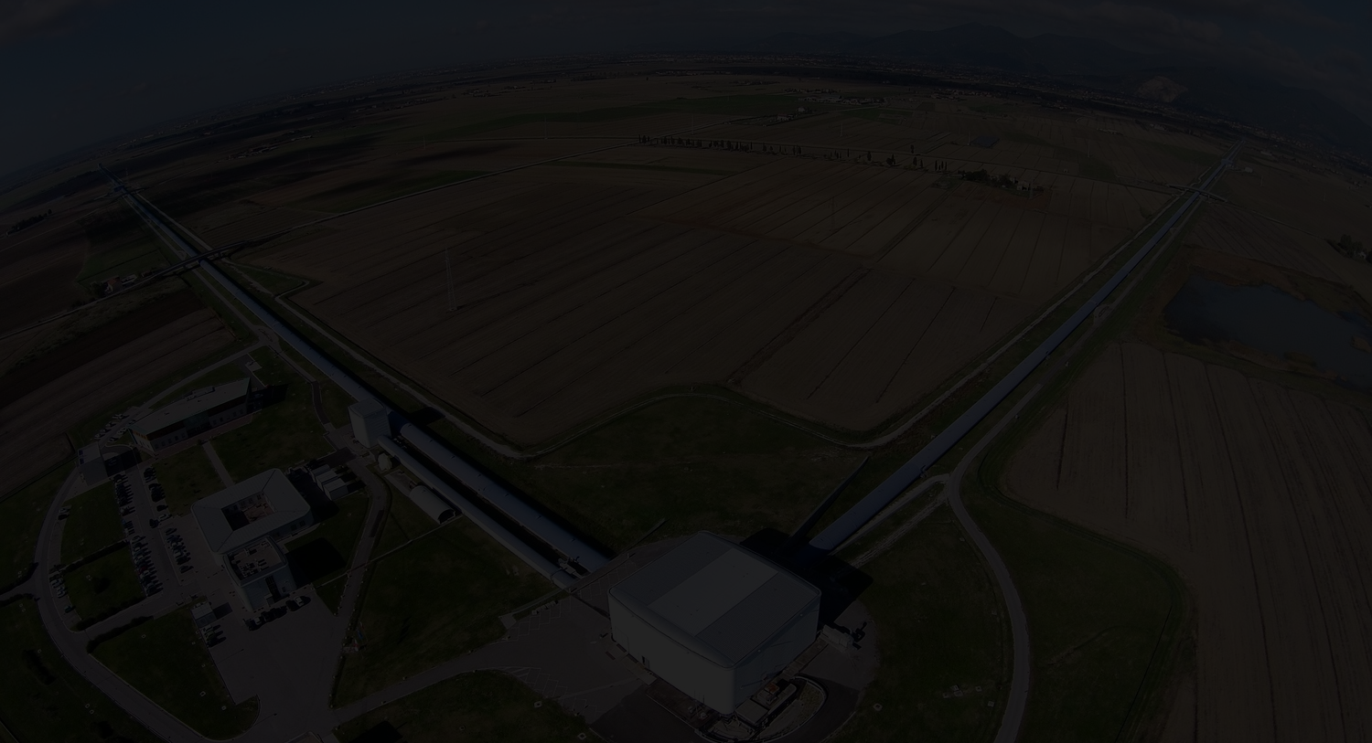
Initial LIGO operated from 2002 - 2010
Virgo joined in 2007
No gravitational waves were discovered
Advanced LIGO was constructed between 2010-2015
Immediately upon turning on, the first binary black hole merger was discovered: GW150914
Credit: LIGO & Virgo, ICRR U Tokyo

Slide 6
GWTC-1 - GWs discovered from September 2015 - August 2017
Credit: LIGO & Virgo

Slide 7
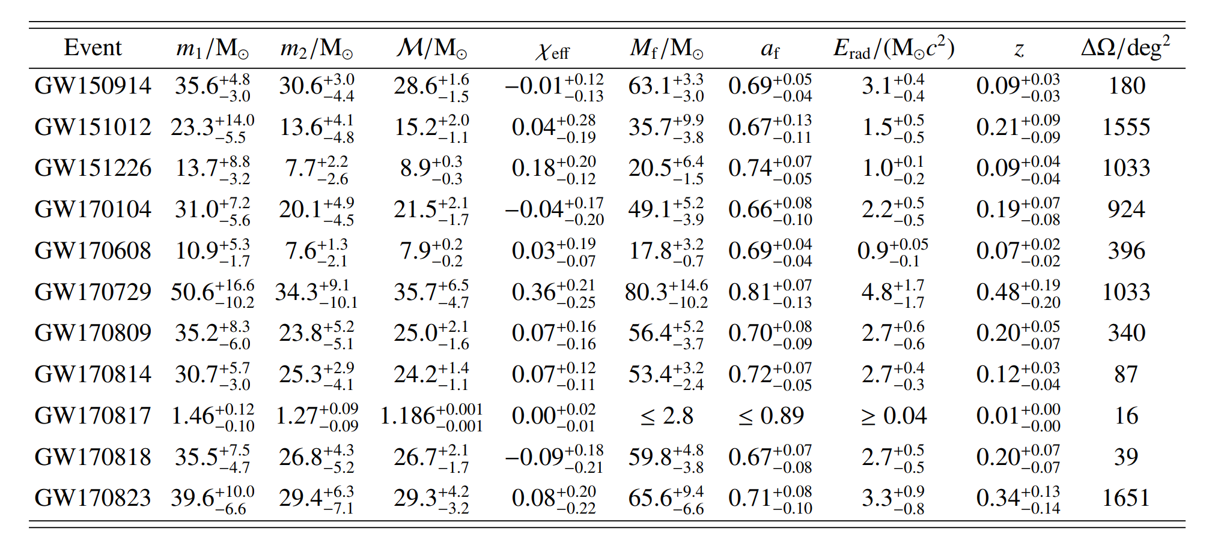
GWTC-1 - GWs discovered from September 2015 - August 2017
B. P. Abbott et al. 2019

Slide 8
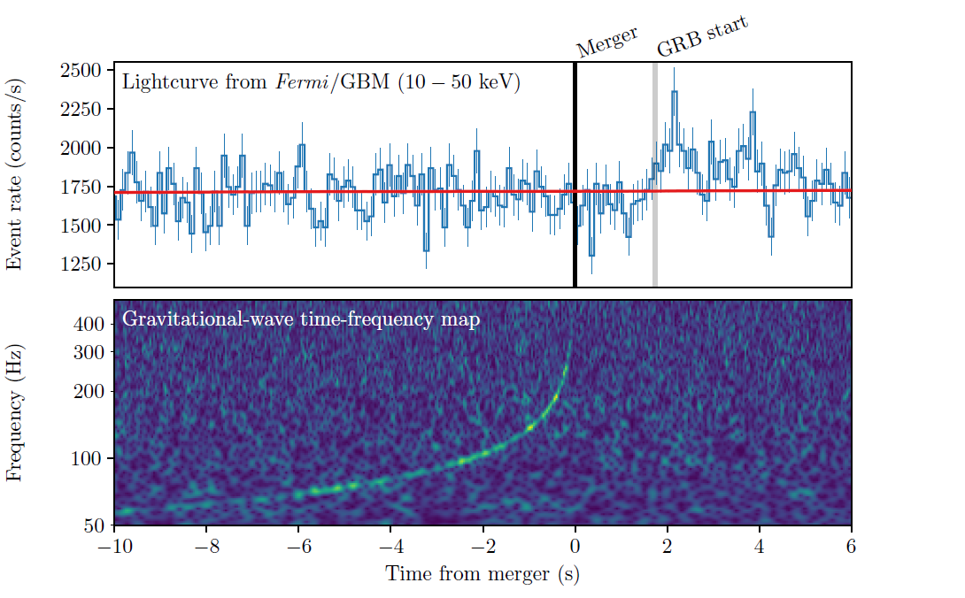
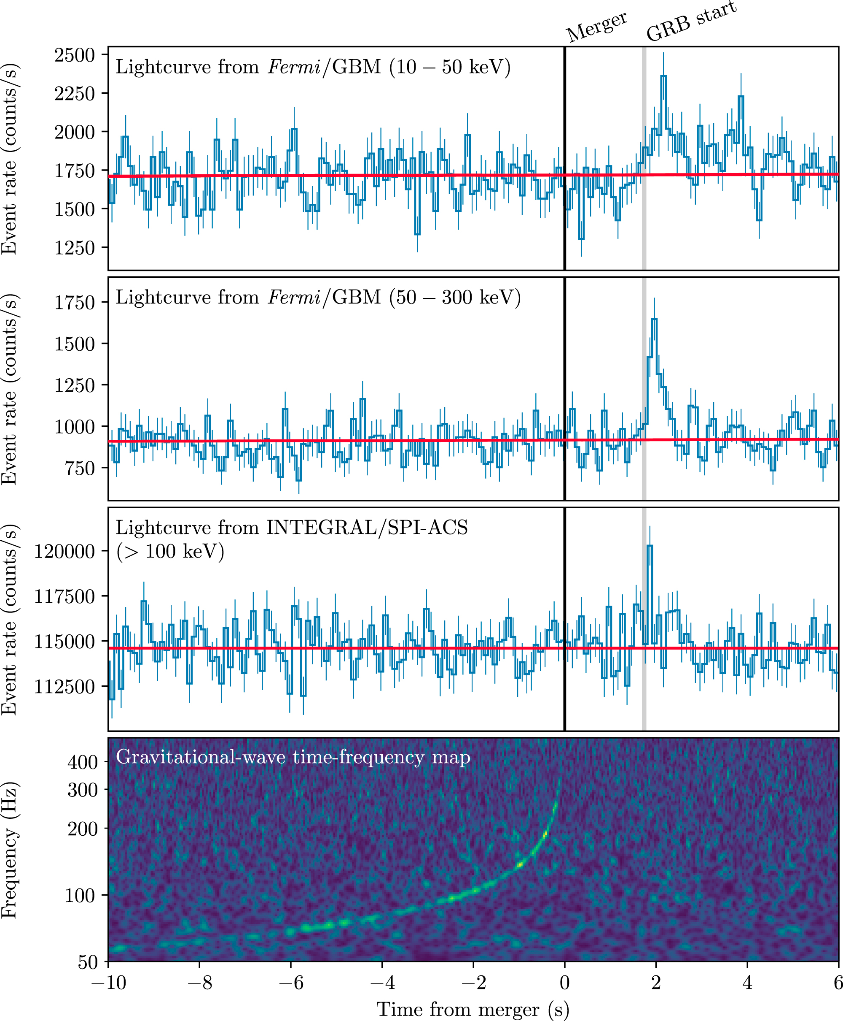
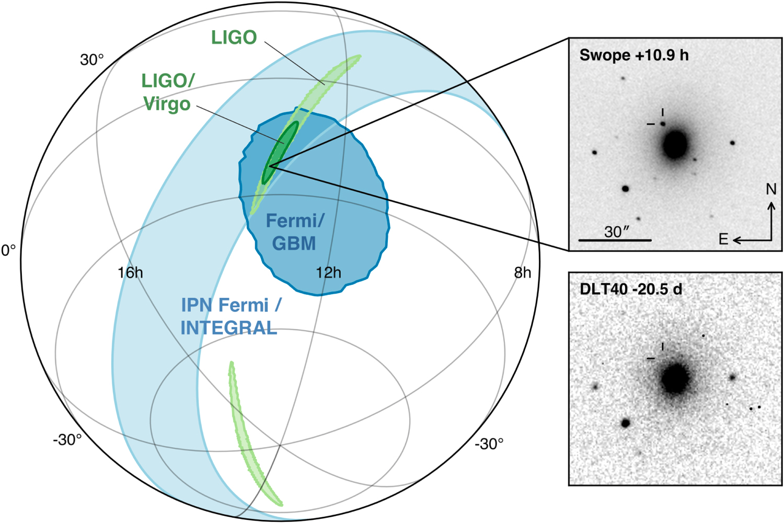
GW170817: First multi-messenger source of GWs
Abbot + ApJL 848 2 (2017)

Slide 9
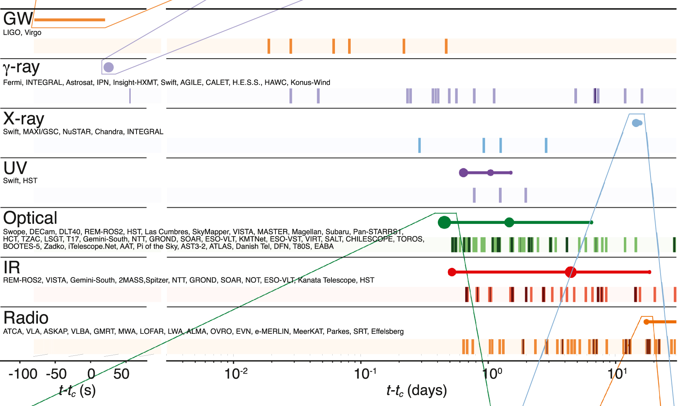
Timeline
O1
Commissioning -
No data
O2
Commissioning-
No data
O3
Sept ‘15 -- Jan ‘16 Nov ‘16 -- Aug ‘17 Apr ‘19 -- ???
Abbot + ApJL 848 2 (2017)

Slide 10
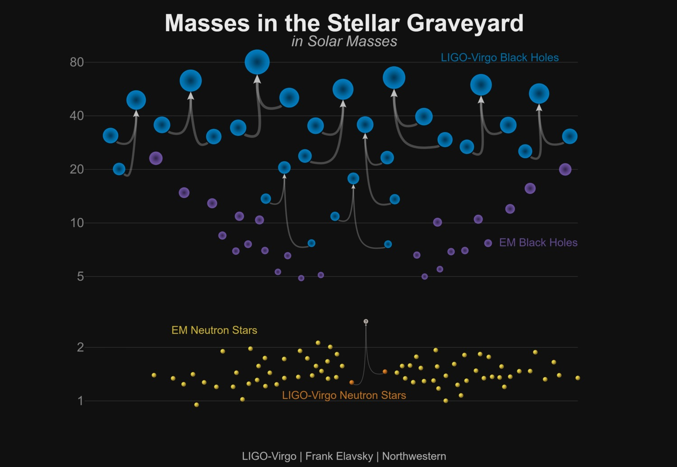
Open questions:
Are LIGO black holes from the same population as “EM” black holes?
Will LIGO continue to see neutron stars consistent with galactic binary population?
Will we continue to see a black hole mass gap?
Solar masses
Ozel et al 2012
Notes:
Aligo work in progress, ever improving, on track to detect hundreds of BH and dozens of ns in coming years.

Slide 11
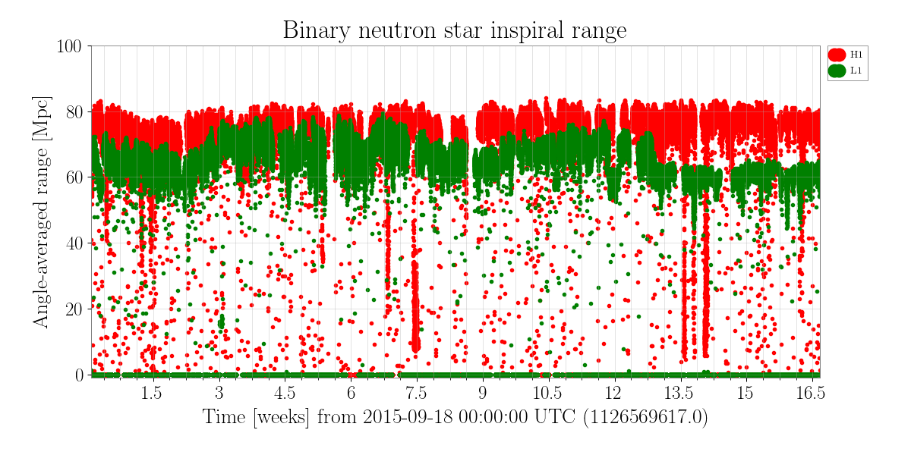
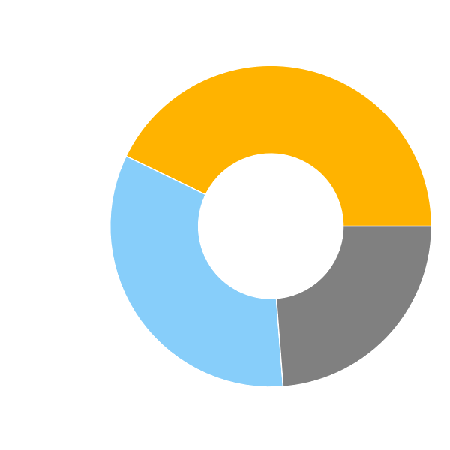
Timeline
O1
Sept ‘15 -- Jan ‘16
Double
42.8%
Single
33.4%
None
23.8%

Slide 12
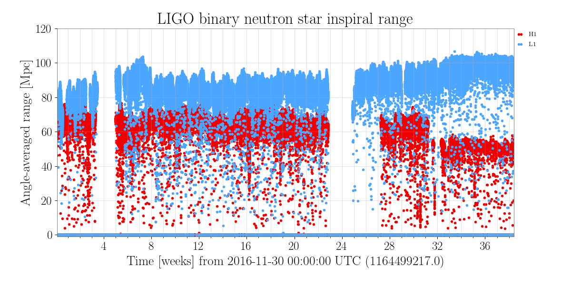
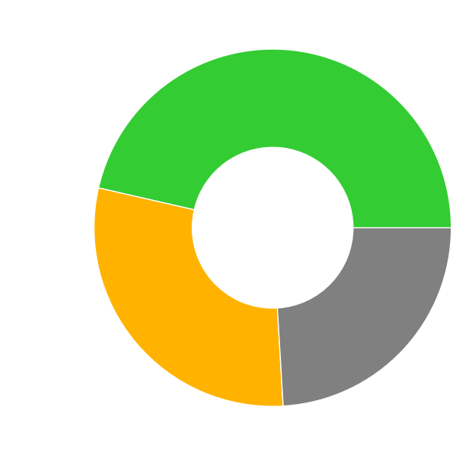
Timeline
O1
Commissioning -
No data
O2
Sept ‘15 -- Jan ‘16 Nov ‘16 -- Aug ‘17
Double
46.4%
Single
29.5%
None
24.1%

Slide 13
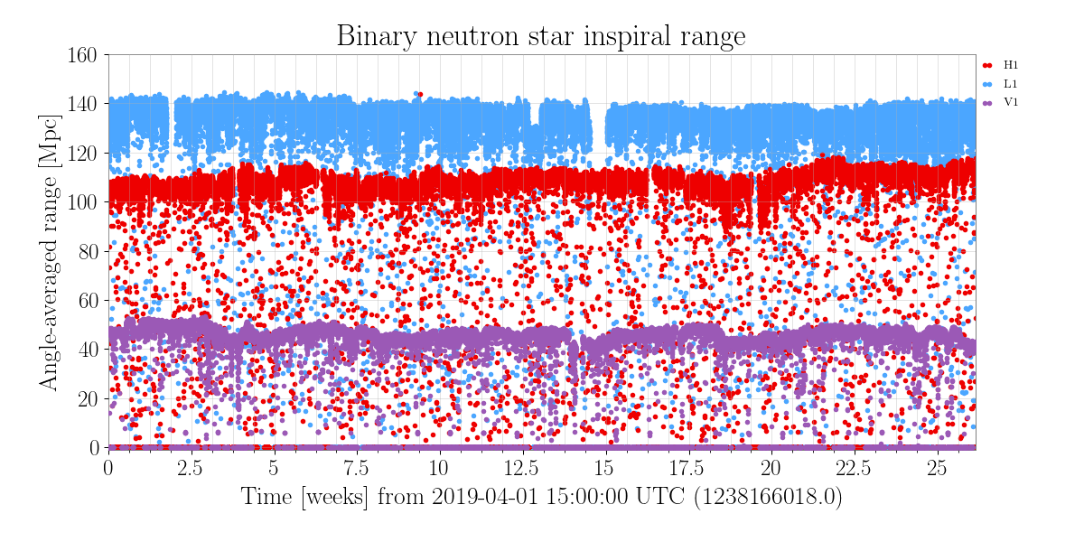
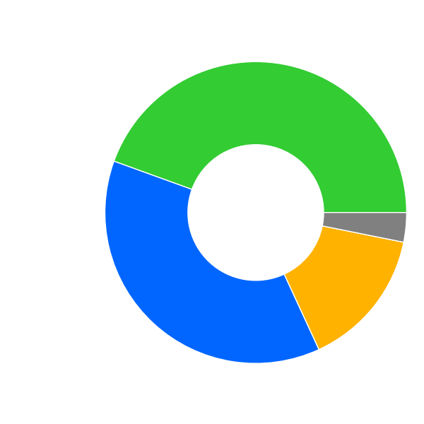
Timeline
O1
Commissioning -
No data
O2
Commissioning-
No data
O3a
Sept ‘15 -- Jan ‘16 Nov ‘16 -- Aug ‘17 Apr ‘19 -- Sep ‘19
Triple
44.5%
None
3.2%
Double
37.4%
Single
15.0%

Slide 14
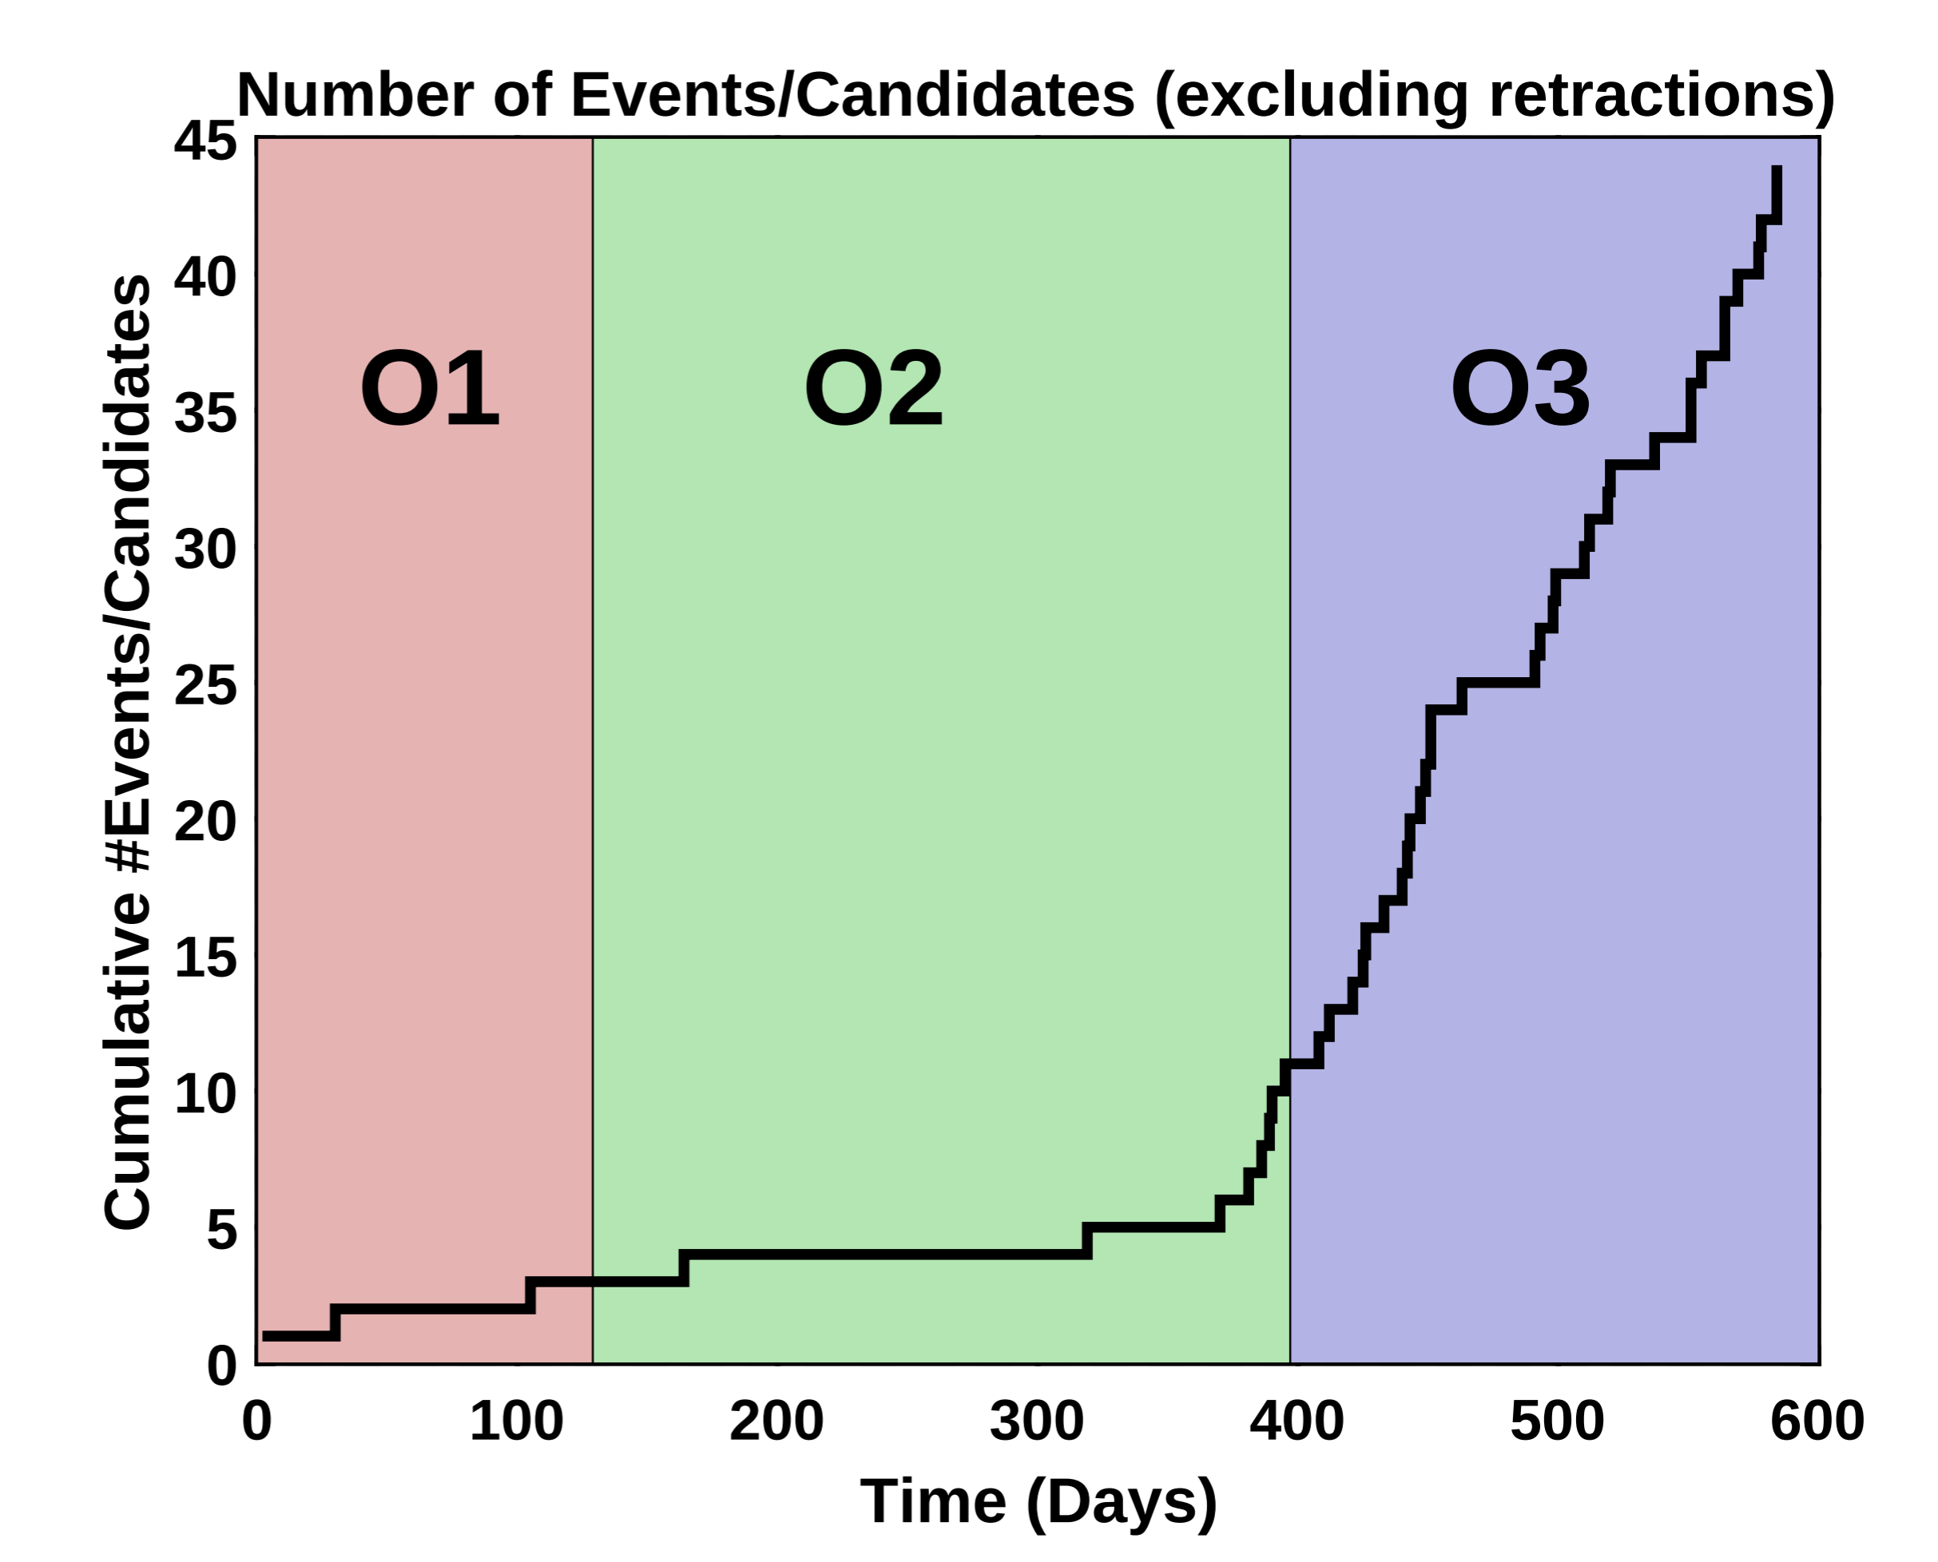
Reitze & Lazzarini LIGO Caltech
Credit: LIGO & Virgo

Slide 15
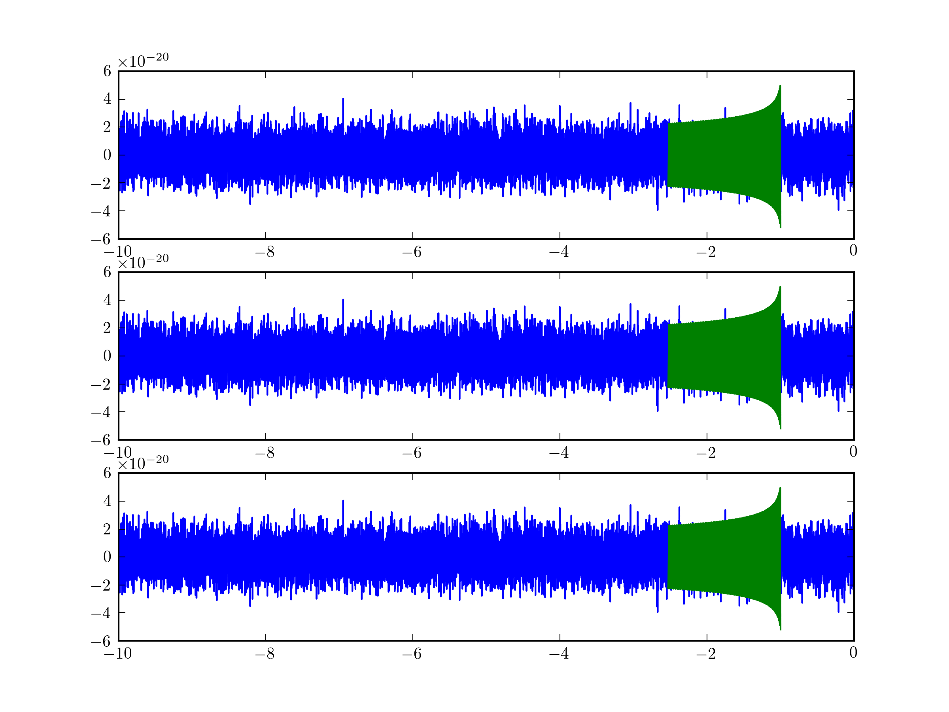
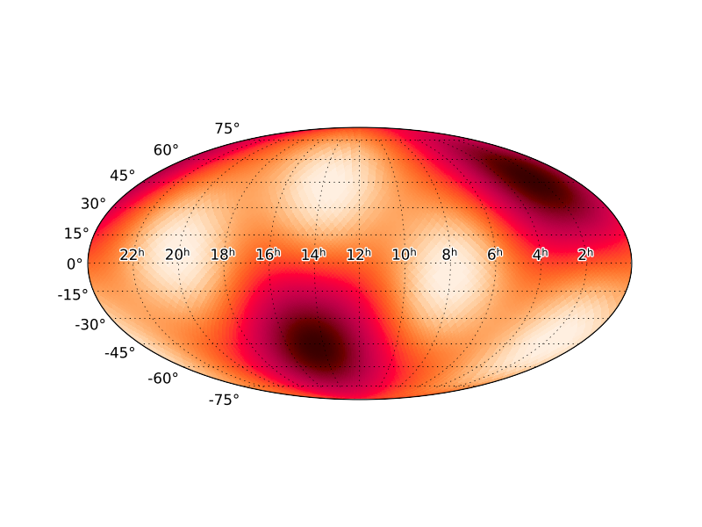
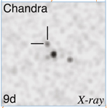
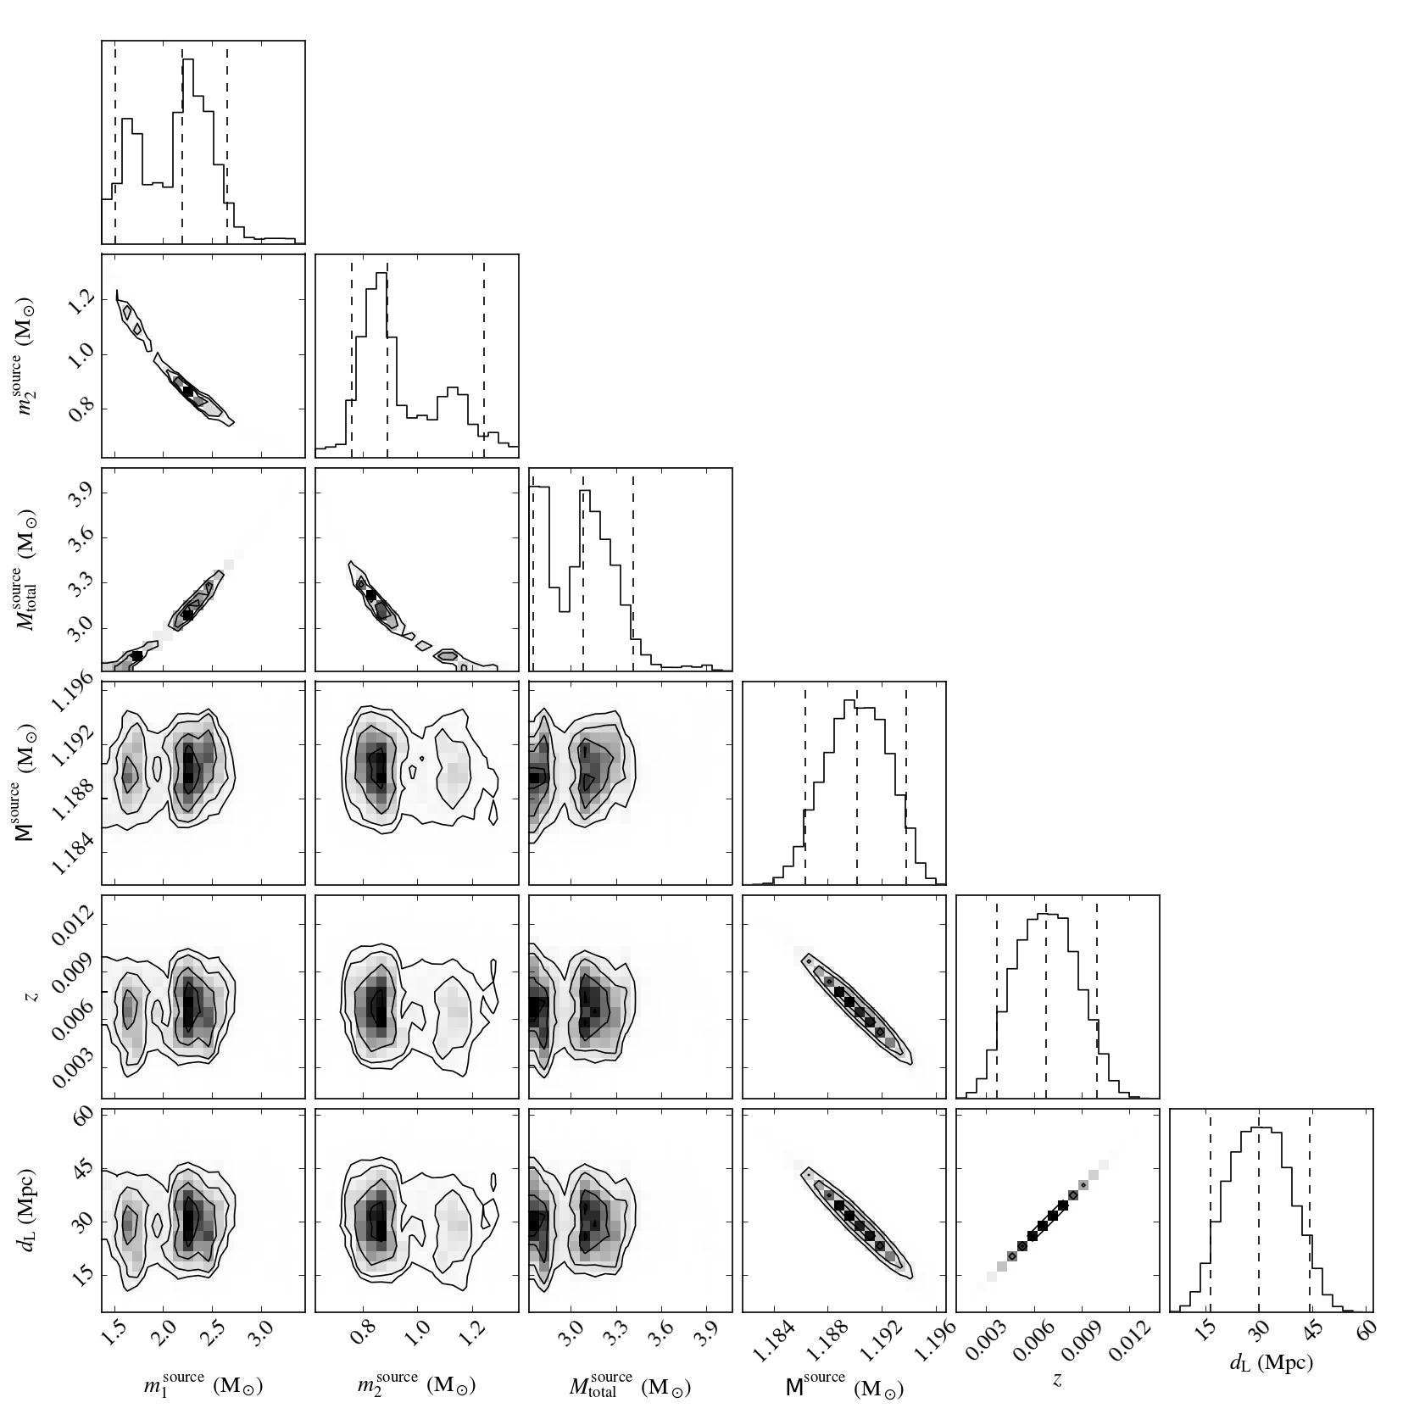
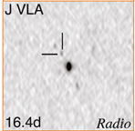
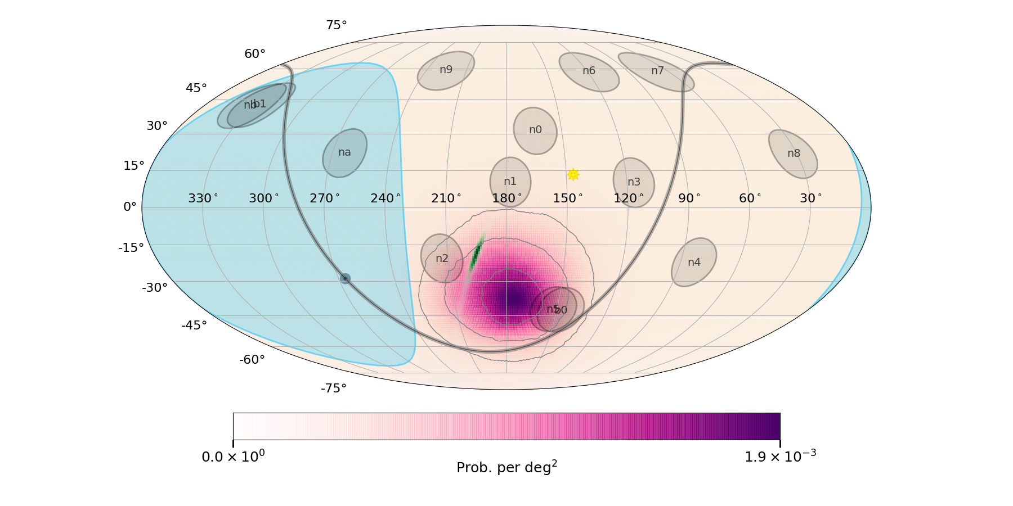
Real-time GW data processing (this is not a complete diagram)
H1
Candidate
database
L1
Multi datacenter redundancy for analysis
V1
GCN
GW data quality
GW skymap generation
MMA Analysis
RAVEN: Temporal coincidence
with external trigger E298046
gives a coincident FAR
= 1.9489803467e-16 Hz
Gamma ray
Optical
X-ray
...
...
𝜈 correlation
Radio
+
GW parameter estimation
Abbott+ 2017

Slide 16
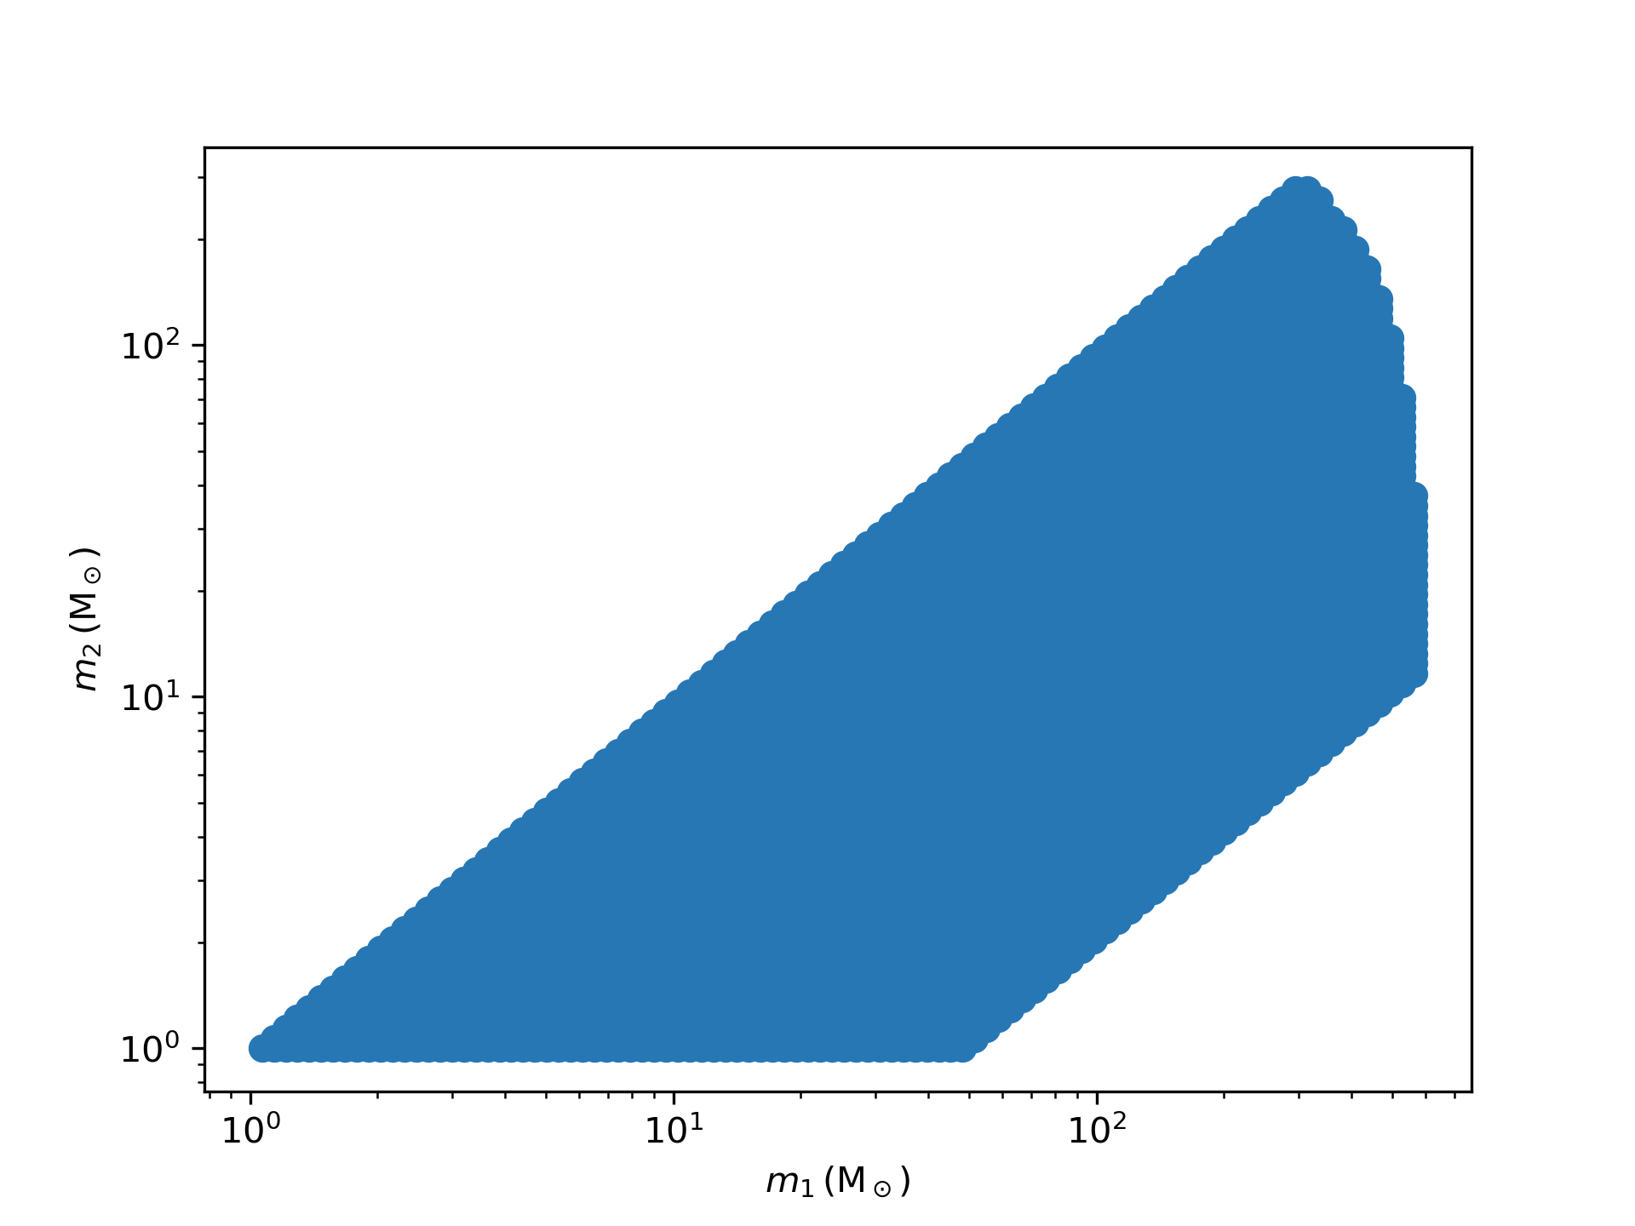
Real-time analysis covers:
Component: 1 - 600 M☉
Total < 600 M☉
NS spin < 0.05
BH spin < 1
Q < 50
Millions of templates are searched in parallel
Candidates are uploaded to GW database within 20 seconds of data acquisition.

Slide 17
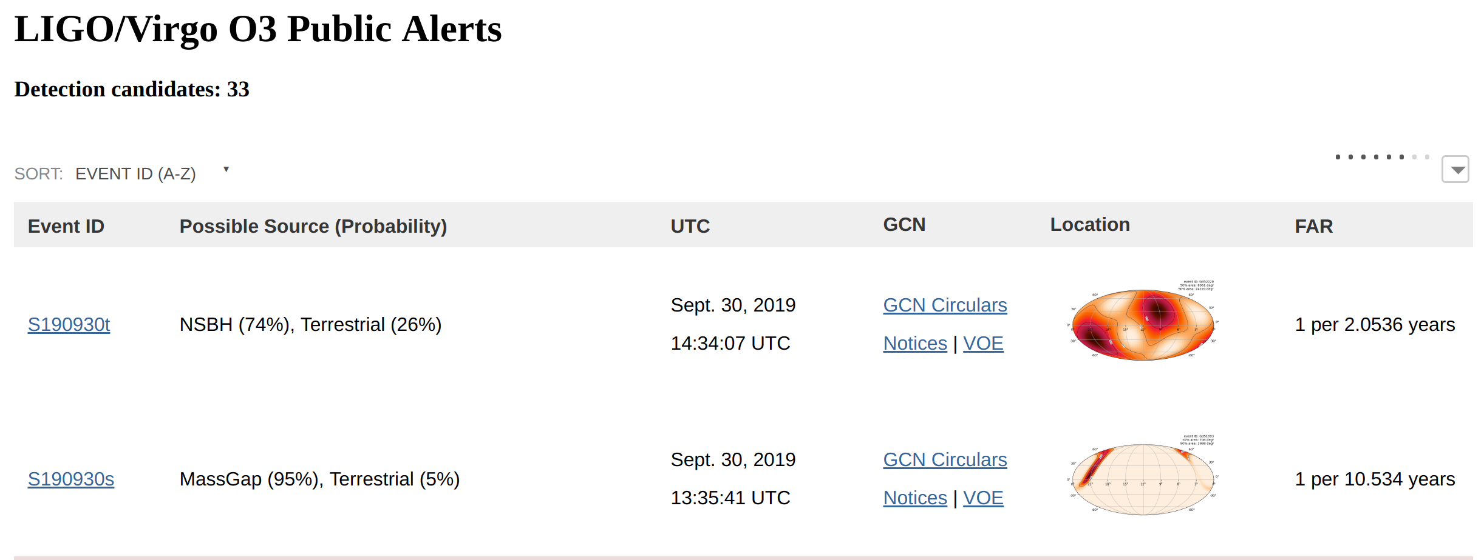
Open public GW alerts: https://gracedb.ligo.org/superevents/public/O3/

Slide 18
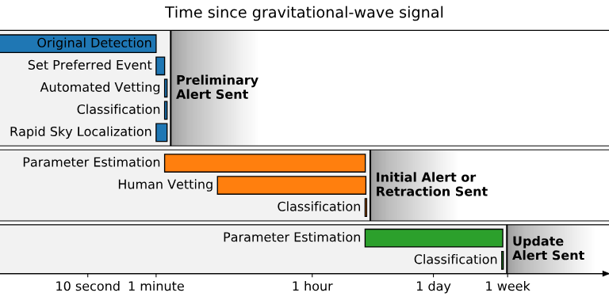
Open public GW alerts: https://emfollow.docs.ligo.org/userguide

Slide 19
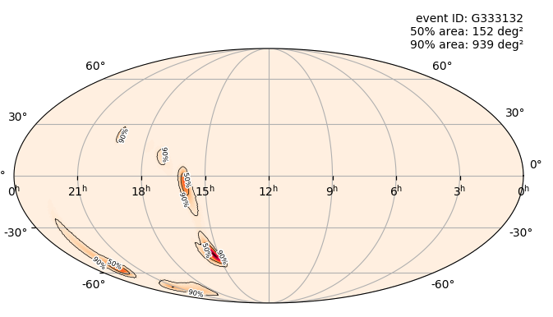
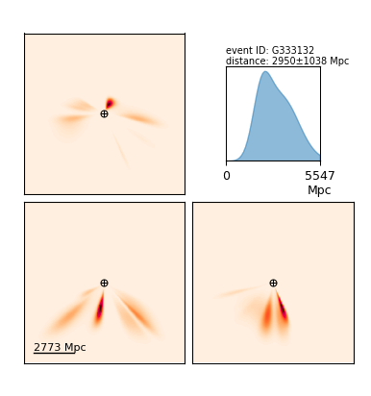
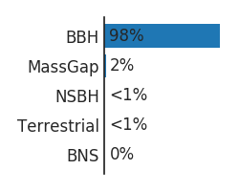
https://gracedb.ligo.org
Foucart, F., Hinderer, T. & Nissanke (2018)

Slide 20
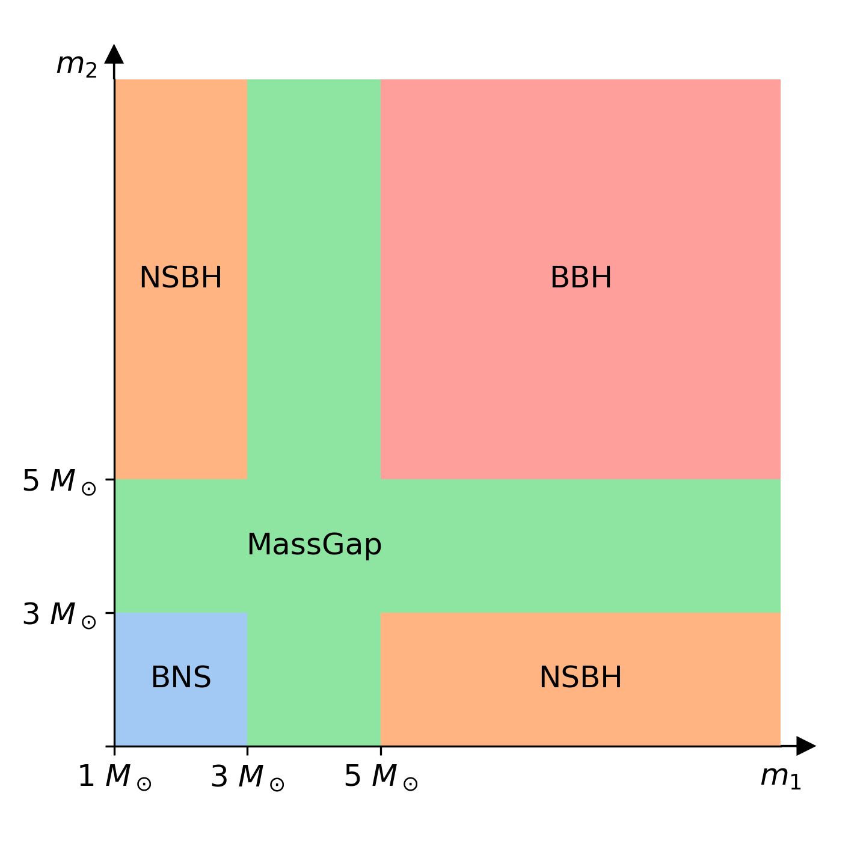
We provide “p-astro” classification based on the mass definitions to the left.
PROB_NS: 0.00 [range is 0.0-1.0]
PROB_REMNANT: 0.00 [range is 0.0-1.0]
https://emfollow.docs.ligo.org/userguide/

Slide 21
Number classified as BBH/Mass Gap: 23
Number classified as BNS: 4 (1 definite **, 1 reclassified as NSBH if real)
Number classified as NSBH: 4 (1 definite **)
Number classified as terrestrial: 2
There have been >1000 GCNs associated with follow-up
**based on mass alone - we do not know that there was an NS

Slide 22
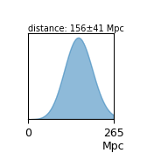
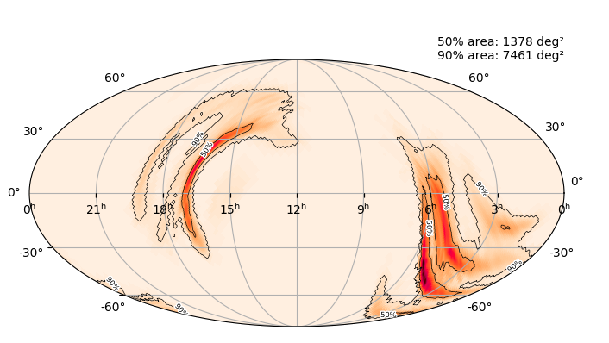
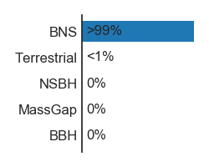
BNS : S190425z (Definite GW)
Originally discovered as L only (V contributed very low SNR)

Slide 23
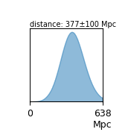
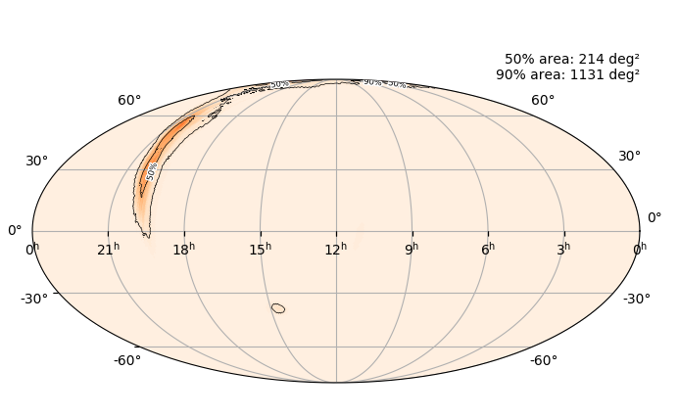
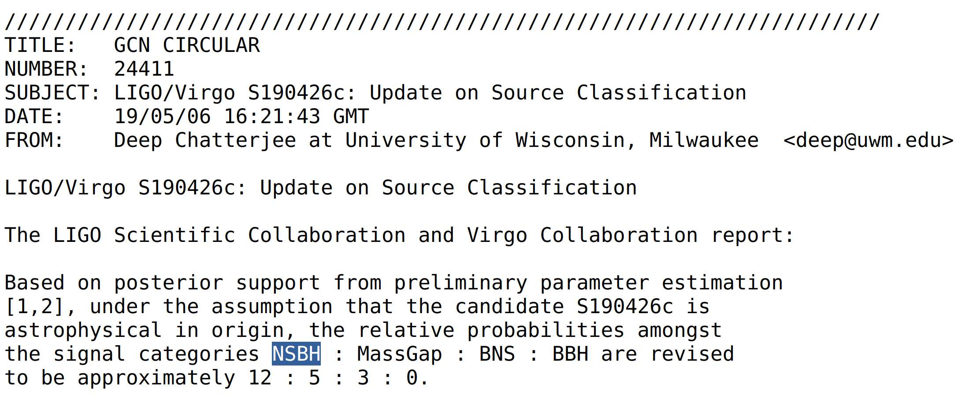
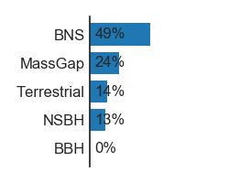
BNS -> NSBH : S190426c (Marginal)
Initially Classified as a BNS but very, very marginal

Slide 24
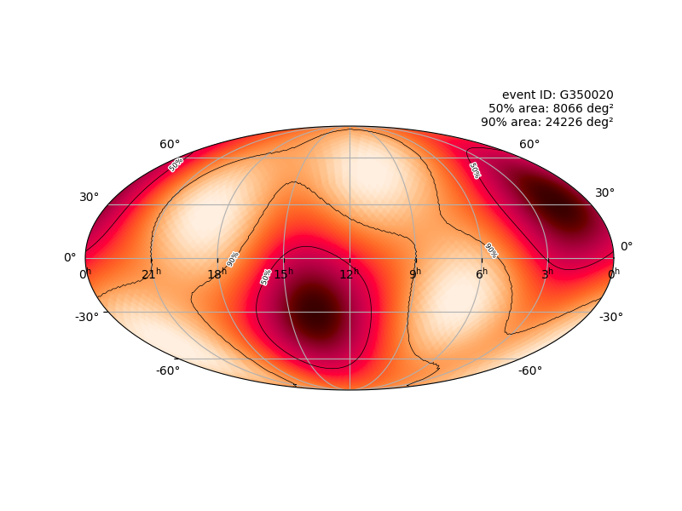
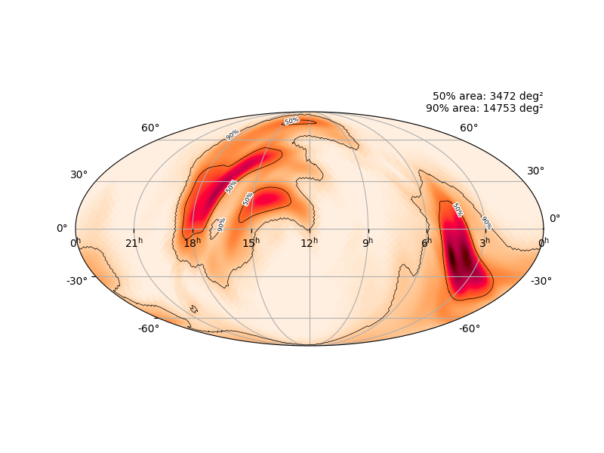
Other marginal BNS : S190901ap, S190910h
S190910h: BNS (61%), Terrestrial (39%)
L1
S190901ap : BNS (86%), Terrestrial (14%)
L1, V1

Slide 25
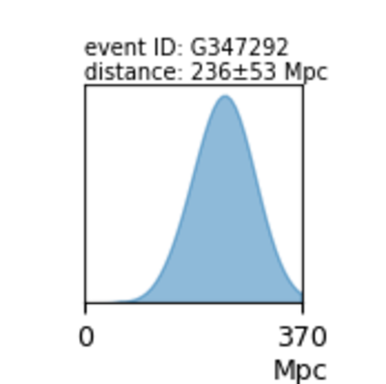
S190814bv (Definite GW)
Originally discovered as L,V only

Slide 26
S190814bv (Definite GW)
H had “low noise” data that was reanalyzed

Slide 27
S190814bv (Definite GW)
After follow-up, was reclassified as NSBH

Slide 28
Other marginal NSBH : S190923y, S190930t, S190910d
S190923y NSBH (68%), Terrestrial (32%)
S190930t NSBH (74%), Terrestrial (26%)
S190910d NSBH (98%), Terrestrial (2%)

Slide 29
Going forward
O3b will begin on November 1, 2019 and run until April 30, 2020.
We are on track for > 50 confident GW detections by the end of the run.

Slide 30
A+
https://arxiv.org/abs/1304.0670
‹#›
2025+

Slide 31
Thanks

Slide 32
‹#›

