Slide 1



Constraining the Rate of SGRBs in the Local Universe
MMGW 2019
Soheb Mandhai
University of Leicester
E-MAIL: SFM13@Leicester.ac.uk
Supervisor: Nial Tanvir
Collaborator(s): Gavin Lamb

Slide 2
Aims
Constrain the rate of SGRB occurrences within the LIGO/Virgo detection volumes
Consider potential offsets from nearby galaxies
Account for potential SGRB catalogue contaminants
What should we expect from the current GW detector run?

Slide 3
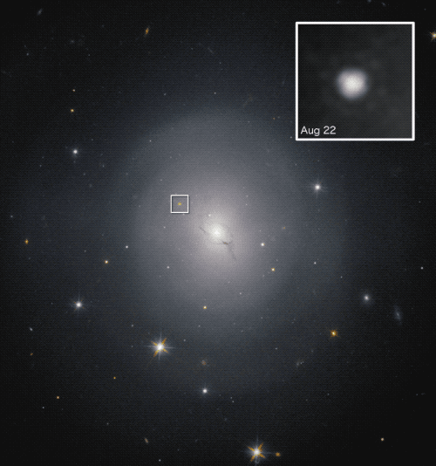
Electromagnetic Counterparts of Gravitational Waves
Common Progenitors of Gravitational Waves
Easier But Still Not Easy To Detect
  Many EM based detectors/telescopes active
Allows for better localisation
Provides insight into the galactic host
Key Counterparts:
  Kilonovae
  Short Duration Gamma Ray Bursts
  Resonant Shattering (?)
NGC 4993 – EM Counterpart to GW170817
Image Source: NASA and ESA

Slide 4
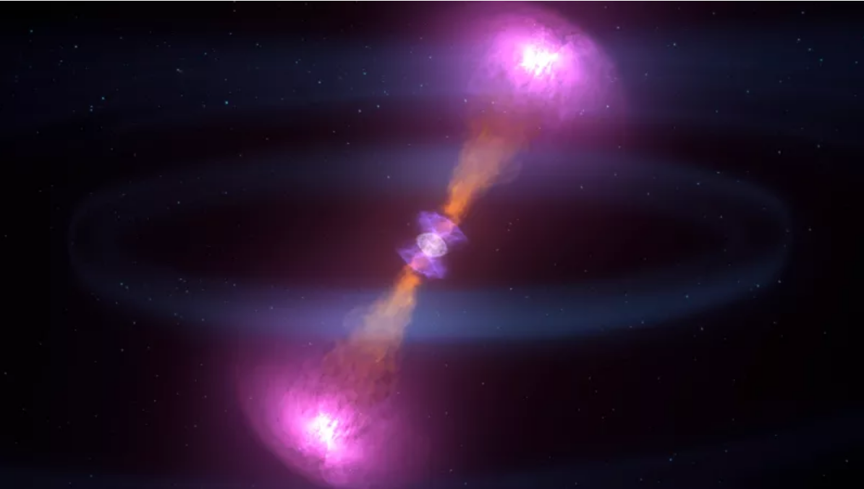
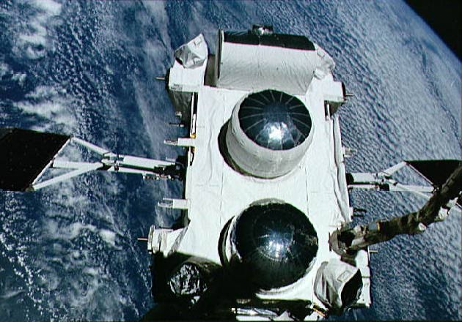
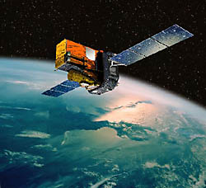
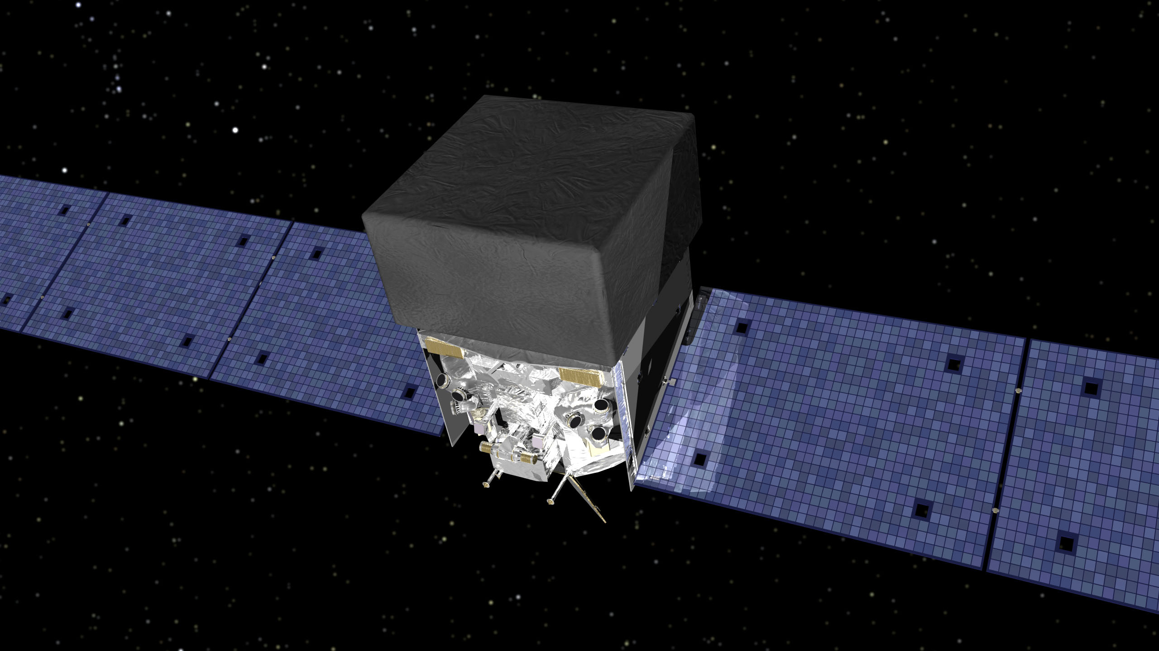
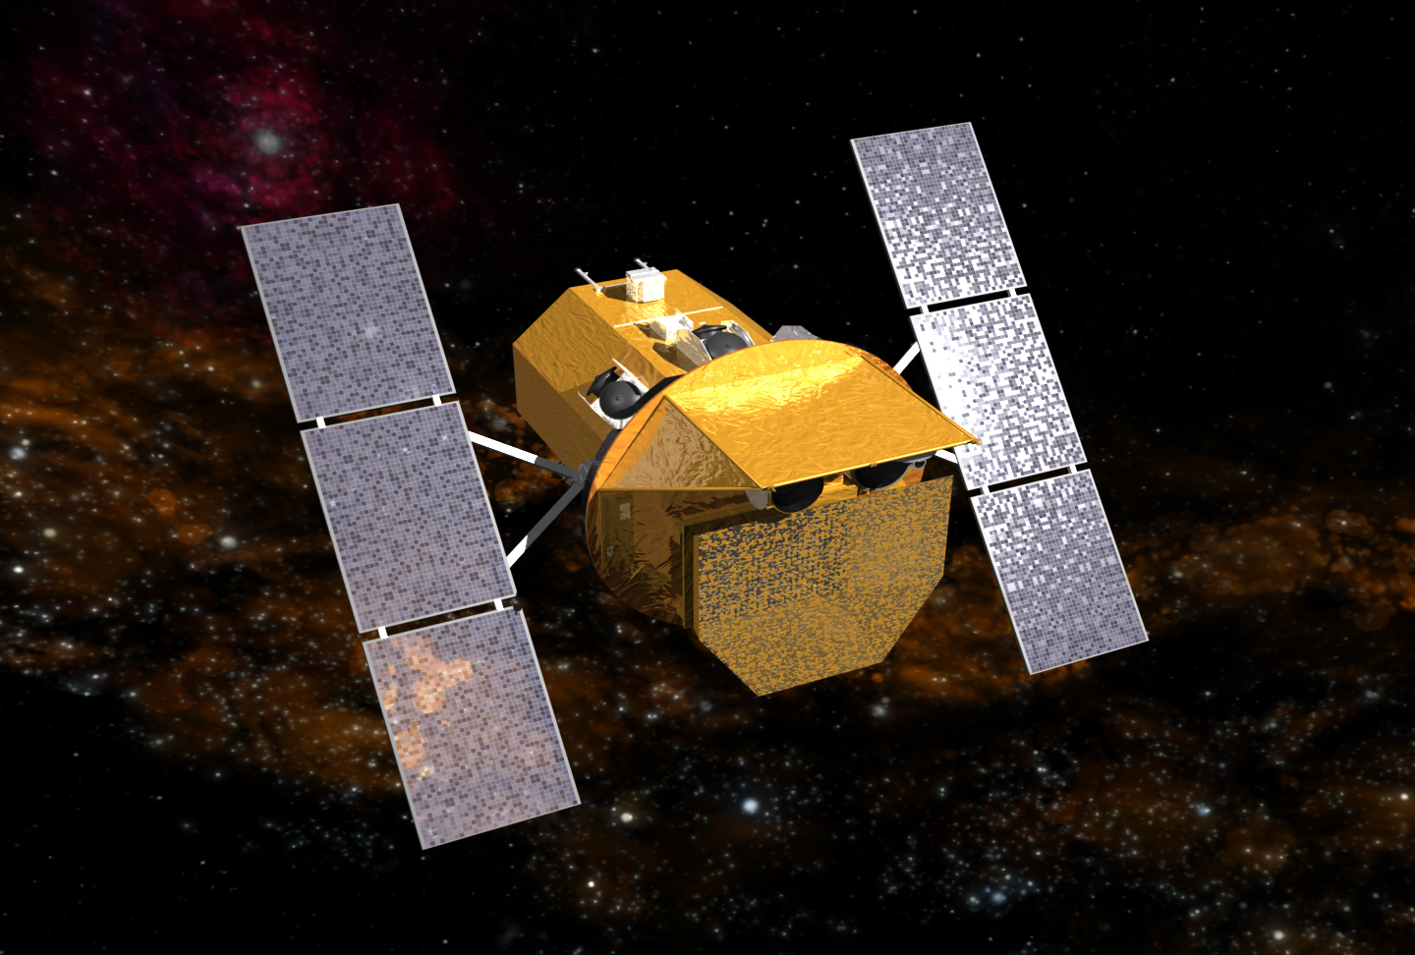
Importance of SGRBs
Product of Compact Binary progenitors (NSNS/BHNS)
GW counterparts
More detections than GW detections
Confirmed counterpart: GRB 170817A to GW170817
CGRO/Swift/Fermi/Integral etc.
Image Credit: Gizmodo
CGRO
Integral
Fermi
Swift

Slide 5
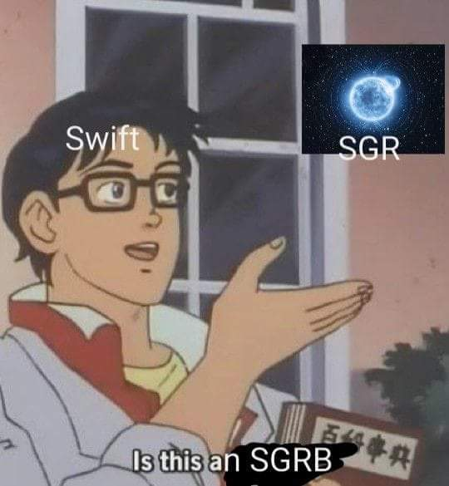
Importance of SGRB Localisation
Adds an upper limit to the number of expected SGRBs
Swift has detected <~ 1 SGRBs out of 110 within 100 Mpc [T90 < 2s]
Host galaxies may be too faint/Kicks too large
Bright galaxies provide a stronger correlation?
Are there more GRB 170817A (counterpart to GW170817) like events expected? [Previous GRB 111020A]
Giant flares from Soft Gamma-Ray Repeaters (SGRs) masquerading as SGRBs (Found at D~ few*10 Mpc)
  SGR = Magnetar (highly magnetic neutron star)
  Giant flares caused by violent reconfiguration

Slide 6
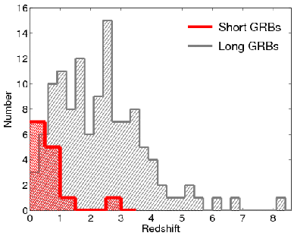
Historical GRB Distribution
- SGRBs can originate from galaxies with z ~ 1
- Biases? Are there any mis-classified burst hosts?
- Could there a be a population of high redshift faint hosts?
Credit: Berger & Fong, 2009

Slide 7
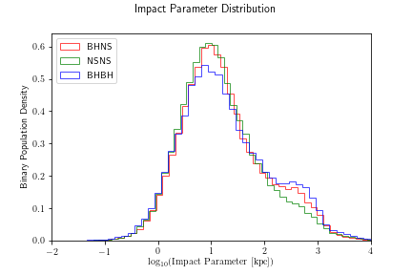
Projected Offsets
Kicks need to be considered
Up to ~few Mpc projected migration from initial host galaxy
Could this explain “Hostless” SGRBs?
See YKIS 2019 Poster Sides/Yokohama GRB 2019 Poster (or email)
Mandhai et al. (preliminary – in prep)

Slide 8
Potential Nearby SGRBs
200 kpc
Observer
200 Mpc
(Average O3 Distance)

Slide 9
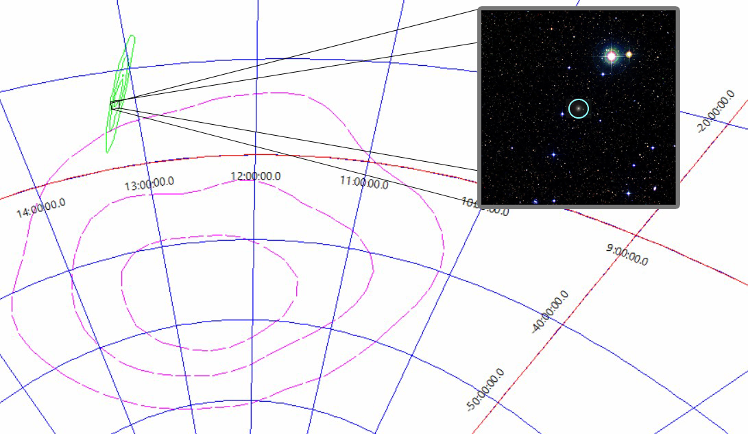
Advantage of Swift

Slide 10
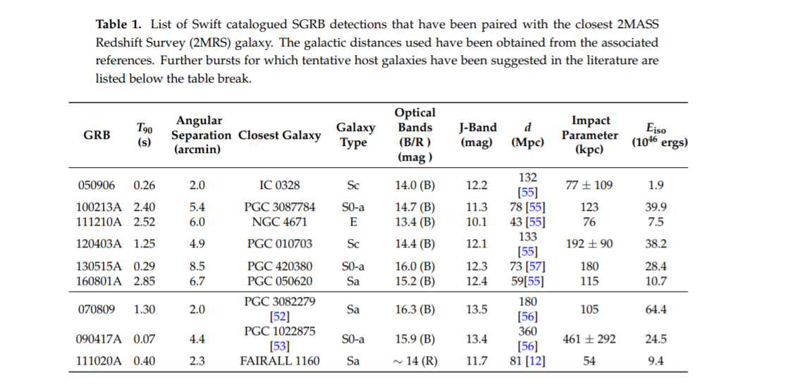
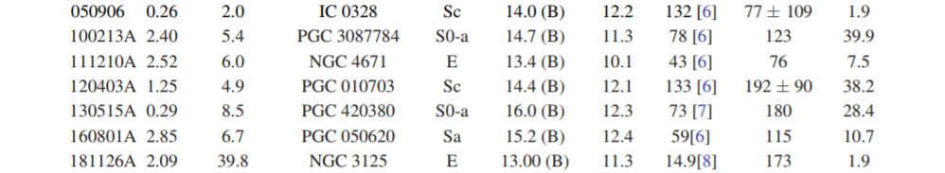

Slide 11
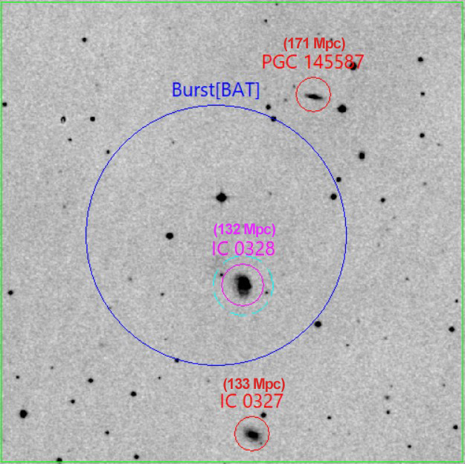
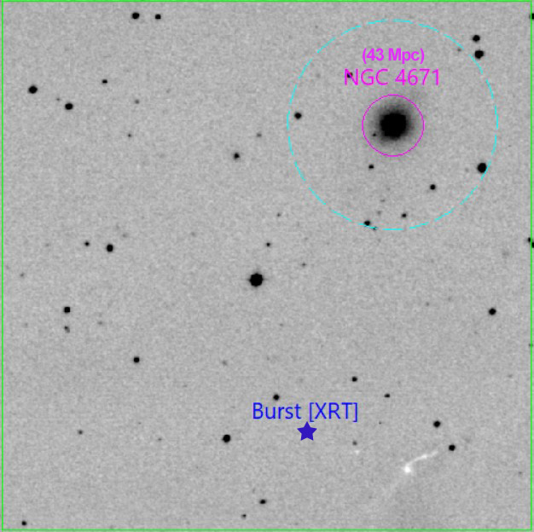
Impact Parameters
Compact Binaries kicks can be large
Burst appears away from host galaxy
Impact parameter = angular separation x distance to galaxy
T90 < 4s
Feasible impact parameters < 200 kpc
Yields an all-sky rate of up to 4 per year (d < 200 Mpc)
See Mandhai et al. 2019 + Poster
GRB 050906
GRB 111210A

Slide 12


Cross-Correlation
2MRS Galaxies + CGRO/BATSE Bursts (500) + Fermi/GBM Bursts (287)
Original Work: Tanvir+05
Correlation Parameter, Φ:
Where: [N/B: $γ_{2}= π$]
Statistical Error (localisation uncertainty)
Angular
Burst-Galaxy Offset
Concentration Parameter
Fractional
Contribution
*Derived from Briggs+99

Slide 13
In a nut-shell
Galaxies
P1
P5
P6
P2
P3
P4
SGRB

Slide 14
Cross-Correlation
2MRS Galaxies + CGRO/BATSE Bursts (500) + Fermi/GBM Bursts (287)
Original Work: Tanvir+05
Correlation Parameter, Φ:
Where: [N/B: $γ_{2}= π$]
Statistical Error (localisation uncertainty)
Angular
Burst-Galaxy Offset
Concentration Parameter
Fractional
Contribution
*Derived from Briggs+99

Slide 15
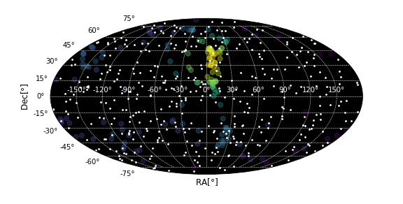
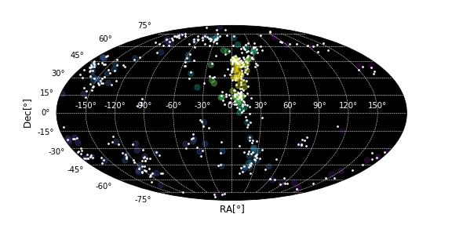
Offset Weighting (Simulated)
D < 10 Mpc
0% Weighted (Random)
100% Weighted

Slide 16
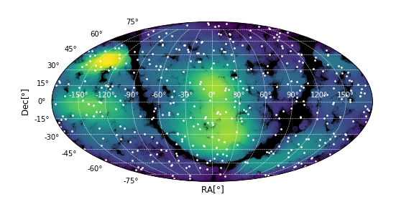
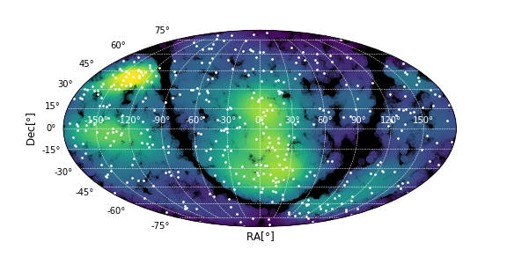
Offset Weighting (Simulated)
D < 100 Mpc
0% Weighted (Random)
100% Weighted

Slide 17
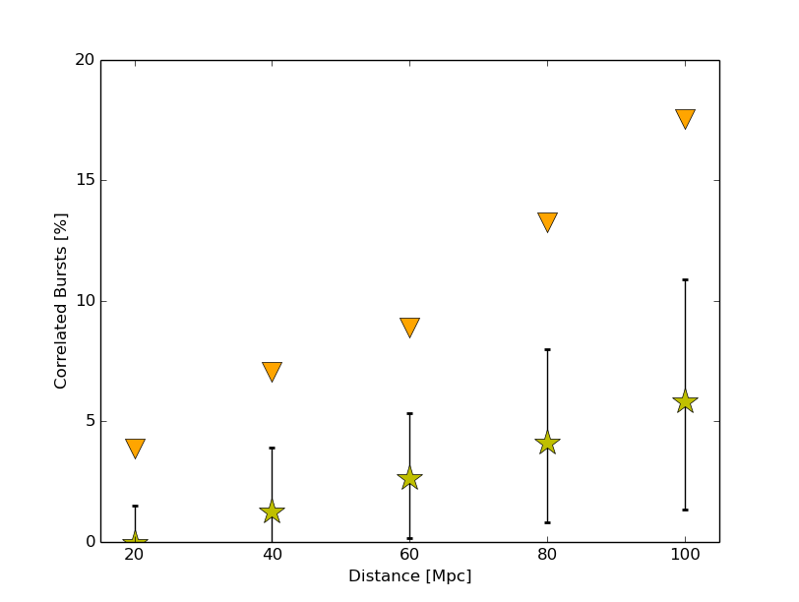
Correlation Results
Correlation present
Galaxies weighted by B-Band
General trend/deviation similar to Tanvir+05 but weaker
Constraint of < 12 bursts per year (1 sigma < 100 Mpc)

Slide 18
So far in O3 (NSNS/BHNS mergers)
6 NSNS/BHNS binary merger candidates
2 Low probability NSNS (most likely noise/other)
5 retractions/glitches
NO (Convincing)ELECTROMAGNETIC COUNTERPARTS
Note: Numbers may vary

Slide 19
Summary
Kicks offsetting/galaxy escape – SGRBs occur away from hosts
SGRB rate < 4 per year (using Swift) < 200 Mpc
SGRB rate < 12 per year (using correlation) < 100 Mpc
SGRs within d< 10 Mpc (if present) should present a GF at < 3 per year
<10% of GW events are expected to have a SGRB counterpart (calculated using NSNS rates from Abbot et al., 2017)
See Mandhai et al. 2019 + Poster during Yokohama GRB 2019
Email: SFM13@Leicester.ac.uk (open to discussions)

Slide 20
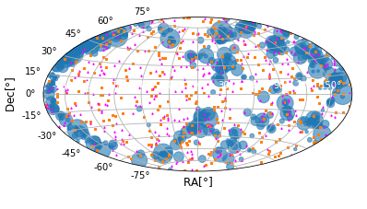
Additional: SGR Correlation
SGR = Soft Gamma-ray Repeater, GF = Giant Flare
Can contribute towards SGRB detections
d < ~ 10 Mpc
T90 < 1 s
Only 3 known detected SGR GFs
Using Karachentsev+13 Galaxies
Upper limit on rate = 3 per year

Slide 21
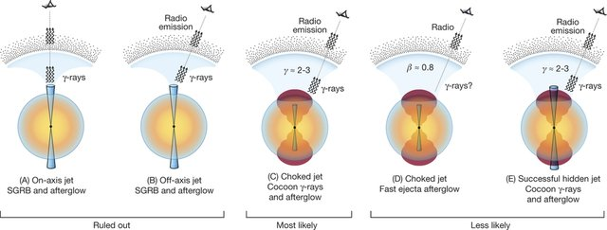
Missing SGRB detections:
Credit: Mooley et al., 2018 (Example in context to GRB 170817A)

Slide 22
References:
Berger, Edo, and Wen-fai Fong. "The Galactic and Sub-Galactic Environments of Short-Duration Gamma-Ray Bursts: Implications for the Progenitors." arXiv preprint arXiv:0912.4142 (2009).
Mandhai, Soheb, et al. "The Rate of Short-Duration Gamma-Ray Bursts in the Local Universe." Galaxies 6.4 (2018): 130.
Mooley, K. P., et al. "A mildly relativistic wide-angle outflow in the neutron-star merger event GW170817." Nature 554.7691 (2018): 207.

