Slide 1
Opportunities for Exotic Particle Searches in STAR @RHIC
Huan Zhong Huang
黄焕中
Department of Physics and Astronomy
University of California
Los Angeles, CA 90095-1547
May 2010 @YITP, Kyoto
Thanks to Hank Crawford, Jinhui Chen, Gang Wang and Wenqin Xu

Slide 2
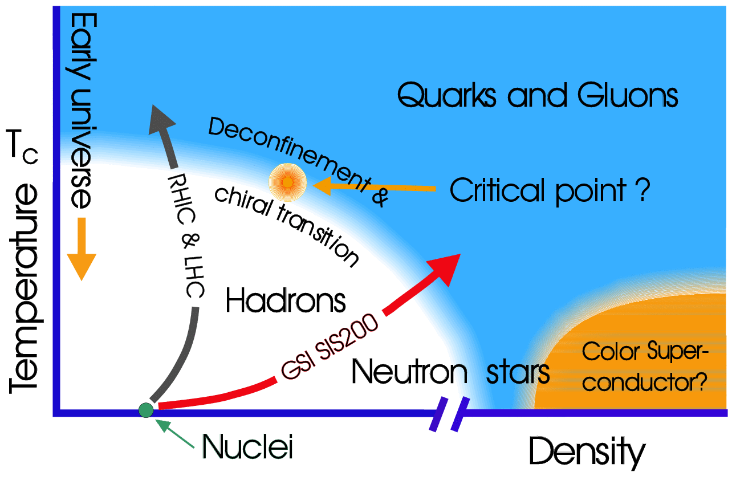
Quark-Hadron Phase Transition
2

Slide 3
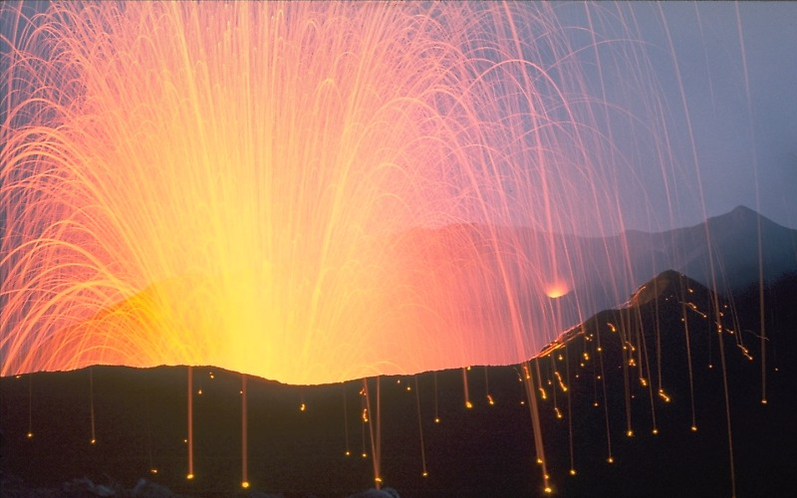
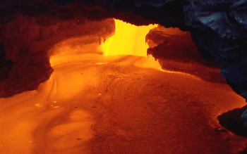
Nucleus-Nucleus Collisions and Volcanic Eruption
Volcanic high p_{T} -- Strombolian eruption
Volcanic mediate p_{T} – Spatter (clumps)
3
Volcanic low p_{T} – Bulk matter flows

Slide 4
Outline
Hadronization of Bulk Partonic Matter
Rare Particle Searches – Hyper-nuclei
Exotic Particle Searches
Summary and Outlook

Slide 5
Elliptic Flow Parameter v₂
coordinate-space-anisotropy ⇔ momentum-space-anisotropy
y
p_{y}
x
p_{x}
Initial/final conditions, dof, EOS
5

Slide 6
Naïve Expectation for Au+Au
High p_{T} particles are from hard scattering of partons --
Use number of binary nucleon-nucleon collisions to
gauge the colliding parton flux:
N-binary Scaling → R_{AA} or R_{CP} = 1
simple superposition of independent nucleon-nucleon collisions !
6

Slide 7
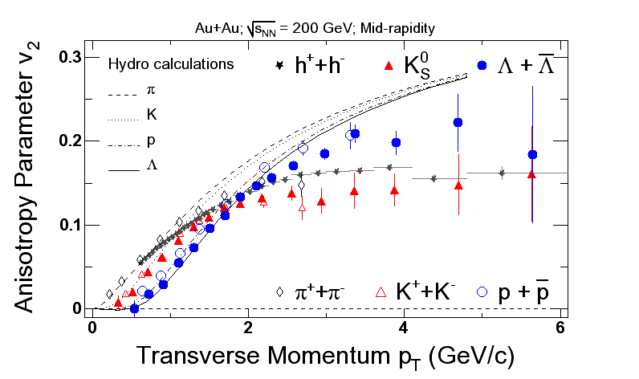
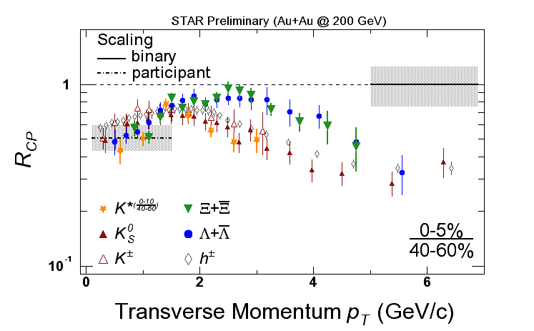
Constituent Quark Scaling
STAR
Baryon
baryons
Meson
mesons
PHENIX
Constituent (n) Quark Scaling
-- Meson n=2 and Baryon n=3 grouping
Saturation of v₂ at Intermediate p_{T}
7

Slide 8
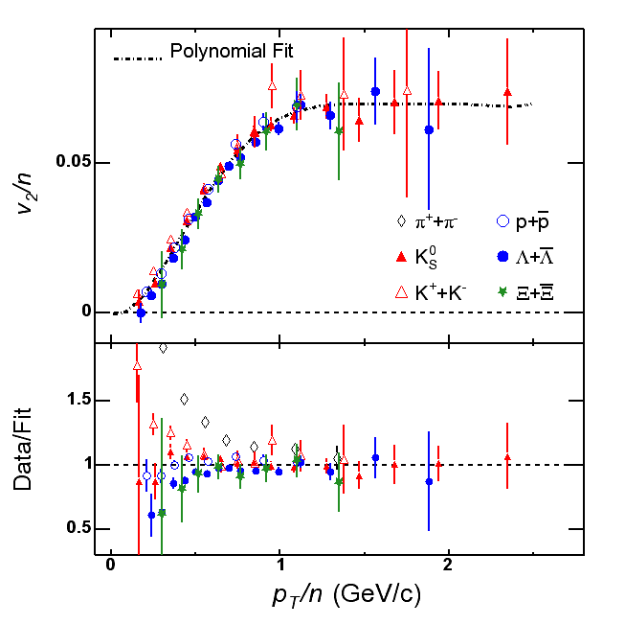
Hadronization of Bulk Partonic Matter → Coalescence
Partons at hadronization
have a v₂
→ Collectivity
Deconfinement !
Quark Coalescence – (ALCOR-J.Zimanyi et al, AMPT-Lin et al,
Rafelski+Danos, Molnar+Voloshin …..)
Quark Recombination – (R.J. Fries et al, R. Hwa et al)

Slide 9
Multi-Parton Dynamics for Bulk Matter Hadronization
Essential Features:
Traditional fragmentation → particle properties mostly
determined by the leading quark !
Emerging picture from RHIC data (R_{AA}/R_{CP} and v₂) → all
constituent quarks are almost equally important in
determining particle properties !
v₂ of hadron comes from v₂ of all constituent quarks !
The fact that in order to explain the v₂ of hadrons
individual constituent quarks (n=2-meson,3-baryon) must
have a collective elliptic flow v₂ and the hadron v₂ is the
sum of quark v₂ → Strong Evidence for Deconfiement !
9

Slide 10
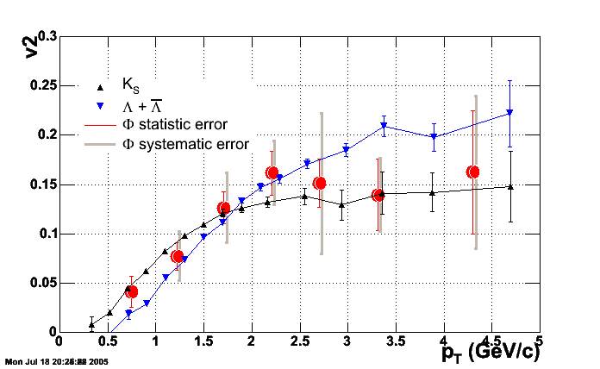
Strangeness from Bulk Partonic Matter
R_{CP}
Λ
Ξ
Constituent Quark Number Scaling
-- Hadronization through quark clustering
-- Effective DOF – constituent quarks
quasi-hadrons at T_{c} ?
Lattice QCD picture?
Ω
φ(ss)
10

Slide 11
Ω and φ are special
– (sss) state; m = 1672.45 MeV
φ -- (ss) state; m = 1019.456 MeV
Strange quark constituents produced in collisions
No decay feeddown contributions
Small hadronic re-scattering cross sections
Messengers from quark-hadron phase boundary !

Slide 12
Parton P_{T} Distributions at Hadronization
If baryons of p_{T} are mostly formed from
coalescence of partons at p_{T}/3 and
mesons of p_{T} are mostly formed from
coalescence of partons at p_{T}/2
and φ particles have no decay feeddown contribution !
decay contribution is small
These particles have small hadronic rescattering cross sections
12

Slide 13
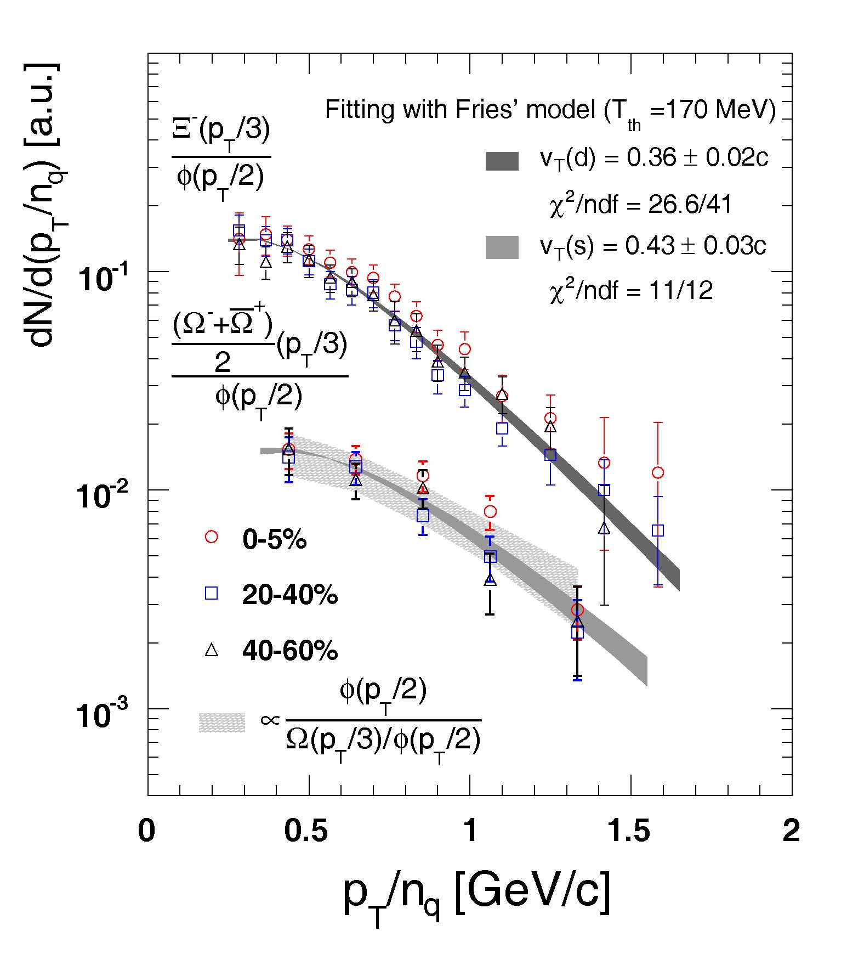
Strange and down quark distributions
s distribution harder
than d distribution
perhaps related to
different s and d
quarks in partonic
evolution
Independent Test –
φ/s should be consistent with s quark distribution
Yes !
13

Slide 14
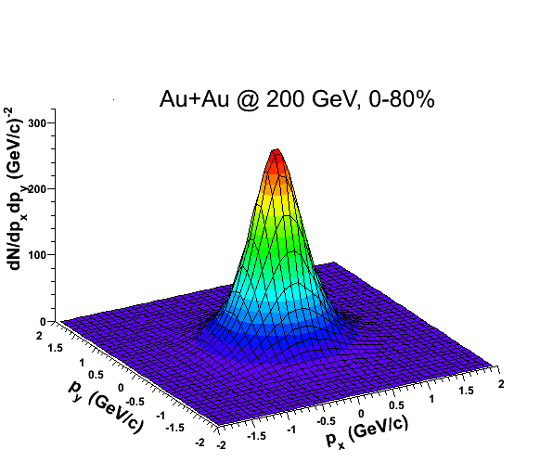
Effective Parton Distribution in the QM Drop at Hadronization
Λ
Parton Spectroscopy
Ξ
Ω
φ
Use particle emission to
measure parton pT distribution
and angular anisotropy (v₂)
in the dense parton drop !!

Slide 15
Discoveries from Unexpected Areas?!
RHIC -- Frontier for bulk partonic matter formation
(quark clustering and rapid hadronization)
-- Factory for exotic particles/phenomena
Rare Particle Production at RHIC
– hyper-nuclei and anti-matter (⁴He)
Exotic particles/phenomena Searches:
tetra- penta-quark states (strange or charmed)
di-baryons
H – (Λ−Λ, uuddss)
[Ω−Ω] (ssssss)
strange quark matter
meta-stable Parity/CP odd vacuum bubbles
disoriented chiral condensate
……
15
15

Slide 16
signal from the data
Science 328 (2010) 58
Signal observed from the data (bin-by-bin counting): 70±17;
Mass: 2.991±0.001±0.002 GeV; Width (fixed): 0.0025 GeV.
Au+Au: 89M MB events and 22M central collision events.
16

Slide 17
Combine particle and anti-particle
Combined hyperT and anti-hyperT signal : 225±35;
It provides a >6σ significance for observation.

Slide 18
Measure the lifetime
We measure τ_{Λ} = 267±5 ps
PDG value is τ_{Λ} = 263±2 ps
ps
PDG: Phys. Lett. B 667 (2008) 1

Slide 19
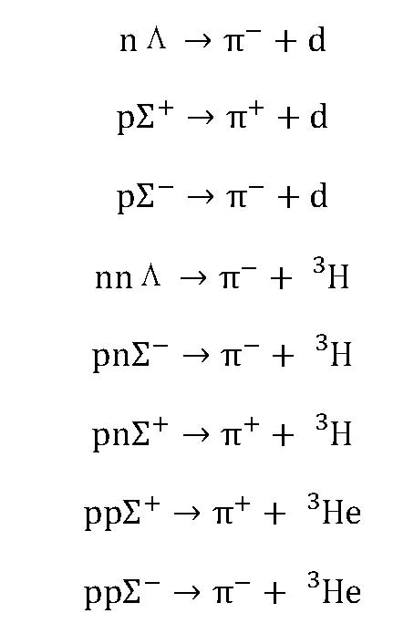
Candidates other than hyper-triton (pnΛ)
STAR detector system is ideally
suited for strange particle
weak decays !
-- large acceptance TPC
-- secondary vertex resolution
-- combinatorial background

Slide 20
Searches for Exotics Beyond 2q and 3q Structure
Resonance Particles are difficult in HIC @RHIIC
-- huge combinatorial background !
Pentaquark candidates to search for
-- pK_{S}
-- pK⁺
-- Ξ⁻ π⁻
-- Ωπ or ΩK
Di-baryons
Λ−Λ correlation and/or H particle
[Ξ⁰-p]→Λp
[Ω-Ω]

Slide 21
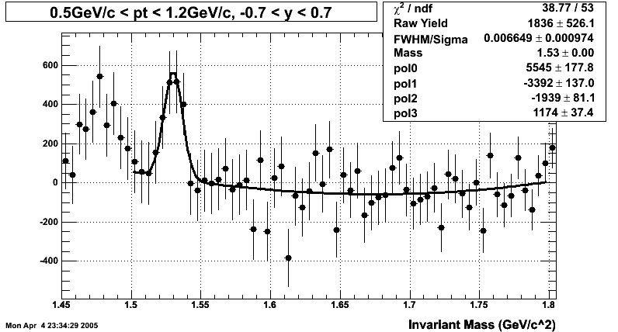
dAu results (year 2003)
The invariant mass distribution is fitted to a Gaussian plus a linear function. A 3.3-5.0 sigma signal is seen.
Measured mass is about 1.53 GeV/c². Full width is about 15 MeV.
18 M d+Au events

Slide 22
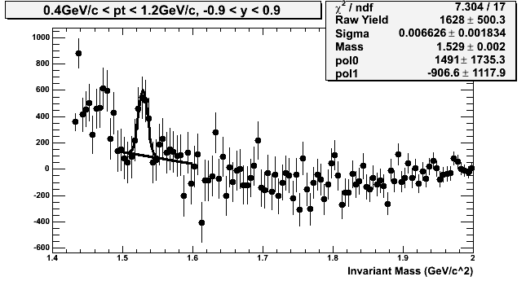
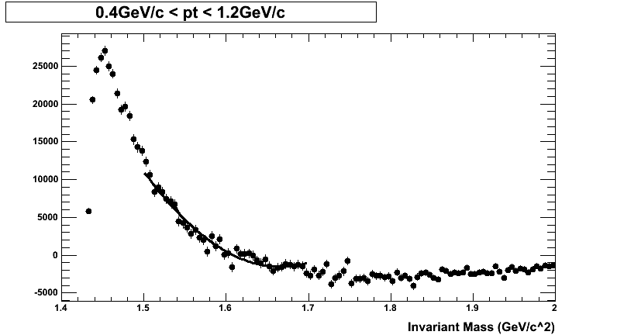
Δ⁺⁺→π+p and using π as K
Θ
π → K
Θ
Δ
Δ

Slide 23
d+Au 2008 Data
Data sample ~ 2X run 2003
still finalizing the TPC calibration
-- space charge distortion
Preliminary analysis showed no pK⁺ signal
Tracking quality is a sensitive issue and we have
to re-visit run 2003 data also !

Slide 24
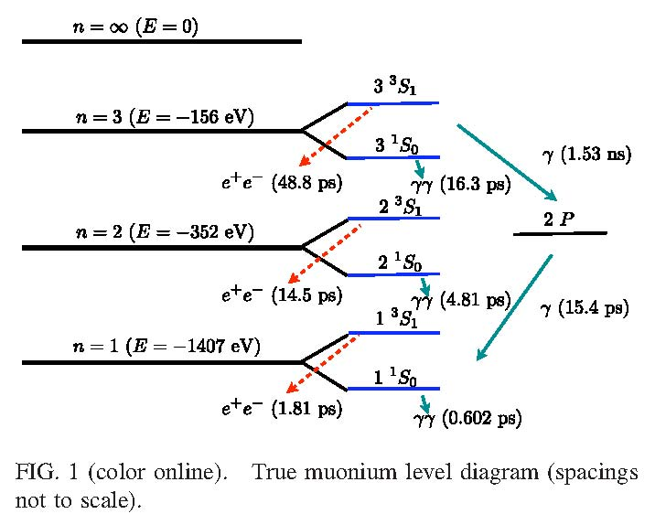
Search for True Muonium State (μ⁺μ⁻) in HIC
S.J. Brodsky and R.F. Lebed, PRL 102, 213401 (2009) for e+e- collisions !
Access thermal muons
Need to estimate the production rate in HIC
Experimentally feasible through decay e+e-

Slide 25
Charmed Exotic Particle Searches
If it is weak decay, may have some sensitivity
when STAR HFT is done
If the branching ratio is small, very difficult
-- need to evaluate the background
and production rate at RHIC
T_{CC} difficult → branching ratio to kπD?

Slide 26
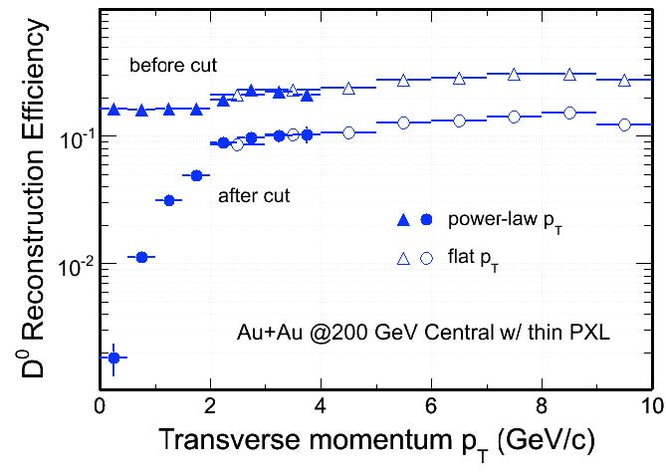
D0 Reconstruction Efficiency in STAR with HFT
The production yield is mostly below pT 3 GeV/c
The overall reconstruction efficiency a few percent
---- not favorable for charmed exotics !
Kinematic cuts to reduce background causes the
main loss of efficiency.

Slide 27
Exotic Particles with Strangeness
Hyperon Reconstruction in STAR will be enhanced
with the full TOF detector upgrade!
-- factor of 5-8 improvement for Ω
STAR TOF upgrade completed in Sept 2009 !
We are ready for searches of strange exotic particles
from run 2010 from Au+Au collisions !

Slide 28
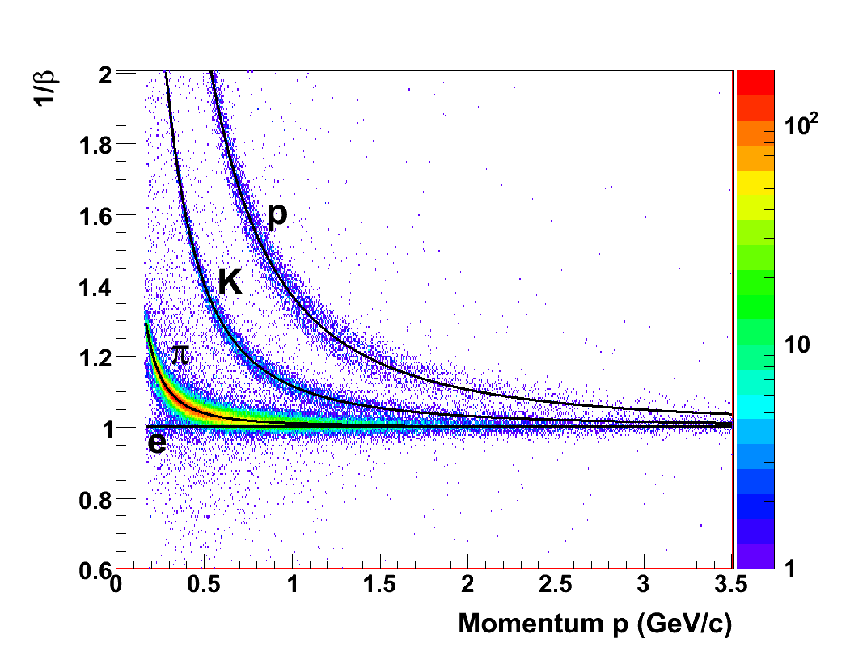
TOF Performance in Run9 at 200 GeV p+p Collisions
Timing resolution:
Start Time ~90 ps; Overall ~117 ps
Stop Time ~74 ps, and it will be improved after final calibration of TPC

Slide 29
Summary and Outlook
Central Au+Au Collisions at RHIC
Bulk Partonic Matter --
1) strangeness equilibrated
2) parton collectivity
v₂ and
hydro expansion
3) multi-parton dynamics
coalescence/
recombination
4) Opportunities for exotic particle searches !
Λ
Ξ
Ω

Slide 30
Future Data Volume from STAR
STAR Run 2010 Au+Au @ 200 GeV data set
~ 350 Million Minimum Bias Events
~ 250 Million Central Collision Events
in 10 weeks of physics running
Au+Au @ 62 GeV data set
~ 140 Million MB
~ 30 Million Central Events in 2 weeks running
Need strong motivation to go through the whole
data set !
Question:
Exotic production mechanism – advantages
for d+Au vs. Au+Au collisions ? 200 vs. 62 GeV ?

Slide 31
Exotic Particles
Hadrons with internal structure beyond existing
QCD qqq and q-qbar framework !!
A New Dimension to RHIC Physics –
Dedicated QCD Machine & Beyond
Exotic
AA
(Deconfinement
Phase Transition)
AA
pp
pp
pA
pA
(spin)
(CGC,EMC)

Slide 32
End

