Slide 1
Exotics search at SPring-8
M. Niiyama, Kyoto Univ.
Introduction of SPring-8/LEPS
Exotics search in backward η production
Photoproduction of Λ(1405)
Θ⁺(1530)
LEPS-II

Slide 2
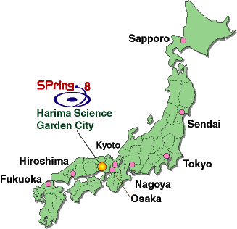
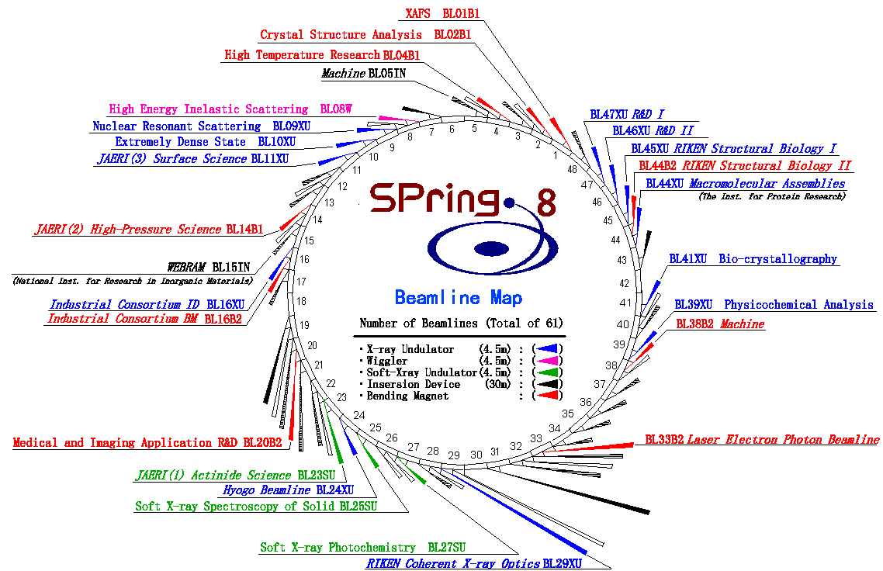
Super Photon Ring 8 GeV (SPring-8)

Slide 3
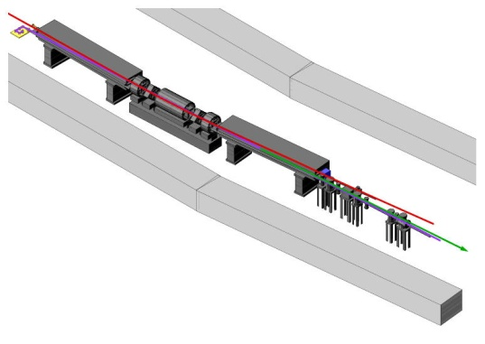
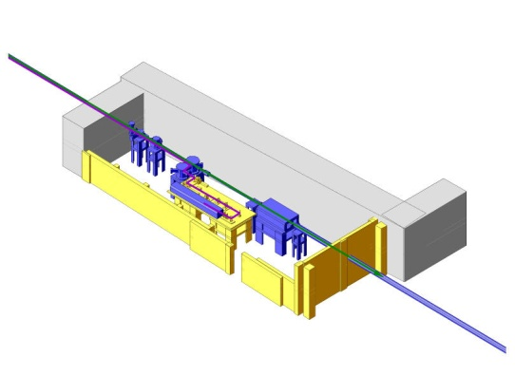
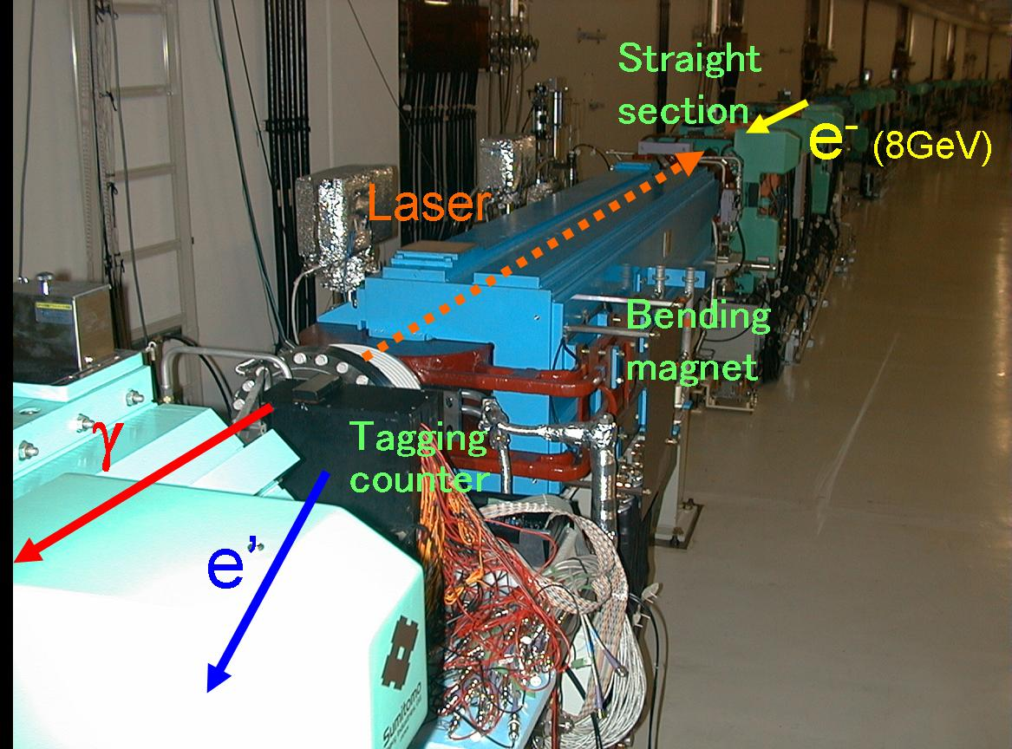
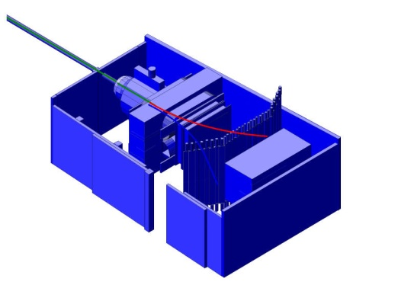
Schematic View of LEPS Facility
Backward-Compton scattering
8 GeV electron
Collision
Recoil electron
Tagging counter
36m
a) SPring-8 SR
70m
Laser light
b) Laser hutch
Compton γ-ray
c) Experimental hutch

Slide 4
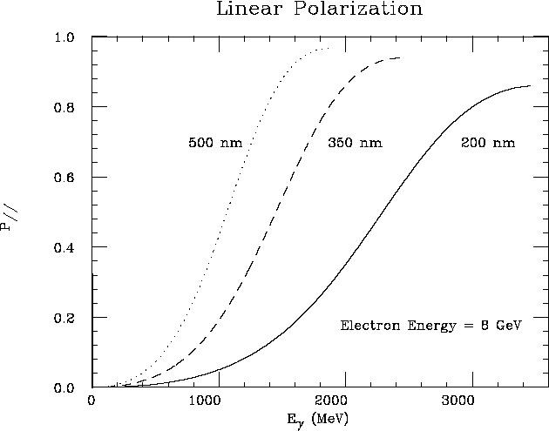
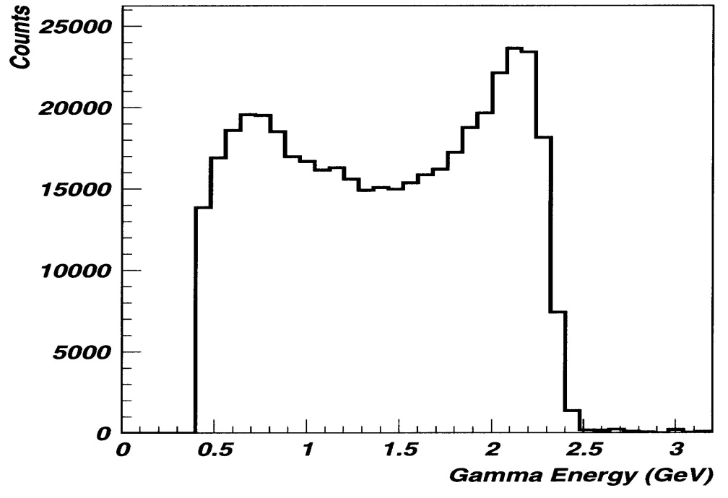
Backward-Compton Scattered Photon
8 GeV electrons in SPring-8 + 351nm Ar laser (3.5eV）
➔ maximum 2.4 GeV photon
Laser Power ~6 W ➔ Photon Flux ~1 Mcps
Eγ measured by tagging a recoil electron ➔ Eγ>1.5 GeV, ΔEγ ~10 MeV
Laser linear polarization 95-100% ⇒ Highly polarized γ beam
PWO measurement
Linear Polarization of γ beam
tagged
photon energy [GeV]
photon energy [MeV]

Slide 5
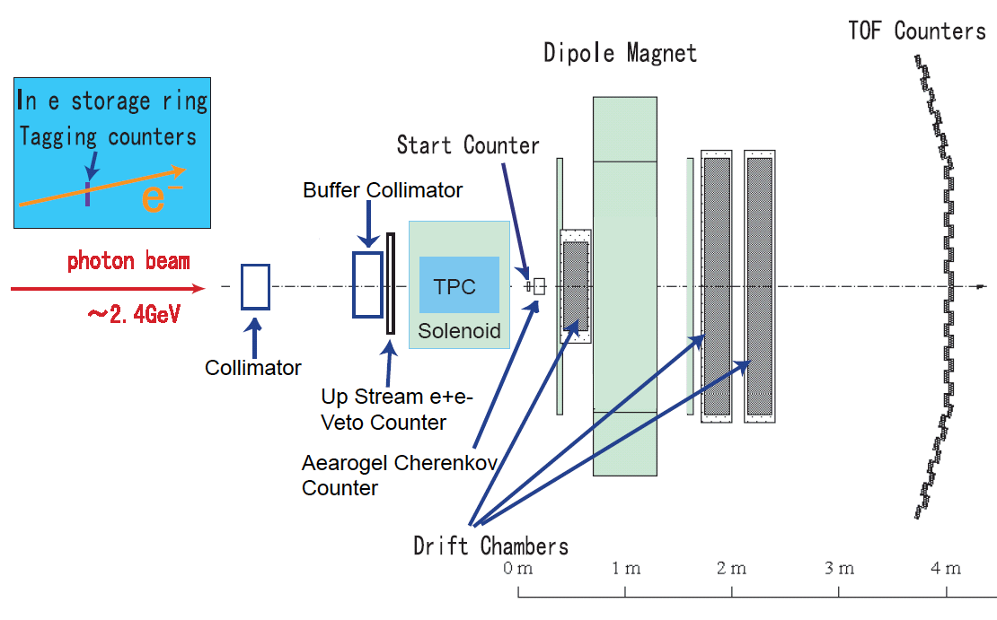
Setup of LEPS Detectors
Only FWD spectrometer
±20°x ±10°
1.5

Slide 6
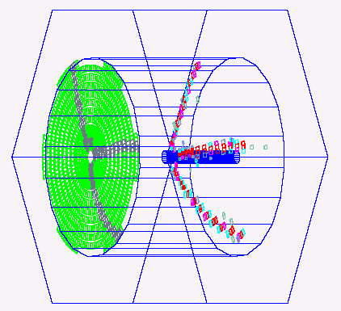
Setup of LEPS Detectors
1.5
γ
E // B
Polarized HD target will be ready soon.

Slide 7
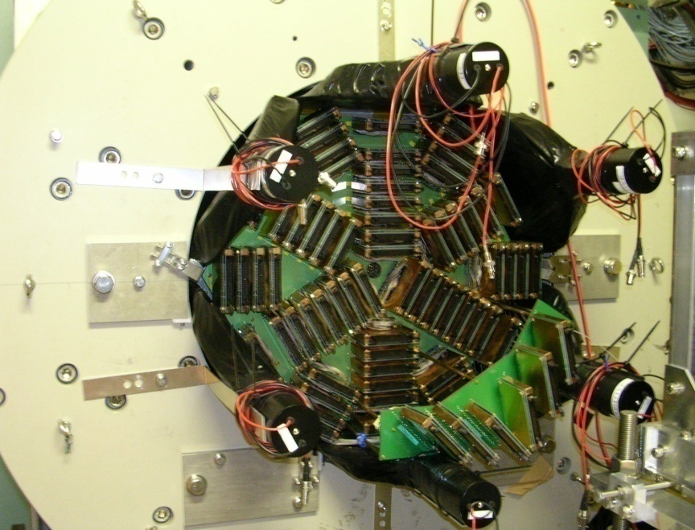
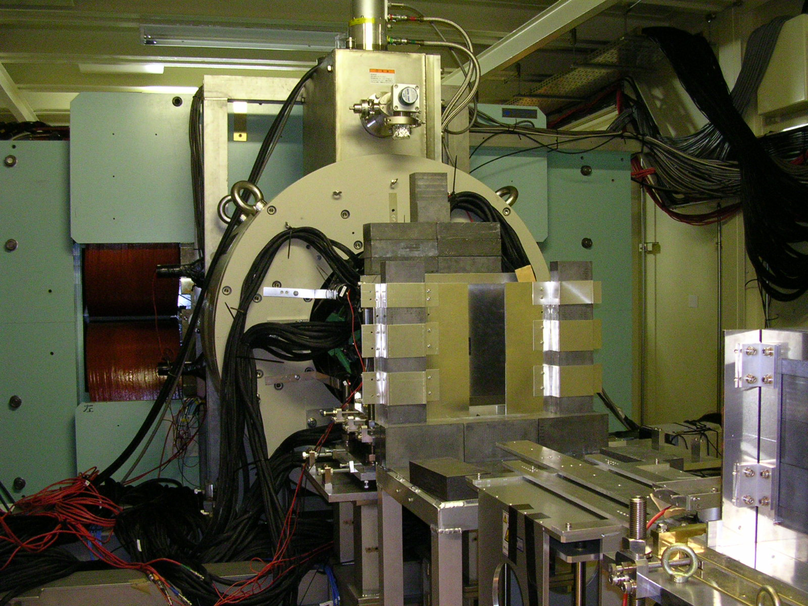
TPC
Solenoid Magnet
Buffer
Collimator 24Φ
Collimator
2１Φ
Dipole
Magnet
TPC
Beam
7

Slide 8
PID in LEPS Spectrometer
K/π separation
SVTX
DC1
TOF
K⁺
π⁺
AC(n=1.03)
Momentum [GeV/c]
Photons
Target
Dipole Magnet
0.7 Tesla
Start Counter
DC2
DC3
Mass/Charge [GeV/c²]
σ_{P} ~6 MeV/c for 1 GeV/c
σ_{TOF} ~150 ps
σ_{MASS} ~30 MeV/c² for 1 GeV/c Kaon

Slide 9
Exotics search in
backward
η production

Slide 10
Experimental method
γ p
p (detect)
π⁰, η, η’, ω (in missing mass )
W ( √s ) = 1.9 – 2.3 GeV
Eγ = 1.5 – 2.4 GeV
cosΘ_{cm} = −1.0 ∼ −0.6

Slide 11
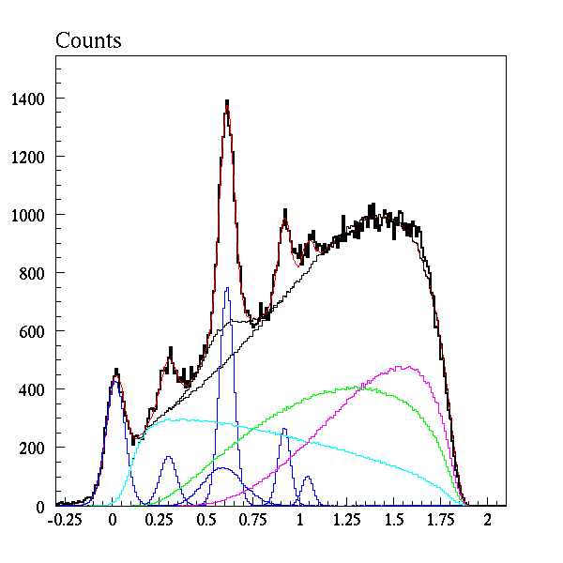
Missing mass spectra
p → p x
ω/ρ
Eγ = 2.3 - 2.4 GeV
cosΘ_{cm} = −1 ∼ −0.9
Data
Fitting result
η’
φ
η
π⁰
4π
3π
2π
Missing Mass² (GeV²/c⁴)

Slide 12
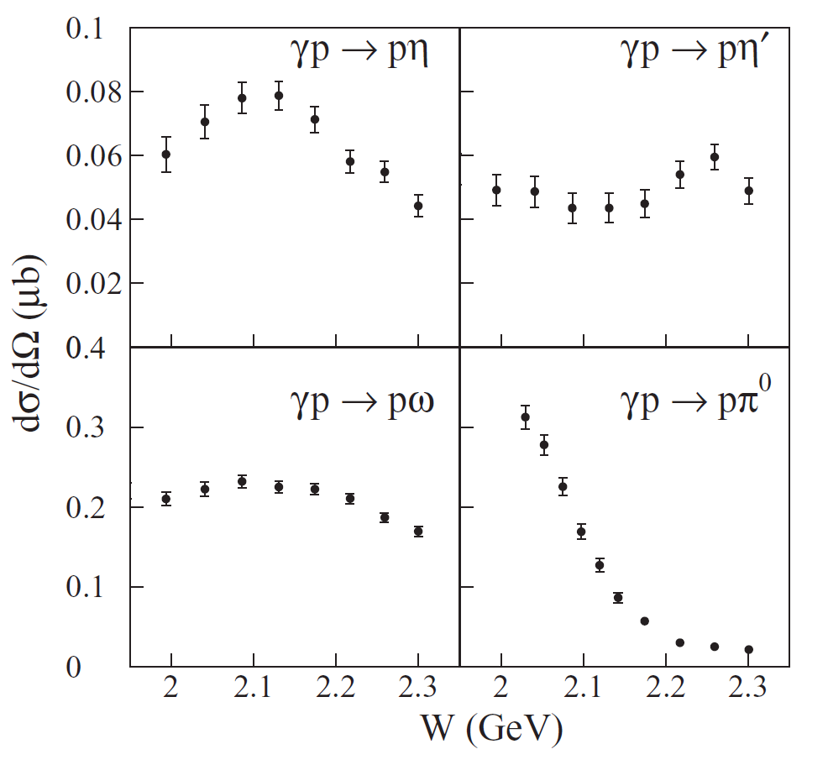
Backward meson production

Slide 13
Differential cross sections for η photoproduction
LEPS data
Jlab/CLAS data
Bonn/ELSA data
SAID -partial-wave analysis
Eta-MAID - isobar model
I = ½, small J, strong coupling to η, heavy → may contain large ss component. PRC 80, 052201

Slide 14
Protoproduction of Λ(1405)

Slide 15

Physics background : Λ(1405)
3 quark or meson-baryon molecule or 4q-qbar pentaquark?
  qq LS force is too small to explain the mass of Λ(1405).
  meson-baryon molecule has been suggested. But not established.
Production mechanisms may reveal exotic structure of Λ(1405).
  Compare production cross section with ordinary baryon Σ(1385).
Λ(1405)
Isgur
PRD18

Slide 16
Missing mass of p ( γ, K⁺) X
K^{+’}s were detected by Spectrometer
Λ(1405)
/Σ(1385)
Λ(1116)
Λ(1520)
Σ(1192)

Slide 17
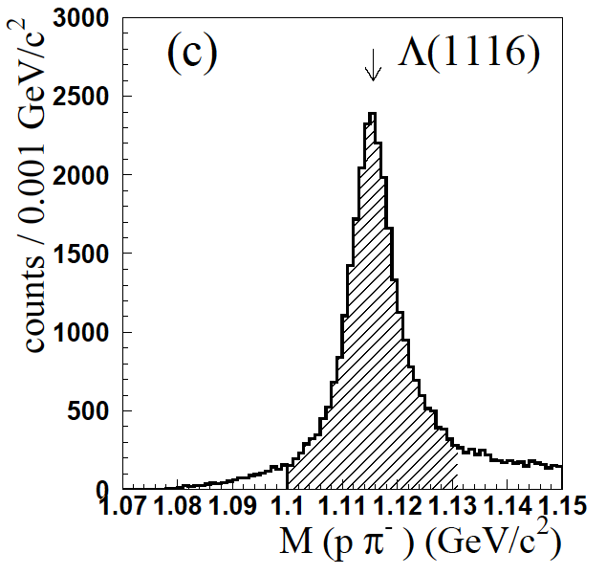
Σ(1385) photoproduction
γ p → K⁺ Σ(1385) → Κ⁺Λ π⁰→ Κ⁺ pπ⁻ π⁰
spectrometer
TPC
1115.4±0.4 MeV
σ 3.9 MeV, 4 MeV by MC

Slide 18
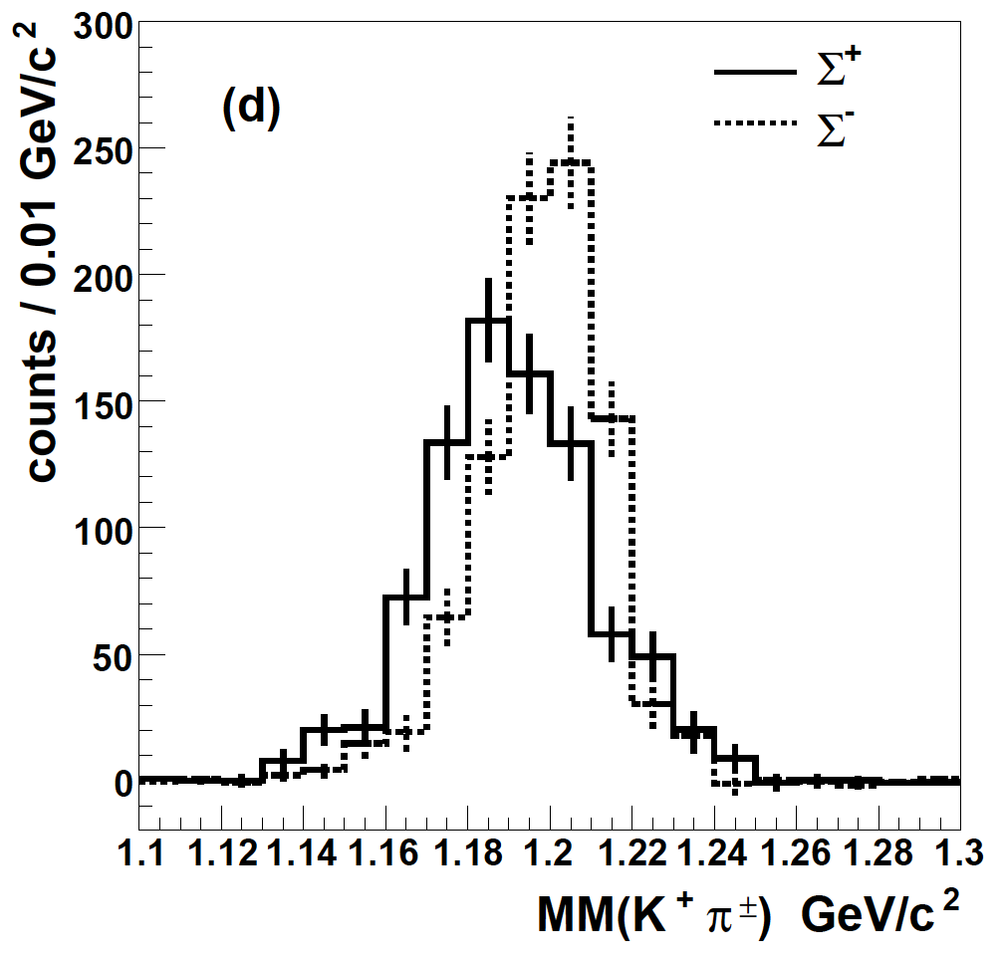
Λ(1405) production
Spectrometer
TPC
γ p → K⁺ Λ(1405) → Κ⁺Σ± π∓ → Κ⁺ π⁺ π⁻ n
kinematic fit with two constraints
MM(Kππ) = n, MM(Kπ) = Σ
peak 945±1 MeV
rms 17 ± 2 MeV (20 MeV by MC)
Σ⁺(1189) = 1191 ±1 MeV
Σ⁻(1197) = 1199 ±1 MeV

Slide 19
Comparison with chiral Lagrangian+coupled unitary (Nacher et al.)
data (Σ⁺π⁻ + Σ⁻π⁺)
Σ(1385) (Λπ⁰ mode)
Σπ phase space
Λ∗/Σ∗ = 0.54 ± 0.17 (1.5<Eγ<2.0)
0.074 ± 0.076(2<Eγ<2.4)
K*(892)Σ⁺
theoretical model
182±26 events
43±32 events

Slide 20




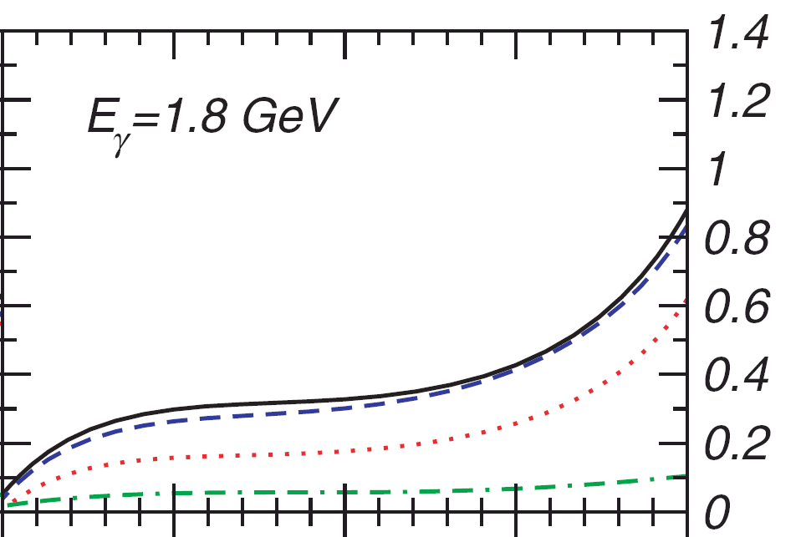
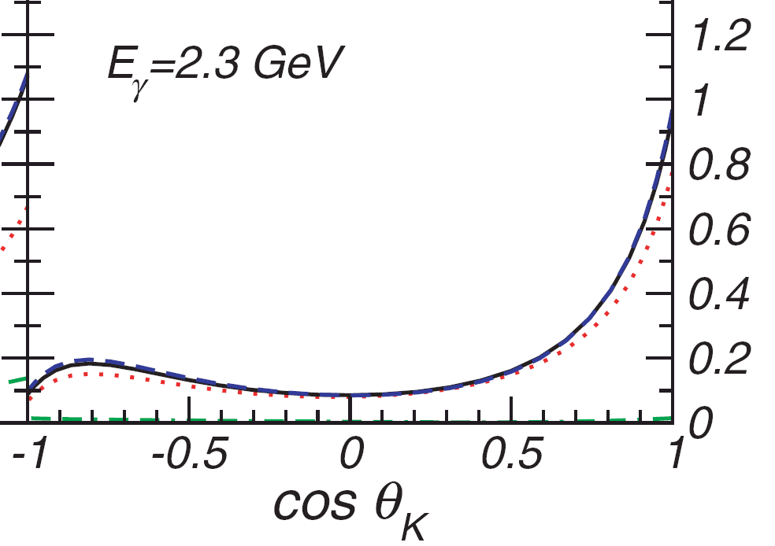
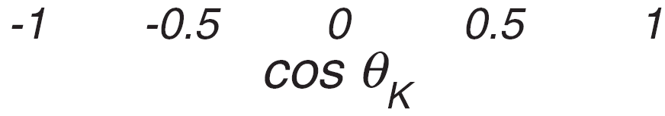
Differential cross section of Σ(1385) production
1.5<Eg<2 GeV
μb
2.0<Eg<2.4 GeV
μb
Consistent with theoretical calculation using effective Lagrangian (～0.8μb, 0.8<cosθ<1) by Oh et al.
dσ/d(cosθ)
dσ/d(cosθ)

Slide 21
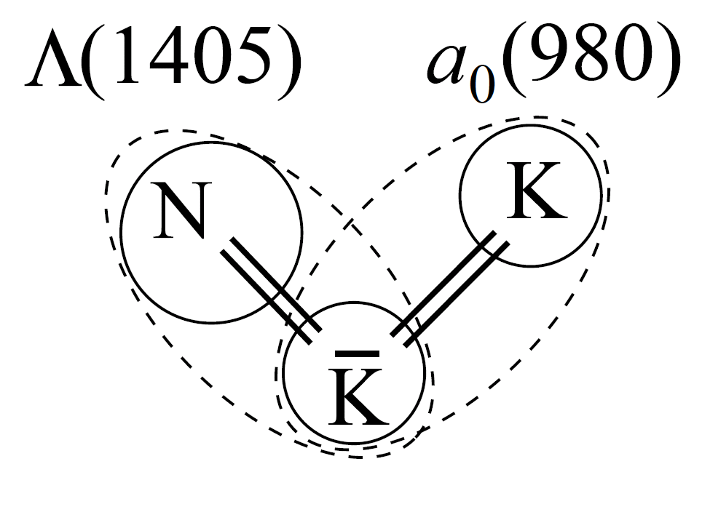
Differential cross section of Λ(1405) production
KKN bound state may
contribute
PRC78
0.8<cosθ_{kCM}<1
M ∼ below KKN
threshold (1930 MeV)
Γ ∼ 90 MeV
-0.45<t<-0.12 GeV²
-0.37<t<-0.08 GeV²
S.I. Nam et al.
arXiv:0806.4029
Nacher et al.
PLB 455
Jido, Enyo (PRC78)
higher statistics LH2 data will come soon!

Slide 22
Θ⁺(1530)

Slide 23
Experimental status
Not seen in the most of the high energy experiments: The production rate of Θ⁺/Λ(1520) is less than 1%.
No signal observation in CLAS γp, KEK-PS (π⁻,K⁻), (K⁺,π⁺) experiments.
The width must be less than 1 MeV. (DIANA and KEK-B) reverse reaction of the Θ⁺ decay: Θ⁺ → n K⁺
LEPS could be inconsistent with CLAS γd experiment (CLAS-g10).
Production rate depends on reaction mechanism.
K* coupling should be VERY small.
K coupling should be small.
Strong angle or energy dependence.

Slide 24
Difference between LEPS and CLAS for γn → K⁻Θ⁺ study
LEPS
Good forward angle coverage
Poor wide angle coverage
Low energy
Symmetric acceptance for K⁺ and K⁻
M_{KK}>1.04 GeV/c²
Select quasi-free process
CLAS
Poor forward angle coverage
Good wide angle coverage
Medium energy
Asymmetric acceptance
M_{KK} > 1.07 GeV/c²
Require re-scattering or large
Fermi momentum of a spectator
~
K⁻ coverage:
LEPS: θ_{LAB} < 20 degree
CLAS: θ_{LAB} > 20 degree

Slide 25
Quasi-free production of Θ⁺ and Λ(1520)
detected
K⁻
K⁺
Eγ=1.5~2.4 GeV
K⁺
K⁻
γ
γ
n
Θ⁺
Λ(1520)
p
p
n
n
p
p
n
Data was taken in 2002-2003.
spectator
Both reactions are quasi-free processes.
Fermi-motion should be corrected.
Existence of a spectator nucleon characterize both reactions.

Slide 26
Results of Λ(1520) analysis
pK⁻ invariant mass with MMSA: Fermi motion effect corrected.
Simple (γ,K⁺) missing mass: No correction on Fermi motion effect.
The total cross section is ~1 μb, which is consistent with the LAMP2 measurements.
Δ(-2lnL) =55.1 for Δndf=2
7.1σ

Slide 27
Results of Θ⁺ analysis
nK⁺ invariant mass with MMSA: Fermi motion effect corrected.
Simple (γ,K⁻) missing mass: No correction on Fermi motion effect.
PRC 79, 025210 (2009)
“The narrow peak appears only after Fermi motion correction.”
Δ(-2lnL) =31.1 for Δndf=2
5.2σ

Slide 28
LEPS-II

Slide 29
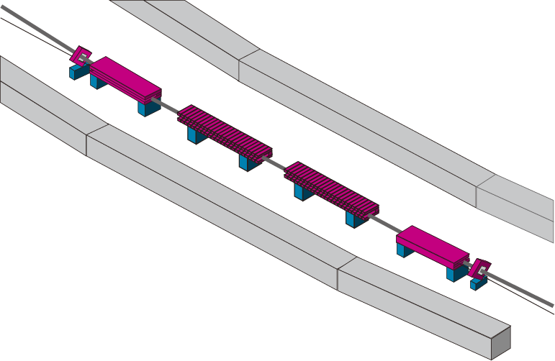
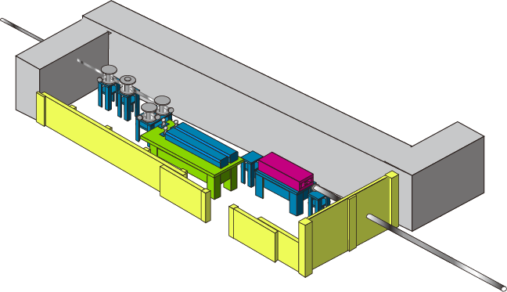
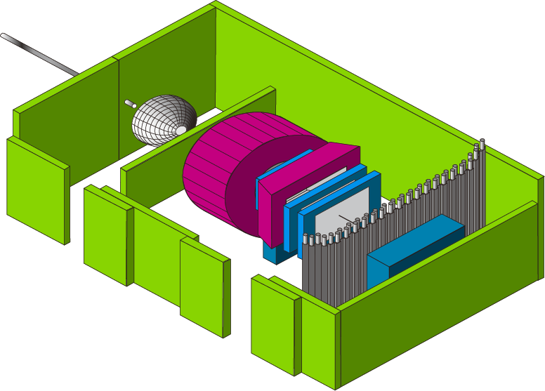
LEPS II Project at SPring-8
Backward Compton Scattering
High intensity：
Multi (ex. 4) laser injection w/
large aperture beam-line &
Laser beam shaping
~10 ⁷ photons/s （LEPS ~10 ⁶ ）
8 GeV electron
Recoil electron
(Tagging)
30m long line
（LEPS 7.8m)
Laser
SPring-8 SR ring
GeV γ-ray
Inside
building
Outside
building
Laser hutch
Large 4π spectrometer based on BNL-E949 detector system.
Experimental hutch

Slide 30
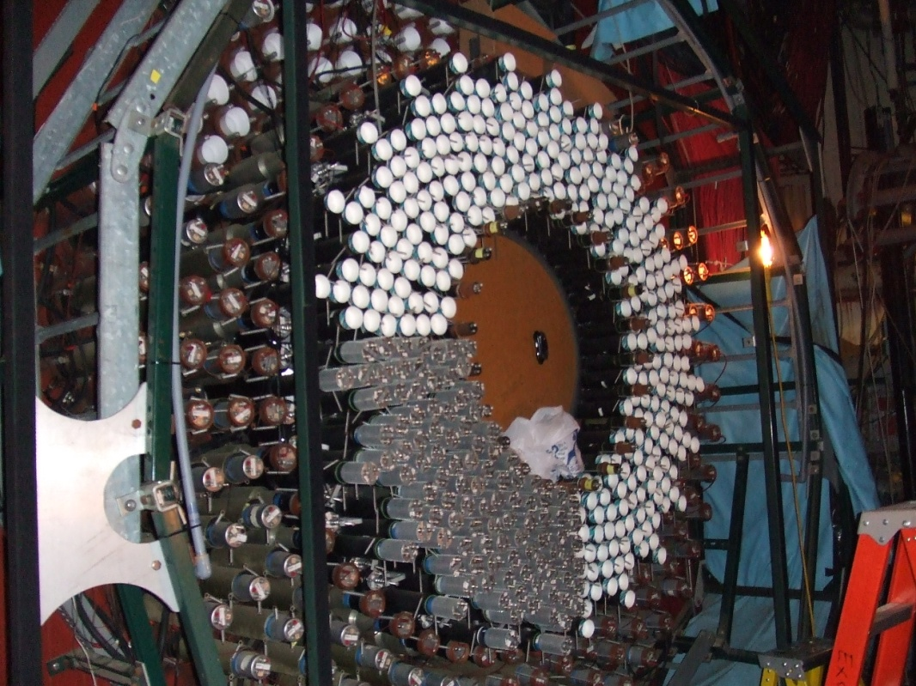
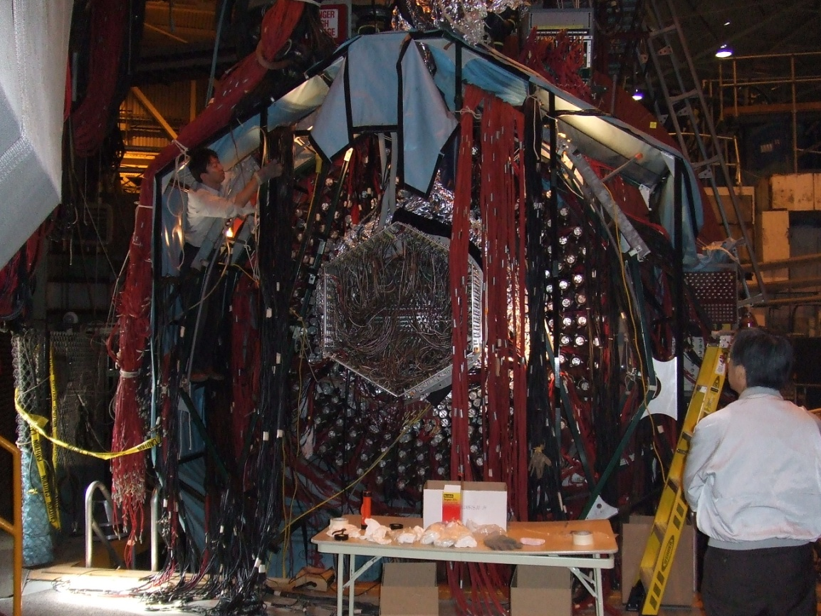
BNL-E949 detector
Solenoid 1 T
Inner volume
2.22x2.96 m
Notes:
30

Slide 31
LEPS2 detector Setup
Cover LEPS I & CLAS acceptance
Detect charged particle, γ, neutron
Magnet
Barrel γ
Range and TOF
Barrel
Tracker
Θ⁺
n → K^{ー}Θ⁺ → K^{ー} K⁰s p
n → K^{ー}Θ⁺ → K^{ー} K⁺ n
Λ(1405)
p → K⁺Λ(1405)
→ K⁺ Σ⁰π⁰ → K⁺ Λγπ⁰
γp → K*⁺(890)Λ(1405)
γ
50ps TOF
MWDC
TPC
Target and SSD
Buget has been approved. Construction from this year!

Slide 32
Summary
Backward η production
  New N* resonance which strongly couples to ηN.
Λ(1405) photoproduction
  Strong enhancement of production cross section
near threshold. N* resonance might contribute.
Θ⁺(1530)
  Blind analysis with 3 times higher statistics is underway.
LEPS II experiment
  10 times higher luminosity.
  Detect charged, γ , neutron simultaneously.
  Construction starts in this year.
  High statistics clean data will be available in near future.

Slide 33
LEPS Collaboration
Research Center for Nuclear Physics, Osaka University ：D.S. Ahn, M. Fujiwara, T. Hotta, Y. Kato,
K. Kino, H. Kohri, Y. Maeda, T. Mibe, N. Muramatsu, T. Nakano, M. Niiyama, T. Sawada, M. Sumihama, M. Uchida, M. Yosoi, T. Yorita, R.G.T. Zegers
Department of Physics, Pusan National University ：J.K. Ahn
School of Physics, Seoul National University ：H.C. Bhang
Department of Physics, Konan University ：H. Akimune
Japan Atomic Energy Research Institute / SPring-8 ：Y. Asano
Institute of Physics, Academia Sinica ：W.C. Chang, J.Y. Chen
Japan Synchrotron Radiation Research Institute (JASRI) / SPring-8 ： S. Date', H. Ejiri, N. Kumagai, Y. Ohashi, H. Ohkuma, H. Toyokawa
Department of Physics and Astronomy, Ohio University ：K. Hicks
Department of Physics, Kyoto University ：K. Imai, H. Fujimura, M. Miyabe, Y. Nakatsugawa, T. Tsunemi
Department of Physics, Chiba University ：H. Kawai, T. Ooba, Y. Shiino
Wakayama Medical University ：S. Makino
Department of Physics and Astrophysics, Nagoya University ：S. Fukui
Department of Physics, Yamagata University ：T. Iwata
Department of Physics, Osaka University ：S. Ajimura, K. Horie, M. Nomachi, A. Sakaguchi, S. Shimizu, Y. Sugaya
Department of Physics and Engineering Physics, University of Saskatchewan ：C. Rangacharyulu
Laboratory of Nuclear Science, Tohoku University ：T. Ishikawa, H. Shimizu
Department of Applied Physics, Miyazaki University ：T. Matsuda, Y. Toi
Institute for Protein Research, Osaka University ：M. Yoshimura
National Defense Academy in Japan ：T. Matsumura

Slide 35
Lineshape of Λ(1405)
The interference term
depends on decay angle of π wrt Λ∗ helicity direction.
previous measurement
This work

