Slide 1
Gravitational Wave and
High Energy Phenomena
Congratulations to Nakamura-san, Maeda-san and JGRG
Kunihito Ioka (KEK)
Y. Suwa (Kyoto), K. Kashiyama (Kyoto),
N. Kawanaka (KEK), Y. Ohira (KEK)
1. Gamma-Ray Burst
2. Cosmic-Ray

Slide 2
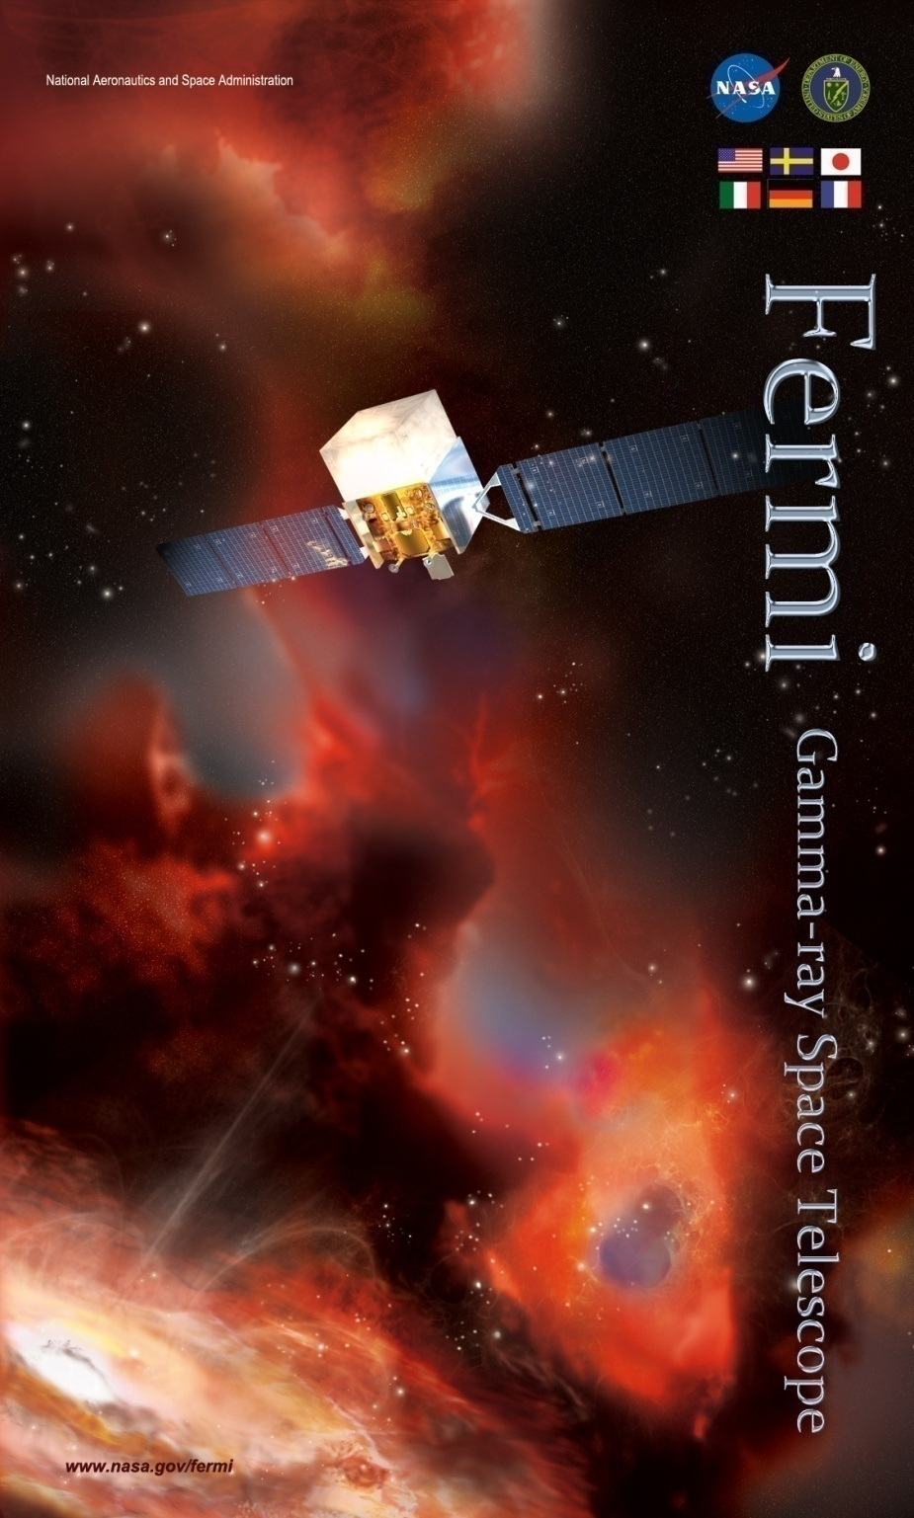
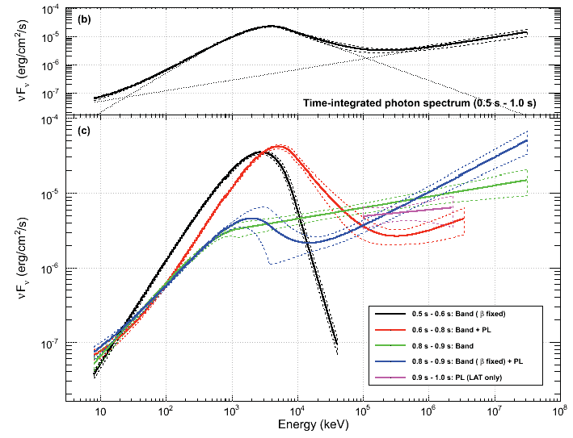
Fermi Revolution
GeV γ from GRBs
GRB 090510
GeV
keV
MeV
Abdo+ 09

Slide 3
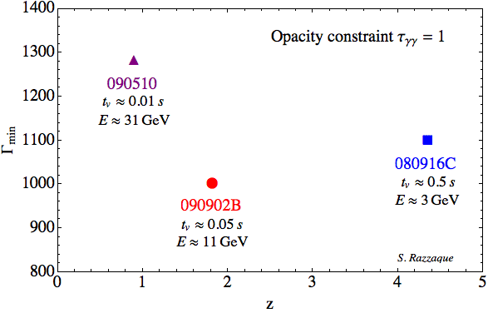
High Lorentz Factor?
γγ→e⁺e⁻ (ε_{th}~MeV)
  R~cΔt ⇒ τ~σ_{T}N_{γ}/4πR²≫1 (γ-ray cannot escape)
Relativistic
  R~Γ²cΔt
  Blueshift
  τ~Γ^{2β-2}~Γ⁻⁶
Γ>10³!
v>0.999999×c
Γ_{min}
But see also Zou, Fan & Piran 10, Li 08, Aoi+KI 10
Redshift

Slide 4

Conventional Γ_{max}
Fireball expands by radiation pressure
In principle, Γ_{max} ~ Energy / Mass
But, Mass↓ ⇒ Transparent before Γ~Γ_{max}
Paczynski 86
Goodman 86
Shemi & Piran 90
Meszaros & Rees
Radiation
Matter

Slide 5
Nonradiative Pressure
Magnetic
Field
e, p
~
γ
KI 10
Collisionless Pressure
of Relativistic Particles
Radiation Pressure ~
Not escape ⇒ Γ=Energy/Mass can be attained

Slide 6
Radiation to Collisionless
Initially
Collisional
γ
Collisionless but Opaque
γ → Relativistic proton
Energy
Fireball
Rela. motion
Radiation
Momentum
2 eqs. for
2 unknowns
: Radiation ~ Relativistic motion
∝r⁻⁴
∝r⁻⁴

Slide 7
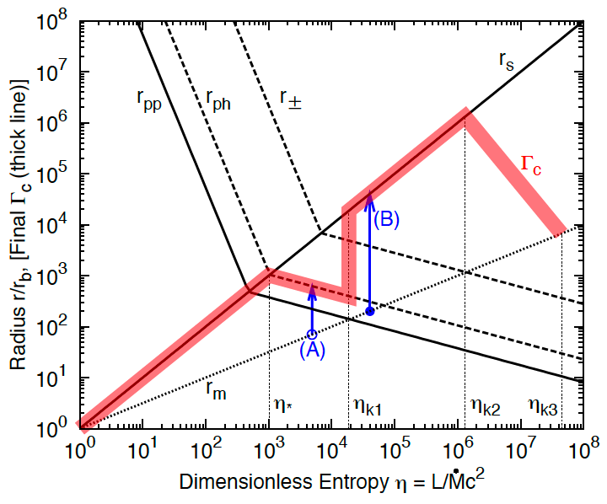
Γ_{max} of Dissipated Fireball
(To be opaque)
Γ_{max}~10⁶!
>Γ_{conv}~10³
Collsionless
bulk-
acceleration
Baryon-Rich
Baryon-Less
KI 10

Slide 8
Photosphere-Internal-External Shock Model
External
Shock
Internal
Shock
Photo-
sphere
E_{γ}~E/2
Variable
Long-lived
e.g., Toma, Wu & Meszaros
Kumar & Barniol Duran 09
Ghisellini+09, Wang+09,KI 10
Zou+ 09, Piran & Nakar 10
keV
MeV
GeV

Slide 9
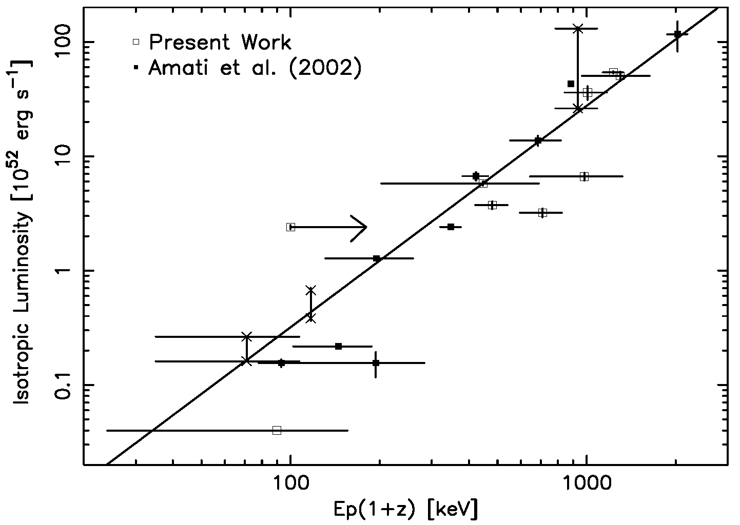
E_{peak}-Luminosity Relation
Dissipation
⇒ r₀↑
⇒ T↓
Stefan-
Boltzmann
L∝T²
L∝T⁴
Yonetoku+KI 03
Amati 02

Slide 10
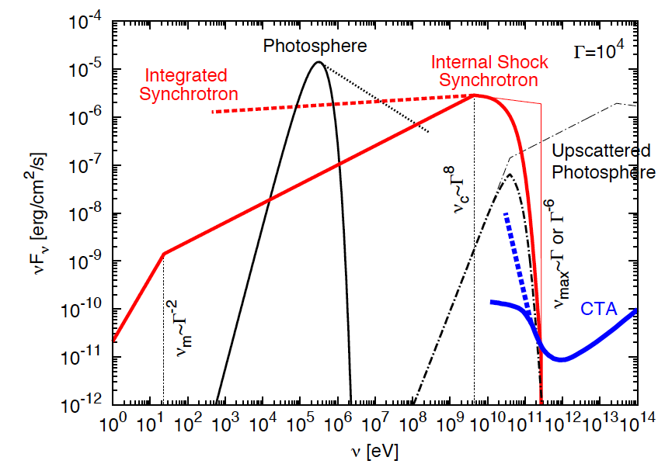
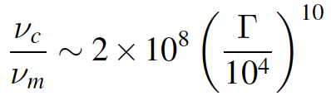
High Γ Internal Shock
GeV γ:
Simple
synchro.
emission
KI 10
GeV
TeV

Slide 11
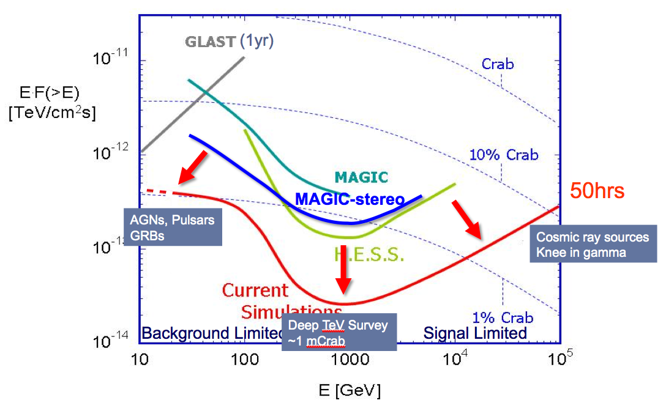
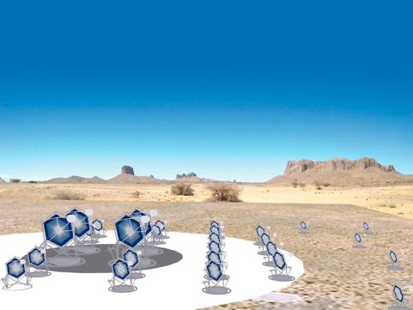
CTA
~20GeV-100TeV
x10 Sensitivity
Δθ~1-2 min
FOV~5-10 deg
~20 s slew (LST)
~2015 (?)
~150€
TeV γ from GRB or not?

Slide 12
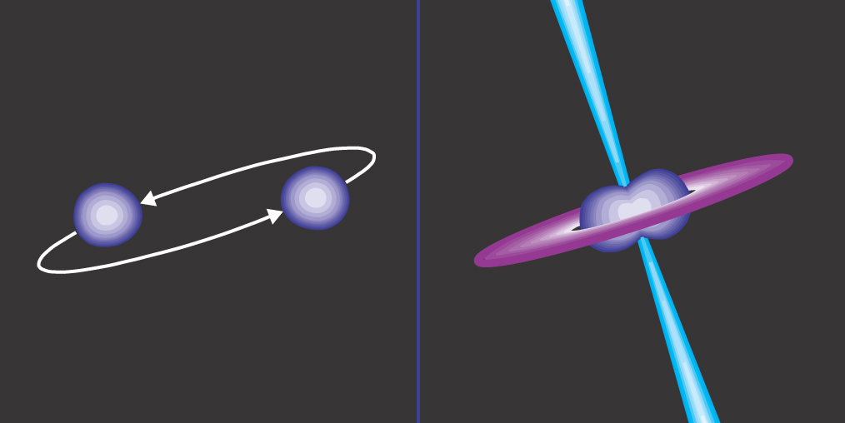
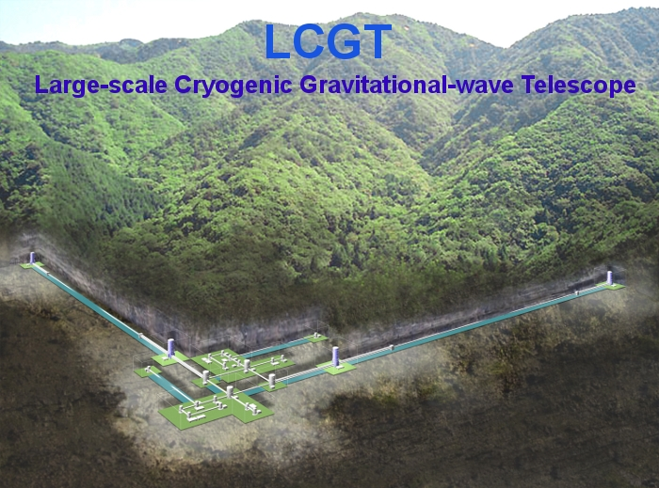
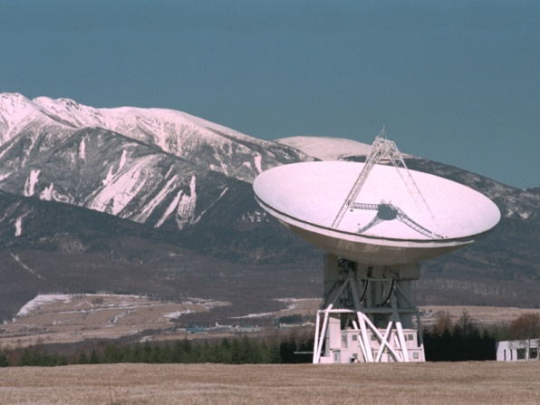
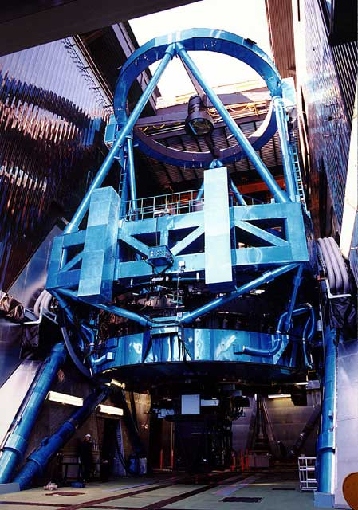
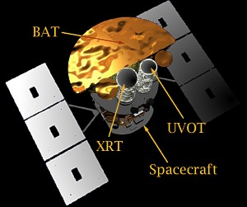
NS merger – Short GRB
NS-NS mergers
are promising
GW sources
⇒ LCGT, LIGO,
Virgo, GEO, …
EM followup
Short GRB?
z ⇒ local H₀
Degeneracies
S/N
Schutz 86
Kochanek
& Piran 93
?
?
?
In most cases, GRB jets are off-axis

Slide 13
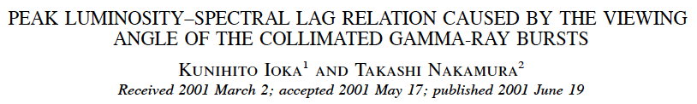

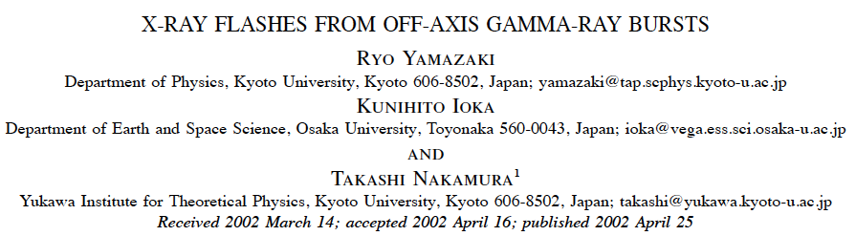
Off-Axis GRB
I am involved in GRB …
Medal of Academy

Slide 14
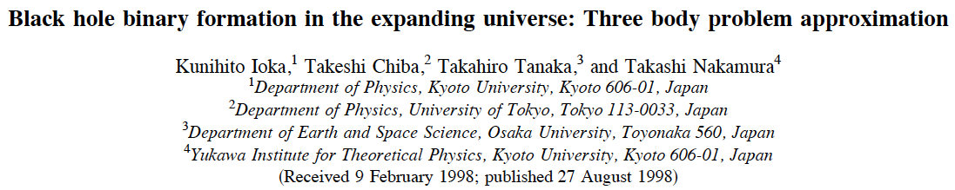
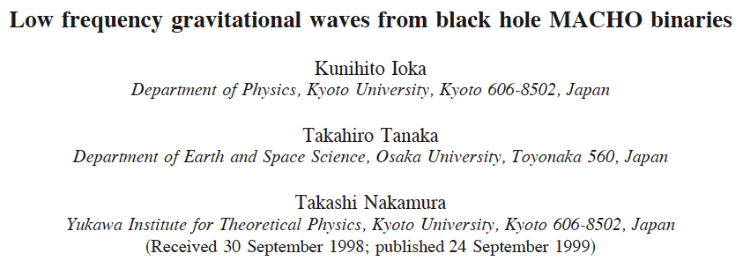
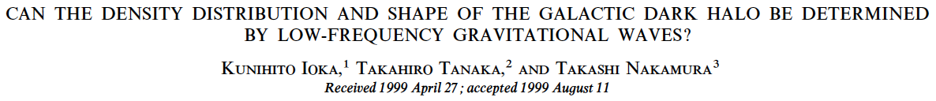
Black Hole MACHO
My first paper

Slide 15
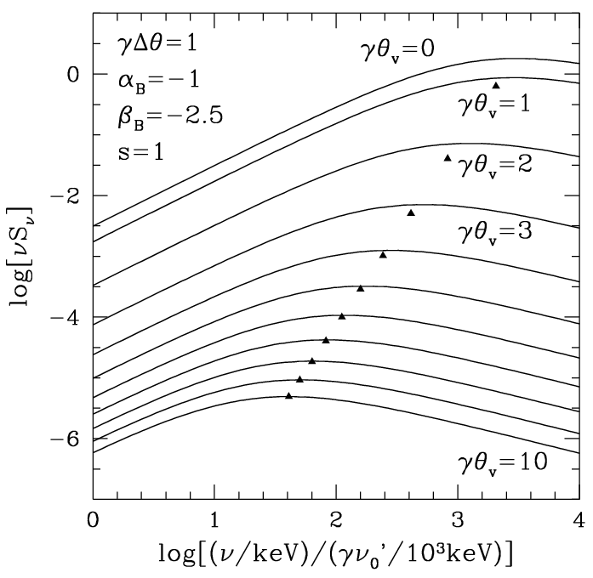
Off-Axis GRBs are Dim
Gamma-ray
Fluence
LΔT~(Γθ_{v})⁻⁶
ΔT~Rθ_{j}/c
Even if ΔT~0.1s,
L<10³⁹erg/s
X-ray
KI & Nakamura 01
Energy

Slide 16
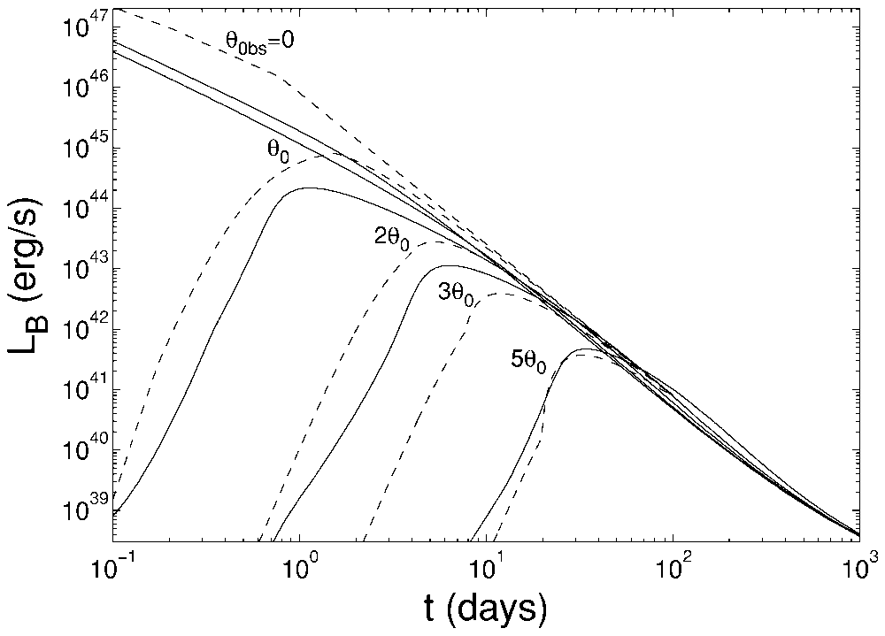
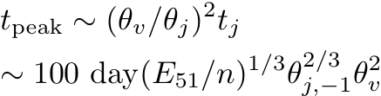
Off-Axis Afterglow
Also very dim
Radio might be
detectable
Granot+ 02
Totani & Panaitescu 02

Slide 17

Merged Neutron Star
Merged NS has T~10MeV
L=4πr²caT⁴~10⁵³erg/s ≫ L_{Edd}
Outflow ~ 10⁻³M/s (?)
  ν-driven wind
  Tidal tail/heating
  Disk wind
Opaque
  L is suppressed by τ
Followed by adiabatic cooling T~r⁻¹ ⇒ L/τ~r⁰
Eichler+ 89
Rosswog 05
Dessart+ 09
⇔ n-rich element

Slide 18
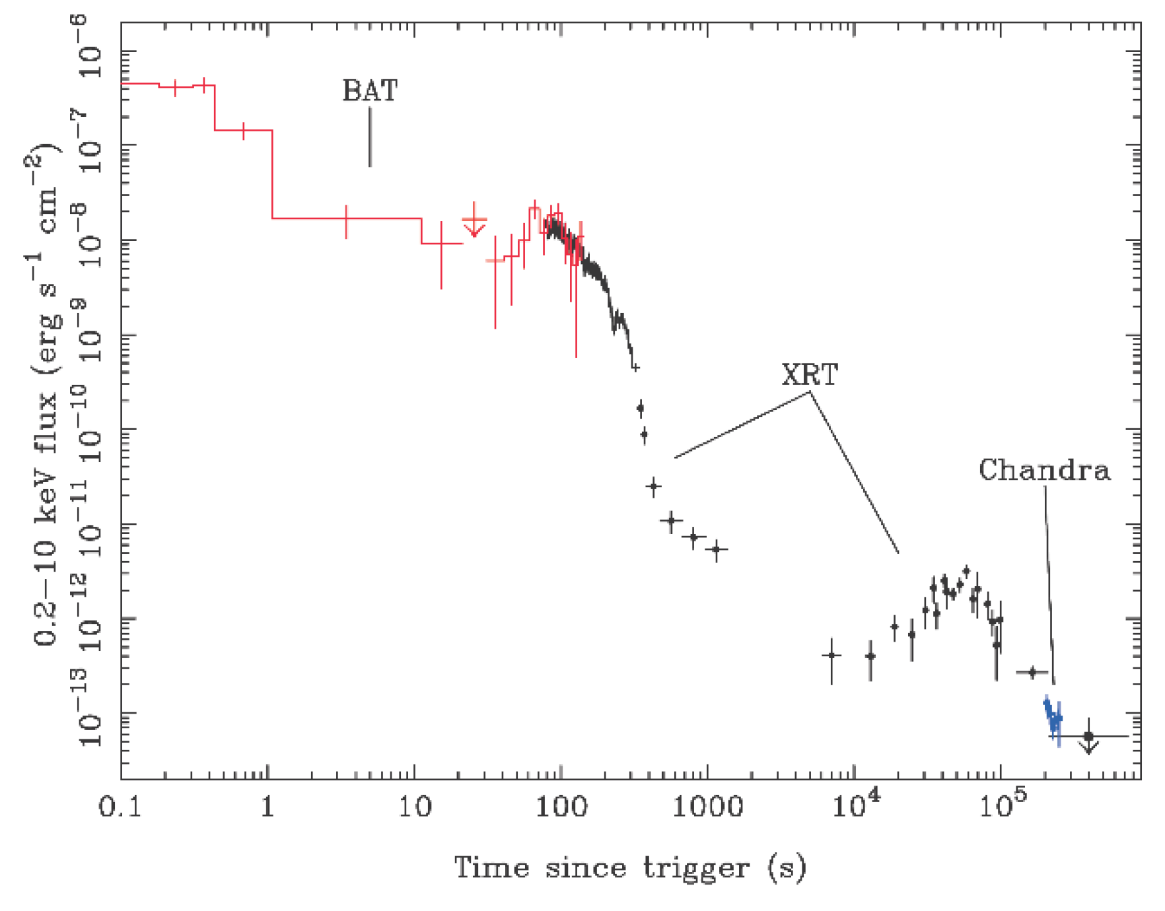
Extended Emission
~1/2 SGRBs
Sharp Drop
⇒ Afterglow
Engine origin
Wind Fallback
t_{acc}~100 s
(r/10⁹cm)
(α/0.1)⁻¹(r/10H)
GRB050724
Short GRB
Extended Emission
~ 2 x E_{spike}
Barthelmy+ 05
Lee & Ramirez-Ruiz 07, Rosswog 07

Slide 19
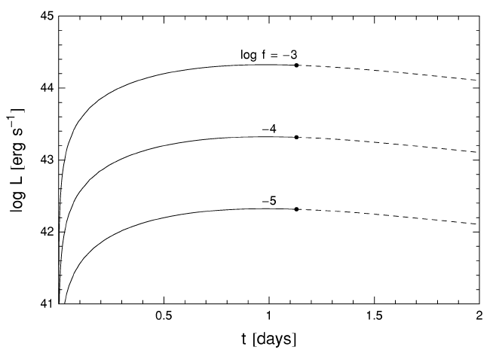
Macronova
Li & Paczynski 98
Kulkarni 05
Radioactive heating (β-decay, fission,⁵⁶Ni→⁵⁶Co→⁵⁶Fe)
M=10⁻²M
v=c/3
Like SN
Duration
∝(M/v)^{1/2}
T∝(f²/Mv)^{1/8}
~ UV-Opt
f~3x10⁻⁶
(Metzger+ 10)
⇒ Dim SN
optically thin
~SN
f: fraction of rest mass
released as heat

Slide 20
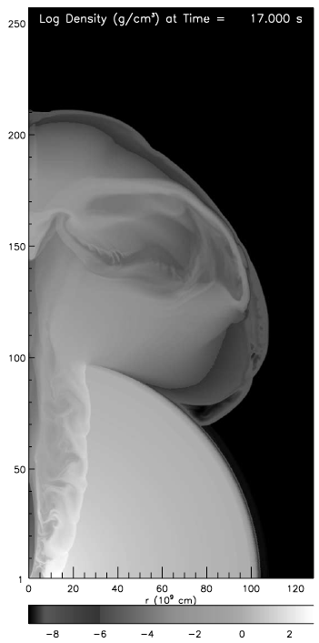
Jet Penetration
Morsony+ 07
Even ~10⁻⁶M causes
baryon load problem
Shocked mass ⇒ Cocoon
like long GRB collapsar
Γ~1 ⇒ Visible from off-axis
τ~c/v
Cocoon
≫1 still opaque
(max)
Brighter than SN

Slide 21
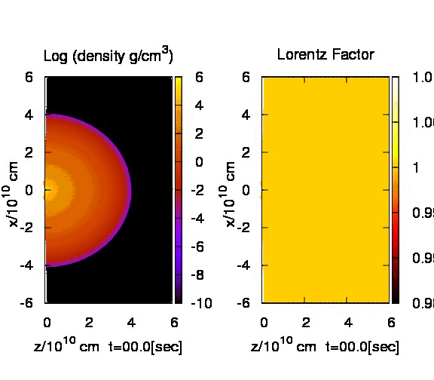
A. Mizuta’s calculation

Slide 22
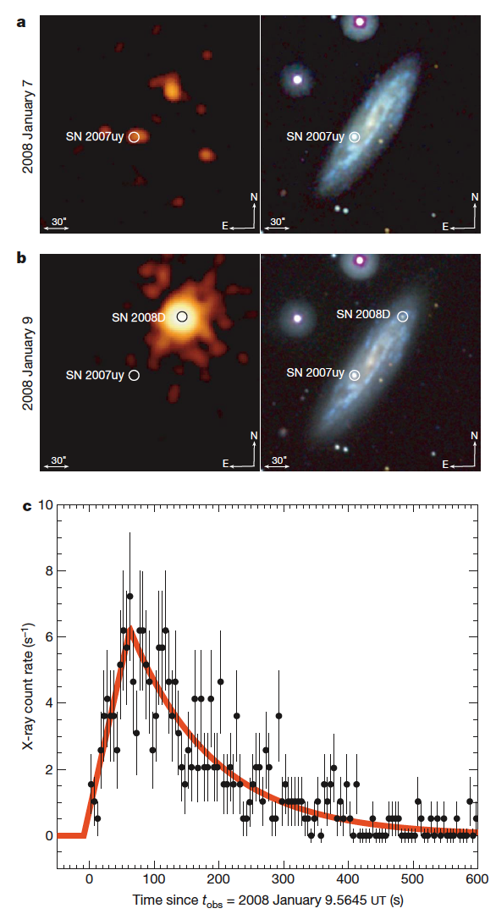
Shock Breakout
Cocoon breakout from wind
~ Supernova shock breakout
v/c>0.2 ⇒ Thermal equilibrium
T_{shock}~10-200keV > T_{down}
X-ray SN shock breakout is
detected recently @27Mpc
Swift/XRT ⇒ up to 200Mpc
(Klein & Chevalier 78, Weaver 76, Katz+ 10)
Soderberg+ 08

Slide 23
Off-Axis Short GRB
~0.1s
On-Axis
[My understanding]
~10⁵¹erg/s
~100s
~10⁴⁸erg/s
Fade away if τ<1
SGRBs have no SN
~min
~ms
~100s
~1day
~10⁴⁵erg/s
(max)
~100 day
Magnetar
Activity
(keV-MeV)
Cocoon
Breakout
(X-ray)
Cocoon
Breakout
(UV-Opt)
Afterglow
(Radio)
KI & Taniguchi 00
Hansen & Lyutikov 01
Time

Slide 24
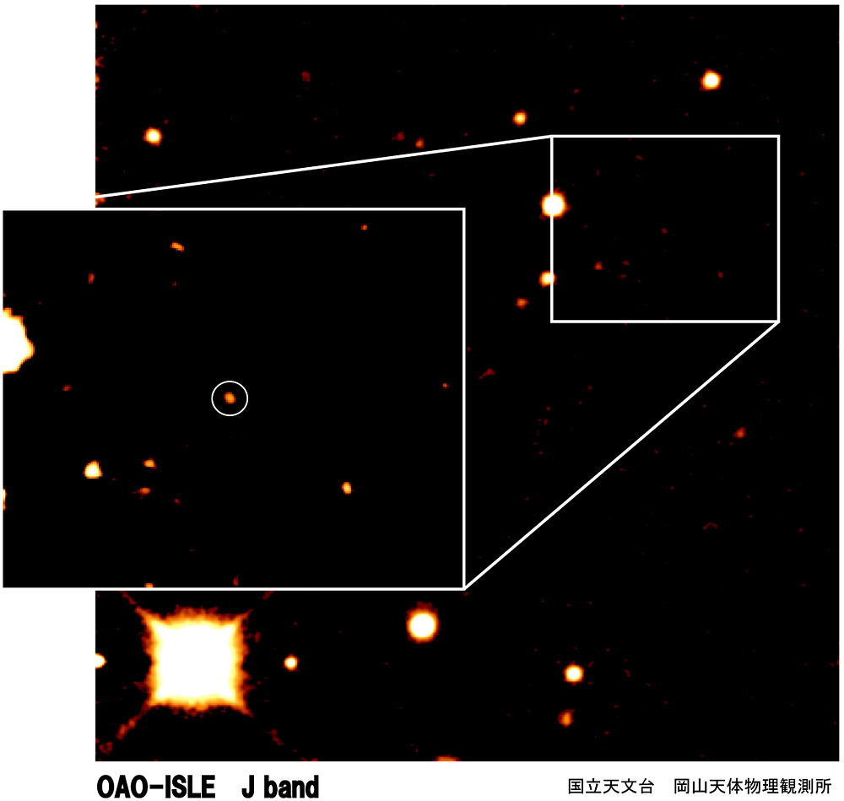
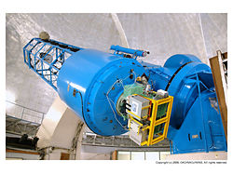
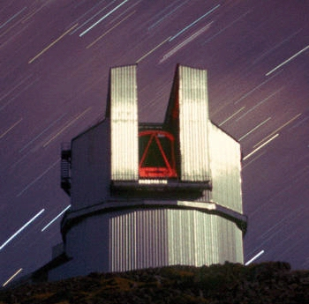
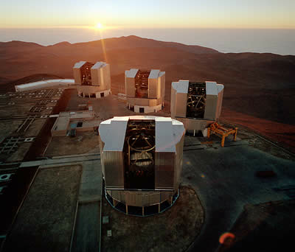
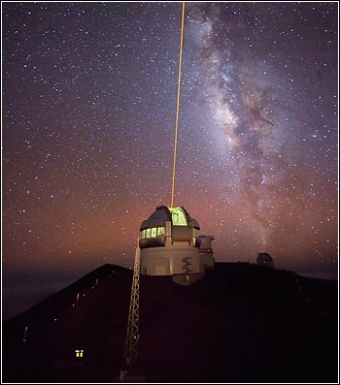
Most Ancient Object
GRB 090423
@ z~8.2
A massive star’s death just 600 Myr after the Big Bang

Slide 25
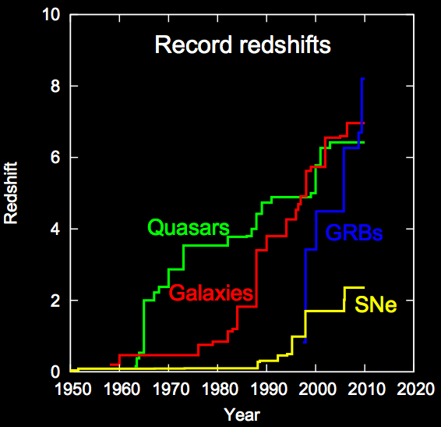

Slide 26
First GRB
Abel+ 02
Bromm+ 02
Omukai+ 03
Yoshida+ 08
Pop III
(Zero Metal)
~100-1000M(!?)
Present Day
Massive Star
~20M
Komissarov & Barkov 10
Meszaros & Rees 10
Gigantic (x100) GRB @ z~10-30???

Slide 27
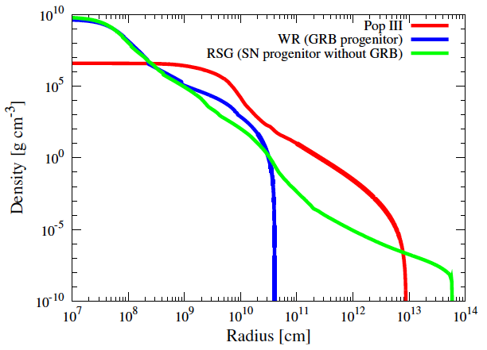
Massive Envelope
R/c~10³s > T_{GRB}~10s
⇒ No GRB?
No mass loss via
line driven wind
Core
Envelope
Ohkubo+ 09
Heger+ 03
Suwa & KI 10

Slide 28
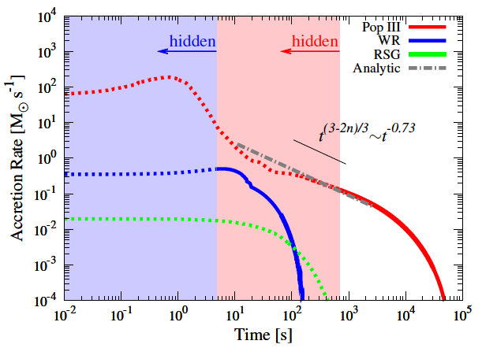
Envelope Accretion
⇒ v_{Jet head}
Energetic
Very long
Modest L
Bright phase
⇒ Cocoon
Suwa & KI 10

Slide 29

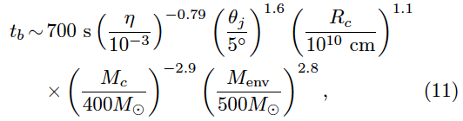
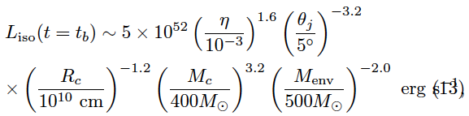
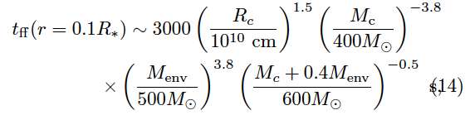
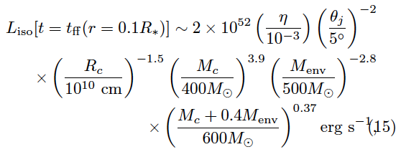
Analytic Expressions

Slide 30
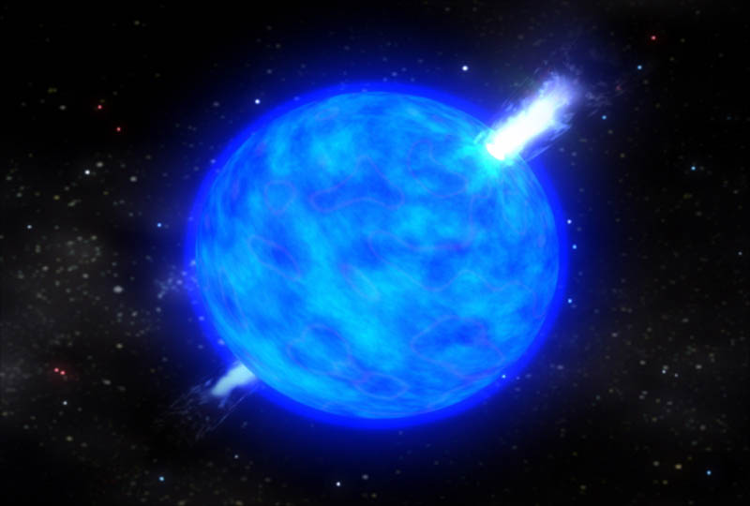
GRB jet can breakout the first star!
Yudai SUWA P-68

Slide 31
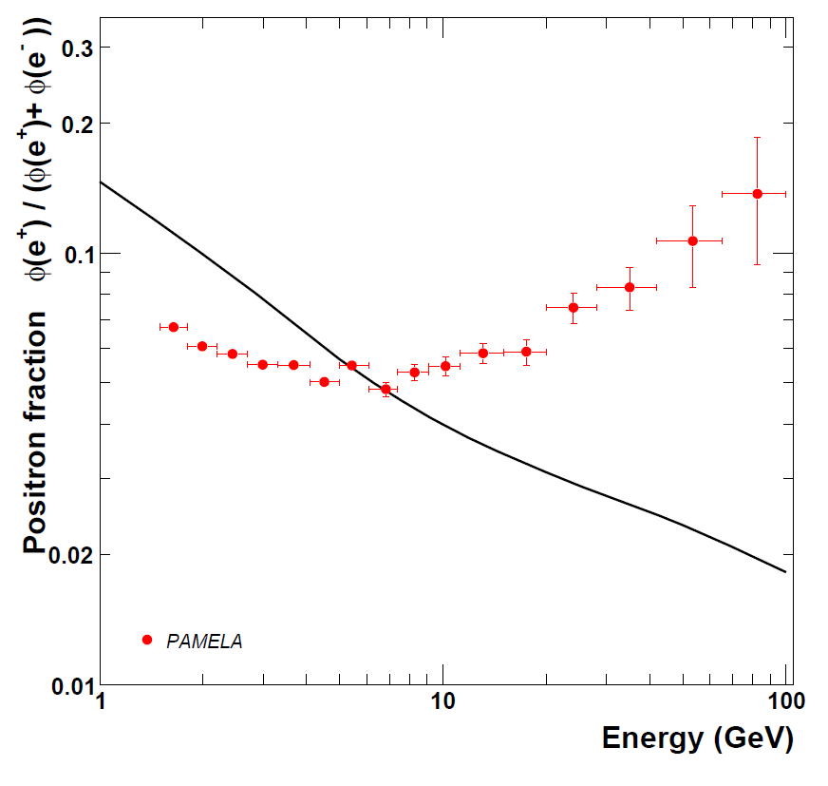
PAMELA
Positron excess above the predicted secondary
⇒ Primary sources
− Dark matter?
− Astrophysical?
⇒ (Too) Many papers
>500
Positron
Excess
Solar
modulation
Expected
Secondary
Jul 06 - Feb 08
151672 e-, 9430 e+
Adriani+ 08, 10

Slide 32
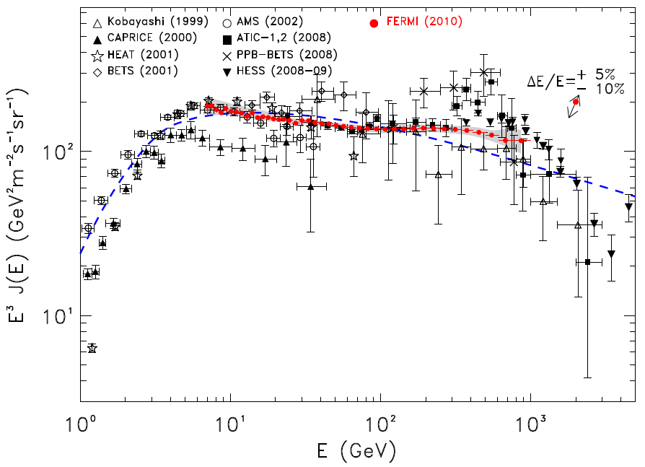
Cosmic-Ray Electron
An Excess also in (e⁺+e⁻) Spectrum
ATIC/PPB-BETS
Peak + Cutoff
~600GeV DM?
Fermi
Smooth E⁻³
No peak
HESS
~TeV cutoff
conventional diffusive model
Abdo+ 09
Ackermann+ 10
Chang+ 08, Torii+ 08
Aharonian+ 08, 09

Slide 33
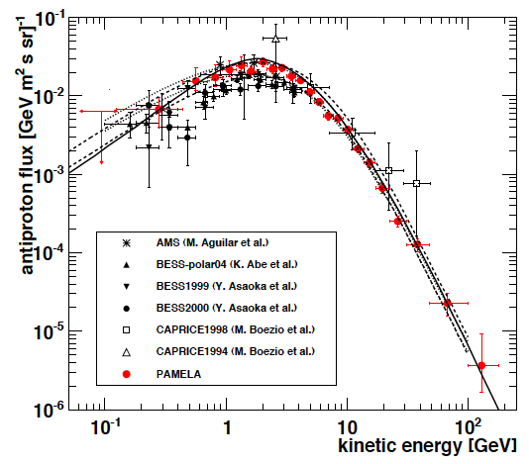
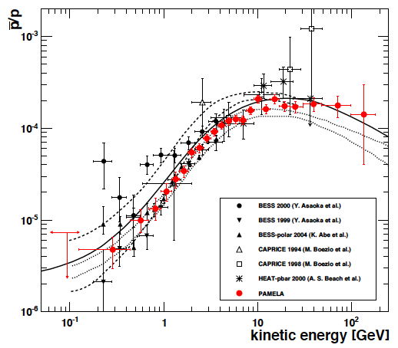
Antiproton as predicted
No excess for antiproton
Adriani+(PAMELA) 08, 10
BESS 95-97, 99

Slide 34
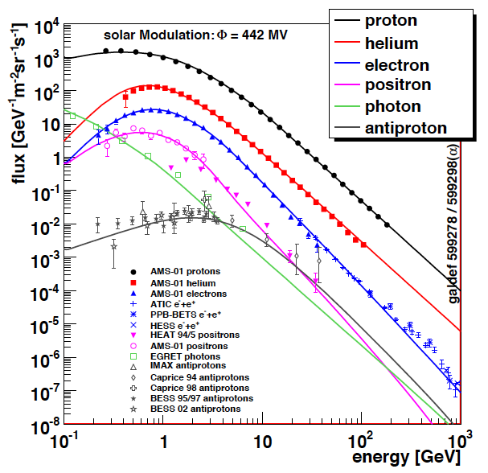
Cosmic-Ray Inventory
ρ(proton)
~1eV/cm³
~Suprenova
Remnants
ρ(electron)
~10⁻²eV/cm³
ρ(positron)
~10⁻³eV/cm³
~ 0.1% of p
Origin unknown
ε^{-2.7}
0903.1987

Slide 35
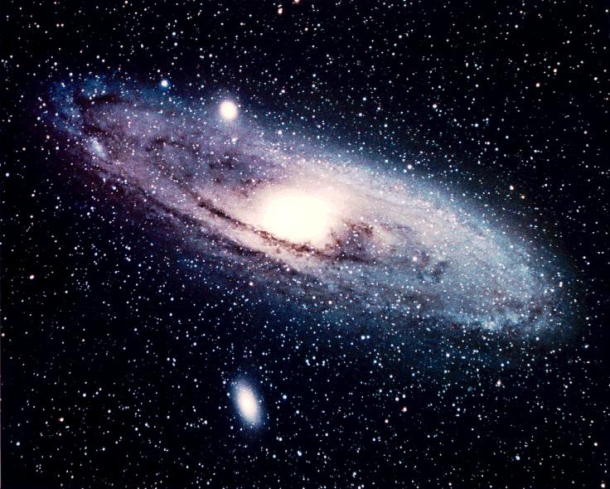
e± cooling
We are here
Our galaxy
e± lose energy (cool)
via inverse Compton
and synchroton
Positron source
d<~1kpc

Slide 36
Dark Matter?
Annihilation
Decay
e
DM
e
DM
DM
e
χ
Q ~ n²
E_{cut} ~ m_{DM}
<σv>~3x10⁻²⁴cm³/s
>3x10⁻²⁶cm³/s
boost factor ~100
Q ~ n
E_{cut} ~ m_{DM}/2
τ_{decay}~10²⁶sec (>H⁻¹)
γ-ray constraints are getting tight

Slide 37
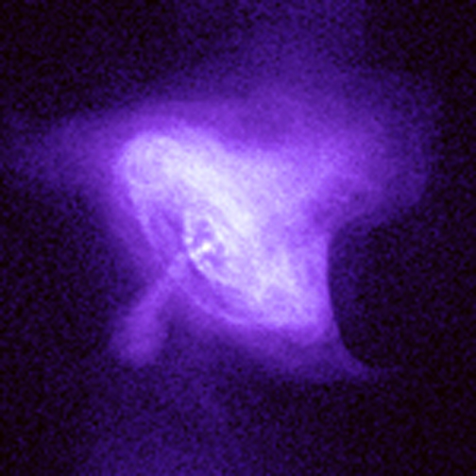
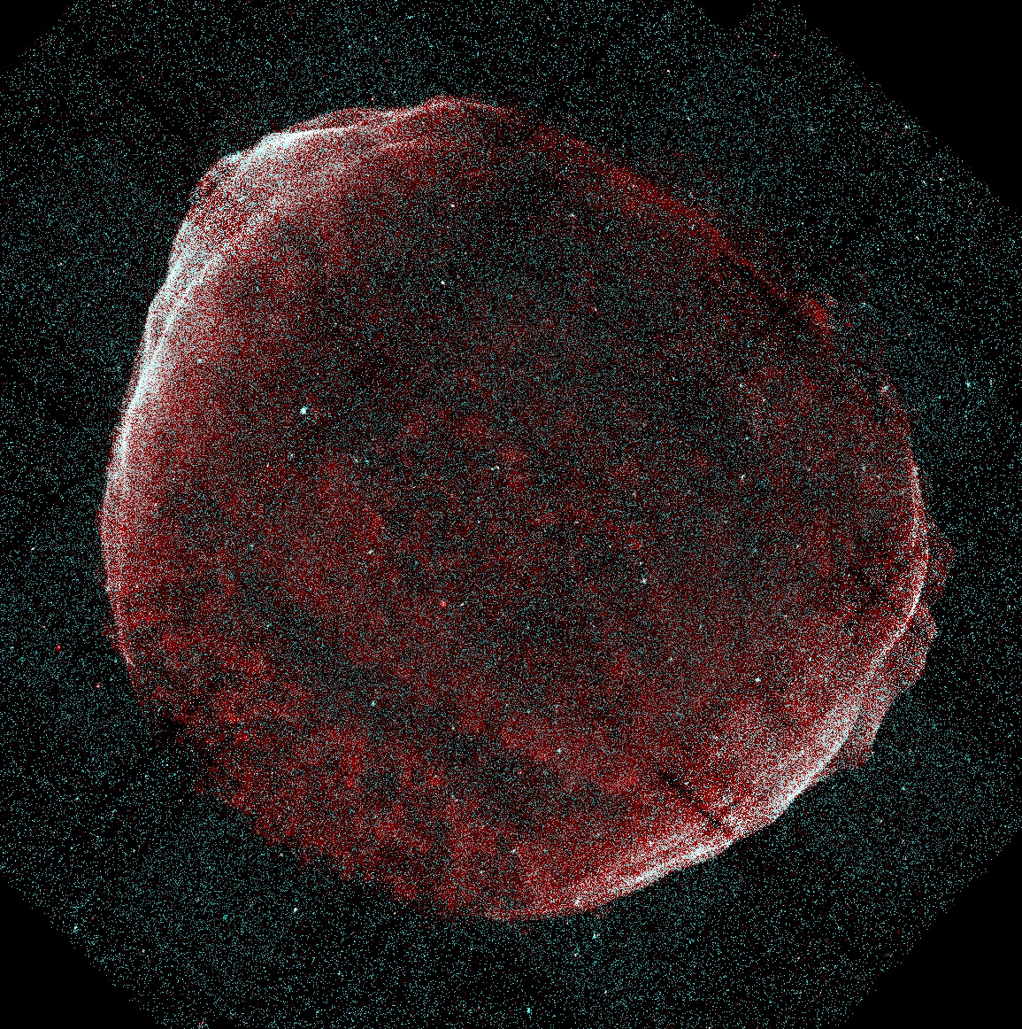
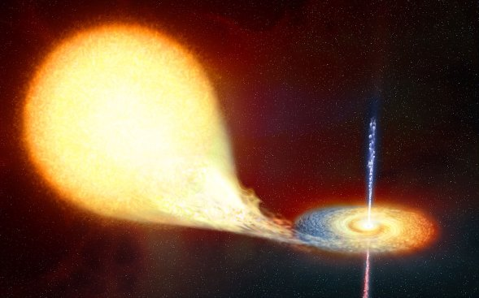
Astrophysical Models
Pulsar
SNR
Microquasar
Heinz &
Sunyaev
02
GRB
KI 10
Calvez
& Kusenko
10
Shen & Berkey 68;
Pohl & Esposito 98;
Kobayashi+ 04;
Shaviv+ 09; Hu+ 09;
Fujita+KI 09; Blasi 09;
Blasi & Serpico 09;
Mertsch & Sarkar 09;
Biermann+ 09
Shen 70; Aharonian+ 95;
Atoyan et al. 95; Chi+ 96;
Zhang & Cheng 01;
Grimani 07; Yuksel+ 08;
Buesching+ 08;
Hooper+ 08; Profumo 08;
Malyshev+ 09; Grasso+ 09
Kawanaka, KI & Nojiri 09;
Cosmic-ray proton energy
10⁻³ x 10⁵⁰erg/SN
~10⁵⁰erg/10³SN
Propagation
Delahaye+ 08;
Cowsik & Burch 09
Proton Comtami.
Fazely+ 09; Schubnell 09

Slide 38
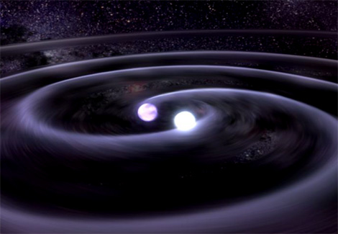
Astrophysical Models
White Dwarf Pulsar
via Binary Merger
Pulsar
SNR
Microquasar
Heinz &
Sunyaev
02
GRB
KI 10
Calvez
& Kusenko
10
Shen & Berkey 68;
Pohl & Esposito 98;
Kobayashi+ 04;
Shaviv+ 09; Hu+ 09;
Fujita+KI 09; Blasi 09;
Blasi & Serpico 09;
Mertsch & Sarkar 09;
Biermann+ 09
Shen 70; Aharonian+ 95;
Atoyan et al. 95; Chi+ 96;
Zhang & Cheng 01;
Grimani 07; Yuksel+ 08;
Buesching+ 08;
Hooper+ 08; Profumo 08;
Malyshev+ 09; Grasso+ 09
Kawanaka, KI & Nojiri 09;
Cosmic-ray proton energy
Kazumi KASHIYAMA P-91
10⁻³ x 10⁵⁰erg/SN
~10⁵⁰erg/10³SN
Propagation
Delahaye+ 08;
Cowsik & Burch 09
Proton Comtami.
Fazely+ 09; Schubnell 09

Slide 39


LISA Background
SNIa
or
Rapidly
spinning
WD

Slide 40
Energy Budget
Neutron Star
Pulsar
White Dwarf
Pulsar
Rotational
Energy
~1/100yr
Event Rate
~1/100yr
~1%
Energy Loss/High B Fraction
~1%
~10⁴⁸erg/SN
~10⁴⁸erg/SN

Slide 41


e± Factory
e±
Unipolar Induction
e± cascade
~10TeV
Goldreich & Julian 69
Ruderman & Sutherland 75

Slide 42

Pulsar Death Line
After merger,
P ~ 50 sec
High B pulsars
can create e±
Kashiyama+ 10

Slide 43


Only WD Pulsar Model
Electron
Positron
WD pulsars are long-lived (~10⁹yr⇔10⁵yr)
⇒ Many nearby sources (~100⇔1)

Slide 44


NS+WD Mixed Model
Electron
Positron
NS
WD
WD pulsars are long-lived (~10⁹yr⇔10⁵yr)
⇒ Each WD is too dim to detect

Slide 45
New Window
?
Electron CR
CALET (2013-)
CTA (2015-)
?
Positron CR
AMS-02 (2011-)

Slide 46


CALET
(CALorimetric Electron Telescope)
Cosmic Ray Electrons
up to ~10TeV
w/ ΔE~a few % (>100GeV)
© Torii

Slide 47

Cosmic Ray Escape
High E
Only ~1 source (e.g., Vela) in TeV window
Low E
All escape
Supernova
Remnant
If confined,
CR lose energy
⇒ F∝E⁻² is
changed
⇒ CR Origin
Kawanaka, KI+ 10
Ptuskin & Zirakashvili 05

Slide 48

Hadronic v.s. Leptonic
SNR model:
pp → π⁺ → e⁺e⁻
(w/ surrounding)
⇒ Inevitably
anti-proton
excess above
~100 GeV
Anti-proton
fraction
Fujita+KI 09

Slide 49
Summary
Gamma-Ray Burst
  Fireball Γ_{max}~10⁶ in principle ⇔ Fermi GRB
  Off-axis NS merger: Cocoon breakout
  GRB jet can breakout the first star (P-68)
Cosmic-Ray
  CR e± from white dwarf pulsars (P-91)
  New window @~TeV e± ⇒ CR origin
Gravitational Wave
  Final messenger to come soon

Slide 50
Thanks
and
Congratulations to
Nakamura-san
Maeda-san
and JGRG

