Slide 1

Non-linear perturbations from cosmological inflation
JGRG20, YITP, Kyoto 25th September 2010
David Wands
Institute of Cosmology and Gravitation
University of Portsmouth

Slide 2
summary:
non-linear perturbations offer distinctive observational signatures of physics of inflation

Slide 3
gravity + inflation:
accelerated expansion of FLRW cosmologies
horizon, entropy, flatness...
relativistic perturbations
quantum fluctuations of free scalar and tensor modes
non-linear perturbations
second-order tensor modes from scalar fluctuations
second-order density perturbations and non-Gaussian distributions
inflation driven by (modified) gravity
e.g., Starobinsky (1980)

Slide 4



coming of age...
(c) Masashi Kiko 2010

Slide 5
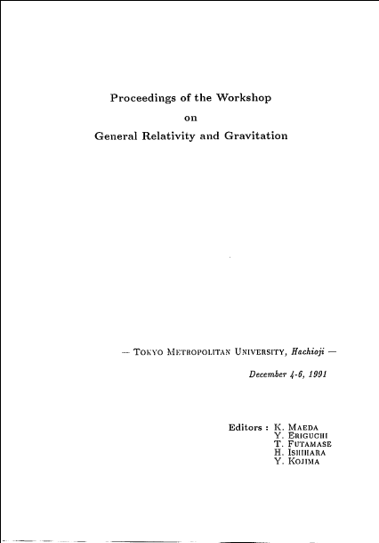
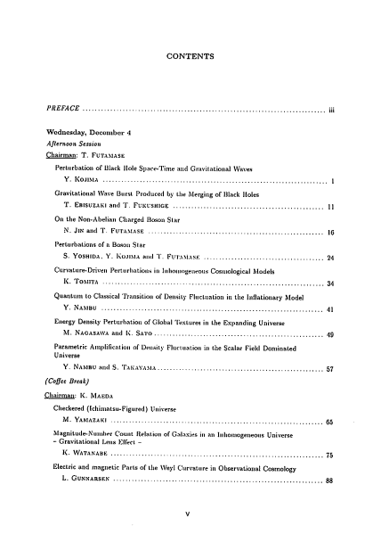
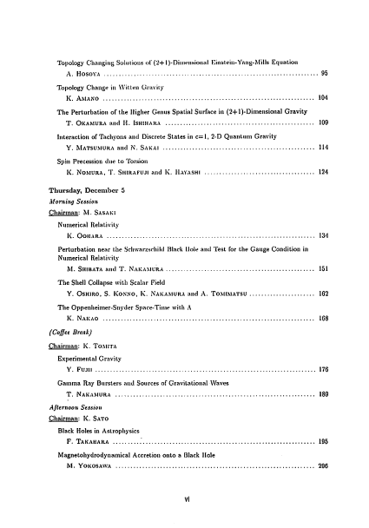
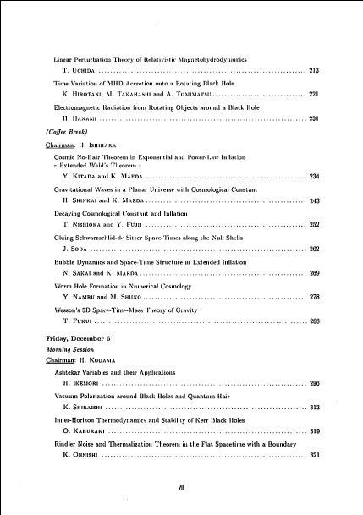
inflation circa 1990

Slide 6

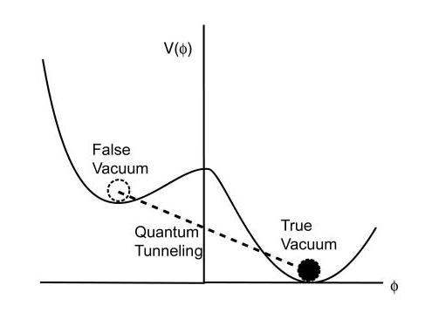
extended inflation
La & Steinhardt 1989
Barrow & Maeda 1990
Steinhardt & Accetta 1990
simple, compelling model for gravity-driven inflation...
false vacuum + first-order transition
+ Brans-Dicke gravity
solves graceful exit problem of Guth’s old inflation
Φ grows during inflation, Hubble rate decreases, until first-order transition completes
scale-free gravity (one dimensionless parameter)

Slide 7
dynamical solution to hierarchy problem
E. Weinberg 1989
Liddle & Wands 1992
start near Planck scale
bubble nucleation rate
S_{E}>>1 is dimensionless Euclidean action (“shape parameter”)
percolation parameter
P grows as Φ grows (gravity gets weaker) and H decreases
phase transition completes / inflation ends when p=1

Slide 8
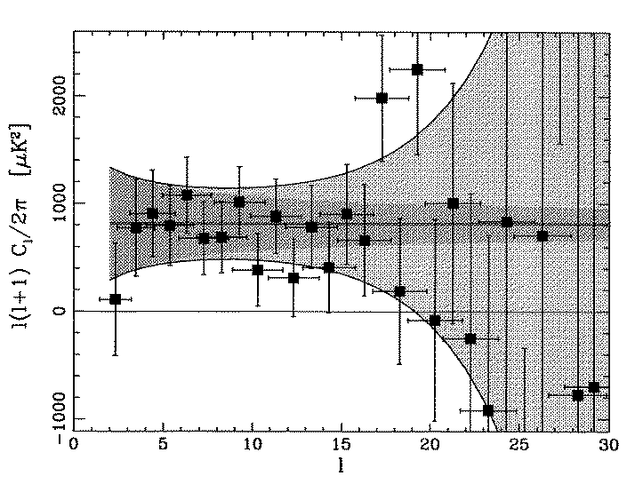
power law inflation
power-law inflation
linear perturbations
[conformal transform to Einstein frame (Brans 1962, Maeda 1989)]
reproduces scale-invariant spectrum as ω→ ∞
non-linear perturbations
first-order transition leads to distribution of bubbles
spectrum of bubbles also becomes scale-invariant as ω→ ∞
“big bubble problem” Weinberg (1989); Liddle & Wands; Maeda & Sakai (1992)
CoBE (1994)

Slide 9
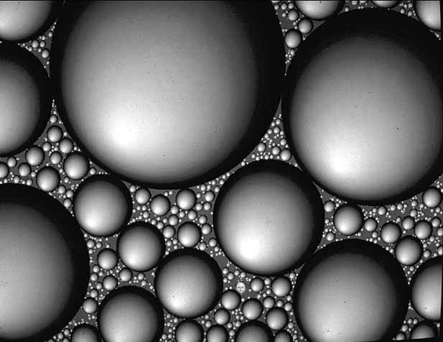

Slide 10
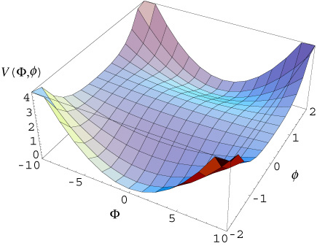
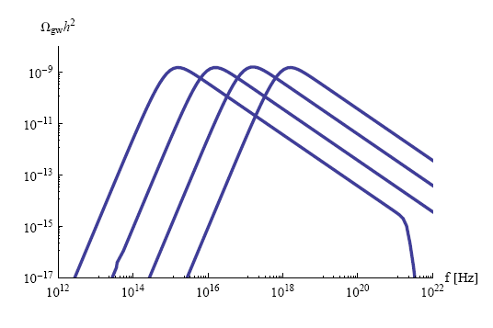
hybrid inflation
Linde 1993
inflaton field changes shape of false vacuum potential
S_{E}(t) => Γ(t)~ M⁴exp[- S_{E}(t)]
ends by sudden phase transition
first- or second-order
non-linear perturbations only on small scales
inhomogeneous bubbles or tachyonic preheating
spectrum of relic gravitational waves on characteristic scale
ϕ(t)
Lyth; Fonseca, Sasaki & Wands 2010
+ see poster by Gong
Easther ‘09

Slide 11
Sources of primordial gravitational waves:
Quantum fluctuations of gravitational field
First-order phase transitions?
Preheating after inflation?
Cosmic string cusps?
Primordial density perturbations

Slide 12

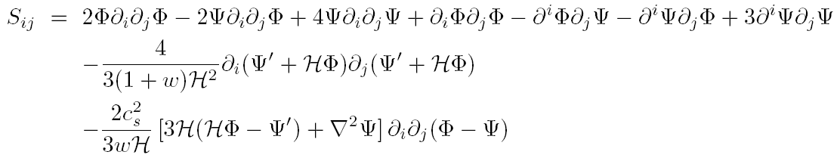
Second-order GW from first-order density perturbations
Tomita (1967); Matarrese et al (1994); Hwang; K. Nakamura; Ananda, Clarkson & Wands (2006)
scalar, vector and tensor modes couple at second and higher order
tensor perturbations become gauge-dependent
in longitudinal gauge for general FRW cosmology w=P/ρ, c_{s}²=dP/d ρ
where second-order source is transverse-tracefree part of
Baumann, Steinhardt, Takahashi, Ichiki, hep-th/0703290

Slide 13
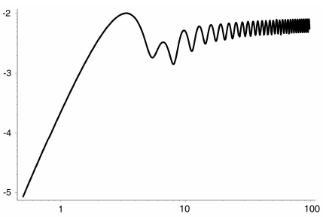
GW from density perturbations in radiation era
Ananda, Clarkson & Wands, gr-qc/0612013
almost scale-invariant primordial density power spectrum
generates almost scale-invariant gravitational wave background
e.g.,

Slide 14
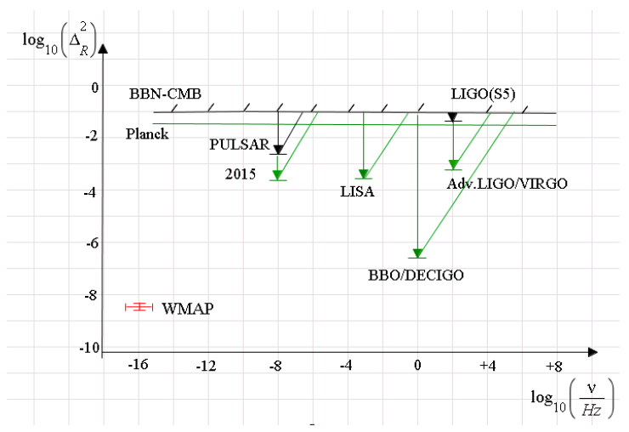
Constraints on primordial density perturbations
Assadullahi & Wands, arXiv:0907.4073
LIGO/VIRGO
Advanced LIGO/VIRGO
LISA
BBO/DECIGO
Pulsar timing data rules out intermediate mass primordial black holes
Saito & Yokoyama, arXiv:0812.4339 (Phys Rev Lett)
Bugaev & Klimai, arXiv:09080664

Slide 15
second-order density perturbations
non-linear evolution lead to non-Gaussian distribution
non-zero bispectrum and higher-order correlators
Local-type non-Gaussianity
super-Hubble evolution of Gaussian random field from multi-field inflation
Equilateral-type non-Gaussianity
sub-Hubble interactions in k-inflation/DBI inflation
Topological defects
cosmic strings from phase transitions
templates required to develop optimal estimators
matched filtering to extract small non-Gaussian signal

Slide 16
the δN formalism for primordial perturbations
t
in radiation-dominated era curvature perturbation ζ on uniform-density hypersurface
during inflation field perturbations δφ_{I}(x,t_{i}) on initial spatially-flat hypersurface
x
on large scales, neglect spatial gradients, treat as “separate universes”
Starobinsky `85; Sasaki & Stewart `96
Lyth & Rodriguez ’05 – works to any order

Slide 17
the δN formalism order by order at Hubble exit
t
sub-Hubble quantum interactions
super-Hubble classical evolution
N’
N’
N’’
N’
N’
N’
Byrnes, Koyama, Sasaki & DW

Slide 18
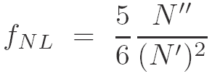
simplest local form of non-Gaussianity applies to many models inflation including curvaton, modulated reheating, etc
ζ = δN(φ ) is local function of single Gaussian random field, φ
where
odd factors of 3/5 because (Komatsu & Spergel, 2001, used) Φ₁ =(3/5)ζ₁

Slide 19
large non-Gaussianity from inflation?
single inflaton field
adiabatic perturbations => ζ constant on large scales
during conventional slow-roll inflation
for any* adiabatic model (Creminelli&Zaldarriaga 2004)
k/DBI - inflation
multi-field models
typically f_{NL}~1 for slow-roll inflation
could be much larger from sudden transition at end of inflation ?
modulated reheating
curvaton f_{NL}~1/Ω_{decay} >>1 ?
new ekpyrotic models |f_{NL}|>>1
* but ask Sasaki-san!

Slide 20
curvaton scenario: Linde & Mukhanov 1997; Enqvist & Sloth, Lyth & Wands, Moroi & Takahashi 2001
V(χ)
χ
curvaton χ = a weakly-coupled, late-decaying scalar field
light during inflation (m<<H) hence acquires an almost scale-invariant, Gaussian distribution of field fluctuations on large scales
energy density for massive field, ρ_{χ}=m²χ²/2
spectrum of initially isocurvature density perturbations
transferred to radiation when curvaton decays with some efficiency≈ Ω_{χ,decay}

Slide 21
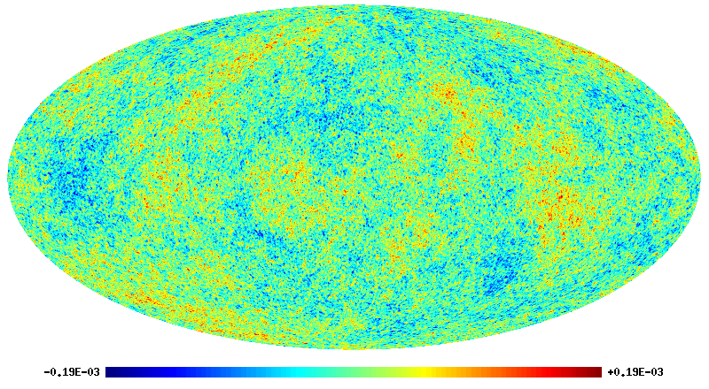
Liguori, Matarrese and Moscardini (2003)

Slide 22
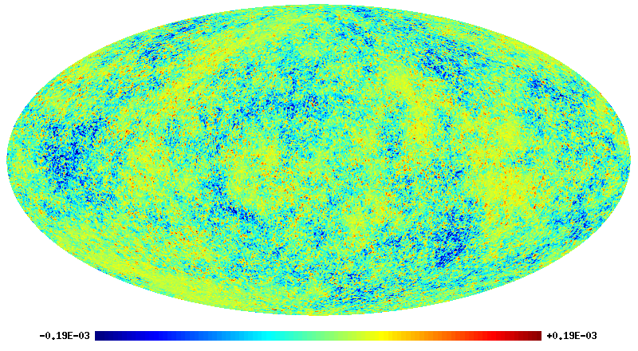
f_{NL}=+3000
Liguori, Matarrese and Moscardini (2003)

Slide 23
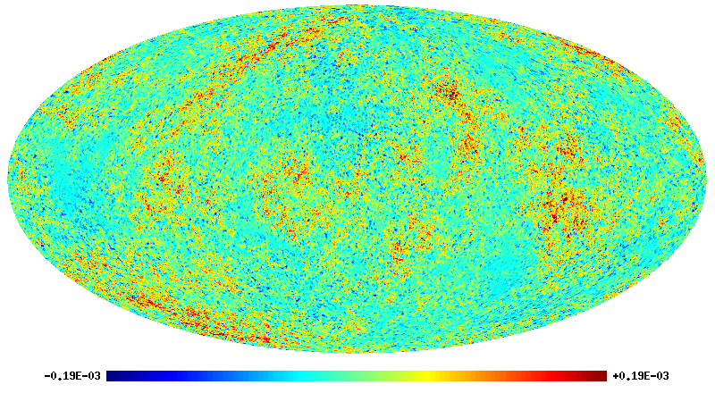
f_{NL}=-3000
Liguori, Matarrese and Moscardini (2003)

Slide 24
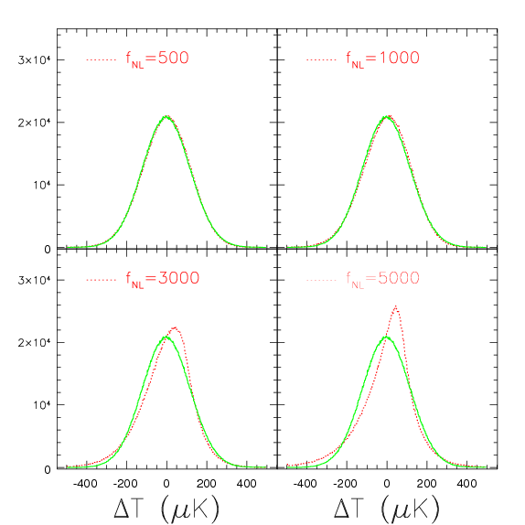
remember: f_{NL} < 100 implies Gaussian to better than 0.1%

Slide 25
evidence for local non-Gaussianity?
ΔT/T ≈ -Φ/3, so positive f_{NL} ⇒ more cold spots in CMB
various groups have attempted to measure this with the WMAP CMB data using estimators based on matched filtering (all 95% CL) :
27 < f_{NL} < 147 Yadav & Wandelt WMAP3 data
-9 < f_{NL} < 111 Komatsu et al WMAP5
-4 < f_{NL} < 80 Smith et al. Optimal WMAP5
-10 < f_{NL} < 74 Komatsu et al WMAP7
Large scale structure observations have recently given independent indications due to non-local bias on large scales (Dalal et al 2007):
-29 < f_{NL} < 70 (95% CL) Slosar et al 2008
27 < f_{NL} < 117 (95% CL) Xia et al 2010 [NVSS survey of AGNs]

Slide 26
non-Gaussianity from inflation
 | Source of non-Gaussianity | Bispectrum type
Initial vacuum | Excited state | Folded?
Sub-Hubble evolution | Higher-derivative interactions e.g. k-inflation, DBI, ghost | Equilateral (+orthogonal?)
Hubble-exit | Features in potential
Super-Hubble evolution | Self-interactions+gravity | Local
End of inflation | Tachyonic instability | Local
(p)Reheating | Modulated (p)reheating | Local
After inflation | Curvaton decay | Local
Radiation + matter + last-scattering | Primary anisotropies | Local+equilateral
ISW/lensing | Secondary anisotropies | Local+equilateral
inflation
primordial non-Gaussianity

Slide 27
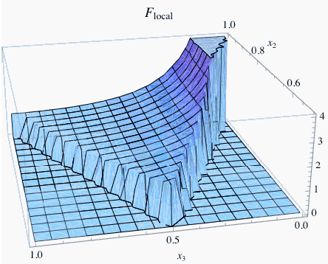
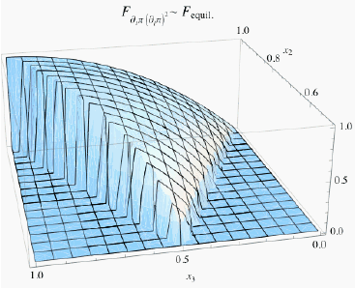
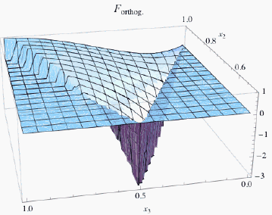
templates for primordial bispectra
local type (Komatsu&Spergel 2001)
local in real space (fNL=constant)
max for squeezed triangles: k<<k’,k’’
equilateral type (Creminelli et al 2005)
peaks for k1~k2~k3
orthogonal type (Senatore et al 2009)

Slide 28
the δN formalism order by order at Hubble exit
t
sub-Hubble quantum interactions
super-Hubble classical evolution
N’
N’
N’’
N’
N’
N’
Byrnes, Koyama, Sasaki & DW

Slide 29
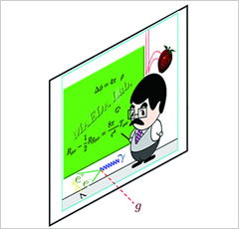
sub-Hubble interactions:
requires non-minimal kinetic Lagrangian
k-inflation (Armendariz-Picon & Mukhanov 1999)
super-luminal c_{s}²>1
DBI brane inflation (Alishahiha, Silverstein & Tong 2004)
probe brane in AdS bulk
c_{s}²<1 , f_{NL} ~ 1/c_{s}²
Galileon fields (Nicolis, Ratazzi & Trincherini 2009)
(ghost-free) DGP like scalar field with second-order equations of motion
c_{s}²<1 , f_{NL} ~ 1/c_{s}²
see posters by Kobayashi & Mizuno 2010
Galileon and DBI reunited (de Rham & Tolley 2010)
brane + most general second-order gravity in AdS bulk

Slide 30
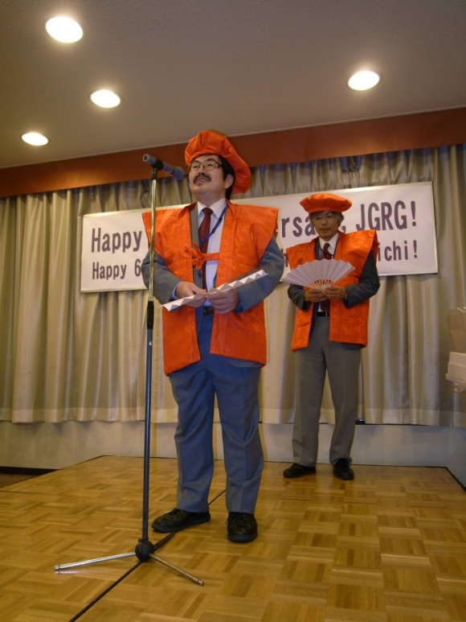
summary:
non-linear perturbations offer distinctive observational signatures of (gravitational) physics of inflation
Happy Birthday!

