Slide 1
Lattice Fermion with Chiral Chemical Potential
Arata Yamamoto
(University of Tokyo)
AY, Phys. Rev. Lett. 107, 031601 (2011)
AY, Phys. Rev. D 84, 114504 (2011)
NTFL workshop, Feb. 17, 2012

Slide 2
Introduction
In lattice QCD at finite density,
“sign problem”
For small chemical potential,
reweighting, Taylor expansion, canonical ensemble,
imaginary chemical potential, density of states, …
For large chemical potential,
two-color QCD, isospin chemical potential,
chiral chemical potential

Slide 3
Chiral chemical potential
[K.Fukushima, D.E.Kharzeev, H.J.Warringa (2008)]
right-handed
Fermi sea
left-handed
Fermi sea
Chiral chemical potential produces a chirally imbalanced matter.

Slide 4
Wilson-Dirac operator
NO sign problem !!

Slide 5
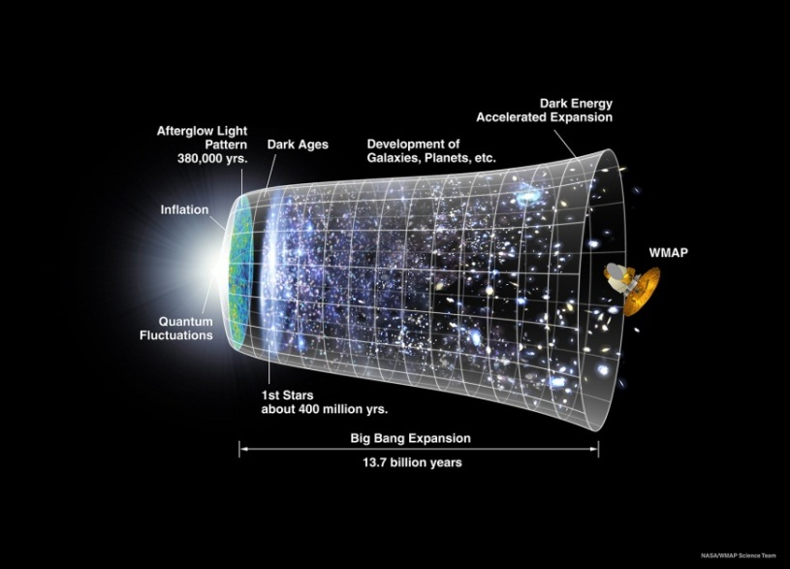
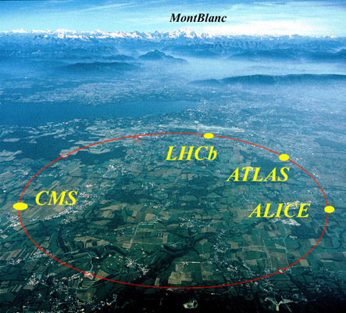
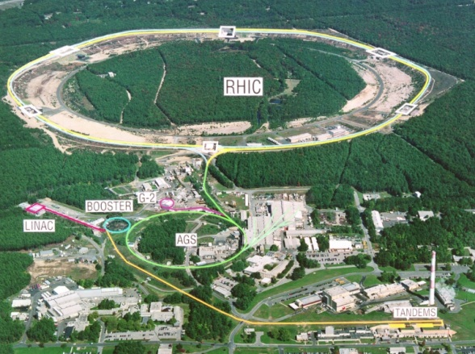
Chiral Magnetic Effect
[D.E.Kharzeev, L.D.McLerran, H.J.Warringa (2007)]
chiral magnetic effect:
charge separation induced by a strong magnetic field
via the axial anomaly, i.e., nontrivial topology
Early Universe
heavy-ion collision (RHIC&LHC)
[from KEK’s web page]
[from NASA’s web page]
[from BNL’s web page]

Slide 6
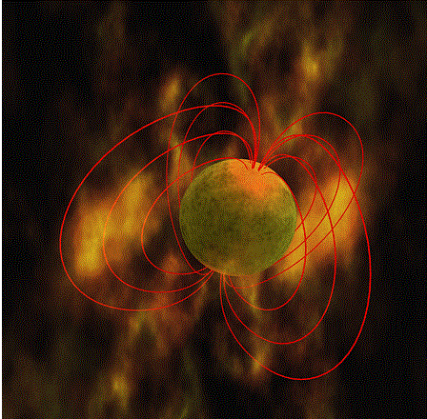
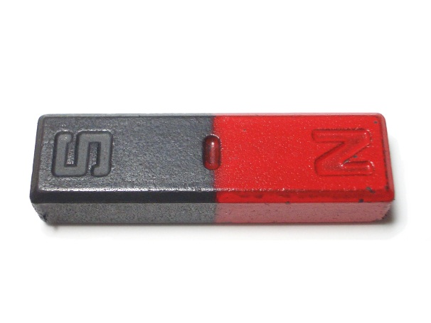
non-central collision of heavy ions
beam
beam
magnetic field ~ 10⁴ MeV²
cf.) permanent magnet ~ 10² eV² magnetar ~ 10 MeV²

Slide 7
electric current
electric current
magnetic field
If L = R, the net current is zero.
If L R, the net current is nonzero.
assumption: quarks are massless and deconfined.

Slide 8
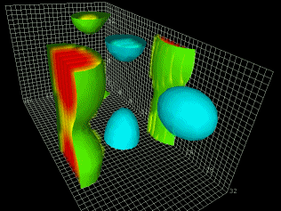
the index theorem:
topological fluctuation in lattice QCD
Globally,
[from D.Leinweber’s web page]
Locally,

Slide 9
magnetic field
electric current
beam
beam
topological fluctuation
“event-by-event” charge separation

Slide 10
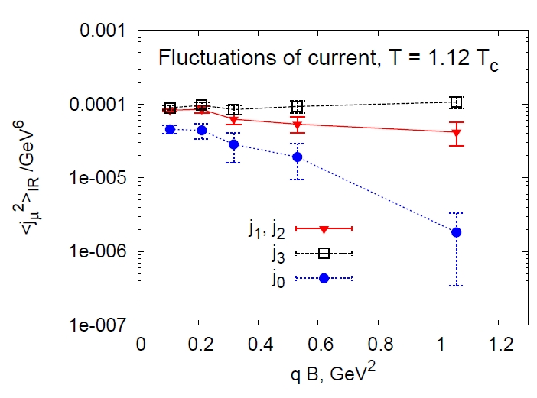
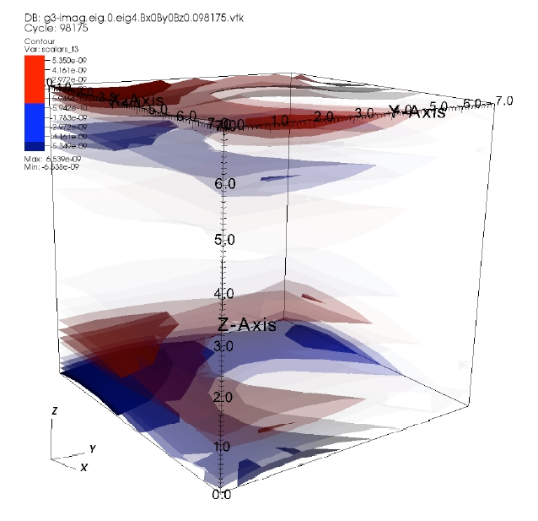
Chiral magnetic effect in lattice QCD
SU(2) quenched QCD
with the overlap fermion
[P.V.Buividovich, M.N.Chernodub,
E.V.Luschevskaya, M.I.Polikarpov (2009)]
instanton solution & 2+1 flavor QCD
with the domain-wall fermion
[M.Abramczyk, T.Blum,
G.Petropoulos, R.Zhou (2009)]

Slide 11
Chiral chemical potential
positive helicity
negative helicity
magnetic field
electric current

Slide 12
Induced current
[K.Fukushima, D.E.Kharzeev, H.J.Warringa (2008)]
the Dirac equation coupled with a background magnetic field
induced electric current
magnetic field
electric current

Slide 13
Lattice QCD Simulation
full QCD simulation with a finite chiral chemical potential
external magnetic field
vector current
chirally imbalanced matter
L R

Slide 14
Simulation setup
the Wilson gauge action + the Wilson fermion action
flavor:
lattice size:
lattice spacing: fm
pion/rho-meson mass:
deconfinement phase

Slide 15
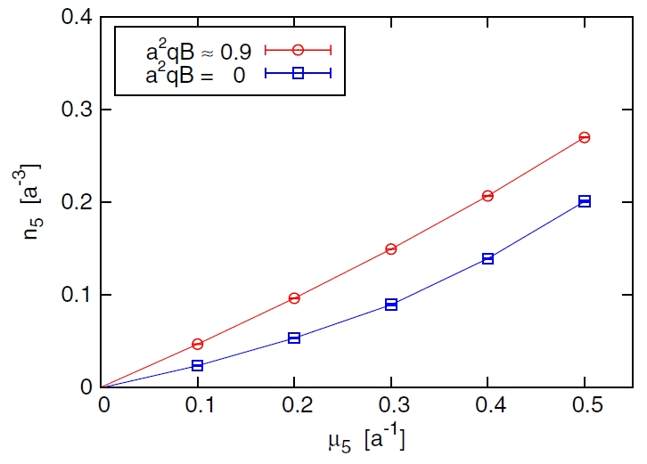
Chiral charge density

Slide 16
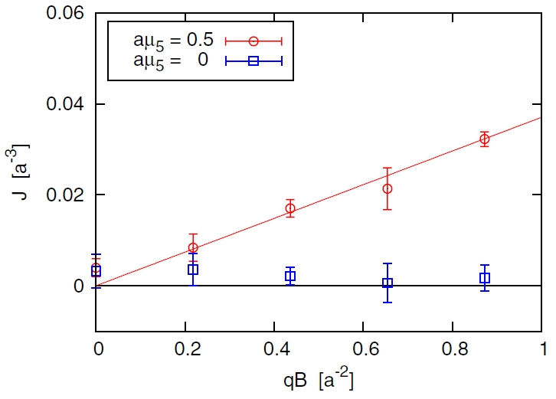
Induced current

Slide 17
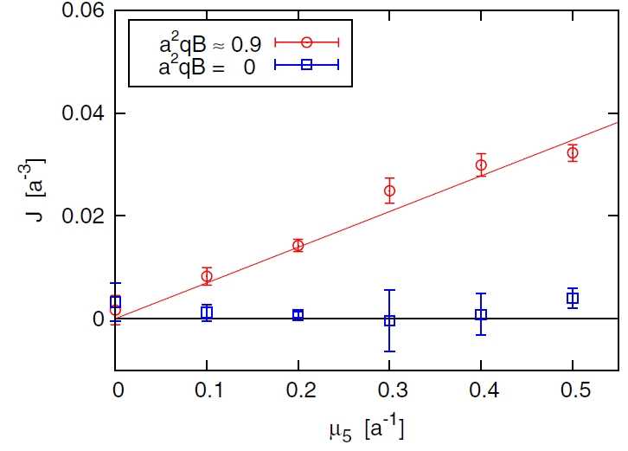
Induced current

Slide 18
Induced current
by fitting the lattice data
from the Dirac equation
[K.Fukushima, D.E.Kharzeev, H.J.Warringa (2008)]
lattice artifacts
e.g. renormalization
physical effects
e.g. dielectric correction
[K.Fukushima, M.Ruggieri (2010)]

Slide 19
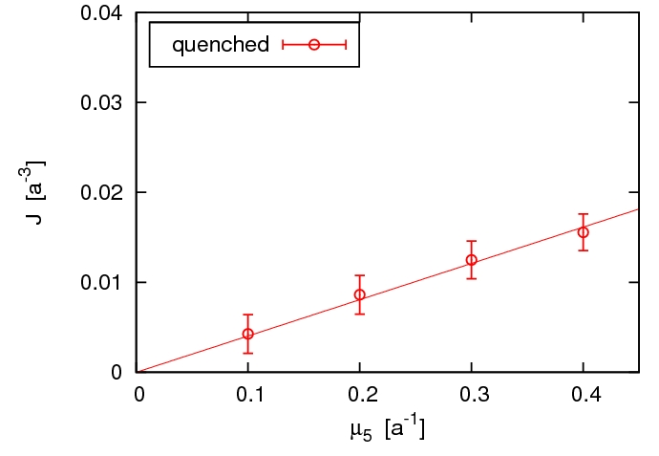
Systematic Analysis
quenched QCD simulation
lattice spacing dependence
volume dependence
quark mass dependence
of

Slide 20
Renormalization
The local vector current is renormalization-group variant on the lattice.
In the continuum limit ,
renormalization factor:
discretization artifact:
cf.) nonperturbative renormalization
[L.Maiani, G.Martinelli (1986)]

Slide 21
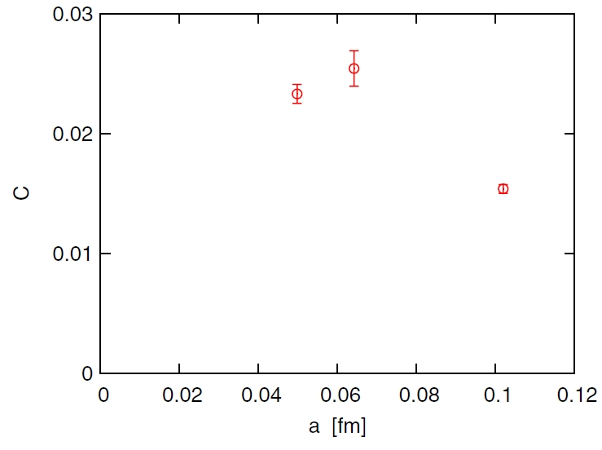
Lattice spacing
The induced current depends on the lattice spacing.

Slide 22
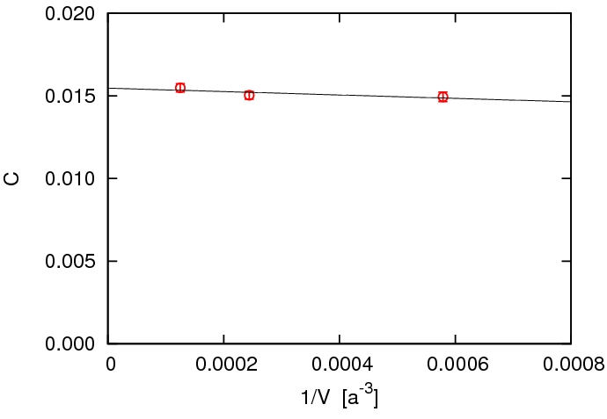
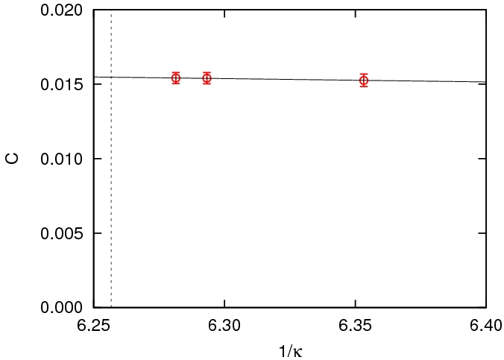
Spatial volume
Quark mass
chiral limit
The induced current is independent of volume and quark mass.

Slide 23
Summary
We have performed a lattice QCD simulation with the chiral chemical potential.
By applying an external magnetic field, we have obtained the induced current by the chiral magnetic effect.
The continuum extrapolation is quantitatively important.
chiral symmetry ?

