Slide 1
YIPQS Symposium Perspectives in Theoretical Physics --- From Quark-Hadron Sciences to Unification of Theoretical Physics --- 6th February 2012 Yukawa Institute for Theoretical Physics, Kyoto, Japan

Slide 2
Confirming Prejudices and Encountering Surprises
in the Study of the AdS/CFT correspondence.
Based on work with J.L.F Barbon
Eliezer Rabinovici
Racah Institute of Physics Hebrew University, Jerusalem

Slide 3
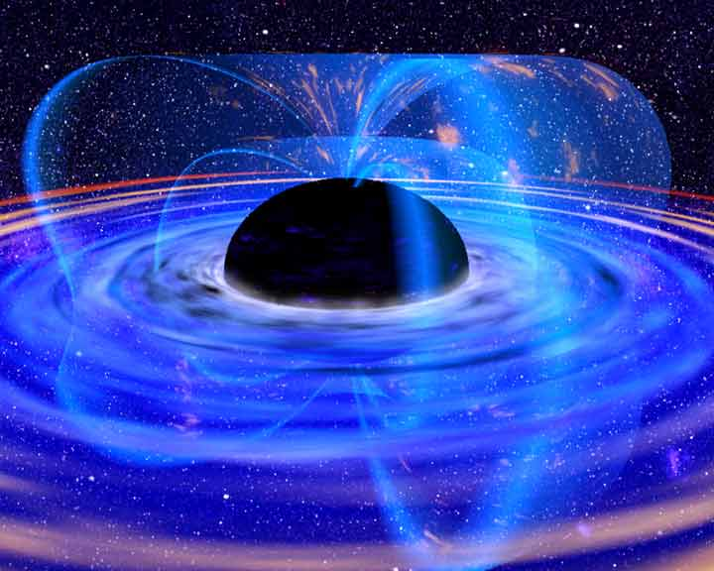
In a Black Hole

Slide 4
NO
BLACKHOLE INFORMATION PARADOX

Slide 5
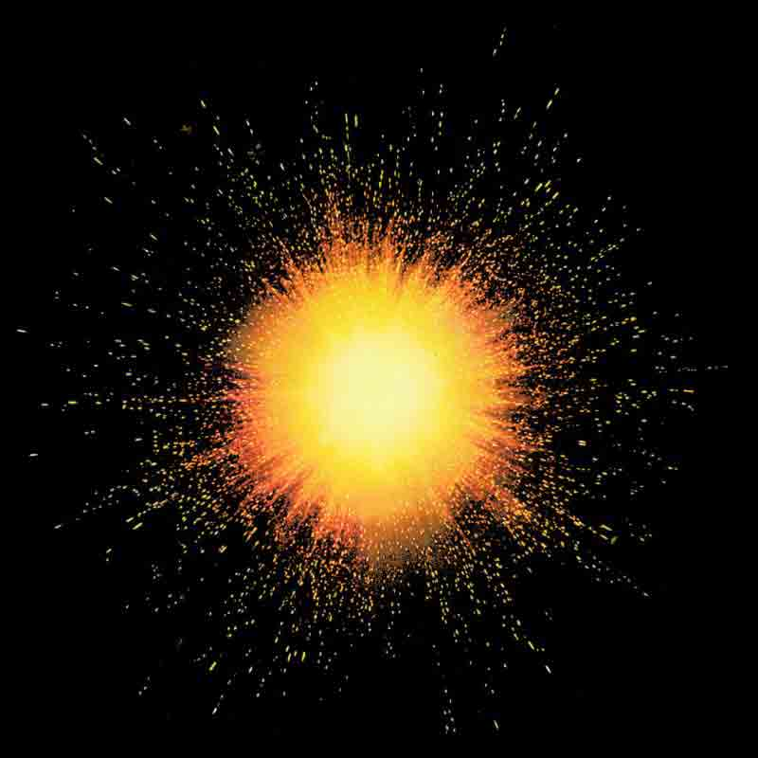
The Big Bang

Slide 6
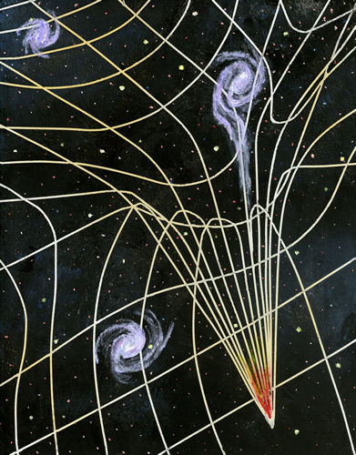
The Big Crunch

Slide 7
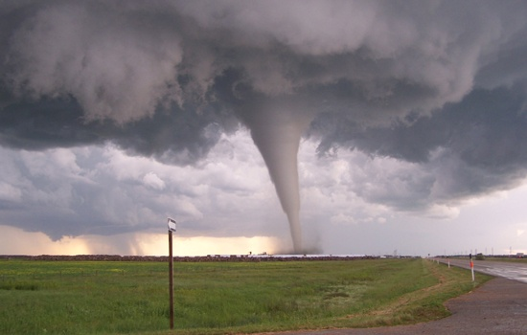
Magic of String Theory

Slide 8
Juan Maldacena

Slide 9
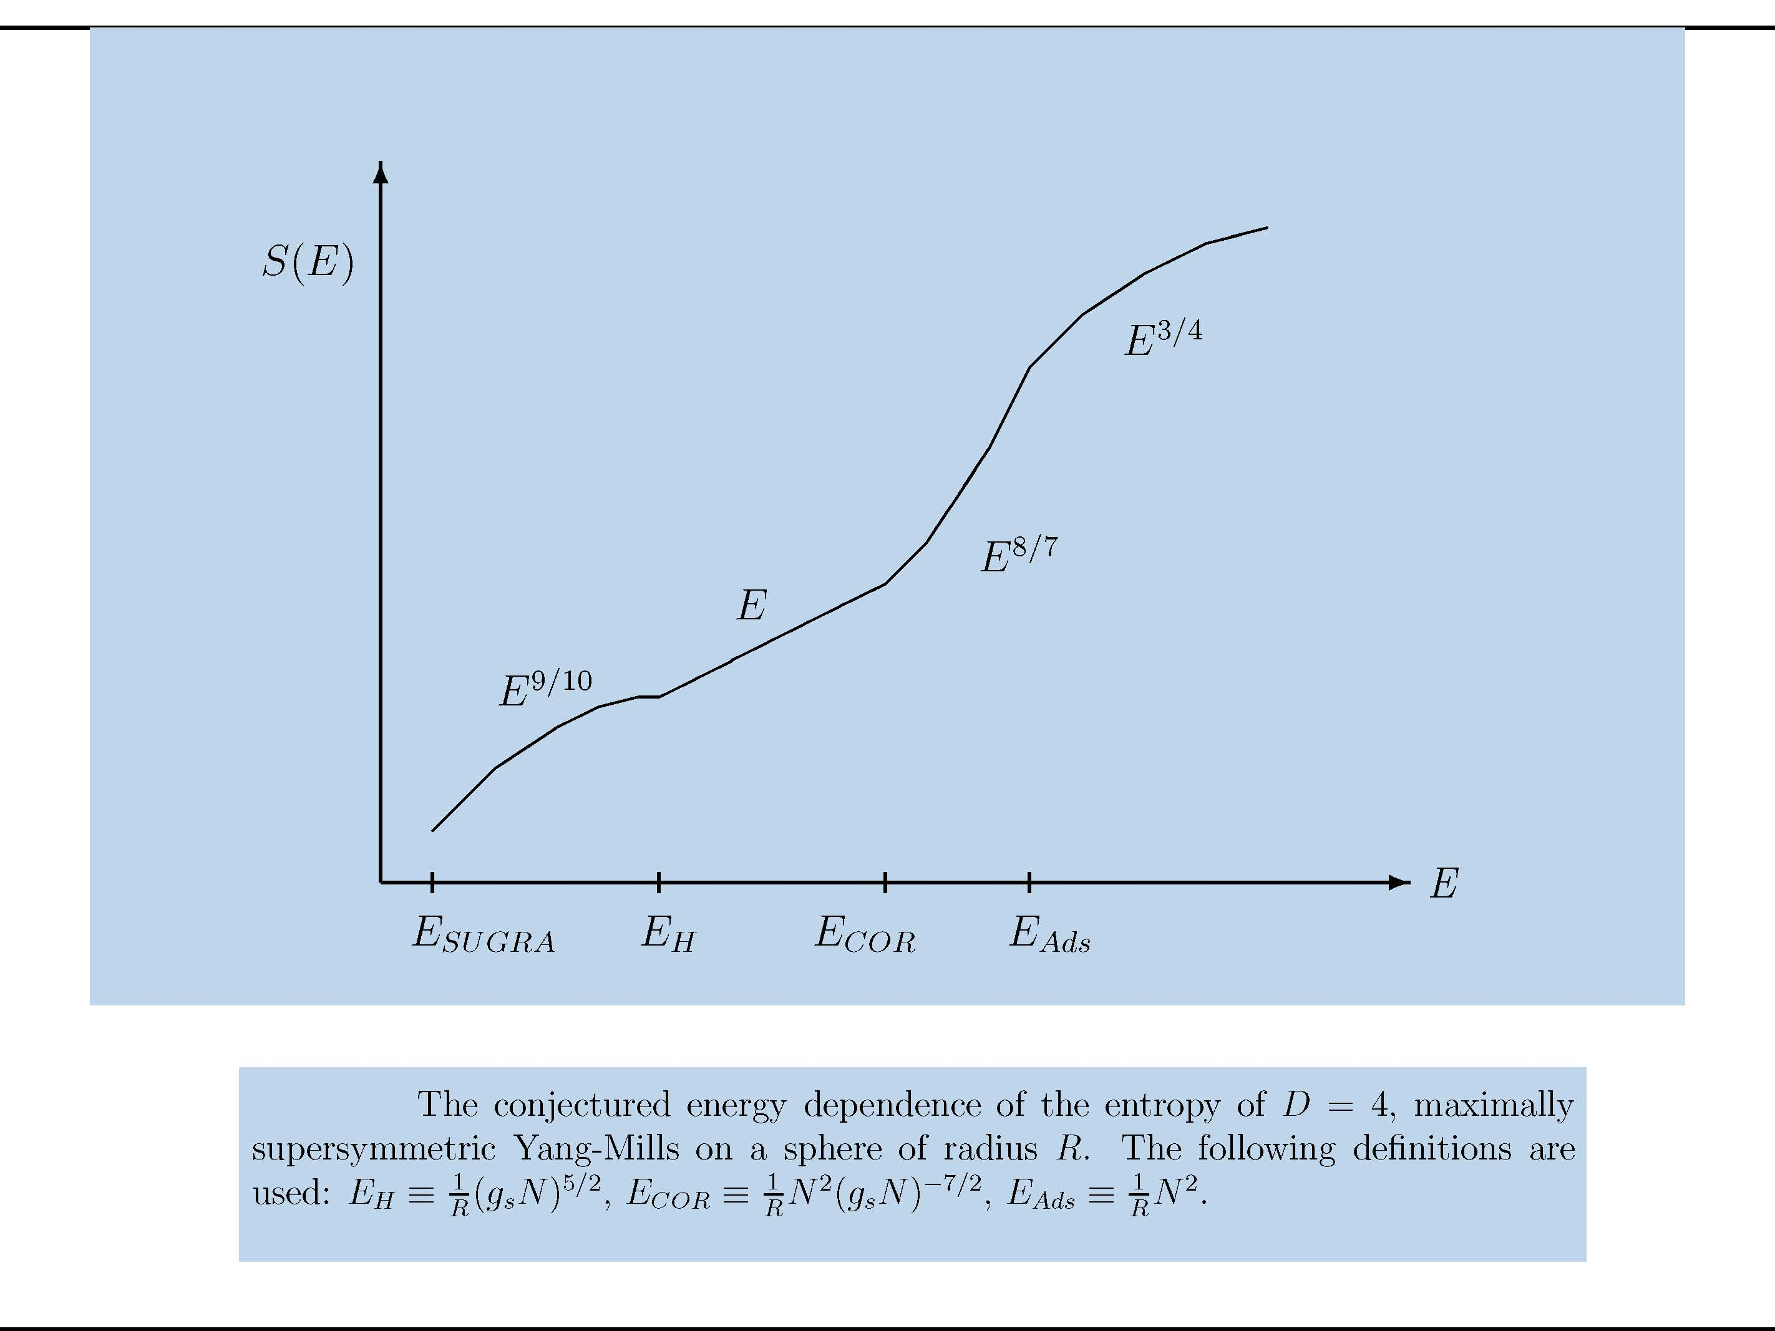
Banks, Douglas ,Horowitz ,Martinec

Slide 12
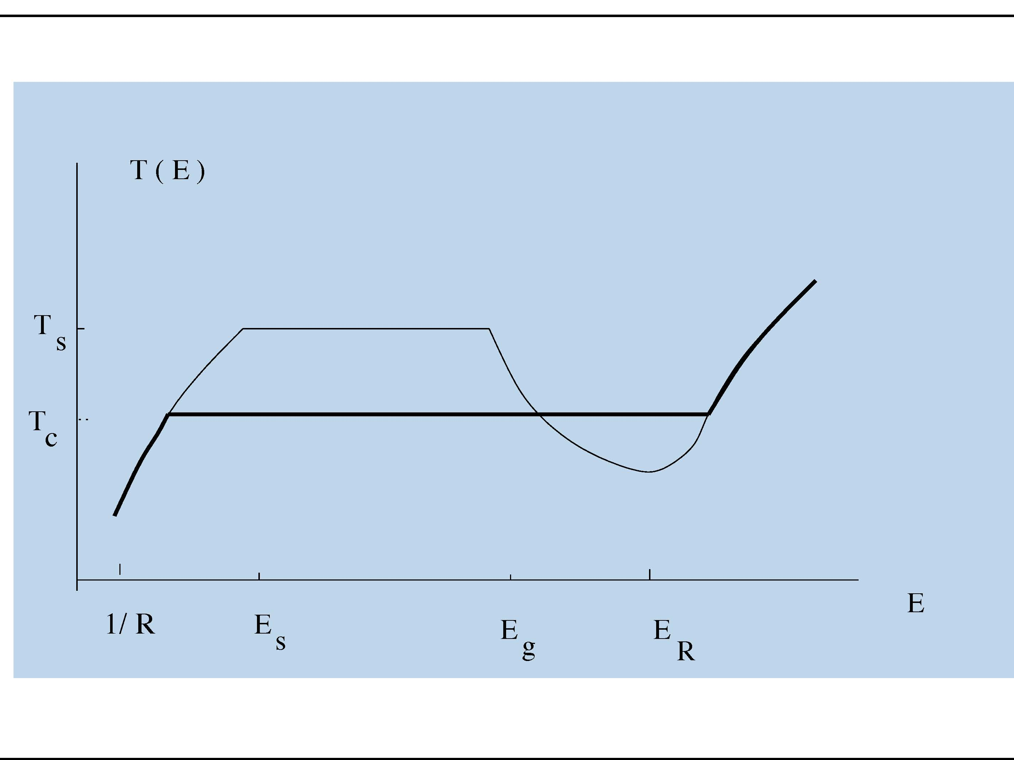

Slide 13
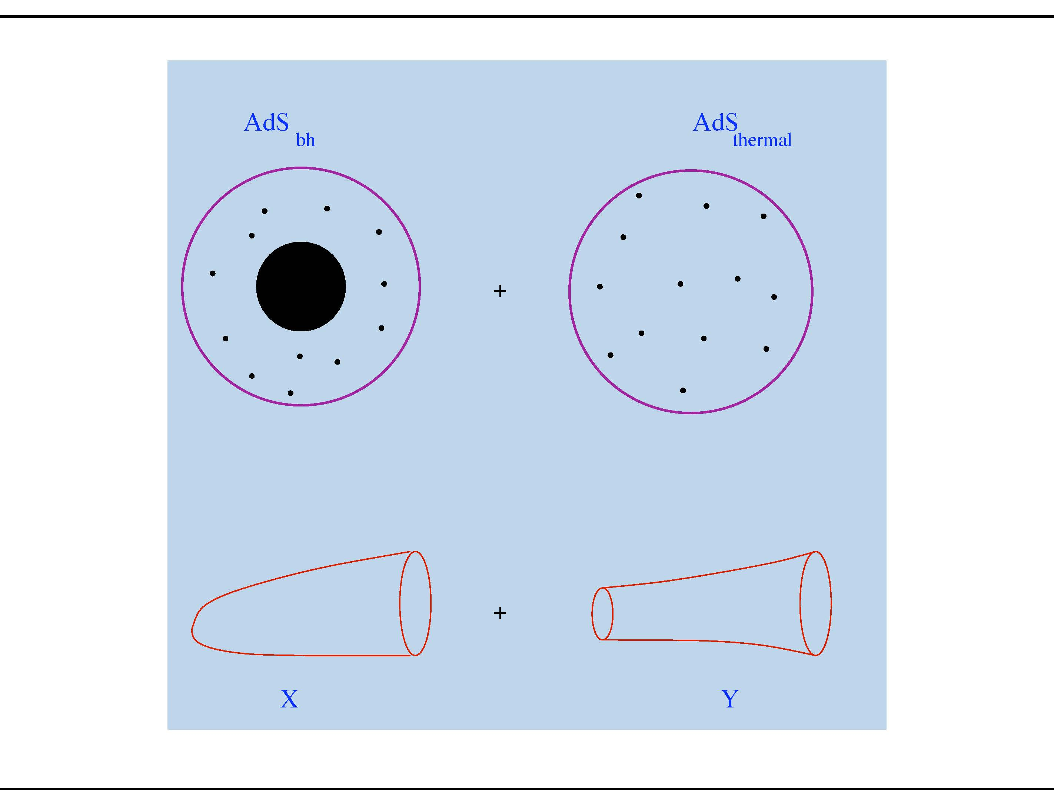

Slide 14
The energy spectrum of a CFT representing AdS_{d} quantum gravity. The spectrum is discrete on a sphere of radius R, with gap of order 1/R. The asymptotic energy band of very dense “black hole” states sets in beyond energies of order N²/R. The corresponding density of states is that of a conformal fixed point in d−1 spacetime dimensions.

Slide 20
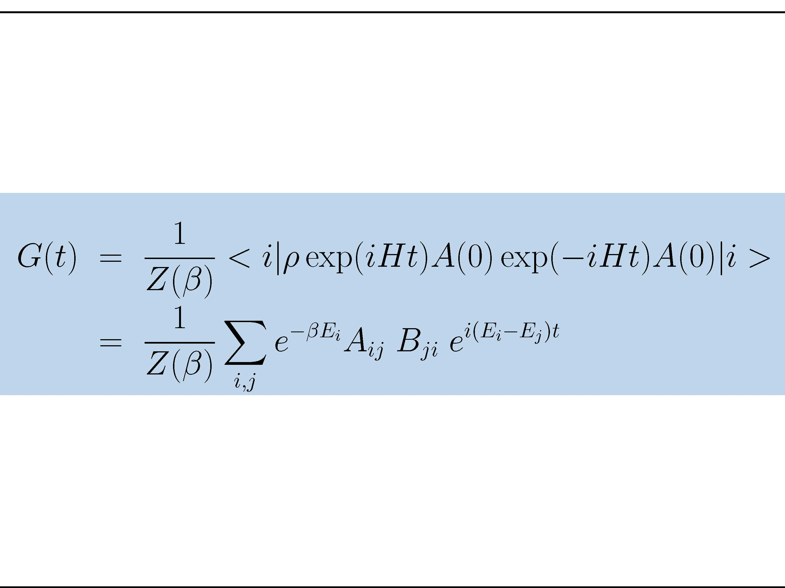

Slide 21
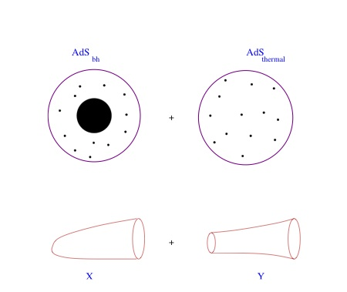
Basic Point: one needs to mix topologies
Klein: The number of particles is not fixed in an interacting relativistic theory.
Does one need to mix topologies?
For Holography to work, YES.

Slide 22
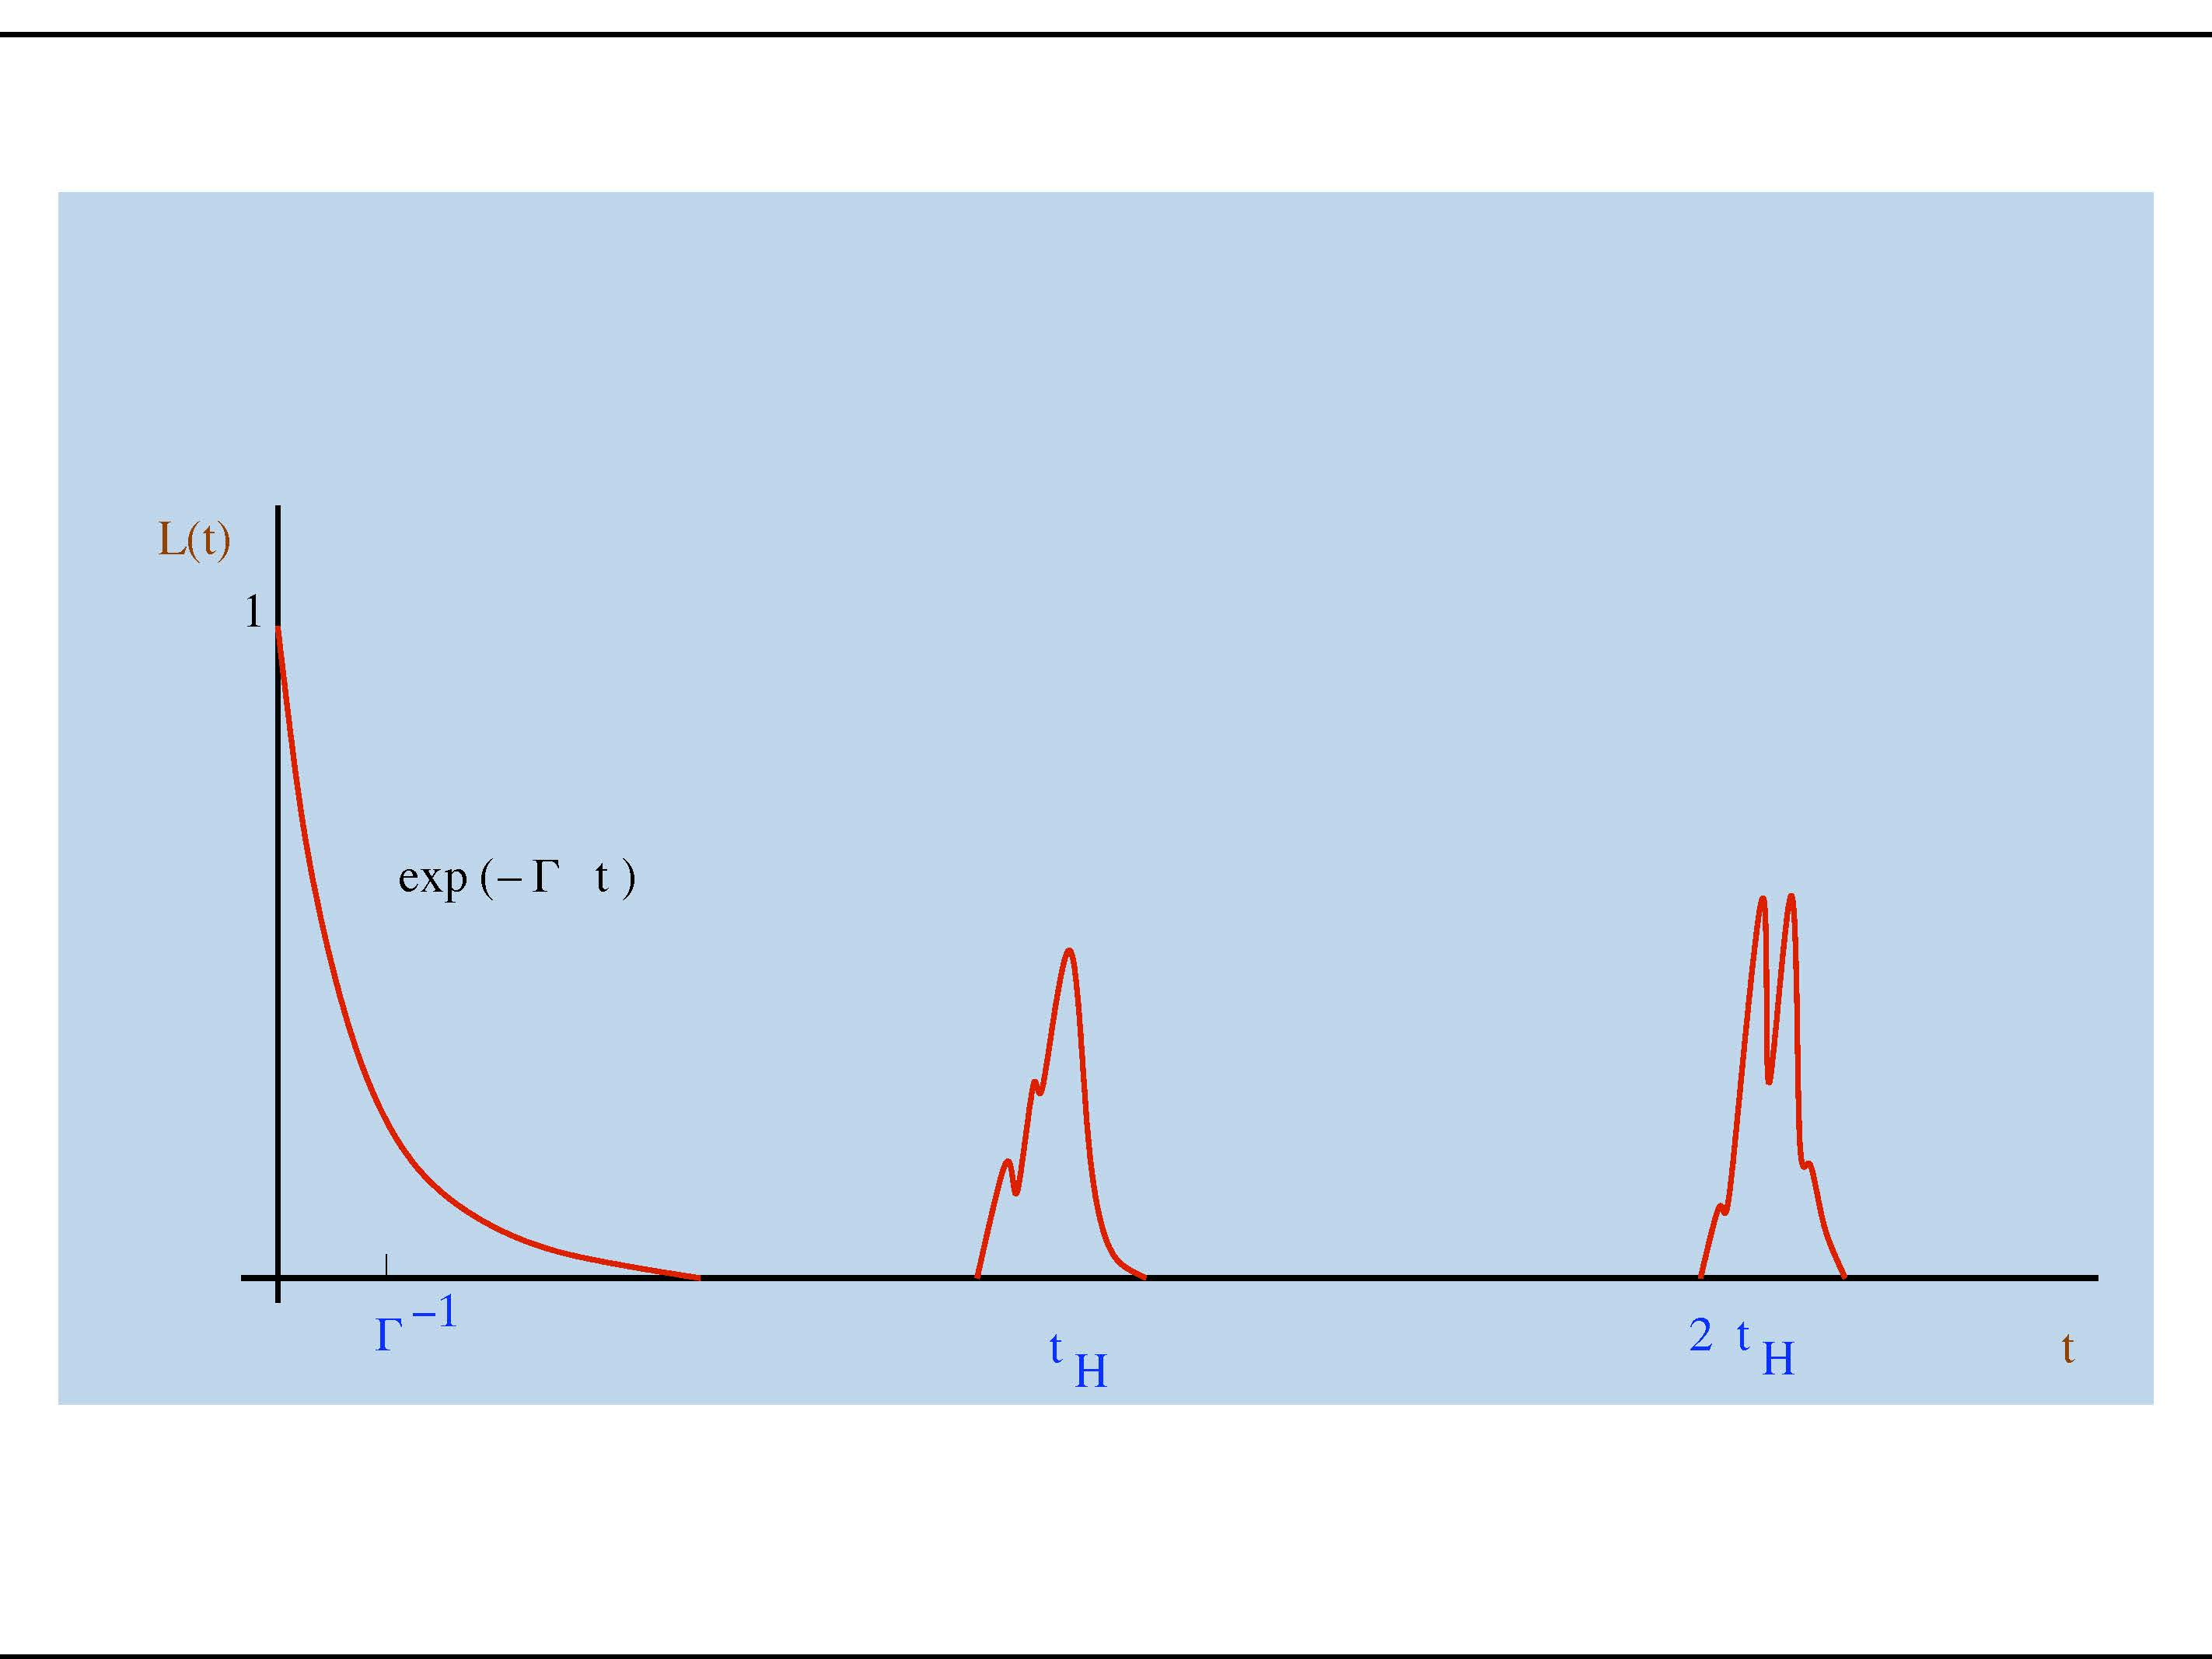

Slide 24
Calculate this in the bulk

Slide 25
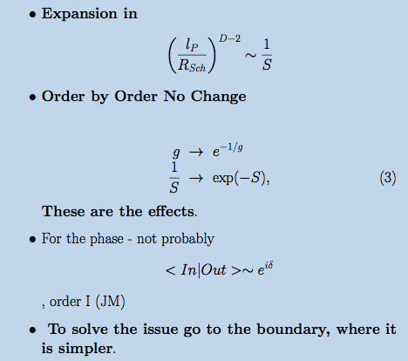

Slide 26
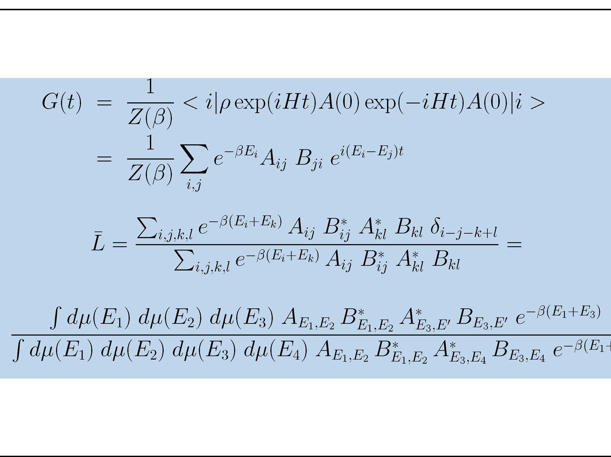

Slide 27
For large enough T Black Hole is dominant

Slide 28
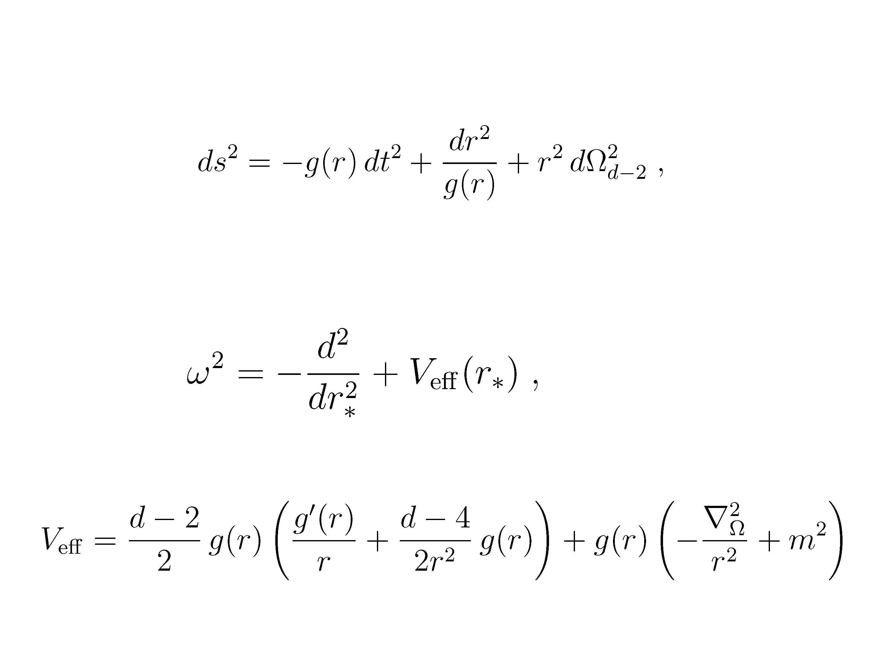

Slide 29
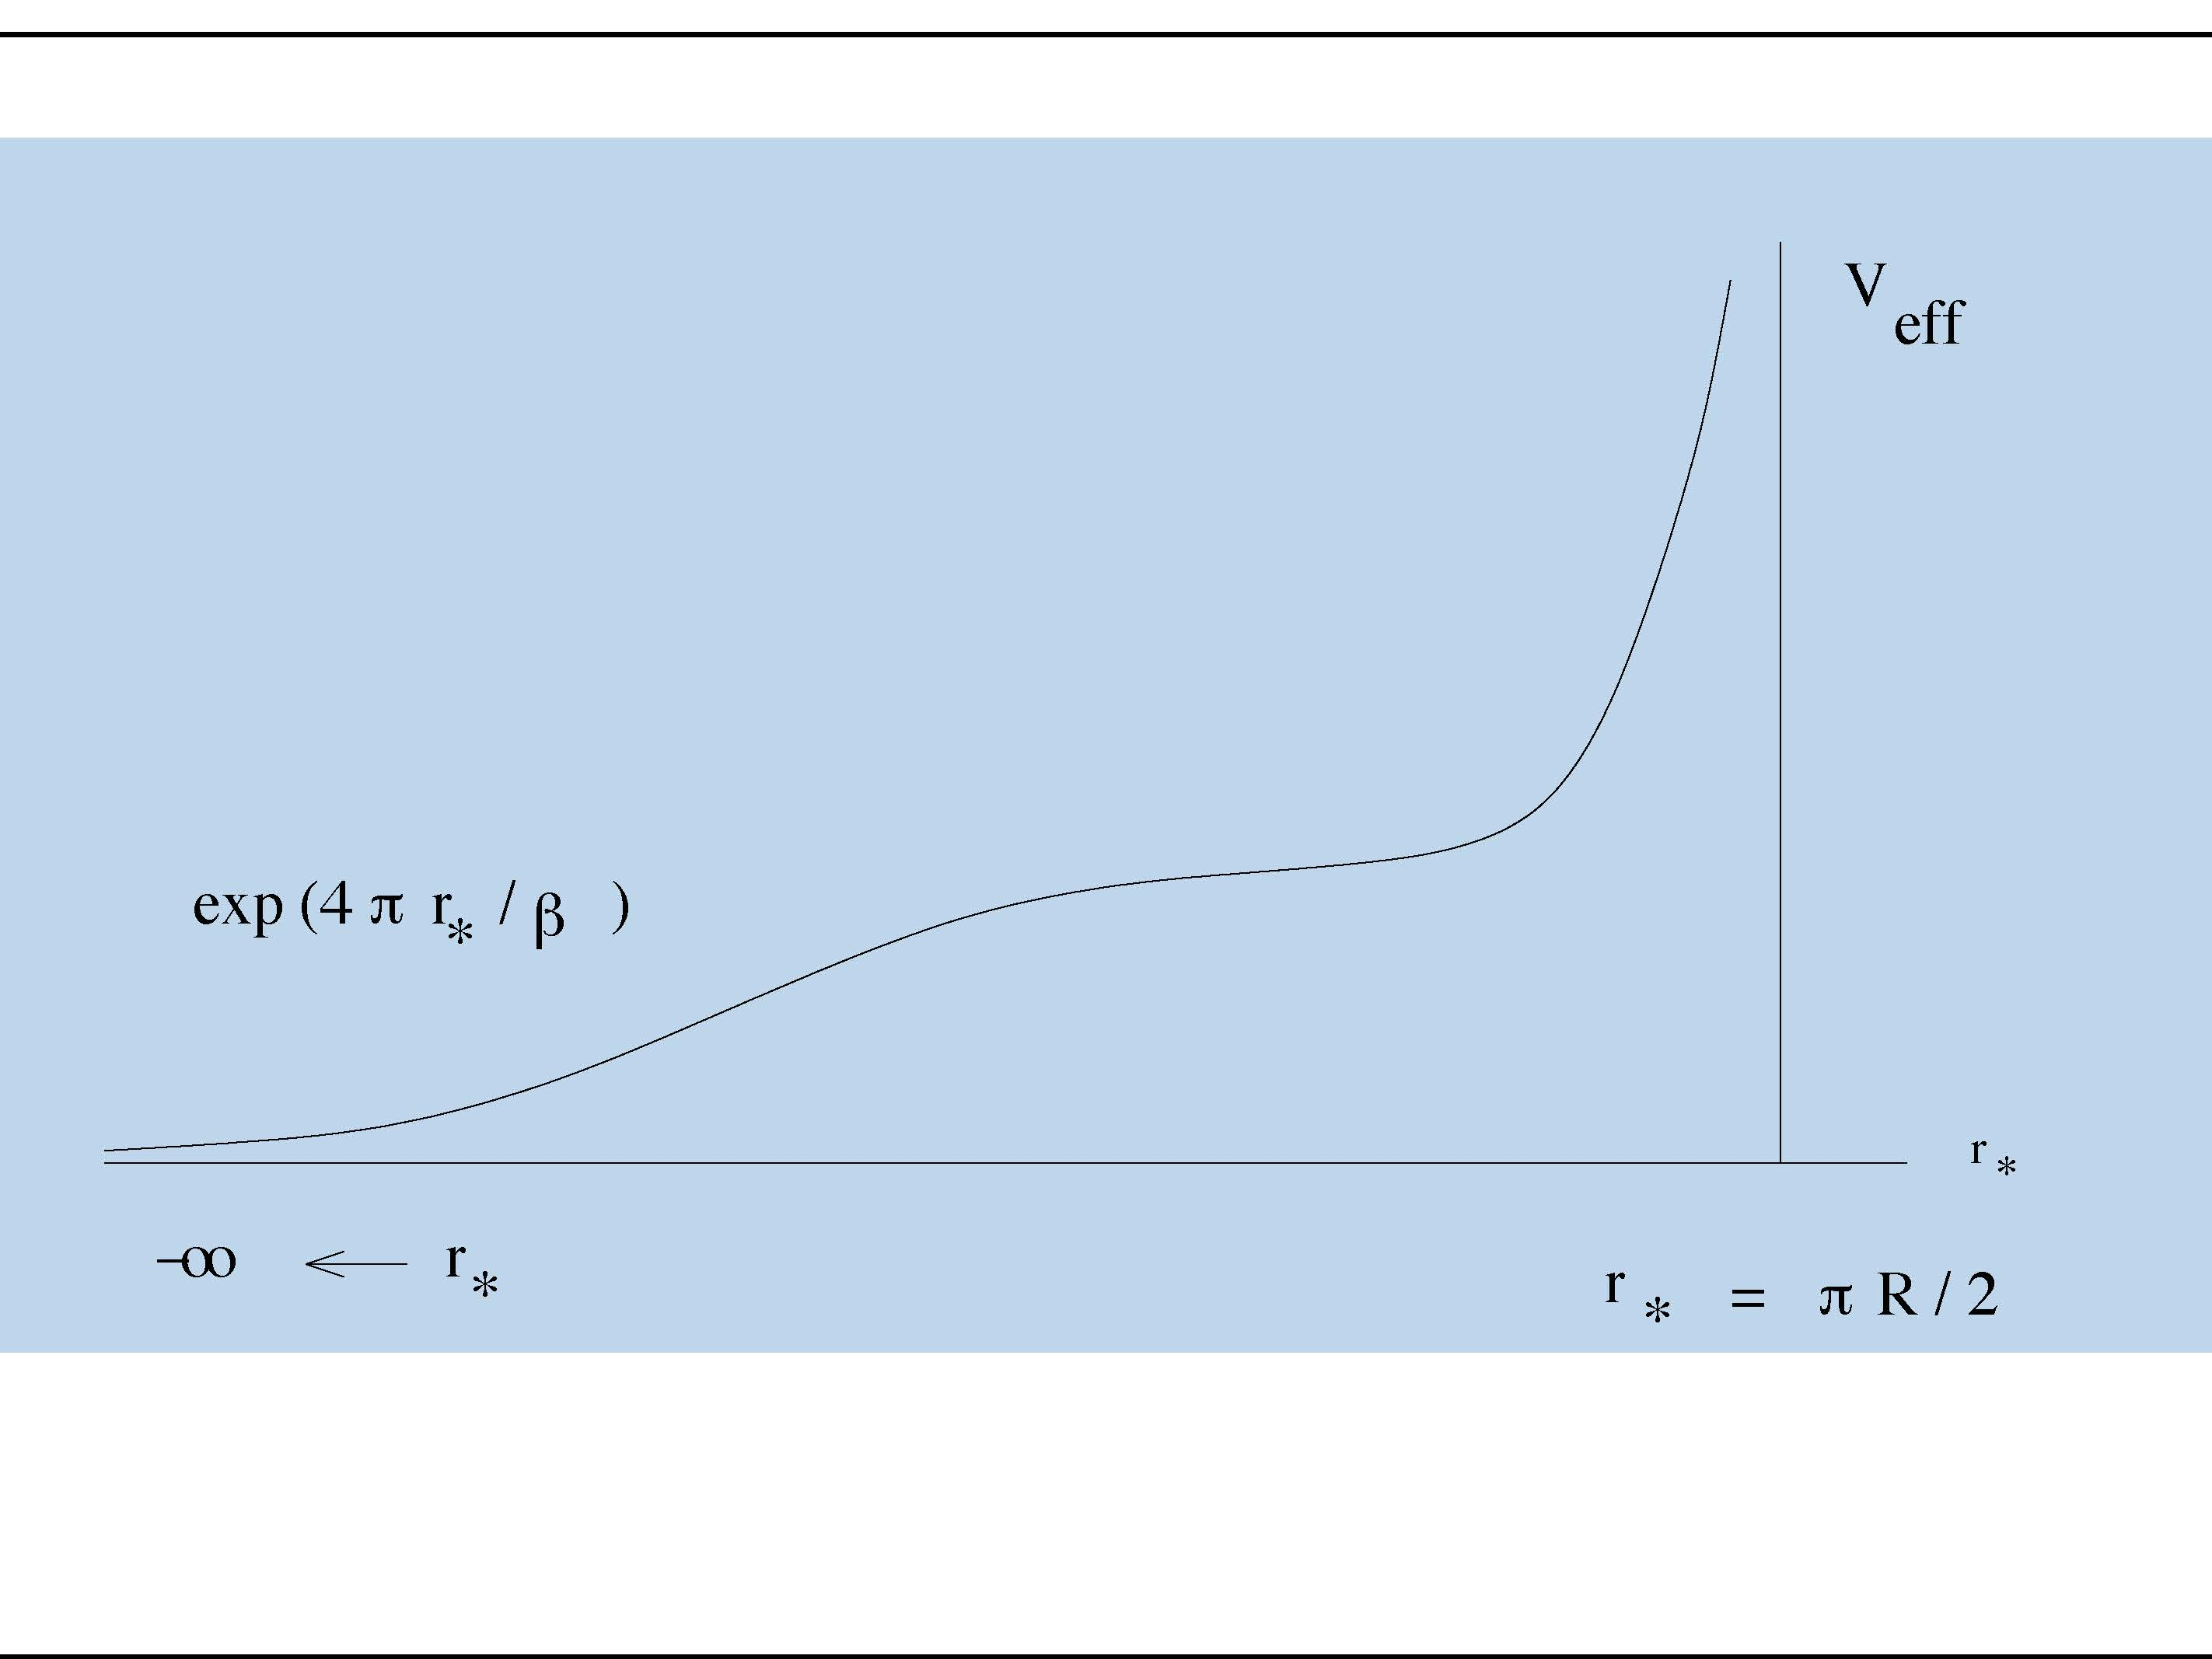

Slide 30
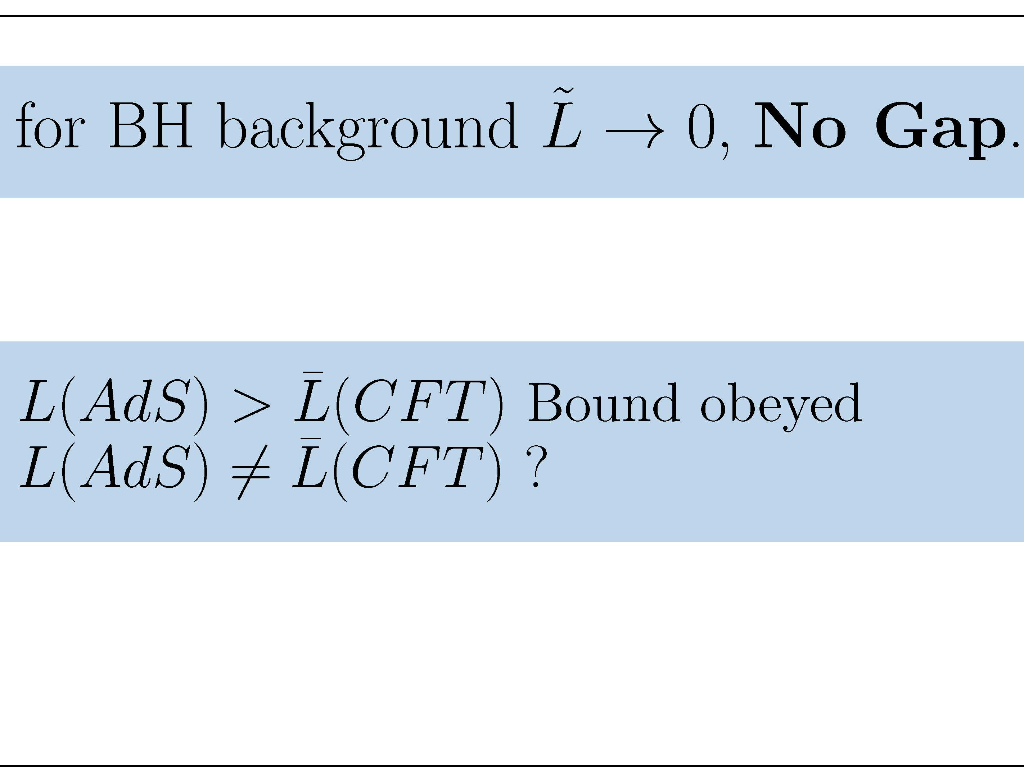

Slide 34
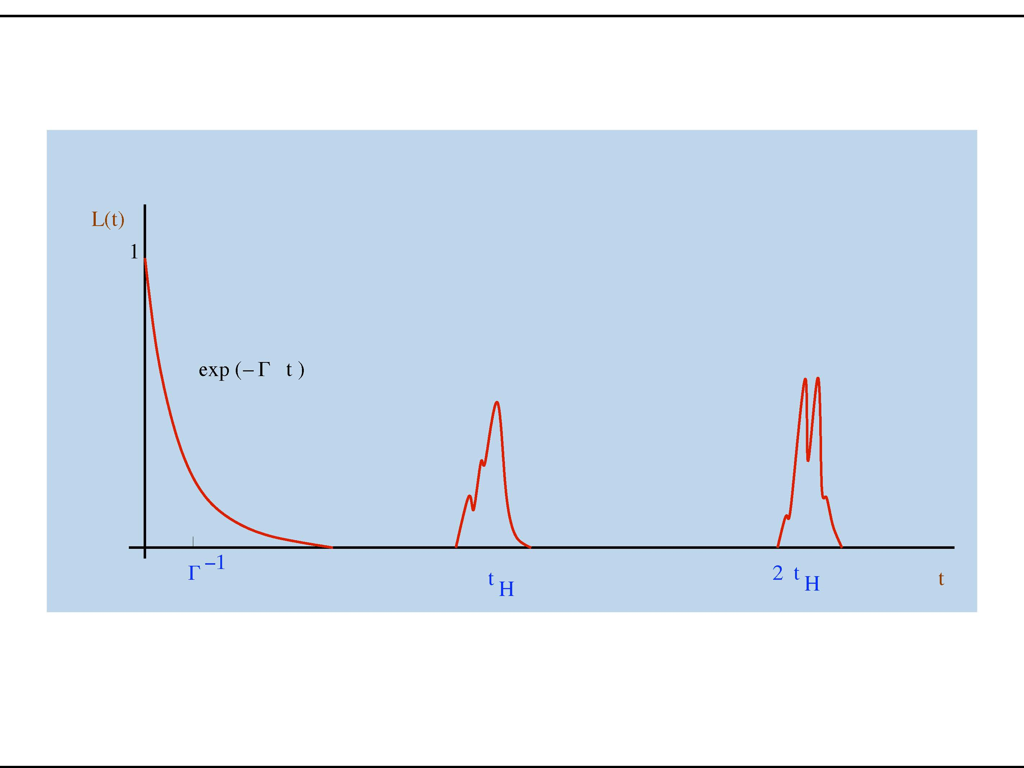

Slide 35
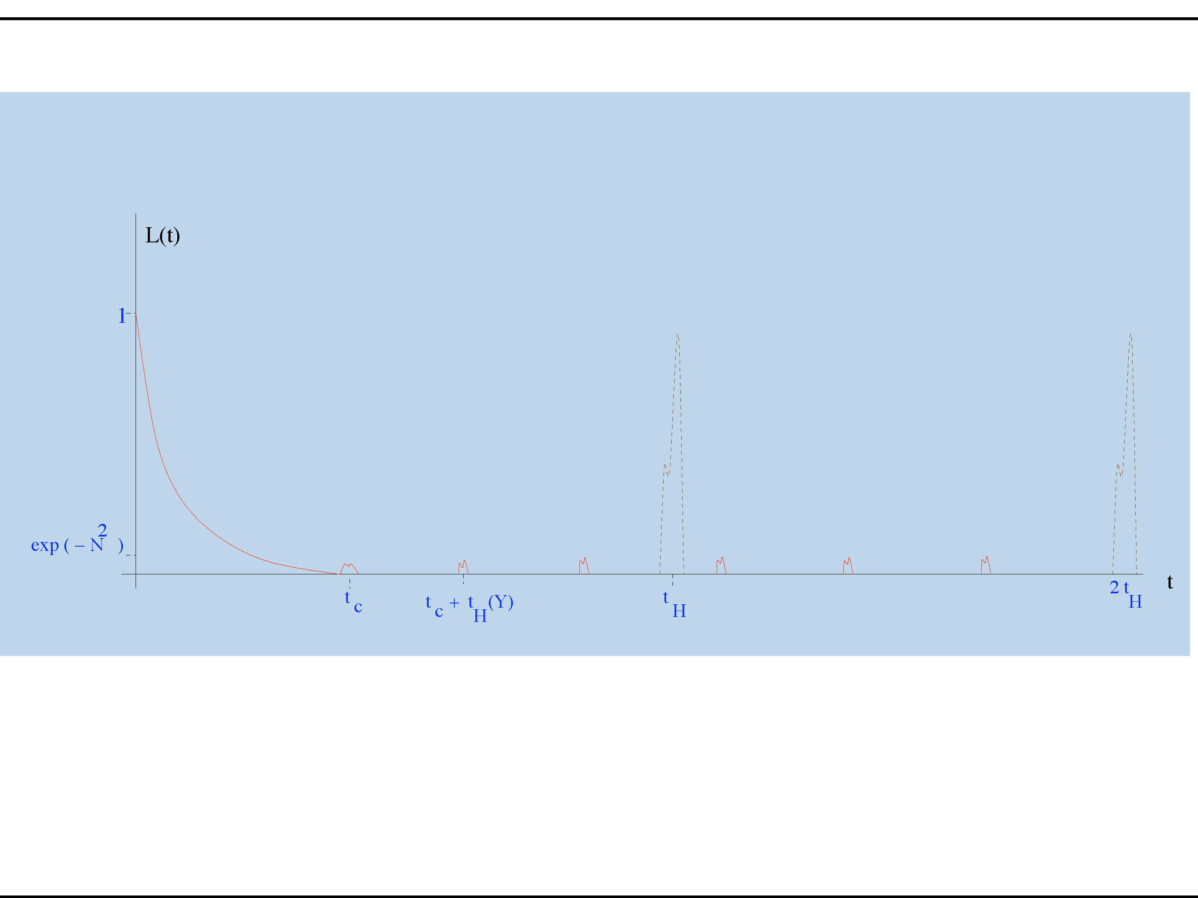

Slide 36
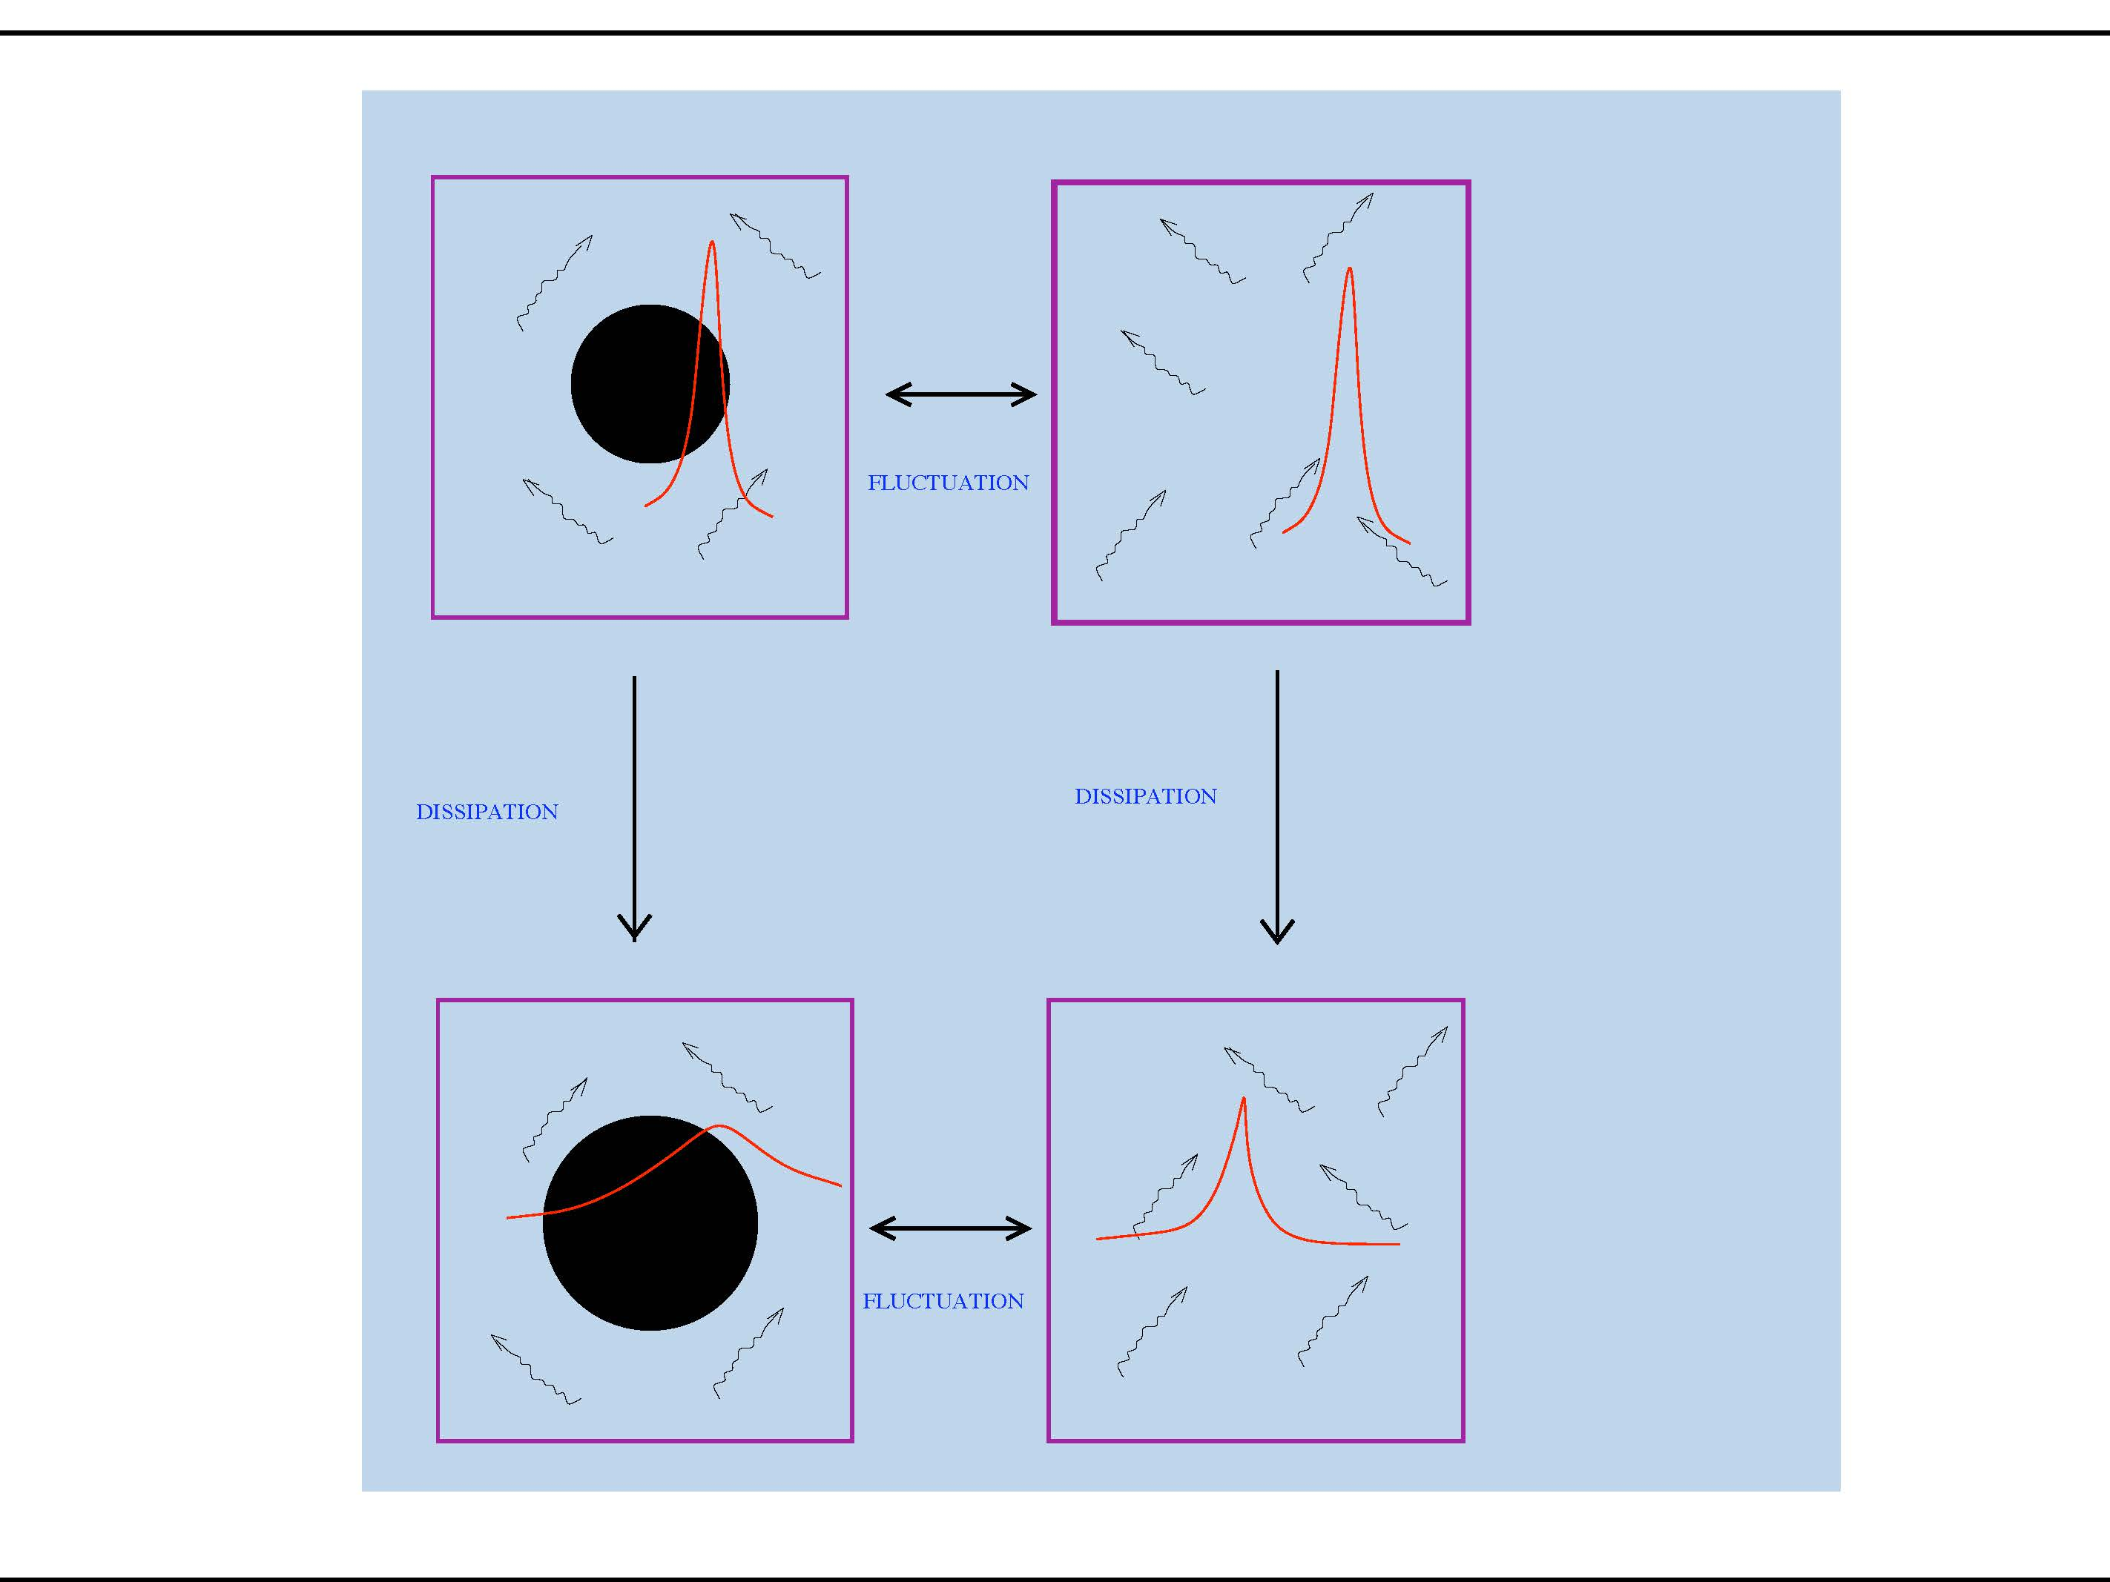

Slide 37
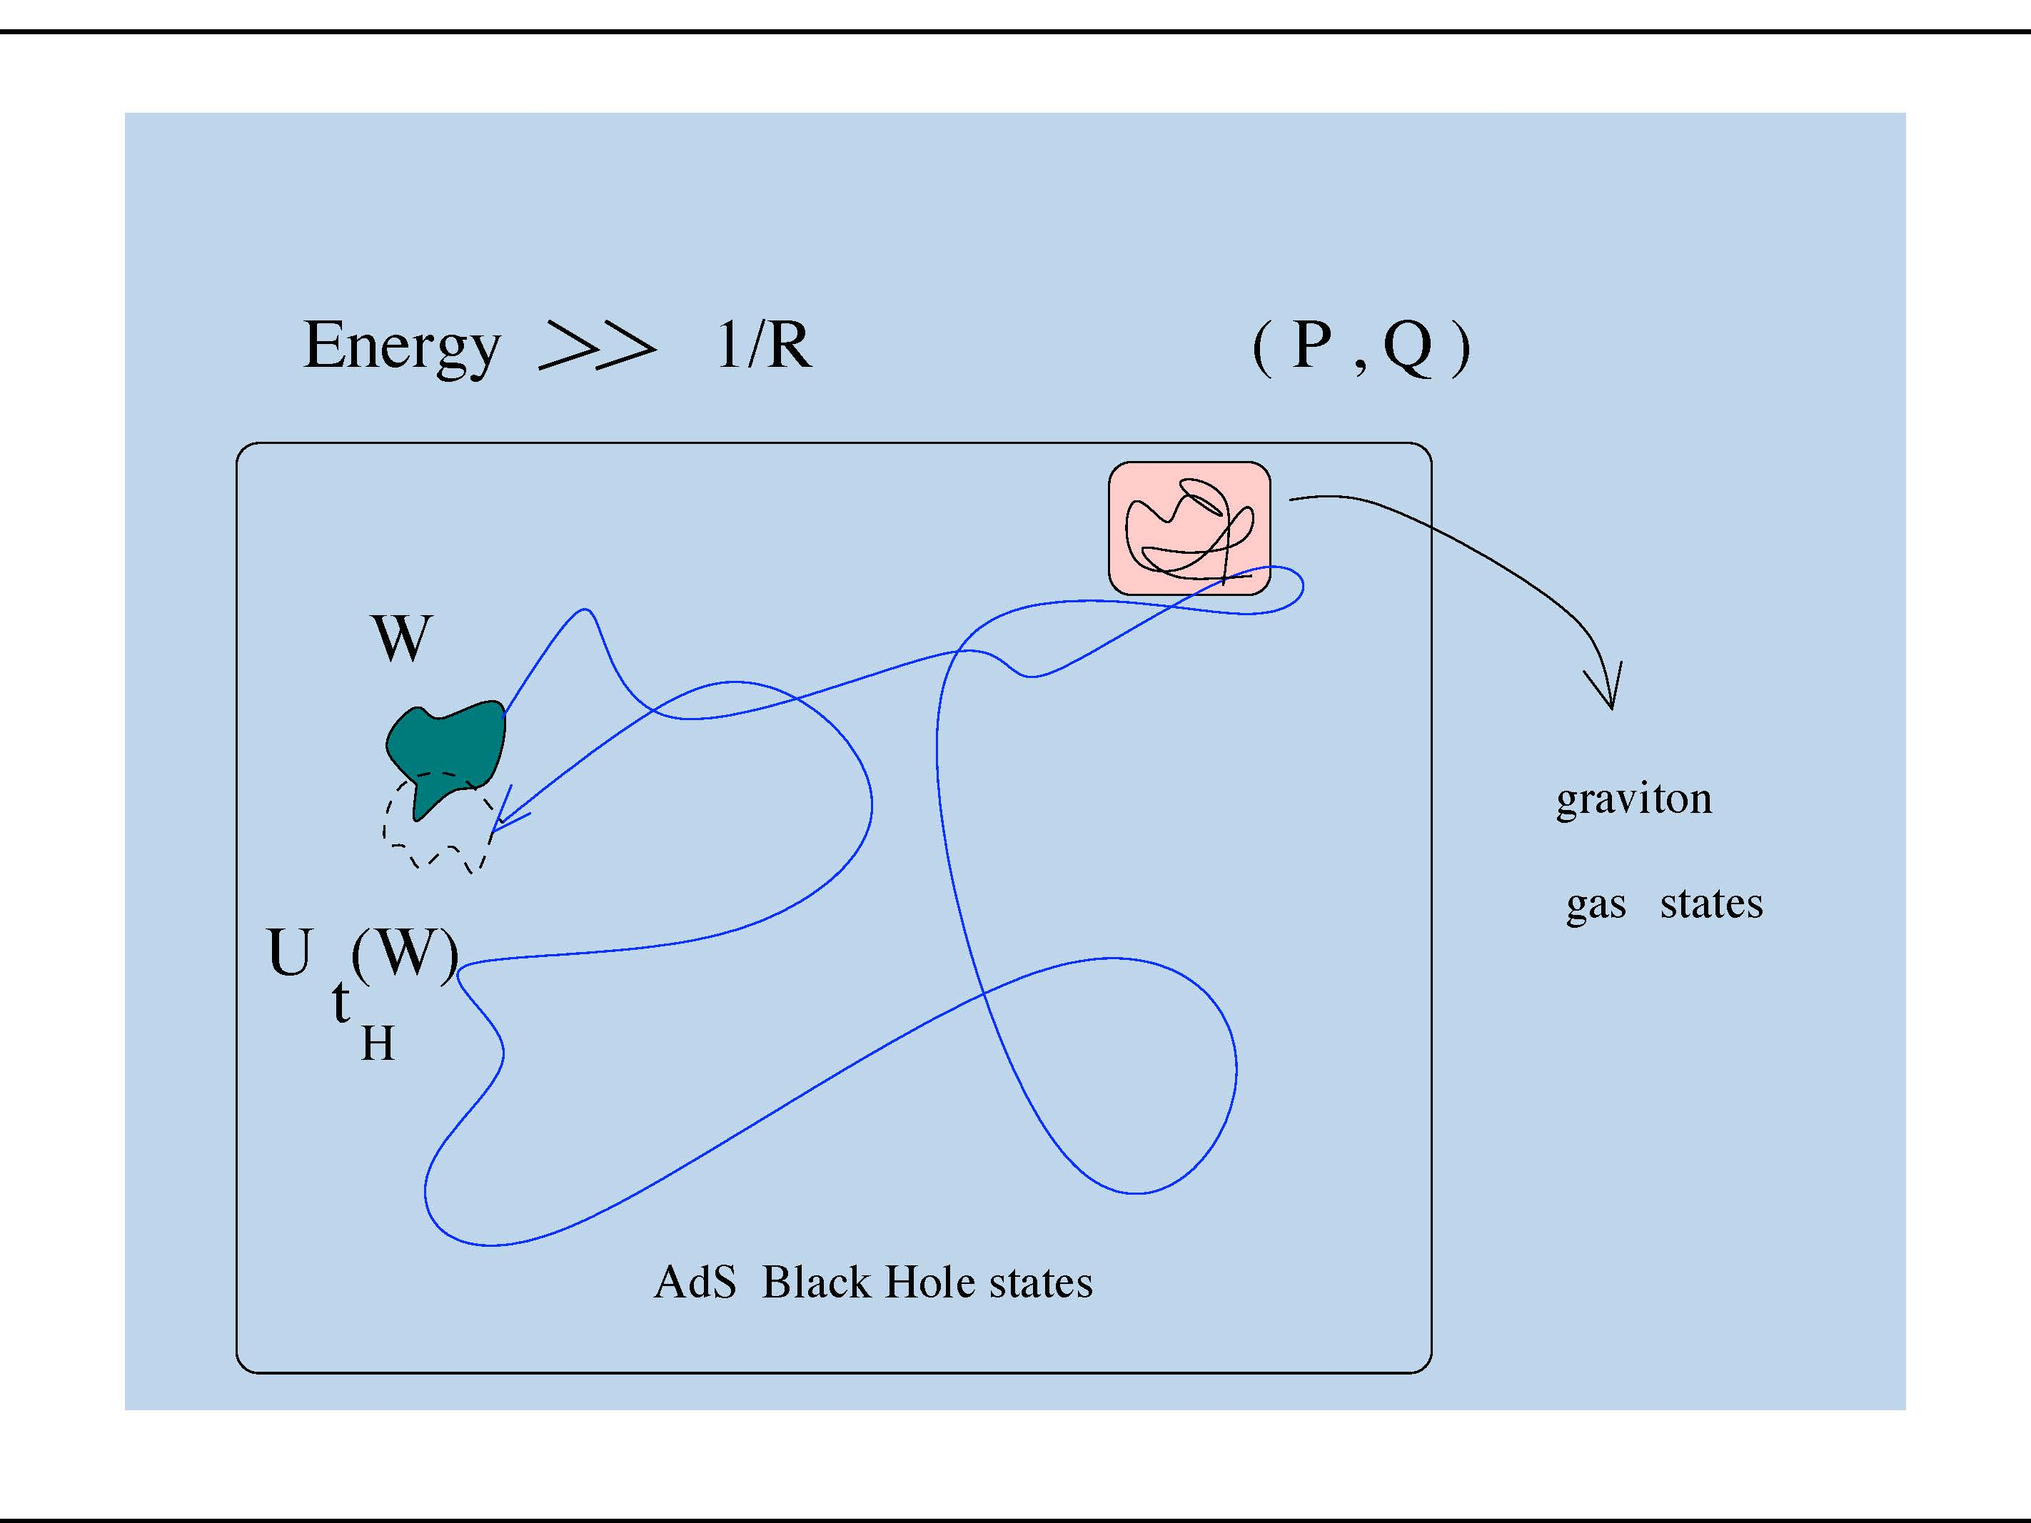

Slide 38
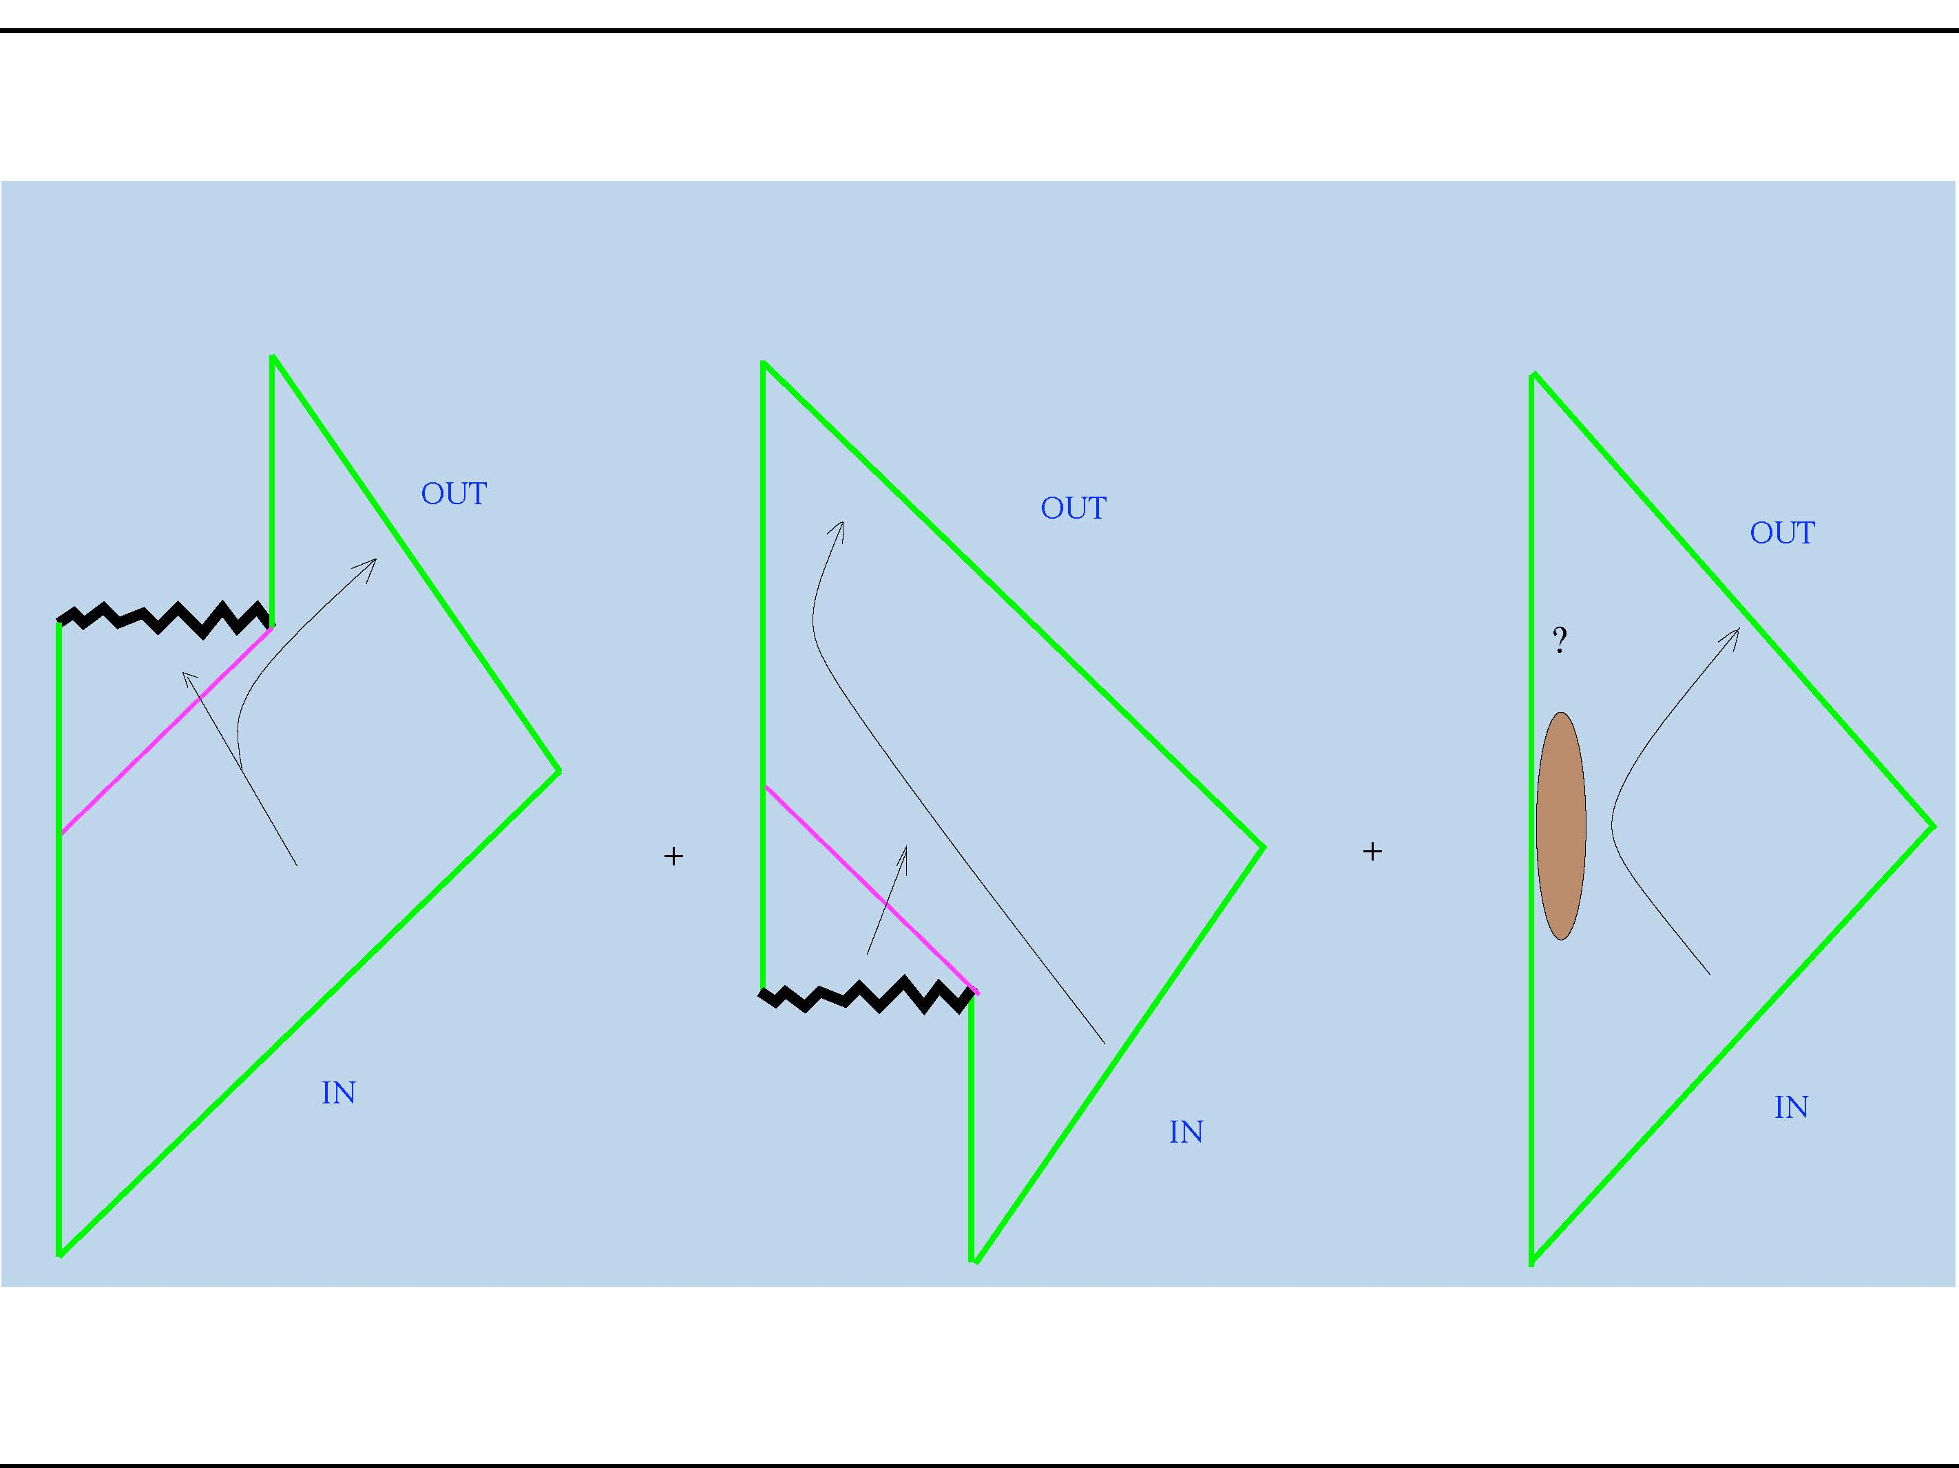

Slide 39
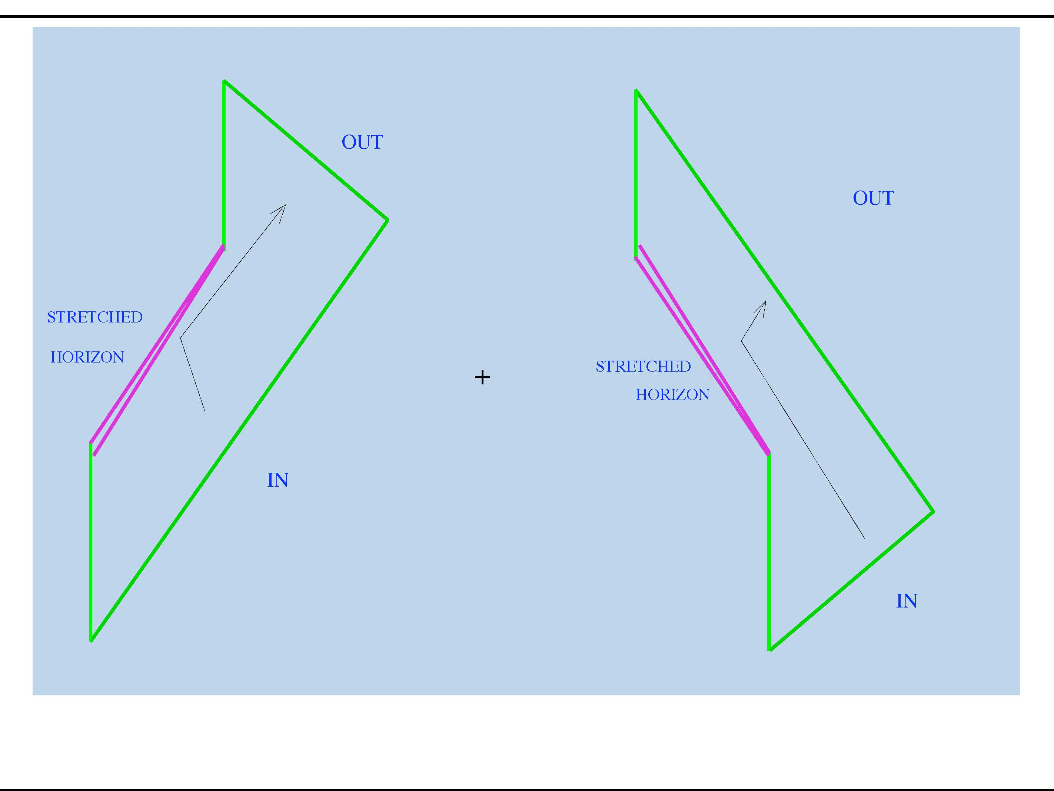

Slide 40
A hole punched in Hawking’s argument
Topological diversity
How to get an effective stretched horizon picture ?
Dimensional Transmutation Like QCD?

Slide 41
String Magic Metric R=1/R

Slide 42
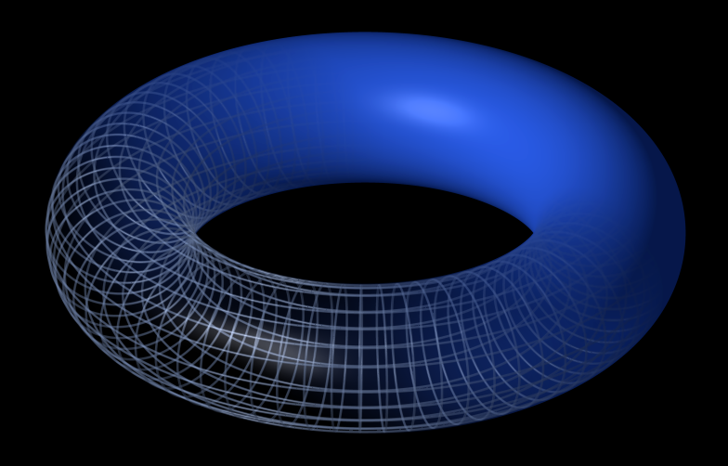
Magic of String Theory With extended objects Surface of a Sphere=Torus
Topology
=

Slide 43
Magic of String Theory With extended objects 1=3 , 4=10
Dimension

Slide 44
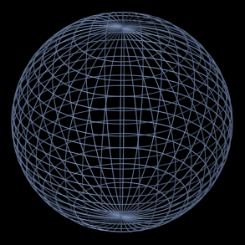
SU(2) dim=3, rank=1

Slide 45
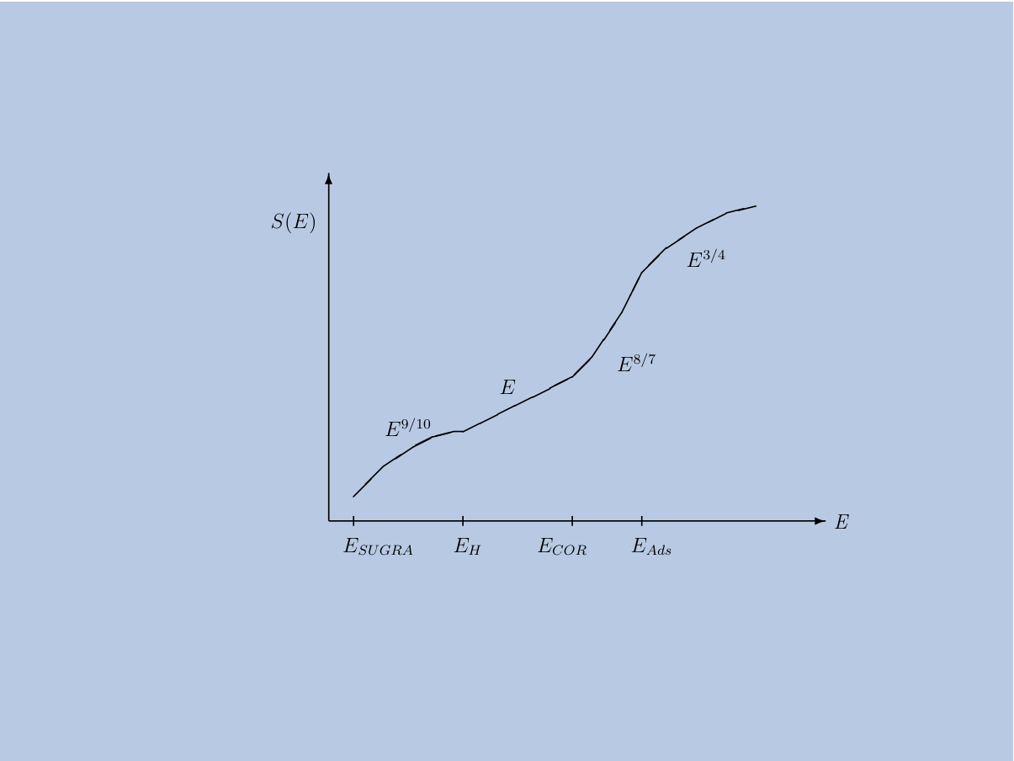

Slide 46
Magic of String Theory With extended objects
Singularities

Slide 48
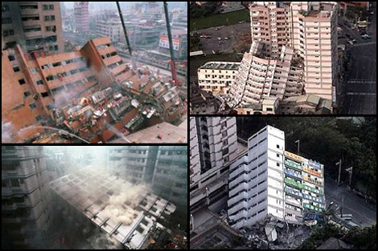
Magic of String Theory With extended objects
commutativity
[x,y]=0 =

Slide 50
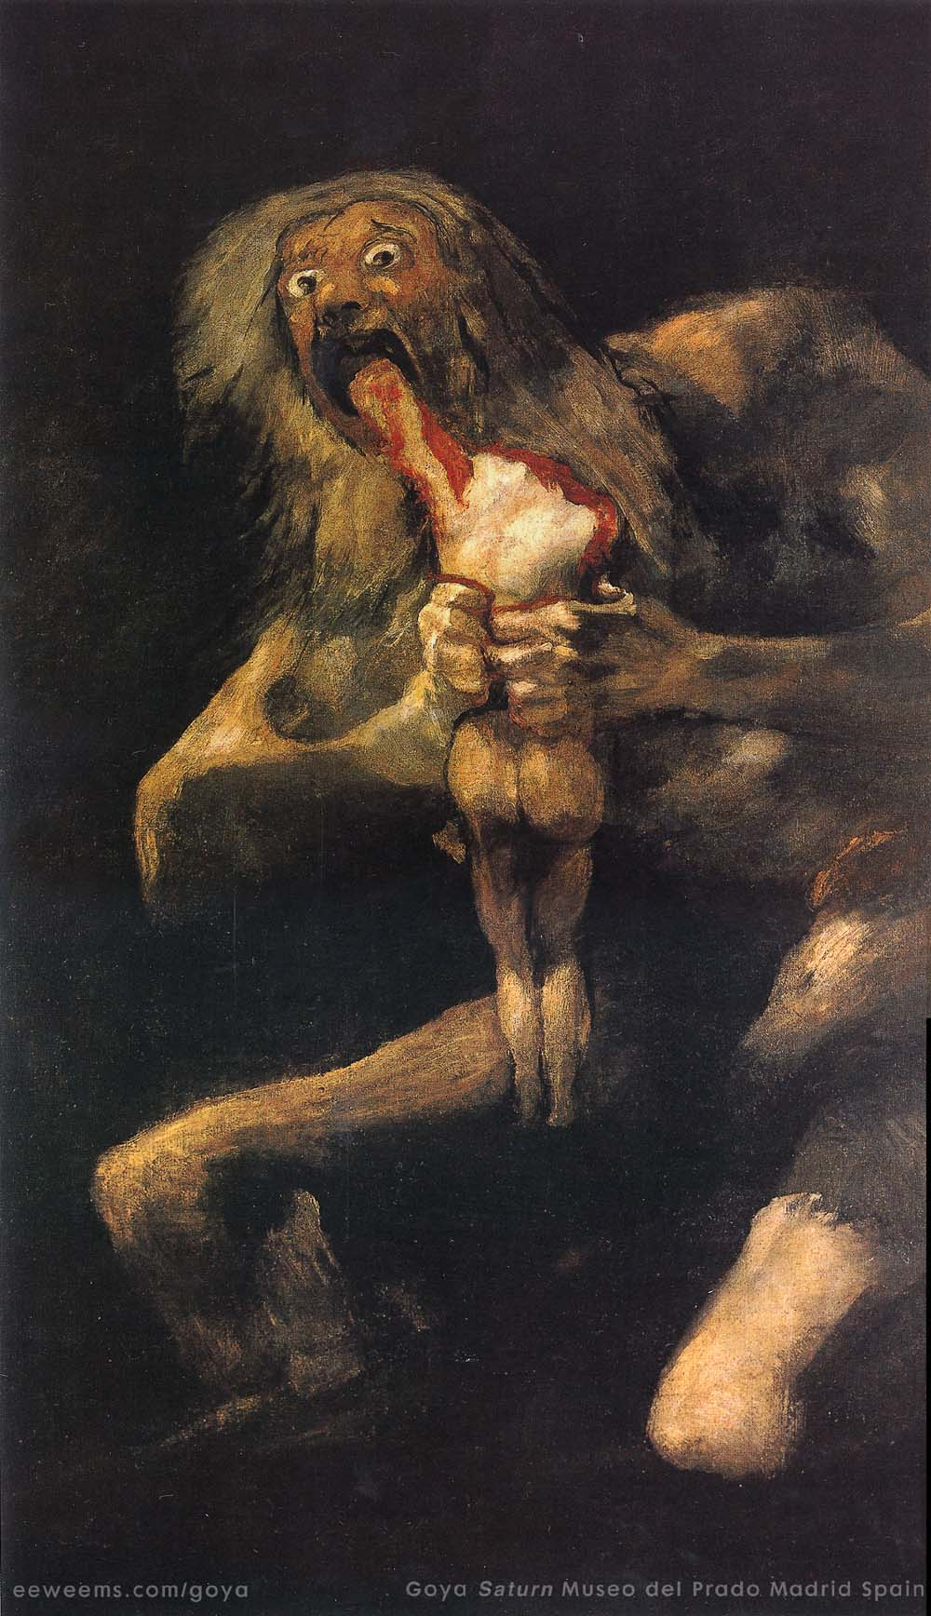

Slide 51
Magic of String Theory
Singularities are a reflection of a breakdown of an approximation.
Gravity has magic cloaks to hide its secrets
HORIZONS

Slide 53
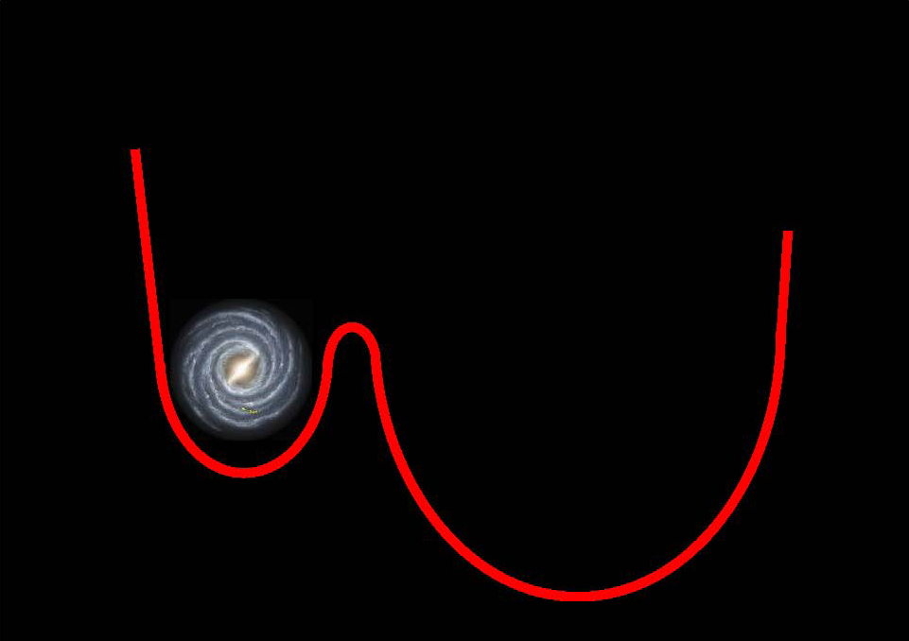

Slide 54
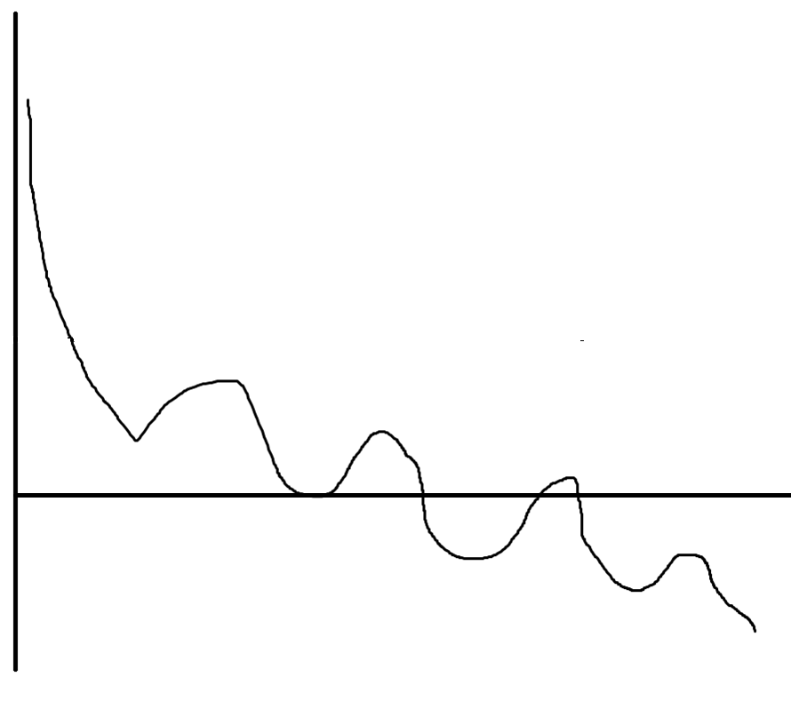
What you see is not what you get

Slide 55
+++++

Slide 60
IN FLAT SPACE FOR LARGE ENOUGH BUBBLE VOLUME BEATS SURFACE
IN ADS SPACE FOR LARGE ENOUGH BUBBLE VOLUME PROPORTIONAL TO SURFACE

Slide 61
Text
Text

Slide 62
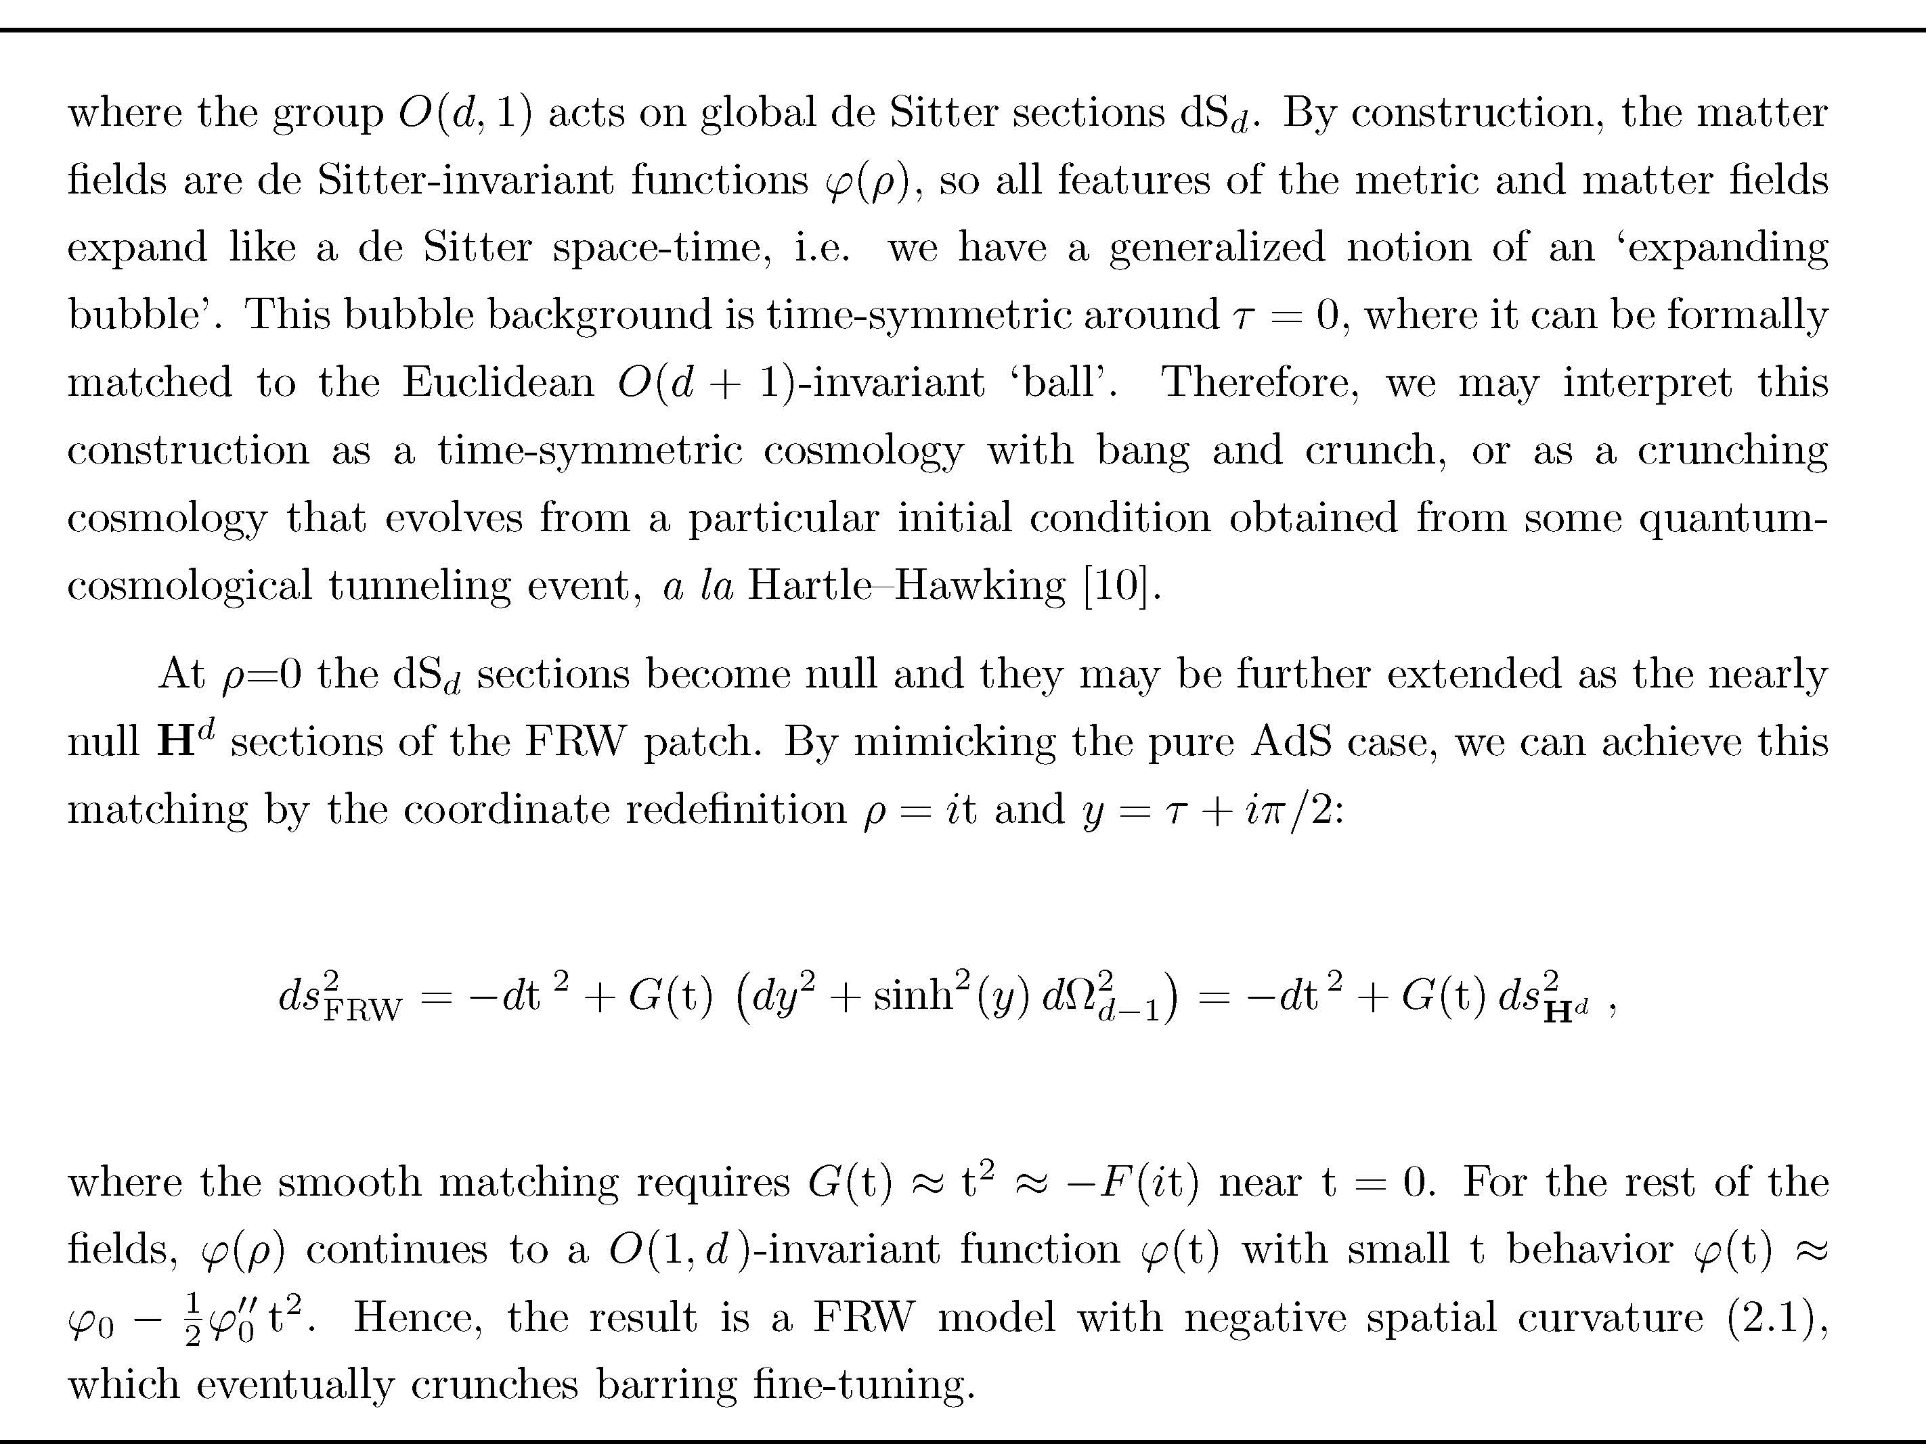
Text
Text

Slide 63
schematic diagram showing the analytic construction of the crunching FRW space- time, with H^{d} spatial sections, matching to the ‘bubble’ patch with dSd time-like sections, and finally the Euclidean ‘ball’ background, with S^{d} sections. The Euclidean piece is O(d + 1)- invariant, whereas the Lorentz-signature piece is O(d,1)-invariant. The grey line signals the radius ρ = ρO ∼ log ΛO , where the metric begins to differ significantly from the asymptotic AdS form. Equivalently, it is associated to the energy scale ΛO in the dual QFT.

Slide 64
-------
Text
-------
Text

Slide 65
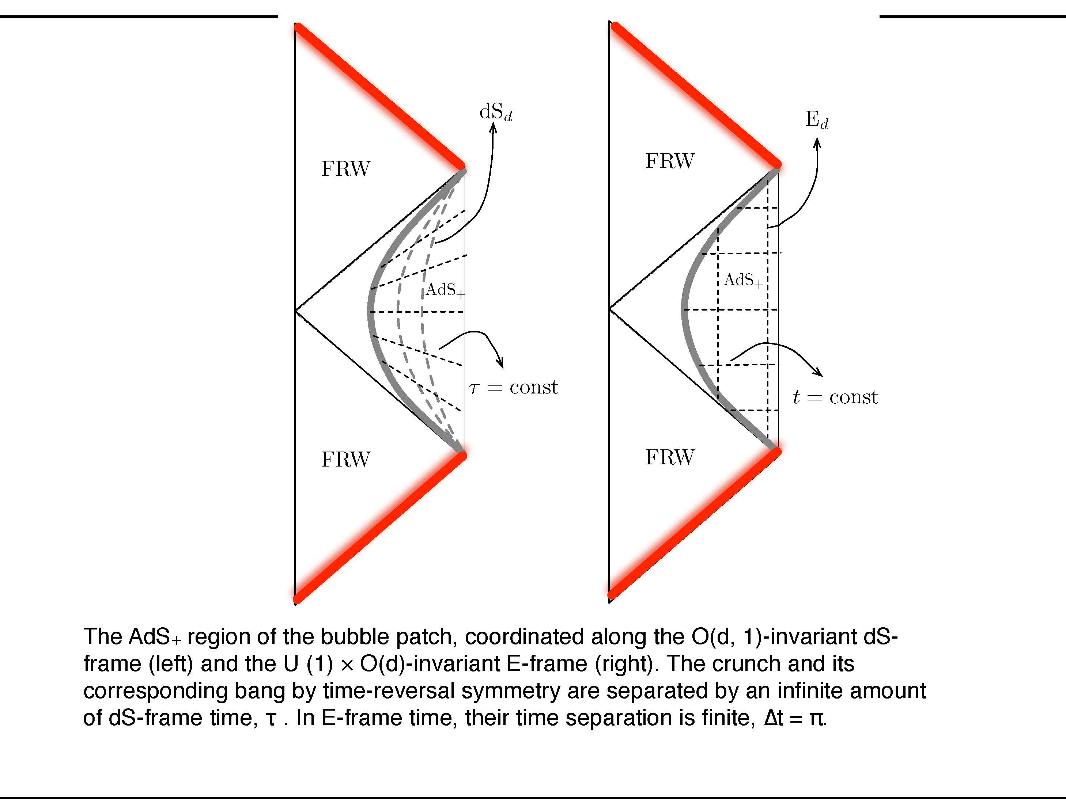
The AdS+ region of the bubble patch, coordinated along the O(d, 1)-invariant dS-frame (left) and the U (1) × O(d)-invariant E-frame (right). The crunch and its corresponding bang by time-reversal symmetry are separated by an infinite amount of dS-frame time, τ . In E-frame time, their time separation is finite, ∆t = π.

Slide 66
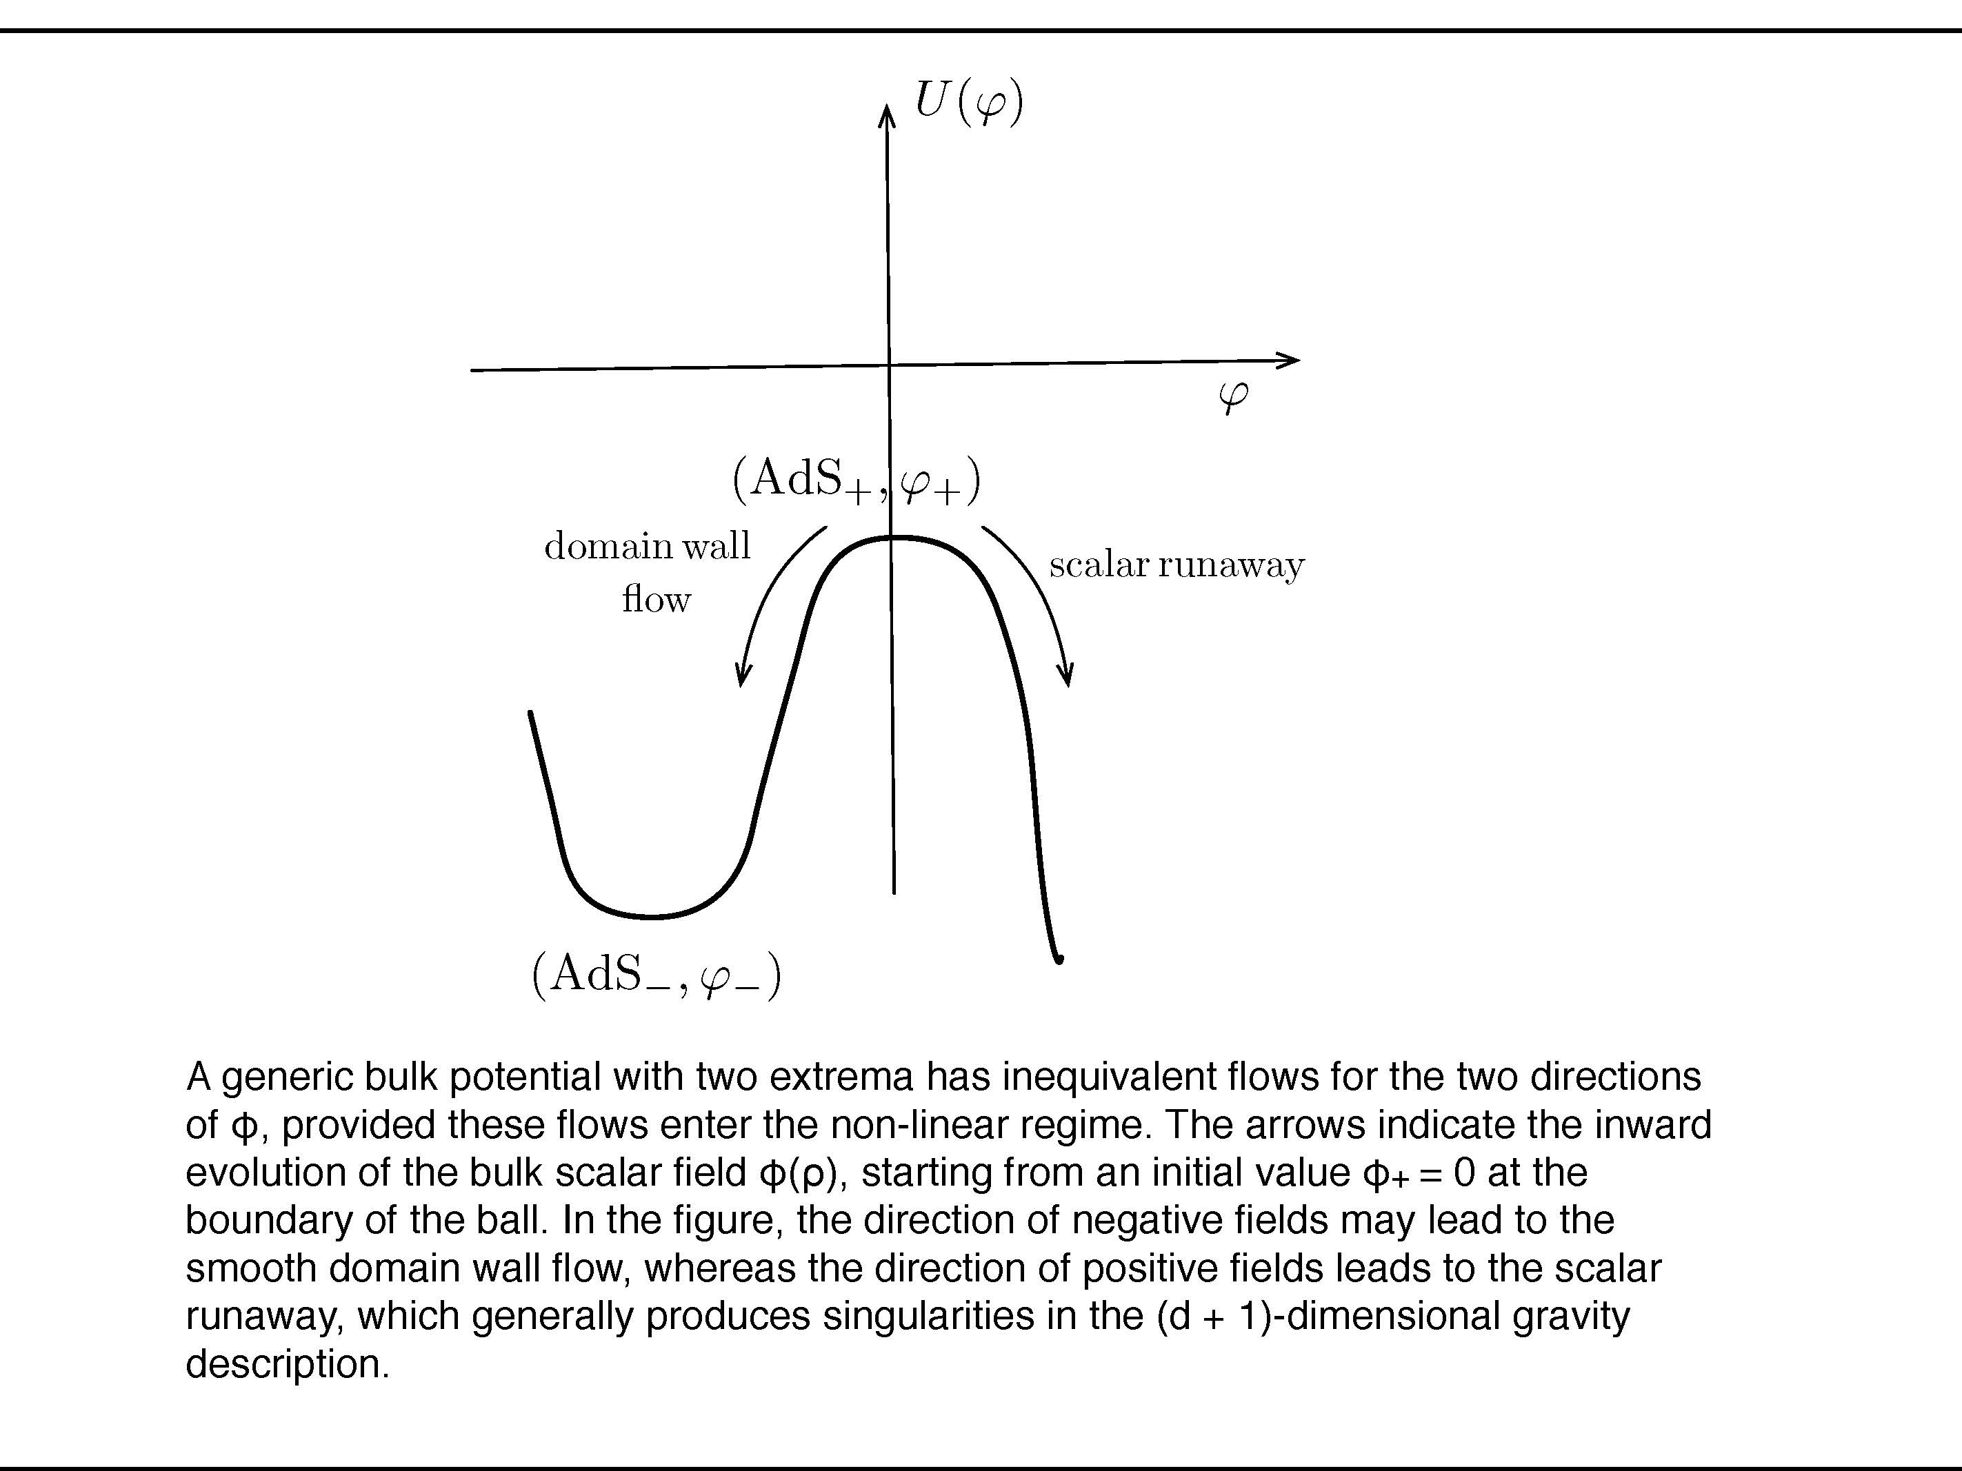
A generic bulk potential with two extrema has inequivalent flows for the two directions of φ, provided these flows enter the non-linear regime. The arrows indicate the inward evolution of the bulk scalar field φ(ρ), starting from an initial value φ+ = 0 at the boundary of the ball. In the figure, the direction of negative fields may lead to the smooth domain wall flow, whereas the direction of positive fields leads to the scalar runaway, which generally produces singularities in the (d + 1)-dimensional gravity description.

Slide 67
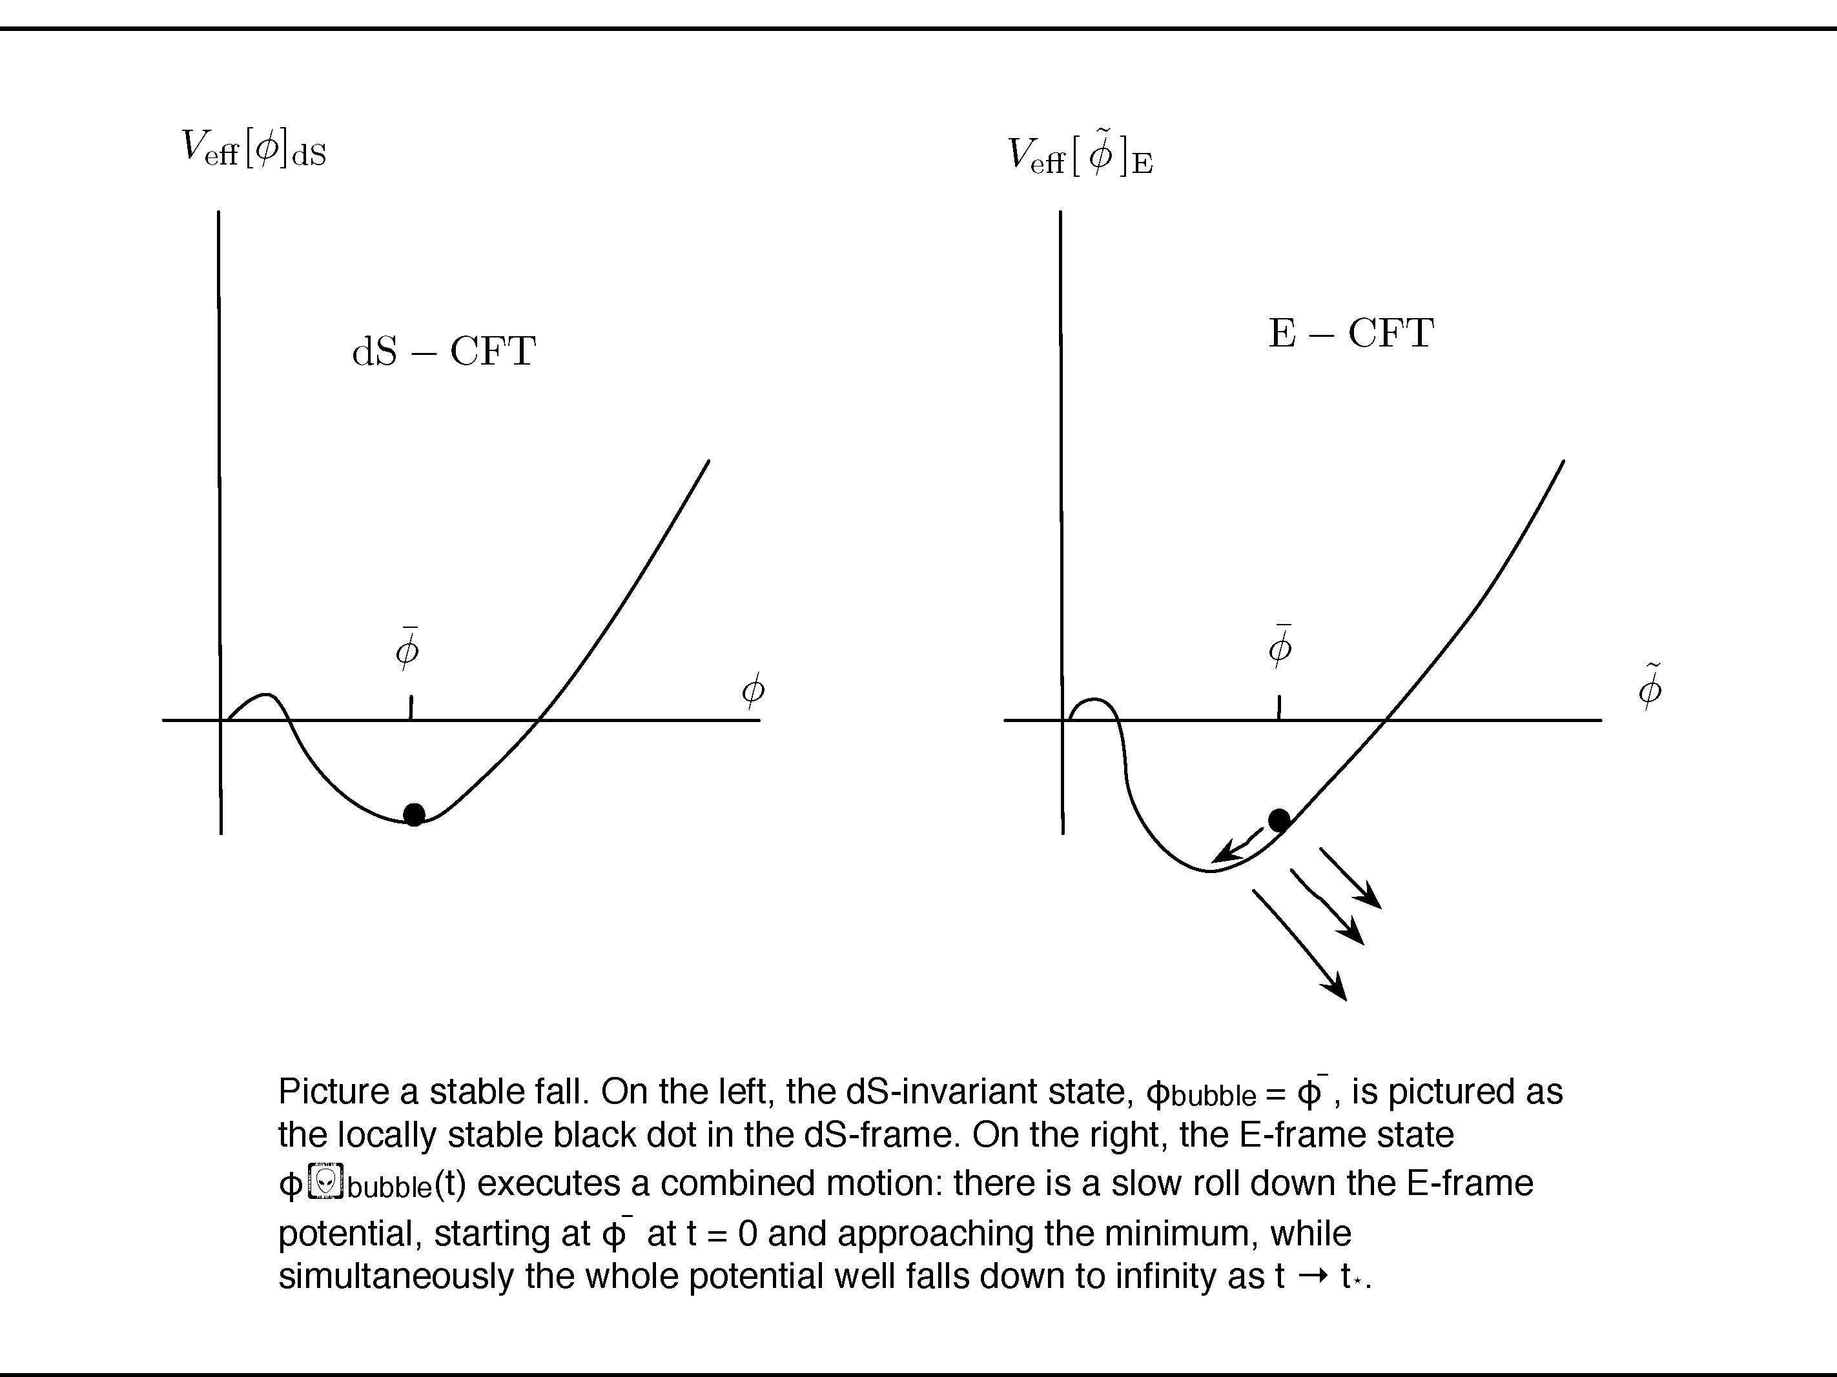
Picture a stable fall. On the left, the dS-invariant state, φbubble = φ ̄, is pictured as the locally stable black dot in the dS-frame. On the right, the E-frame state φ􏰆bubble(t) executes a combined motion: there is a slow roll down the E-frame potential, starting at φ ̄ at t = 0 and approaching the minimum, while simultaneously the whole potential well falls down to infinity as t → t⋆.

Slide 68
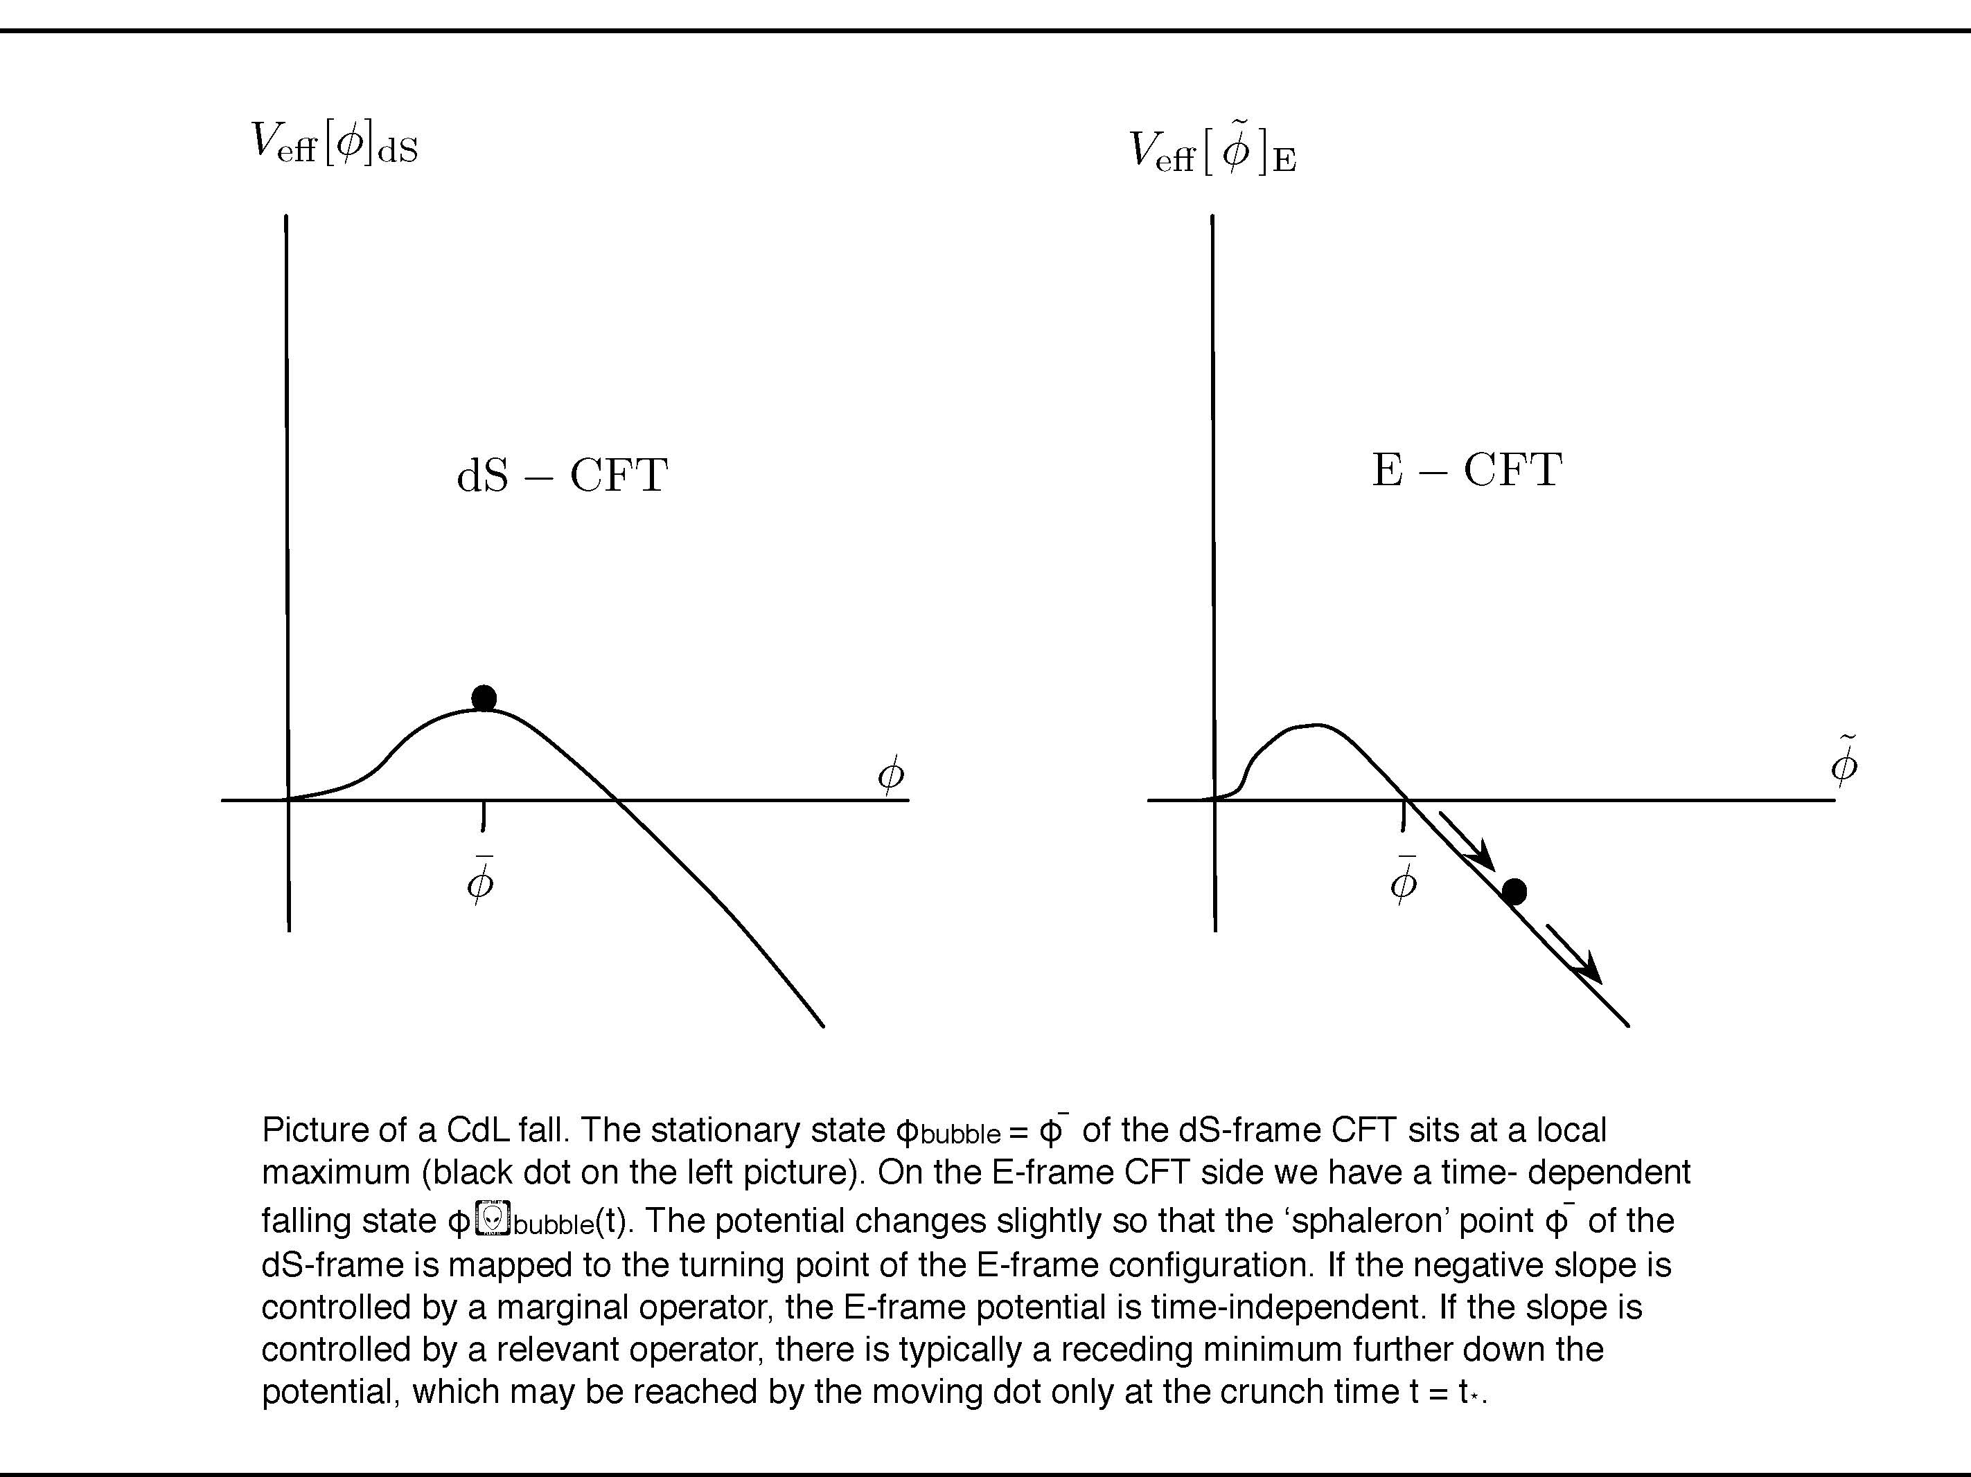
Picture of a CdL fall. The stationary state φbubble = φ ̄ of the dS-frame CFT sits at a local maximum (black dot on the left picture). On the E-frame CFT side we have a time- dependent falling state φ􏰆bubble(t). The potential changes slightly so that the ‘sphaleron’ point φ ̄ of the dS-frame is mapped to the turning point of the E-frame configuration. If the negative slope is controlled by a marginal operator, the E-frame potential is time-independent. If the slope is controlled by a relevant operator, there is typically a receding minimum further down the potential, which may be reached by the moving dot only at the crunch time t = t⋆.

Slide 69
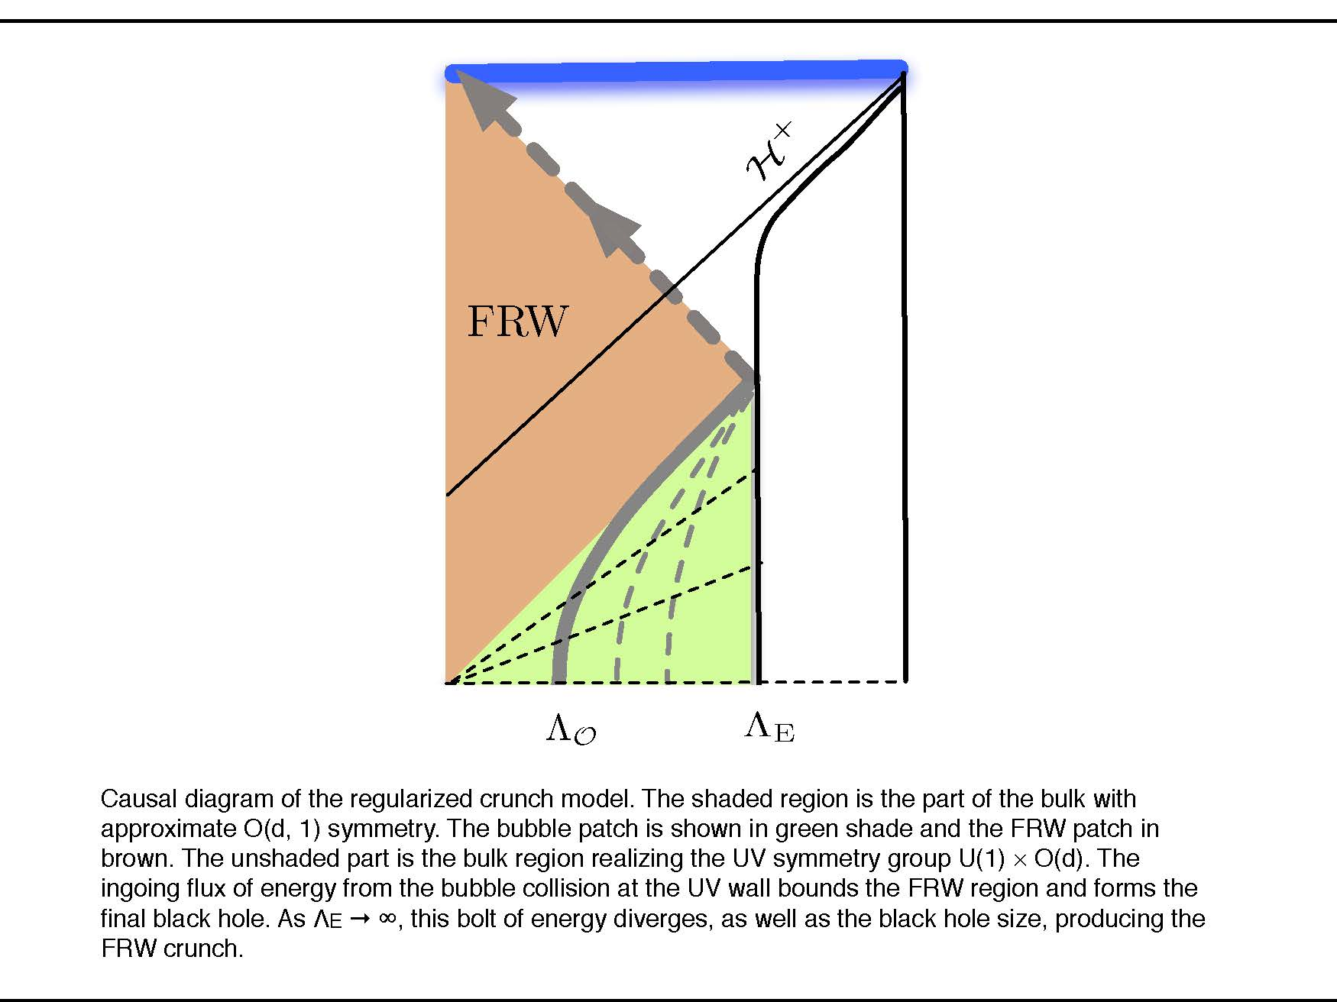
Causal diagram of the regularized crunch model. The shaded region is the part of the bulk with approximate O(d, 1) symmetry. The bubble patch is shown in green shade and the FRW patch in brown. The unshaded part is the bulk region realizing the UV symmetry group U(1) × O(d). The ingoing flux of energy from the bubble collision at the UV wall bounds the FRW region and forms the final black hole. As ΛE → ∞, this bolt of energy diverges, as well as the black hole size, producing the FRW crunch.

Slide 71
DUALITY
COMPLEMENTARITY
STRETCHED HORIZON

Slide 72
ありがとう
תודה רבה

Slide 73
Algebra, matrices and representations to replace geometry ?

Slide 75
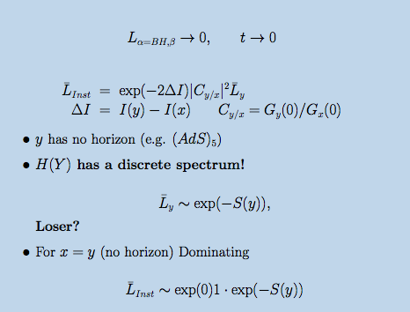

Slide 76
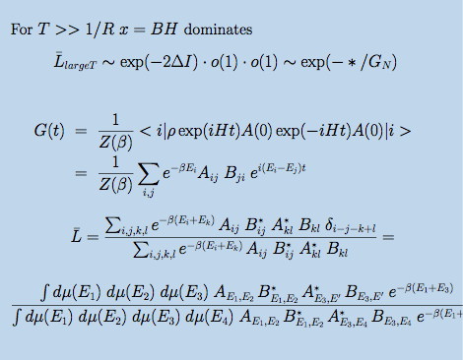

Slide 77
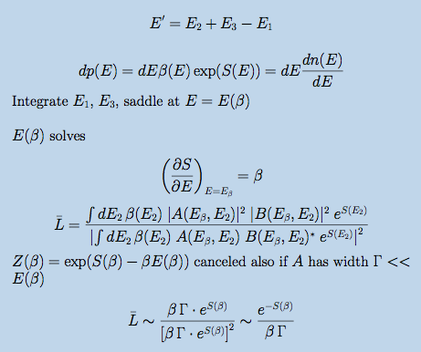

Slide 78
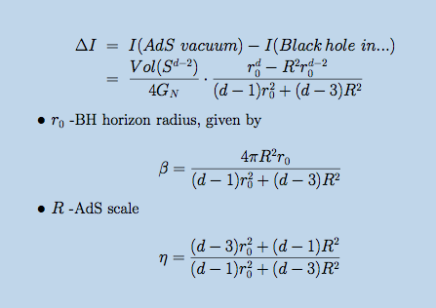

Slide 79
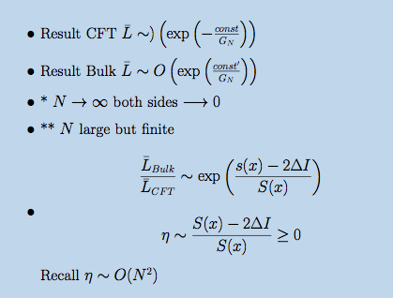

Slide 82
Magic of String Theory
No concept in Math remains unambiguous

Slide 83
Magic of String Theory With extended objects Large=Small
Metric

Slide 84
Magic of String Theory With extended objects 1=3 , 4=10
Dimension

Slide 85
Magic of String Theory

Slide 86
Magic of String Theory With extended objects
[x,y]=0
commutativity
Non commutative [s,t] ≠ 0

Slide 87
Confirming Prejudices and Encountering Surprises in the Study of the AdS/CFT correspondence. Based on work with J.L.F Barbon
February 14, 2012

