Slide 1
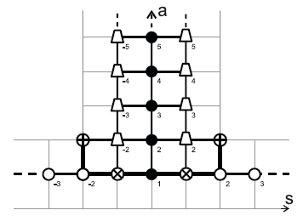

Exact spectrum of 4D gauge theories from integrability
Nikolay Gromov
Based on works with V.Kazakov, F. Levkovich-Maslyuk,
S.Leurent, P.Vieira, D.Volin, D.Serban, Z.Tsuboi

Slide 2

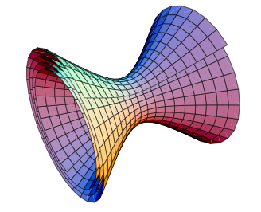
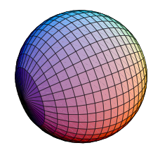
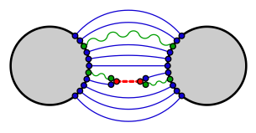

(type IIB super) string theory in AdS5xS⁵
x
Maldacena
is dual to a 4 dimensional conformal field theory (N=4 SYM)
Local operators String states

Slide 3
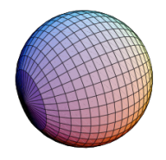
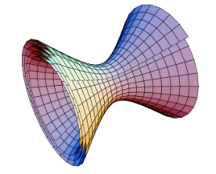
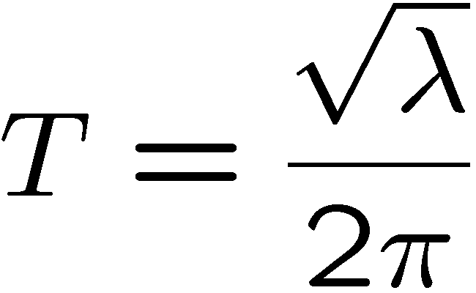
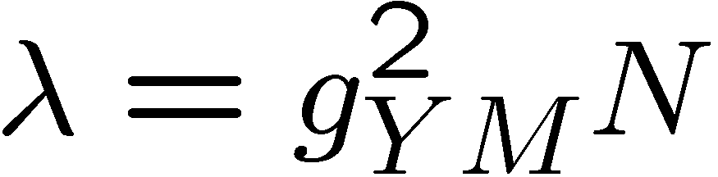
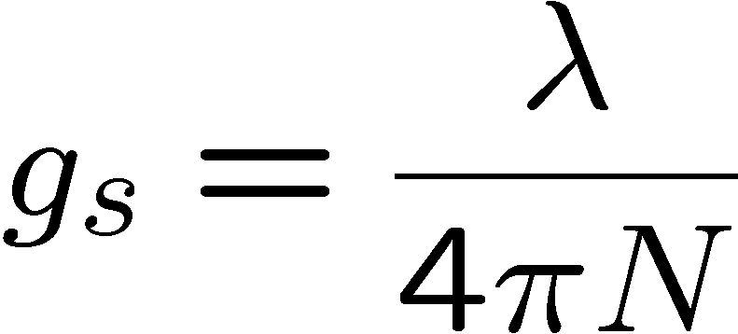
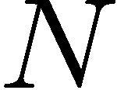

x
String tension
`t Hooft coupling
String coupling
Number of colors
We will mainly focus on
limit
i.e. planar limit in YM, and free strings

Slide 4
Lipatov
Faddeev,Korchemsky
Minahan,Zarembo,
Beisert,Kristijanssen,Staudacher
Bena,Roiban,Polchinski
Kazakov,Marshakov, Minahan,
Zarembo, Frolov, Tseytlin
Beisert,Kazakov,Sakai,Zarembo
NG,Vieira
Arutyunov,Frolov,Staudacher
Staudacher, Beisert
Janik
Hernandez,Lopez
Roiban, Tseytlin
Beisert,Eden,Staudacher
Ambjorn,Janik,Kristijanssen
Arutyunov,Frolov
Bajnok,Janik
NG , Kazakov, Vieira
Bombardelli,Fioravanti, Tateo
NG , Kazakov,Vieira
Arutyunov, Frolov
Aharony, Bergman, Jafferson, Maldacena
Minahan,Zarembo,
NG , Vieira
Babichenko,Stefanski,Zarembo
Origins of YM integrability: Lipatov’s BFKL Hamiltonian
Perturbative integrability in N=4 SYM
Classical integrability of string ϭ-model on AdS₅×S⁵
Finite gap solution and quasilcassics
S-matrix, asymptotic Bethe ansatz (ABA). Cusp dimension
Finite size corrections and mirror model
Y-system for all operators at all couplings, Konishi dimension
numerics
TBA for AdS/CFT, confirming and clarifying the Y-system
New integrable AdS/CFT’s: AdS4/CFT3, AdS3/CFT2,.....
Notes:
4

Slide 5

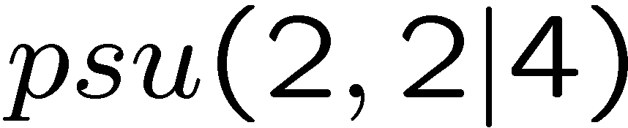
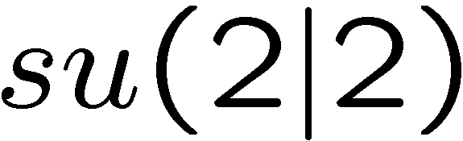
SU(N) Super Yang-Mills :
`t Hooft coupling
Anomalous dimensions of YM = spectrum of 2D integrable field theories
Symmetry:
In string theory:
Fixing light-cone gauge:
No Lorenz symmetry
No worldsheet conformal symmetry
No psu(2,2|4) symmetry
S-matrix is well defined
S-matrix factorizes – “only” 256 components

Slide 6
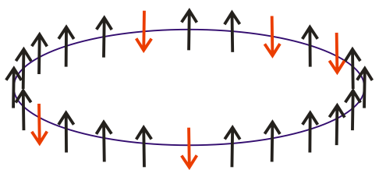
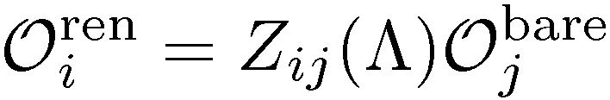
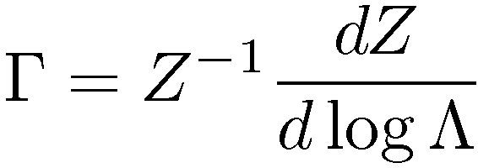
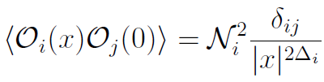
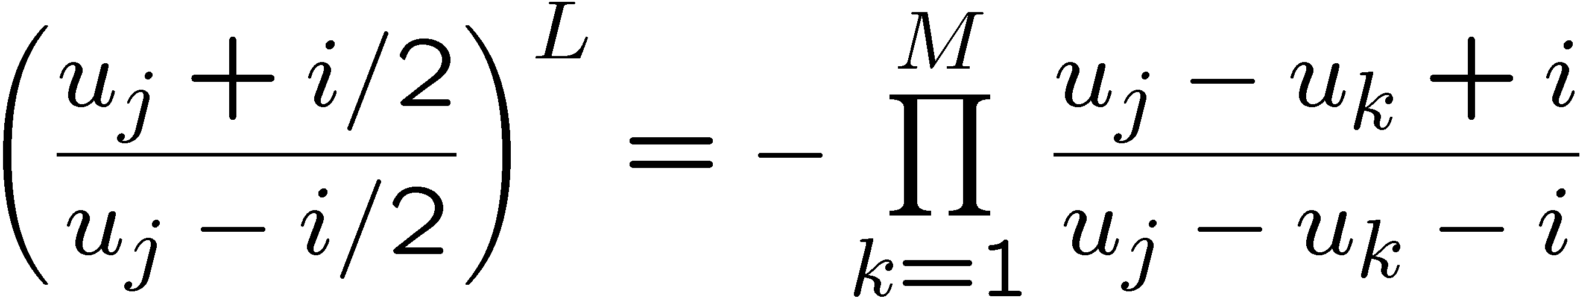
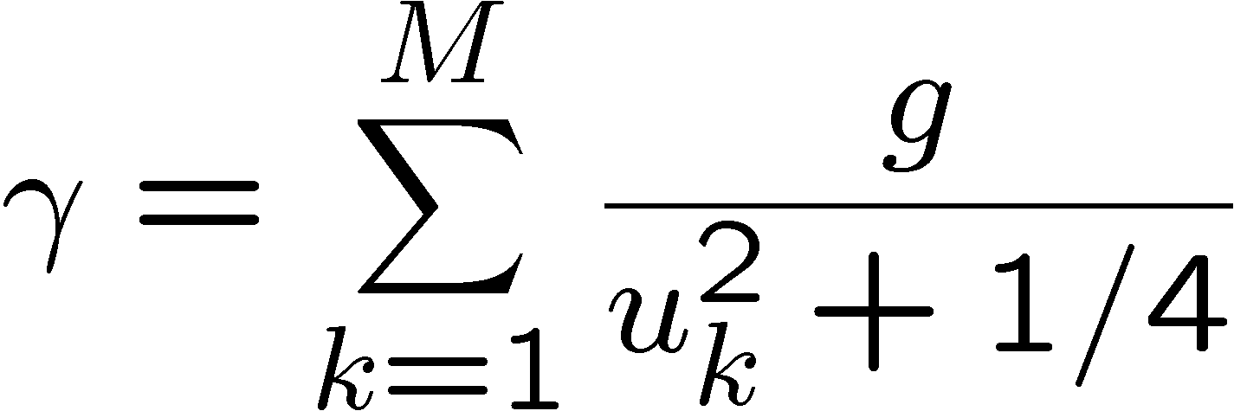
- Mixing matrix –
integrable Hamiltonian
At one loop:
[Minahan, Zarembo 2002&2008]

Slide 7
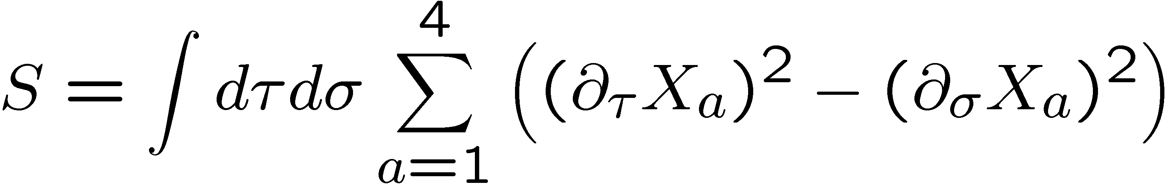
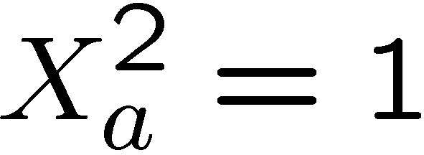
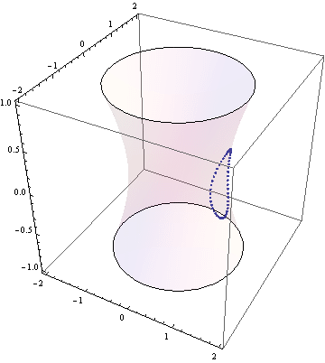
The scalar fields are constrained
Motion of the string:

Slide 8
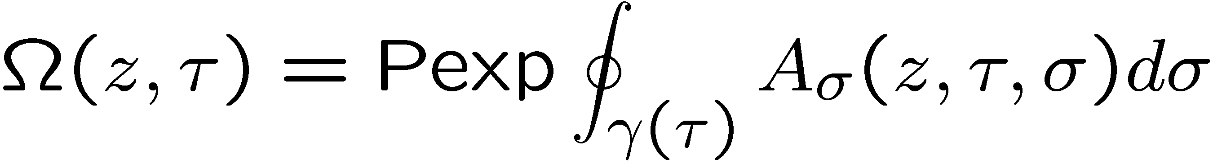
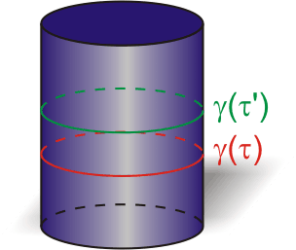
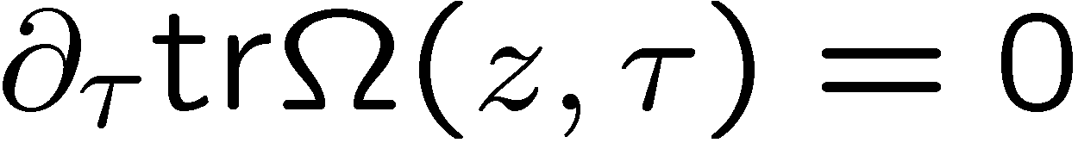
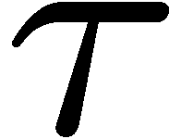
on equations of motion
Bena, Polchinski, Roiban;
Kazakov, Marshakov, Minahan, Zarembo;
Eigenvalues = integrals of motion

Slide 9
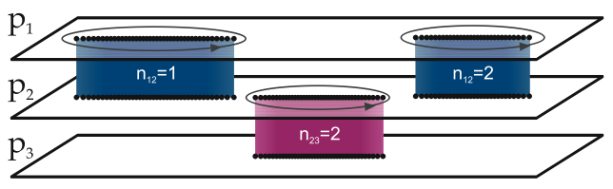
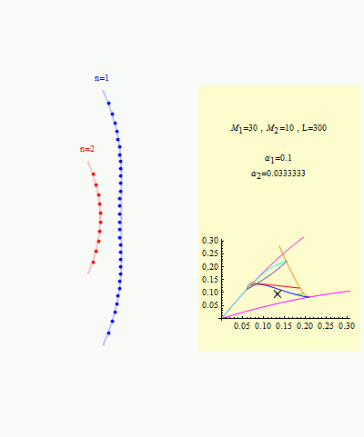

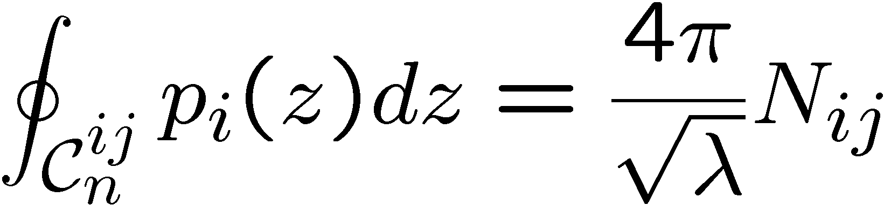
According to Beisert, Kazakov, Sakai and Zarembo, we can map a classical string motion to an 8-sheet Riemann surface

Slide 10
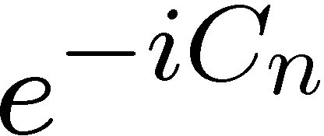
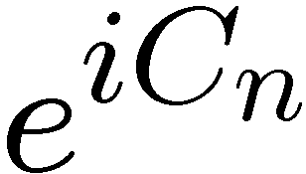
S
S
S
S
S
Yang-Baxter equation
S
S
p1
p2
p3
p1
p2
p3
p1
p2
p3
Notes:
Consider some 3 particle scattering.
Initially the 3 particles are very far from each other then all three of them enter into interaction domain.
Due to the quantum unsertainty the we have no good description of the system in that moment
where the particles could exchange some virtual quanta and number of particles could change inside that domain,
Hovewer asymptotically when the particles are again far from each other we know the general statement that their number finally should be the same as before.
Instead of going inside the domain where the tree particles are close to each other and trying to understand what is
really happening there we can do a simple trick. We can act on the initial state by an approriate combination of
conserved chages to displace the initial particles so that only paiwise interaction happens. Having this picture in mind we can expect that the 3 particle scattering can be infact be replaced by a 3 consequent 2 particle scatterings.
The 3 particle scattering could be however expressed in two different ways. And that one more constraing
on the scattering matrix.
We conclude that in integrable theories we only need 2 particle S matrix and moreover the 2 particle S matrix is constrained by a Yang-Baxter relation.

Slide 11
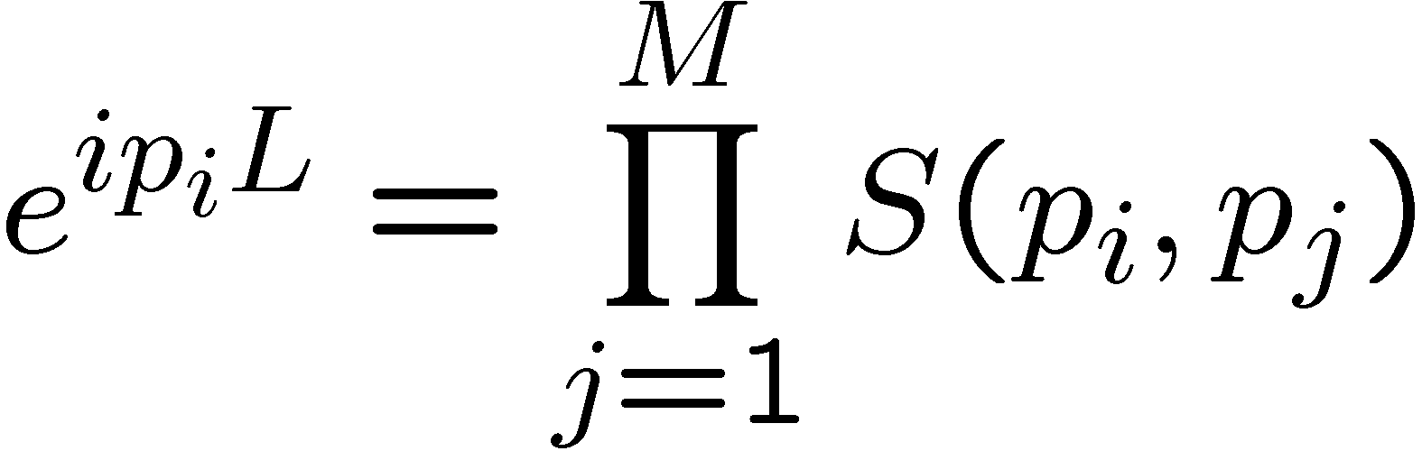

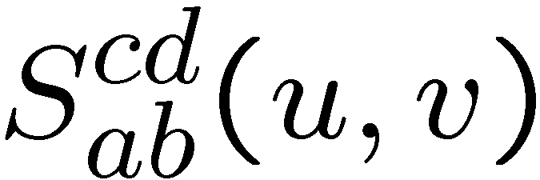




For spectral density we need finite volume
From periodicity of the wave function
SU(2|2) invariant tensor with 4 fundamental indexes
S
Notes:
Due to the properties we described above the number of particles is a conserved quantity, when the particles are far from each other. Accordingly the spectrum of the theory in the large box can be labeled by the number of particles.
Inside each sector the problem is almost finite dimentional – like nonrel. quantum mechanics with delta function iteraction.
One particle state – wave function should be periodical => e
Two prticle state – x<<y x>>y – two wave functions + Psi(x,y)=Psi(x+L,y)

Slide 12
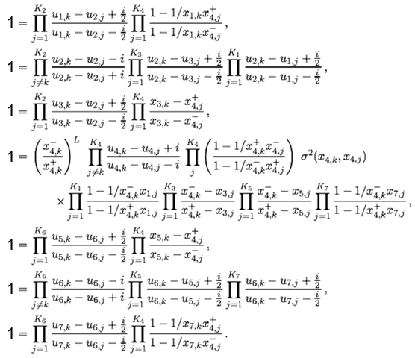
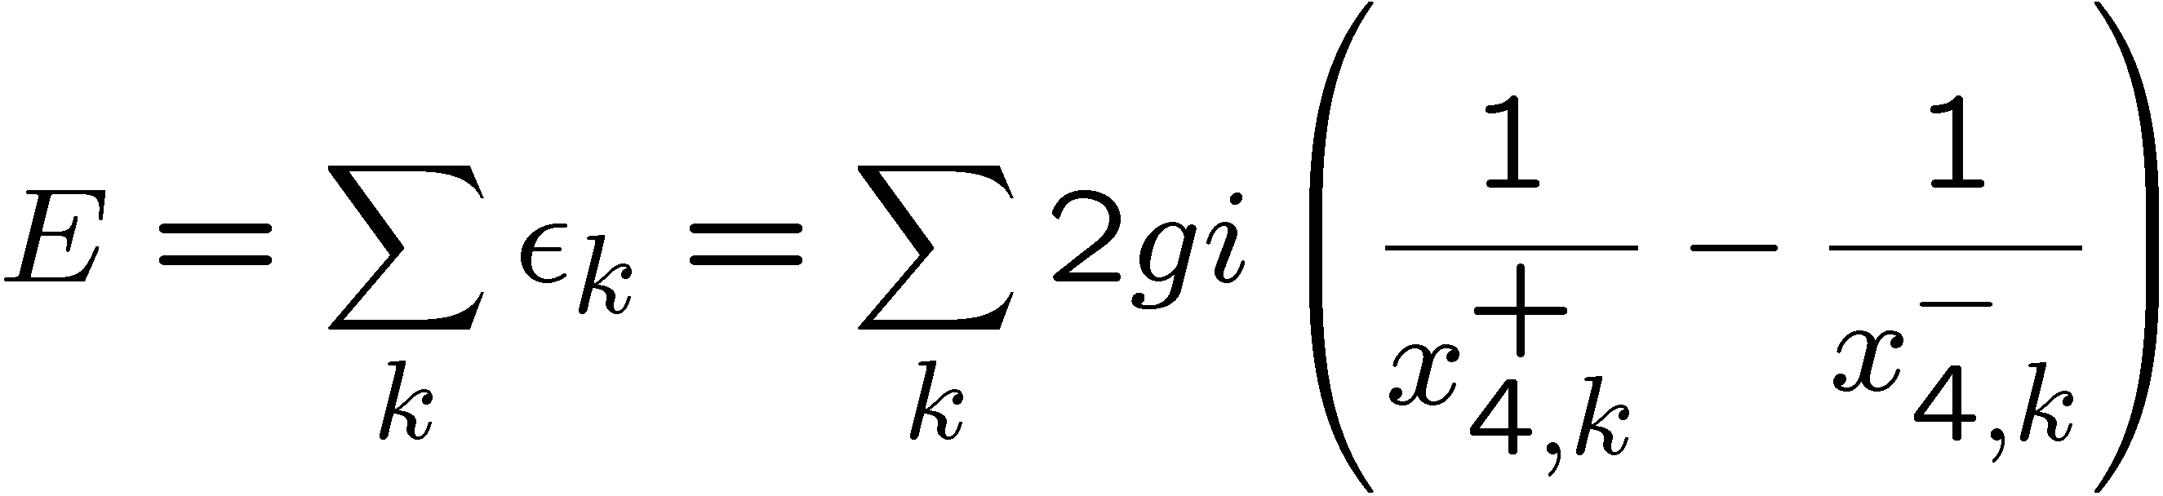
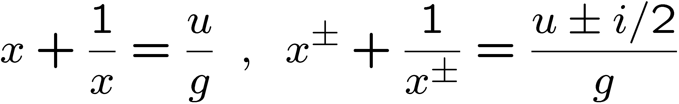
Beisert, Staudacher;
Beisert, Hernandez, Lopez;
Beisert,Eden,Staudacher

Slide 13
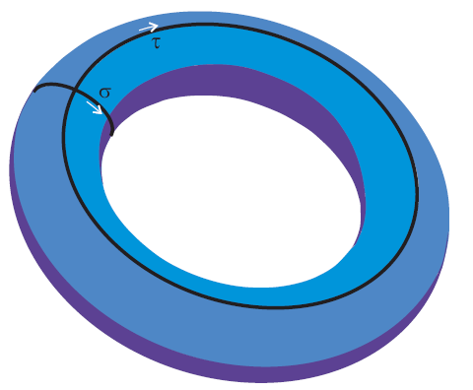
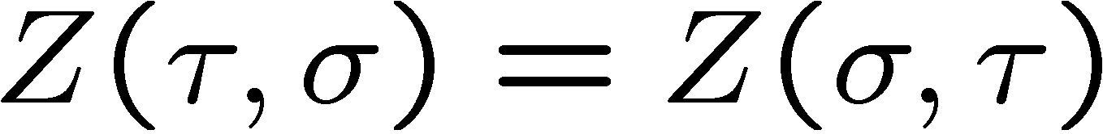
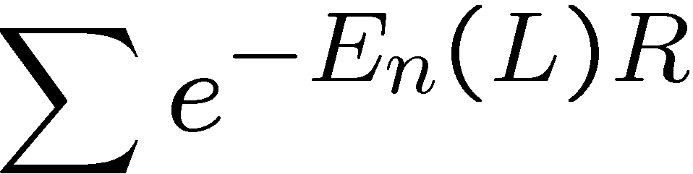
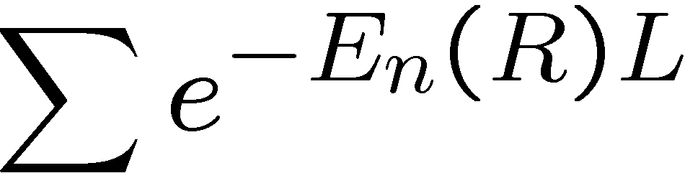
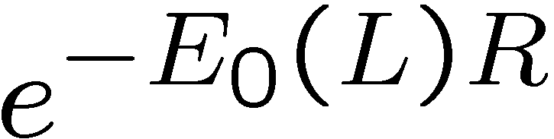
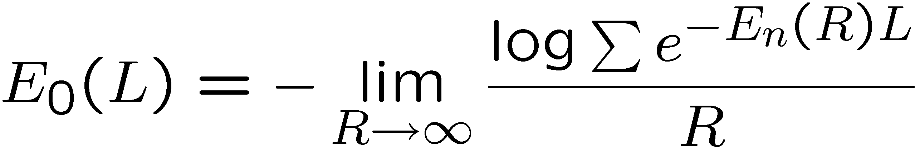
…,Matsubara, Zamolodchikov,…
I.e. from the asymptotical spectrum (infinite R) we can compute the Ground state energy for ANY finite volume!

Slide 14


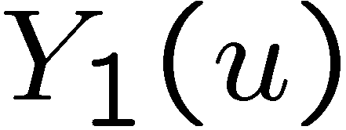
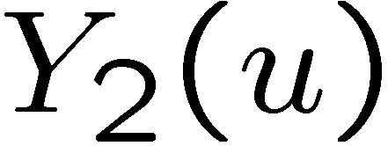
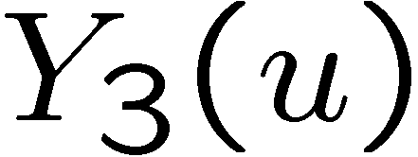
+
+
+ …

Slide 15
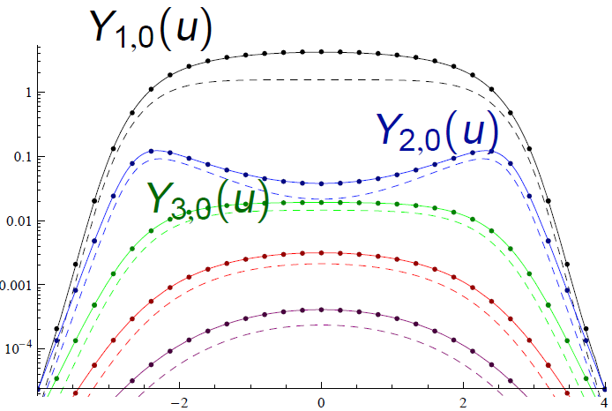
Maxwell-like distributions

Slide 16
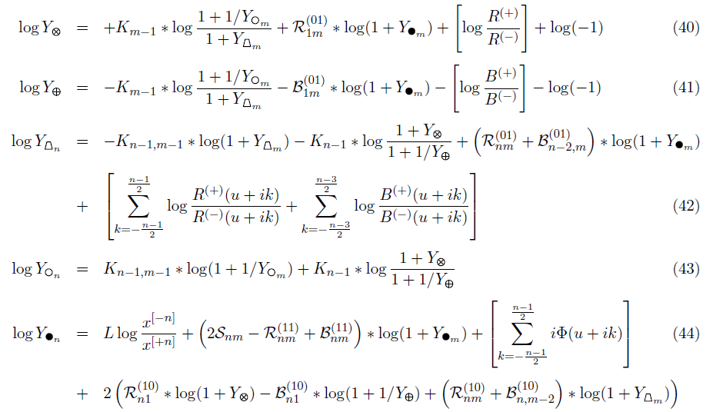
Bombardelli, Fioravanti, Tateo
N.G., Kazakov, Vieira
Arutynov, Frolov

Slide 17

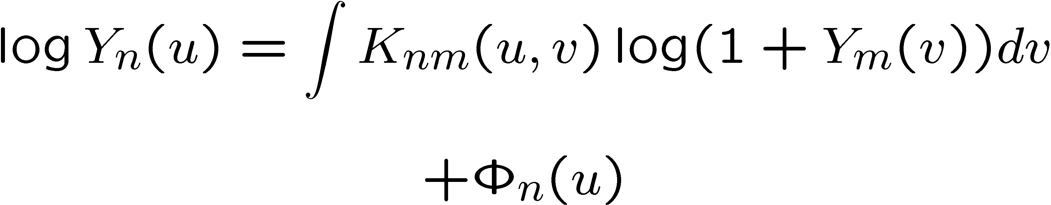
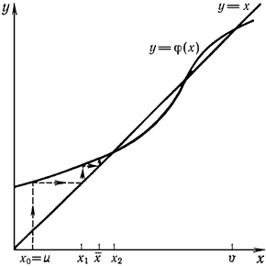
Bazhanov, Lukyanov, Zamolodchikov,
P.Dorey, Toteo, Fioravanti, Fendley
Bombardelli, Fioravanti, R.Tateo
N.G., Kazakov, Vieira
Arutynov, Frolov
Equations for First exciting state:
N.G., Kazakov, Vieira ‘09
Different (?) set of eqation
Arutyunov, Frolov, Suzuki `10

Slide 18
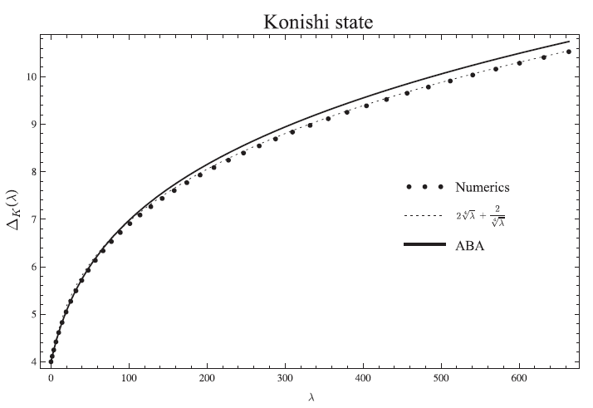

N.G., Kazakov, Vieira ‘09
Fit:

Slide 19
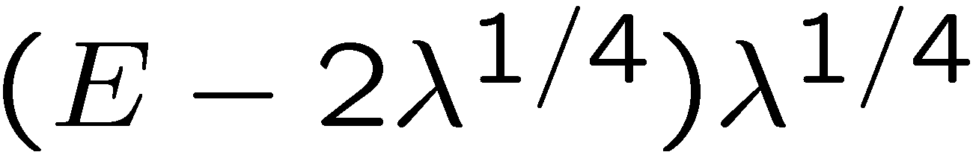


NG, Kazakov, Viera `09
Fit `09
Data `09
Roiban, Tseytlin `09

Slide 20

N.G., Kazakov, Vieira ‘09
Numerics
Gromov, Serban, Shenderovich, Volin`11;
Roiban, Tseytlin`11;
Vallilo, Mazzucato`11
N.G., Valatka`11
String theory
Gubser, Klebanov, Polyakov `98
Agrees with weak coupling gauge theory up to 5 loop!
Fieamberti, Fantambrogio, Sieg, Zanon `08
Eden, Heslop, Korchemsky, Smirnov, Sokatchev `12
Bajnok, Janik, Lukowski `08
Bajnok, Hegedus, Janik, Lukowski `09
Arutyunov, Frolov, Suzuki `10

Slide 21

Is it the final answer to the spectral problem???

Slide 22

Intermediate λ
N.G., Kazakov, Vieira ‘09
Integrability
Hirota 1971
Gromov, Serban, Shenderovich, Volin`11;
Roiban, Tseytlin`11;
Vallilo, Mazzucato`11
N.G., Valatka`11
String theory
© V.Kazakov 2012

Slide 23


N.G., Kazakov, Vieira `09
In the parameterization:
The integral equations become:
Universal equation for integral theories:

Slide 24



N.G., Kazakov, Vieira

Slide 25
Quasiclassical quantization
From the algebraic curve

Slide 26



For any given classical solution
We can compute the first quantum correction to the energy
(and any other conserved charge) by deforming in an appropriate way
its algebraic curve!

Slide 27



Consider some classical solution:
We can excite it by a small extra cut:
The action variables are known to be:
Spectrum of excitations is quantized

Slide 28




For the harmonic oscillator we have
So far we understood how to get
Beisert, Freyhult,
N.G. Pedro Vieira
Now we can compute shift of the energy level due to the zero point energies
Frolov, Tseytlin

Slide 29







For the harmonic oscillator we have
Poles can be only at the
specia points of the curve
For bosons
For fermions
We can rewrite the sum as an integral
Where

Slide 30
Strong coupling QC spectrum from
Y-system

Slide 31




N.G. 2009,
N.G.,Kazakov,Tsuboi 2010
At strong coupling:
Hirota equation:
General solution is given by characters
With 8-paramiters

Slide 32








Hirota equation satisfied by gl(N) characters:
N.G., Tsuboi, Kazakov ‘10
Unitary representations of PSU(2,2|4)!!

Slide 33



1) For a given classical solution we compute
2) Diagonalize it
3) Compute super-character

Slide 34


For some particular combinations the result is very simple:
The expression for the energy becomes:
Coinsides with the expression from the quasi-classical quantization!

Slide 35
Weak coupling

Slide 36


Use Hirota equation:

Slide 37

SU(2|2) invariant tensor with 4 fundamental indexes
S
Obeys Yang-Baxter:
S
S
S
S
S
S
Then:
S
S
S
S
The eigenvalues solve Hirota
for rep =

Slide 38




Instead of computing the transfer matrices explicitly one can use:
Beisert
By a short code we can generate any Tas
Bazhanov, Reshitikhin

Slide 39


In particular for Konishi:
In agreement with perturbation theory!!
4-loops!
Kotikov, Lipatov, Rej, Staudacher and Velizhanin
Sieg, Torrielli
Janik, Bojnok,
N.G., Kazakov, Vieira

Slide 40
AdS4/CFT3: N=6 ABJM

Slide 41



Pattern of flucuations for ABJM OSP(2,2|6):
N.G., P.Vieira 2008
Y-system is known:
N.G., V.Kazakov, P.Vieira 2009,
D.Bombardelli, D.Fioravanty,
R.Tateo 2010
N.G., F.Levkovich-Maslyuk 2010
0901.3753
0908.2463
J.A. Minahan, O.Ohlsson Sax, C. Sieg
Y-system leads to the following key structure:
N.G., F.Levkovich-Maslyuk 2010

Slide 42
Wilson loops

Slide 43


N.Drukker 2012
D.Correa, J.Maldacend, A.Sever 2012

Slide 44
Conclusions
We propose the system of functional equations for the spectral problem of Y-system (Hirota)
QC results should agree with Y-system generically
Tested at weak and strong coupling
Hidden structures in the perturbation theory
What’s next? 3-point functions? Conformal bootstrap?

