Slide 1
Higher spin supergravity dual of Kazama-Suzuki model
Yasuaki Hikida (Keio University)
Based on
JHEP02(2012)109 [arXiv:1111.2139 [hep-th]]; arXiv:1209.5404 with
Thomas Creutzig (Tech. U. Darmstadt) & Peter B. Rønne (University of Cologne)
October 19th (2012)@YKIS2012

Slide 2
1. Introduction
Higher spin gauge theories and holography

Slide 3
Higher spin gauge theories
Higher spin gauge field
A totally symmetric spin-s field
Vasiliev theory
Non-trivial interacting theory on AdS space
Only classical theory is known
Toy models of string theory in the tensionless limit
Singularity resolution
Simplified AdS/CFT correspondence

Slide 4
Examples
AdS₄/CFT₃ [Klebanov-Polyakov ’02]
Evidence
Spectrum, RG-flow, correlation functions [Giombi-Yin ’09, ’10]
AdS₃/CFT₂ [Gaberdiel-Gopakumar ’10]
Evidence
Symmetry, partition function, RG-flow, correlation functions
Supersymmetric extensions [Creutzig-YH-Rønne ’11,’12]
4d Vasiliev theory
3d O(N) vector model
3d Vasiliev theory
Large N minimal model

Slide 5
N=2 minimal model holography
Our conjecture ’11
Gravity side: N=2 higher spin supergravity by Prokushkin-Vasiliev ’98
CFT side: N=(2,2) CP^{N} Kazama-Suzuki model
N=1 version of the duality [Creutzig-YH-Rønne ’12]
Motivation of SUSY extensions
SUSY typically suppresses quantum corrections
It is essential to discuss the relation to superstring theory (c.f. for AdS₄/CFT₃ [Chang-Minwalla-Sharma-Yin ’12])
N=2 Vasiliev theory
N=(2,2) minimal model

Slide 6
Plan of the talk
Introduction
Higher spin gauge theories
Dual CFTs
Evidence
Conclusion

Slide 7
2. Higher spin gauge theories
Higher spin supergravity and its Chern-Simons formulation

Slide 8
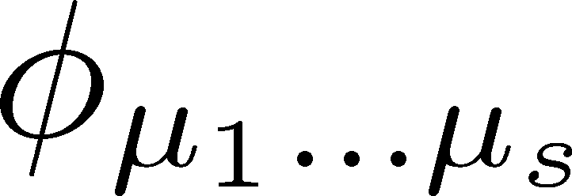
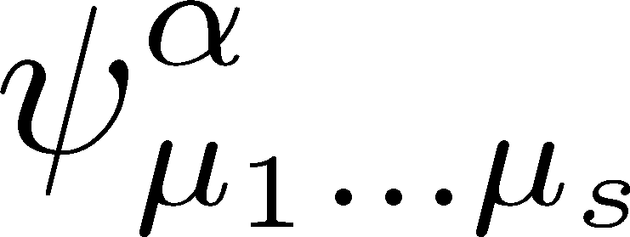
Metric-like formulation
Low spin gauge fields
Higher spin gauge fields
Totally symmetric spin-s tensor
Totally symmetric spin-s tensor spinor
The higher spin gauge symmetry

Slide 9
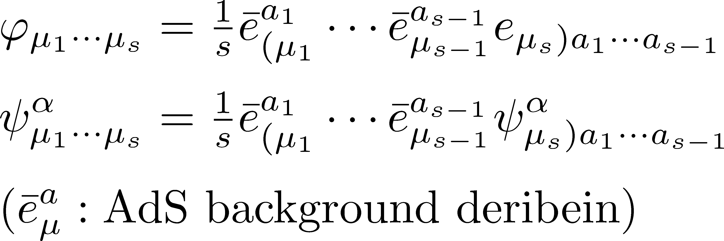
Flame-like formulation
Higher spin fields in flame-like formulation
Relation to metric-like formulation
SL(N+1|N) x SL(N+1|N) Chern-Simons formulation
A set of fields with s=1,…,N+1 can be described by a SL(N+1|N) gauge field

Slide 10
Relation to Einstein gravity
Chern-Simons formulation [Achucarro-Townsend ’86, Witten ’88]
SL(2) x SL(2) CS action
Gauge transformation
Relation to Einstein Gravity
Einstein-Hilbert action with with $Λ<0$in the first order formulation
Dreibein:
Spin connection:

Slide 11
Extensions of CS gravity
N=(p,q) supergravity
OSP(p|2) x OSP(q|2) CS theory [Achucarro-Townsend ’86]
Bosonic sub-group is SL(2) x A
Higher spin gravity
SL(N) x SL(N) CS theory
Decompose sl(N) by sl(2) sub-algebra

Slide 12
SUSY + Higher spin
N=2 higher spin supergravity
SL(N+1|N) x SL(N+1|N) CS theory
Decomposed by gravitational sl(2)
Comments
Spin-statistic holds for superprincipal embedding
Vasiliev theory includes shs[$λ$] x shs[$λ$] CS theory
shs[$λ$]: “a large N limit” of sl(N+1|N), sl(N+1|N) for $λ=−N$, bosonic sub-algebra is hs[$1−λ$] x hs[$λ$]
Gravitational sl(2)
Bosonic higher spin
Fermionic higher spin

Slide 13
Asymptotic symmetry
Chern-Simons theory with boundary
Degrees of freedom exists only at the boundary
Boundary theory is described by WZNW model on G
Classical asymptotic symmetry
Asymptotically AdS condition is assigned for AdS/CFT
The condition is equivalent to Drinfeld-Sokolov reduction [Campoleoni, Fredenhagen, Pfenninger, Theisen ’10, ’11]
Group G | Symmetry
SL(2) | Virasoro | Brown-Henneaux ’86, c=3l/2G
SL(N) | W_{N} | Henneaux-Rey ’10, Campoleni-Fredenhagen-Pfenninger-Theisen ’10, Gaberdiel-Hartman ’11
SL(N+1|N) | N=2 W_{N +1} | Creutzig-YH-Rønne ’11, Henneaux-Gómez-Park-Rey ’12, Hanaki-Peng ’12

Slide 14
Gauge fixings & conditions
Coordinate system
t: time, (ρ,θ) disk coordinates, boundary at $ρ→∞$
Solutions to the equations of motion
Gauge fixing & boundary condition
The condition of asymptotically AdS space
Same as the constraints for DS reduction [Campoleoni, Fredenhagen, Pfenninger, Theisen ’10, ’11]

Slide 15
3. Dual CFTs
Our proposal of the Kazama-Suzuki model dual to N=2 higher spin supergravity

Slide 16
Minimal model holography
Gaberdiel-Gopakumar conjecture ’10
Evidence
Symmetry
Asymptotic symmetry of bulk theory coincides to that of dual CFT [Henneaux-Rey ’10, Campoleni-Fredenhagen-Pfenninger-Theisen ’10, Gaberdiel-Hartman ’11, Campoleni-Fredenhagen-Pfenninger ’11, Gaberdiel-Gopakumar ’12]
Spectrum
One loop partition functions of the dual theories match [Gaberdiel-Gopakumar-Hartman-Raju ’11]
Interactions
Some three point functions are studied [Chang-Yin ’11, Ammon-Kraus-Perlmutter ’11]
3d Vasiliev theory
Large N minimal model

Slide 17
The dual theories
Gravity side
A bosonic truncation of higher spin supergravity by Prokushkin-Vasiliev ’98
Massless sector
hs[$λ$] x hs[$λ$] CS theory ➔ Asymptotic symmetry is $W_{∞}[λ]$
Massive sector
Complex scalars with
CFT side
Minimal model with respect to W_{N}-algebra
A ’t Hooft limit

Slide 18
SUSY extension
Question
What is the CFT dual to the full sector of Prokushkin-Vasiliev?
Two Hints
Massless sector
shs[$λ$] x shs[$λ$] CS theory
➔ Dual CFT must have N=(2,2) W algebra as a symmetry
Massive sector
Complex scalars with
Dirac fermions with
➔ Dual conformal weights from AdS/CFT dictionary

Slide 19
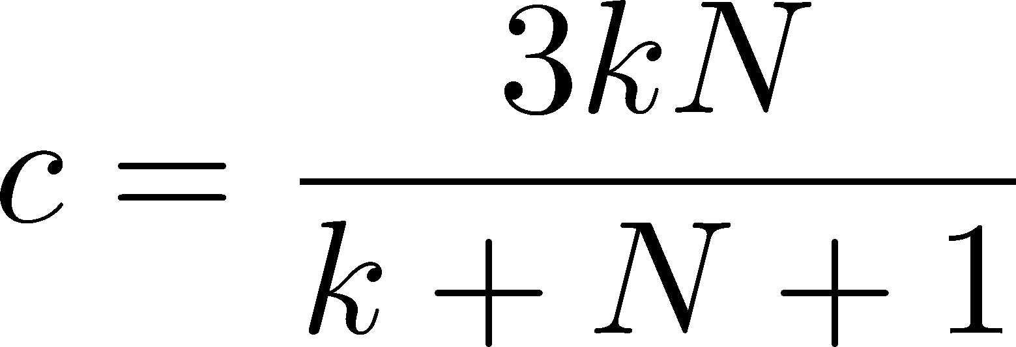
Dual CFT
Our proposal
Dual CFT is CP^{N} Kazama-Suzuki model
Need to take a ’t Hooft limit
Two clues
Clue 1: Symmetry
The symmetry of the model is N=(2,2) W_{N+1} algebra [Ito ’91]
Clue 2: Conformal weights
Conformal weights of first few states reproduces those from the dictionary

Slide 20
CP^{N} Kazama-Suzuki model
Labels of states: $\left(ρ,s;ν,m\right)$
$ρ,ν$ are highest weights for su(N+1), su(N)
s=0,2 for so(2N) and $m∈Z_{N\left(N+1\right)\left(N+k+1\right)}$ for u(1)
Selection rule
Conformal weights
First non-trivial states
States duel to scalars and fermions
Scalars:
Fermions:

Slide 21
4. Evidence
Evidence for the duality based on symmetry, spectrum, correlation function & N=1 extension

Slide 22
N=2 minimal model holography
Our conjecture ’12
Evidence
Symmetry
Asymptotic symmetry of bulk theory coincides with the symmetry of CP^{N} model [Creutzig-YH-Rønne ’11, Henneaux-Gómez-Park-Rey ’12, Hanaki-Peng ’12, Candu-Gaberdiel ’12]
Spectrum
Gravity one-loop partition function is reproduced by the ’t Hooft limit of dual CFT [Creutzig-YH-Rønne ’11, Candu-Gaberdiel ’12]
Interactions
Boundary 3-pt functions are studied [Creutzig-YH-Rønne, to appear]
N=1 duality [Creutzig-YH-Rønne ’12]
N=2 higher spin sugra
N=(2,2) CP^{N} model

Slide 23
Agreement of the spectrum
Gravity partition function
Bosonic sector
Massive scalars [Giombi-Maloney-Yin ’08, David-Gaberdiel-Gopakumar ’09]
Bosonic higher spin [Gaberdiel-Gopakumar-Saha ’10]
Fermionic sector
Massive fermions, fermionic higher spin [Creutzig-YH-Rønne ’11]
CFT partition function at the ’t Hooft limit
It is obtained by the sum of characters over all states and it was found to reproduce the gravity results
Bosonic case [Gaberdiel-Gopakumar-Hartman-Raju ’11]
Supersymmetric case [Candu-Gaberdiel ’12]
Identify

Slide 24
Partition function at 1-loop level
Total contribution
Higher spin sector + Matter sector
Higher spin sector
Two series of bosons and fermions
Matter part sector
4 massive complex scalars and 4 massive Dirac fermions
Identify

Slide 25
Boundary 3-pt functions
Scalar field in the bulk ⬄ Scalar operator at the boundary
Boundary 3-pt functions from the bulk theory [Chang-Yin ’11, Ammon-Kraus-Perlmutter ’11]
Comparison to the boundary CFT
Direct computation for s=3 (for s=4 [Ahn ’11])
Consistent with the large N limit of W_{N} for s=4,5,..
Analysis is extended to the supersymmetric case
3-pt functions with fermionic operators [Creutzig-YH-Rønne, to appear]

Slide 26
Further generalizations
SO(2N) holography [Ahn ’11, Gaberdiel-Vollenweider ’11]
Gravity side: Gauge fields with only spins s=2,4,6,…
CFT side: WD_{2N} minimal model at the ’t Hooft limit
N=1 minimal model holography [Creutzig-YH-Rønne ’12]
Gravity side: N=1 truncation of higher spin supergravity by Prokushkin-Vasiliev ’98
CFT side: N=(1,1) S^{2N} model at the ’t Hooft limit

Slide 27
Comments on N=1 duality
Spectrum
Gravity partition function can be reproduced by the ’t Hooft limit of the dual CFT [Creutzig-YH-Rønne ’12]
Symmetry
N=1 higher spin gravity
Gauge group is a “large N limit” of $OSP\left(2N+1|2N\right)⊗OSP\left(2N+1 | 2N\right)$ ➔Asymptotic symmetry is obtained from DS reduction
N=(1,1) S^{2N} model
Generators of symmetry algebra are the same
➔(Anti-)commutation relations should be checked

Slide 28
5. Conclusion
Summary and future works

Slide 29
Summary and future works
Our conjecture
N=2 higher spin supergravity on AdS₃ by Prokushkin-Vasiliev is dual to N=(2,2) CP^{N} Kazama-suzuki model
Strong evidence
Both theories have the same N=(2,2) W symmetry
Spectrum of the dual theories agrees
Boundary 3-pt functions are reproduced from the bulk theory
N=1 duality is proposed
Further works
1/N corrections
Light (chiral) primaries ⬄ Conical defects (surpluses)
Black holes in higher spin supergravity
Relation to superstring theory

