Slide 1
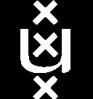
(Entanglement)Entropy in 3d Higher Spin Theories
Jan de Boer, Amsterdam
Kyoto, October 19, 2012
Cf talks by Gopakumar, Hikida
Based on work with work with Juan Jottar (to appear)
Review plus many references in Ammon, Kraus, Gutperle, Perlmutter, arXiv:1208.5182

Slide 2
私たちはこの素晴らしい会議のためにもう一度主催者に感謝させて頂きます。
私は、Googleが翻訳は良い仕事をしましたことを願っています。
K·橋本（理研）、K.細道（YITP）、伊藤（東工大）
Y.今村（東工大）、T. KUGO（YITP、椅子）、H.国友（YITP）S·中村（京都）、M. Natsuume（KEK）、Y.松尾（東京）、K·堺（YITP）、T.酒井（名古屋）、S.杉本（IPMU）T·高柳（YITP）、S.寺島（YITP）

Slide 3
2d CFT with extended symmetries
2d CFT
AdS3 gravity
AdS3 higher-spin gravity
SL(2,R)xSL(2,R) Chern-Simons theory
SL(N,R)xSL(N,R) Chern-Simons theory
Many universal results (Cardy formula, entanglement entropy,….)
Many universal results????? (Cardy formula, entanglement entropy,….)

Slide 4
Cardy formula:
Finite temperature entanglement entropy:
a: UV cutoff

Slide 5
3d gravity vs CS theory
Relation to 3d gravity
Obtain Einstein-Hilbert action with negative cosmological constant in first order form.

Slide 6
For AdS application, boundary conditions are very important.
Consider only A from now on. Pick coordinates where is the radial direction.
Define
Then the AdS boundary conditions are

Slide 7
where a is up to corrections of order equal to the following flat 2d connection
non-normalizable
normalizable
Flatness is equivalent to
which is simply expressing conservation of the stress tensor in the presence of an interaction

Slide 8
One also needs a boundary term to make everything work but I will not discuss this.
Gauge transformations that preserve this form of the connection have infinitesimal gauge parameter
and change the stress tensor to
which is exactly the correct behavior under diffeomorphisms.

Slide 9
Generalization to higher spin theories uses ideas from so-called Drinfeld-Sokolov reduction.
Take any SL(2) embedding in SL(N). These are classified by the way the fundamental representation decomposes in SL(2) representations. If N is irreducible this called the principal embedding.
These give rise to the “standard” W-algebras.
Denote SL(2) generators by

Slide 10
Then
normalizable modes
non-normalizable modes
Example for SL(3) principal embedding:

Slide 11
Flatness: Conservation of currents in the presence of sources (aka Ward identities)
Gauge transformations that preserve the form of a: non-linear classical W-algebra. These form the asymptotic symmetry group of the system.
So SL(N)xSL(N) Chern-Simons theory with a suitable boundary term and with the above boundary conditions describes the universal sector of CFTs with higher spin symmetries.
Campoleoni et al; Henneaux, Rey; work in 90’s

Slide 12
Important subtlety:
The parameter corresponds to turning on a non-trivial metric in the boundary theory. (“Beltrami differential”)
Instead of putting it in the gauge field one can also put it in the choice of modular parameter of the boundary torus in the Euclidean case. Then connection to temperature is manifest.
One can use either formulation but there are technical differences in choices of boundary terms etc.

Slide 13
We want to consider systems at finite temperature/finite chemical potentials for the higher spin fields.
Idea: Euclidean signature, impose regularity for the gauge field along the contractible time circle: trivial monodromy.
The rhs follows by insisting that when we turn of all charges we recover BTZ.
There may be other branches but will ignore this.
David, Ferlaino, Prem Kumar

Slide 14
For example, for SL(2):

Slide 15
Entanglement entropy?
Starting observation: geodesic distance in AdS3 can be written as
Not gauge invariant?? Not a problem.
Since entanglement entropy in AdS3 is related to the geodesic distance (Ryu Takayangi) this motivates us to look for an expression in terms of Wilson lines.

Slide 16
Further motivation:
Bulk theory is topological so it is reasonable to look for topological quantities
Entanglement entropy related to two-point function of twist fields. In first quantized form such a two-point function involves the action of a point particle coupled to the gauge field. Except that there is no propagating point particle – all that is left is the coupling to a gauge field i.e. a Wilson line.

Slide 17
Proposal:
Structure implied by holomorphic factorization.
A special representation appears: if
then it is the representation with highest weight
(a sum over fundamental weights)

Slide 18
Test 1: reproduce standard AdS3 results
works OK!

Slide 19
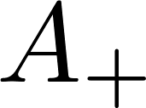
Test 2: reproduce thermal entropy of higher spin black holes
To do this, we need to loop around the horizon once on the cylinder when computing the entanglement entropy, and take a high-temperature limit.
It is not difficult to see that the eigenvalues of and
will appear in the result. In fact, the entropy will be the sum of two logarithms of linear combinations of eigenvalues.
To compare to the higher spin black holes entropy, we first present a new expression for these entropies.

Slide 20
In fact, 20 years ago we computed
JdB, Goeree
which for constant sources should yield the free energy we are interested in. The answer was expressed in terms of WZW theory. We get the same answer from Chern-Simons theory using the usual connection between Chern-Simons theory and WZW theory.
After some rewriting the final answer for the entropy is
Cf Banados, Canto, Theisen; David, Ferlaino, Prem Kumar

Slide 21
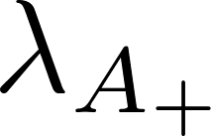
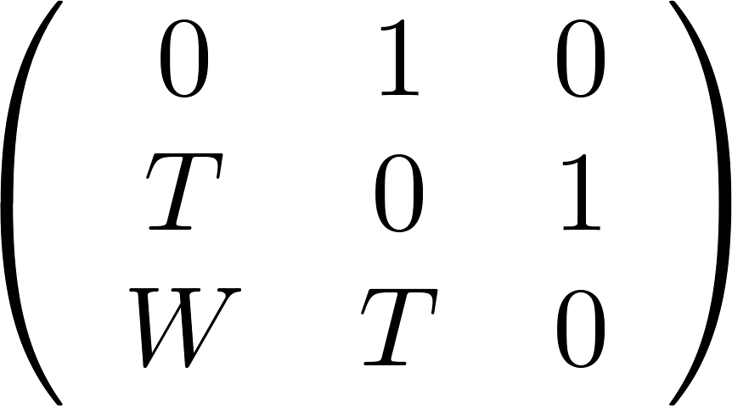
We can diagonalize all the matrices that appear here (the connection was flat). Recall that
and therefore if we denote by the diagonal matrix of eigenvalues of then the entropy is
This is a simple linear combination of the eigenvalues of !
For W3 this is the difference of the largest and smallest eigenvalue of

Slide 22
With this technology, one can then show that the entanglement entropy does reduce to the thermal entropy for principal embeddings.
More about non-principal embeddings later.

Slide 23
Test 3: strong subadditivity
We have verified numerically that our result for the entanglement entropy for W3
indeed obeys strong subadditivity. We do not yet have a general proof.

Slide 24
What about non-principal embeddings?
Bosonic version of the N=2 superconformal algebra. The shift in T guarantees that T is the full stress-tensor of the theory and gives the total energy. Entropy formula still works and is spectral flow invariant.

Slide 25
However, the proposed entanglement entropy does not quite reproduce the thermal entropy. In particular, it is not spectral flow invariant (presumably it should be).
Can fix this in a somewhat ad hoc way, but the result for the entanglement entropy then no longer has a clear relation to Wilson lines – one needs to introduce compensating U(1) transformations somehow.
Non-principal embeddings always give rise to U(1) currents and these are the cause of the disagreement.

Slide 26
With sources for U(1) currents, one has to perhaps rethink what one is doing. Some of the higher spin currents are charged under U(1) and in the presence of a chemical potential for U(1) they may no longer have a zero mode.
So perhaps one needs to extend the framework to allow for twisted boundary conditions…

Slide 27
Take home message:
There appear to be generalizations of the Cardy formula and the expression for entanglement entropy for theories with higher spin charges.
It is not clear whether they are universal for all CFTs (what replaces modular invariance?) or only for CFTs with a gravitational dual.
Everything depends in a relatively simple way on the eigenvalues of the DS matrix

Slide 28
Conclusions
Look at supersymmetric extensions – presumably everything remains the same with groups replaced by supergroups
Prove strong subadditivity in general
Understand non-principal embeddings
Connection to conical defects/surpluses, use this to understand phase transitions in these theories?
What about higher spin symmetries that are not of DS form?
Any first principles derivation that does not use AdS/CFT?

