Slide 1
A model for heap formation in vibrated gravitational suspensions
Hiroyuki EBATA¹ and Masaki SANO²
¹ Chiba University
² The University of Tokyo
Experiment
Simulation
Gravitational suspension: granules are heavier than the fluid.
Notes:
In this talk, I introduce a model of heaps in vibrated dense suspensions.
Thus, I focus on the surface instability of the dense suspensions.

Slide 2
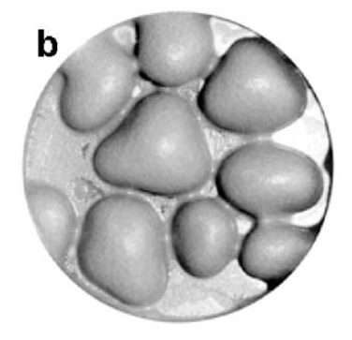
Localized structures in vibrated suspensions
Stable hole
Cornstarch
+ water
Expanding hole
Glass beads
+ silicone oil
Heaps
Bronze beads
+ water
F.S.Merkt et. al., PRL, 92, 184501 (2004)
H.Ebata et. al., PRE 79, 066308 (2009)
J.M. Schleier-Smith and H.A. Stone, PRL, 86, 3016 (2001)
Quasi 2D
Even if we take time average of the shape, localized structures remain.
Notes:
There are several work about the surface instability of dense suspensions.
Here, I introduce the localized or isolated structures of dense suspensions.
First, the case of cornstarch and water suspension. Put the suspension in the container and vibrate it. Then, we make a deformation on the surface, and deformation grows to form a hole. And this hole persists for long time.
If we use glass beads and silicone oil, deformation also grows to form a hole but hole start to expand. Finally, kink structure appears.
If we use bronze beads and water, above critical acceleration, flat surface become unstable and heaps appear.
Even if we take time average of the shape, hole, kink and heaps remain.
Thus, these surface instabilities causes steady surface deformation.

Slide 3
What is the mechanism?
For ordinary fluid,
Gravity and surface tension suppress the deformation.
Yield stress? – No!
By the strong vibration, suspensions are fluidized in all the cases.
Models:
Hole ― hysteresis of the viscosity, R. D. Deegan, PRE 81, 036319, (2010)
Kink ― convectional flow, H.Ebata et. al., PRE 79, 066308 (2009)
We try to derive the evolution equation of deformation
from constitutive equations.
Notes:
If we make a hole on a Newtonian fluid, the hole is unstable and collapse immediately.
Similarly, when we make a heap by Newtonian fluid, the heap is unstable and spread out.
Gravity and surface tension strongly suppress the steady deformation.
Thus, they need special rheological features to sustain the localized structures.
One possibility is yield stress.
However, because we impose vertical vibration, the suspensions are fluidized in all the cases.
So, yield stress disappears and can not work.
There are a couple of models for the hole and the kink structures.
For the hole, Deegan proposed that hysteresis of the viscosity near the onset of the dilation can help to sustain the hole.
For the kink, we proposed that the convectional flow near the kink can sustain the structure against the gravitational pressure.
However, these models are a kind of toy model, and we need to derive the evolution equation of deformation from constitutive equations.
Here, we focus on the heaping and try to make a model.

Slide 4
Heaping
Gravitational suspension: granules are heavier than
the fluid.
Quasi 2D
3D
3D
3D： J.M. Schleier-Smith and H.A. Stone, PRL, 86, 3016 (2001)
7.5cm
・Critical acceleration of heaps are independent of vibration frequency.
・Heap instability is similar to Rayleigh-Taylor instability.
Gravitational suspensions are necessary for the heap formation.
We focus on the boundary condition of the gravitational suspensions.
We assume a mixture of granules and interstitial fluid as a single fluid.
Notes:
I explain the basic feature of heaps in suspensions.
In the experiment, we use gravitational suspensions.
Let me define the gravitational suspensions.
Gravitational suspension contains granules denser than fluid. Thus, non-density matched suspension.
Above critical acceleration, flat surface becomes unstable and heaps grows. In the heaps, convectional flows exist as shown in figure.
Critical acceleration of heaps are independent of vibration frequency.
It is said that heap instability is similar to Rayleigh-Taylor instability.
Most important point is that Denser granules are needed to use.
To make the model, We focus the boundary condition of the gravitational suspensions.
In the modeling, We assume a mixture of granules and interstitial fluid as a single fluid.
Thus, all the variables are the average of granules and fluids.

Slide 5
Slip boundary condition
[1] P. Ballesta et al. PRL 101, 258301 (2008)
[2] L. Chen et al. Fuel 89, 1119 (2010)
・Boundary condition on the wall [1,2]
・Under the critical stress τ_{c}, suspensions stick on the wall.
・ Above the critical stress, suspensions slip on the wall.
Schematic illustration
τ_{c}= 0
slip
τ_{c}= ∞
non slip
g(t)
g(t)
Bottom
Bottom
We assume that τ_{c} is a function of the gravity.
Slip / non-slip condition switches in synchronization with vertical vibration.
Notes:
When we calculate or simulate the flow of Newtonian fluid, we usually use the non-slip boundary condition.
However, it is known that dense suspension can slip on the wall.
There are critical stress tauc to slip. Under the critical stress, suspensions stick on the wall. However, above the critical stress, suspensions slip on the wall.
This relation is shown in above equation. Vx is velocity of fluid parallel to the wall, and tauxz is shear stress on the wall.
Vx and tauxz has linear relation, and beta is called as slip length. Slip length is mean gap between wall and nearest granules. Etaw is viscosity of interstitial fluid.
Here, we modified the above equation. We assume that tauc is a function of the gravity.
From now, vibration is included into gravity.
Thus, gravity is oscillating instead of the bottom plate.
Schematic illustration is shown in right figure. As we use the denser granules, granules are bouncing on the bottom.
If the gravity acts upward, granules detach form the bottom. Then, granules should be easy to slip and tauc becomes small.
If the gravity acts downward, granules are pressed on the bottom. Then, granules should be hard to slip and tauc becomes large.
For the simplicity, we assume that tauc is zero when gravity acts upward, and tauc becomes infinity when gravity acts downward.
Now, slip boundary condition is simplified by using effective slip length. Effective slip length is step function of the gravity.
This boundary condition means that slip / non-slip condition switches with vertical vibration, and this switching boundary condition is a key of our model.

Slide 6
Governing equation
n
n : unit normal vector
h : thickness of fluid
κ : curvature
σ : surface tension
h(x,t)
z
x
Bottom
１． Equation of motion
４．Boundary condition at free surface
２． incompressibility
３．Non-Newtonian viscosity
In 2D
５．Switching boundary condition
at the bottom
Notes:
Here, I explain the governing equations we used.
We consider the situation that fluid layer is placed on the plate.
Then, time evolution of the thickness of the fluid is calculated.
First, we use motion equation, and we assume incompressibility.
For the constitutive equation, we use non-Newtonian viscosity. For the simplicity, we neglect the elasticity.
Upper boundary condition is ordinary free surface condition.
Bottom boundary condition is slip/non slip switching boundary condition.

Slide 7
Lubrication approximation
λ
Lubrication approximation
h₀
Bottom
: Wave length of
the instability
h₀ : Mean thickness
Normalization
：A small parameter
Assume the simple shear flow at each position.
Stokes’ approximation
We neglect the inertia terms.
Notes:
Next, to make the calculation simpler, we introduce a couple of approximation.
It is known that, near the critical acceleration, size of the heaps are larger than depth of the heaps.
Thus, we use lubrication approximation. We set lambda as wave length of the instability and h0 as the mean thickness of the fluid.
Here, we introduce a small parameter epsilon. Epsilon is defined as ratio of h0 and lambda.
By using epsilon, we normalize all the variables and parameters as following.
This normalization is almost same as the ordinary lubrication approximation.
The important point of lubrication approximation is that lambda is larger than h0, and gradient of pressure and gradient of shear stress is dominant.
This approximation gives simple shear flow at each position.
In addition, because viscosity of the suspension is large, we use Stokes’ approximation and neglect the inertia terms.

Slide 8
Lowest order of ε
・Equation of motion
Pressure and shear stress can be calculated.
・At the free surface (Z=H),
Constitutive equations are
Velocity field is obtained.
・At the bottom (Z=0),
Evolution equation of thickness H.
Notes:
Put all the normalized parameters into governing equation and we pick up the lowest order of epsilon.
Then, equation of motion and boundary condition becomes very simple.
Equation of motion gives simple shear flow. So, pressure and shear stress can be calculated easily.
Constitutive equation also becomes very simple, and velocity field is obtained by using this equation.
Put the velocity field into boundary condition of free surface, and we get the evolution equation of thickness H.

Slide 9
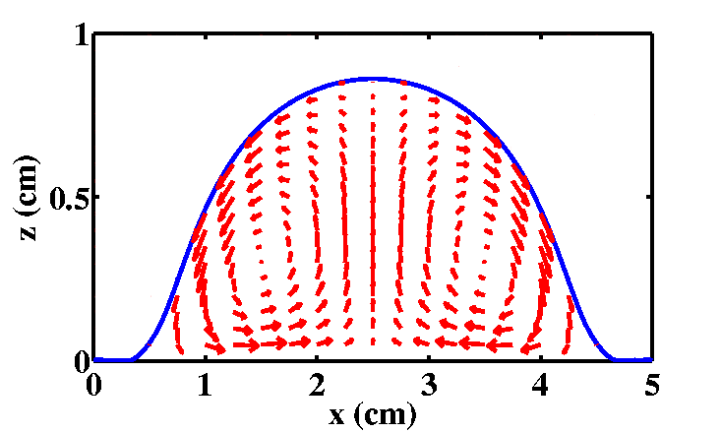
Evolution equations
=2.69 , f=10Hz, ν=η/ρ=100mm²/s
σ=72mN/s, η/η_{w}β₀=h0
In the case of Non-Newtonian viscosity
In the case of Newtonian viscosity
y (cm)
= Aω²/g , A : Vibration amplitude,
ω : Vibration frequency, σ : Surface tension
x (cm)
Notes:
The obtained evolution equation is written as follows.
If we set the functional form of the viscosity, we can calculate the evolution equation.
For the simplest case, Newtonian viscosity gives following equations.
The most important point is slip length beta switches with vibration.
Then we calculate this equation with periodic boundary condition in x direction.
When acceleration exceeds critical value, surface deformation grows to form heaps.
We calculated time average flow in the heaps and found a convectional flow.
This flow coincide with the experimental result.
We calculate the evolution equation in 3 dimension, and also heaps appear.

Slide 10
Mechanism of surface instability
Flow to decrease the deformation
Flow to enhance the deformation
g(t)
g(t)
Non-slip at the bottom
Slip on the bottom
Rayleigh-Taylor instability
Time average
g
Denser fluid
Lighter fluid
・Same mechanism as Rayleigh-Taylor instability.
・Independent of constitutive equations
・Switching boundary condition is crucial.
cf. Droplet on the ceil
Notes:
The schematic picture of the mechanism of instability is following.
Consider the case that the small deformation is made on the surface.
If the gravity acts downward, flow to decrease the deformation is generated.
If the gravity acts upward, flow to enhance the deformation is generated.
This flow is the same as that of Rayleigh-Taylor instability.
Because the time averaged gravity acts downward, deformation decreases with ordinary boundary condition.
However, in our model, boundary condition is non-slip for left figure case, and fluid is hard to flow.
Boundary condition is slip for right figure case, and fluid is easy to flow.
So, if the vibration is strong, flow of right figure can overcome the flow of left figure.
Then, deformation grows and convectional flow appears.
Thus, this instability should be same as Rayleigh-Taylor instability, and it is independent of constitutive equations.
Switching boundary condition is crucial for this instability.

Slide 11
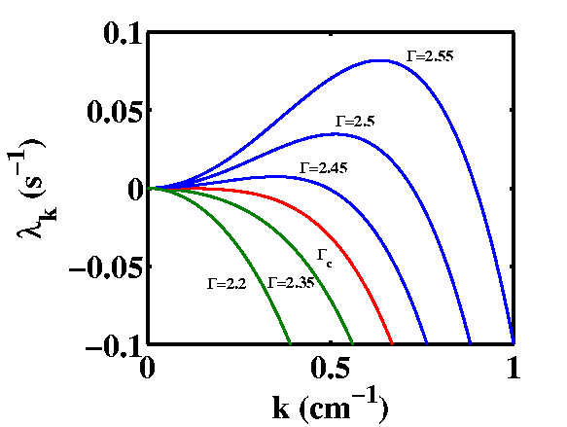
Linear stability analysis
・Without yield stress
・Finite viscosity at zero shear rate
λ_{k} : Time averaged linear growth rate of wave number k
・Linear growth rate contains only
the term of k² and k⁴.
・Instability appears from k ~ 0.
Γ : acceleration
Rayleigh-Taylor instability
Critical acceleration Γ_{c}
Critical acceleration by J.M.S.Smith
Notes:
Then, I calculate time averaged linear growth rate of wave number k, lambda k.
I skip the precise calculation, but it is easy to calculate.
Lambda k has following functional form.
It looks rather complicated.
However, the dependence of wave number k is simple.
Lambda k only contains the term of k to two and k to four.
Thus, instability appears from k=0.
This dependence is completely same as that of Rayleigh-Taylor instability.
We calculate the critical acceleration, and its functional form is comparable to that proposed from experiment.

Slide 12
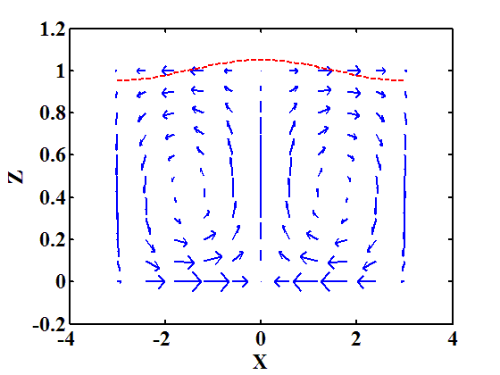
Time averaged flow
・Periodic boundary condition with width λ.
・Only the wave number k=2π/λ is a neutral stability.
Deformation of surface ξ becomes periodic function.
Time averaged flow
Ignore the non-linear term of ξ.
Time averaged flow becomes
Flow direction does not depend on the parameters.
Notes:
Next, we calculate time averaged flow.
Here, we assume that periodic boundary condition with width lambda, and lambda is large.
Only the wave number which corresponds system size is a neutral stability.
Deformation of surface xi becomes periodic function.
We ignore the non-linear term of xi.
Then, time averaged flow is written as following.
This flow field show the convectional flow. And flow go up at the peak of deformation, and flow go down at the bottom of the deformation.
This rotational direction is comparable to that observed in the experiment.
Most important parameter is integral I.
If the wave number is small, I always becomes positive.
Thus, rotational direction of convection does not depend on the parameter.

Slide 13
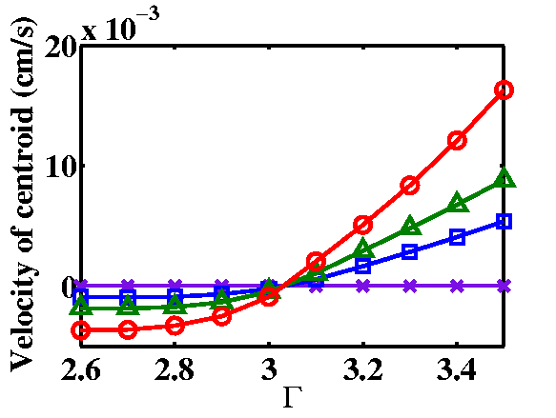
Application: Drift of the Heaps
In the case of inclined bottom plate
θ_{b}: inclining angle
θ_{b}=0°
θ_{b}=0.5 °
θ_{b}=1.0 °
θ_{b}=2.0 °
simulation
At low acceleration, Γ=2.6
At high acceleration, Γ=3.5
Heaps climb up the slope.
Downward gravity
Non-slip
Upward gravity
Slip
Notes:
Here, we introduce the application of our model.
First, we consider that the bottom plate is slightly inclined form horizon.
We set theta b as the inclining angle of the bottom.
We set g as the gravity normal to the bottom, and gh as the gravity parallel to the bottom.
Evolution equation is slightly modified and the term gh is added here.
Notice that Gh contains constant term. Thus in ordinary case, fluid goes down the plate.
Then, we put isolated heap on the plate and simulate.
This movie is the stroboscopic movie. So we show the slow mode of the dynamics.
If the acceleration is low, heap goes down the plate.
However, if the acceleration is high, heap start to climb up the plate.
This mechanism is following.
If downward gravity acts, heap stick on the bottom.
If upward gravity acts, heap slip on the bottom.
Thus, heap can climb the plate at high acceleration.
I found that the critical acceleration of climbing is independent of inclining.
Thus, I briefly analyze the equations.

Slide 14
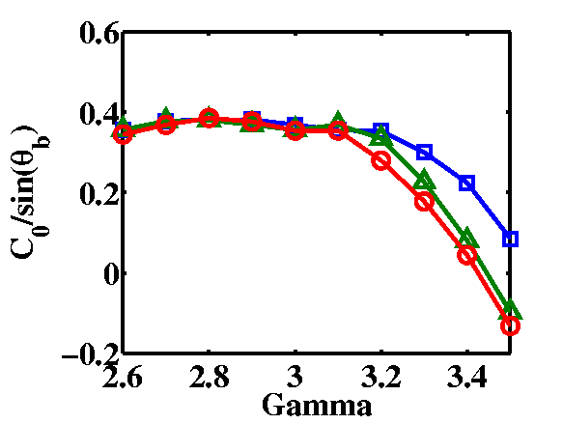
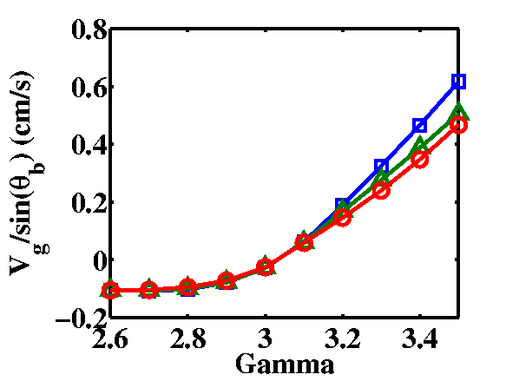
Drift of the Heaps
In the case of inclined bottom plate
θ_{b}: inclining angle
Velocity of the centroid V_{g}
S₀ is almost constant.
C₀ reflects the asymmetric shape of the heap.
When the asymmetric deformation is small,
Notes:
We take time and space average of the evolution equation.
Then, we obtain the velocity of the centroid of a heap.
Vg has the following functional form.
First term in Vg comes from surface tension and second term in Vg comes from parallel gravity.
C0 and S0 is calculated from shape of the heap.
Especially, C0 reflects asymmetric deformation.
If heap has symmetric shape, C0 vanishes.
In this case, asymmetric deformation comes from parallel gravity.
Thus, if gh is small, C0 should be proportional to gh, and therefore, sin theta b.
And we found that C0 is proportional to sin theta b at low acceleration.
Because second term in Vg contains sin theta b, Vg is proportional to sin theta b.
This is the reason that critical acceleration of climbing is independent of inclining angle theta b.

Slide 15
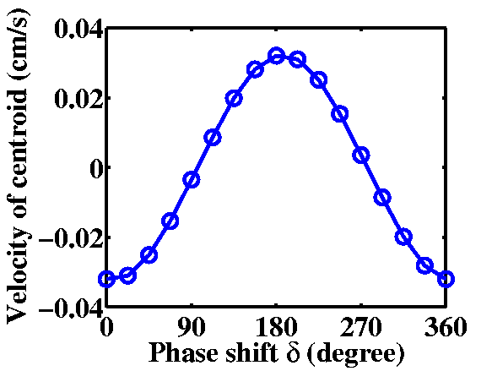
Drift of the Heaps 2
δ=0°
If the horizontal vibration is applied,
δ=90°
Γ=2.7, Γ_{h}=0.0473, δ=0
Simulation
Downward gravity
Non-slip
Upward gravity
Slip
Drift motion induced by horizontal vibration
Notes:
Next, we consider another case.
The bottom plate is horizontal, but we apply horizontal vibration.
Evolution equation is almost same as previous case.
However, gh does not have constant term.
In general, g and gh have the phase shift.
Then we simulate the motion of isolated heap, and heap start to drift.
By changing the phase shift, we calculate the velocity of centroid.
And we found that heap could not move if the phase shift is around 90 degree.
This clearly indicates that synchronization between slip/nonslip switching and horizontal vibration is crucial to drift.

Slide 16
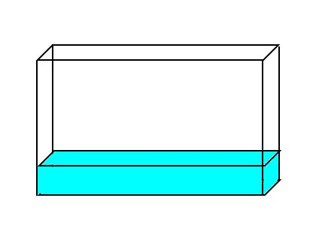
Drift of the Heaps (experiment)
With the horizontal vibration,
0.3cm
Γ=107.2m/s²
10cm
1cm
Γ_{h}=0.82m/s², δ=-0.848
Quasi 2D cell
granules： titanium
Diameter: 0.2mm
density: 4.51g/cm³
Packing fraction: 60%
Movie is 8 times faster than real speed.
Γ_{h}=4.96m/s², δ=0.2978
Notes:
I briefly check the drift of the heaping in the experiment.
We use a quasi 2 dimensional cell, and put the titanium suspension with 3 mm depth.
Packing fraction is 60%.
Then, we apply the horizontal vibration.
This movie is the stroboscopic movie. So we show the slow mode of the dynamics.
If the horizontal vibration is small, heaps are almost stationary.
However, if the horizontal vibration is large, heap drifts.
Further experiment is needed, but this result support the prediction from our model.

Slide 17
Summary
１．slip / non-slip switching
３．Convectional flow in the heaps
g(t)
experiment
Non-slip on the bottom
g(t)
simulation
Slip on the bottom
２．Rayleigh-Taylor instability
４．Drift of the heaps

