Slide 1
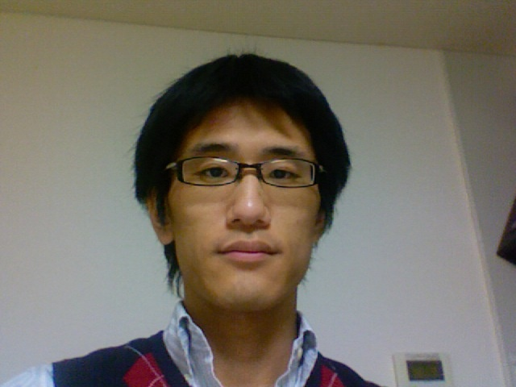
Non-equilibrium identities and nonlinear response theory for Granular Fluids
Hisao Hayakawa
(Yukawa Institute for Theoretical Physics, Kyoto University, Japan)
and Michio Otsuki (Shimane Univ.)
See arXiv:1306.0450
at Mini-workshop on “Physics of Granular Flows” at YITP, Kyoto University, (June 24-July 5, 2013) on June 25
Notes:
See arXiv:1306.0450

Slide 2
Contents
Introduction
What is Fluctuation theorem and what is its implication?
Our tool=> Liouville equation
Nonequilibrium identities
IFT, FT,( Jarzynski equality), generalized Green-Kubo
Numerical verification for sheared granular flow
Discussion: The implication of this study
Summary

Slide 3
Contents
Introduction
What is Fluctuation theorem and what is its implication?
Our tool=> Liouville equation
Nonequilibrium identities
IFT, FT, Jarzynski equality, generalized Green-Kubo
Numerical verification for sheared granular flow
Discussion: The implication of this study
Summary

Slide 4
Introduction
Evans, Cohen and Morriss proposed the fluctuation theorem (FT) (1993).
Gallavotti and Cohen proved some aspects of FT (1995).
Jarzynski demonstrated the existence of Jarzynski equality (1997).
Crooks discussed the mutual relation (1999).
Seifert proposed the integral fluctuation theorem (IFT) (2005).

Slide 5
The significance of FT
The FT (together with the Axiom of Causality) gives a generalisation of the second law of thermodynamics which includes as a special case, the conventional second law (from Wikipedia).
Actually, FT can reproduce both Green-Kubo and Onsager’s reciprocal relation as well as the second law of thermodynamics (which is from Jarzynski equality).

Slide 6
Basis of FT
It is believed that FT is the reflection of local time reversal symmetry (or the local detailed balance).
Therefore, most of persons do not believe the existence of FT in microscopically irreversible systems.
Granular materials do not have any time reversal symmetry.

Slide 7
Nevertheless…
There are not a few papers on FT of granular materials.
Experimental papers:
K. Feitosa and N. Menon, Phys. Rev. Lett. 92, 164301 (2004): N. Kumar, S. Ramaswamy and A. K. Sood, Phys. Rev. Lett. 106, 118001 (2011): S. Joubaud, D. Lohse and D. van der Meer, Phys. Rev. Lett. 108, 210604 (2012): A. Naert, EPL 97, 20010 (2012) : A. Mounier and A. Naert, EPL 100, 30002 (2012).
Theoretical papers:
A. Puglisi, P. Visco, R. Barrat, E. Trizac and F. van Wijland, Phys. Rev. Lett. 95, 11-202 (2005): A. Puglisi, P. Visco, E. Trizac and F. van Wijland, EPL 72, 55 (2005): A. Puglisi, P. Visco, E. Trizac and F. van Wijland, Phys. Rev. E 73, 021301 (2006): A. Puglisi, L. Rondoni, and A. Vulpiani, J. Stat. Mech. (2006) P08001: A. Sarracino, D. Villamaina, G. Gradenigo and A. Puglisi, EPL 92, 34001 (2010).

Slide 8
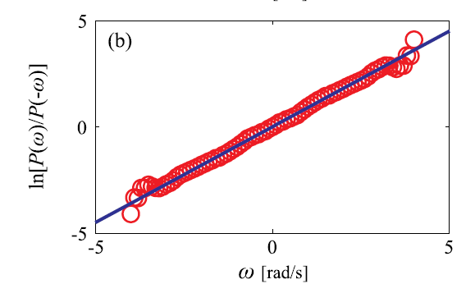
One example
Joubaud et al. (2012) did the experiment of an asymmetric rotor with four vanes in a granular gas, and confirm the existence of FT.

Slide 9
Our previous paper and the purpose of this talk
This is not new subject even for me.
Chong, Otsuki and Hayakawa proved IFT for granular fluid under a constant plane shear (2010).
The initial condition: equilibrium state
Purpose of this work
What can we get if we start from a nonequilibrium state?
What happens for more general systems?
What happens if the external field depends on the time?
How can we check its validity?
How can we understand many related papers?

Slide 10
Contents
Introduction
What is Fluctuation theorem and what is its implication?
Our tool=> Liouville equation
Nonequilibrium identities
IFT, FT, Jarzynski equality, generalized Green-Kubo
Numerical verification for sheared granular flow
Discussion: The implication of this study
Summary

Slide 11
Simulation model

Slide 12
SLLOD equation

Slide 13
Liouville equation
We begin with Liouville equation.
An arbitrary observable A($Γ(t)$) satisfies
=

Slide 14
Liouville operator

Slide 15
Liouville equation for distribution function
Non-Hermitian
Phase volume
contraction

Slide 16
Nonequilibrium distribution
We have to specify what the statistical weight is.
The simplest choice: the canonical distribution
There are a lot of advantages to simplify the argument, but we cannot discuss the response around a nonequilibrium state.
Here, we give a general or unspecified initial weight.

Slide 17
Contents
Introduction
What is Fluctuation theorem and what is its implication?
Our tool=> Liouville equation
Nonequilibrium identities
IFT, FT, (Jarzynski equality), generalized Green-Kubo
Numerical verification for sheared granular flow
Discussion: The implication of this study
Summary

Slide 18
IFT
It is readily to obtain the integral fluctuation theorem by using another expression of Z:
IFT simply represents the conservation of the probability.
where
Notes:
where

Slide 19
Consequence of IFT
From Jensen’s inequality, we obtain the second law like relation;
Because IFT is held for any t, we can rewrite it as

Slide 20
Derivation of FT
FT can be derived by using inverse path from the end point to the initial point.
To simplify the argument we start from
We introduce:
Notes:
where

Slide 21
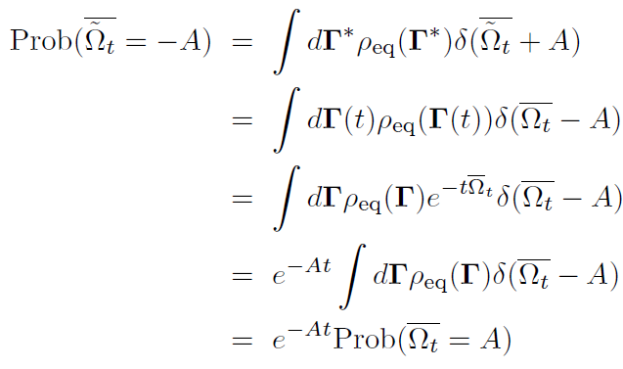
The derivation of FT
But FT might be useless because we use non-physical path.

Slide 22
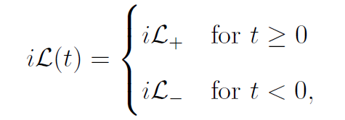
Generalized Green-Kubo formula
Generalized Green-Kubo (GGK) formula has been introduced by Evans and Morriss, which is the nonlinear version of Kubo formula.
We thought GGK is equivalent to IFT, but the condition to be held is narrower.
Namely, GGK is only valid for steady processes as

Slide 23
Generalized Green-Kubo formula
If we focus on the steady dynamics, it is easy to derive the generalized Green-Kubo formula.
In the zero dissipation limit from equilibrium

Slide 24
Contents
Introduction
What is Fluctuation theorem and what is its implication?
Our tool=> Liouville equation
Nonequilibrium identities
IFT, FT, Jarzynski equality, generalized Green-Kubo
Numerical verification for sheared granular flow
Discussion: The implication of this study
Summary

Slide 25
Numerical verifications
So far, we have not introduced any approximations.
We may need physical relevancies of these identities.
For this purpose, we perform numerical simulations for sheared granular systems under SLLOD dynamics and Lees-Edwards boundary condition.

Slide 26
Parameters
Unit: m, d, k
Viscous parameter $ς=0.00045.$=> e=0.999
N=18, $φ=0.66>$jamming point
Initial temperature
Time increment
Two step shear with ${\dot{γ}}_{0}$=0.1 and ${\dot{γ}}_{1}$=0.2
800,000 samples

Slide 27
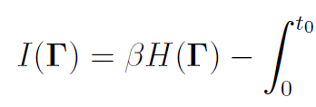
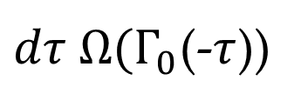
How can we get the nonequilibrium distribution?
The nonequilibrium distribution function in Liouville equation can be represented by
$iℒ_{0}$=
$dτ Ω(Γ_{0}$(-$τ$))

Slide 28
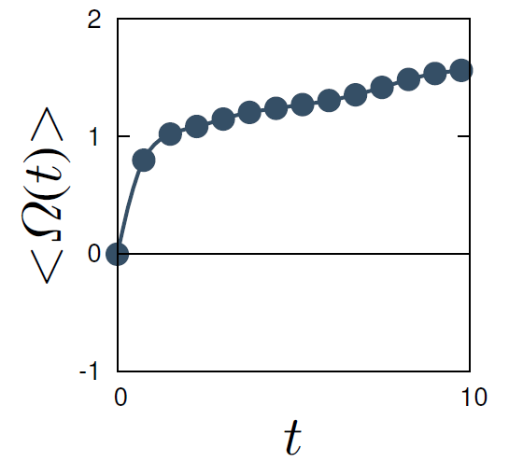
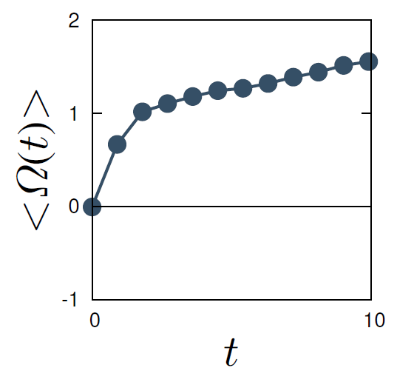
“Entropy”

Slide 29
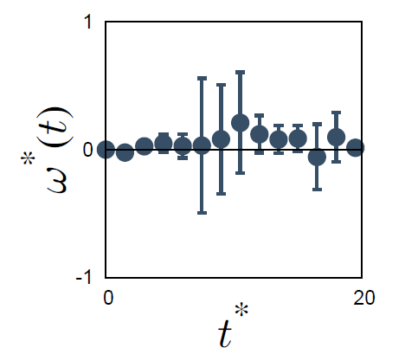
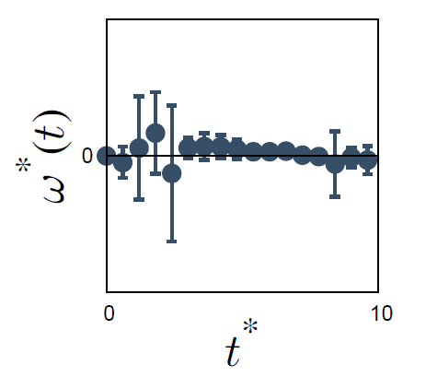
IFT

Slide 30
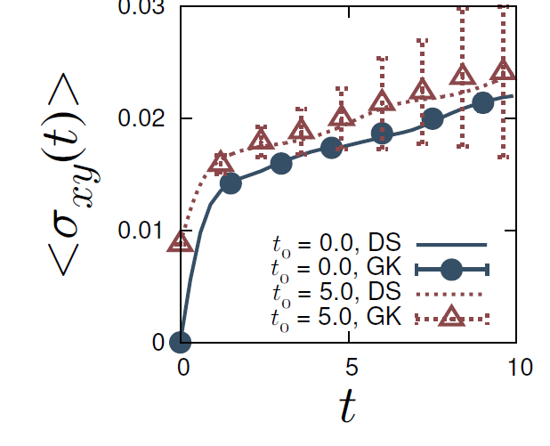
Generalized Green-Kubo formula

Slide 31
Contents
Introduction
What is Fluctuation theorem and what is its implication?
Our tool=> Liouville equation
Nonequilibrium identities
IFT, FT, Jarzynski equality, generalized Green-Kubo
Numerical verification for sheared granular flow
Discussion: The implication of this study
Summary

Slide 32
The implication of this study
We have derived some nonequilibrium identities which can be used even for systems without local time reversal symmetry.
Such identities can be used to test the validity of approximated calculation such as perturbation analysis.
More importantly, an arbitrary dissipative system still has the “ second law”.

Slide 33
Contents
Introduction
What is Fluctuation theorem and what is its implication?
Our tool=> Liouville equation
Nonequilibrium identities
IFT, FT, Jarzynski equality, generalized Green-Kubo
Numerical verification for sheared granular flow
Discussion: The implication of this study
Summary

Slide 34
Summary
We have derived IFT, FT,( Jarzynski equality) and generalized Green-Kubo formula.
There is a “second law” even for systems without local time reversal symmetry.
We numerically verified the validity of these identities for sheared granular flows.
These are still valid above the jamming point.
Our achievement may suggest the existence of “thermodynamics” for an arbitrary dissipative system.
See arXiv:1306.0450v1.

Slide 35
Thank you for your attention.

