Slide 1
the kinetic theory of lane formation
Physics of granular flows
M. Ikeda, H. Hayakawa
YITP, Kyoto-Univ

Slide 2
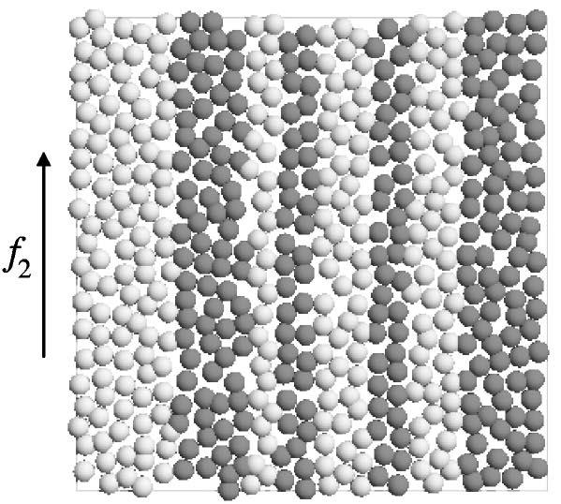
Lane formation in oppositely driven binary particle systems
experiment of oppositely charged colloids
Lane formation in
pedestrian dynamics
E
Mirjam E. Leunissen, et al., Nature 437; 235 - 240 (2005)
computer simulations of oppositely charged colloids
撮影場所：新広島球場
J. Dzubiella, G. P. Hoffmann, and H. Löwen, Phys. Rev. E 65, 021402 (2002);

Slide 3
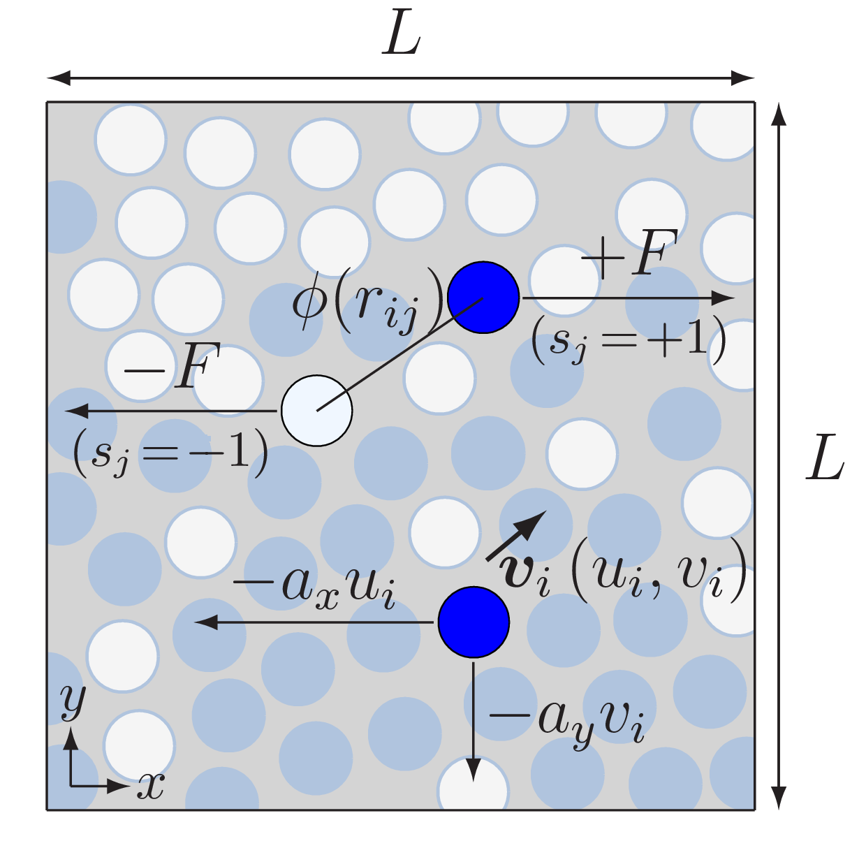
The model of counter driven particles with anisotropic dissipation
$$m\frac{dv_{i}}{dt}=a_{x}\left(s_{i}V_{0}−u_{i}\right)e_{x}−a_{y}v_{i}e_{y}−\sum_{j}{\frac{∂φ\left(r_{ij}\right)}{∂x}}$$
N particles interacting with a Weeks-Chandler-Andersen (WCA) potential $φ\left(r_{ij}\right)$
$s_{i}=+1,(−1)$ are driven to the positive (negative) x-direction by $F=a_{x}V_{0}$
in the case of $a_{x}≠a_{y}$ friction coefficients is anisotropic.
number density is 1.0
biperiodic boundary condition
$$F=a_{x}V_{0}$$
M. Ikeda, H. Wada, H. Hayakawa EPL 99 68005 (2012)

Slide 4
Typical results of MD simulation
small transverse friction
isotropic friction
$${a_{y}}/{a_{x}}=0.0, V_{0}=5.0$$
$${a_{y}}/{a_{x}}=1.0, V_{0}=5.0$$
($a_{x}=1.0$)

Slide 5
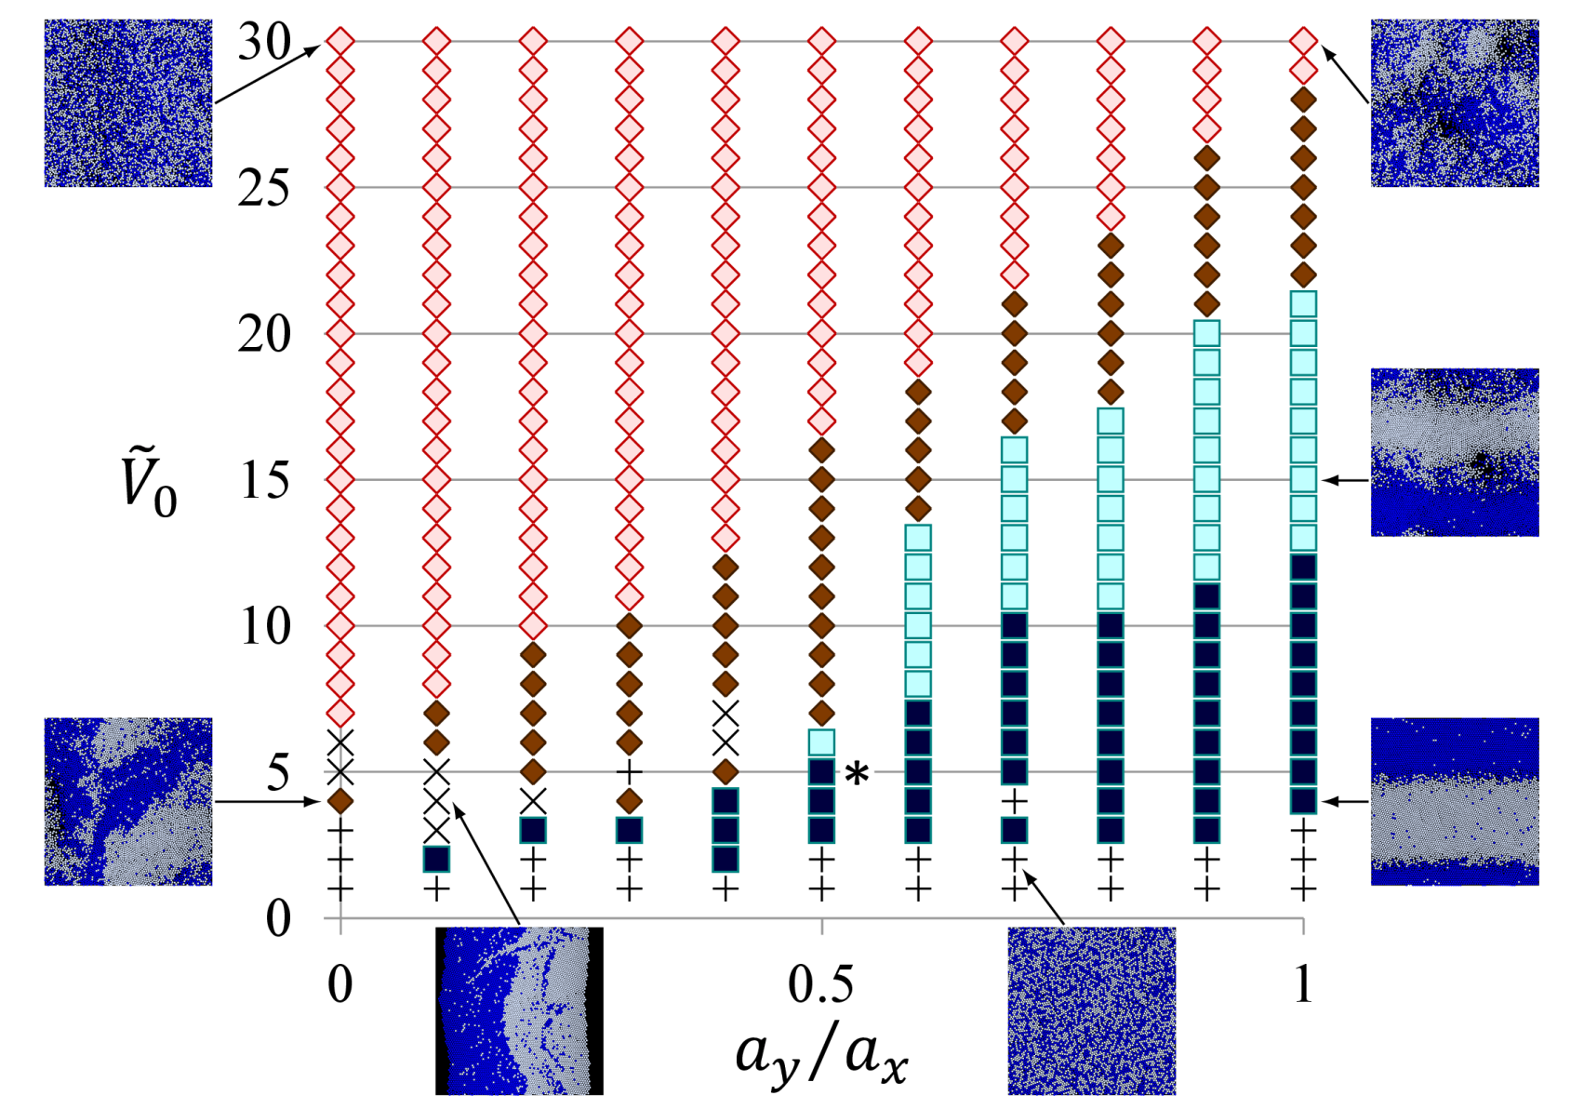
Phase diagram
$$Φ=0.00−0.25$$
$$Φ=0.25−0.50$$
$$Φ=0.50−0.75$$
$$Φ=0.75−1.00$$
$$ρσ^{2}=1.0 , L=80σ$$

Slide 6
Phase diagram
uniform gas
$$Φ=0.00−0.25$$
$$Φ=0.25−0.50$$
$$Φ=0.50−0.75$$
intermittent
lane
$$Φ=0.75−1.00$$
turbulence-like
lane
jammed
randomly mixed
$$ρσ^{2}=1.0 , L=80σ$$

Slide 7
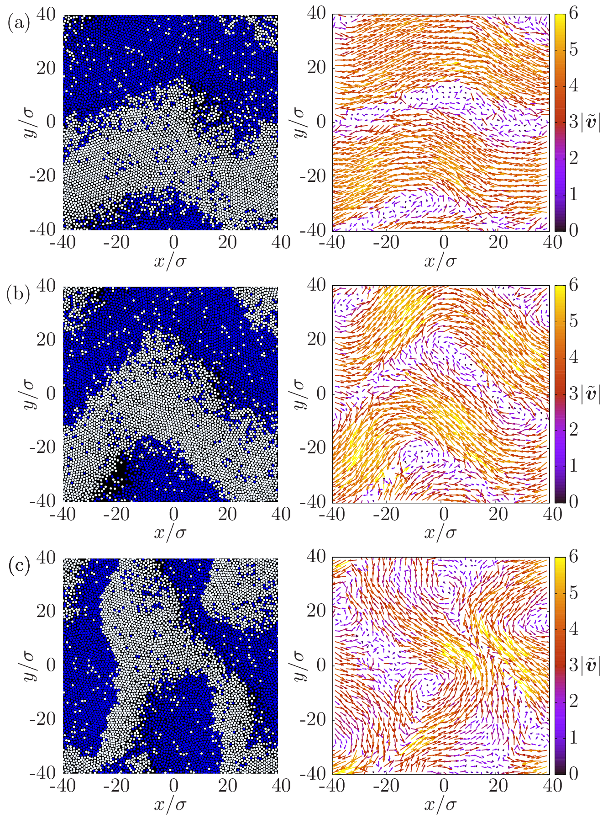
buckling motion
Typical time evolution of a transiently
formed lane structure in its unstable regime observed in our simulations. This lane formation is only transient and
is unstable against long-wavelength
undulations of the interfaces.
$$\left({a_{y}}/{a_{x}}=0.4, V_{0}=5.0\right)$$
$$\left({a_{y}}/{a_{x}}=0.2, V_{0}=5.0\right)$$

Slide 8
Number density, Temperature and Velocity field of the lane
$a_{x}=1.0, a_{y}=1.0, V_{0}=4.0,$ $ρσ^{2}=1.0$
Velocity field ${\left\langle u\right\rangle }_{x,t}$
The temperature $T_{A}$ of the lane phase is almost zero inside the lanes, whereas it is higher in the boundary layers between the oppositely oriented lanes.
In contrast, the number density $ρ_{A}$ is lower in the boundary layers and is higher inside the lanes.

Slide 9
the kinetic theory
We derived a set of hydrodynamic equations based on Enskog equation to to describe the lane formation process for counter driven dissipative particles
Enskog equation is expansion of the Boltzmann equation, and the Enskog equation is used for moderate dense gas.
Here, particles are hard sphere, and dissipation is isotropic.
V. Garzo and J. W. Dufty, Phys. Rev. E 59, 5895 (1999).

Slide 10
The Enskog Equation
The model for
particle-based simulations
introduce the enskog equation
collision term
Particles constitute as a hard sphere with size of diameter $σ$
geometric factor $χ$ is approximation for finite density effect
$f^{+}\left(r,v,t\right),f^{−}\left(r,v,t\right)$ is distribution function of $s_{i}=+1,−1$
Velocity moments of this equation provides fluid equations.

Slide 11
Approximate to Maxwell-Boltzmann distribution
We approximate distribution function $f^{±}(r,v,t)$ to Maxwell-Boltzmann distribution
We suppose that temperature $T$ does not depend on ingredient $\left(s=±1\right)$ here.
kinetic stress tensor and heat current from this distribution function is
When we approximate to Maxwell-Boltzmann distribution, effects of viscosity and heat current disappear. So we adopt the additional viscosity and heat current term from one component system.
K. Saitoh and H. Hayakawa ,Phys. Rev. E 75, 021302 (2007)

Slide 12
Fluid equations
Enskog Equation
derivation of velocity moments
Approximate to Maxwell-Boltzmann distribution
additional viscosity and heat current term
fluid equations for the lane forming systems.
density field
velocity field
……… ,
temperature
…… .

Slide 13
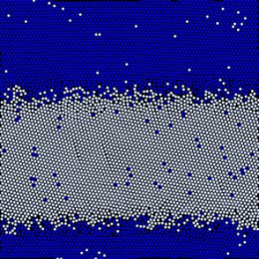
$$n^{+}−n^{−}$$
time evolution with
an assumption of
uniform state for x
$$y$$
$$x$$
$∂_{x}=0$,
$mV_{0}=2.0aσ$ , Initial state
$$u_{x}$$
$$u_{y}$$
$$u_{x}^{+}−u_{x}^{−}$$
$$u_{y}^{+}−u_{y}^{−}$$

Slide 14
$$n^{+}−n^{−}$$
time evolution with
an assumption of
uniform state for x
$$y$$
$$x$$
$∂_{x}=0$,
$mV_{0}=2.0aσ$ , $t=10m/a$
A calculation fails after this
$$u_{x}$$
$$u_{y}$$
$$u_{x}^{+}−u_{x}^{−}$$
$$u_{y}^{+}−u_{y}^{−}$$

Slide 15
summary
The anisotropy in the friction force is one of the key parameters that control the onset and stability of the lane formation.
We introduce the Enskog Equation to oppositely driven binary particle systems to provide fluid equations
$\text{time} \text{evolution} \text{with} \text{an} \text{assumption} \text{of} \text{uniform} \text{state} \text{for} \text{x}$
But there are some errors.

