Slide 1

Study of Hadron Properties in QCD Medium using the High-Energy Heavy-Ion Collisions
Hideki Hamagaki
Institute for Nuclear Study
Graduate School of Science
The University of Tokyo

Slide 2
Contents
Introduction
Low mass e+e- pair production at RHIC
  SPS results
  PHENIX (preliminary) results
  STAR (preliminary) results
Quarkonia and heavy flavors at LHC
  Recombination process in J/ψ production
  Energy loss of charm and bottom
  Charm thermalization
Summary

Slide 3
Introduction

Slide 4
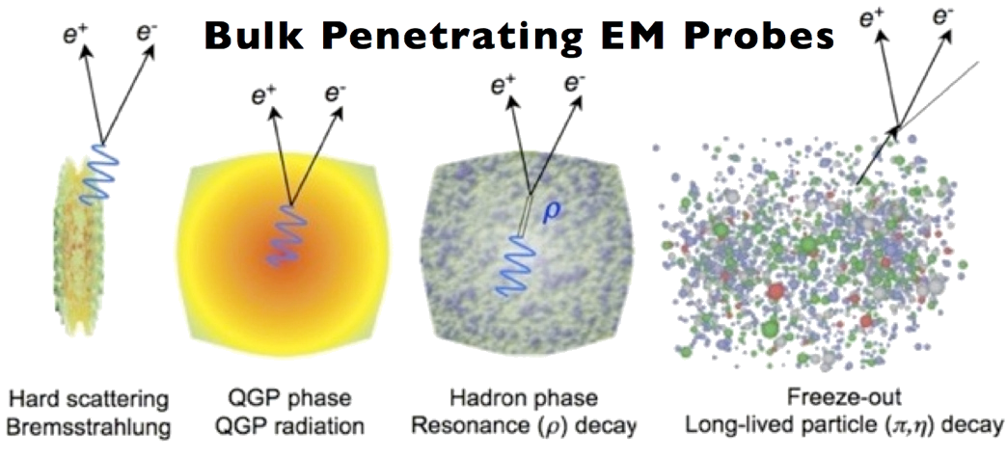
Dileptons in Heavy Ions
Low-mass range: M_{ee} <1.1 GeV/c²
  Nuclear modification of low-mass vector mesons in the dense hadronic/quark matter
  Relevance to the partial restoration of chiral symmetry
Quarkonia suppression
  A signature of deconfinement via Debye screening
  Clear enhancement seen at LHC, probably due to charm recombination process

Slide 5
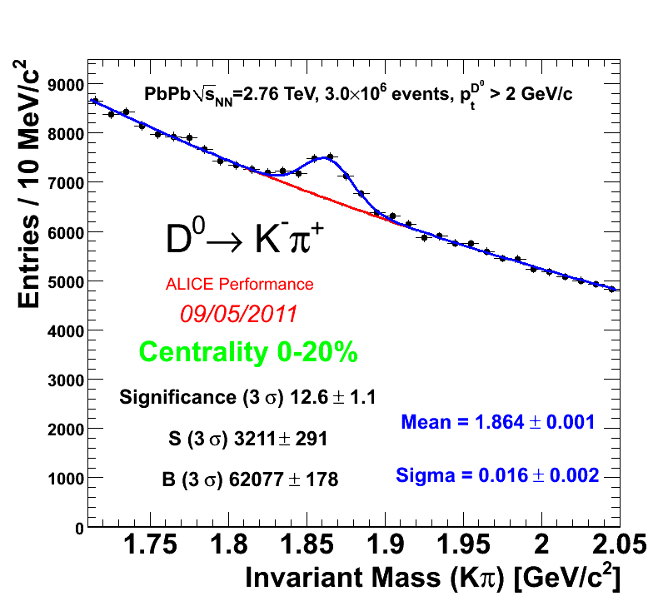
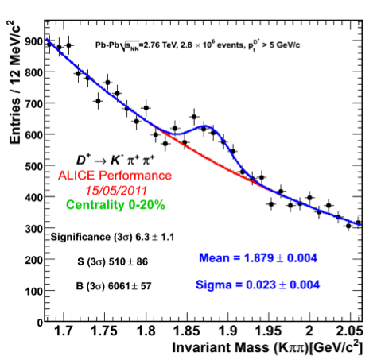
Charm Measurement at ALICE
D⁰→ Κ π
Semi-leptonic
Exclusive
D⁺→ Κ ππ
π⁺
Meson | D±,D⁰
Mass | 1869(1865) GeV
BR D⁰ → Kπ | 3.85 ± 0.10 %
BR D → e +X | D±: 17.2, D⁰: 6.7 %

Slide 6
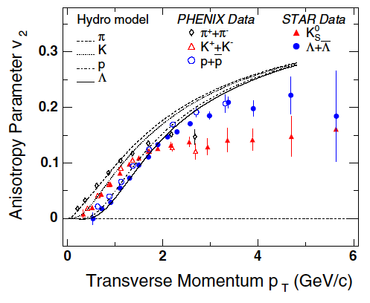
Three p_{T} Regions in Hadron Production
Low p_{T} (p_{T} < 1.5)
  Hydrodynamics of quarks/hadrons in the whole collision process
Medium p_{T} (2 < p_{T} < 6)
  Large contribution from quark recombination process
  Sensitive to behavior of quarks in QGP phase
  Thermalization of heavy quarks?
High p_{T} (p_{T} > 8)
  Mainly from jet fragmentation process
  Information on energy loss of parent partons in hot QCD matter

Slide 7
Two Quantities Used Frequently
v₂ = magnitude of elliptic anisotropy in azimuth relative to reaction plane in the angular distribution of emitted particles
R_{AA} = nuclear modification factor; particle yield in AA relative to pp, scaled with number of binary N-N collisions

Slide 8
Low mass e+e- Pairs in HI Collisions

Slide 9
Result from CERES Experiment
Pb+Au collisions at 158 A GeV
Comparison with the model calculations
  “In-medium hadronic” scenario provides better description compared to “dropping ρ mass” scenario
  Inclusion of “baryon effect” is essential to reproduce the invariant-mass spectral shape in the low mass region
Physics Letters B 666 (2008) 425–429

Slide 10
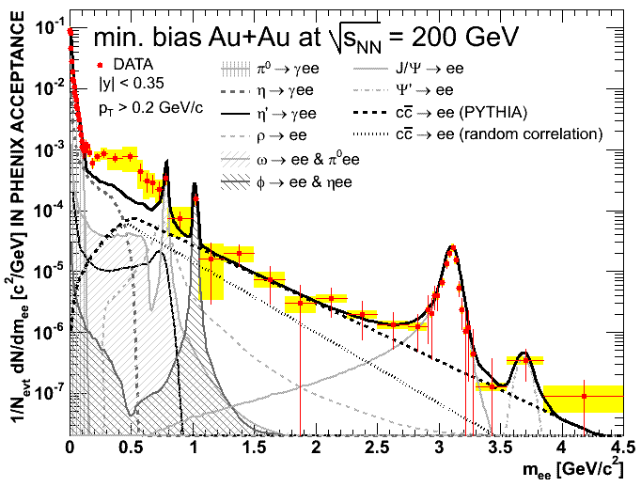
PHENIX: Dileptons in Au+Au collisions
PRC 81, 034911 (2010)
Strong enhancement of e+e- pairs at low masses: m_{inv} = 0.2 – 0.7 GeV/c²

Slide 11
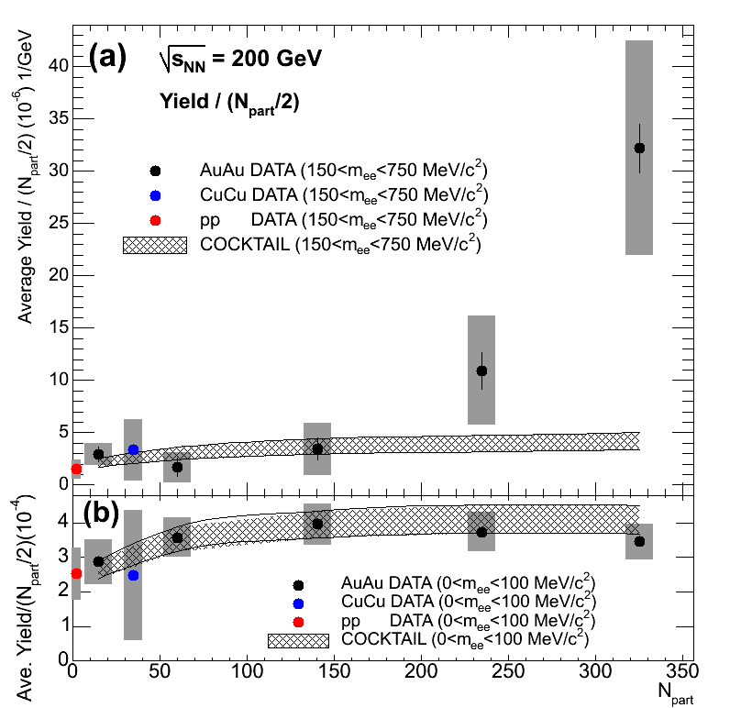
Centrality Dependence of Low Mass Continuum Yield
Excess region: 150 < m < 750 MeV
Yield/N_{part} has large increase at large N_{part}
  suggesting the in-medium production of electron-pairs via ππ or qq annihilation
π⁰ region: m < 100 MeV

Slide 12
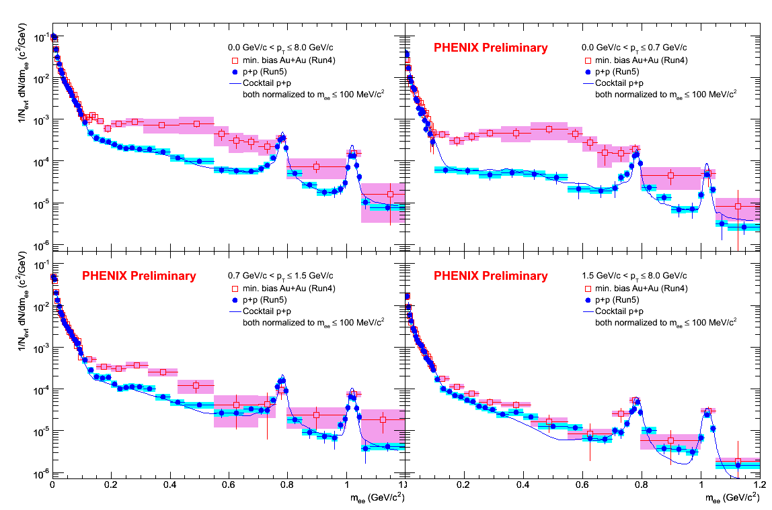
Low Mass Enhancement in Low-p_{T}
Au+Au
p+p
0<p_{T}<8.0 GeV/c
0<p_{T}<0.7 GeV/c
0.7<p_{T}<1.5 GeV/c
1.5<p_{T}<8 GeV/c
Low mass excess in Au-Au concentrated at low p_{T}

Slide 13
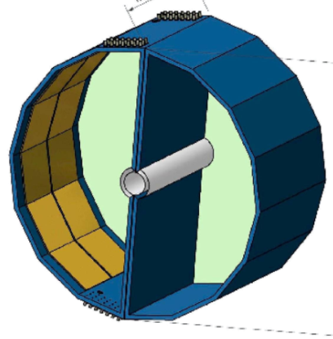
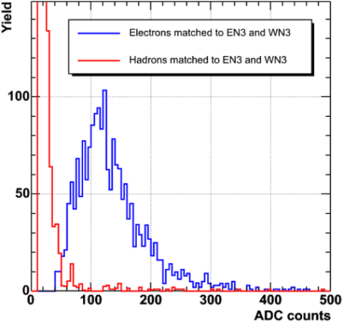
PHENIX: Hadron Blind Detector
Large uncertainty due to the huge combinatorial background from π⁰ Dalitz decays and γ-conversions
A Hadron Blind Detector (HBD), to improve S/B by rejecting conversions and π⁰ Dalitz decays
  Windowless CF₄ Cherenkov detector
  GEM/CsI photo-cathode readout
  Operated in B-field free region
Successfully operated in 2009 p+p run, and 2010 Au+Au run
  20 p.e. for a single electron
  Preliminary results: S/B improvement of ~5 wrt the previous results w/o HBD
Hadron blindness
e-h separation

Slide 14
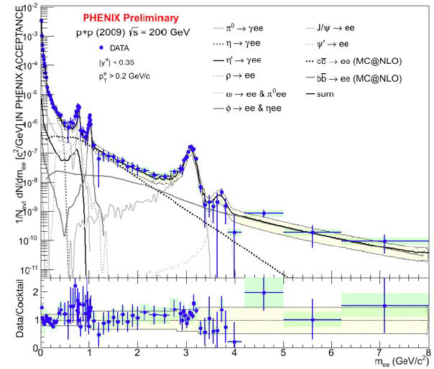
Run-9 p+p dilepton with HBD
Fully consistent with published result in PR C81, 034911 (2010)

Slide 15
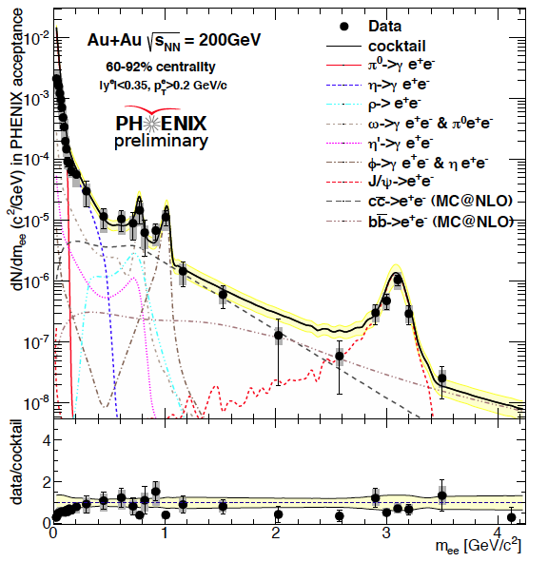
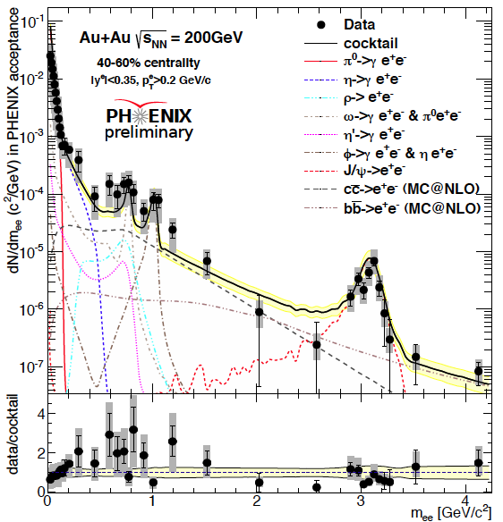
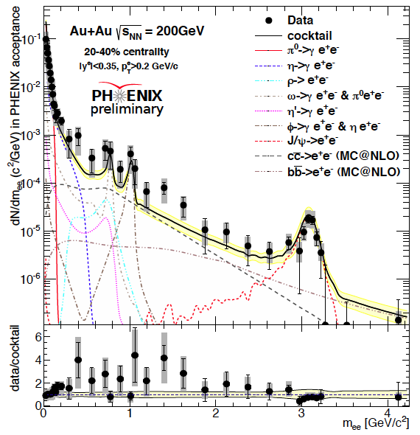
Au+Au dilepton at √s_{NN}=200 GeV
Peripheral
Semi-peripheral
Semi-central

Slide 16
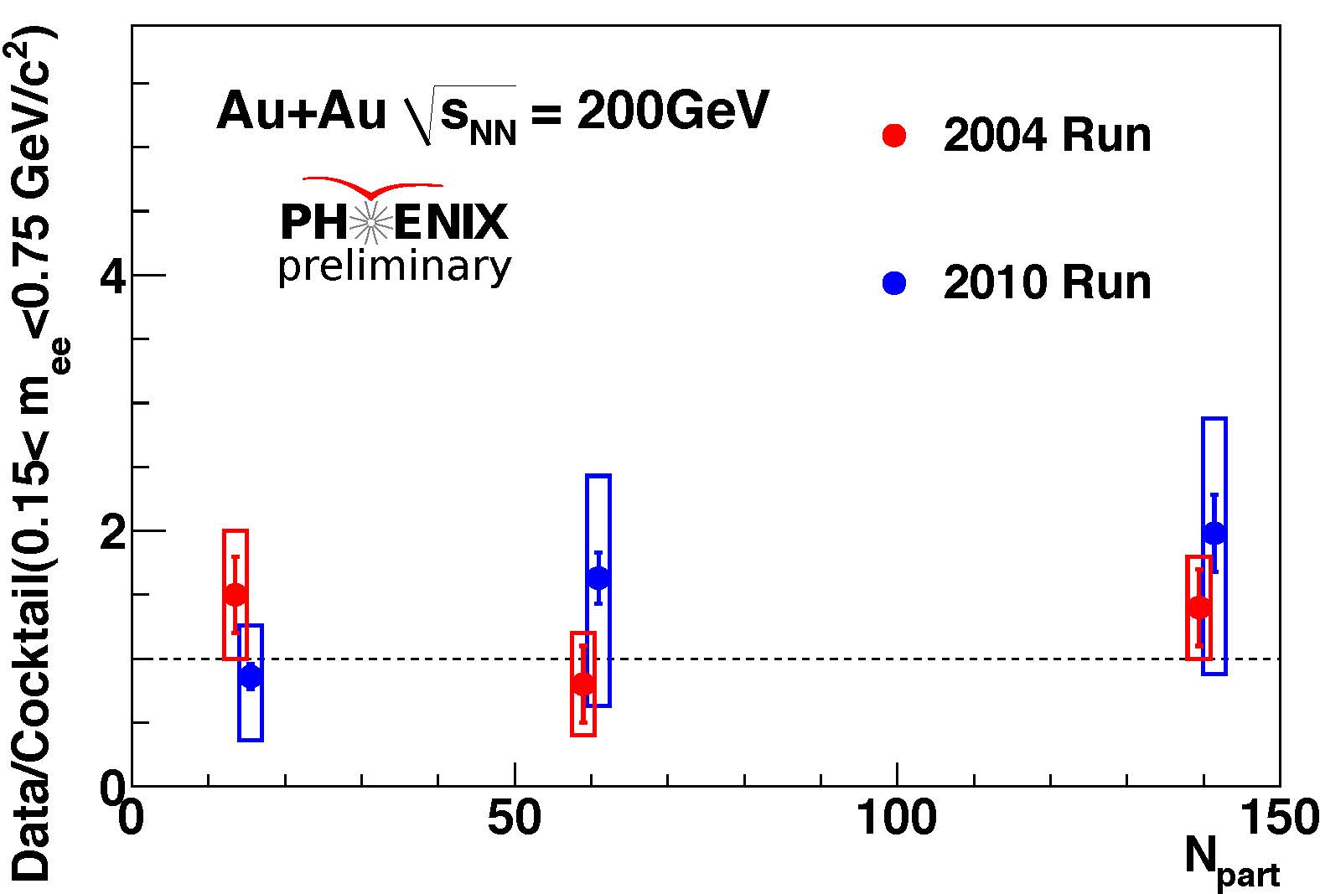
Comparison of the Two Results
Low mass region (m = 0.15 – 0.75 GeV/c2)
Only the results below N_{part} < 150 are available at this moment
Run-4 and Run-10 results are consistent -- encouraging
Completion of analysis for central collisions is eagerly hoped

Slide 17
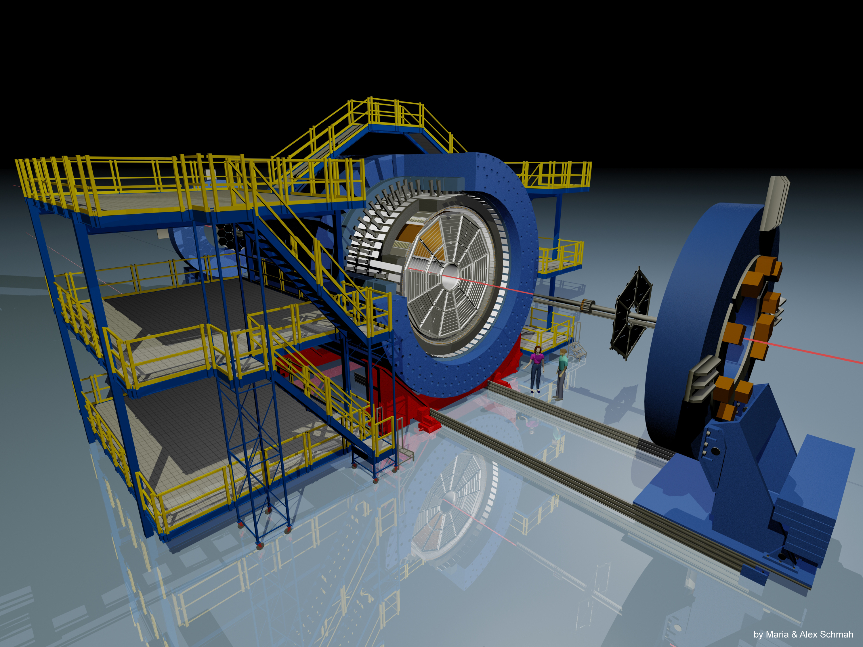
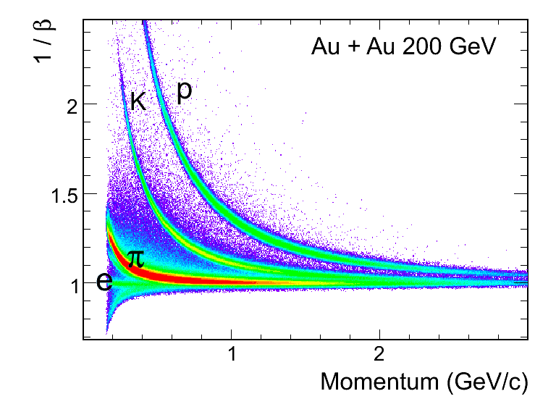
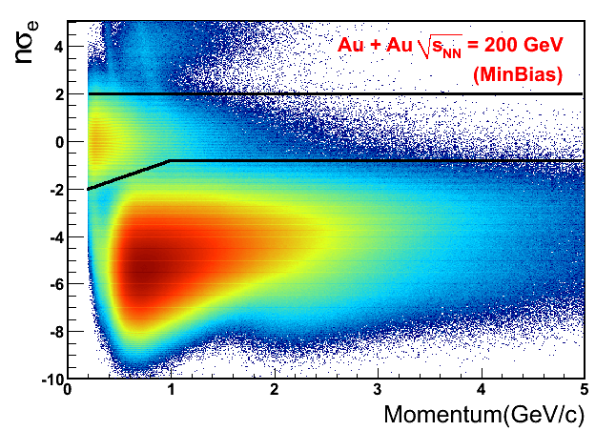
The STAR Experiment
Large acceptance electron ID
Time Projection Chamber
Time-of-Flight detector
  Removes “slow” hadrons
  improves electron purity
    ~92% for central events
    ~95% for min-bias events
Electromagnetic Calorimeter
Time-of-Flight Detector
  0<ϕ<2π, |η|<0.9
Time resolution < 100ps
Significantly improves PID

Slide 18
STAR: e+e- in p+p at 200 GeV
Phys. Rev. C 86, 024906 (2012)
STAR claims that cocktail simulation is consistent with data
Data/Cocktail strongly deviates from one at low-mass region

Slide 19
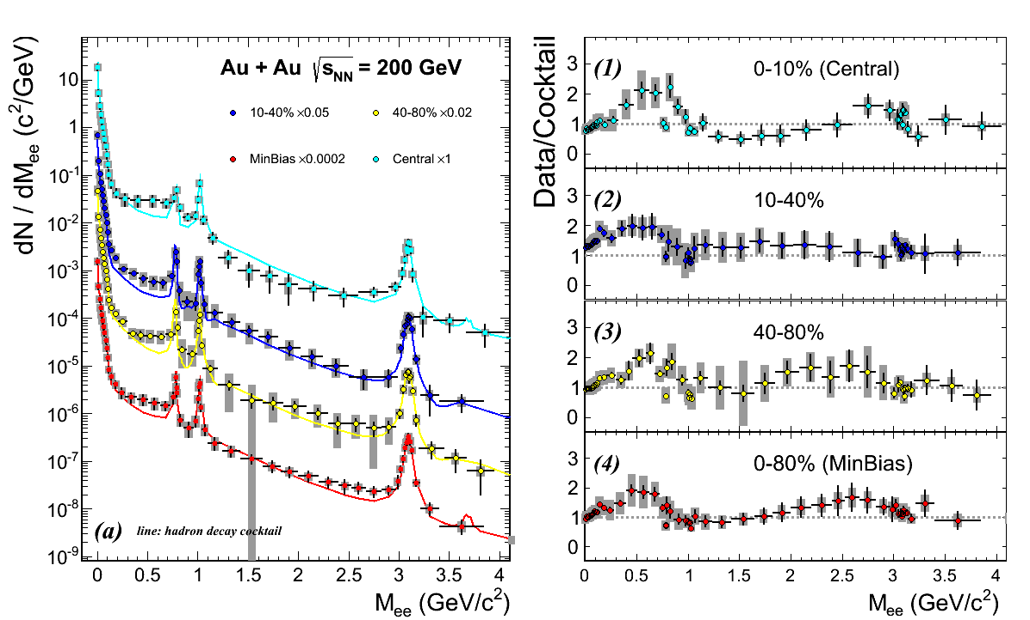
STAR: Au+Au at 200 GeV
STAR Preliminary
Enhancement when compared to cocktail
Centrality dependence is not large
Caveat: Understanding of background contributions?

Slide 20
Dielectron Production at lower √s_{NN}
Beam Energy Scan in 2010 – 2011
Au+Au at 62.4, 39, and 19.6 GeV
  Data samples; 55M, 99M, and 34M min-bias events

Slide 21
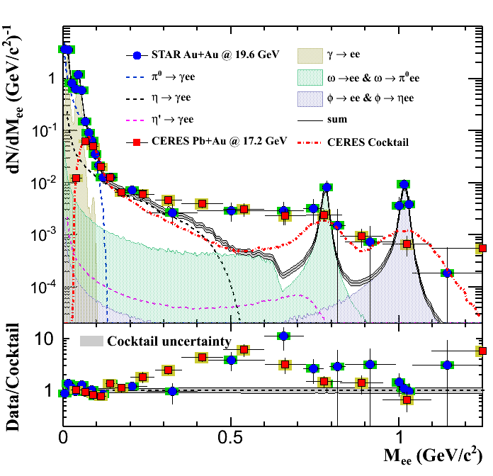
Comparison to SPS measurements
CERES Pb+Au at 17.2 GeV/c
  Eur. Phys. J. C 41 (2005) 475
  semi-central (0-28%)
  pT > 0.2GeV/c, 2.1 < η < 2.65, θee > 35mrad
STAR Au+Au at 19.6 GeV/c
  min-bias (0 - 80%)
  pT > 0.2GeV/c, |η|<1, |yee|<1
STAR Preliminary
STAR result is comparable to CERES
  … and with better mass resolution

Slide 22
Heavy Flavor in Pb-Pb collisions at LHC

Slide 23
R_{AA}(J/ψ) at LHC
PRL109, 072301 (2012)
forward rapidity
mid-rapidity
At LHC, R_{AA}(J/ψ) doesn’t decrease at large <N_{part}>, or even increase at mid-rapidity
Consistent with large contribution from recombination process
larger charm density at mid-rapidity

Slide 24
v₂(J/ψ) at LHC
arXiv:1303.5880
Sizable v₂(J/ψ) at LHC
  Null v₂(J/ψ) at RHIC
Consistent with the scenario of recombination of charms with finite v₂
  Not a trivial statement = charm starts to flow with in QGP
Model calculations
  Both assumes charm thermalization
APhysPolBSupp.5.323

Slide 25
v₂(D) at mid-p_{T}
arXiv:1207.7239
Sizable v₂ of D mesons at LHC
  Together with the J/ψ result, strong support of rapid thermalization of charm
Non-prompt J/ψ and D will provide information on bottom thermalization
  Better vertex determination and higher statistics are needed --> Upgrade, which will be mentioned later
BAMPS: Phys. Lett. B 717 (2012) 430
BAMPS: transport model, named as Boltzmann Approach to Multi-Parton Scatterings

Slide 26
D_{s}⁺ vs D^{0,+}
Larger D_{s}⁺/D⁰ and D_{s}⁺/D⁺ ratio seen in Pb-Pb, compared to those in pp for p_{T} < 8 GeV/c
Qualitatively consistent with the quark recombination picture
  Larger strangeness density --> additional D_{s}⁺ in Pb-Pb collisions

Slide 27
R_{AA} of D and non-prompt J/ψ
Non-prompt J/ψ from B decay <-- CMS
Compatible p_{T} range for D and the parent B of non-prompt J/ψ
Clear difference between charm and bottom: R_{AA}(np-J/ψ) > R_{AA}(D)
  Difference in energy loss of c and b in QGP?

Slide 28
summary & outlook

Slide 29
Summary & Outlook
Low mass e+e- pair production at RHIC
  New preliminary results from PHENIX and STAR
  Hope to reach converged unified view soon
Results on J/ψ and charmed mesons from ALICE
  Recombination process for J/ψ production in Pb-Pb
  Thermalization of charm in Pb-Pb?
  Energy loss of charm and bottom
Importance of data with higher statistics --> Major upgrade is planned at ALICE
  Pb-Pb data will be recorded with 50 kHz (= MB Pb-Pb rate after LHC intensity upgrade); ~100 times higher than current (-500Hz)
  New ITS (inner tracking system), GEM TPC with no gating grid, faster electronics and wider bandwidth …

Slide 30
Outlook – continued --
Significantly higher statistic data with high quality may make possible
To study interactions of charmed mesons/baryons with surrounding mesons/baryons
To search for exotic hadrons
  Multi-strange di-baryons and multi-baryons
  Charmed di-baryons
  Something more exotic

Slide 31
Backup

Slide 32
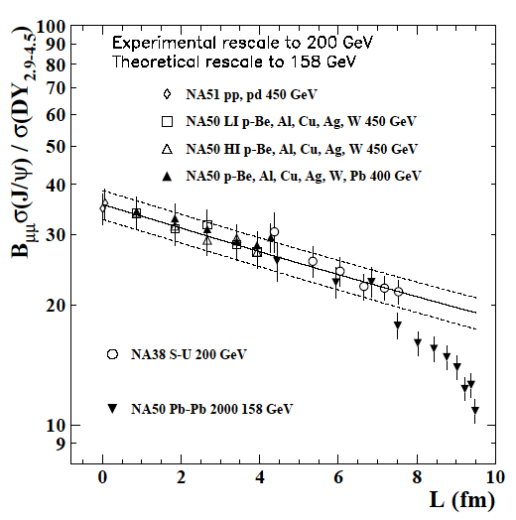
J/ψ at SPS & RHIC
J/ψ suppression; proposed as a probe of deconfinement by T. Matsui and H. Satz (1985)
Anomalous suppression was observed in Pb-Pb at SPS
Suppression with a similar magnitude to SPS was observed at RHIC

Slide 33
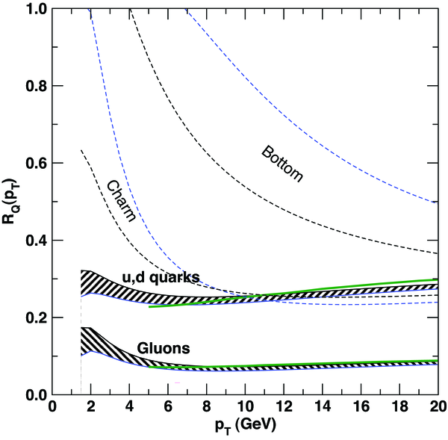
Heavy Flavor as Probes
Production = initial stage; pQCD
High p_{T} → energy loss
  Dead-cone effect
  gluon radiation suppressed at small angles (q < m_{Q}/E_{Q})
  Y. Dokshitzer, D. Kharzeev, PLB 519, 199 (2001), hep-ph/0106202
Low to medium p_{T} → thermalization
hot and dense medium
parton
Wicks et al., Nucl. Phys. A784, 426 (2007)
Bottom
Gluon radiation probability:
Charm
33

Slide 34
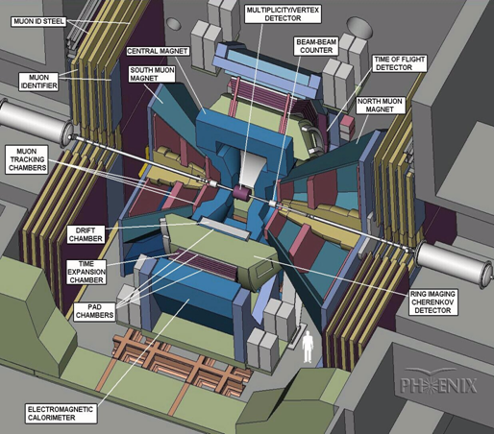
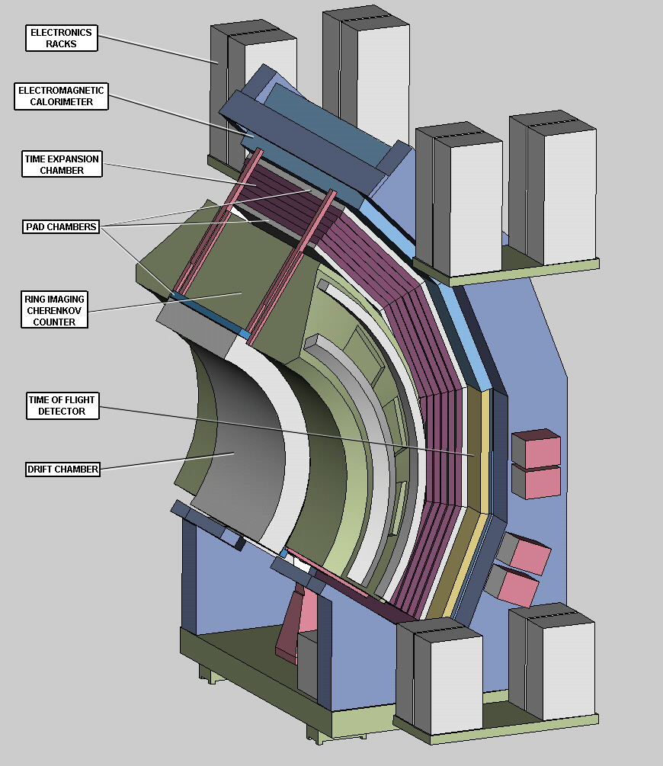
PHENIX experiment at RHIC
Design principle
  measure as many observables as possible
  hadrons with PID
  electrons, muons and photons
Two central arms
  for hadron, electron and photon measurement
  tracking chambers (DC + PC1,2,3 + TEC), PID (TOF + RICH), EM calorimeter (EMCAL)
Two muon arms
  lampshade magnet
  tracking chambers and muID
Inner detectors
  event trigger & event characterization
  BBC, MVD,ZDC

Slide 35
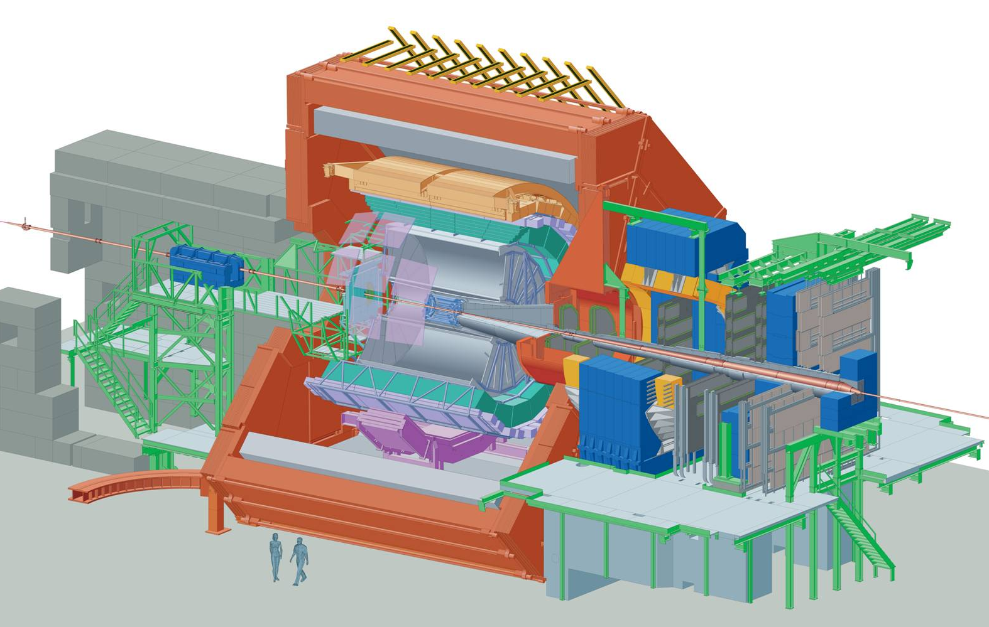
A Large Ion Collider Experiment
EMCAL
γ, π⁰, jets
T0/VZERO
Trigger/Centrality
L3 Magnet
ACORDE
Cosmic trigger
TRD
Electron ID (TR)
HMPID
PID (RICH) @ high p_{T}
TOF
PID
PMD
γ multiplicity
Dipole
TPC
Tracking,
PID (dE/dx)
ITS
Low p_{T} tracking
PID + Vertexing
MUON
μ-pairs
FMD
Charged
multiplicity
PHOS
γ, π⁰, jets
Not shown: ZDC (at ±116m)

Slide 36
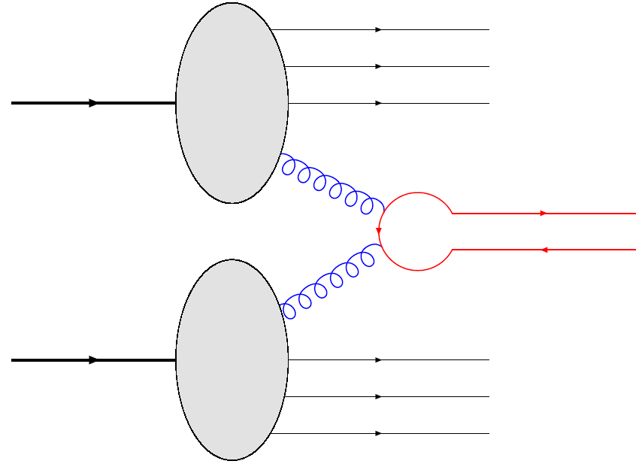
Heavy Quark Production in pp
Two-gluon fusion process
Copious production at LHC
  Charm: ~5mb@2.76TeV (8.5mb@7TeV)
  Bottom: ~0.3mb@7TeV

Slide 37
J/ψ production as a function of dN_{ch}/dy in pp collisions at √s = 7 TeV
dN_{J/ψ}/dy depends almost linearly on dN_{ch}/dy
Not accounted for by the direct hard process, as implemented in Phythia 6.4
Suggesting the effect of MPI (multi parton interaction) in c-cbar production
  c-cbar production is NOT be a very hard process at LHC?
Further studies are interesting for Υ, open charm, …
Physics Letters B 712 (2012) 165–175

Slide 38
D Yield in pp Collisions
dN_{D}/dy is almost linearly dependent on dN_{ch}/dy
Similar trend to that seen in J/ψ

