Slide 1
In-medium QCD forces for HQs at high T
New Frontiers in QCD 2013
Yukinao Akamatsu
Nagoya University, KMI
Y.Akamatsu, A.Rothkopf, PRD85(2012),105011 (arXiv:1110.1203[hep-ph] )
Y.Akamatsu, PRD87(2013),045016 (arXiv:1209.5068[hep-ph])
arXiv:1303.2976[nuch-th]

Slide 2
Contents
Introduction
In-medium QCD forces
Influence functional of QCD
Perturbative analysis
Summary & Outlook

Slide 3
1. Introduction

Slide 4
Confinement & Deconfinement
HQ potential
Singlet channel
V(R)
Coulomb + Linear
T=0
String tension K ~ 0.9GeVfm⁻¹
Debye screened potential
R
Debye Screened
High T>>T_{c}
Debye mass ω_{D} ~ gT (HTL)
The Schrödinger equation
Existence of bound states (cc, bb)
→ J/Ψ suppression in heavy-ion collisions
_
_
Matsui & Satz (86)

Slide 5
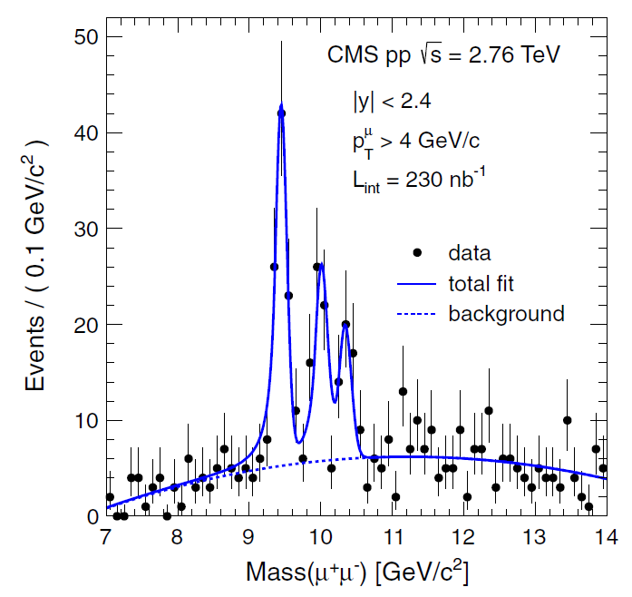
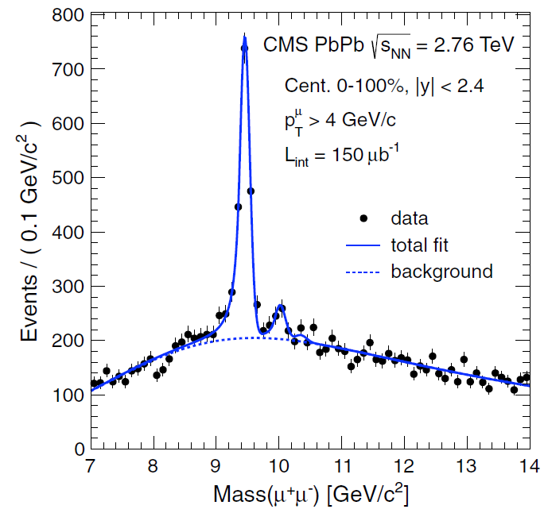
Quarkonium Suppression at LHC
CMS
Sequential melting of bottomonia
p+p
A+A
Time evolution of quarkonium states in medium is necessary

Slide 6
2. In-medium QCD forces

Slide 7
In-medium Potential
Definition
T>0, M=∞
r
R
Long time dynamics
Complex potential !
Laine et al (07), Beraudo et al (08),
Bramilla et al (10), Rothkopf et al (12).
t
σ(ω;R,T)
i=0 i=1 …
(0<τ<β)
Γ(R,T)
V(R,T)
ω
Lorentzian fit of lowest peak in SPF σ(ω;R,T)

Slide 8
In-medium Potential
Stochastic potential
Akamatsu & Rothkopf (‘12)
Noise correlation length ~ l_{corr}
Imaginary part
= Local correlation only
Phase of a wave function gets uncorrelated at large distance > l_{corr}
Decoherence → Melting (earlier for larger bound states)

Slide 9
In-medium Forces
Whether M<∞ or M=∞ matters
Debye screened force
+
Fluctuating force
M=∞
(Stochastic) Potential force
→Hamiltonian dynamics
M<∞
Drag force
Non-potential force
Langevin dynamics
→Not Hamiltonian dynamics

Slide 10
3. Influence functional of QCD

Slide 11
Open Quantum System
sys = heavy quarks
env = gluon, light quarks
Basics
Hilbert space
von Neumann equation
Trace out the environment
Reduced density matrix
Master equation
(Markovian limit)

Slide 12
Closed-time Path
QCD on CTP
Factorized initial density matrix
Influence functional
Feynman & Vernon (63)

Slide 13
Influence Functional
Reduced density matrix
1
2
s
Path integrate until s, with boundary condition

Slide 14
Influence Functional
Functional master equation
Effective initial wave function
Effective action S1+2
→Single time integral
Long-time behavior (Markovian limit)
Analogy to the Schrödinger wave equation
Functional differential equation

Slide 15
Hamiltonian Formalism (skip)
Technical issue
Order of operators = Time ordered
Change of Variables (canonical transformation)
Kinetic term
Instantaneous interaction
or
Remember the original order
Make 1 & 2 symmetric
Determines without ambiguity

Slide 16
Hamiltonian Formalism (skip)
Technical issue
Variables of reduced density matrix
Renormalization
Latter is better (explained later)
Convenient to move all the functional differential operators to the right in
In this procedure, divergent contribution from e.g. Coulomb potential at the origin appears → needs to be renormalized

Slide 17
Reduced Density Matrix
Coherent state
Source for HQs

Slide 18
Reduced Density Matrix
A few HQs
One HQ
Similar for two HQs, …

Slide 19
Master Equation
From fields to particles
Functional master equation
For one HQ
Functional differentiation
Master equation
Similar for two HQs, …

Slide 20
4. Perturbative analysis

Slide 21
Approximation (I)
Leading-order perturbation
Influence functional
Expansion up to 4-Fermi interactions
Leading-order result by HTL resummed perturbation theory

Slide 22
Approximation (II)
Heavy mass limit
Non-relativistic kinetic term
Expansion up to
Non-relativistic 4-current (density, current)
(quenched)

Slide 23
Approximation (III)
Scattering time ~ 1/q (q~gT, T)
HQ time scale is slow:
Color diffusion ~ 1/g²T
Momentum diffusion ~ M/g⁴T²
Long-time behavior
Time-retardation in interaction
Low frequency expansion

Slide 24
Effective Action
LO pQCD, NR limit, slow dynamics
Stochastic potential
(finite in M→∞)
Drag force
(vanishes in M→∞)

Slide 25
Physical Process
Scatterings in t-channel
Q
g
q
q
. . .
. . .
Scatterings with hard particles contribute to drag, fluctuation, and screening
. . .
g
. . .
g
Q
Independent scatterings

Slide 26
Single HQ
Master equation
Ehrenfest equations
Moore et al (05,08,09)

Slide 27
Complex Potential
Forward propagator
Time-evolution equation + Project on singlet state
Laine et al (07), Beraudo et al (08), Brambilla et al (10)

Slide 28
Stochastic Potential
Stochastic representation
M=∞ : Stochastic potential
Debye screened potential
Fluctuation
D(x-y): Negative definite
M<∞ : Drag force
Two complex noises c1,c2
→ Non-hermitian evolution

Slide 29
5. Summary & OUTLOOK

Slide 30
Open quantum systems of HQs in medium
Stochastic potential, drag force, and fluctuation
Influence functional and closed-time path
Functional master equation, master equation, etc.
Toward phenomenological application
Stochastic potential with color
Emission and absorption of real gluons
More on theoretical aspects
Conform to Lindblad form
Non-perturbative definition

Slide 31
Backup

Slide 32
In-medium Potential
Definition
r
T=0, M=∞
R
Long time dynamics
t
σ(ω;R)
V(R) from large τ behavior
V(R)
ω

Slide 33
Closed-time Path
1
Basics
2
Partition function

Slide 34
Functional Master Equation
Renormalized effective Hamiltonian

Slide 35
Functional Master Equation
Analogy to Schrödinger wave equation
Anti-commutator in functional space

