Slide 1


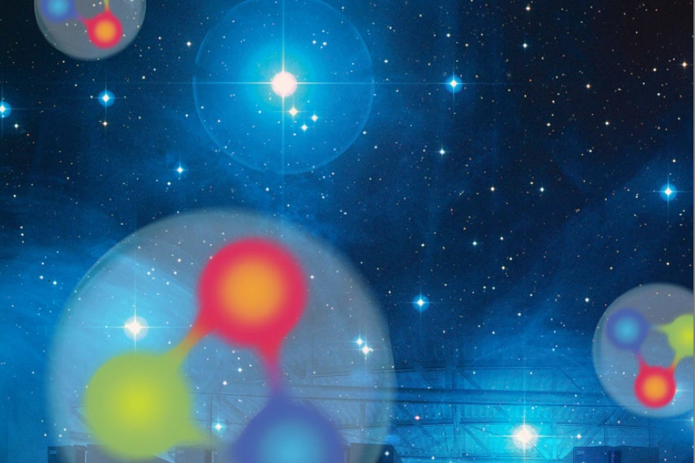

Symposium on New Frontiers in QCD 2013
Jet transport coefficients in heavy-ion collisions
Xin-Nian Wang
Central China Normal University / Lawrence Berkeley National Lab

Slide 2
Properties of QGP
Space-time profile:
EOS:
EM response:
Bulk transport:
Jet transport:
…
Notes:
it is important to take a look back at what properties of QGP we are interested in and what can be studied in heavy-ion collisions.
W_{\mu\nu}(q)=\int \frac{d^4x}{4\pi} e^{iq\cdot x}\langle j_\mu(0) j_\nu(x)\rangle
\eta =\lim_{\omega\rightarrow 0}\frac{1}{2\omega}\int dt dx e^{i\omega t}\langle \left[T_{xy}(0),T_{xy}(x)\right]\rangle
\hat q= \frac{4\pi^2\alpha_s C_R}{N_c^2-1}\int\frac{dy^-}{\pi}\langle F^{\sigma +}(0) F_{\sigma}^{\,+}(y)\rangle

Slide 3
Probes of QGP in A+A Collisions
EM Probes: Medium response
to EM interaction
γ prod., J/Ψ suppression:
Hard probes: medium response to
hard scattering
Jet quenching:
Soft probes: Bulk properties of medium
collective flow:
Notes:
q\frac{dR_\gamma}{d^3q}=\Gamma_0 +\frac{\pi^{\mu\nu}}{2(e+p)} \Gamma_{\mu\nu}

Slide 4
Multiple scattering and gauge invariance
Belitsky, Ji & Yuan’ 2002
Collins & Soper(82)
....
p
k
Jet transport operatordue to color Lorentz force
Liang, XNW & Zhou （2008）
Notes:
Among all hard and EM probes, one must study the interaction of partons in medium, for jet quenching in involves energteic partons almost along the light-cone.
f_A^q(x,\vec k_\perp)=\int\frac{d y^-}{4\pi}\frac{d^2y_\perp}{(2\pi)^2}
e^{ixp^+y^- -i \vec k_\perp\cdot \vec y_\perp} \langle A |\bar \psi(0) \gamma^+ {\cal L}(0,y)\psi(y) | A\rangle
{\cal L}(0,y)={\cal L}^\dagger_\parallel(\infty,0;\vec 0_\perp)
{\cal L}_\perp^\dagger(\infty;\vec y_\perp,\vec 0_\perp) {\cal L}_\parallel(\infty,y^-;\vec y_\perp)
f_A^q(x,\vec k_\perp)\approx \frac{A}{\pi \Delta}\int d^2 q_\perp
\exp\left[-\frac{(\vec k_\perp - \vec q_\perp)^2}{\Delta}\right]f_N^q(x,\vec q_\perp)
\Delta =\langle \Delta k_\perp^2\rangle=\int d\xi_N^- \hat q(\xi_N)
{\cal L}_\parallel(-\infty,y^-,\vec y_\perp)={\cal P} \exp\left[-ig\int_{y^-}^{-\infty} d\xi^- A_+(\xi^-,\vec y_\perp)
\right]
{\cal L}_\perp(-\infty;\vec y_\perp,\vec 0)={\cal P} \exp\left[-ig\int_{y^-}^{-\infty} d\vec\xi_\perp\cdot \vec A_\perp (\xi^-,\vec y_\perp)\right]
{\cal L}_\perp(-\infty;\vec y_\perp,\vec 0)={\cal P} \exp\left[-ig\int_{\vec 0_\perp}^{\vec y_\perp} d\vec\xi_\perp\cdot \vec A_\perp (-\infty,\vec \xi_\perp)\right]
{\cal L}(0;y)={\cal L}^\dagger_\parallel(-\infty,0,\vec 0_\perp)
{\color{red}{\cal L}_\perp^\dagger(-\infty;\vec y_\perp,\vec 0_\perp) }{\cal L}_\parallel(-\infty,y^-;\vec y_\perp)
\hat q= \frac{4\pi^2\alpha_s C_R}{N_c^2-1}\int\frac{dy^-}{\pi}\langle F^{\sigma +}(0) F_{\sigma}^{\,+}(y)\rangle=\frac{4\pi^2\alpha_s C_R}{N_c^2-1}\rho_A xG_N(x)|_{x\rightarrow 0}

Slide 5
Transverse momentum broadening
Random talk or two-gluon correlation approximation:
(BDMPS’96)
Notes:
\langle W_\perp^{2n}\rangle_A \sim \left[\int d\xi_N\frac{\rho_A(\xi_N)}{2p^+}\langle N| F^{+\perp}F^+_\perp |N\rangle \right]^n \sim \left[\int d\xi_N\rho_A(\xi_N) xG(x)_N\right]^n
f_A^q(x,\vec k_\perp)=\int\frac{d y^-}{4\pi}\frac{d^2y_\perp}{(2\pi)^2}
e^{ixp^+y^- -i \vec k_\perp\cdot \vec y_\perp} \langle A |\bar \psi(0) \gamma^+ {\cal L}(0,y)\psi(y) | A\rangle
{\cal L}(0,y)={\cal L}^\dagger_\parallel(\infty,0;\vec 0_\perp)
{\cal L}_\perp^\dagger(\infty;\vec y_\perp,\vec 0_\perp) {\cal L}_\parallel(\infty,y^-;\vec y_\perp)
f_A^q(x,\vec k_\perp)\approx \frac{A}{\pi \Delta }\int d^2 q_\perp
\exp\left[-\frac{(\vec k_\perp - \vec q_\perp)^2}{\Delta}\right]f_N^q(x,\vec q_\perp)
\Delta =\langle \Delta k_\perp^2\rangle=\int d\xi_N^- \hat q(\xi_N)
{\cal L}_\parallel(-\infty,y^-,\vec y_\perp)={\cal P} \exp\left[-ig\int_{y^-}^{-\infty} d\xi^- A_+(\xi^-,\vec y_\perp)
\right]
{\cal L}_\perp(-\infty;\vec y_\perp,\vec 0)={\cal P} \exp\left[-ig\int_{y^-}^{-\infty} d\vec\xi_\perp\cdot \vec A_\perp (\xi^-,\vec y_\perp)\right]
{\cal L}_\perp(-\infty;\vec y_\perp,\vec 0)={\cal P} \exp\left[-ig\int_{\vec 0_\perp}^{\vec y_\perp} d\vec\xi_\perp\cdot \vec A_\perp (-\infty,\vec \xi_\perp)\right]
\hat q= \frac{4\pi^2\alpha_s C_R}{N_c^2-1}\int\frac{dy^-}{\pi}\langle F^{\sigma +}(0) F_{\sigma}^{\,+}(y)\rangle=\frac{4\pi^2\alpha_s C_R}{N_c^2-1}\rho_A xG_N(x)|_{x\rightarrow 0}

Slide 6
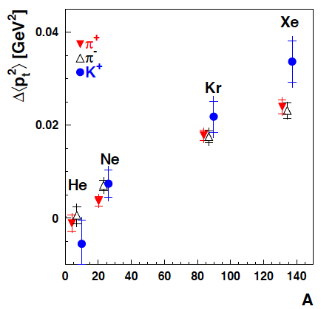
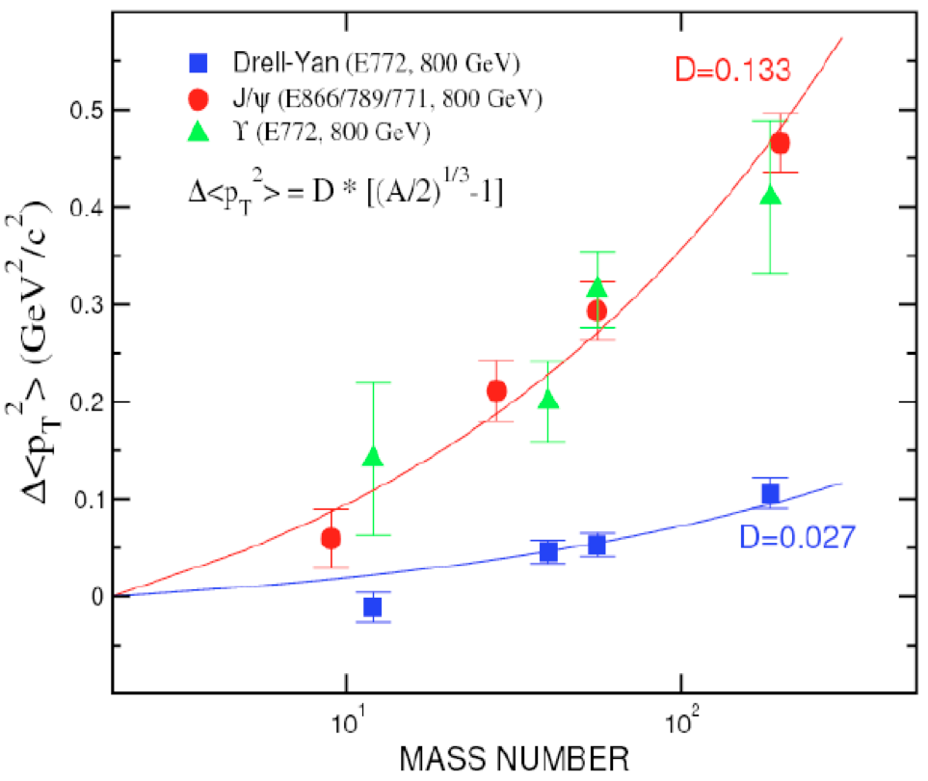
pt broadening in cold nuclei
e+A → hadrons + X
p+A → l^{+l-}, J/Ψ + X
Notes:
\hat q_0\approx 0.02 \,\,\, {\rm GeV}^2/fm {\rm (at \,the \, center\, of\, a\, nucleus)}

Slide 7


Azimuthal asymmetry
Liang & XNW (2007)
Gao, Liang & XNW (2010)
Song, Gao Liang & XNW
(2011), (2013)
Notes:
\langle \cos\phi\rangle_{eA}=\frac{2(2-y)\sqrt{1-y}}{1+(1-y)^2}\frac{k_T}{Q}\frac{x_B f_{A\perp}^q(x_B,k_T)}{f_A^q(x_B,k_T)}
f_{A\perp}^q(x,k_T)=p^+\int\frac{d y^-}{4\pi}\frac{d^2y_\perp}{(2\pi)^2}
e^{ixp^+y^- -i \vec k_\perp\cdot \vec y_\perp} \langle A |\bar \psi(0)\frac{\gamma\cdot k_T}{k_T^2} {\cal L}(0,y)\psi(y) | A\rangle

Slide 8
Jet transport in thermal QCD medium
LO pQCD (with HTL)
Gelis, Blaizot & Baym 2007
NLO pQCD (with HTL)
Caron-Huot 2008
LO
Notes:
f(\vec k_\perp, L)=\int d^2y_\perp e^{-i\vec k_\perp\cdot \vec y_\perp} f(y_\perp,L), \;\; f(y_\perp,L)=\frac{1}{N_c}{\rm Tr} \langle {\cal L}(0,L^-,\vec y_\perp)\rangle
\hat q=\frac{1}{L} \int\frac{d^2k_\perp}{(2\pi)^2} k_\perp^2 f(k_\perp,L) \approx \frac{4\pi^2\alpha_s C_R}{N_c^2-1}\int\frac{dy^-}{\pi}\langle F^{\sigma +}(0)F_\sigma^+(y^-)\rangle
C(k_\perp)=\frac{d\Gamma_{LO}}{d^2k_\perp}=\frac{f(k_\perp, L)}{L(2\pi)^2}=\frac{C_a}{(2\pi)^2}\frac{g^2m_D^2 T}{k_\perp^2(k_\perp^2+m_D^2)}
\frac{\hat q_{\rm NLO}}{T^3}=\frac{C_ag^4}{2\pi}\left[\frac{3}{2} \log\frac{T}{m_D}+\frac{7}{4}\frac{\xi(3)}{\xi(2)}\log\frac{q_{\rm max}}{T}
+2.198\frac{m_D}{T} + \cdots \right]
Soft sector, tilt the tilt the parton beyond the light cone into the space-like domain upon which the associated Wilson loop becomes amenable to Euclidean methods
\langle {\cal W}(0) {\cal W}(y^-)\rangle \rightarrow \langle {\cal W}(0,0) {\cal W}(0,z)\rangle +{\cal O}(T/p_z)
V(y_\perp)=-\frac{d\ln f(y_\perp,L)}{dL}
=\int\frac{d^2k_\perp}{(2\pi)^2}(1-e^{i\vec k_\perp \cdot \vec y_\perp})C(k_\perp)
\hat q_{\rm EQCD}\approx 0.55 g_E^6

Slide 9
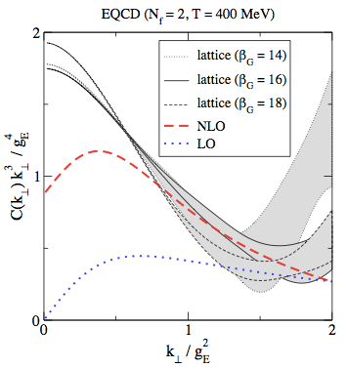
Non-perturbative contribution to qhat
Analytic continuation: Majumder (2012)
Tilt the parton into space-like or boost to the rest frame of the probe
Caron-Huot (2009), Ji (2013):
EQCD: for soft mode ; match to NLO pQCD at higher k_{T}
Panero, Rummukainen & Schaefer (2013)
D’Eramo, et al (2012)
Laine & Rothkopf (2013)
Notes:
f(\vec k_\perp, L)=\int d^2y_\perp e^{-i\vec k_\perp\cdot \vec y_\perp} f(y_\perp,L), \;\; f(y_\perp,L)=\frac{1}{N_c}{\rm Tr} \langle {\cal L}(0,L^-,\vec y_\perp)\rangle
\hat q=\frac{1}{L} \int\frac{d^2k_\perp}{(2\pi})^2 k_\perp^2 f(k_\perp,L)
Soft sector, tilt the tilt the parton beyond the light cone into the space-like domain upon which the associated Wilson loop becomes amenable to Euclidean methods
\langle {\cal W}(0) {\cal W}(y^-)\rangle \rightarrow \langle {\cal W}(0,0) {\cal W}(0,z)\rangle +{\cal O}(T/p_z)
V(y_\perp)=-\frac{d\ln f(y_\perp,L)}{dL}
=\int\frac{d^2k_\perp}{(2\pi)^2}(1-e^{i\vec k_\perp \cdot \vec y_\perp})C(k_\perp)
\hat q_{\rm EQCD}\approx 0.55 g_E^6

Slide 10
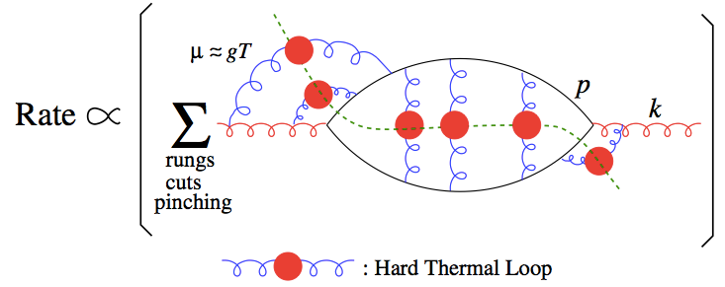
Parton energy loss in Medium
k
(BDMPS’96)
....
Arnold, Moor, Yaffe (AMY’01): DS eqs.
McGill-AMY: coupled rate equations
Gyulassy-Levai-Vitev (GLV’00): Opacity expansion
High-twist approach: Modified frag. Func.
Guo & XNW’00, Zhang,Wang, XNW’03
McGill-AMY, MARTINI-AMY, CUJET, HT-BW, HT-M, JEWEL, JaYEM, PCM, BAMPS ….
Notes:
i\vec\partial_{y_\perp} {\cal L}(0,y)={\cal L}(0,y) \left [ i\vec D_\perp(y)+g\int_{-\infty}^{y^-}d\xi^- \vec F_{+\perp}(\xi^-,y_\perp)\right]
\vec W_\perp(y^-,\vec y_\perp)\equiv i\vec D_\perp(y)+g\int_{-\infty}^{y^-}d\xi^- \vec F_{+\perp}(\xi^-,y_\perp)
\langle \Delta k^2_T\rangle = \int dy \hat q(y)
\hat q = \int d^2q_\perp \langle \rho \frac{d\sigma}{d^2q_\perp}\rangle q_\perp^2
\hat q(y) =\frac{4\pi^2\alpha_s C_R}{N_c^2-1}\rho(y) xG(x)|_{x\approx 0}
\frac{\Delta E}{E}=\frac{2\alpha_s N_c}{\pi}\int \frac{d\ell_T^2}{\ell_\perp^4}dz[1+(1-z)^2]
\int d\xi^- \hat q(\xi) \sin^2(x_Lp^+\xi^-)
\Delta E \approx \frac{\alpha_sN_c}{4} \hat q L^2
\frac{dN_g}{dxd^2k_\perp}(T, \mu_D^2, L)

Slide 11

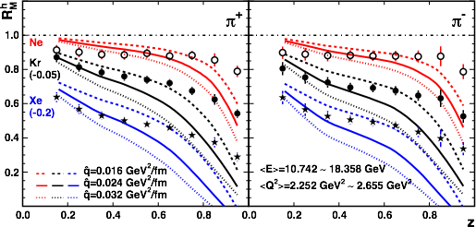
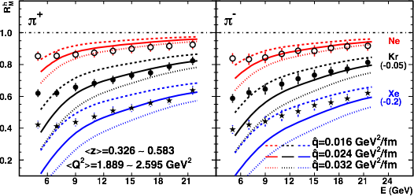
qhat from DIS of large nuclei
e⁻
Single hadron
dihadron
Deng & XNW (2010)
Majumder, Wang, XNW (2007)

Slide 12
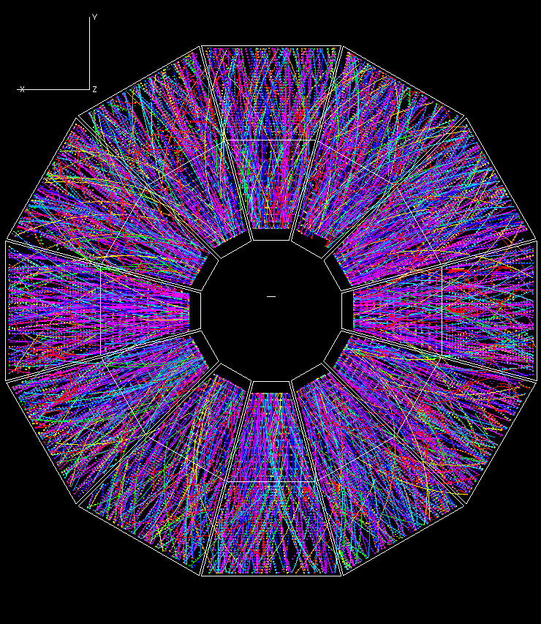
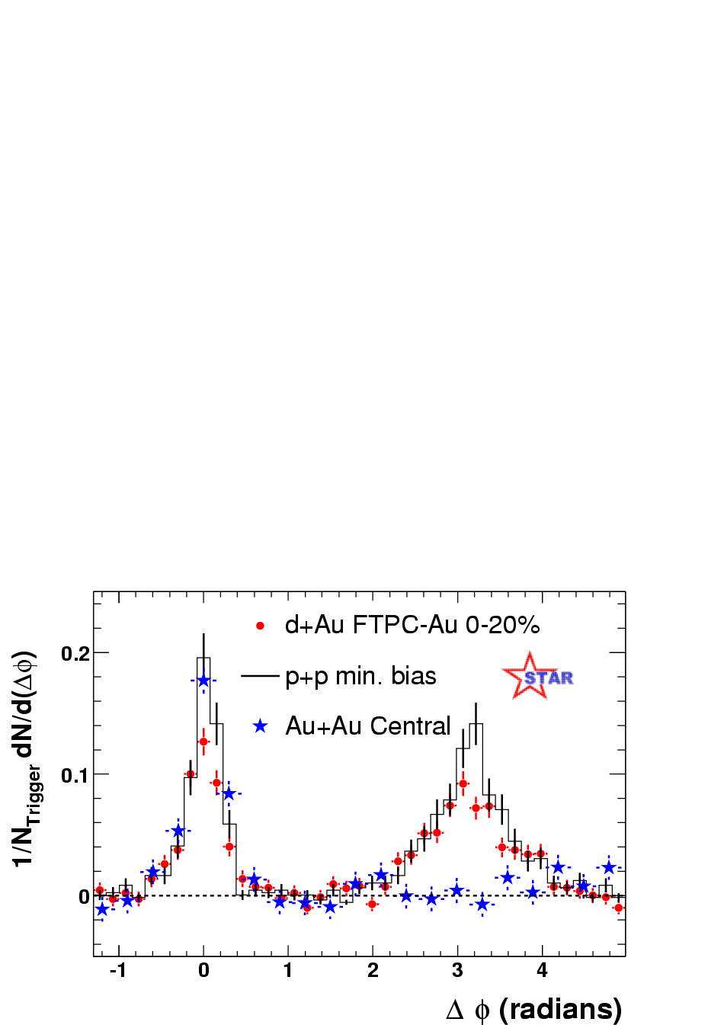
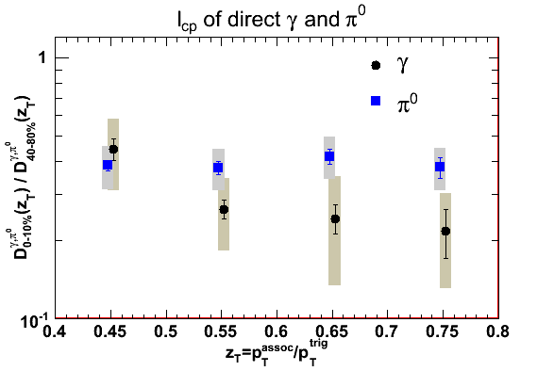
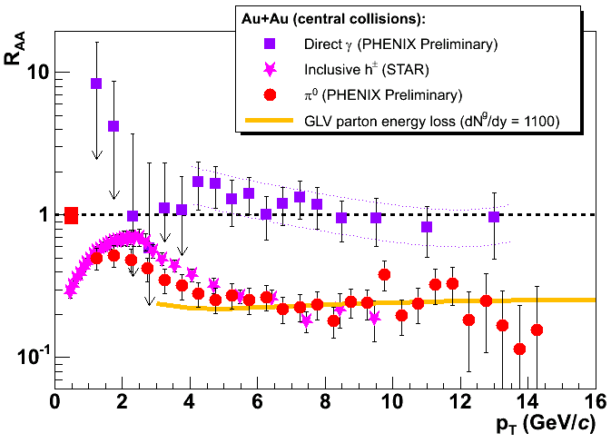
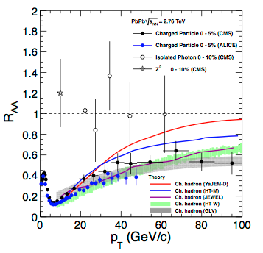
Jet Quenching at RHIC & LHC
STAR Preliminary
Pedestal&flow subtracted
Notes:
RHIC experiments marked a milestone for jet quenching, from a theoretical concept to a reality.

Slide 13
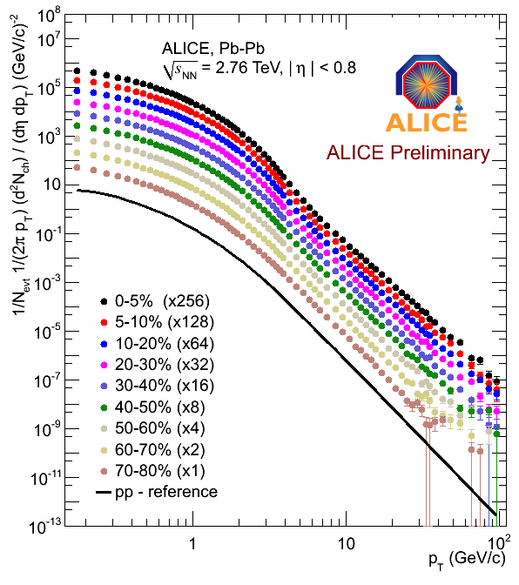
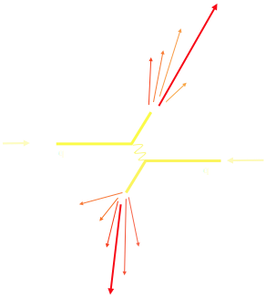
Hard and soft probes
Pb-Pb
pp reference
soft probes
hard probes

Slide 14
Jet quenching phenomenology
3+1D hydro +
Jet transport +
Hadronization
A general framework for numerical implementation of different approaches & improvement of jet transport
Hadronization: fragmentation & recombination
Realistic bulk evolutions: e-by-e 3(2)+1 hydro : constrained by bulk hadron spectra, v_{n,}
http://jet.lbl.gov
iEBE: E-by-E viscous hydro- generating bulk medium on-demand
First JET package: viscous hydro+ semi-analytic jet quenching: CUJET, McGill-AMY, MARTINI-AMY, HT-BW, HT-M (will expand to other models)

Slide 15
Jet quenching phenomenology
McGill-AMY
HT-BW
HT-M

Slide 16
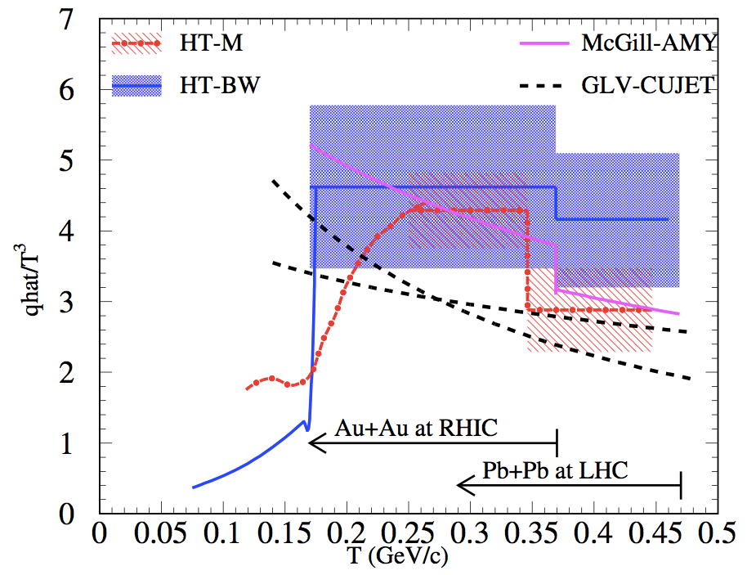
Jet transport coefficient
preliminary
JET Collaboration (preliminary)
Future: dihadron, gamma-hadron, flavor dependence, jet observables
Notes:
LHC: T_0=473 MeV qhat/T^3=3.14
RHIC: T_0=373 MeV qhat/T^3=3.47

Slide 17
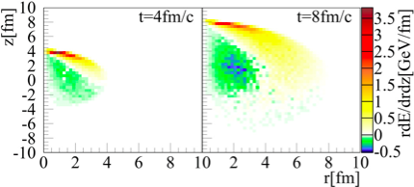
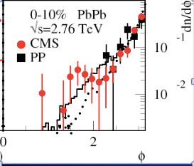
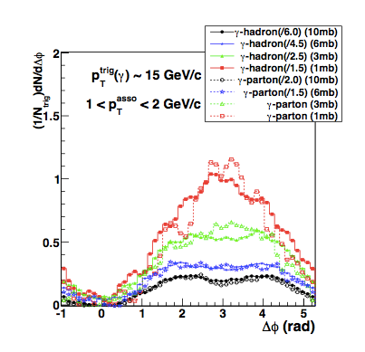
Effect of recoils and jet broadening
XNW and Zhu (2013)
Li, Liu, Ma, XNW and Zhu （2010）
Ma and XNW (2011)

Slide 18
Medium mod. of frag function
Seen in CMS & ATLAS single jets
XNW and Zhu, PRL 111(2013)062301
XNW, Huang & Sarcevic (1996)
Energy of reconstructed jet dominated by leading particle
Suppression of fragmentation functions relative to initial energy

Slide 19
NLO and factorization
arXiv:1106.1106
Uncertainty in scale dependence of collinear LO results
Medium properties & hard scattering factorizable?
51 diagrams
Complete cancellation of soft-collinear divergence
Complete factorization of the collinear divergence
Kang, Wang, XNW, Xing (2013)
Notes:
\frac{d\langle k_\perp^2\sigma\rangle_{\rm NLO}}{dz_h} =\sigma_0 D_h(z,\mu_f^2) \otimes H_{\rm NLO}(x,x_B, Q^2, \mu_f^2) \otimes T_{qg}(x,x_1,x_2, \mu_f^2)
\frac{\partial}{\partial \ln\mu_f^2} T_{qg}(x_B,0,0,\mu_f^2) = \frac{\alpha_s}{2\pi}
\int_{x_B}^1 \frac{dx}{x} \bigg[{\mathcal P}_{qg\to qg} \otimes T_{qg} + P_{qg}(\hat x) T_{gg}(x, 0, 0, \mu_f^2)\bigg]
\hat q \Longrightarrow \hat q(E, Q^2)

Slide 20
Gluon saturation in QGP
Gluon saturation
Casalderrey-Salana, & XNW’07
DGLAP
DGLAP evolution in linearized regime

Slide 21
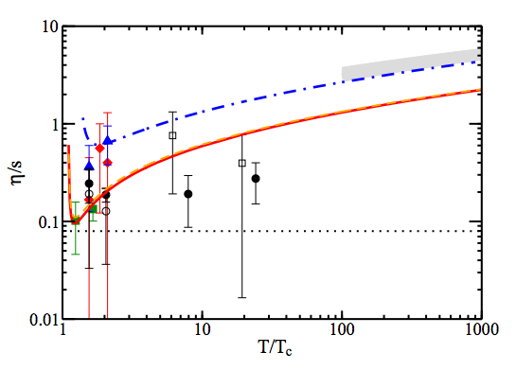
Summary
EM emissions, quarkonium, jet quenching & collective flows: constraints on the transport properties of the sQGP in A+A
Future: mapping out T-dependence at RHIC & LHC
Bluhm, Kampfer & Redlich 2010
AdS/CFT
Majumder, Muller & XNW (2007)
Notes:
\frac{\eta}{s} \ge \frac{3T^3}{2\hat q}

Slide 23
Backup

Slide 24
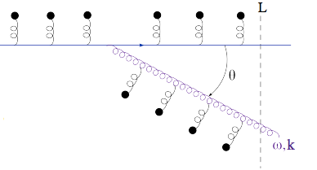
Multiple gluon emissions
Iteration of single gluon emission:
  mDGLAP (HT), MC of rate equation (JEWEL, MARTINI, LBT, PCM)
Formation time
Color coherence is rapidly lost in medium,
independent emission is enhanced by L/τ_{f}
Blaizot, Dominguez,
Iancu, Mehtar-Tani’ 12
Mehta-Tani,Salgado,Tywoniuk’10
Talks by: Iancu, Salgado, ,Mehtar-Tani , Apolinário, Tywoniuk ,Wu
Notes:
\frac{1}{\tau_f}\sim \frac{k_T^2}{2\omega}
\tau_f(\omega)\sim \sqrt{\frac{2\omega}{\hat q}}
Soft & large angle emission

Slide 25
Factorization at twist-4
Transverse momentum square weighted
cross section
T-4 LO
T-4 NLO
Finite contribution from asymmetric-cut diagrams

Slide 26
Evolution equation for T4 - NEW
soft-soft
hard-hard & soft-hard & hard-soft
When , there is no phase space for the gluon radiation from the initial gluon.

Slide 27


Linear Boltzmann jet transport
Induced radiation
Li, Liu, Ma, XNW and Zhu, PRL 106 （2010） 012301
XNW and Zhu, PRL 111 (2013) 062301
Notes:
f_i(p_i)=\frac{1}{e^{p_i\cdot u/T}\pm 1} (i=2,4)
f_i(p)=(2\pi)^3\delta^3(\vec p_i-\vec p_0)\delta^3(\vec x-\vec x_0-t\vec v_i) [i=1,3]
\frac{dN_g}{dzd^2k_\perp dt}=\frac{2\alpha_s N_c}{\pi k_\perp^4} P(z)
(\hat p\cdot u) \hat q \sin^2(\frac{t-t_0}{2\tau_f})

Slide 28
Jet-induced medium excitation
Jet propagation in a uniform medium

Slide 29

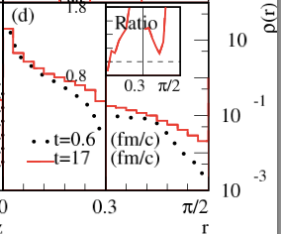
Broadening of jet transv. profile
R=0.3

Slide 30
Broadening of γ-hadron correlation
γ-jet from LBT
γ-hadron from AMPT calculation
Jet azimuthal angle broadening is smaller but still finite
Li, Liu, Ma, XNW and Zhu, PRL 106 （2010） 012301
Ma and XNW, PRL 106 (2011) 162301

Slide 31
Running coupling in jet quenching
2013

Slide 32
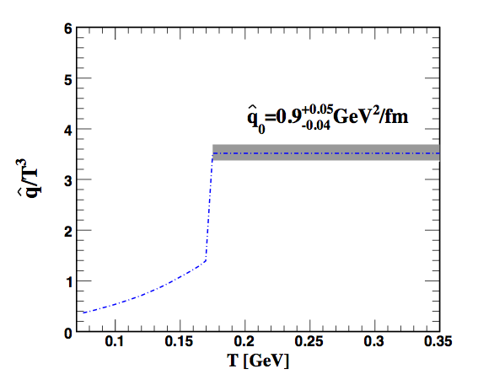

Jet transport coefficient
Chen, Greiner, Wang, XNW, Xu, PRC 81（2010）064908
RHIC
from DIS
Deng & XNW PRC 81 (2010) 024902
Notes:
LHC: T_0=473 MeV qhat/T^3=3.14
RHIC: T_0=373 MeV qhat/T^3=3.47

