Slide 1
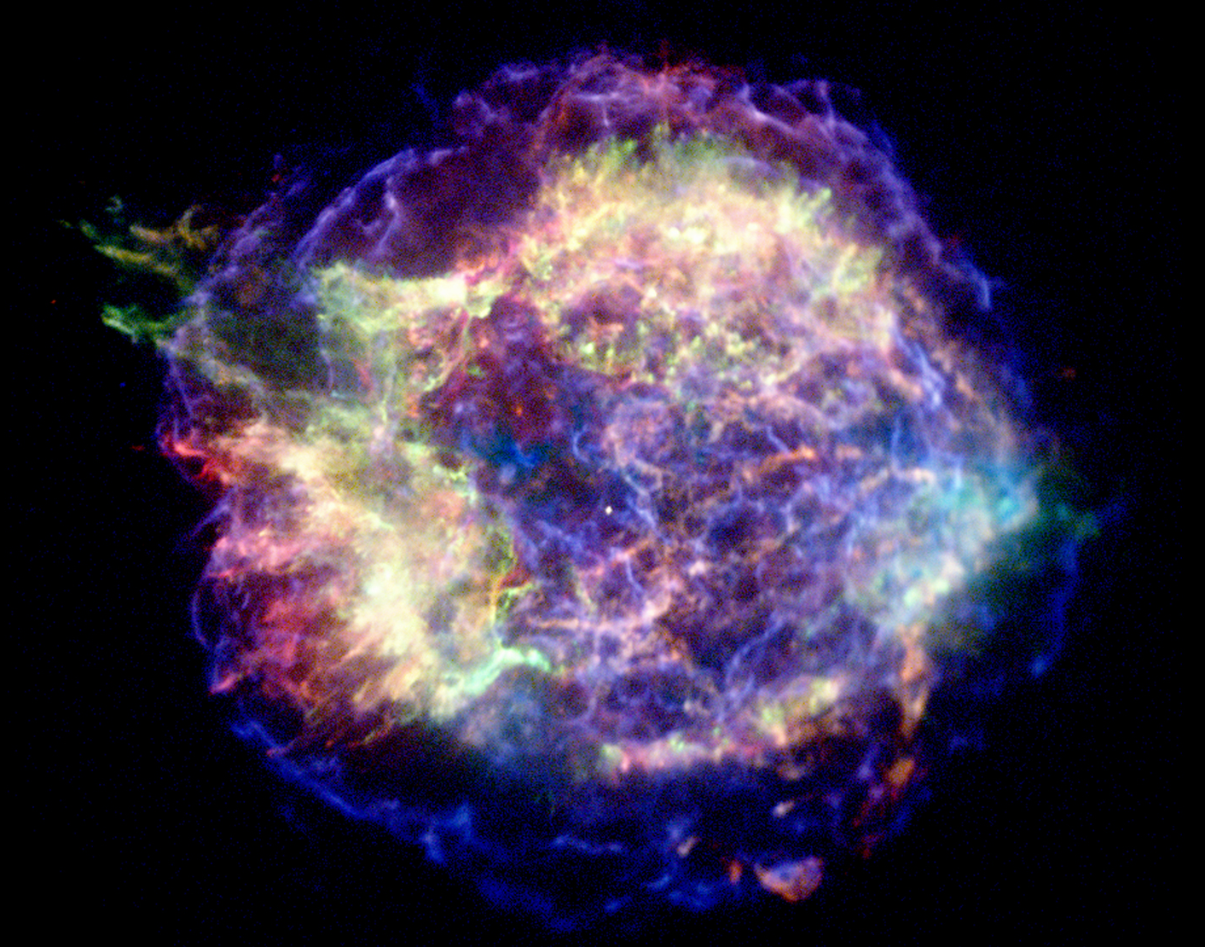
The signature of the CE in the weakest relativistic explosions
What happens when jets barely break out of a star?
Raffaella Margutti
Harvard – Institute for Theory and Computation
On behalf of the Harvard SN forensic team
Kyoto2013

Slide 2
MASSIVE STAR
core
WINDS
H envelope
1
?
Why only ~ few % of type Ibc SN harbors a CE
CE
2
?
How does the CE manifest its presence
Type Ic SN

Slide 3
How does the central engine manifest its presence?
Temporal Variability
Prompt gamma-ray emission
(e.g. Morsony+10)
X-ray flares
(Margutti+13; Chincarini+10;Bernardini+12; Margutti+11a; Margutti+11b )
X-ray plateau
Magnetar (e.g. Dall’Osso+10)
or accretion (e.g. Kumar+08)
GRB100316D/SN2010bh
Energy partitioning + Late-time X-ray excess
Margutti et al.,2013 ApJ 778 18, (arXiv:1308.1687)

Slide 4
Ejecta kinetic energy profile
Ek
OPTICAL
Thermal emission
(Γβ)^{-5.2}
Hydrogen-stripped progenitor
Core-collapse
RADIO
NON Thermal emission
Hydrodynamical collapse
(Tan 2001)
Γβ

Slide 5
Margutti +13; Kamble +13; Soderberg +06, +10
Kyoto2013

Slide 6
Ejecta kinetic energy profile
Ek
(Γβ)^{-0.6}
(Γβ)^{-5.2}
Central Engine
Hydrogen-stripped progenitor
Core-collapse
Hydrodynamical collapse
(Tan 2001)
Γβ

Slide 7
Energy partitioning
Non-collimated
Non-relativistic
Hydrod. collapse
COLLIMATED (jets)
Relativistic
Kyoto 2013

Slide 8
Take-away list:
1.
The key difference between an ordinary explosion and an engine-powered explosion is the way the energy budget is PARTITIONED.
Kyoto 2013

Slide 9
Energy partitioning
Hydrod. collapse
Kyoto 2013

Slide 10
-->Continuum
Less energetic than GRBs
(local universe)
Mildly relativistic
Less collimated than GRBs
Their Ek profile still requires a CE
10 times more common than GRBs
Collimation
Kyoto 2013

Slide 11
Take-away list:
1.
The key difference between an ordinary explosion and an engine-powered explosion is the way the energy budget is PARTITIONED.
2.
There is a continuum of properties, that bridges the gap between ultra-relativistic, collimated explosions and ordinary SNe, populated by:
Sub-E GRBs and relativistic SNe
Kyoto 2013

Slide 12
WHY
do we care so much about these intermediate explosions
?
GRB100316D/SN2010bh
Margutti et al.,2013 ApJ 778 18
Kyoto 2013

Slide 13
X-rays
Radio
Kyoto 2013

Slide 14
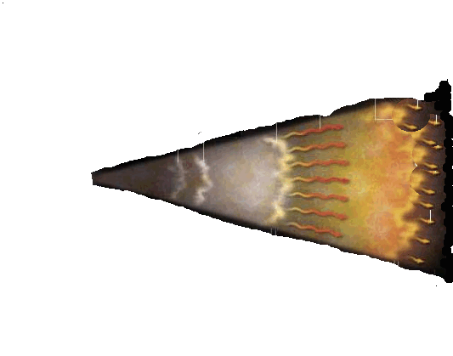
Engine ON
Engine OFF
MILD decay + Extremely SOFT emission
100316D/2010bh
Ambient medium interaction
Slower blob
Collision
Faster
blob
EXTERNAL SHOCK
STANDARD GRB MODEL
Central
engine
Synchrotron
Pre Burst
Prompt Emission
Afterglow

Slide 15
Synchrotron emission
Fireball Dynamics
GRBs
UCSC 2013

Slide 16
Synchrotron emission
Fireball Dynamics
GRBs
Not synchrotron
UCSC 2013

Slide 17
100316D/ 2010bh
Synchrotron
X-rays
Radio
Radio
SED, t=36 days
X-rays
UCSC 2013

Slide 18
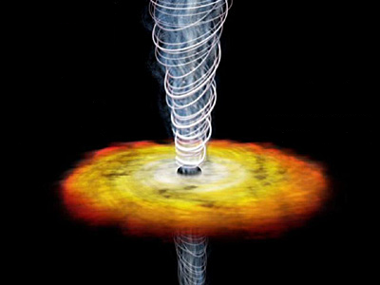
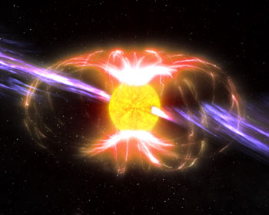
What is the origin?
Accretion on BH
“modified” fall-back scenario”
100316D/2010bh
t^{-0.8}
~10^52 erg
CE
Inverse Compton emission
Magnetar spin-down
10 days
37 days
Rapidly rotating!! (ms!)
…an X-ray excess…

Slide 19
Take-away list:
1.
The key difference between an ordinary explosion and an engine-powered explosion is the way the energy budget is PARTITIONED.
2.
There is a continuum of properties, that bridges the gap between ultra-relativistic, collimated explosions and ordinary SNe, populated by:
Sub-E GRBs and relativistic SNe
3.
Sub-energetic GRBs reveal the emission of the CE at late times, either in the form of a rapidly rotating magnetar or a BH (in a non-standard fall-back accretion scenario)
Kyoto 2013

Slide 20
The big picture: H-stripped explosions
Jet
CE
GRBs
Engine
Fully developed jet
Ordinary SNe Ibc
NO Engine, NO JET
Sub-E GRBs
Engine
Weak jet
We can study the engine with late-time radio and X-rays
Jet
CE
Kyoto 2013

Slide 21
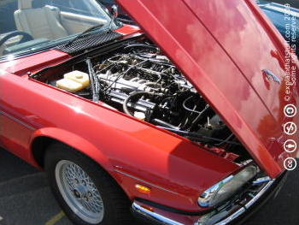
Radio
X-rays
The End
Kyoto 2013

Slide 22
BACK-UP SLIDES

Slide 23
Lazzati +12, Morsony +07, +10
Is the SAME CE?
What is the fraction of SNe with CE?
What is the nature of the CE?
UCSC 2013
Notes:
How this compares to simulations? Now we can have a look at this plot in its entirety. You can see the results from some simulations. Questions that still remain unsolved. How to answer to these questions? With late-time radio and X-ray monitoring. We have active programs with Chandra and the VLA. All of these stars exploded after having lost their H envelope. This gives me the link to the second part of the talk, how do massive stars lose their envelope?

Slide 25
OPTICAL
RADIO → synchrotron
SN shock interaction with the medium
Drout +11
Wellons +12
LC width τ≈(Mej³/Ek)^{1/4}
F_{ν,peak}(t)
V_{phot}≈Ek/Mej
-5/2
-(p-1)/2
ν_{peak} (t)
Soderberg+04, +06,+10

Slide 26
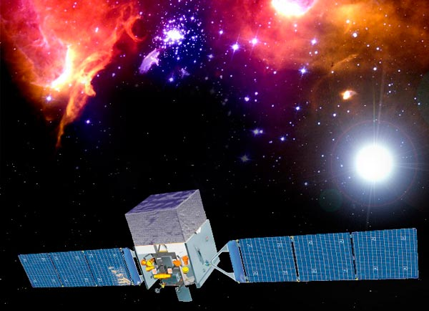
Gamma-Ray Bursts
γ-rays
Log(Flux)
INTERNAL SHOCK
Ambient medium interaction
Slower blob
Collision
Faster blob
JET
EXTERNAL SHOCK
X-rays
Optical
Radio
Central
engine
Pre Burst
Prompt Emission
Afterglow
~10^51 erg
Log(Time)
~30 s
~hours
Notes:
Gamma-Ray bursts were first discovered in the Gamma-rays as VERY SHORT duration, very energetic EXTRAGALACTIC explosions. Only years later it has been possible to discover their counterparts at lower frequencies, in the optical, UV, NIR and radio. There is still no consensus about what produces the prompt gamma-ray emission, and I’m not going into details here. However, the key information here (+ something on which people do generally agree) is that the emission is BEAMED. So we DO have a JET, a relativistic JET.

Slide 27
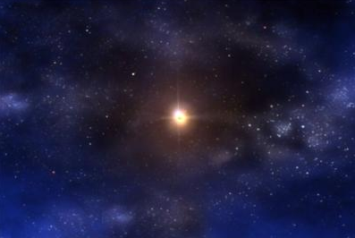
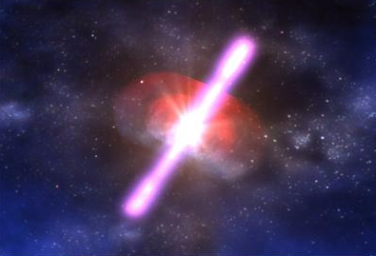
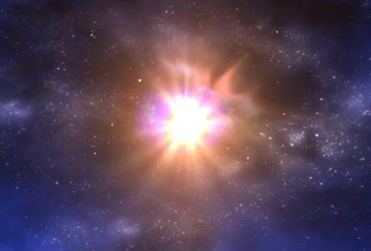
A typical
GRB
Explosion:
PROMPT
Log (Flux)
 t⁻³
AFTERGLOW
 t⁻¹
SN bump
 t⁻²
Black Hole (?)
t _{break1}
(300 s)
t _{break2}
(10^4 s)
Log(Time)
~10 days

Slide 28
SNe associated w. GRBs
HIGH expansion velocity!
30000-40000 km/s
vs.
10000 km/s
GRB980425
SN/GRB
SN2010ay
Modjaz 2006
GRB060218
Photosperic Velocity (10³ km/s)
BL-SN Ibc
NO Hydrogen
FAST
Sanders 2012
UCSC 2013
Notes:
So which kind of SNe are those connected with GRBs? First, they have no hydrogen in their spectra, indicating that our progenitor star was able to get rid of its hydrogen envelope before explosding. So the two things to keep in mind is that they have NO hydrogen and they are FAST, BUT, key info, there are other SNe non associated with GRBs that are as fast as GRB-SNe. So these conditions are neecssary but NOT sufficient

Slide 29
Broad-lined + large Ek + large Ni mass = Very powerful / energetic explosions
Hydrogen-poor
Super Luminous SNe (M<-21)
(e.g. Gal-Yam 2012)
7x10⁴³ erg/s
GRB/SNe
“Standard”, envelope stripped SN Ibc
SN2002ap
SN1994I
UCSC 2013
Notes:
Let’s now have a look at the enregetics. They tend to be brighter than standard Ibc, but they are NOT the brightest hydrogen-stripped SN explosions we know.

