Slide 1

2017/03/09
Geometry, Duality and Strings@YITP, Kyoto U.
Yang-Baxter deformations
and generalized supergravity
Kentaroh Yoshida (Dept. of Phys., Kyoto U.)

Slide 2
Introduction

Slide 3


The AdS/CFT correspondence
type IIB string on AdS₅ x S⁵
4D SU(N) SYM
Recent progress: the discovery of integrability
[For a big review,
Beisert et al., 1012.3982]
Integrability is so powerful!
The integrability enables us to compute exactly physical quantities
even at finite coupling, without relying on supersummetries.
EX anomalous dimensions, amplitudes etc.
Indeed, there are many directions of study with this integrability.
Here, among them, we are concerned with
the classical integrability on the string-theory side.
The existence of Lax pair (kinematical integrability)

Slide 4
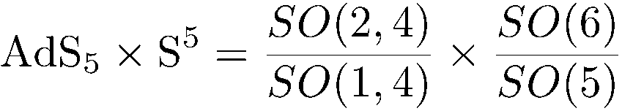
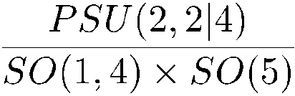
The classical integrability of the AdS₅ x S⁵ superstring
The coset structure of AdS₅ x S⁵ is closely related to the integrability.
: symmetric coset
Z₂-grading classical integrability
Including fermions
: super coset
[Metsaev-Tseytlin, 1998]
Z₄-grading classical integrability
elucidated by
[Bena-Polchinski-Roiban, 2003]
This fact is the starting point of our later argument.

Slide 5
The next issue
Integrable deformations of the AdS₅ x S⁵ superstring
Integrable deformations
Deformed AdS₅ x S⁵ geometries
(as a 2D non-linear sigma model)
Questions
Do the integrable deformations lead to solutions of type IIB SUGRA?
or, do they break the on-shell condition of type IIB SUGRA?
The main subject of my talk is to answer these questions
for a specific class of integrable deformations called
Yang-Baxter deformations

Slide 6
Yang-Baxter deformations
What is Yang-Baxter deformation?
Recent progress on this issue

Slide 7


Yang-Baxter deformations
[Klimcik, 2002, 2008]
Integrable deformation!
An example
G-principal chiral model
Yang-Baxter sigma model
: a const. parameter
What is R?
a classical r-matrix satisfying
a linear op.
the modified classical Yang-Baxter eq. (mCYBE)
An integrable deformation can be specified by a classical r-matrix.
Strong advantage
Given a classical r-matrix, a Lax pair follows automatically.
No need to construct Lax pair in an intuitive manner case by case

Slide 8



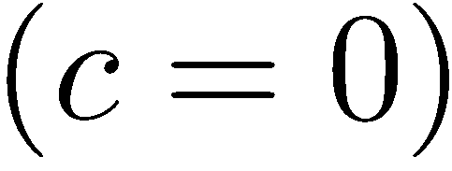
Relation between R-operator and classical r-matrix
A linear R-operator A skew-symmetric classical r-matrix
Two sources of classical r-matrices
1) modified classical Yang-Baxter eq. (mCYBE) the original work by Klimcik
( )
2) classical Yang-Baxter eq. (CYBE) a possible generalization

Slide 9
The list of generalizations of Yang-Baxter deformations
(2 classes)
(i) modified CYBE (trigonometric class)
a) Principal chiral model
[Klimcik, hep-th/0210095, 0802.3518]
b) Symmetric coset sigma model
[Delduc-Magro-Vicedo, 1308.3581]
1)
c) The AdS₅ x S⁵ superstring
[Delduc-Magro-Vicedo, 1309.5850]
(ii) CYBE (rational class)
a) Principal chiral model
[Matsumoto-KY, 1501.03665]
b) Symmetric coset sigma model
[Matsumoto-KY, 1501.03665]
2)
c) The AdS₅ x S⁵ superstring
[Kawaguchi-Matsumoto-KY, 1401.4855]
NOTE bi-Yang-Baxter deformation
[Klimcik, 0802.3518, 1402.2105]
(applicable only for principal chiral models)

Slide 10
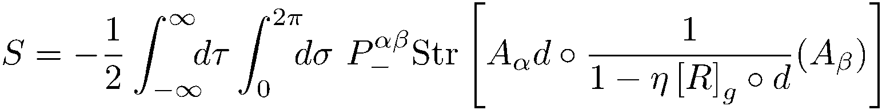
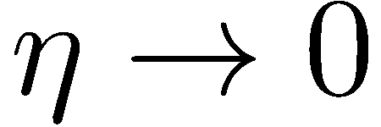
[Delduc-Magro-Vicedo, 1309.5850]
YB deformation of the AdS₅ x S⁵ superstring
[Kawaguchi-Matsumoto-KY, 1401.4855]
R satisfies (m)CYBE.
The undeformed limit: the Metsaev-Tseytlin action
[Metsaev-Tseytlin, hep-th/9805028]
Lax pair is constructed : classical integrability
Kappa invariance : a consistency as string theory at classical level
NOTE
The difference between mCYBE and CYBE is reflected in some coefficients
of some quantities such as Lax pair and kappa-transformation.

Slide 11
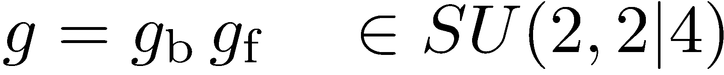
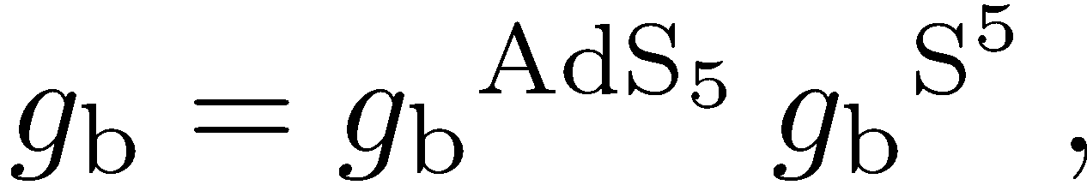
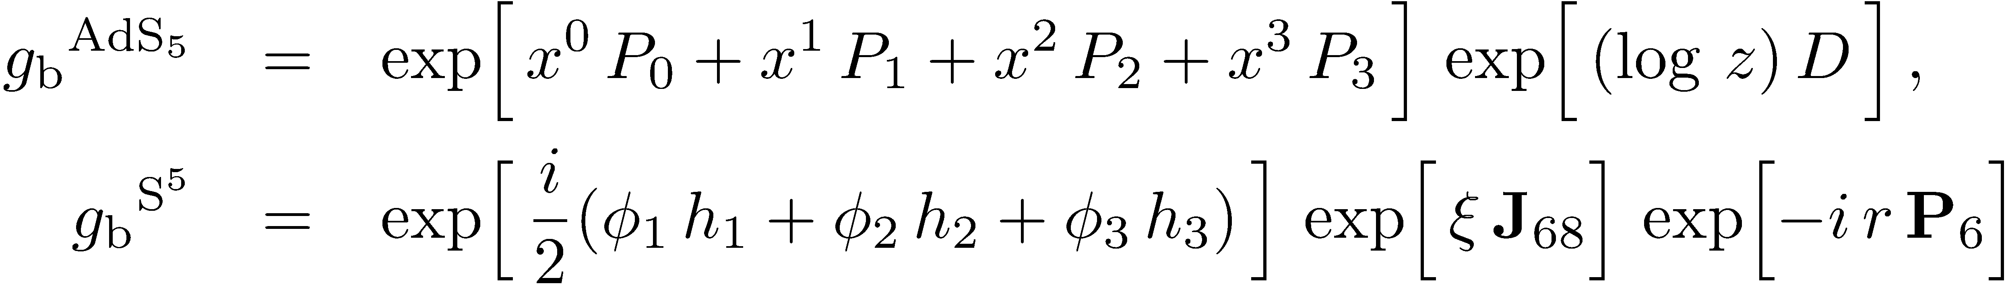
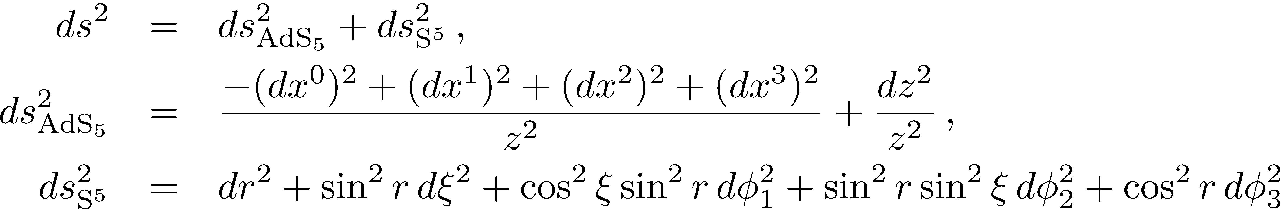
A group element:
[For a big review, Arutyunov-Frolov, 0901.4937]
When we take a parametrization like
,
the metric of AdS₅ x S⁵ is given by
(the undeformed case)

Slide 12
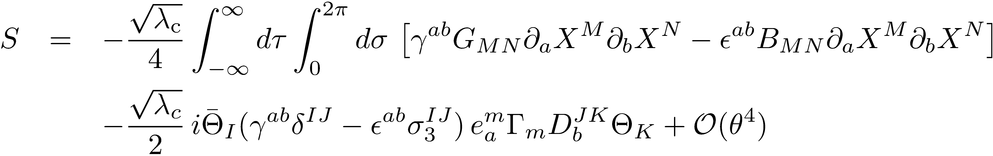

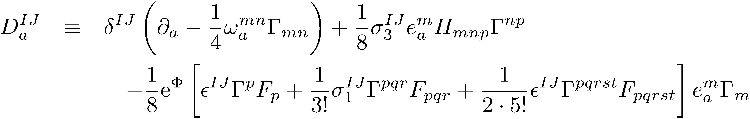
An outline of supercoset construction
[Arutyunov-Borsato-Frolov, 1507.04239]
[Kyono-KY, 1605.02519]
The deformed action can be rewritten into the canonical form:
This action is expanded w.r.t the fermions.
In general, the covariant derivative is given by
[Cvetic-Lu-Pope-Stelle, hep-th/9907202]
From this expression, one can read off all of the fields of type IIB SUGRA.

Slide 13
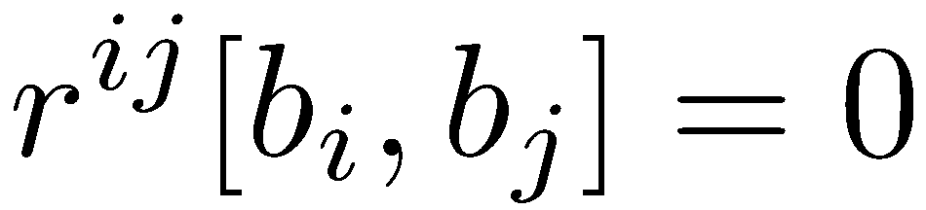
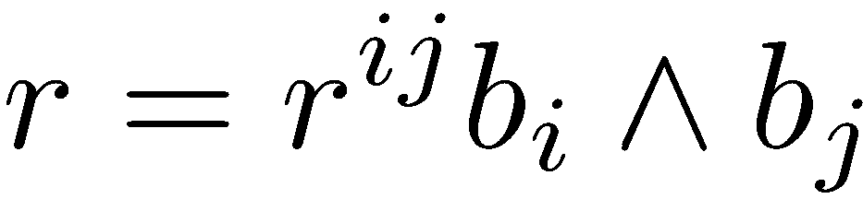
Summary of the resulting backgrounds
1) The mCYBE case
[Delduc-Magro-Vicedo, 1309.5850]
η-deformation or standard q-deformation
[Arutyunov-Borsato-Frolov, 1312.3542]
The background is not a solution of the usual type IIB SUGRA,
but satisfies the generalized type IIB SUGRA.
[Arutyunov-Borsato-Frolov, 1507.04239]
[Arutyunov-Frolov-Hoare-Roiban-Tseytlin, 1511.05795]
2) The CYBE case
[Kawaguchi-Matsumoto-KY, 1401.4855]
A certain class of classical r-matrices satisfying
The unimodularity condition
[Borsato-Wulff, 1608.03570]
for a classical r-matrix
Solutions of the standard type IIB SUGRA
EX Lunin-Maldacena-Frolov, Maldacena-Russo, Schrödinger spacetimes
[Kyono-KY, 1605.02519]
The other ones lead to solutions of the ``generalized’’ type IIB SUGRA

Slide 14
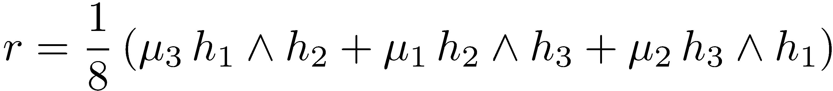
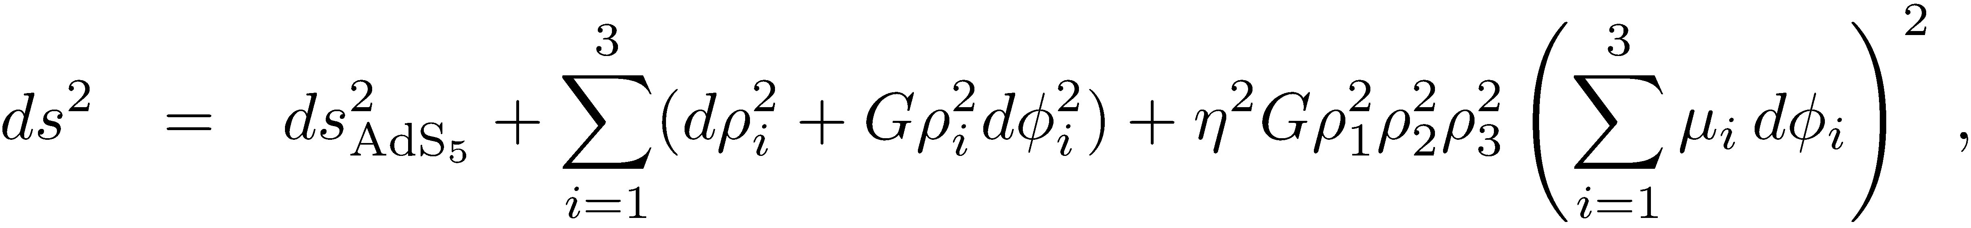
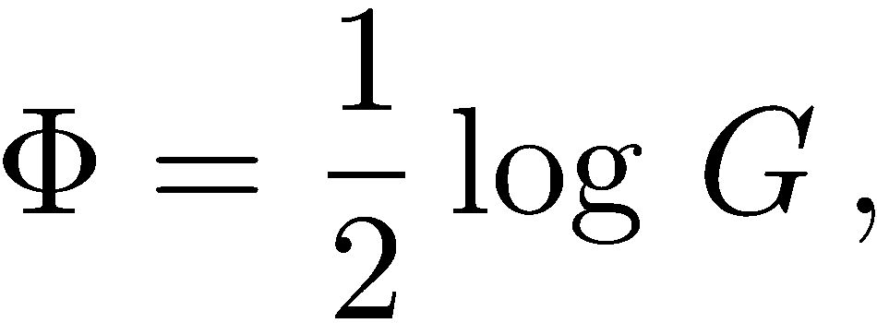

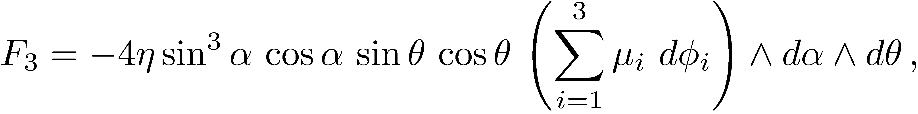
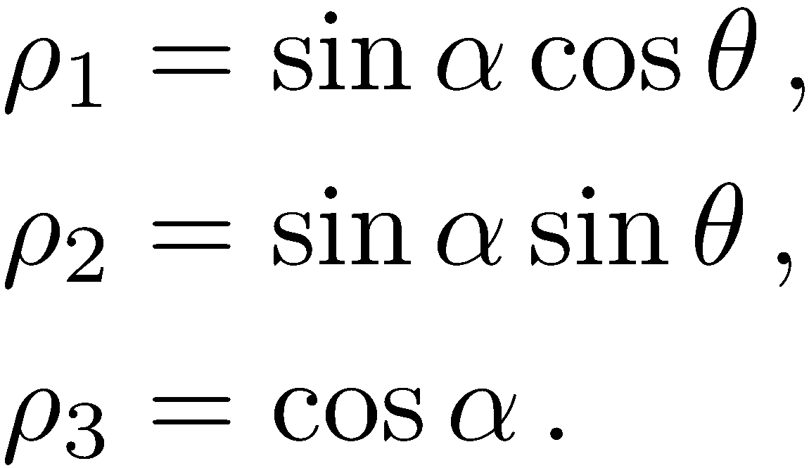

i) gamma-deformations of S⁵
c.f. Leigh-Strassler deformation
[Matsumoto-KY, 1404.1838]
Abelian classical r-matrix:
Metric:
B-field:
dilaton:
R-R:
[Lunin-Maldacena, Frolov, 2005]

Slide 15
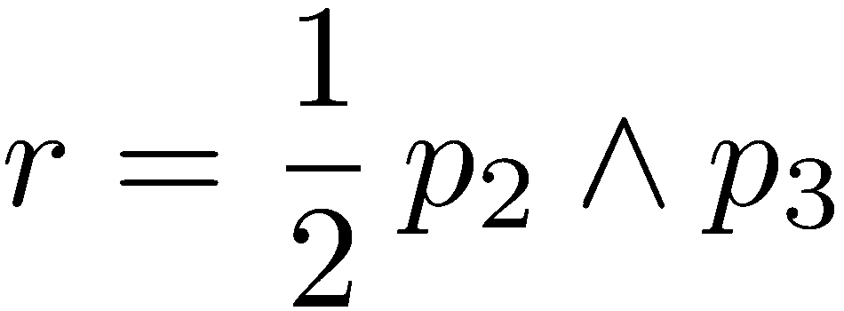




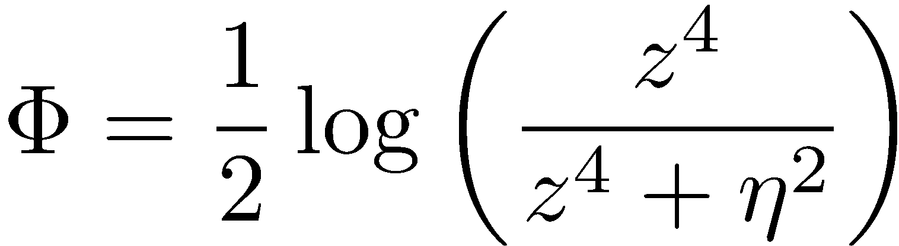
ii) Gravity duals for SYM on non-commutative space
c.f. Seiberg-Witten, 1999
Abelian Jordanian r-matrix:
[Matsumoto-KY, 1404.3657]
where
,
,
Metric:
B-field:
dilaton:
R-R :
[Hashimoto-Itzhaki, Maldacena-Russo, 1999]
Note
This solution can also be reproduced as a special limit of η-deformed AdS₅ .
[Arutyunov-Borsaro-Frolov, 1507.04239]
[Kameyama-Kyono-Sakamoto-KY, 1509.00173]

Slide 16
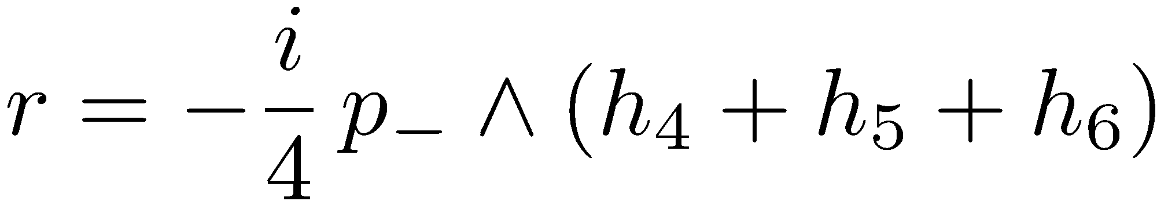
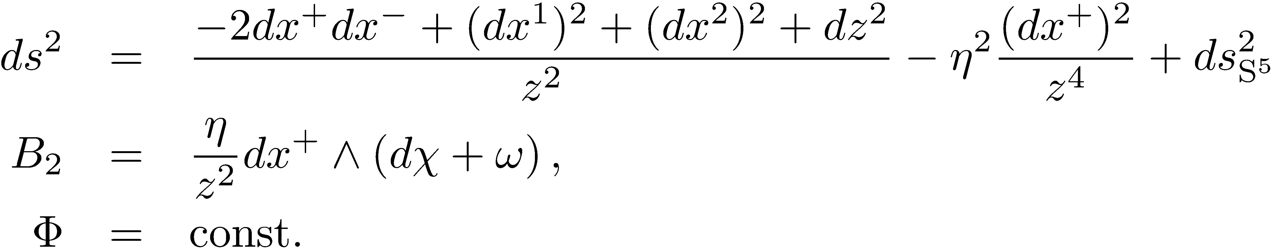
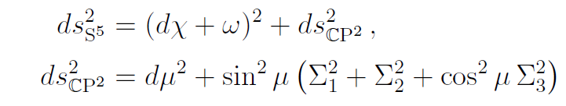
iii) Schrödinger spacetimes
c.f. [Son, 0804.3972],
[Balasubramanian-McGreevy, 0804.4053]
Mixed r-matrix:
[Matsumoto-KY, 1502.00740]
Metric:
B-field:
dilaton:
[Herzog-Rangamani-Ross, 0807.1099]
[Maldacena-Martelli-Tachikawa, 0807.1100]
The R-R sector is the same as AdS₅ x S⁵.
[Adams-Balasubramanian-McGreevy, 0807.1111]
S⁵ -coordinates:
NOTE the dilaton and R-R sector have not been deformed.
In the middle of computation, the fermionic sector becomes really messy and
quite complicated. So the cancellation of the deformation effect seems miraculous.

Slide 17
What is the generalized type IIB SUGRA?

Slide 18
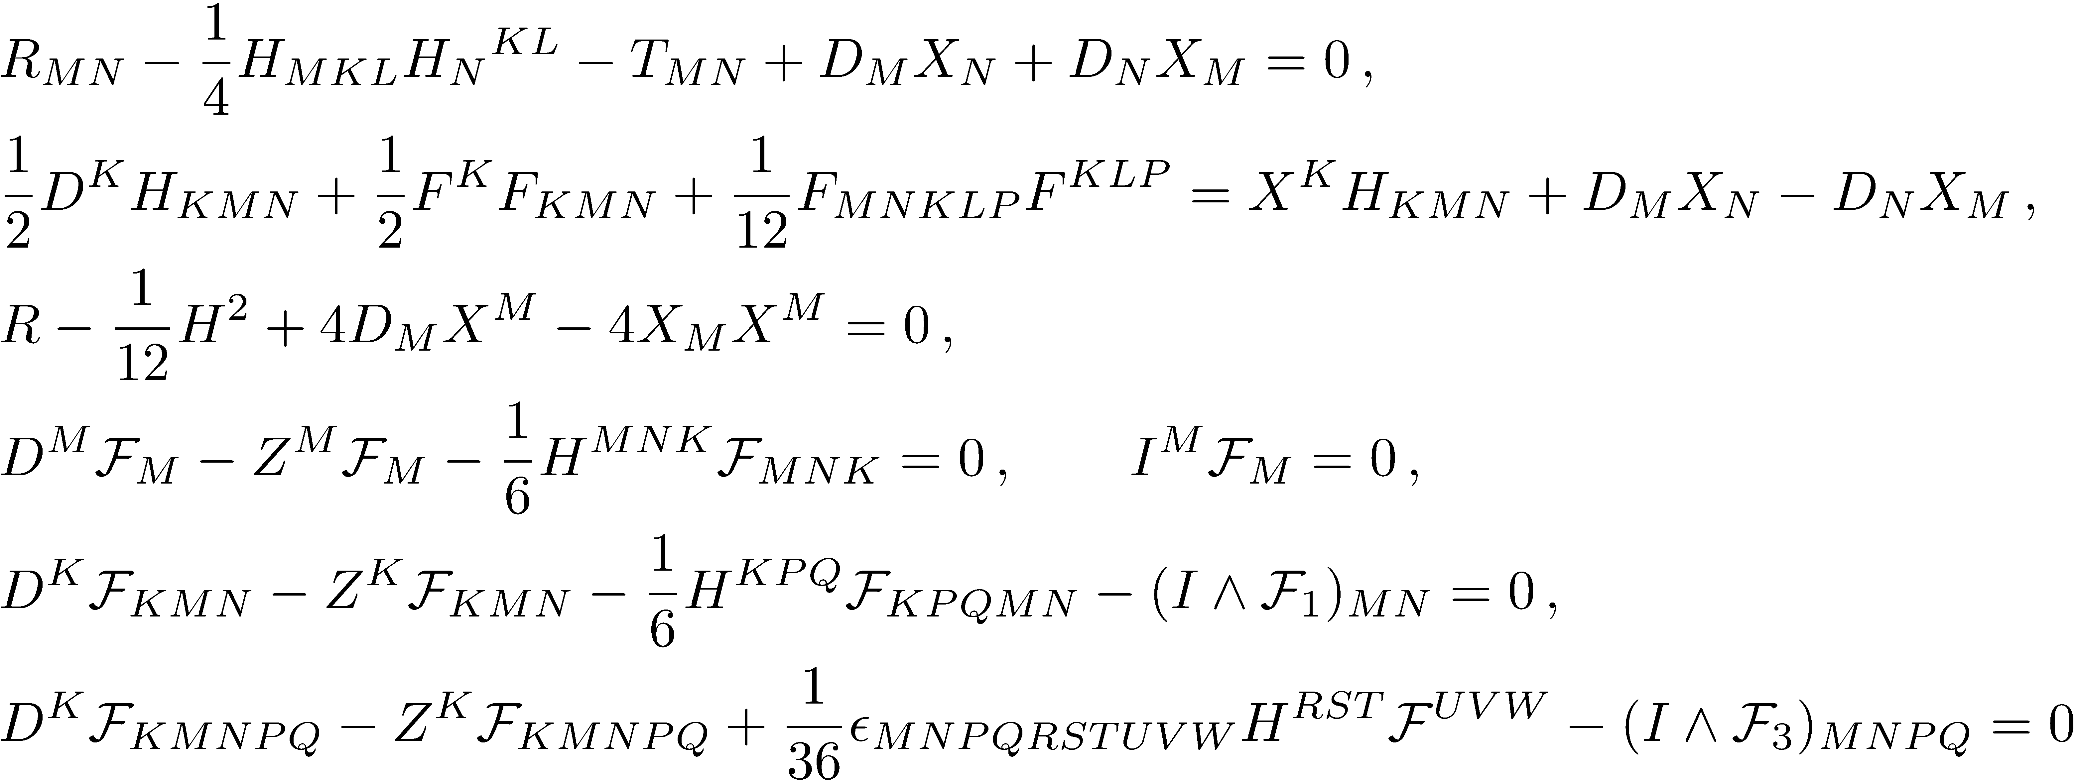
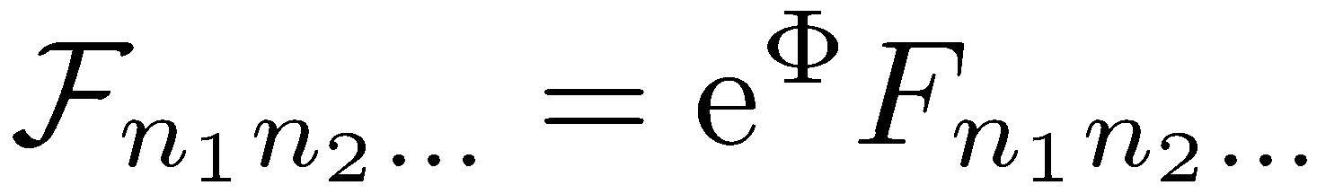
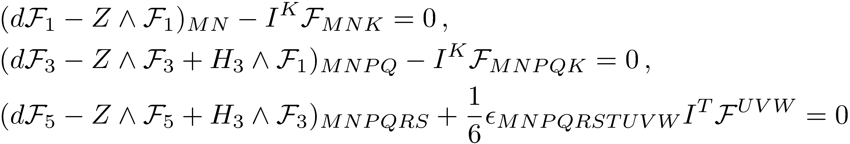
The generalized eqns of type IIB SUGRA
[Arutyunov-Frolov-Hoare-Roiban-Tseytlin,
1511.05795]
Modified Bianchi identities

Slide 19

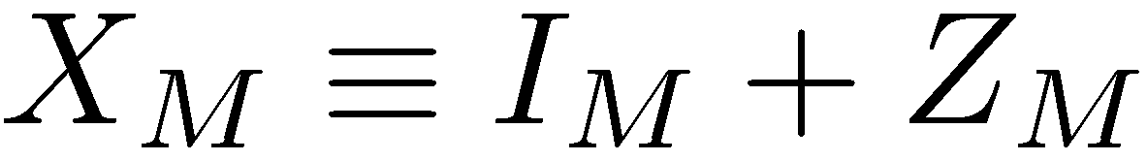




New ingredients: 3 vector fields
But , so two of them are independent.
Then satisfy the following relations:
Assuming that is chosen such that the Lie derivative
vanishes, the 2nd equation above can be solved by
.
Thus only is independent after all.
Note
When , the usual type IIB SUGRA is reproduced.

Slide 20
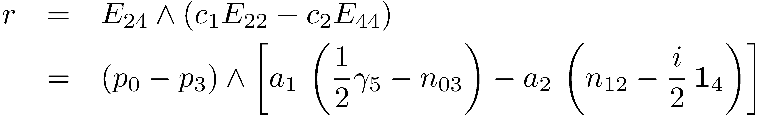
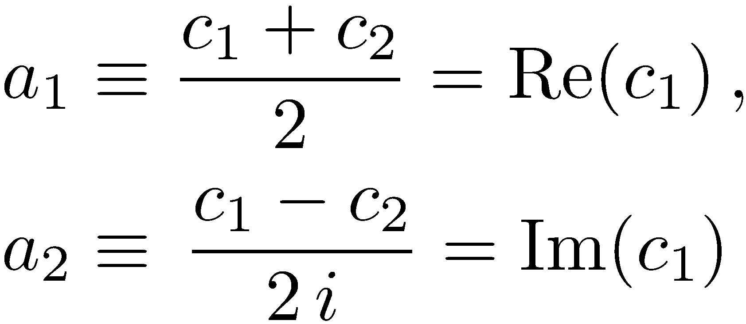
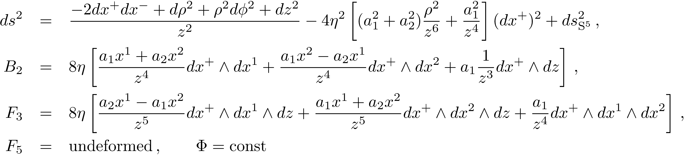
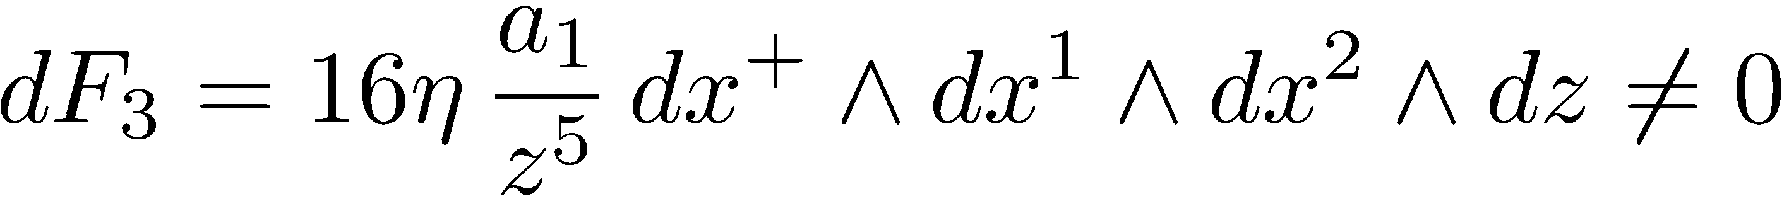
An example of solutions of the generalized SUGRA
\
The resulting background:
[Kyono-KY, 1605.02519]
The Bianchi identity is broken.
The e.o.m. of B₂ is not satisfied as well.

Slide 21
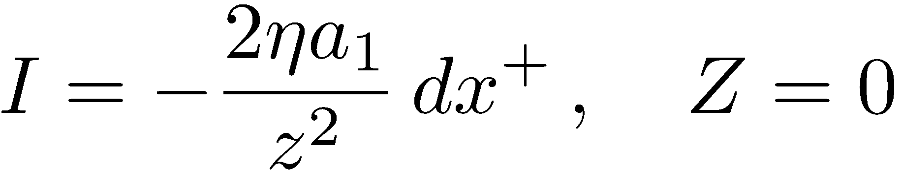
Some comments
Special case
The a1=0 case is special. The classical r-matrix becomes unimodular.
The background is a solution of type IIB SUGRA.
[Hubeney-Rangamani-Ross, hep-th/0504034]
General case
The resulting background is not a solution of type IIB SUGRA,
but still satisfies the generalized equations with
It is more interesting to perform ``generalized T-dualities’’ for this solution
(i.e., a generalized Buscher rule) a solution of the usual type IIB SUGRA.
Furthermore, this ``T-dualized’’ background is locally equivalent to
the undeformed AdS₅ x S⁵ !
[Orlando-Reffert-Sakamoto-KY, 1607.00795]
What is the physical interpretation of this result?

Slide 22
A great progress on the Green-Schwarz string
Relation between kappa-symmetry and SUGRA
Old result: the on-shell condition of the standard type IIB SUGRA
kappa-invariant GS string theory
[Grisaru-Howe-Mezincescu
-Nilsson-Townsend, 1985]
The inverse was conjectured.
New result: kappa-invariant GS string theory
the generalized type IIB SUGRA
[Tseytlin-Wulf, 1605.04884]
This issue has been resolved after more than 30 years from the old work.
Pathology?
[Arutyunov-Frolov-Hoare-Roiban-Tseytlin, 1511.05795]
The string world-sheet is not Weyl invariant but scale invariant,
if the background is not a solution of type IIB SUGRA.

Slide 23
Summary and Discussion

Slide 24
Summary
I have given a review of recent progress on
Yang-Baxter deformations of the AdS₅ x S⁵ superstring
The mCYBE case
An η-deformation of AdS₅ x S⁵ is not a solution of type IIB SUGRA,
but satisfies the generalized type IIB SUGRA.
There would be no solutions of the usual type IIB SUGRA.
The CYBE case
1) The unimodular classical r-matrices lead to sols. of type IIB SUGRA.
EX Lunin-Maldacena-Frolov, Maldacena-Russo, Schrödinger spacetimes
2) The other non-unimodular ones lead to sols. of the generalized SUGRA.

Slide 25
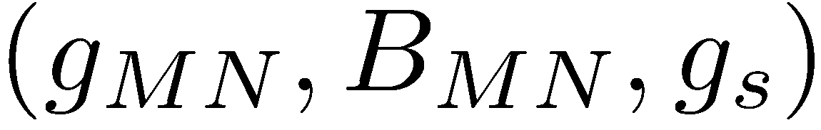
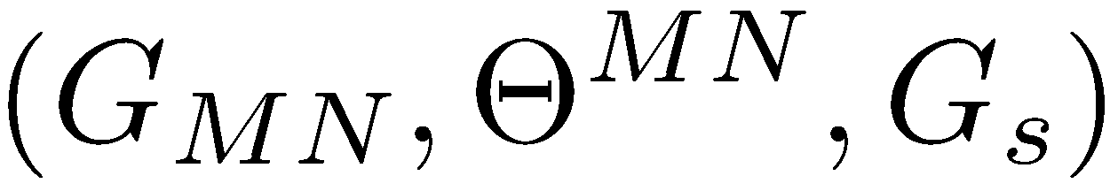
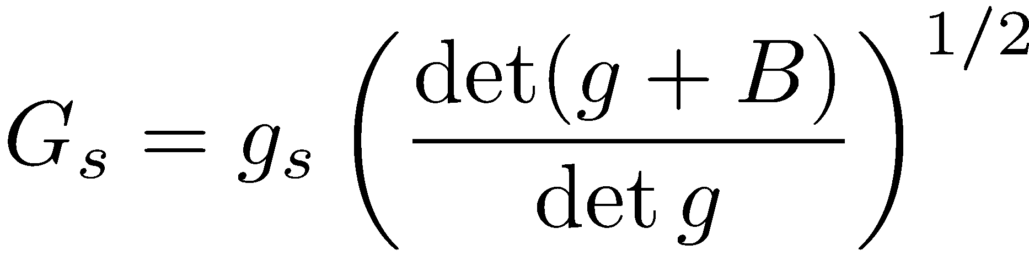




Discussions
So far, we have considered the closed string picture .
But it would be much nicer to consider the open string picture .
The relations
Open string picture of YB deformations of AdS₅ with homogeneous CYBE:
[Araujo-Bakhmatov-O Colgain-Sakamoto-Sheikh Jabbari-KY, 1702.02861]
: the undeformed AdS₅ x S⁵ : const.
Only the non-commutative parameter depends on the deformation.
Classical r-matrices determine non-commutativities

Slide 26
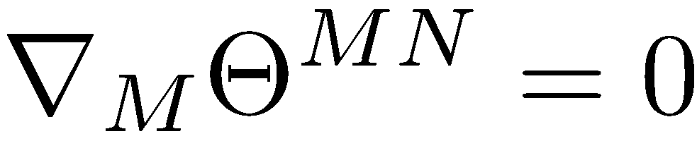

The relation between SUGRA and noncommutativity
[Araujo-Bakhmatov-O Colgain-Sakamoto-Sheikh Jabbari-KY, 1702.02861]
The on-shell condition of type IIB SUGRA (= the unimodularity condition)
This condition is necessary for the cyclic property of star product
For the generalized IIB SUGRA,
The extra vector field I has been related to the noncommutativity!
This relation implies an intimate relation to non-geometric flux (Q-flux), DFT (or EFT).
[Sakatani-Uehara-KY, 1611.05856]
[Sakamoto-Sakatani-Uehara-KY, in progress]

Slide 27
Thank you!

Slide 28
Back up

Slide 29


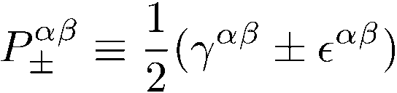

Definitions of the quantities
Maurer-Cartan 1-form
Projection on the group manifold
,
Projection on the world-sheet
A chain of operations

