Slide 1
Kondo effect of
heavy hadrons in nuclear matter
arXiv:1607.07948 [hep-ph]
Shigehiro Yasui
Tokyo Institute of Technology
Meson in Nucleus (MIN) 2016@YITP, 31 Jul. – 2 Aug. 2016

Slide 2
Contents
1. Charm nucleus
2. Kondo effect: introduction
3. Kondo effect of Ds and Ds* mesons
4. Conclusion

Slide 3
1. Charm nucleus
1. Hadron-nucleon interaction
→ Flavor symmetry, chiral symmetry, heavy quark symmetry
2. Hadron in medium
→ Chiral symmetry breaking, quark confinement
3. Nuclear structure
→ Spin-isospin correlations, high density state (ρ>ρ₀ )

Slide 4
1. Charm nucleus
Review : “Heavy Hadrons in Nuclear Matter”(107 pages)

Slide 5
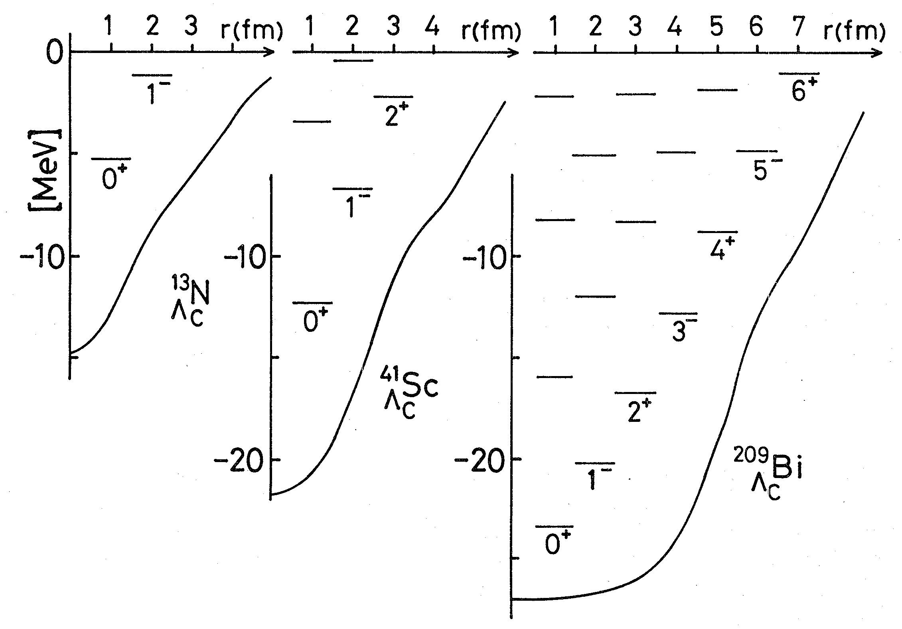
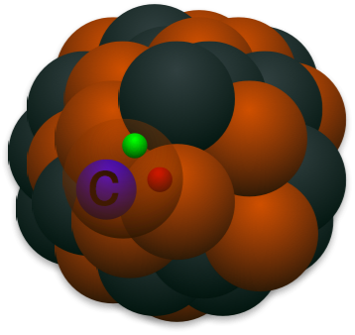
1. Charm nucleus
Example 1
Strangeness
Charm
Λ(uds) → Λ_{c}(udc)
Charm baryon Λ_{c}(udc)
H.Bando, “Flavor Nuclei”, PTP Suppl. 81, 197 (1985)

Slide 6
1. Charm nucleus
Example 2
D⁽*⁾NN
DNN
B⁽*⁾NN
M. Bayer, C. W. Xiao, T. Hyodo, A. Dote, M. Oka, E. Oset, Phys. Rev. C86, 044004 (2012)
Y. Yamaguchi, S.Y., A. Hosaka, Nucl. Phys. A927, 110 (2014)
J/ψNN
η_{c} N N
Λ_{c} N N
A. Yokota, E. Hiyama, M. Oka,
Pog. Ther. Exp. Phys. 2013, 113D01
S. Maeda, M. Oka, A. Yokota, E. Hiyama, Y-R. Liu, Pog. Ther. Exp. Phys. 2016, 023D02

Slide 7
1. Charm nucleus
1 What is new property
of charm nuclei ?

Slide 8
1. Charm nucleus
・Heavy mass of charm hadron
m_{c}=1.3 GeV and m_{b}=4.7 GeV
・Heavy Quark Symmetry (HQS)
Hadron spin = light quark spin x heavy quark spin

Slide 9
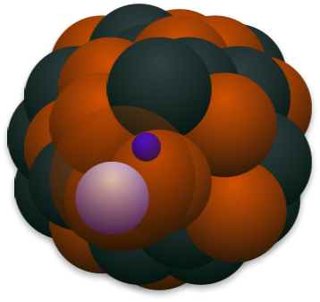
1. Charm nucleus
Heavy-light meson
Kondo effect
“Heavy impurity” nuclear physics
Ds, Ds*
(cs)
q
c
Nucleus

Slide 10
2. Kondo effect
2 What’s “Kondo effect” ?

Slide 11
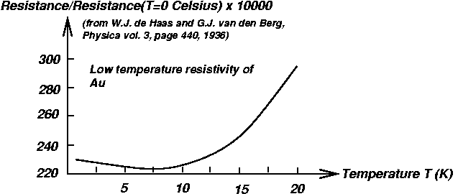
2. Kondo effect
Original Work: J. Kondo (Prog. Theor. Phys. 32, 37 (1964))
Impurity atom with spin ½
with Tª・Tª interaction
T²
(classical)
electron
metal
Log T/T_{K}
(quantum)
T¹, ..., T^{n^2-1}: generators of SU(n)
(n=2 for spin ½)
T_{K}: Kondo temperature
“Kondo bound state”
impurity
spin
electron
spin

Slide 12
2. Kondo effect
Original Work: J. Kondo (Prog. Theor. Phys. 32, 37 (1964))
impurity
fermion
Heavy impurity
1
Fermi surface
(degenerate state)
2
Loop effect
(particle-hole creation)
3
Non-Abelian int.
(SU(n) symmetry)

Slide 13
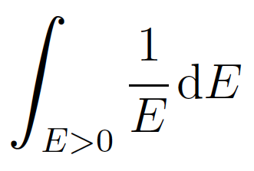
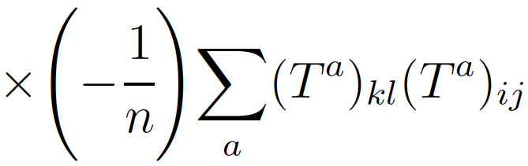
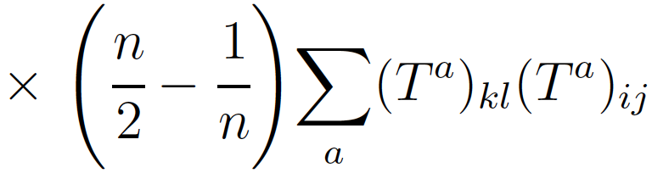
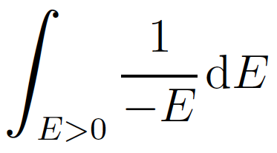
2. Kondo effect
Original Work: J. Kondo (Prog. Theor. Phys. 32, 37 (1964))
impurity
fermion
Scattering amplitude at tree and one-loop levels
electron
l
k
impurity atom
j
i
k, l, i, j=↑, ↓ in SU(n) (n=2 for spin ½)
T¹, ..., T^{n^2-1}: generators of SU(n)
(Tª)_{kl}(Tª)_{ij} interaction
electron
l
k
l
k
+
+
j
i
j
i
E: energy from Fermi surface
hole
Log E divergence for infrared limit (E→0) for any small coupling
→ Logarithmic divergence in resistance of electron

Slide 14
2. Kondo effect
impurity
fermion
Application of Kondo effect to
Hadron/nuclear physics
Fermi gas
electron gas
nuclear matter
(p,n)
quark matter
(u,d,s)
Heavy impurity
spin-atoms
D/B mesons
c/b quarks
Fermi surface
(degenerate state)
✔︎
✔︎
✔︎
Loop effect
(particle-hole creation)
electron-hole︎
nucleon-hole︎
quark-hole︎
Non-Abelian int.
(SU(n) symmetry)
SU(2)_{spin}
SU(2)_{isospin}
SU(3)_{color}
Change of matter properties
(ex. transport coefficients)
1. NJL-type: S.Y., K.Sudoh, Phys. Rev. C88, 015201 (2013)
2. QCD: K. Hattori, K. Itakura, S. Ozaki, S.Y., Phys. Rev. D92, 065003 (2015)
3. “Magnetic catalysis QCD Kondo effect”:
S. Ozaki, K. Itakura, Y. Kuramoto, arXiv:1509.06966 [hep-ph]
4. Kondo effect in nucleus: S.Y., Phys. Rev. C93, 065204 (2016)
5. QCD Kondo phase: S.Y., K. Suzuki, K. Itakura, arXiv:1604.09229 [hep-ph]

Slide 15
2. Kondo effect
Ds/Ds*

Slide 16
2. Kondo effect
3 Why Ds/Ds* mesons ?

Slide 17
2. Kondo effect
Ds/Ds*
D/D*
(cs)
(cu,cd)
Short-distance
repulsion to
nucleon
No
Yes
Electric charge
(Coulomb-bound)
-1
0, -1
< 2.1 MeV,
0.834 MeV
Long life-time of
vector-meson
< 1.9 MeV
Non-Abelian
interaction
spin
spin+isospin

Slide 18
3. Kondo effect of Ds and Ds* mesons
1 Interaction of Ds (Ds*) meson and nucleon

Slide 19
3. Kondo effect of Ds and Ds* mesons
1 Interaction of Ds (Ds*) meson and nucleon
non-relativistic limit for nucleon
spin-nonexchange term
spin-exchange term

Slide 20
3. Kondo effect of Ds and Ds* mesons
2 Renormalization group equation
nucleon
Ds, Ds*
Ds, Ds*
nucleon (hole)
(Λ: loop momentum)

Slide 21
3. Kondo effect of Ds and Ds* mesons
2 Renormalization group equation
nucleon
Ds, Ds*
Ds, Ds*
nucleon (hole)
spin-nonexchange term
(fixed point c_{s}*=c_{s})
(Λ: loop momentum)
spin-exchange term
(fixed point c_{t}*=∞ for c_{t}>0)
Kondo scale
(infrared singularity)

Slide 22
3. Kondo effect of Ds and Ds* mesons
3 Mean-field approach
Kondo scale → non-perturbative treatment
Boson-fermion correspondence
Hamiltonian with auxiliary fermion
auxiliary fermion
(σ: light-spin, i:heavy-quark spin)
constraint condition
HQS breaking
“Gap” function as mean-field
Thermodynamic potential
mixing of auxiliary fermion
and nucleon

Slide 23
3. Kondo effect of Ds and Ds* mesons
3 Mean-field approach
Kondo scale → non-perturbative treatment
Spectral function
exact HQS
δ: width of resonance
= “gap”
“Kondo resonance”
small HQS breaking
Kondo scale
(infrared singularity)
large HQS breaking
“Ds” “Ds*”

Slide 24
4. Conclusion

Slide 25
4. Conclusion
1. We study the Kondo effect of Ds/Ds* meson
in nuclear matter.
Ds/Ds* meson in nuclear matter
x HQS interaction
= “Kondo resonance”
2. We apply the renormalization group equation
and find fixed point at the Kondo scale.
3. The Kondo scale is relevant to the width of the
Kondo resonance as mixing of Ds/Ds* meson and
nucleon in the ground state.
Future works:
1. Application to realistic Ds/Ds* meson-nucleon interaction.
2. Application to other heavy hadrons.
3. Observables and reactions for experiments.
4. etc.

Slide 26
Related references
HQS doublet/singlet in exotic hadrons and nuclei
S.Y., K.Sudoh, Y.Yamaguchi, S.Ohkoda, A.Hosaka, T.Hyodo, Phys. Lett. B727, 185 (2013)
Y.Yamaguchi, S.Ohkoda, T.Hyodo, A.Hosaka, S.Y., Phys. Rev. D91, 034034 (2015)
D⁽*⁾N, D⁽*⁾NN hadronic molecules
S.Y., K.Sudoh, Phys. Rev. D80, 034008 (2009)
Y.Yamaguchi, S.Ohkoda, S.Y., A.Hosaka, Phys. Rev. D84, 014032 (2011)
Y.Yamaguchi, S.Ohkoda, S.Y., A.Hosaka, Phys. Rev. D85, 054003 (2013)
Y.Yamaguchi, S.Y., A.Hosaka, Nucl. Phys. A927, 110 (2014)
D⁽*⁾ in nuclear matter and Kondo effects
S.Y., K.Sudoh, Phys. Rev. C87, 015202 (2013)
S.Y., K.Sudoh, Phys. Rev. C88, 015201 (2013)
NLO in 1/m_{Q} expansion for D⁽*⁾ in nuclear matter
S.Y., K.Sudoh, Phys. Rev. C89, 015201 (2014)
D⁽*⁾N hadronic molecules
Y.Yamaguchi, S.Ohkoda, S.Y., A.Hosaka, Phys. Rev. D87, 074019 (2013)

Slide 27
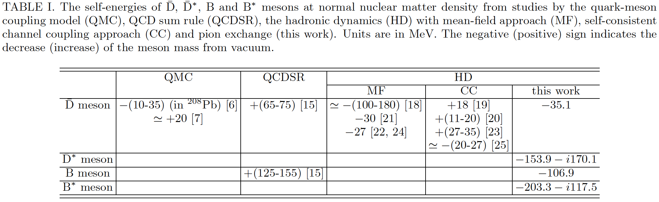
D (B) meson in nuclear matter
Quark-meson coupling model, QCD sum rules, hadronic interactions (mean-field approach, channel coupling, pion interaction), ...
Binding energy [MeV]
Hadron dynamics
Quark-meson coupling model
QCD rum rule
Mean field
WT-type coupling
π exchange
~ a few ten MeV
Repulsive? or Attractive?
[26]
-50 MeV [27]
+30 MeV [28]
-66 MeV [29]
[6] K. Tsushima, D. -H. Lu, A. W. Thomas, K. Saito and R. H. Landau, Phys. Rev. C 59, 2824 (1999).
[7] A. Sibirtsev, K. Tsushima and A. W. Thomas, Eur. Phys. J. A 6, 351 (1999).
[15] T. Hilger, R. Thomas and B. Kampfer, Phys. Rev. C 79, 025202 (2009).
[16] T. Hilger, R. Schulze and B. Kampfer, J. Phys. G G 37, 094054 (2010).
[17] Z. -G. Wang and T. Huang, Phys. Rev. C 84, 048201 (2011).
[18] A. Mishra, E. L. Bratkovskaya, J. Schaffner-Bielich, S. Schramm and H. Stoecker, Phys. Rev. C 69, 015202 (2004).
[19] M. F. M. Lutz and C. L. Korpa, Phys. Lett. B 633, 43 (2006).
[20] L. Tolos, A. Ramos and T. Mizutani, Phys. Rev. C 77, 015207 (2008).
[21] A. Mishra and A. Mazumdar, Phys. Rev. C 79, 024908 (2009).
[22] A. Kumar and A. Mishra, Phys. Rev. C 81, 065204 (2010).
[23] C. E. Jimenez-Tejero, A. Ramos, L. Tolos and I. Vidana, Phys. Rev. C 84, 015208 (2011).
[24] A. Kumar and A. Mishra, Eur. Phys. J. A 47, 164 (2011).
[25] C. Garcia-Recio, J. Nieves, L. L. Salcedo and L. Tolos, Phys. Rev. C 85, 025203 (2012).
[26] S. Yasui, K. Sudoh, Phys. Rev. C87, 015202 (2013).
[27] A. Hayashigaki, Phys. Lett. B487, 96 (2000)
[28] K. Suzuki, P. Gubler, M. Oka, Pos Hadron2013, 179 (2014).
[29] K. Azzi, N. Er, H. Sundu, Eur. Phys. J. C74, 3021 (2014).

