Slide 1

Production of the eta meson
with nucleons and nuclei
Paweł Moskal
Jagiellonian University, Cracow,Poland
Abstract:
We report on the status of the search for the eta-mesic nuclei.
New results on the analyzing power for the pp->ppeta reaction close to the eta meson production threshold
will be presented”
-
Mesons in Nuclei 2016
Yukawa Institute for Theoretical Physics,
Kyoto University, 31 August 2016
Notes:
1
1
I am truly glad to take part in the school and I regret....
Since I am the first time (shame on me) ....
I have prepared a presentation on the Kindergarten level....
Maria left me kindly a choise of the subjcet..
So I guess, you may easly imagine all the agonies
of having to make a choice which I experienced last week.
Here I have to mention that I will explain the meaning of WASA and COSY …
(WASA is the detector… and COSY is the proton Cooler Synchrotron)

Slide 2

Production and interaction of the eta meson
with nucleons and nuclei
mesic-nuclei
ppη production
Notes:
Kindergarten .... ; please be awake until the third point .... This is not anymore as fluctuations or efficiency artefacts ....
contributing to the study of the muon
anomalous magnetic moment
Jakos to poskladac do kupy … dlaczego eta SM etc…
Polaczyc z nastepna strona i nawiazac podobnie as two years ago I will repeat since …than to Falsify the theory !!!
With Wasa at COSY we study both production and decays of the eta-meson but Today I will concentrate
of decays which is also a primordial aim of the experiment
In general we search for the phenomena which cannot be describe by the Standard Model…

Slide 3
THE ETA-MESIC NUCLEUS
η meson bound with nucleus via
STRONG INTERACTION
+
+
+
N*
π‾
+
η
N*
+
COSY, J-PARC, MAMI, GSI, LPI/JINR
Talk by Wojciech Krzemień at this conference …
G. A, Sokol et al., arXiv:nucl-ex/0106005

Slide 4
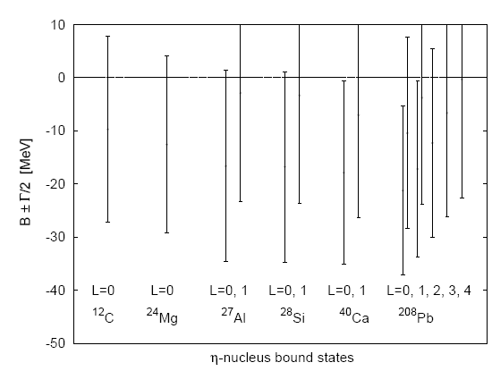
  Attractive interaction between η and N
  (R. Bhalerao and L. C. Liu, Phys. Lett. B54 (1985) 685 )‏
  possible existence of bound states
  of the η meson with nuclei for A>10
  (Q. Haider and L. C. Liu, Phys. Lett. B172 (1986) 257 )‏
  (C.Garcia-Recio, T. Inoue, J.Nieves,
  E. Oset, Phys. Lett. B550 (2002) 47).

Slide 5
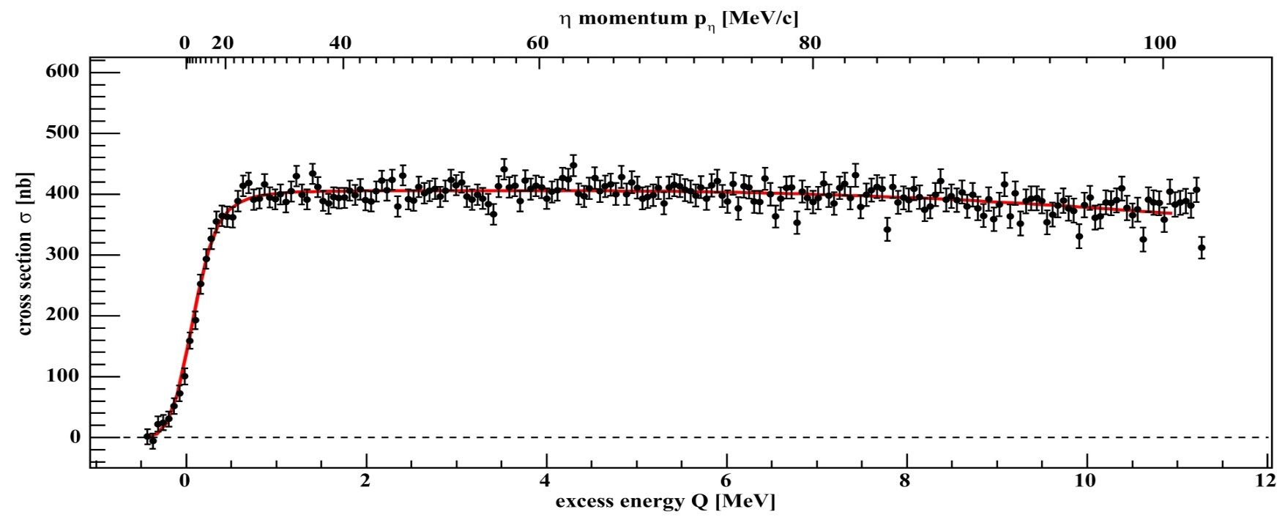
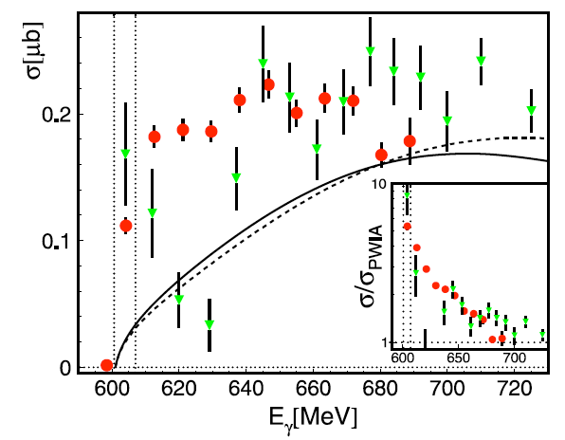
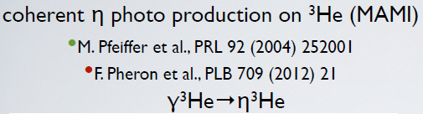
+
η - ³He
+
dp→ ³Heη γ ³He → ³Heη
COSY
MAMI
η
MAMI:
M. Pfeiffer et al., Phys. Rev. Lett. 92 252001 (2004)
F. Pheron et al., Phys. Lett. B709 21 (2012)
ANKE: T. Mersmann et al., Phys. Rev. Lett. 98 242301 (2007)
COSY-11: J. Smyrski et al., Phys. Lett B 649 258-262 (2007)
T. Mersmann et al., Phys. Rev. Lett. 98, 242301 (2007)
Notes:
SO its connected to the eta-3He system !!!
Is it production or interaction in the final state??? It has rather something to do with hel-eta because…

Slide 6
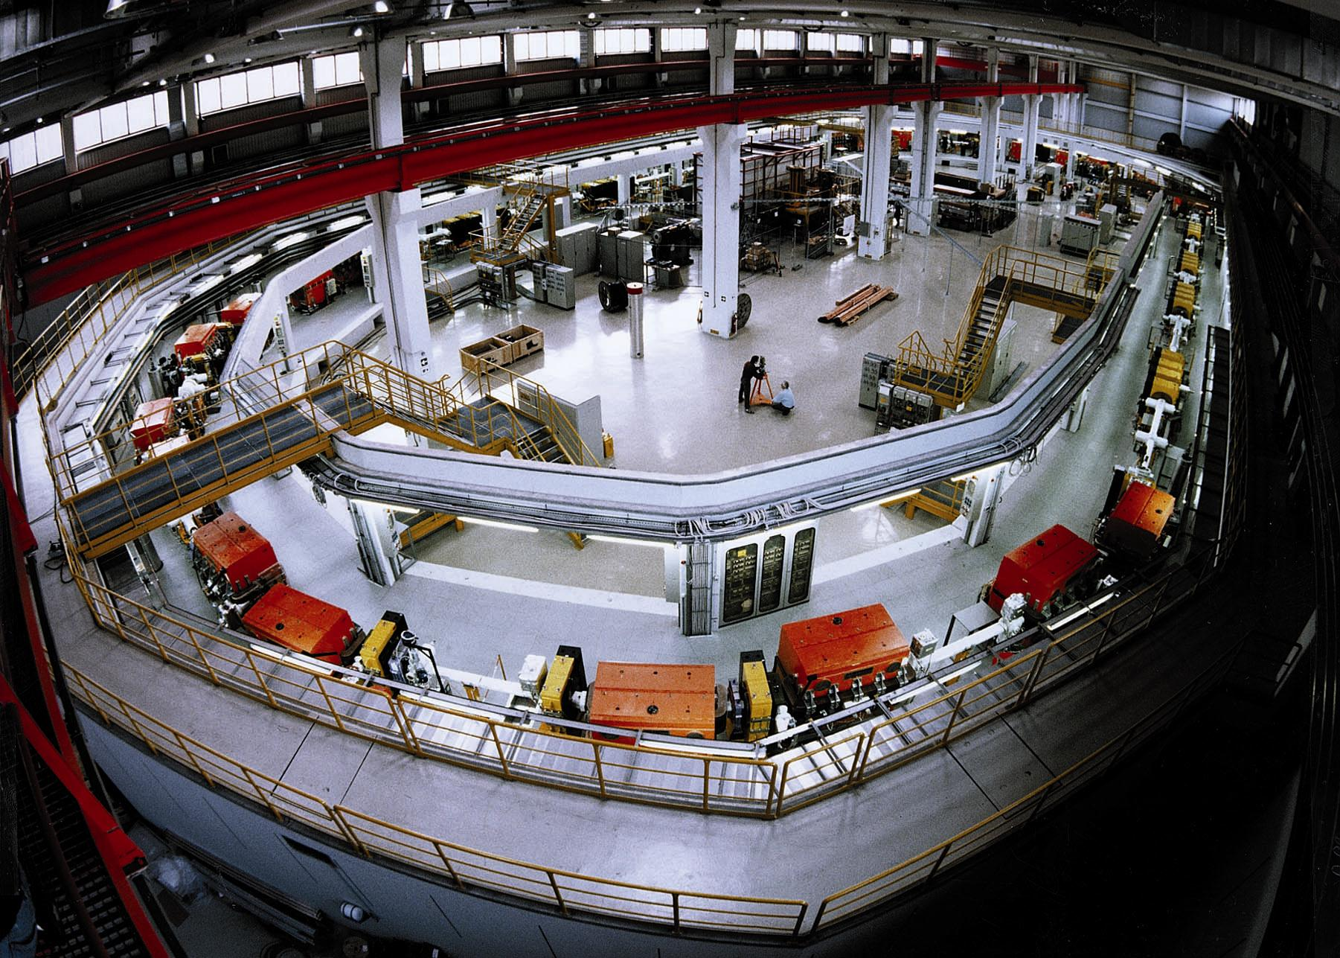
spolaryzowana lub niespolaryzowana
wiązka protonów i deuteronów
polarised and unpolarised proton
and deuteron beams
chłodzenie stochasyczne i elektronowe
stochastic and electron cooling
zakres pędu: 600 – 3700 MeV/c
momentum range: 600 – 3700 MeV/c
produkcja mezonów do φ(1020) włącznie
meson production up to φ(1020)‏
COoler SYnchrotron COSY
Notes:
6
6

Slide 7
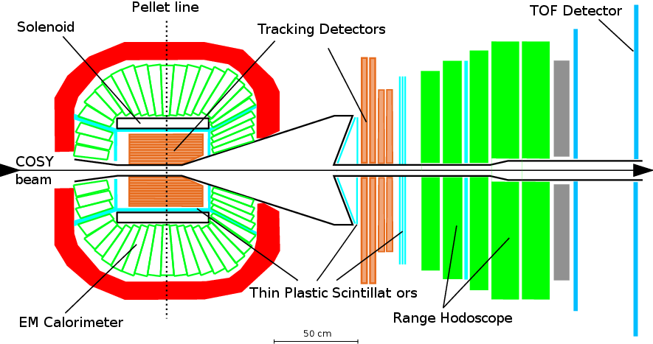
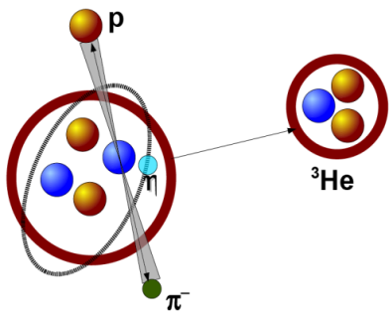
WASA-at-COSY
d+d → (⁴He-η)_{bound}→ ³He + p + π⁻
d+d → ³He + p + π⁻
→
Notes:
Tu wpsomniec o Pelletach … ( a może ktos ma szkic albo zdjęcie ..)
TU PRZYDAŁOBY SIĘ WIDMO POKAZUJACE IDENTYFIKACJE …
Magdalena ??
Polaryzacj at Q=15 and at Q=72…

Slide 8
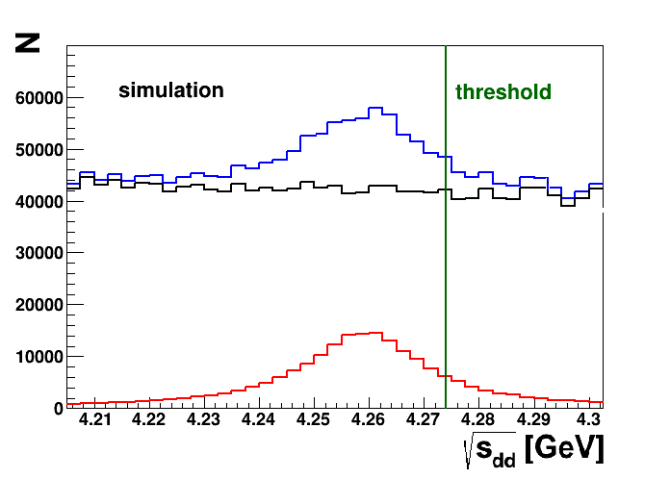
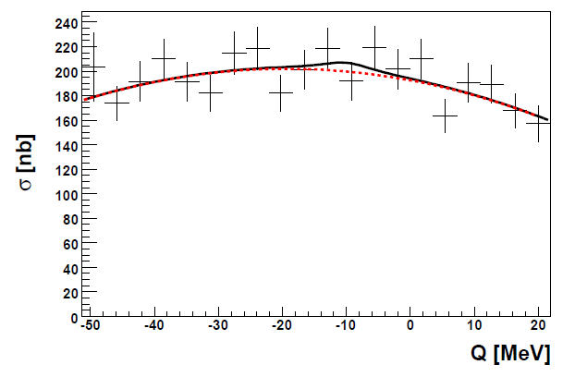
d+d → (⁴He-η)_{bound}→ ³He + p + π⁻
d+d → ³He + p + π⁻
SIMULATIONS
EXPERIMENT
Upper limit of about 25 nb
WASA-at-COSY: Phys. Rev. C87(2013) 035204
Notes:
Zamienic rysunek na nowy Magdy...

Slide 9
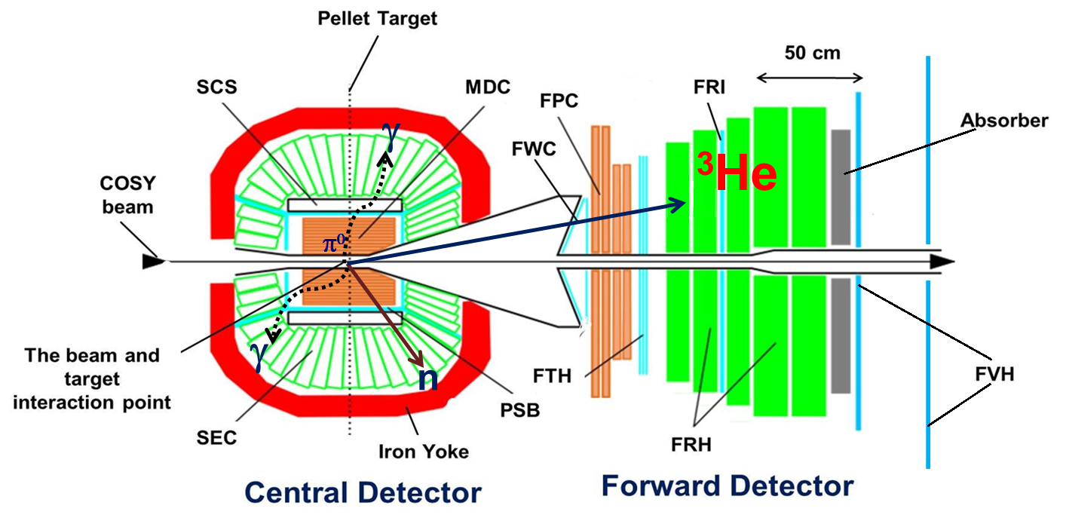
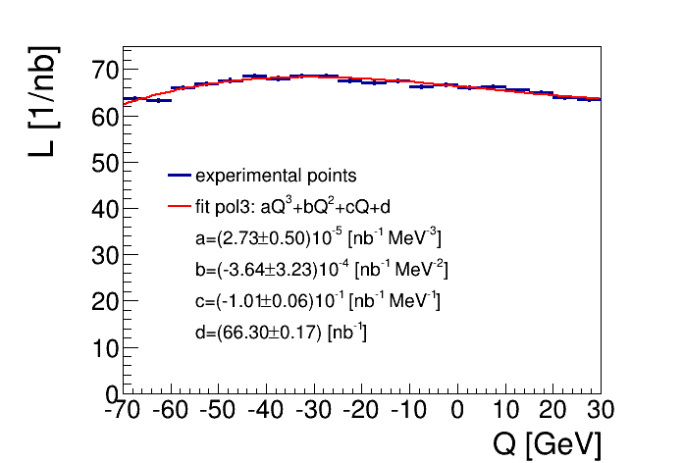
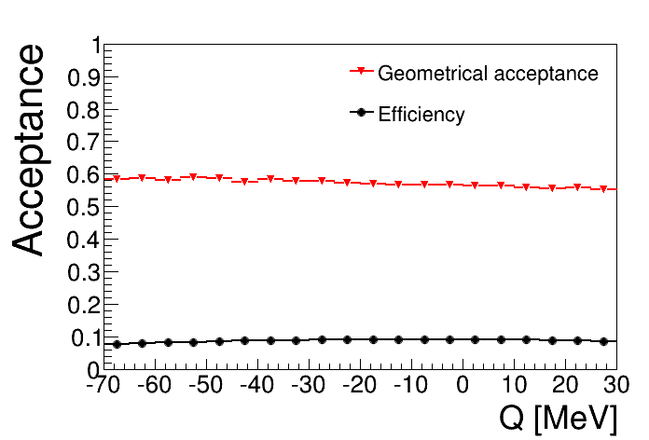

Slide 10
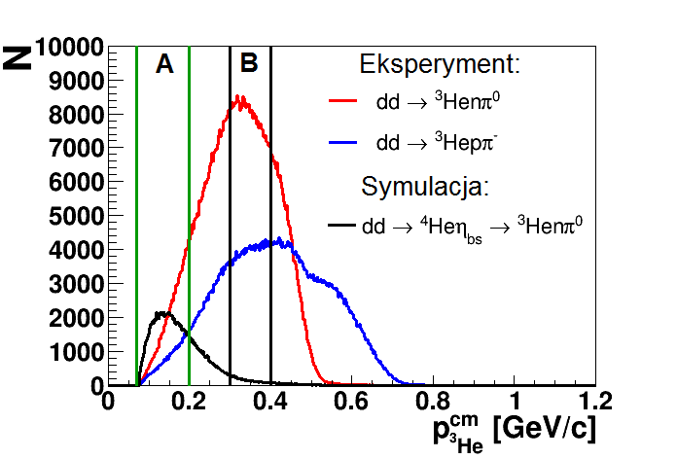
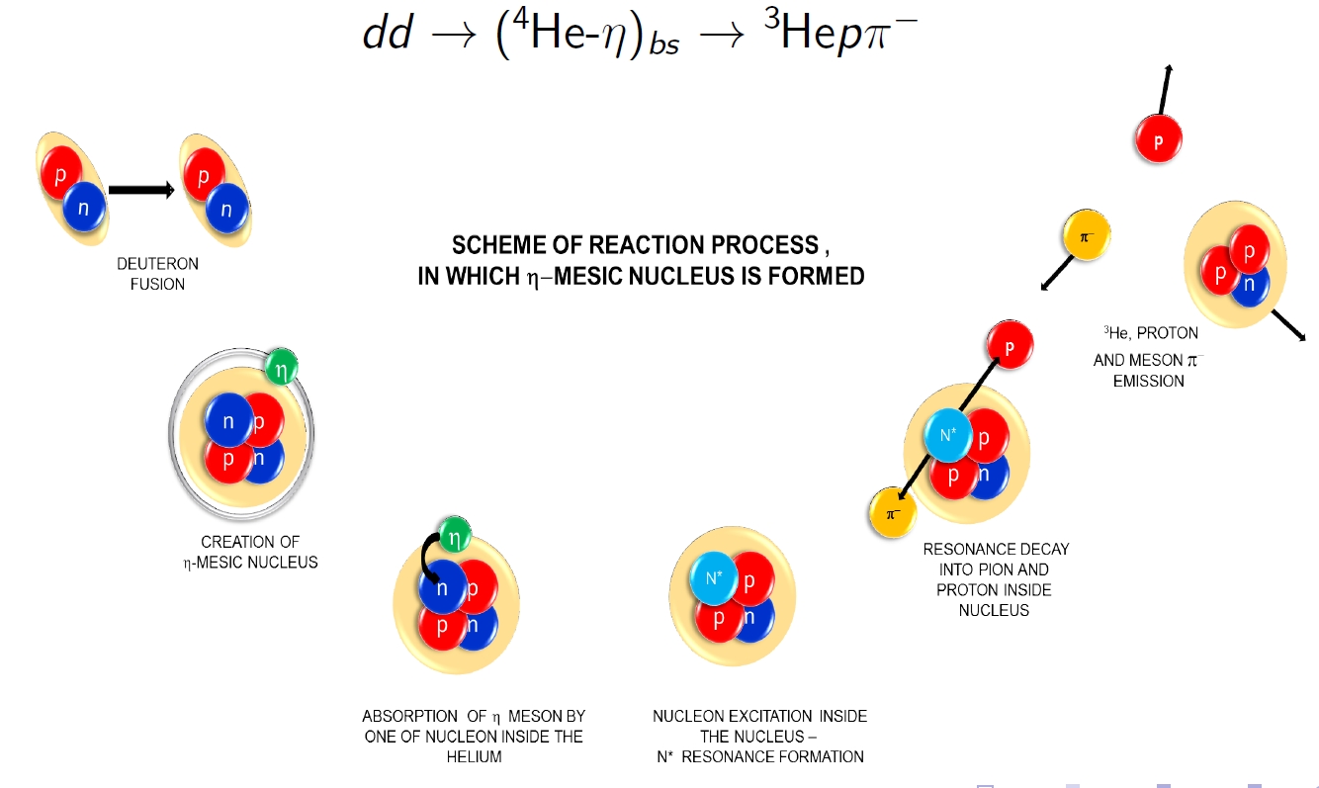

Slide 11
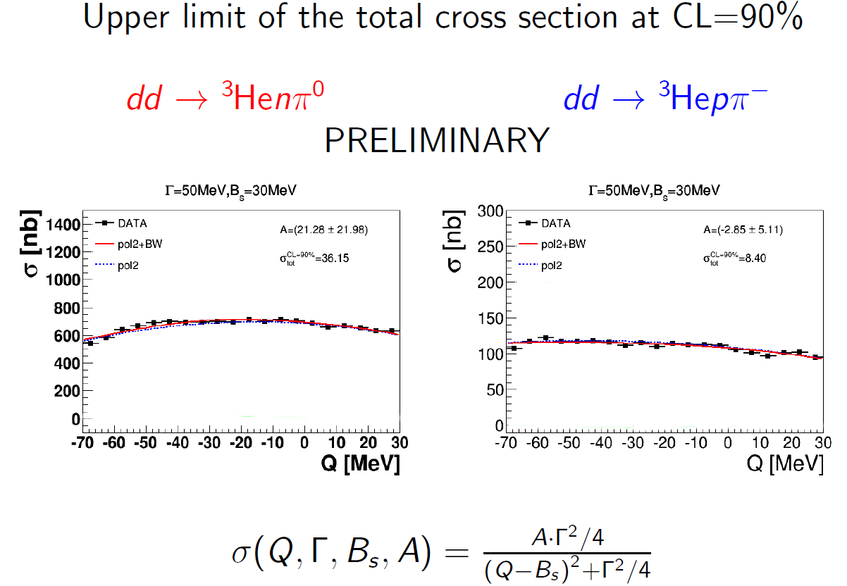

Slide 12
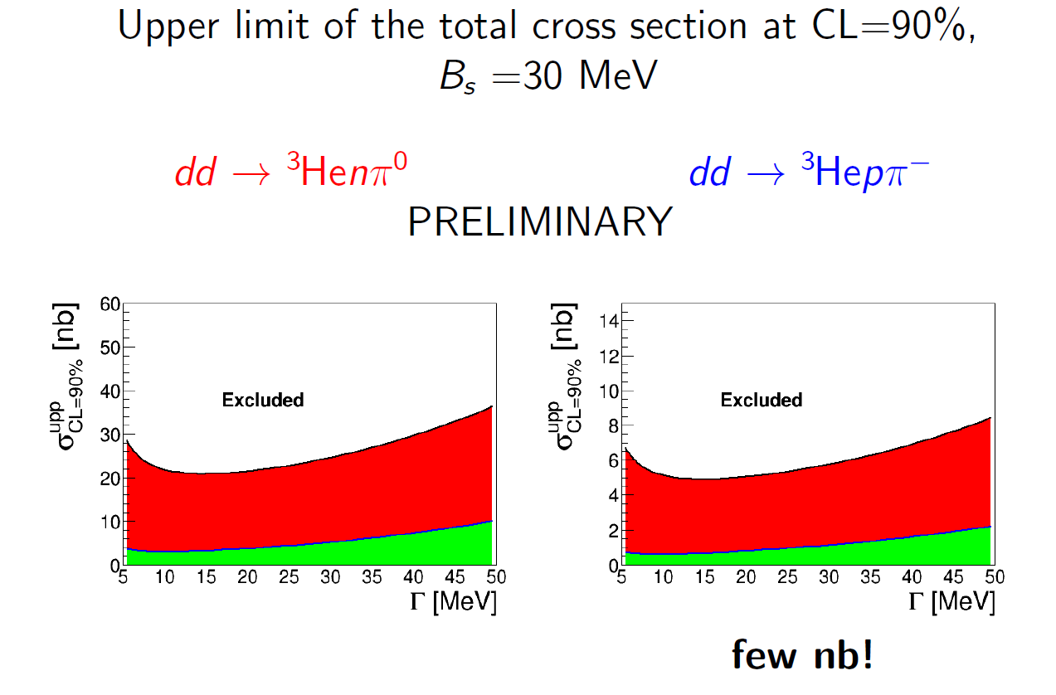

Slide 13
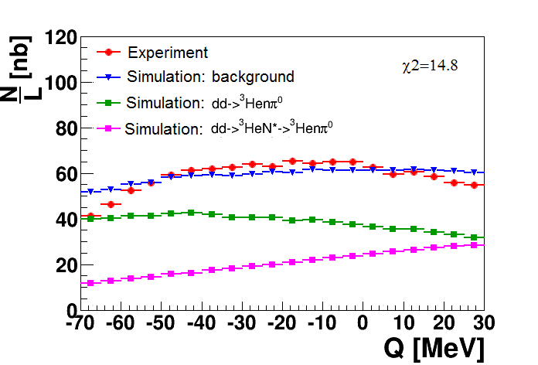
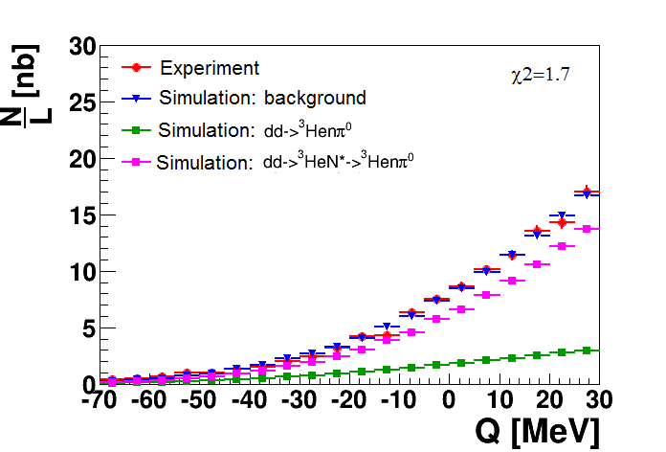

Slide 14
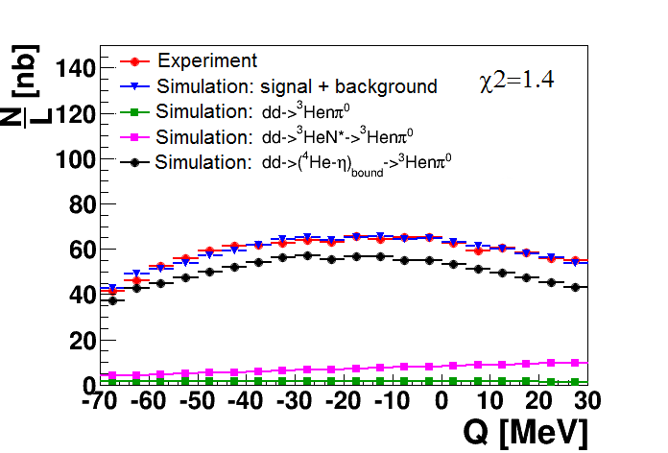

Slide 15
η - ⁴He
~ 6 nb -- Present preliminary experimental upper limit .
~ 4 nb -- Theoretical estimation .
S. Wycech, W. Krzemien , Acta. Phys. Pol. B45 (2014) 745 .
η - ³He
~270 nb -- Present experimental upper limit pppπ⁻
COSY-11: Acta Phys. Pol B41 (2010) 21
~80 nb -- Theoretical estimation .
C. Wilkin, Acta. Phys. Pol. B45 (2014) 603
~ 10nb -- expected from New WASA-at-COSY data
collected in May 2014

Slide 16
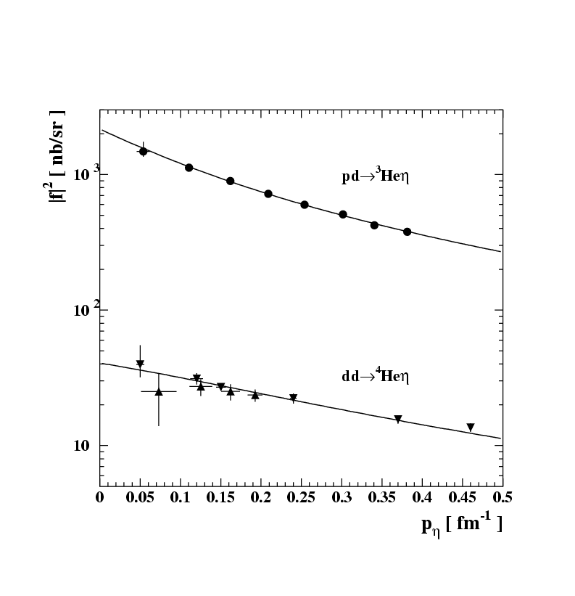
η - ⁴He
~ 6 nb -- Present preliminary experimental upper limit .
~ 4 nb -- Theoretical estimation .
S. Wycech, W. Krzemien , Acta. Phys. Pol. B45 (2014) 745 .
η - ³He
~270 nb -- Present experimental upper limit pppπ⁻
COSY-11: Acta Phys. Pol B41 (2010) 21
~80 nb -- Theoretical estimation .
C. Wilkin, Acta. Phys. Pol. B45 (2014) 603
~ 10nb -- expected from New WASA-at-COSY data
collected in 2014

Slide 17
J.-J. Xie, W.-H. Liang, E.Oset et al., (priv. com. 2016)
Chiral unitary approach
Generates the 3He-eta amplitude from the eta-3He potential
fitted to the data. With this optical potential solve the BSE
for the η 3He system and find an η bound state around 0.3 MeV
and a width around 3 MeV,
Notes:
Bethe-Salpeter equation (BSE),

Slide 18
via N*
p+d → (³He-η)_{bound}→ p + p + p+ π⁻
p+d → (³He-η)_{bound} → d + p + π⁰
p+d → (³He-η)_{bound} → p + p + n + π⁰
p+d → (³He-η)_{bound} → d + n + π⁺
decay while orbiting
p+d → (³He-η)_{bound} → ³He 6γ
p+d → (³He-η)_{bound} → ³He γγ
Notes:
Based on C. Wilkin, Acta Phys. Pol. B45 (2014)

Slide 19
Production and interaction of the eta meson
with nucleons and nuclei
mesic-nuclei
ppη production
Notes:
Kindergarten .... ; please be awake until the third point .... This is not anymore as fluctuations or efficiency artefacts ....
contributing to the study of the muon
anomalous magnetic moment
Jakos to poskladac do kupy … dlaczego eta SM etc…
Polaczyc z nastepna strona i nawiazac podobnie as two years ago I will repeat since …than to Falsify the theory !!!
With Wasa at COSY we study both production and decays of the eta-meson but Today I will concentrate
of decays which is also a primordial aim of the experiment
In general we search for the phenomena which cannot be describe by the Standard Model…

Slide 20
threshold as a spin filter
in the laboratory
P
3 GeV/c
η
P
before reaction:
after reaction:
in the centre of mass system
1 GeV/c
P
η
P
1 GeV/c
L = 1, S = 1
L = 0, l=0
⇒ Reaction parameter b ∼ 0.2 fm
³P₀→¹S₀s
Notes:
Pauli principle and small energy => Ss DOPISAC O POCHODNEJ NA dm/dP …!!! → mass resolution etc…
This was the most decisive factor in minimizing uncertainties of the missing-mass determination, since at threshold the partial derivative of the miss-
ing mass with respect to the outgoing proton momentum tends to zero. In addition, close to threshold the signal-
to-background ratio increases due to the more rapid reduction of the phase space for multimeson production than for the η′ !!!
.
etc
Parity of eta = -1 … => L=1….,
Experiment: So in the laboratory they fligh in small cone….small experiments … full 4pi
Threshold: With small relative velocities … large effect expected from interaction….

Slide 21
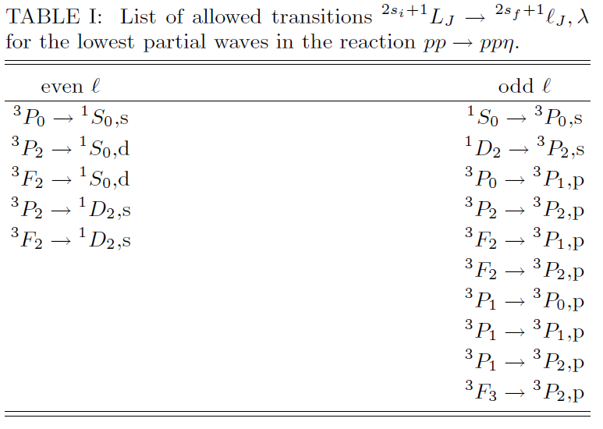
A. Deloff, nucl-th/0309059
Ss, Sp, Sd, Ps, Pp
Ss, Sd, Ps, Pp

Slide 22
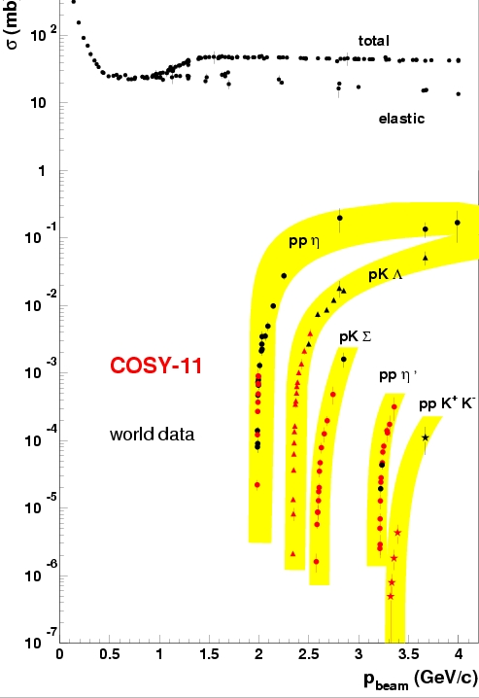
experimental challenge !
Notes:
The challange is that the cross sections grows rapidly at threshold (phase spase opens…)
by many orders of magnitudes at few MeV (few tens of MeV)….
Since many of you are intersted in eta-prime I will emphasise some aspects of eta-prime ....

Slide 23
spolaryzowana lub niespolaryzowana
wiązka protonów i deuteronów
polarised and unpolarised proton
and deuteron beams
chłodzenie stochasyczne i elektronowe
stochastic and electron cooling
zakres pędu: 600 – 3700 MeV/c
momentum range: 600 – 3700 MeV/c
produkcja mezonów do φ(1020) włącznie
meson production up to φ(1020)‏
COoler SYnchrotron COSY
Notes:
23
23

Slide 24
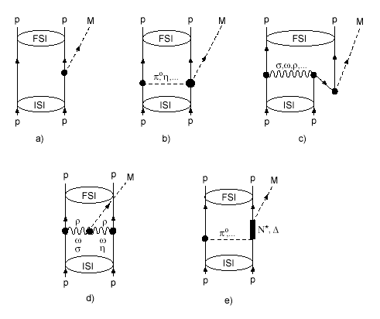
production dynamics e.g. meson η
σ = dV_{ps} |M|²
What would the first experimental physicists tell us?
|M|² ~ |M₀|² |M_{FSI}|²
Salviati. But if, of many computations,
not even two came out in agreement,
what would you think of that?
Simplicio. If that is how the matters stand,
it is truly a serious defect
GALILEO GALILEI
”Dialogue concerning the two chief world systems”
dynamics → |M₀|²
What would the best student
of the Jagellonian University tell us?
He is encouraging us to continue:
For what is determinate
cannot have innumerable explanations
NICOLAUS COPERNICUS
”Minor Works III, Letter against Wagner”
P
1 GeV/c
P
η
P
P
1 GeV/c
P
ONE NUMBER and MANY GRAPHS

Slide 25
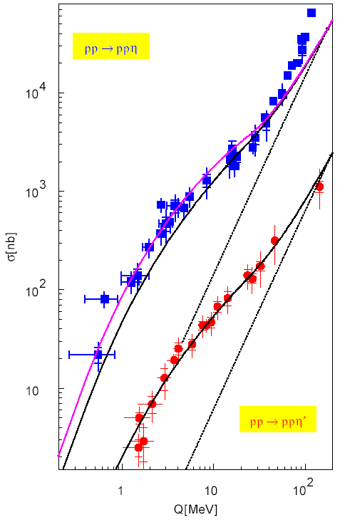
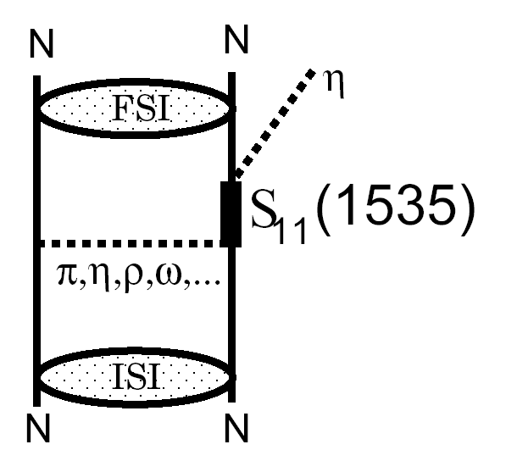
dynamics → |M₀|²
LARGE → RESONANSE
CELSIUS
COSY
SATURNE

Slide 26
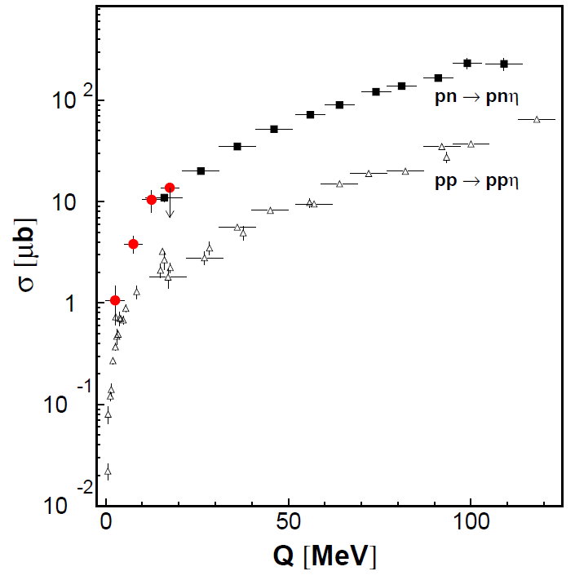
X
X
X
  STRONG ISOSPIN DEPENDENCE
  Eta meson is by factor of 12
  more coupiously produced
  when the total isospin of nucleons
  is equal to 0
  than when it is equal to 1
  Strong evidence of isovector meson
  exchange in production mechanism
CELSIUS
COSY
SATURNE

Slide 27
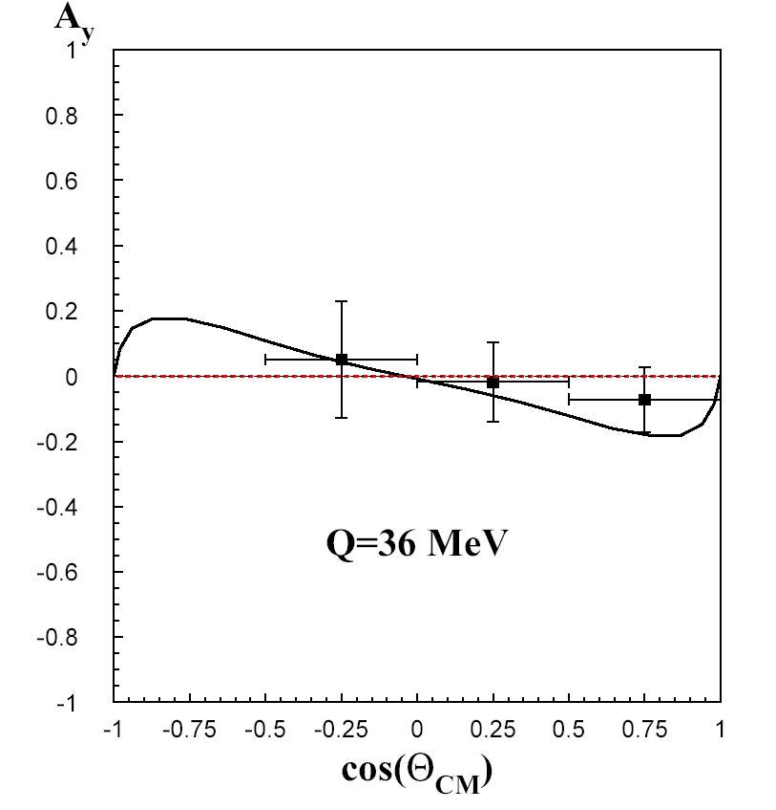
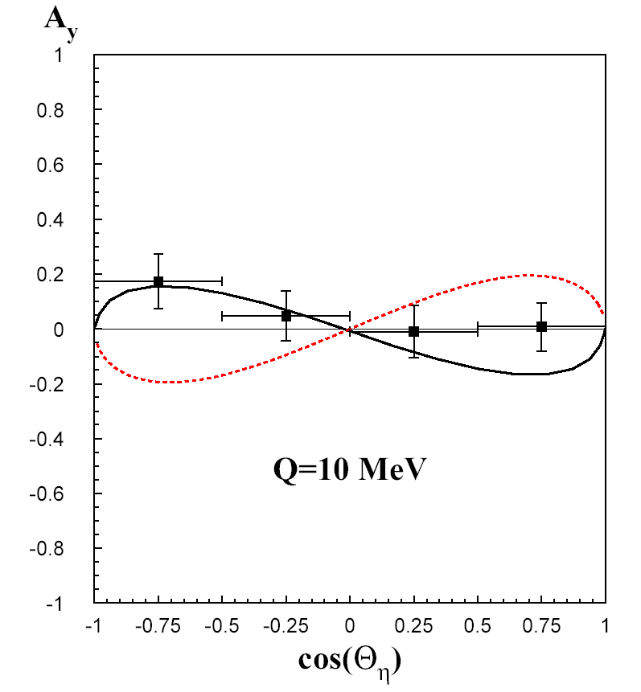
This was PREDICTED already about 2500 years ago
by the very first physicists
Thus, it is suggested that among created beings
there must be some basic agent which will move
things and bring them together
ARISTOTLE
“Metaphysics”
X
X
X
X
K. Nakayama et al., Phys. Rev. C 65 (2002) 045210 pseudoscalar
G. F ̈aldt and C. Wilkin, Phys. Scripta 64 (2001) 427 vector meson
π
ρ
COSY-11: Phys. Rev. Lett. 98 (2007) 122003
Notes:
ALBO TO TU WSPOMNIEC A WIECEJ PRZY OKAZJI interakcji…
PERSPEKTYWY / WASA / POKAZAC WIDMA POLARYZACJI… !...dla XX %...WYKLAD MH z MAIUS…
ORAZ O FOTOPRODUKCJI
This will be improved by THE WASA-at-COSY collaboartion, I will come to this in few minutes…

Slide 28
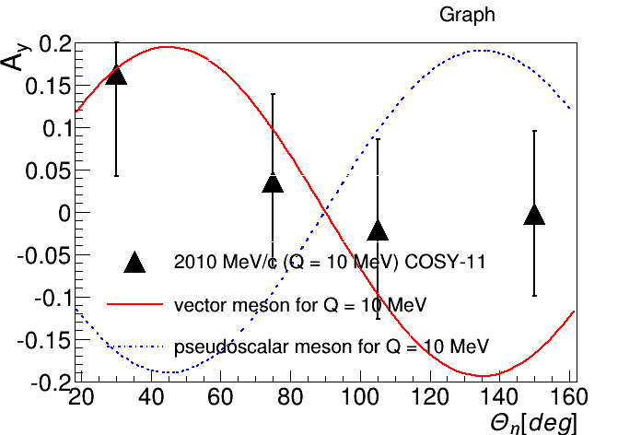
This was PREDICTED already about 2500 years ago
by the very first physicists
Thus, it is suggested that among created beings
there must be some basic agent which will move
things and bring them together
ARISTOTLE
“Metaphysics”
X
X
X
X
ρ
π
K. Nakayama et al., Phys. Rev. C 65 (2002) 045210 pseudoscalar
G. F ̈aldt and C. Wilkin, Phys. Scripta 64 (2001) 427 vector meson
COSY-11: Phys. Rev. Lett. 98 (2007) 122003
Notes:
ALBO TO TU WSPOMNIEC A WIECEJ PRZY OKAZJI interakcji…
PERSPEKTYWY / WASA / POKAZAC WIDMA POLARYZACJI… !...dla XX %...WYKLAD MH z MAIUS…
ORAZ O FOTOPRODUKCJI
This will be improved by THE WASA-at-COSY collaboartion, I will come to this in few minutes…

Slide 29
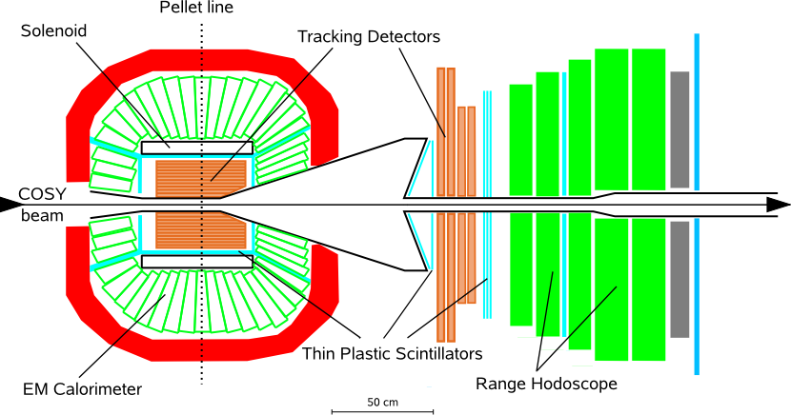

WASA detector
γ
P
P
γ
η
6

Slide 30
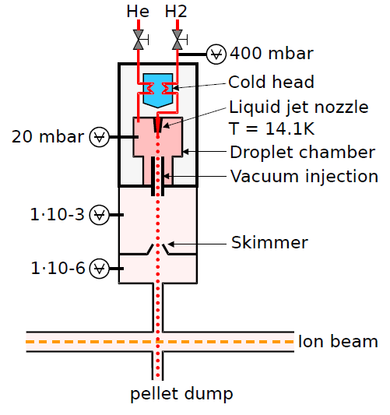
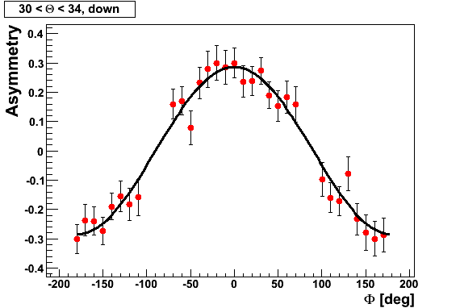
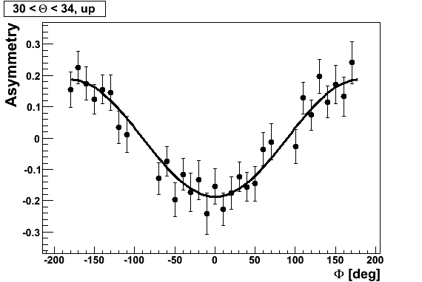
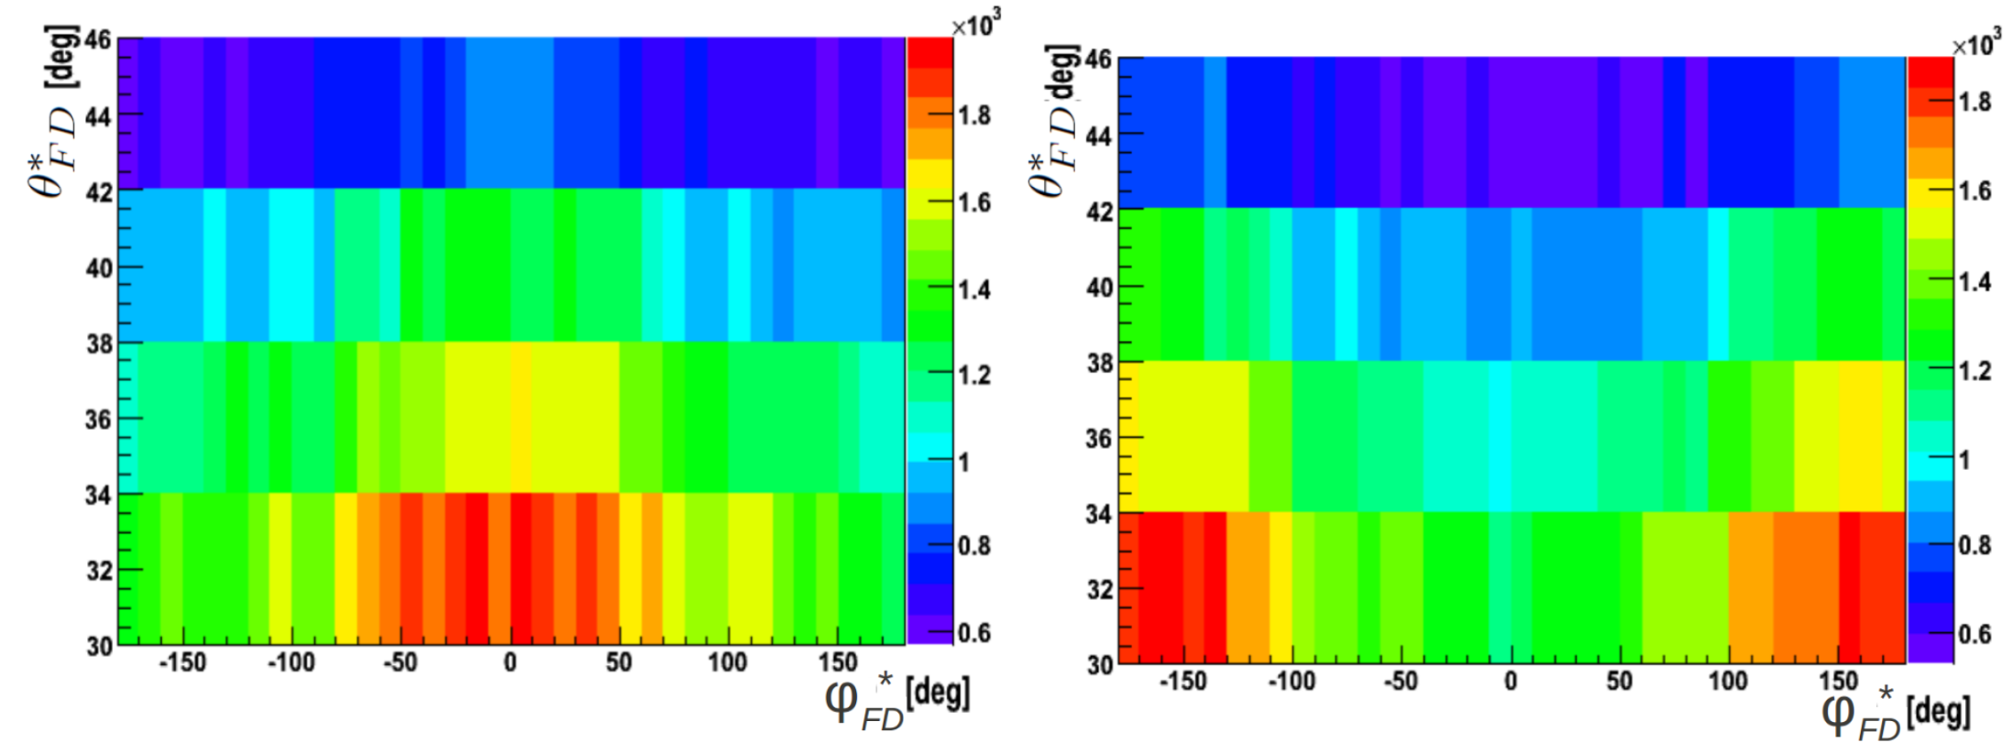
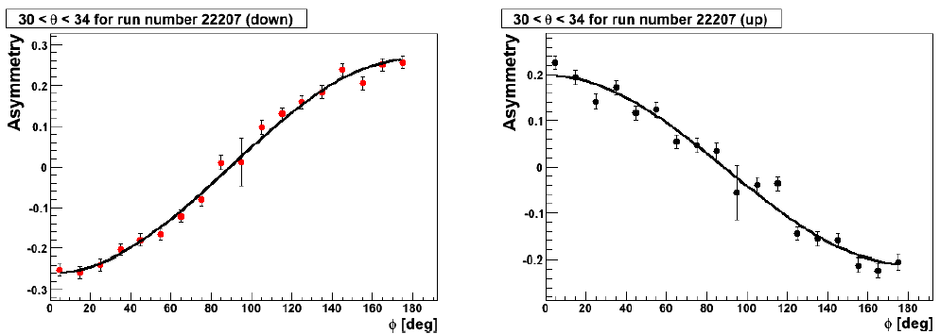
WASA-at-COSY
p p → p p M 10⁹ η and 10¹¹ π⁰ on discs
p p → p p η 10⁶ η mesons on discs ; Polarization of about 70%
more than factor of 100 larger statistics
I. Ozerianska, P.M., M. Zieliński, Acta Phys. Pol. B 46 (2015) 153
→
SPIN DOWN SPIN UP
Notes:
Tu wpsomniec o Pelletach … ( a może ktos ma szkic albo zdjęcie ..)
TU PRZYDAŁOBY SIĘ WIDMO POKAZUJACE IDENTYFIKACJE …
Magdalena ??
Polaryzacj at Q=15 and at Q=72…

Slide 31
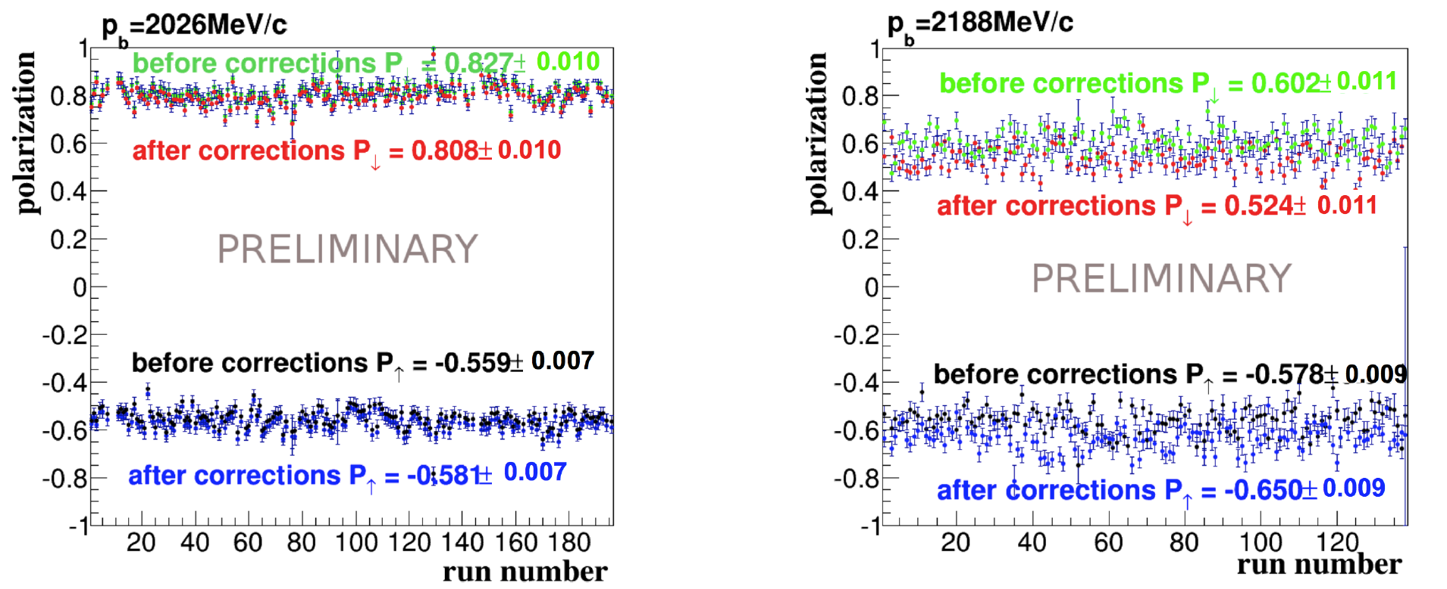
WASA-at-COSY
p p → p p M 10⁹ η and 10¹¹ π⁰ on discs
p p → p p η 10⁶ η mesons on discs ; Polarization of about 70%
more than factor of 100 larger statistics
I. Ozerianska, P.M., M. Zieliński, Acta Phys. Pol. B 46 (2015) 153
→
Notes:
Tu wpsomniec o Pelletach … ( a może ktos ma szkic albo zdjęcie ..)
TU PRZYDAŁOBY SIĘ WIDMO POKAZUJACE IDENTYFIKACJE …
Magdalena ??
Polaryzacj at Q=15 and at Q=72…

Slide 32
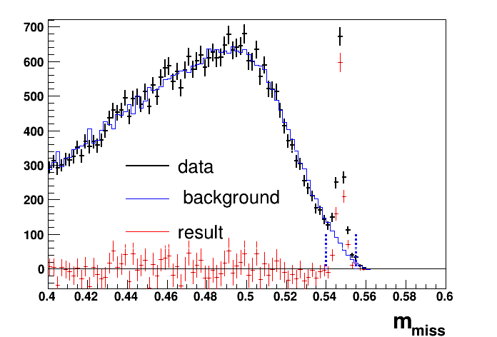
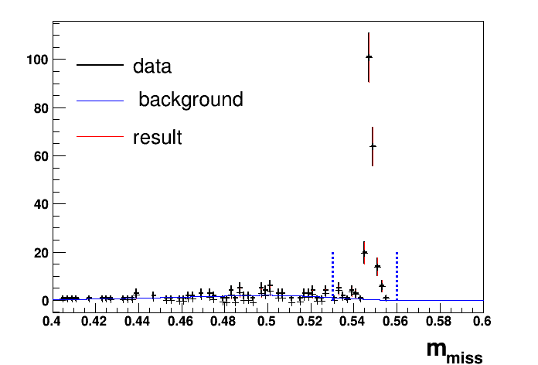
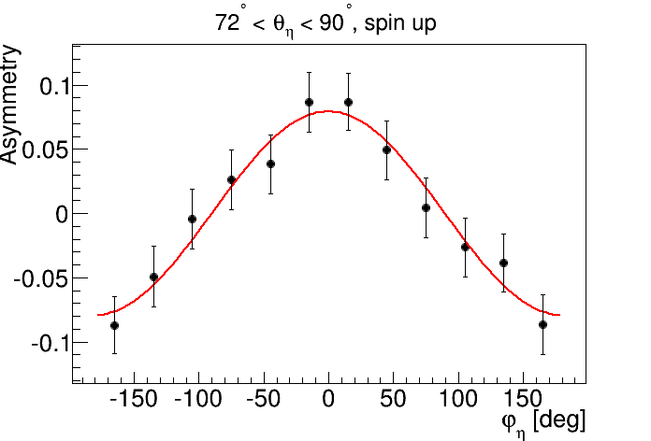
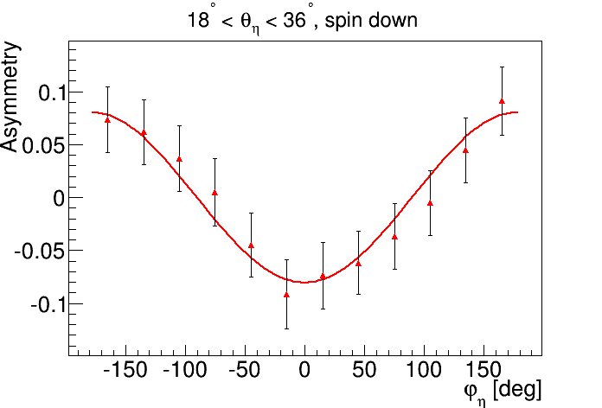
Notes:
Przykład Asymmetry dla Q=72 oraz eta->2g
Masy brakujace dla 2g (lewy) i 6g(prawy)...

Slide 33
ρ
π

Slide 34
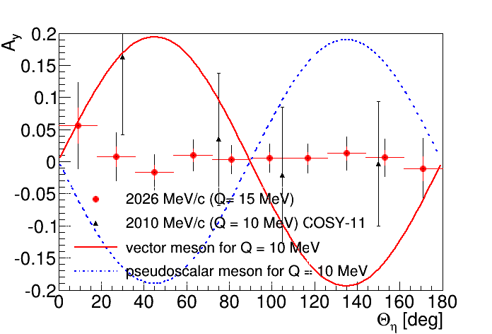
WASA-at-COSY
pp->ppη
ρ
π

Slide 35
This was PREDICTED already about 2500 years ago
by the very first physicists
Thus, it is suggested that among created beings
there must be some basic agent which will move
things and bring them together
ARISTOTLE
“Metaphysics”
X
X
X
X
X
ρ
π
COSY-11: Phys. Rev. Lett. 98 (2007) 122003
Notes:
ALBO TO TU WSPOMNIEC A WIECEJ PRZY OKAZJI interakcji…
PERSPEKTYWY / WASA / POKAZAC WIDMA POLARYZACJI… !...dla XX %...WYKLAD MH z MAIUS…
ORAZ O FOTOPRODUKCJI
This will be improved by THE WASA-at-COSY collaboartion, I will come to this in few minutes…

Slide 36
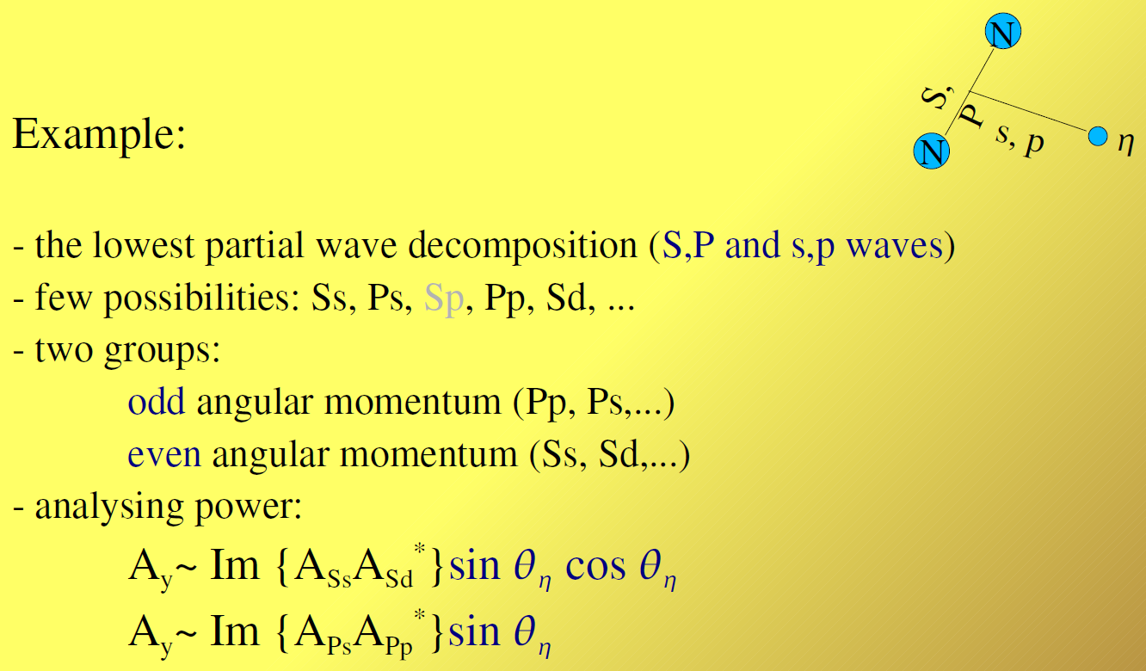

Slide 37
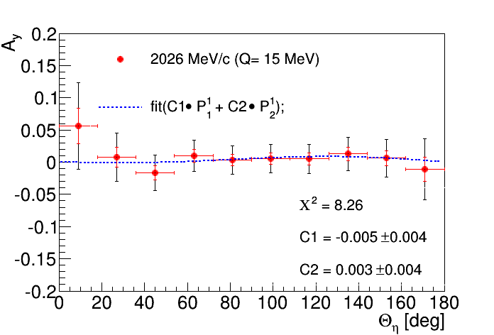
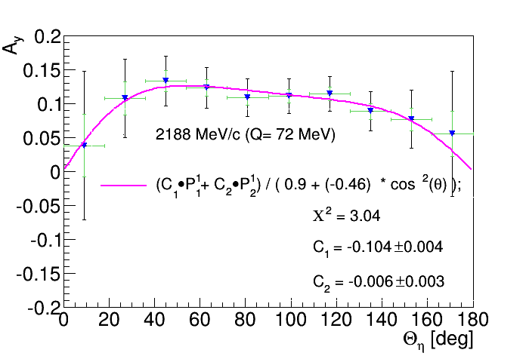
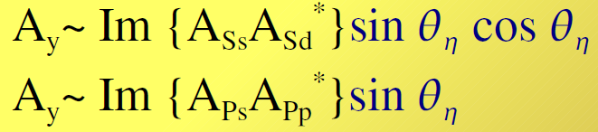
PRELIMINARY
Q =15 MeV Q = 72
s, p, d … s, p, d …
X
X
X
Notes:
Na górze zdefiniowac P1 i P2 i do czego są proporcjonalne ....

Slide 38
THANK YOU
FOR YOUR ATTENTION

