Slide 1
Comprehensive study of
S = -1 hyperon resonances via the coupled-channels analysis of
K⁻ p and K⁻ d reactions
Hiroyuki Kamano
(KEK)
YITP Workshop on “Meson in Nucleus 2016” (MIN16)
Kyoto, Jul. 31th-Aug. 2th, 2016

Slide 2
Outline
Dynamical Coupled-Channels (DCC) analysis of
K⁻ p reactions and Y* (= Λ*, Σ*) spectroscopy
Study of K⁻ d → πYN reactions to establish
low-lying Y* resonances
HK, Nakamura, Lee, Sato, PRC90(2014)065204; 92(2015)025205
HK, Lee, in preparation
Notes:
ハイペロン共鳴の話に移ります。
かなりのことが分かっていると思っている人もいるかもしれないが、核子共鳴に比べれば断然わかってない。
例えば、核子共鳴とは対照的にlow-lyingな状態にも存在が怪しい状態がいくつかある。
KbarNのしきい以下には、Lambda(1405)以外にも、13xxMeVくらいの質量をもつＳ波共鳴がいる可能性が指摘されている。
これらPDGに載っている状態は、散乱振幅の極として定義されたmodel-independentな共鳴質量ではなくて、Ｂｒｅｉｔ-Wigner共鳴と多項式のバックグラウンドの和でパラメトライズした、ユニタリー性を満たさない部分波振幅を用いた解析で得られたいわゆるBreit-Wignerの質量とよばれるものを集めたものです。
実際、散乱振幅の極でもって定義されたハイペロン共鳴を抜き出す目的で行われた部分波解析は2013年のKent State Universityのグループによるものが初めてで、我々はそれに続いて二例目になります。

Slide 3
Dynamical Coupled-Channels (DCC) analysis of K⁻ p reactions and
Y* spectroscopy
(1 of 2)

Slide 4
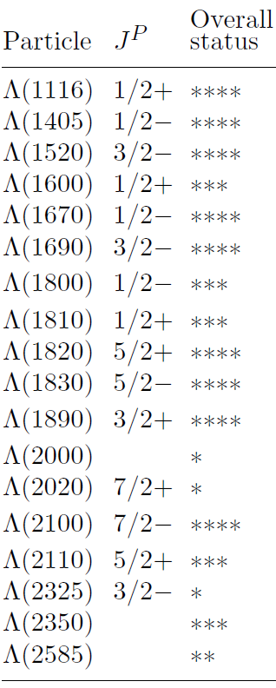

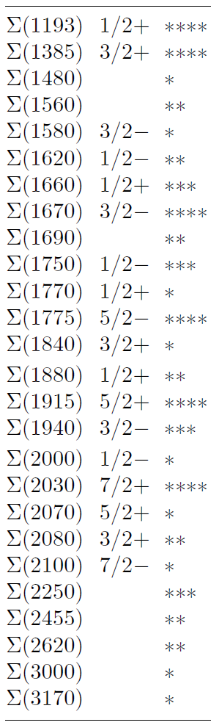
Current situation of Y*(= Λ*, Σ*) spectroscopy
Y* (= Λ*, Σ*) resonances are much less understood than N* & Δ* !!
Λ*
Σ*
Most of Σ*s are poorly established.
Spin-parity has not been determined for
a number of Y* resonances.
Before 2012, PDG listed only Breit-Wigner (BW)
mass and width [except Σ(1385)3/2⁺, Λ(1520)3/2⁻ ]
ONLY 6 out of 26 reported Σ*s are rated as 4* by PDG
Even low-lying states are still uncertain.
N* & Δ* case:
Resonances defined by poles of scattering
amplitudes are extensively studied;
PDG lists BOTH pole and BW parameters.
PDG listing
Notes:
ハイペロン共鳴の話に移ります。
かなりのことが分かっていると思っている人もいるかもしれないが、核子共鳴に比べれば断然わかってない。
例えば、核子共鳴とは対照的にlow-lyingな状態にも存在が怪しい状態がいくつかある。
KbarNのしきい以下には、Lambda(1405)以外にも、13xxMeVくらいの質量をもつＳ波共鳴がいる可能性が指摘されている。
これらPDGに載っている状態は、散乱振幅の極として定義されたmodel-independentな共鳴質量ではなくて、Ｂｒｅｉｔ-Wigner共鳴と多項式のバックグラウンドの和でパラメトライズした、ユニタリー性を満たさない部分波振幅を用いた解析で得られたいわゆるBreit-Wignerの質量とよばれるものを集めたものです。
実際、散乱振幅の極でもって定義されたハイペロン共鳴を抜き出す目的で行われた部分波解析は2013年のKent State Universityのグループによるものが初めてで、我々はそれに続いて二例目になります。

Slide 5
Current situation of Y*(= Λ*, Σ*) spectroscopy
Y* (= Λ*, Σ*) resonances are much less understood than N* & Δ* !!
Λ*
Σ*
Comprehensive partial-wave analyses
of K⁻ p reactions to extract Y* defined
by poles have been accomplished
just recently :
Kent State University (KSU) group
(➔ 2013, “KSU on-shell parametrization” of S-matrix)
Our group
(➔ 2014-2015, dynamical coupled-channels approach)
Zhang et al., PRC88(2013)035204, 035205.
Reanalysis of KSU single-energy solution using an on-shell K-matrix
model (Femandez-Ramirez et al., arXiv:1510.07065)
HK, Nakamura, Lee, Sato, PRC90(2014)065204; 92(2015)025205
PDG listing
Notes:
ハイペロン共鳴の話に移ります。
かなりのことが分かっていると思っている人もいるかもしれないが、核子共鳴に比べれば断然わかってない。
例えば、核子共鳴とは対照的にlow-lyingな状態にも存在が怪しい状態がいくつかある。
KbarNのしきい以下には、Lambda(1405)以外にも、13xxMeVくらいの質量をもつＳ波共鳴がいる可能性が指摘されている。
これらPDGに載っている状態は、散乱振幅の極として定義されたmodel-independentな共鳴質量ではなくて、Ｂｒｅｉｔ-Wigner共鳴と多項式のバックグラウンドの和でパラメトライズした、ユニタリー性を満たさない部分波振幅を用いた解析で得られたいわゆるBreit-Wignerの質量とよばれるものを集めたものです。
実際、散乱振幅の極でもって定義されたハイペロン共鳴を抜き出す目的で行われた部分波解析は2013年のKent State Universityのグループによるものが初めてで、我々はそれに続いて二例目になります。

Slide 6


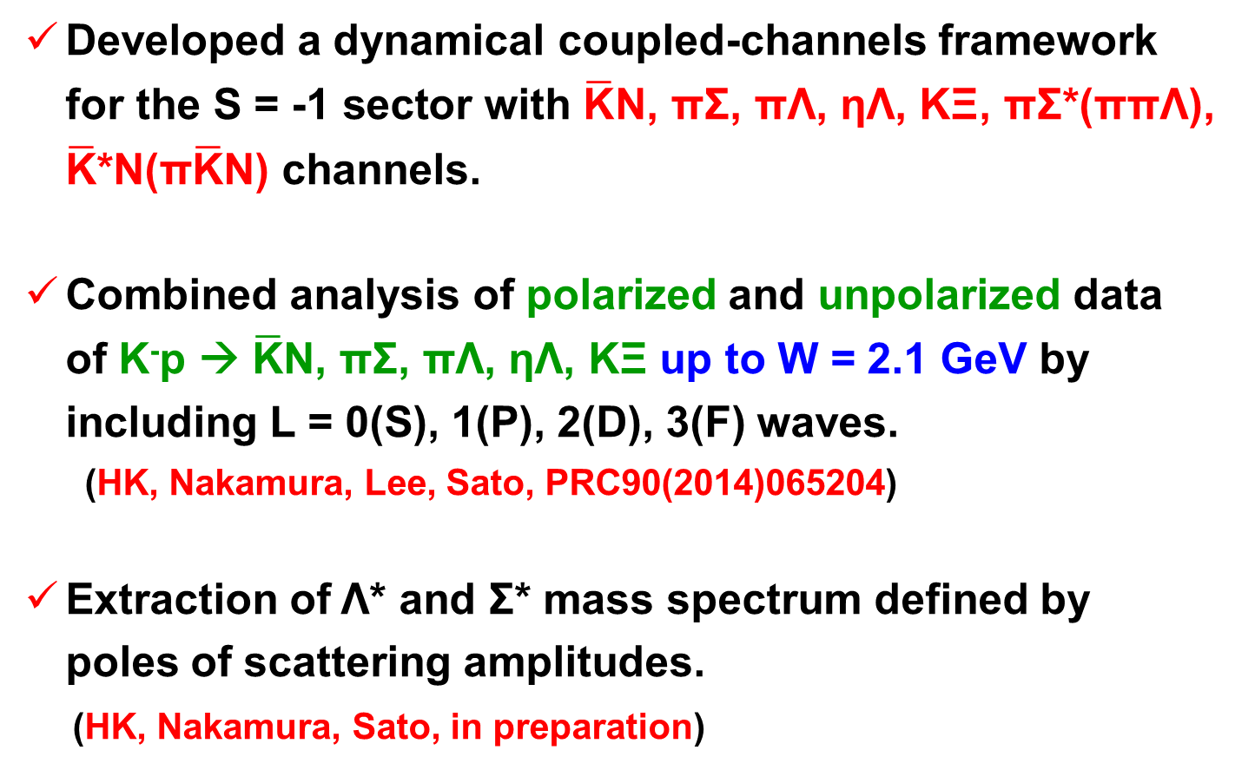

Dynamical Coupled-Channels (DCC) approach to Λ* & Σ* productions
Dynamical Coupled-Channels (DCC) model:
[Matsuyama, Sato, Lee, PR439(2007)193; HK, Nakamura, Lee, Sato, PRC88(2013)035209;90(2014)065204]
CC
effect
off-shell
effect
quasi two-body channels of
three-body ππΛ & π$\overline{\text{K}}$N
Summing up all possible transitions between reaction channels !!
(➔ satisfies multichannel two- and three-body unitarity)
Momentum integral takes into account off-shell rescattering effects
in the intermediate processes.
e.g.）$\overline{\text{K}}$N scattering
$$\overline{\text{K}}$$
$$\overline{\text{K}}$$
π
Σ
K
Ξ
π
Σ*
…
＝
V
＋
＋
＋
N
N

Slide 7



What we have done so far
With the DCC approach developed for the S= -1 sector, we made:
Supercomputers are necessary
for the analysis !!
Comprehensive analysis of ALL available
data (more than 17,000 data points) of
K⁻ p → $\overline{\text{K}}$N, πΣ, πΛ, ηΛ, KΞ up to W = 2.1 GeV.
[HK, Nakamura, Lee, Sato, PRC90(2014)065204]
Determination of threshold parameters (scattering lengths, effective ranges,…); the partial-wave amplitudes of
$\overline{\text{K}}$N → $\overline{\text{K}}$N, πΣ, πΛ, ηΛ, KΞ for S, P, D, and F waves.
[HK, Nakamura, Lee, Sato, PRC90(2014)065204]
Extraction of Y* resonance parameters (mass, width, couplings, …) defined by poles of scattering amplitudes.
[HK, Nakamura, Lee, Sato, PRC92(2015)025205]

Slide 8
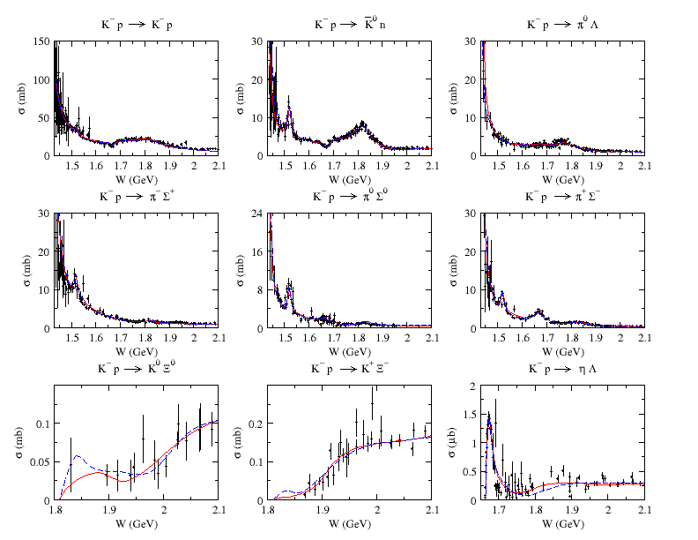
Results of the fits
K⁻ p → MB total cross sections
HK, Nakamura, Lee, Sato, PRC90(2014)065204
Red: Model A
Blue: Model B
“Incompleteness” of
the current database
allows us to have two
parameter sets that
give similar quality
of the fit.

Slide 9
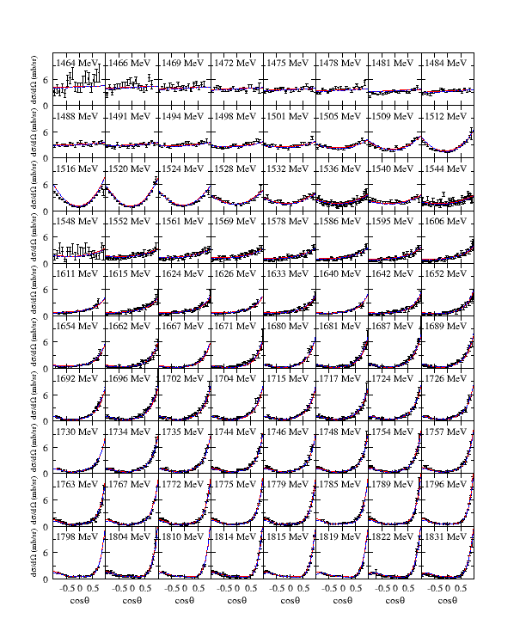
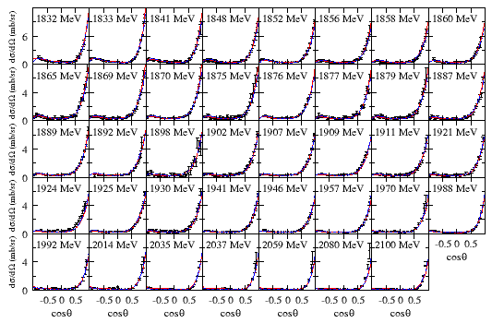
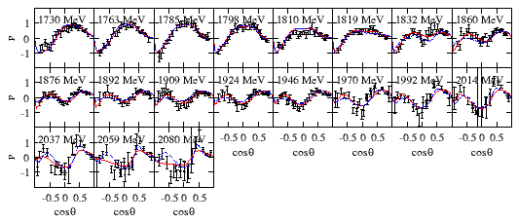
Results of the fits
K⁻ p → K⁻ p scattering
HK, Nakamura, Lee, Sato, PRC90(2014)065204
dσ/dΩ (1464 < W < 1831 MeV)
dσ/dΩ (1832 < W < 2100 MeV)
P (1730 < W < 2080 MeV)
Red: Model A Blue: Model B

Slide 10
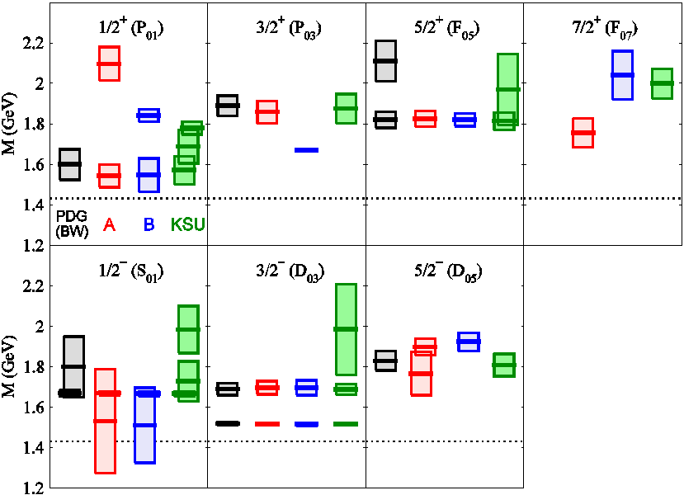
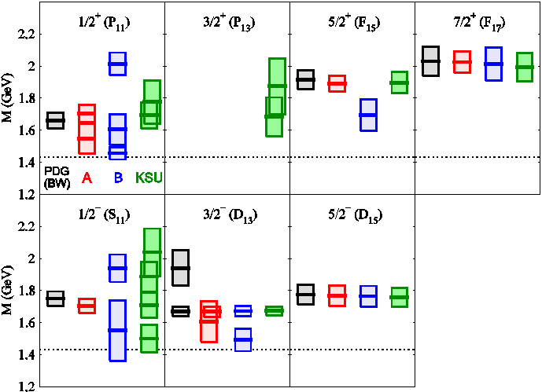

Extracted Λ* and Σ* mass spectrum
Spectrum for Y* resonances found above the $\overline{\text{K}}$N threshold
HK, Nakamura, Lee, Sato, PRC92(2015)025205
(+ updates)
Red: Model A
Blue: Model B
Green: KSU[PRC88(2013)035205]
Black: PDG (only 4- & 3-star Y*;
Breit-Wigner)
New narrow 3/2⁺ resonance
M = 1671 – 5i MeV
near the ηΛ threshold !!
-2Im(M_{R})
(“width”)
Re(M_{R})
M_{R} : Resonance
pole mass
(complex)
J^{P}(L_{I 2J})
“Λ” resonance (I=0)
J^{P}(L_{I 2J})
“Σ” resonance (I=1)
$\overline{\text{K}}$N threshold

Slide 11
Extracted Λ* and Σ* mass spectrum
Spectrum for Y* resonances found above the $\overline{\text{K}}$N threshold
HK, Nakamura, Lee, Sato, PRC92(2015)025205
(+ updates)
Red: Model A
Blue: Model B
Green: KSU[PRC88(2013)035205]
Black: PDG (only 4- & 3-star Y*;
Breit-Wigner)
New narrow 3/2⁺ resonance
M = 1671 – 5i MeV
near the ηΛ threshold !!
-2Im(M_{R})
(“width”)
Re(M_{R})
M_{R} : Resonance
pole mass
(complex)
dσ/dΩ of K⁻ p → ηΛ
J^{P}(L_{I 2J})
“Λ” resonance (I=0)
J^{P}(L_{I 2J})
“Σ” resonance (I=1)
Model A
Model B
P03 off
New narrow P03 resonance
found in Model B is responsible for
the angular dependence of dσ/dΩ !!
$\overline{\text{K}}$N threshold

Slide 12
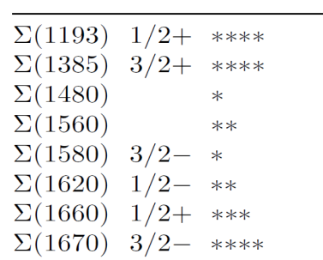
Extracted Λ* and Σ* mass spectrum
Spectrum for Y* resonances found above the $\overline{\text{K}}$N threshold
HK, Nakamura, Lee, Sato, PRC92(2015)025205
(+ updates)
Red: Model A
Blue: Model B
Green: KSU[PRC88(2013)035205]
Black: PDG (only 4- & 3-star Y*;
Breit-Wigner)
New narrow 3/2⁺ resonance
M = 1671 – 5i MeV
near the ηΛ threshold !!
-2Im(M_{R})
(“width”)
Re(M_{R})
M_{R} : Resonance
pole mass
(complex)
J^{P}(L_{I 2J})
“Λ” resonance (I=0)
J^{P}(L_{I 2J})
“Σ” resonance (I=1)
$\overline{\text{K}}$N threshold
Low-lying Σ* resonances (PDG)
Spin partner of
Λ(1520)3/2⁻ ??
?

Slide 13
Study of K⁻ d → πYN reactions
to establish low-lying Y* resonances
(2 of 2)

Slide 14








Strategy for establishing Y* resonances
using antikaon-induced reactions
πΛ
πΣ
$\overline{\text{K}}$N
ηΛ
new spin partner
of Λ(1520) ??
poorly established
(one- & two-star)
Σ* resonances
Λ(1405)
new narrow
3/2⁺ Λ* ??
high-mass
Y* resonances
s^{1/2}
$\overline{\text{K}}$d → πYN
$$\overline{\text{K}}$$
“Complete experiments” for K⁻p → $\overline{\text{K}}$N, πY, ηY, KΞ, ωY, η’Y, …
N
$\overline{\text{K}}$N
πΣ
πΛ
ππΛ
π$\overline{\text{K}}$N
…
d
$$\overline{\text{K}}$$
π
$$\overline{\text{K}}$$
Λ*, Σ*
・
Y
・
N
・
(e.g, J-PARC E31)
Application of our DCC
approach to $\overline{\text{K}}$d reactions
is underway (HK & Lee),
aiming at COMBINED
analysis of $\overline{\text{K}}$N and $\overline{\text{K}}$d
reactions !!!
2 → 3 reactions: K⁻p → ππΛ, π$\overline{\text{K}}$N,…
New measurements at J-PARC ??

Slide 15

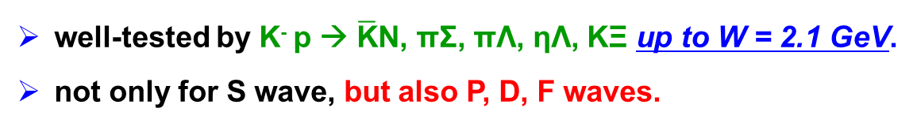



Model for deuteron-target reactions
Multistep processes are treated “perturbatively”.
Off-shell amplitudes for meson-baryon sub-processes ( ) are
taken from our dynamical coupled-channels model.
HK, Nakamura, Lee, Sato, PRC90(2014)065203
“Impulse” term
“$\overline{\text{K}}$-exchange” term
“YN rescattering” term
$$\overline{\text{K}}$$
π
$$\overline{\text{K}}$$
$$\overline{\text{K}}$$
π
N
N
N
d
+
d
$$\overline{\text{K}}$$
π
+
d
+ ...
Y
Y
Y
Use, e.g.,
deuteron w.f. from
ANL-V18 potential
[PRC51(1995)38]
Use YN potential, e.g., in
PRC40(1989)2226;
PRC59(1999)21;
PRC59(1999)3009
Completely dominates the reaction processes at the kinematics with θ_{N} ~ 0.
(➔ J-PARC E31)
Unique feature of our work:
For elementary meson-baryon subprocesses,
we employ amplitudes that are
well-tested by K⁻ p → $\overline{\text{K}}$N, πΣ, πΛ, ηΛ, KΞ up to W = 2.1 GeV.
not only for S wave, but also P, D, F waves.

Slide 16
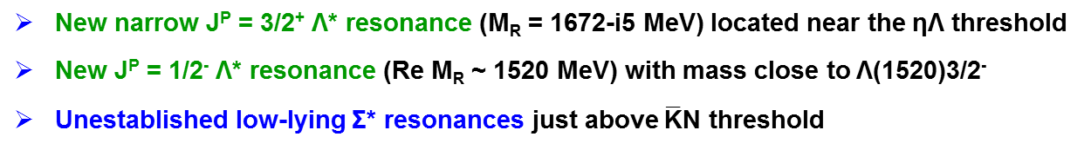

Summary
Accomplished comprehensive analysis of K⁻ p → $\overline{\text{K}}$N, πΣ, πΛ, ηΛ, KΞ
up to W = 2.1 GeV for the first time within a dynamical coupled-channels
approach.
Successfully extracted partial-wave amplitudes (up to F wave) and
Y* resonance parameters defined by poles of amplitudes.
New narrow J^{P} = 3/2⁺ Λ* resonance (M_{R} = 1672-i5 MeV) located near the ηΛ threshold
New J^{P} = 1/2⁻ Λ* resonance (Re M_{R} ~ 1520 MeV) with mass close to Λ(1520)3/2⁻
Unestablished low-lying Σ* resonances just above $\overline{\text{K}}$N threshold

Slide 17

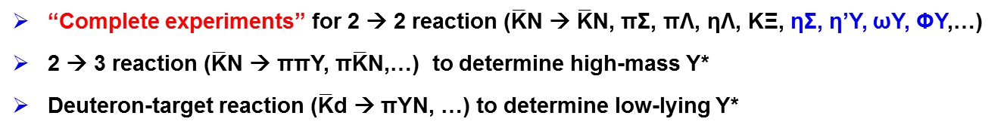
Summary
Accomplished comprehensive analysis of K⁻ p → $\overline{\text{K}}$N, πΣ, πΛ, ηΛ, KΞ
up to W = 2.1 GeV for the first time within a dynamical coupled-channels
approach.
Successfully extracted partial-wave amplitudes (up to F wave) and
Y* resonance parameters defined by poles of amplitudes.
New accurate data for both $\overline{\text{K}}$N and $\overline{\text{K}}$d reactions are much appreciated !!!
New narrow J^{P} = 3/2⁺ Λ* resonance (M_{R} = 1672-i5 MeV) located near the ηΛ threshold
New J^{P} = 1/2⁻ Λ* resonance (Re M_{R} ~ 1520 MeV) with mass close to Λ(1520)3/2⁻
Unestablished low-lying Σ* resonances just above $\overline{\text{K}}$N threshold
“Complete experiments” for 2 → 2 reaction ($\overline{\text{K}}$N → $\overline{\text{K}}$N, πΣ, πΛ, ηΛ, KΞ, ηΣ, η’Y, ωY, ΦY,…)
2 → 3 reaction ($\overline{\text{K}}$N → ππY, π$\overline{\text{K}}$N,…) to determine high-mass Y*
Deuteron-target reaction ($\overline{\text{K}}$d → πYN, …) to determine low-lying Y*

Slide 18
Summary
Accomplished comprehensive analysis of K⁻ p → $\overline{\text{K}}$N, πΣ, πΛ, ηΛ, KΞ
up to W = 2.1 GeV for the first time within a dynamical coupled-channels
approach.
Successfully extracted partial-wave amplitudes (up to F wave) and
Y* resonance parameters defined by poles of amplitudes.
New accurate data for both $\overline{\text{K}}$N and $\overline{\text{K}}$d reactions are much appreciated !!!
New narrow J^{P} = 3/2⁺ Λ* resonance (M_{R} = 1672-i5 MeV) located near the ηΛ threshold
New J^{P} = 1/2⁻ Λ* resonance (Re M_{R} ~ 1520 MeV) with mass close to Λ(1520)3/2⁻
Unestablished low-lying Σ* resonances just above $\overline{\text{K}}$N threshold
“Complete experiments” for 2 → 2 reaction ($\overline{\text{K}}$N → $\overline{\text{K}}$N, πΣ, πΛ, ηΛ, KΞ, ηΣ, η’Y, ωY, ΦY,…)
2 → 3 reaction ($\overline{\text{K}}$N → ππY, π$\overline{\text{K}}$N,…) to determine high-mass Y*
Deuteron-target reaction ($\overline{\text{K}}$d → πYN, …) to determine low-lying Y*
The help of J-PARC is definitely needed for “complete”
determination of Y* resonance mass spectrum !!!

Slide 19
Back up

Slide 20
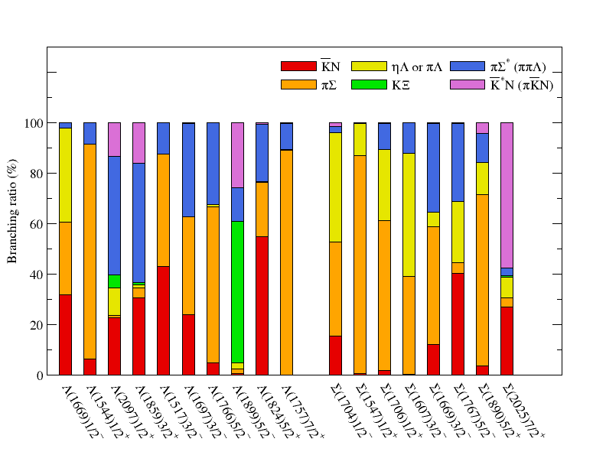
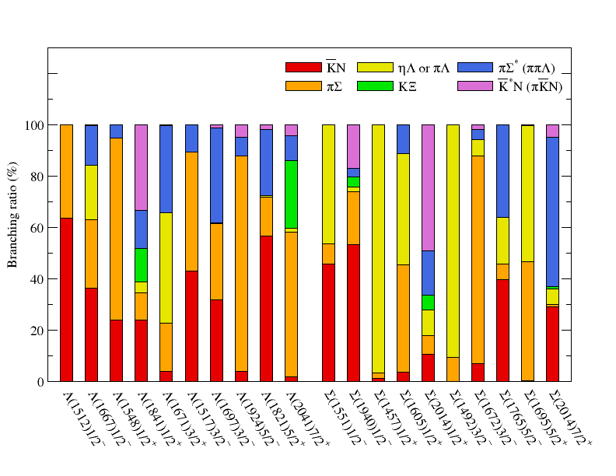
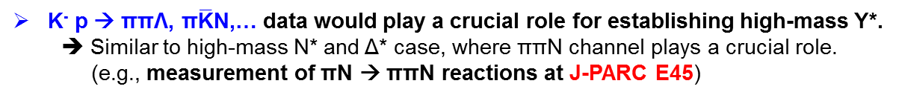
Importance of 2 → 3 reactions:
Branching ratios of high-mass Y* resonances
High-mass Y* have large branching ratio to πΣ* (ππΛ) & $\overline{\text{K}}$*N (π$\overline{\text{K}}$N)
K⁻ p → ππΛ, π$\overline{\text{K}}$N,… data would play a crucial role for establishing high-mass Y*.
➔ Similar to high-mass N* and Δ* case, where ππN channel plays a crucial role.
(e.g., measurement of πN → ππN reactions at J-PARC E45)
Model A
Model B
HK, Nakamura, Lee, Sato, PRC92(2015)025205

Slide 21
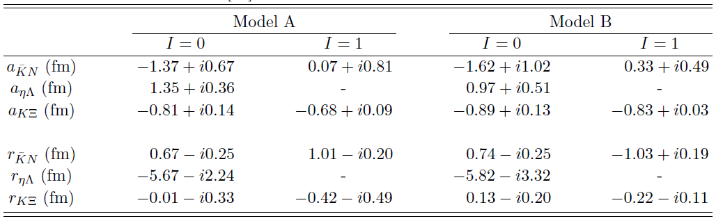
Extracted scattering lengths and effective ranges
HK, Nakamura, Lee, Sato, PRC90(2014)065204
Scattering length and effective range
a_{K-p} = -0.65 + i0.74 fm (Model A)
a_{K-p} = -0.65 + i0.76 fm (Model B)

Slide 22
S-wave dominance ??
K⁻ p → MB total cross sections near threshold
Model B
Solid: Full
Dashed: S wave only
For K- p → πΛ, ηΛ, KΞ,
higher partial waves
visibly contribute
to the cross sections
even in the threshold
region.
→ consistent with the observation in
Jackson et al., PRC91(2015)065208
Naïve expectation for
S-wave dominance
near the threshold
sometimes does not hold !!
HK, Nakamura, Lee, Sato, PRC90(2014)065204

Slide 23
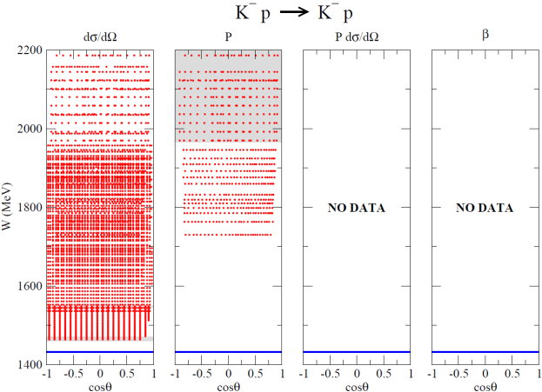
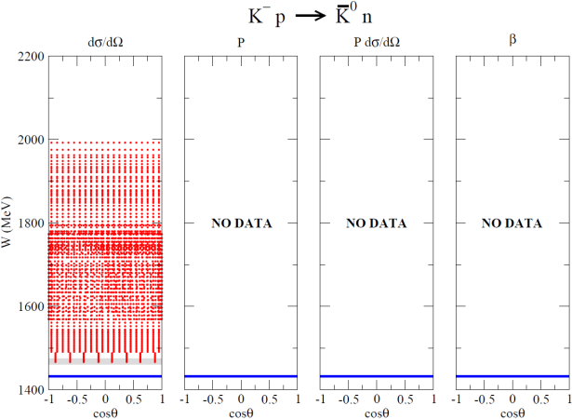
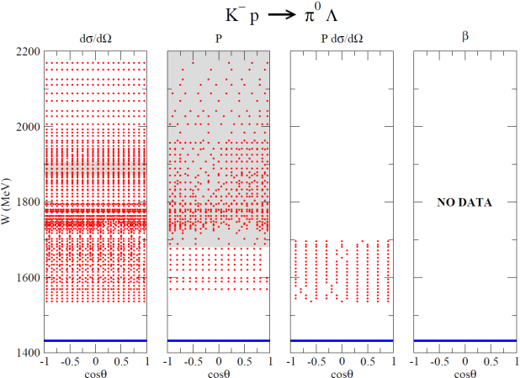
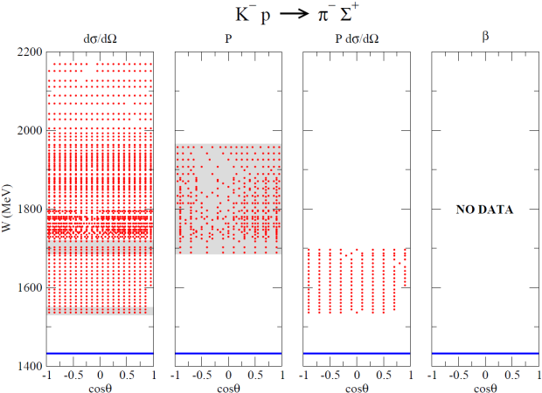
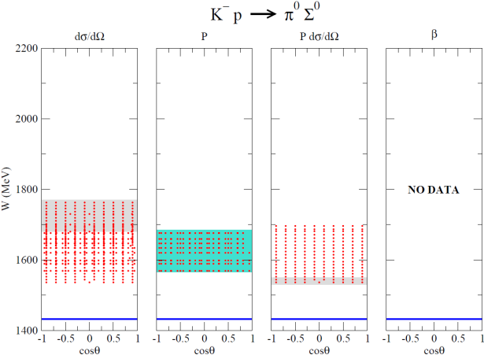
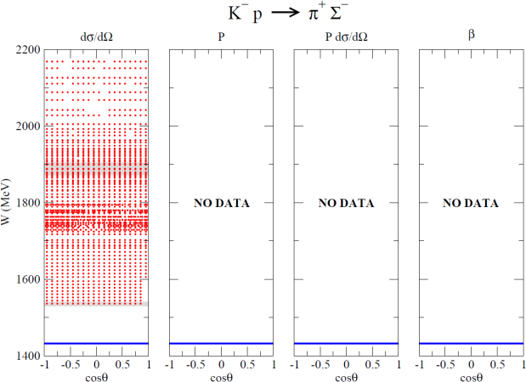
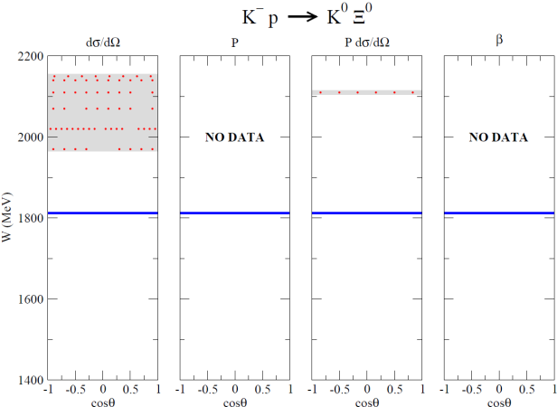
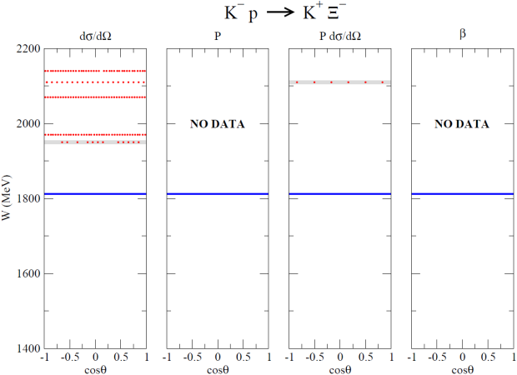
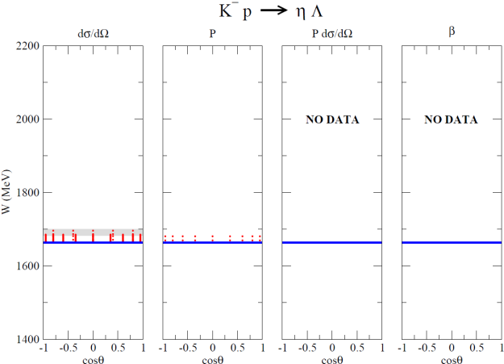

Kinematical (W, cosθ) coverage of
available K⁻ p → $\overline{\text{K}}$N, πΣ, πΛ, ηΛ, KΞ data
data available
dσ/dΩ
P
Pdσ/dΩ
β
low statistics data
conflicting data

Slide 24
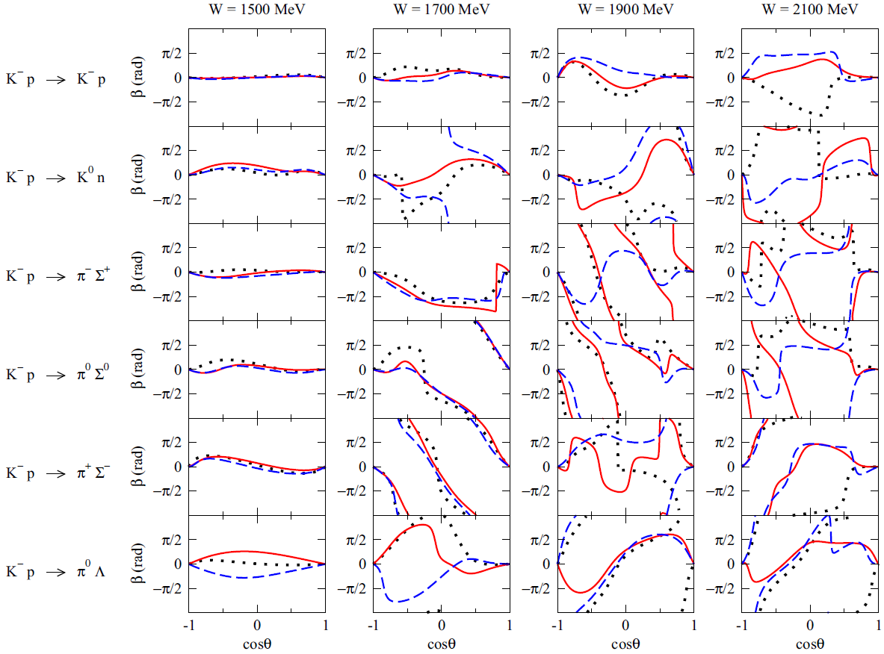
Kinematical (W, cosθ) coverage of
available K⁻ p → $\overline{\text{K}}$N, πΣ, πΛ, ηΛ, KΞ data
Predicted spin-rotation angle β
Red: Model A
Blue: Model B
Black: KSU
The KSU results are
computed by us using
their amplitudes in
PRC88(2013)035204.
## NOTE:
β is modulo 2π
data available
dσ/dΩ
P
Pdσ/dΩ
β
low statistics data
conflicting data

Slide 25
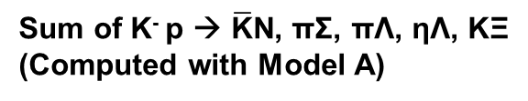

Importance of 2 → 3 reactions:
Dominance of cross sections at high W
TCS for K⁻ p → X
Sum of K⁻ p → $\overline{\text{K}}$N, πΣ, πΛ, ηΛ, KΞ
(Computed with Model A)
Almost come from 2 → 3 reactions !!
TCS for 2 → 3 reactions
(K⁻ p → ππΛ, π$\overline{\text{K}}$N,…):
significant above W ~ 1.7 GeV.
even larger than the 2 → 2 TCS
above W ~ 1.9 GeV !!
Effects of 3-body channels on Y* resonance
parameters are expected to be sizable.
However, at present essentially no differential
cross section data are available for 2 → 3 reactions
that can be used for detailed partial wave analyses !!

