Slide 1
QCD condensates and phi meson spectral moments in nuclear matter
Philipp Gubler, Yonsei University, Seoul
P. Gubler and K. Ohtani, Phys. Rev. D 90, 094002 (2014). P. Gubler and W. Weise, Phys. Lett. B 751, 396 (2015).
P. Gubler and W. Weise, Nucl. Phys. A 954, 125 (2016).
Talk at MIN16 - Meson in Nucleus 2016 -
YITP, Kyoto University, Japan
31. July, 2016
Collaborators:
Keisuke Ohtani (Tokyo Tech)
Wolfram Weise (TUM)

Slide 2




Introduction
Object of study:
Interest:
φ meson
m_{φ} = 1019 MeV
Γ_{φ} = 4.3 MeV

Slide 3
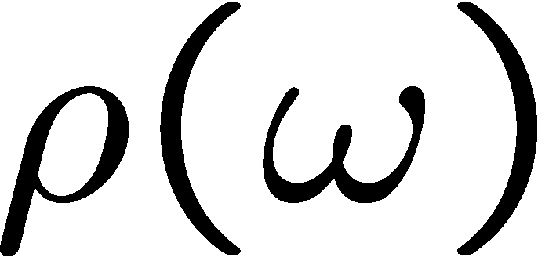

Introduction
Spectral functions at finite density
How is this complicated behavior related to QCD condensates?
modification at finite density
coupling to nucleon resonances?
broadening?
mass/threshold shifts?

Slide 4
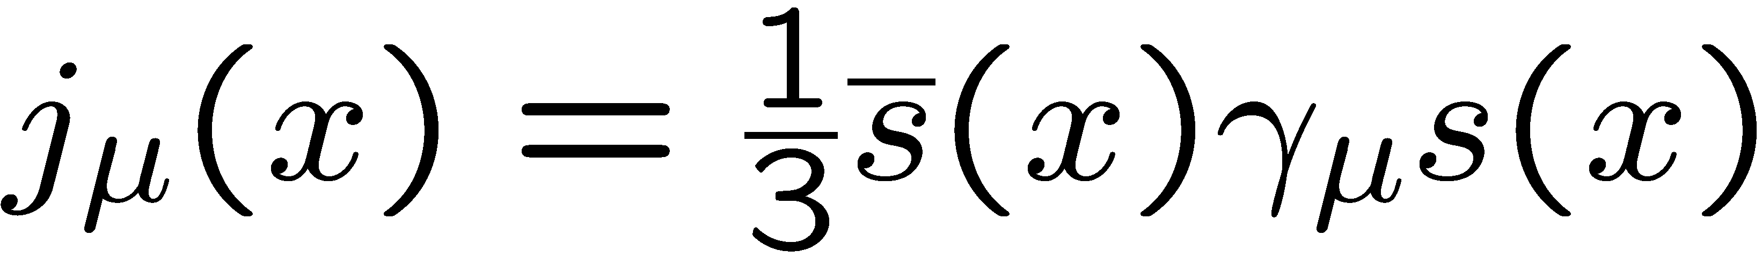
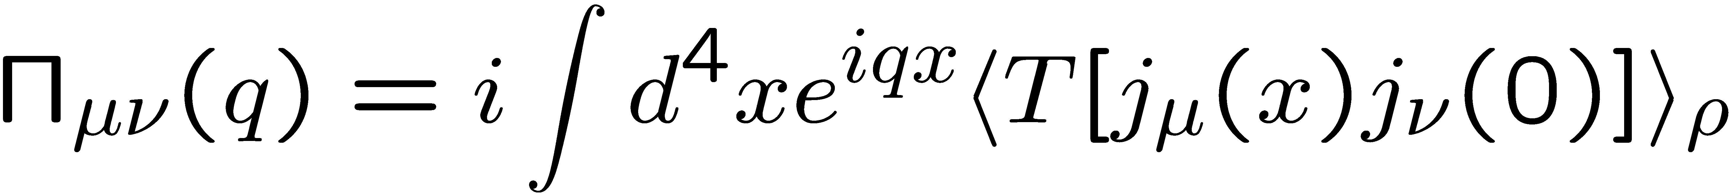
Methods
QCD based approaches
effective theory/model
Ｎ
P
φ
P
Ｎ
Direct relation to fundamental QCD properties
Spectral function can be directly computed
Lattice QCD cannot be used at finite density
Results depend on model assumptions/parameters
Spectral function cannot be directly computed

Slide 5
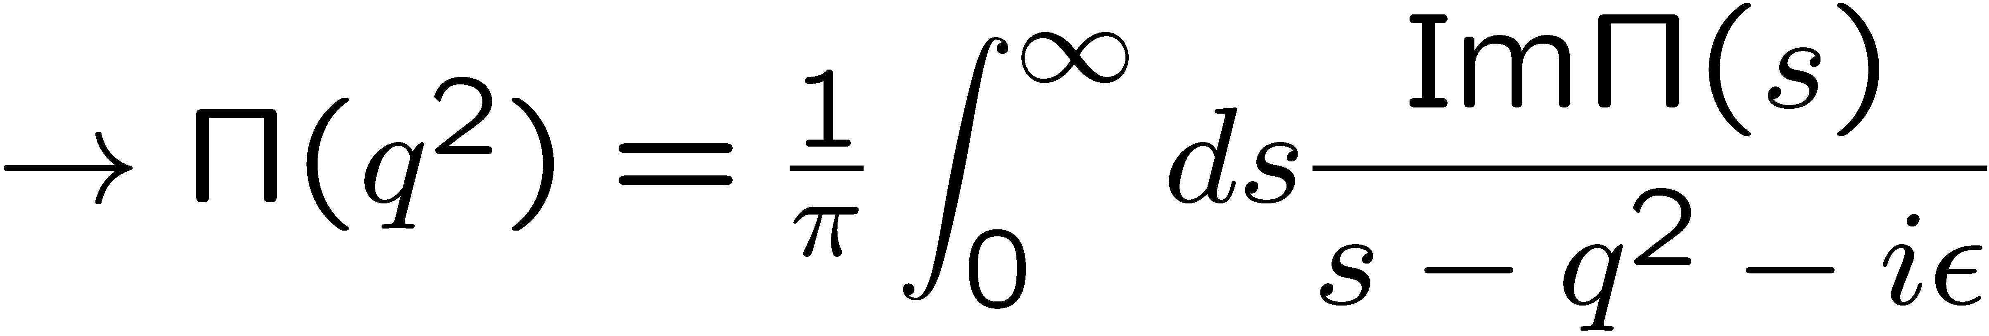
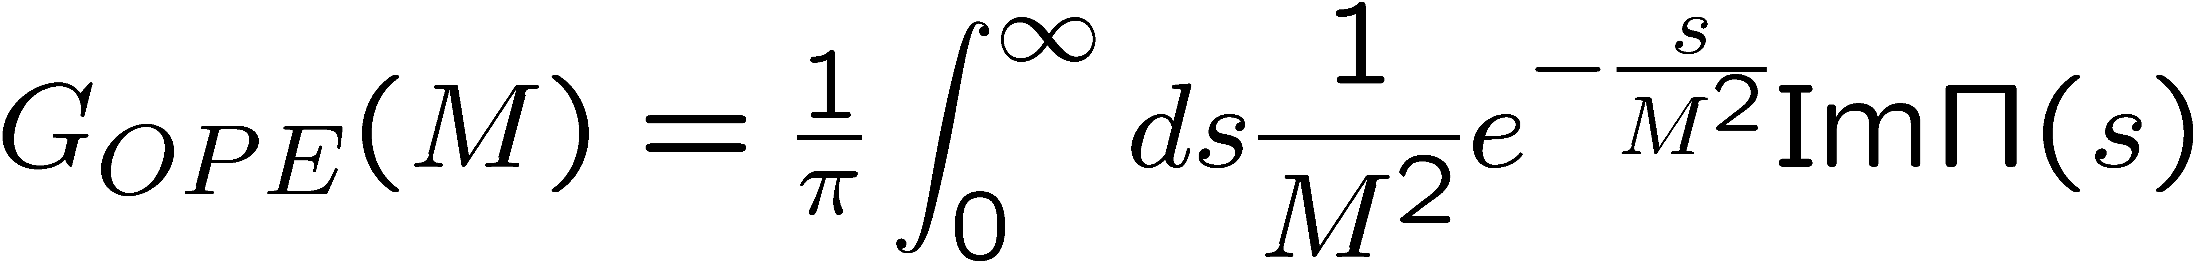
QCD sum rules
M.A. Shifman, A.I. Vainshtein and V.I. Zakharov, Nucl. Phys. B147, 385 (1979); B147, 448 (1979).
Makes use of the analytic properties of the correlation function:
q²
is calculated
“perturbatively”,
using OPE
spectral function
of the operator χ
After the Borel transformation:

Slide 6
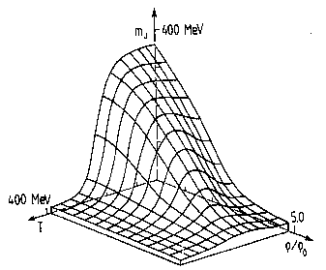
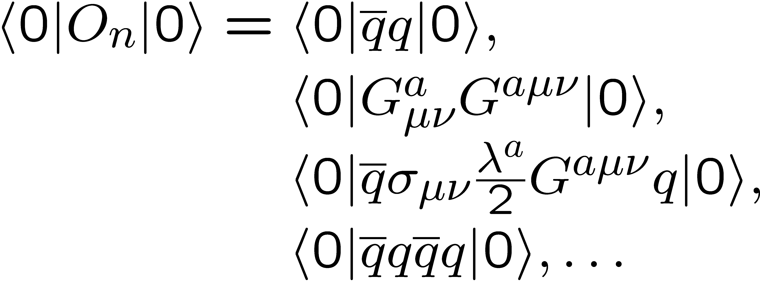
More on the OPE in matter
non-perturbative condensates
perturbative Wilson coefficients
Change in hot or dense matter!

Slide 7
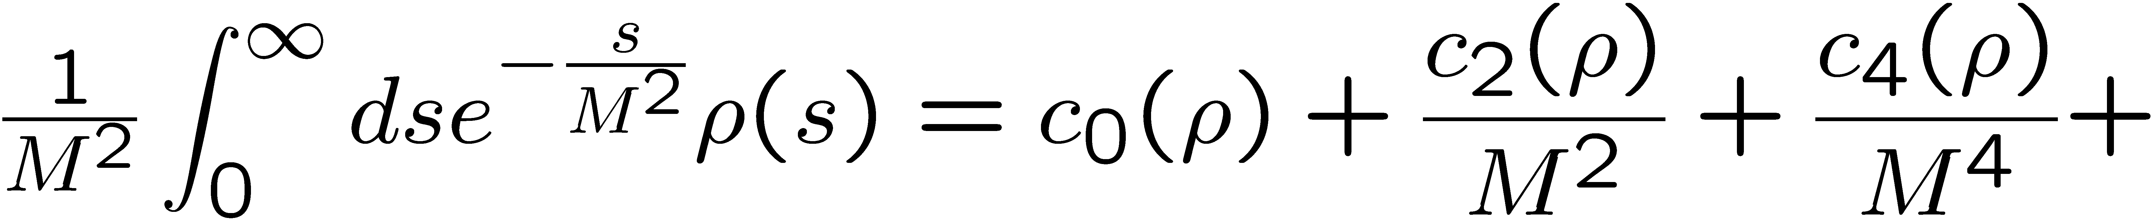
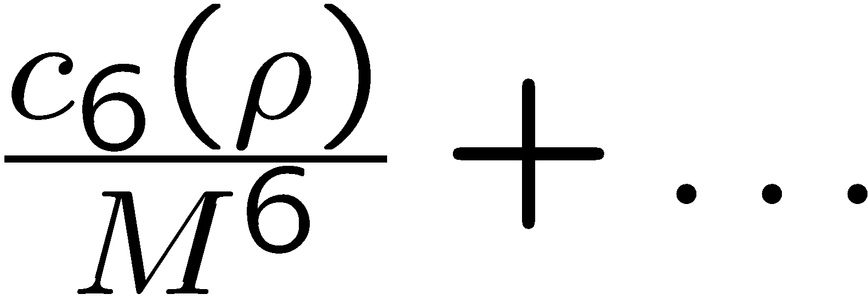
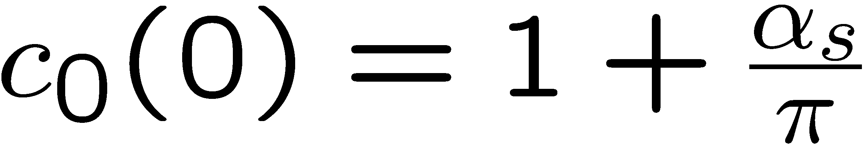
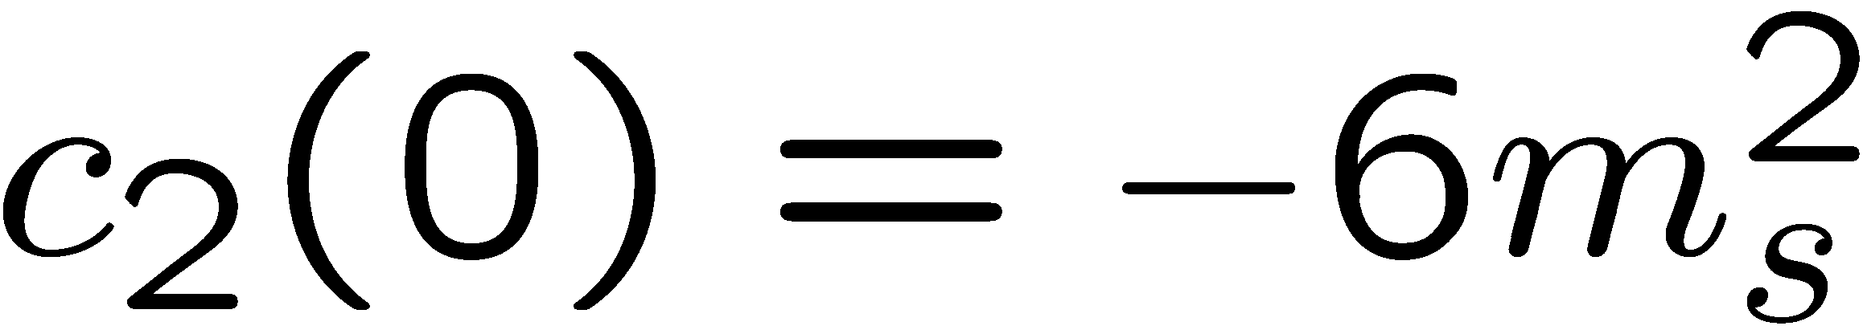
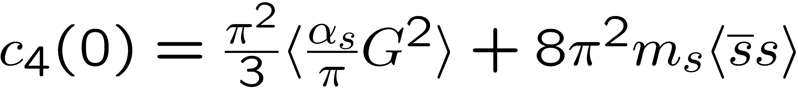
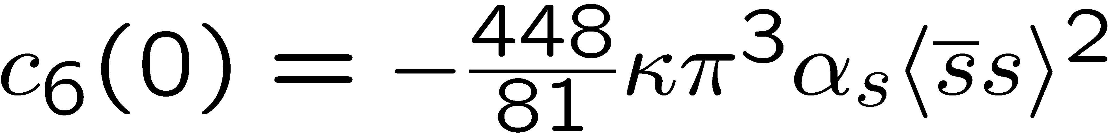
Structure of QCD sum rules for the phi meson
In Vacuum
Dim. 0:
Dim. 2:
Dim. 4:
Dim. 6:

Slide 8
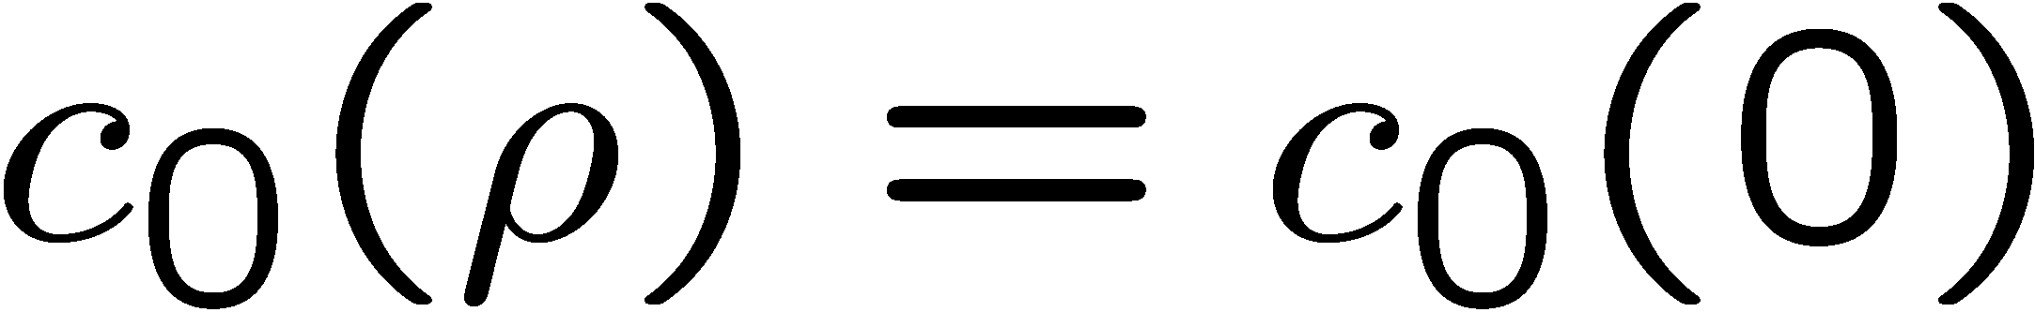
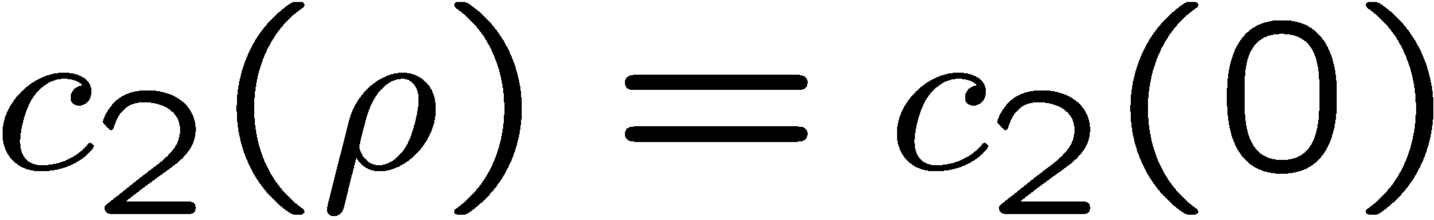
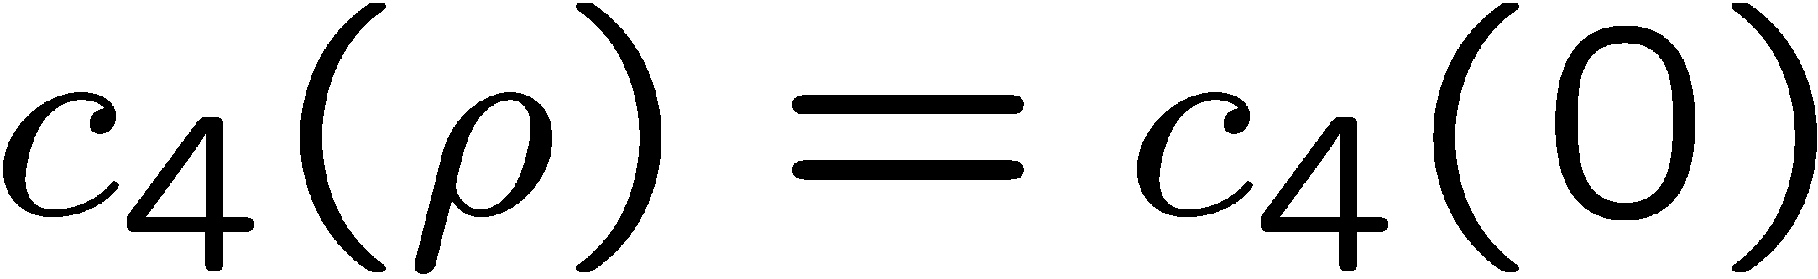
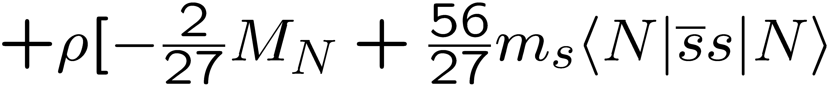
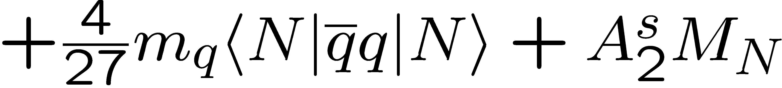
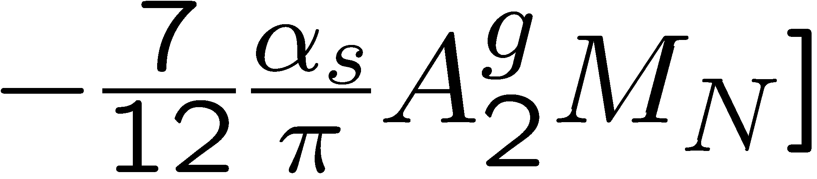
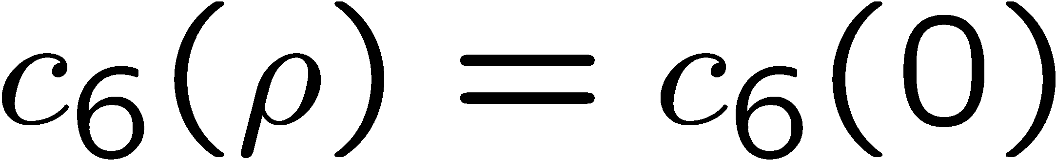
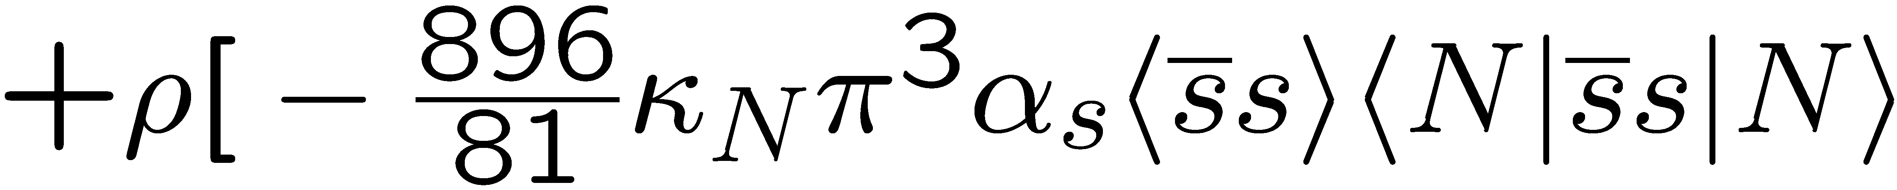
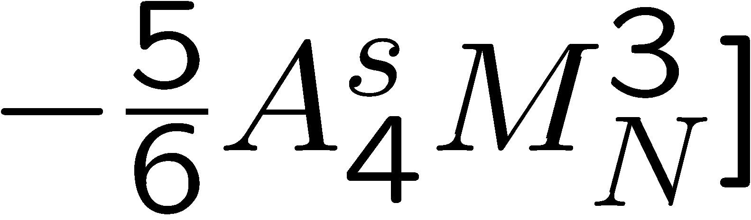
Structure of QCD sum rules for the phi meson
In Nuclear Matter
Dim. 0:
Dim. 2:
Dim. 4:
Dim. 6:

Slide 9
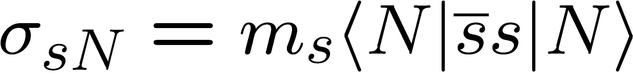
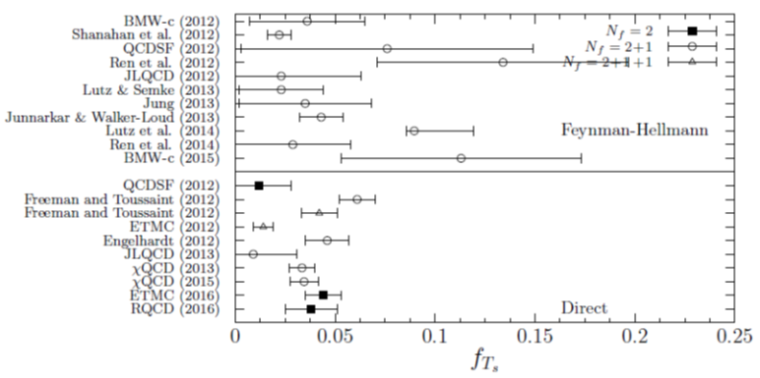
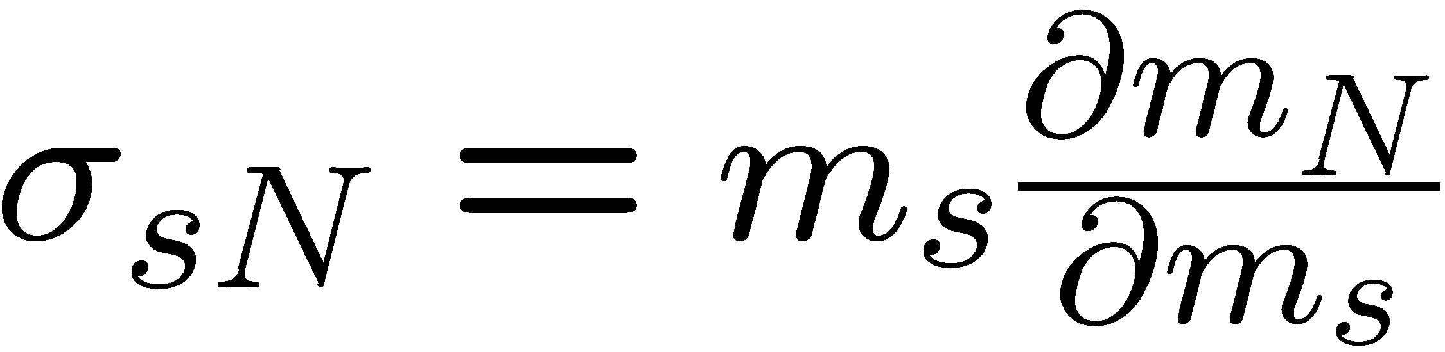
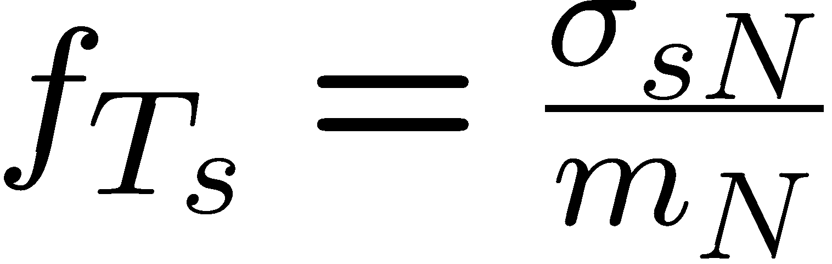
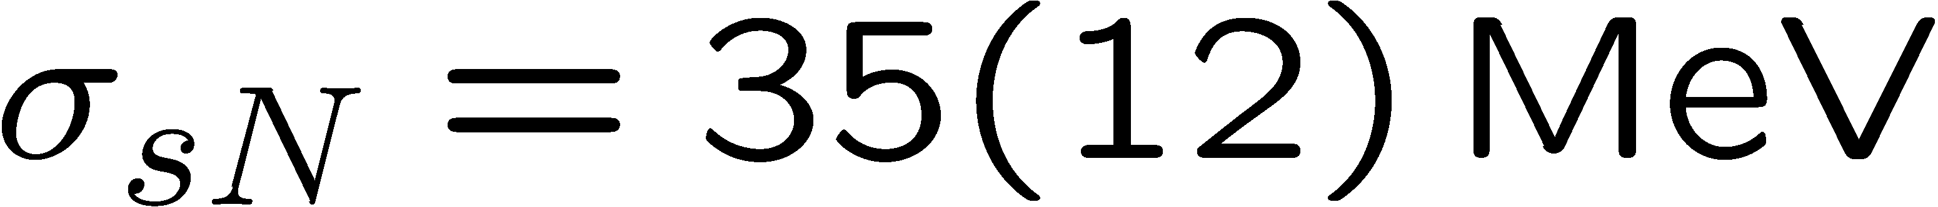
The strangeness content of the nucleon: results from lattice QCD
S. Durr et al. (BMW Collaboration), Phys. Rev. Lett. 116, 172001 (2016).
(Feynman-Hellmann)
Y.-B. Yang et al. (χQCD Collaboration), arXiv:1511.09089 [hep-lat].
(Direct)
A. Abdel-Rehim et al. (ETM Collaboration), Phys. Rev. Lett. 116, 252001 (2016).
(Direct)
G.S. Bali et al. (RQCD Collaboration), Phys. Rev. D 93, 094504 (2016).
(Direct)

Slide 10
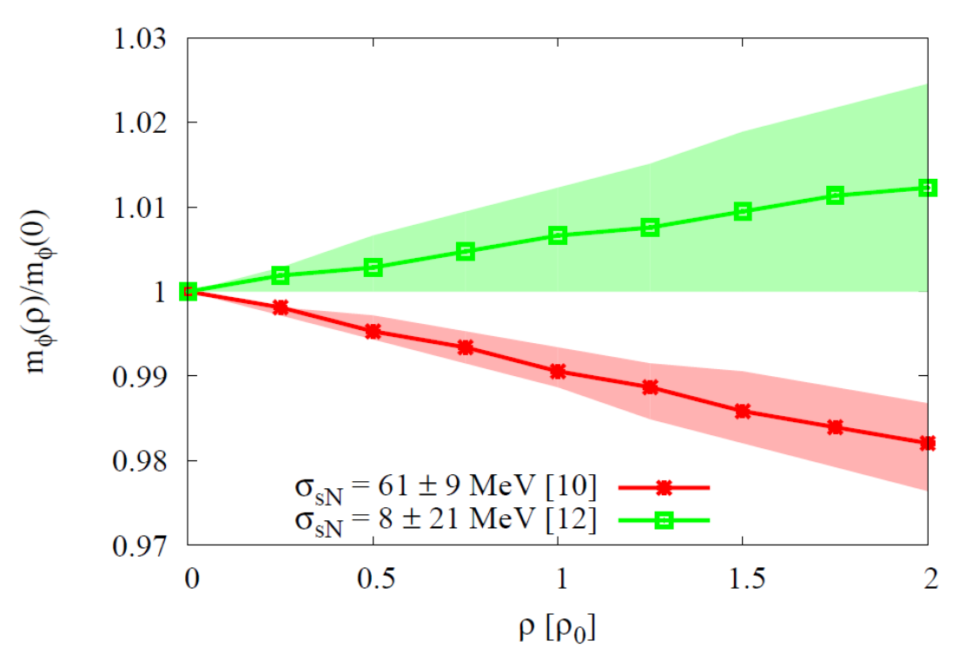
Results for the φ meson mass
Most important parameter, that
determines the behavior of the φ meson mass at finite density:
Strangeness content of the nucleon
P. Gubler and K. Ohtani, Phys. Rev. D 90, 094002 (2014).

Slide 11
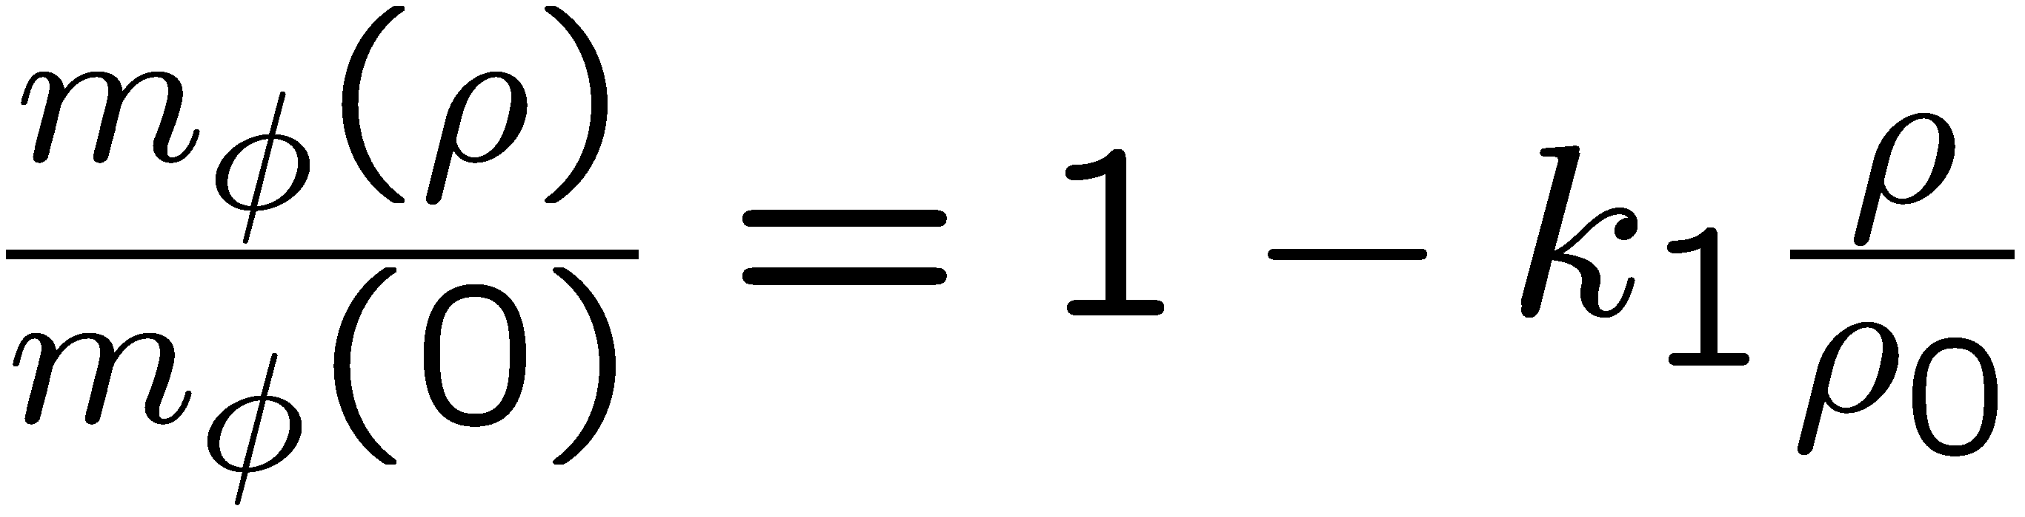
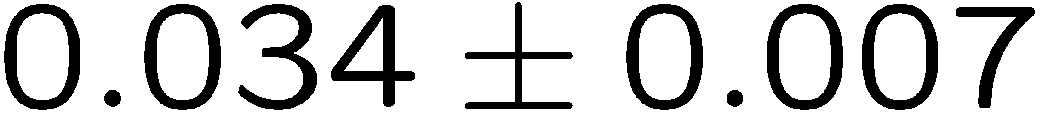
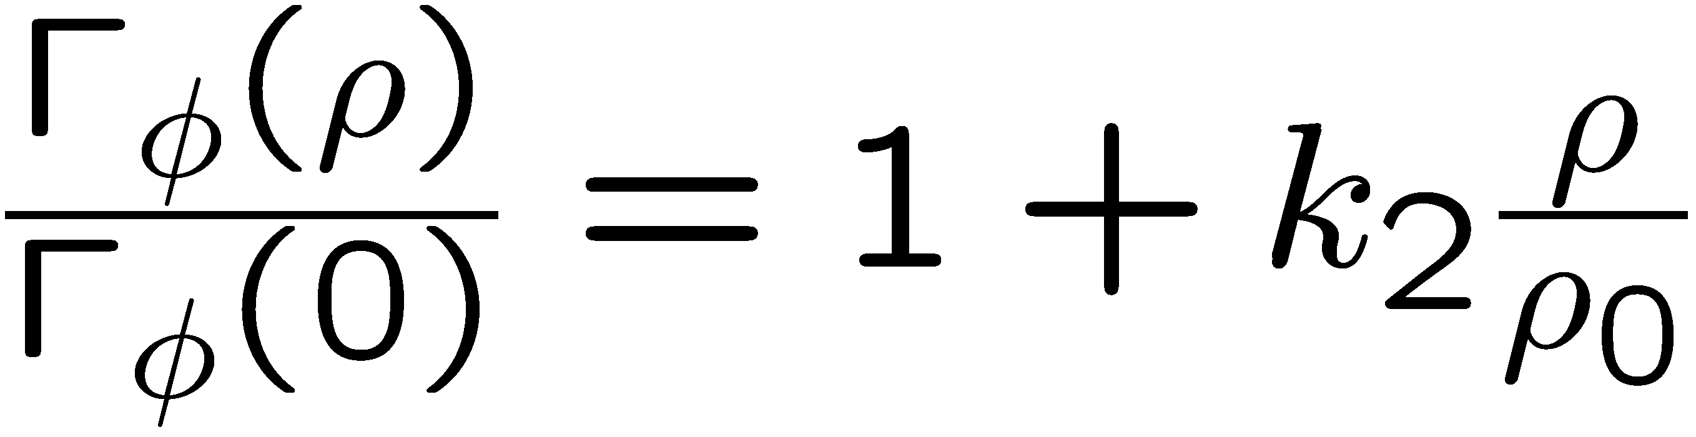
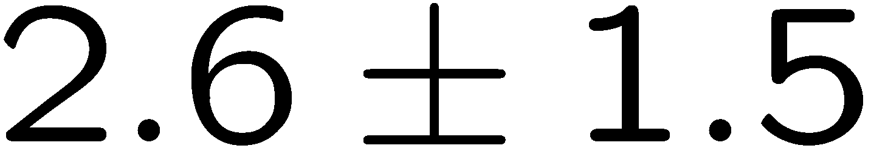
Experimental results from the E325 experiment (KEK)
R. Muto et al, Phys. Rev. Lett. 98, 042501 (2007).
Pole mass:
35 MeV negative mass shift at normal nuclear matter density
Pole width:
Increased width to 15 MeV at normal nuclear matter density
Caution!
Fit to experimental data is performed with a simple Breit-Wigner parametrization
Too simple!?

Slide 12
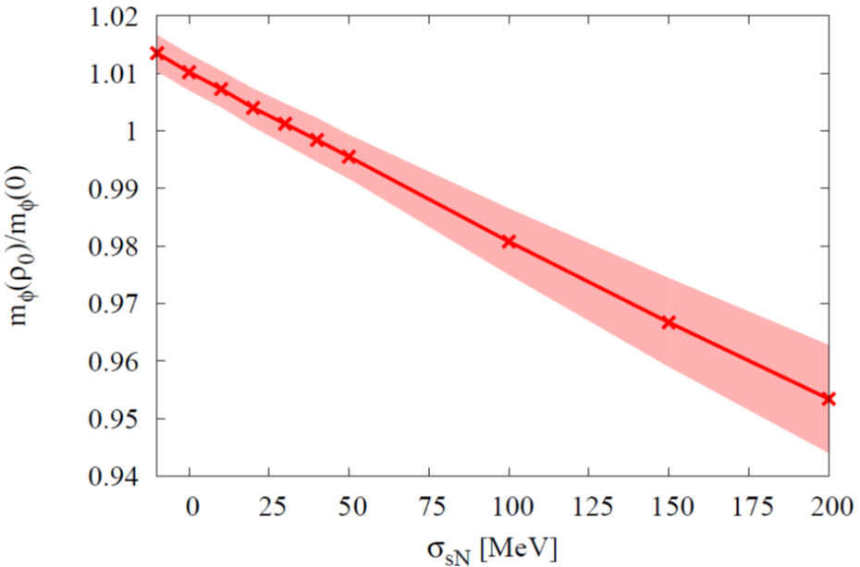
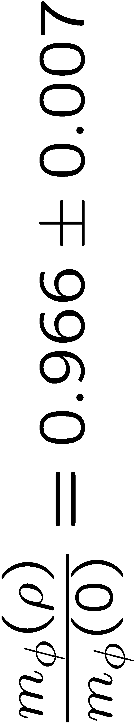
Compare Theory with Experiment
Sum Rules + Experiment
Not consistent?
Experiment
Lattice QCD

Slide 13
BMW version:
Sum Rules + Experiment
?
Experiment
Lattice QCD

Slide 14
χQCD version:
Sum Rules + Experiment
??
Experiment
Lattice QCD

Slide 15
Issues of Borel sum rules
Details of the spectral function cannot be studied (e.g. width)
Higher order OPE terms are always present (e.g. four-quark condensates at dimension 6)
Use a model to compute the complete spectral function
Use moments to probe specific condensates

Slide 16

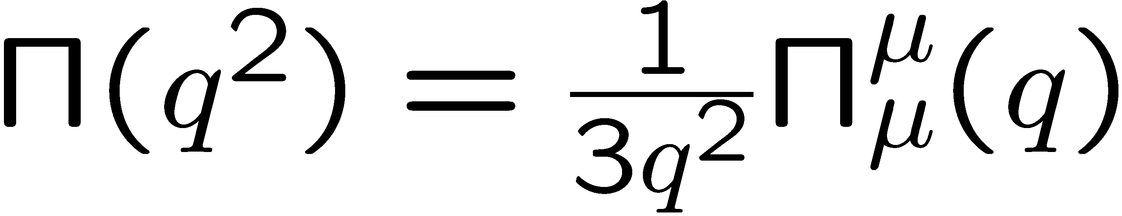
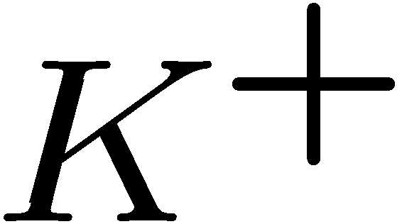
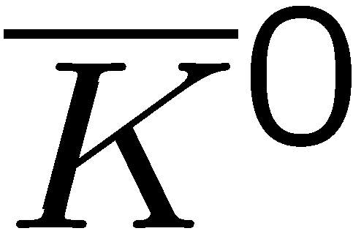
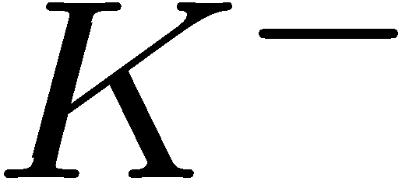
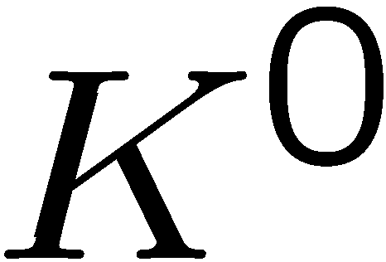
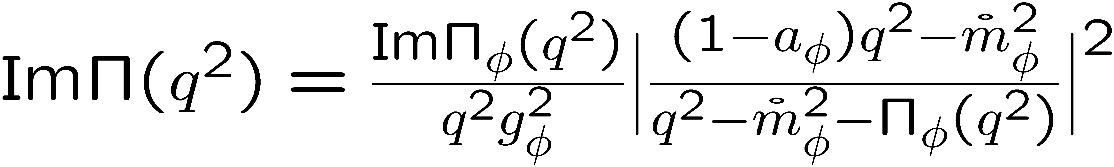
Starting point
Rewrite using hadronic degrees of freedom
(vector dominance model)
Kaon loops

Slide 17
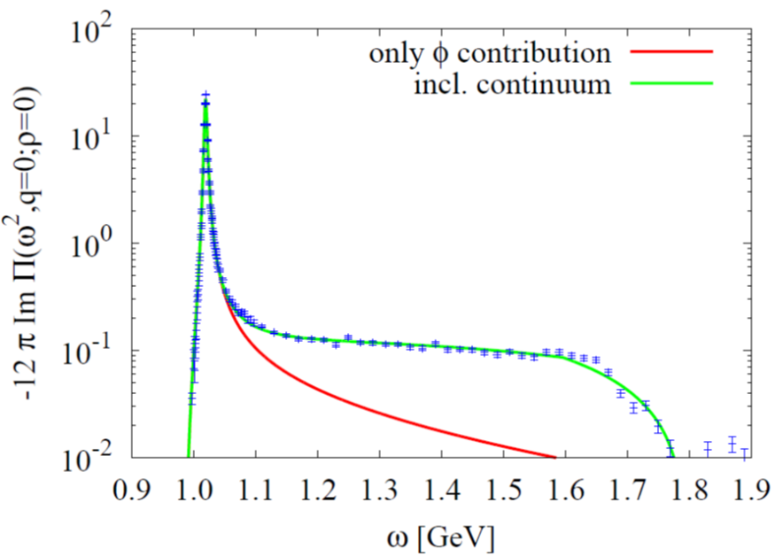
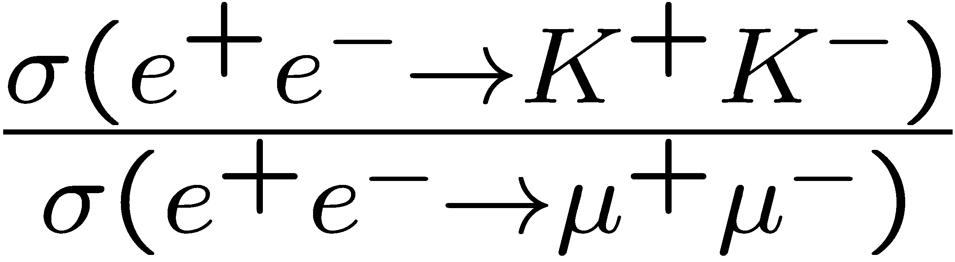
Vacuum spectrum
(Vacuum)
How is this spectrum modified in nuclear matter?
Is the (modified) spectral function consistent with QCD sum rules?
Data from
J.P. Lees et al. (BABAR Collaboration), Phys. Rev. D 88, 032013 (2013).

Slide 18
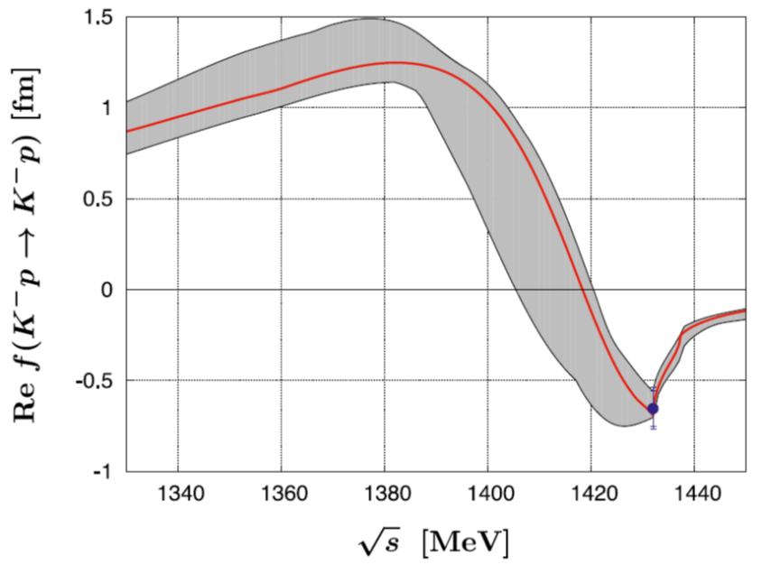
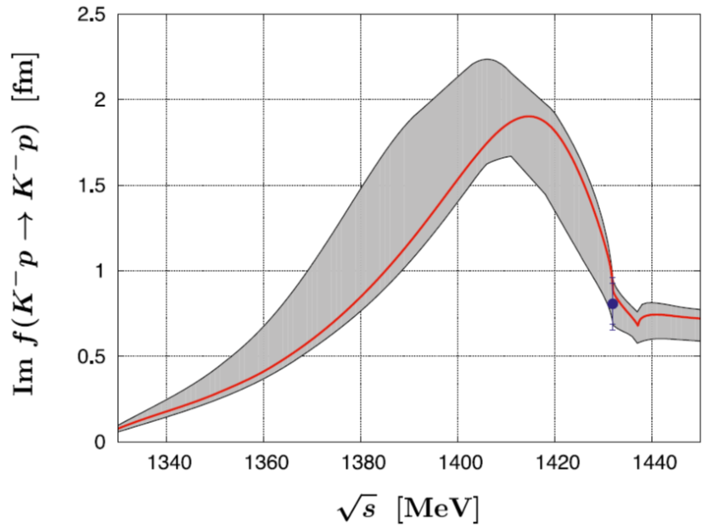
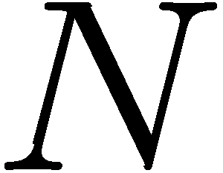
What happens in nuclear matter?
P
N
N
P
Recent fit based on SU(3) chiral effective field theory
Forward KN (or KN) scattering amplitude
If working at linear order in density, the free scattering amplitudes can be used
Y. Ikeda, T. Hyodo and W. Weise, Nucl. Phys. A 881, 98 (2012).

Slide 19
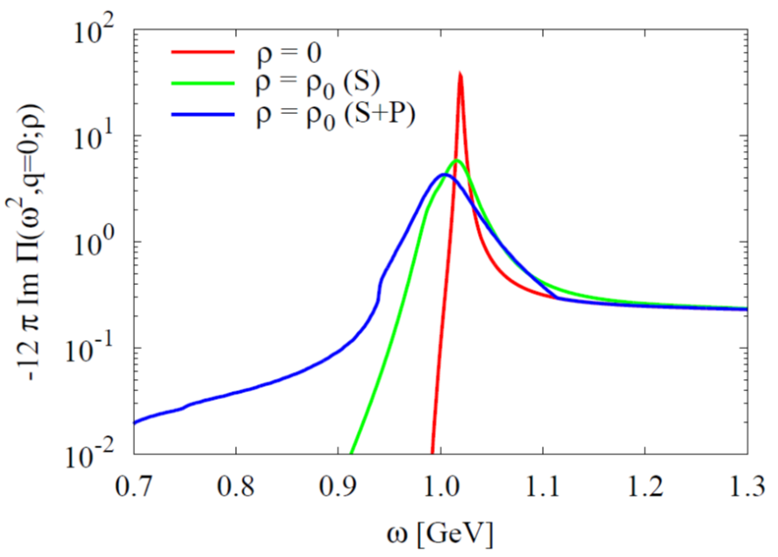
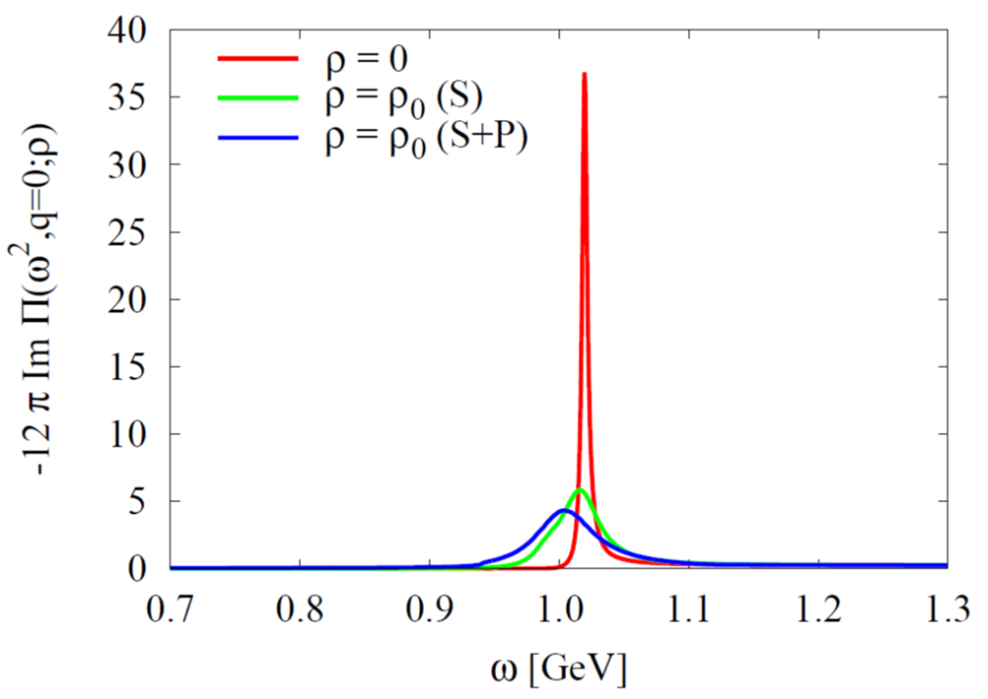
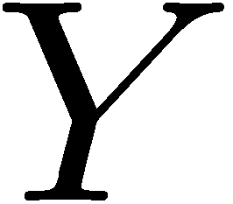
Results (Spectral Density)
Asymmetric modification of the spectrum. → Not necessarily parametrizable by a simple Breit-Wigner peak!
→ Important message for future E16 experiment at J-PARC
Takes into account further KN-interactions with intermediate hyperons, such as:

Slide 20
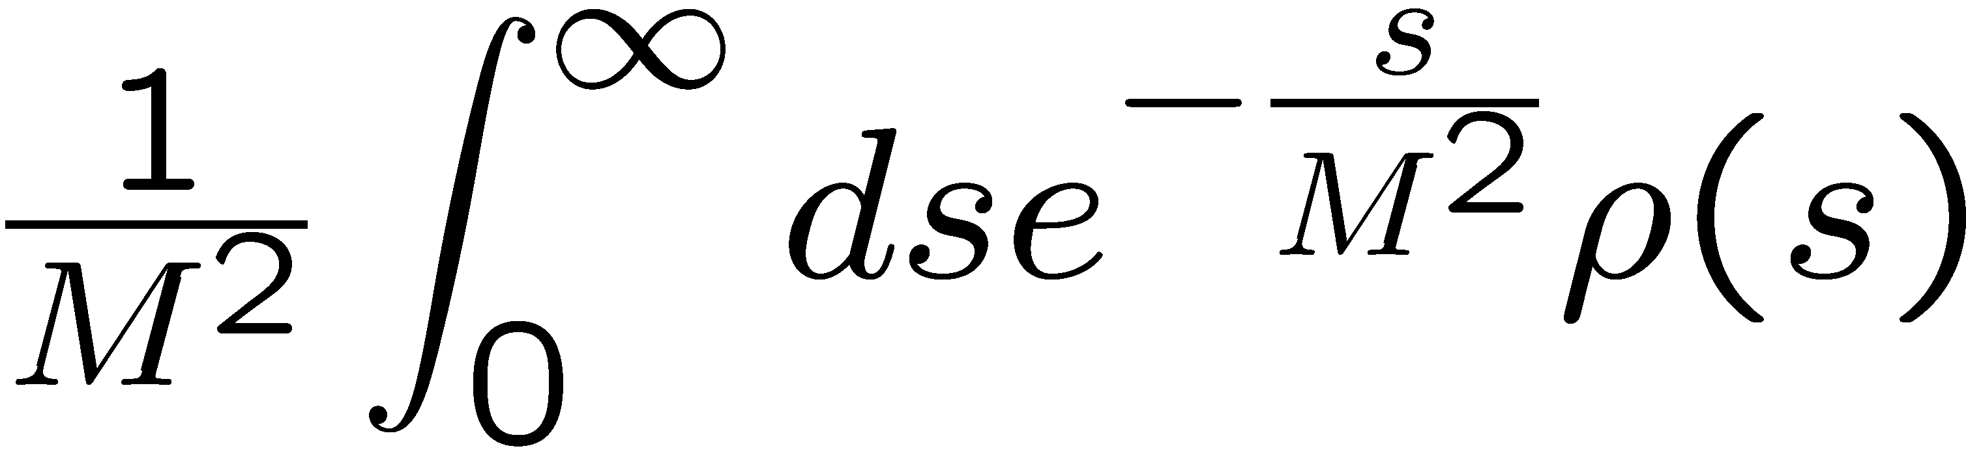
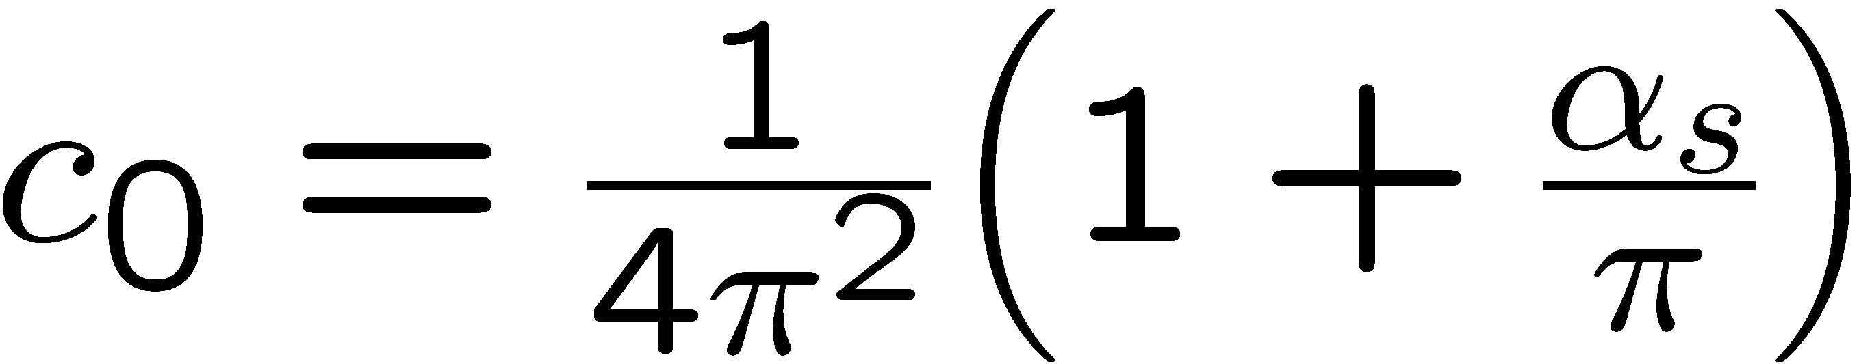





Moment analysis of obtained spectral functions
Starting point: Borel-type QCD sum rules
Large M limit
Finite-energy sum rules

Slide 21


Consistency check
(Vacuum)
Are the zeroth and first momentum sum rules consistent with our phenomenological spectral density?
Zeroth Moment
First Moment
Consistent!

Slide 22




Consistency check
(Nuclear matter)
Are the zeroth and first momentum sum rules consistent with our phenomenological spectral density?
Zeroth Moment
First Moment
Consistent!

Slide 23



Second moment sum rule
Factorization hypothesis
Strongly violated?
Should be tested on the lattice!

Slide 24


Summary and Conclusions
The φ-meson mass shift in nuclear matter constrains the strangeness content of the nucleon:
  Increasing φ-meson mass in nuclear matter
  Decreasing φ-meson mass in nuclear matter
We have computed the φ meson spectral density in vacuum and nuclear matter based on an effective vector dominance model and the latest experimental constraints
Non-symmetric behavior of peak in nuclear matter
Spectral functions are consistent with lowest two momentum sum rules
Moments provide direct links between QCD condensates and experimentally measurable quantities

Slide 25
Backup slides

Slide 26

Previous developments
The E325 Experiment (KEK)
Slowly moving φ mesons are produced in 12 GeV p+A reactions and are measured through di-leptons.
e
e
p
e
p
φ
φ
e
outside decay
inside decay
No effect (only vacuum)
Di-lepton spectrum reflects the modified φ-meson

Slide 27

Fitting Results
βγ<1.25 (Slow)
1.25<βγ<1.75
1.75<βγ (Fast)
Small Nucleus
Large Nucleus

Slide 28








Other experimental results
There are some more experimental results on the φ-meson width in nuclear matter, based on the measurement of the transparency ratio T:
Measured at SPring-8 (LEPS)
Measured at COSY-ANKE
T. Ishikawa et al, Phys. Lett. B 608, 215 (2005).
A. Polyanskiy et al, Phys. Lett. B 695, 74 (2011).

Slide 29




The strangeness content of the nucleon:
Important parameter for dark-matter searches:
Neutralino: Linear superposition of the Super-partners of the Higgs, the photon and the Z-boson
Adapted from: W. Freeman and D. Toussaint (MILC Collaboration), Phys. Rev. D 88, 054503 (2013).
most important contribution
dominates
A. Bottino, F. Donato, N. Fornengo and S. Scopel, Asropart. Phys. 18, 205 (2002).

Slide 30

In-nucleus decay fractions for E325 kinematics
Taken from: R.S. Hayano and T. Hatsuda, Rev. Mod. Phys. 82, 2949 (2010).

Slide 31

More on the free KN and KN scattering amplitudes
For KN:
Approximate by a real constant (↔ repulsion)
T. Waas, N. Kaiser and W. Weise, Phys. Lett. B 379, 34 (1996).
For KN:
Use the latest fit based on SU(3) chiral effective field theory, coupled channels and recent experimental results (↔ attraction)
Y. Ikeda, T. Hyodo and W. Weise, Nucl. Phys. A 881, 98 (2012).
K⁻p scattering length obtained from kaonic hydrogen (SIDDHARTA Collaboration)

Slide 32

Results of test-analysis (using MEM)
Peak position can be extracted, but not the width!
P. Gubler and K. Ohtani, Phys. Rev. D 90, 094002 (2014).

Slide 33

Results of test-analysis (using MEM)
P. Gubler and K. Ohtani, Phys. Rev. D 90, 094002 (2014).

Slide 34


The strangeness content of the nucleon: results from lattice QCD
Two methods
Direct measurement
Feynman-Hellmannn theorem
A. Abdel-Rehim et al. (ETM Collaboration), Phys. Rev. Lett. 116, 252001 (2016).
S. Durr et al. (BMW Collaboration), Phys. Rev. Lett. 116, 172001 (2016).

Slide 35

Dependence on continuum onset?
Ansatz used so far:
However, experiments give us a different picture:

Slide 36




New trial: ramp function
Mimics the experimental behavior of the 2K + nπ states
Will this new ansatz significantly change the behavior of our results?

Slide 37








New trial: ramp function
→ modified sum rules

Slide 38

Results of ramp-function analysis
(Vacuum)
→ Consistent, if W’ is not too small

Slide 39

Results of ramp-function analysis
(Nuclear matter)
→ Also consistent, if W’ is not too small

