Slide 1
Lattice QCD study for relation between confinement and chiral symmetry breaking
Speaker: Takahiro Doi (Kyoto University)
in collaboration with
Krzysztof Redlich (Wroclaw University & EMMI & Duke Univ.)
Chihiro Sasaki (Wroclaw University)
Hideo Suganuma (Kyoto University)
references
“Polyakov loop fluctuations in Dirac eigenmode expansion,”
TMD, K. Redlich, C. Sasaki and H. Suganuma, Phys. Rev. D92, 094004 (2015).
See also:
“Relation between Confinement and Chiral Symmetry Breaking in Temporally Odd-number Lattice QCD,”
TMD, H. Suganuma, T. Iritani, Phys. Rev. D90, 094505 (2014).
“Analytical relation between confinement and chiral symmetry breaking
in terms of the Polyakov loop and Dirac eigenmodes,”
H. Suganuma, TMD, T. Iritani, Prog. Theor. Exp. Phys. 2016, 013B06 (2016).
MIN 2016, August 2, 2016, YITP, Kyoto

Slide 2
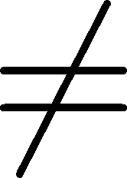
Massage of this talk
Confinement
Chiral symmetry breaking
From
・Lattice QCD formalism
・Analytical discussion as well as numerical calculation
MIN16 - Meson in Nucleus 2016 -
Any mesons and nuclei will not appear in my talk...

Slide 3
Contents
・Introduction
・Quark confinement, Polyakov loop and its fluctuations
・Chiral symmetry breaking and Dirac eigenmode
・Deconfinement transition and chiral restoration at finite temperature
・Our work
Analytical part
・Dirac spectrum representation of the Polyakov loop
・Dirac spectrum representation of the Polyakov loop fluctuations
Numerical part
・Numerical analysis for each Dirac-mode contribution
to the Polyakov loop fluctuations
・Recent progress
・The relation between Polyakov loop and overlap-Dirac modes

Slide 4
Contents
・Introduction
・Quark confinement, Polyakov loop and its fluctuations
・Chiral symmetry breaking and Dirac eigenmode
・Deconfinement transition and chiral restoration at finite temperature
・Our work
Analytical part
・Dirac spectrum representation of the Polyakov loop
・Dirac spectrum representation of the Polyakov loop fluctuations
Numerical part
・Numerical analysis for each Dirac-mode contribution
to the Polyakov loop fluctuations
・Recent progress
・The relation between Polyakov loop and overlap-Dirac modes

Slide 5
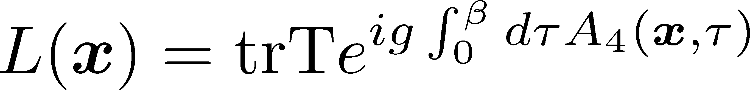
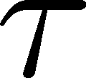
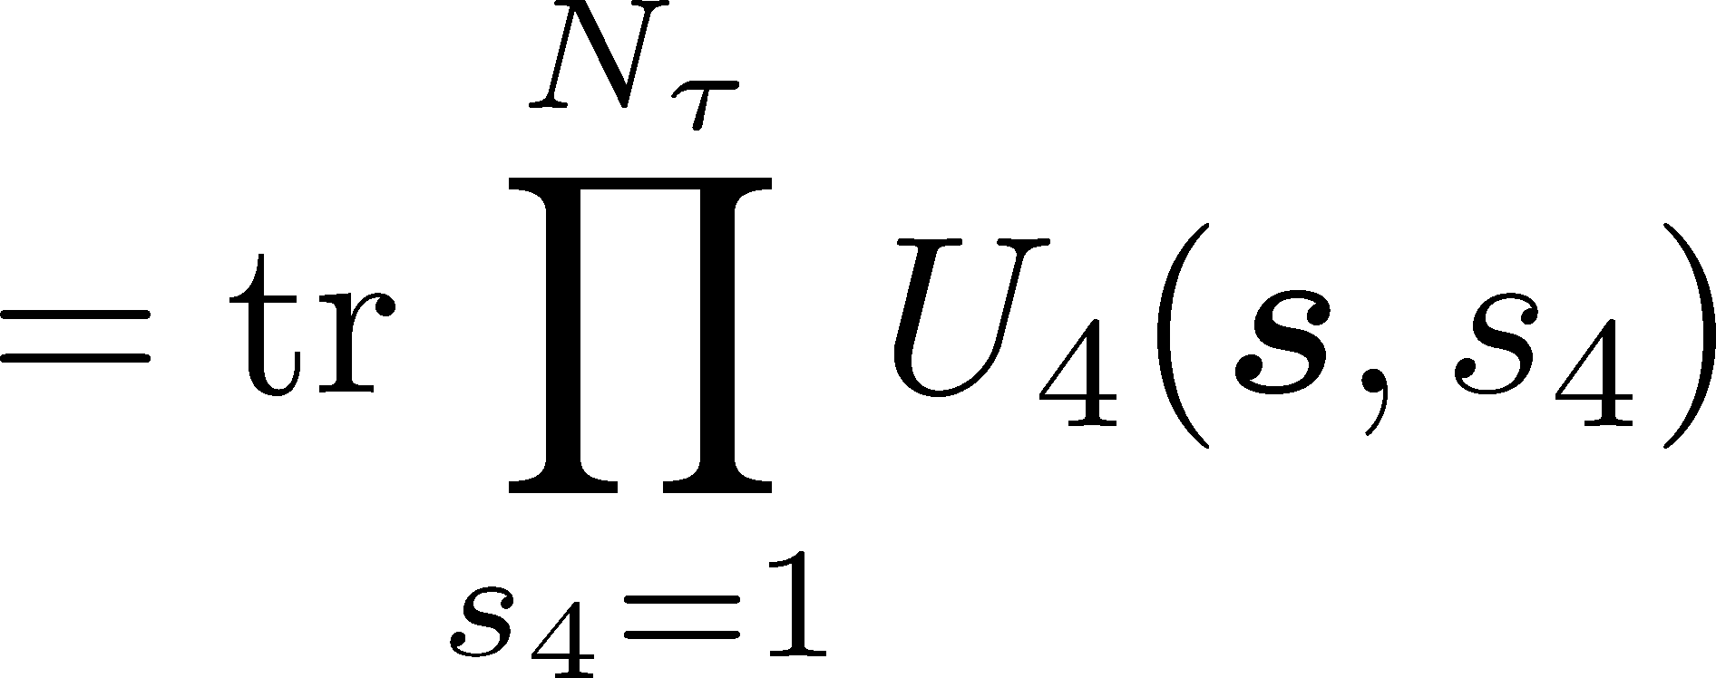
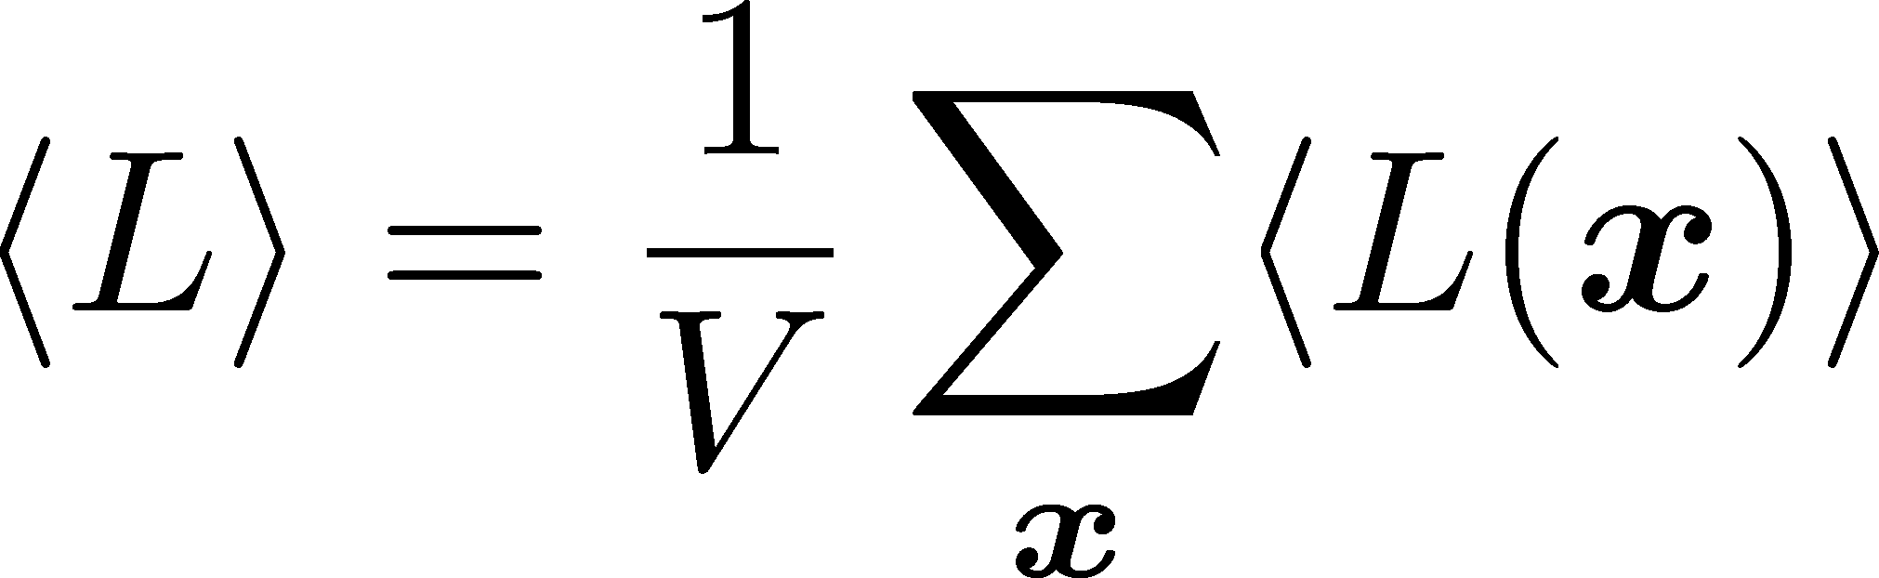

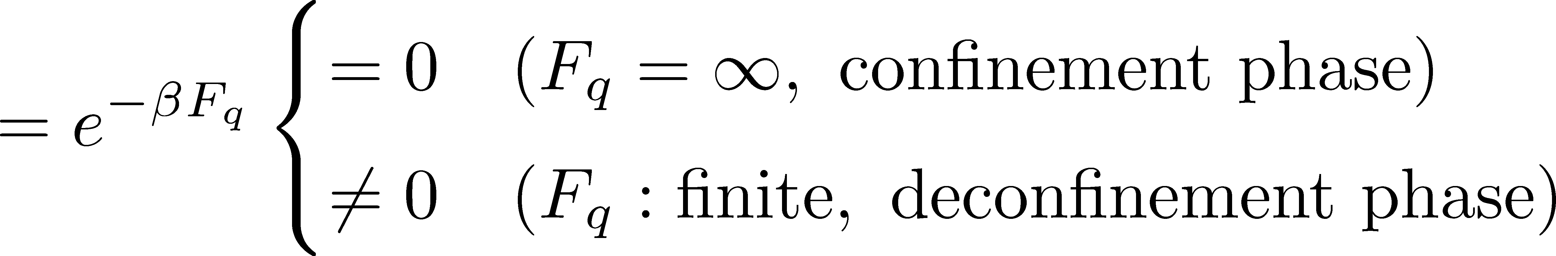
Introduction – Quark confinement
Confinement : colored state cannot be observed (quark, gluon, ・・・)
only color-singlet states can be observed (meson, baryon, ・・・)
Polyakov loop : order parameter for quark deconfinement phase transition
imaginary time
in continuum theory
in lattice theory
Finite temperature :
(anti) periodic boundary condition for time direction
: Polyakov loop
:free energy of the system
with a single static quark

Slide 6
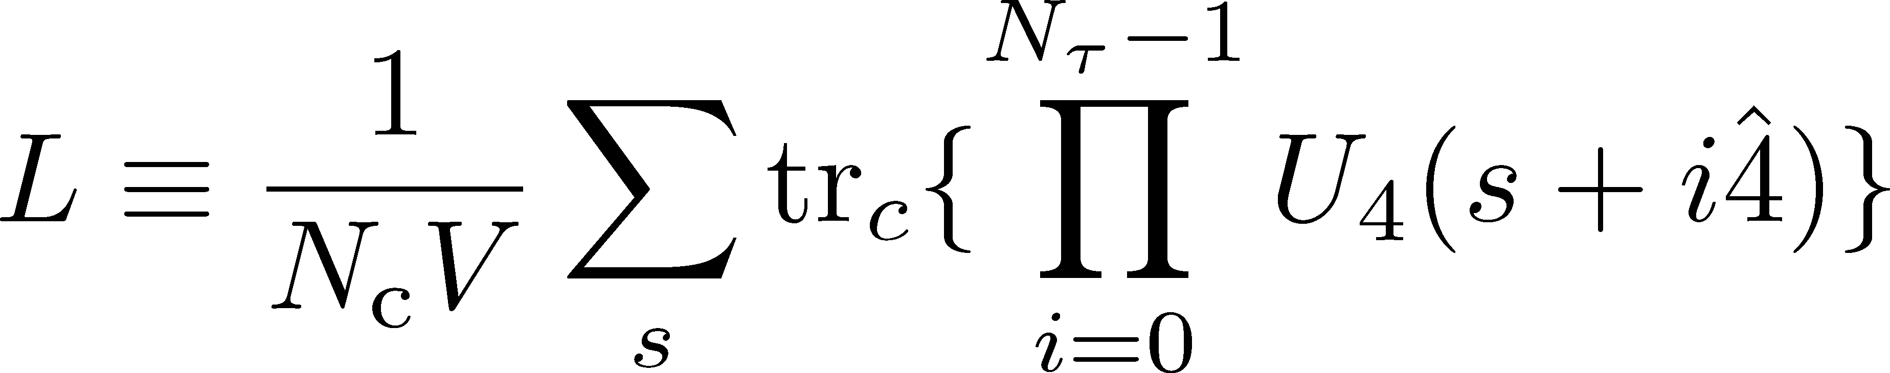
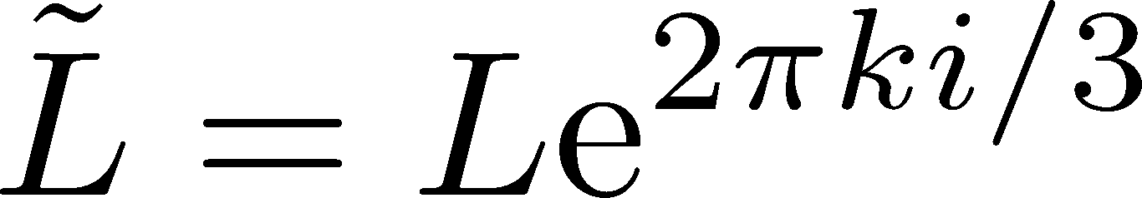
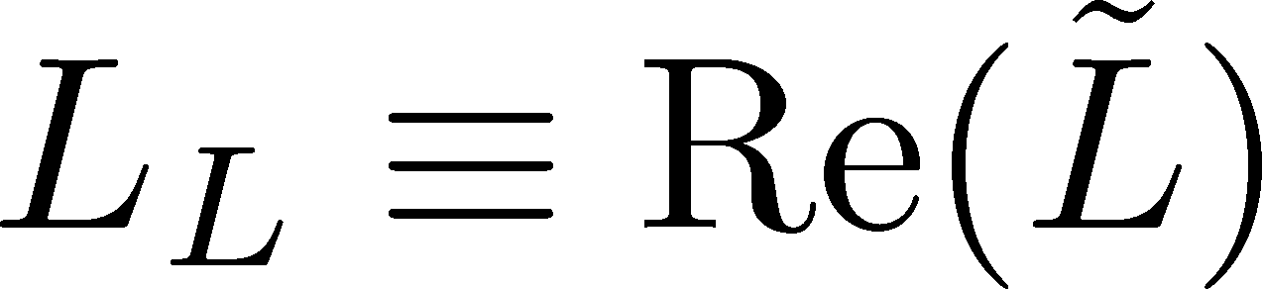
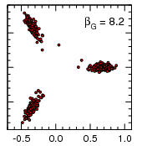
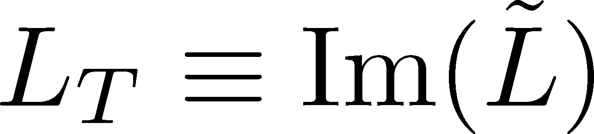
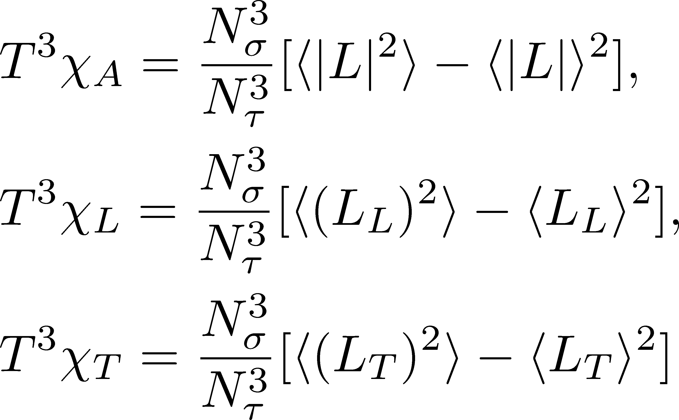

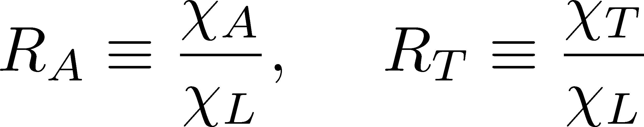

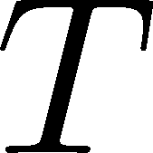
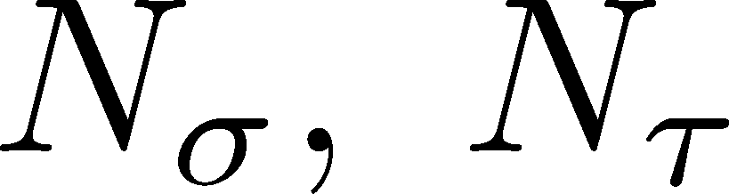
  Polyakov loop fluctuations
P.M. Lo, B. Friman, O. Kaczmarek, K. Redlich and C. Sasaki,
Phys. Rev. D88, 014506 (2013); Phys. Rev. D88, 074502 (2013)
・Polyakov loop:
・Z3 rotated Polyakov loop:
Scattered plot of the Polyakov loops
・longitudinal Polyakov loop:
・Transverse Polyakov loop:
・Polyakov loop susceptibilities:
0.0
・Ratios of Polyakov loop susceptibilities:
: temperature
: spatial and temporal lattice size

Slide 7
  Polyakov loop fluctuations
P.M. Lo, B. Friman, O. Kaczmarek, K. Redlich and C. Sasaki,
Phys. Rev. D88, 014506 (2013); Phys. Rev. D88, 074502 (2013)
・Polyakov loop:
・Z3 rotated Polyakov loop:
Scattered plot of the Polyakov loops
・longitudinal Polyakov loop:
・Transverse Polyakov loop:
k=-1
・Polyakov loop susceptibilities:
0.0
k=0
k=1
・Ratios of Polyakov loop susceptibilities:
: temperature
: spatial and temporal lattice size

Slide 8
  Polyakov loop fluctuations
P.M. Lo, B. Friman, O. Kaczmarek, K. Redlich and C. Sasaki,
Phys. Rev. D88, 014506 (2013); Phys. Rev. D88, 074502 (2013)
・Polyakov loop:
・Z3 rotated Polyakov loop:
Scattered plot of the Polyakov loops
・longitudinal Polyakov loop:
・Transverse Polyakov loop:
・Polyakov loop susceptibilities:
absolute value
transverse
0.0
longitudinal
・Ratios of Polyakov loop susceptibilities:
: temperature
: spatial and temporal lattice size

Slide 9
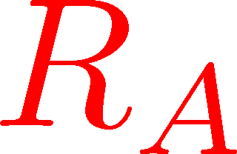
  Polyakov loop fluctuations
P.M. Lo, B. Friman, O. Kaczmarek, K. Redlich and C. Sasaki,
Phys. Rev. D88, 014506 (2013); Phys. Rev. D88, 074502 (2013)
・Polyakov loop:
In particular,
is a sensitive probe
for deconfinement transition
・Z3 rotated Polyakov loop:
・longitudinal Polyakov loop:
・Transverse Polyakov loop:
・Polyakov loop susceptibilities:
・Ratios of Polyakov loop susceptibilities:
※nf=0: quenched level
nf=2+1: (2+1)flavor full QCD
(near physical point)
: temperature
: spatial and temporal lattice size

Slide 10
  Polyakov loop fluctuations
P.M. Lo, B. Friman, O. Kaczmarek, K. Redlich and C. Sasaki,
Phys. Rev. D88, 014506 (2013); Phys. Rev. D88, 074502 (2013)
・Polyakov loop:
In particular,
is a sensitive probe
for deconfinement transition
・Z3 rotated Polyakov loop:
・longitudinal Polyakov loop:
・Transverse Polyakov loop:
・Polyakov loop susceptibilities:
・Ratios of Polyakov loop susceptibilities:
: temperature
is a good probe for deconfinement transition
even if considering light dynamical quarks.
: spatial and temporal lattice size

Slide 11
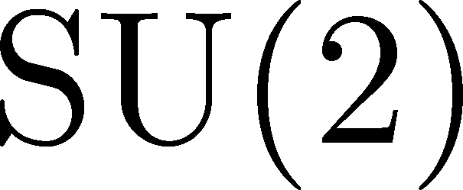
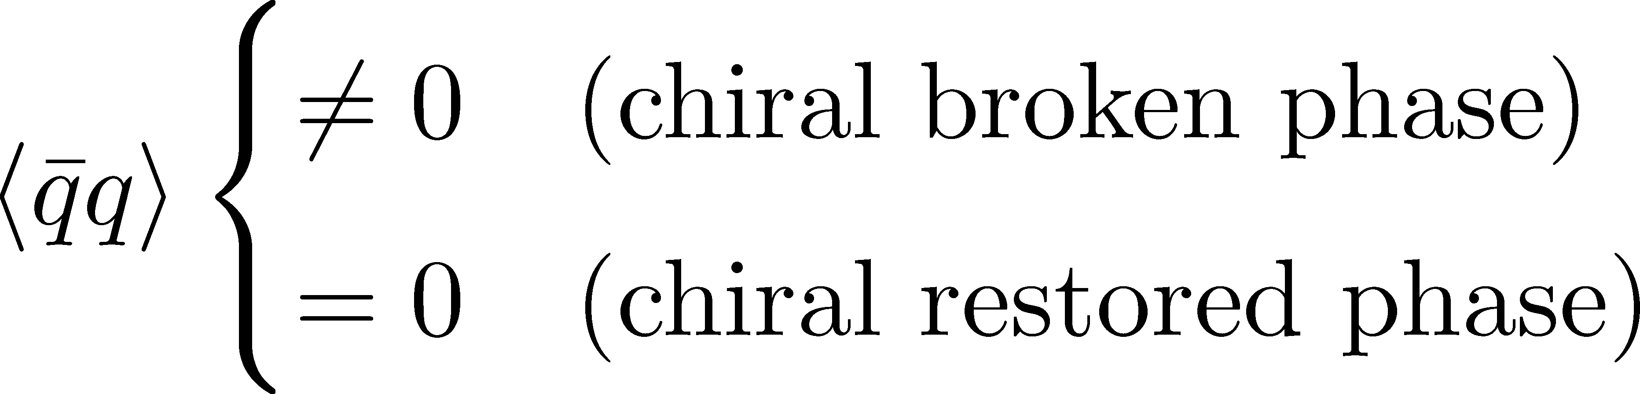
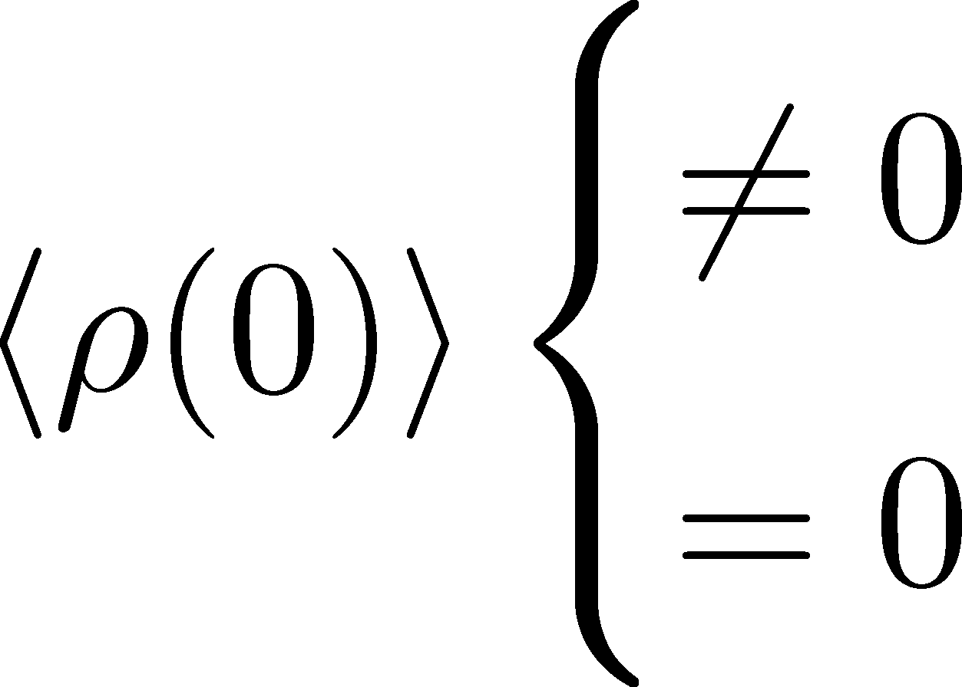
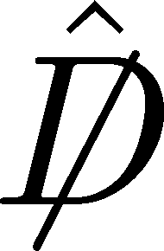
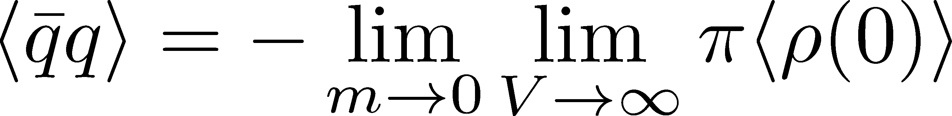
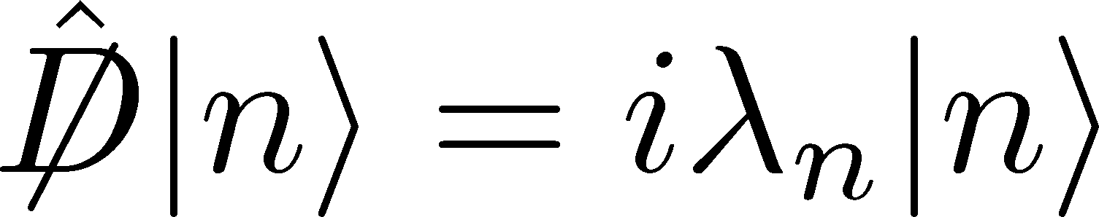
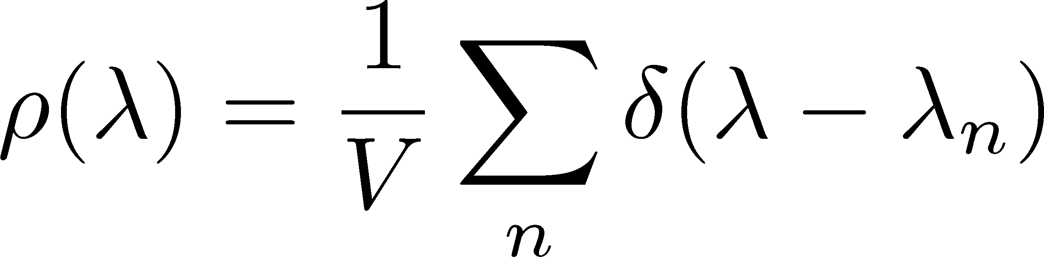
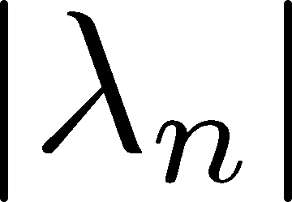
Introduction – Chiral Symmetry Breaking
・Chiral symmetry breaking : chiral symmetry is spontaneously broken
CSB
for example
・ u, d quarks get dynamical mass(constituent mass)
・ Pions appear as NG bosons
・Chiral condensate : order parameter for chiral phase transition
equiv.
⇔
・Banks-Casher relation
:Dirac operator
:Dirac eigenvalue equation
:Dirac eigenvalue density
The most important point:
the low-lying Dirac modes (with small ) are essential for chiral symmetry breaking.

Slide 12
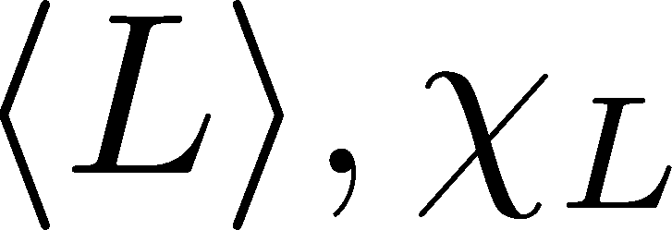
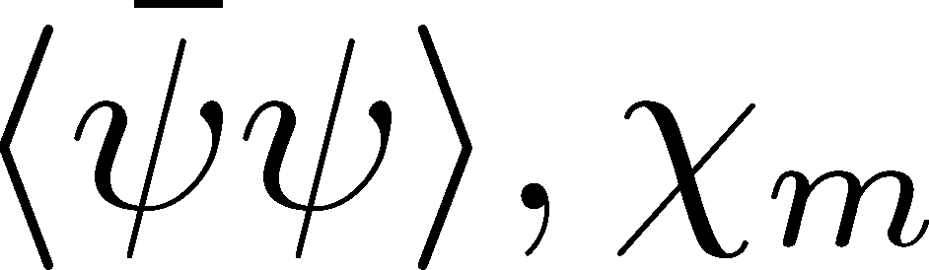
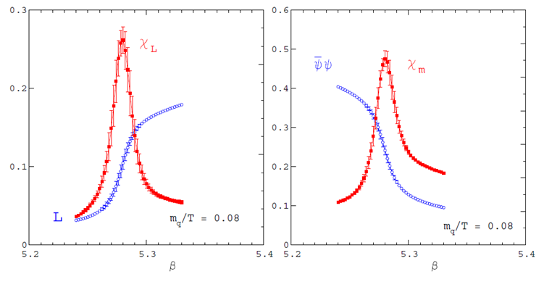
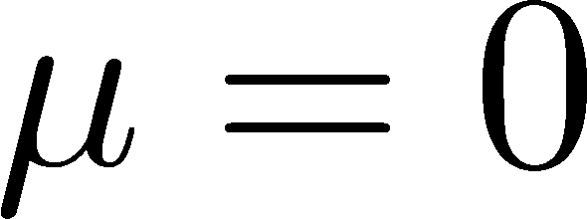
  QCD phase transition at finite temperature
F. Karsch, Lect. Notes Phys. 583, 209 (2002)
: Polyakov loop and its susceptibility
: chiral condensate and its susceptibility
deconfinement transition
chiral transition
・
・ two flavor QCD
with light quarks
Low T
High T
Low T
High T

Slide 13
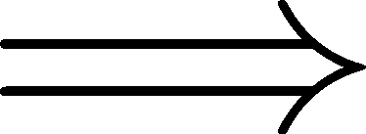
  QCD phase transition at finite temperature
F. Karsch, Lect. Notes Phys. 583, 209 (2002)
: Polyakov loop and its susceptibility
: chiral condensate and its susceptibility
deconfinement transition
chiral transition
・
・ two flavor QCD
with light quarks
We define critical temperature
as the peak of susceptibility
Low T
High T
Low T
High T
These two phenomena are strongly correlated(?)

Slide 14
Contents
・Introduction
・Quark confinement, Polyakov loop and its fluctuations
・Chiral symmetry breaking and Dirac eigenmode
・Deconfinement transition and chiral restoration at finite temperature
・Our work
Analytical part
・Dirac spectrum representation of the Polyakov loop
・Dirac spectrum representation of the Polyakov loop fluctuations
Numerical part
・Numerical analysis for each Dirac-mode contribution
to the Polyakov loop fluctuations
・Recent progress
・The relation between Polyakov loop and overlap-Dirac modes

Slide 15
Our strategy
Our strategy to study relation between confinement and chiral symmetry breaking :
anatomy of Polyakov loop in terms of Dirac mode

Slide 16

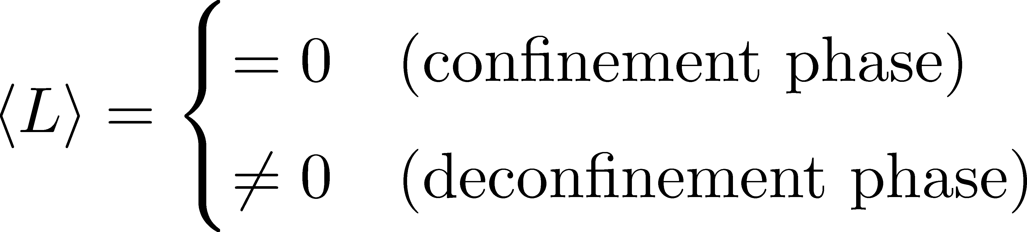
Our strategy
Our strategy to study relation between confinement and chiral symmetry breaking :
anatomy of Polyakov loop in terms of Dirac mode
Polyakov loop : an order parameter of deconfinement transition.

Slide 17
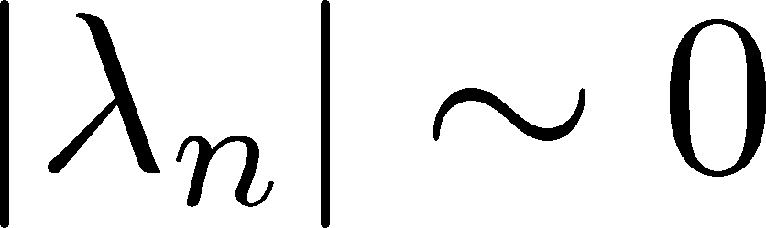
Our strategy
Our strategy to study relation between confinement and chiral symmetry breaking :
anatomy of Polyakov loop in terms of Dirac mode
Polyakov loop : an order parameter of deconfinement transition.
Dirac eigenmode: low-lying Dirac modes (with small eigenvalue )
are essential modes for chiral symmetry breaking.
(recall Banks-Casher relation: )
equiv.
⇔

Slide 18
Our strategy
Our strategy to study relation between confinement and chiral symmetry breaking :
anatomy of Polyakov loop in terms of Dirac mode
Polyakov loop : an order parameter of deconfinement transition.
Dirac eigenmode: low-lying Dirac modes (with small eigenvalue )
are essential modes for chiral symmetry breaking.
(recall Banks-Casher relation: )
equiv.
⇔
General discussion:
If the contribution to the Polyakov loop from the low-lying Dirac modes is very small,
we can state that the important modes for chiral symmetry breaking
are not important for confinement.

Slide 19
Our strategy
Our strategy to study relation between confinement and chiral symmetry breaking :
anatomy of Polyakov loop in terms of Dirac mode
Polyakov loop : an order parameter of deconfinement transition.
Dirac eigenmode: low-lying Dirac modes (with small eigenvalue )
are essential modes for chiral symmetry breaking.
(recall Banks-Casher relation: )
equiv.
⇔
General discussion:
We can analytically show that this situation is valid. ~next page
If the contribution to the Polyakov loop from the low-lying Dirac modes is very small,
we can state that the important modes for chiral symmetry breaking
are not important for confinement.

Slide 20
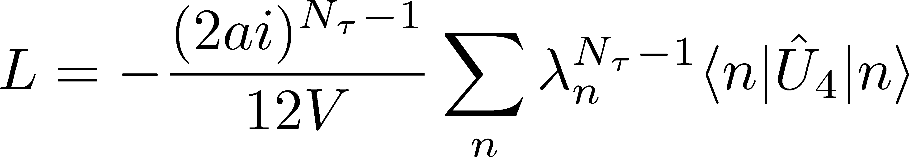
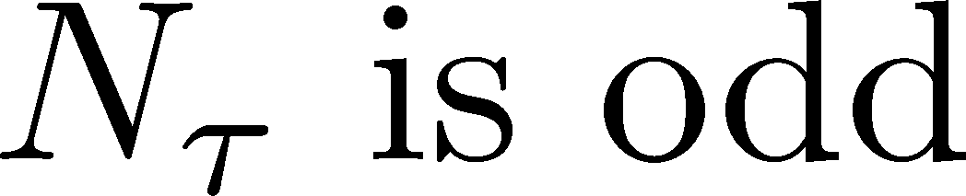
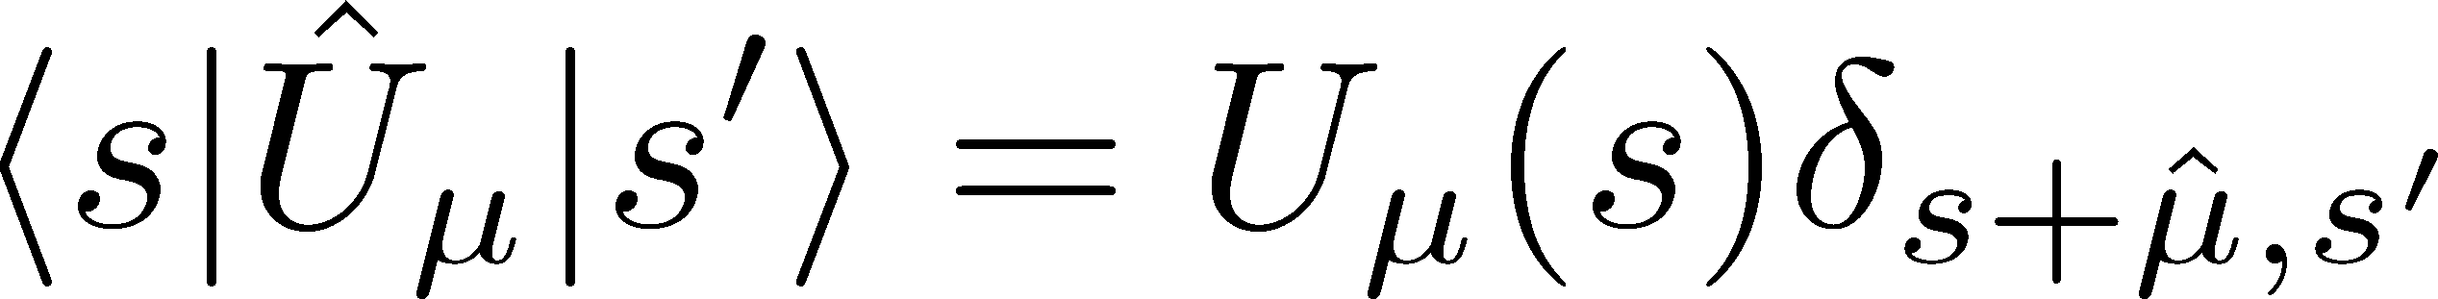
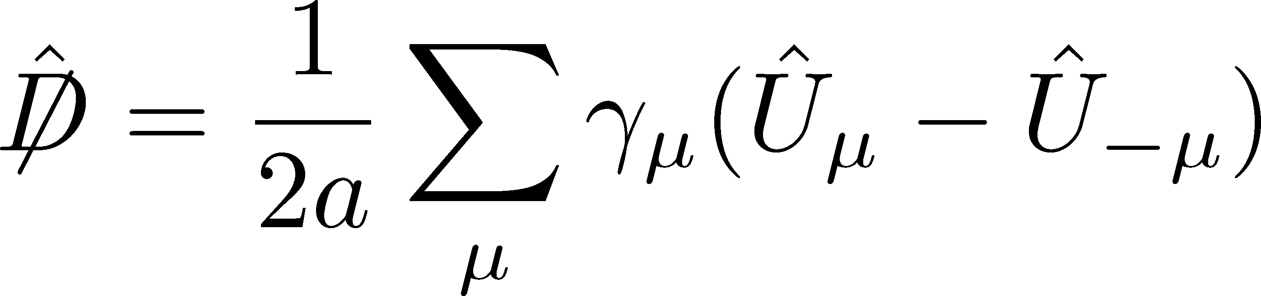
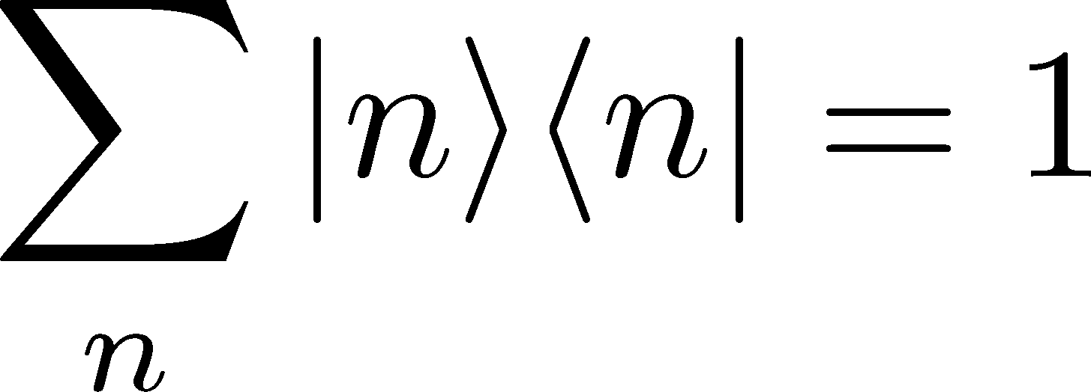
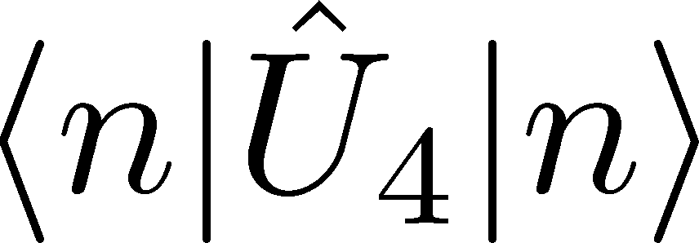
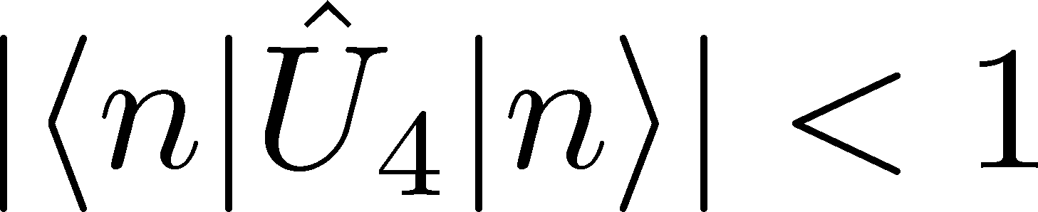
  An analytical relation between Polyakov loop and Dirac mode on temporally odd-number lattice
TMD, H. Suganuma, T. Iritani, Phys. Rev. D 90, 094505 (2014).
H. Suganuma, TMD, T. Iritani, Prog. Theor. Exp. Phys. 2016, 013B06 (2016).
on temporally odd number lattice:
・ Polyakov loop :
・ link variable operator :
with anti p.b.c. for time direction:
notation:
・ Dirac eigenmode :
Dirac operator :
・ The Dirac-matrix element of the link variable operator:
・ This formula is valid in full QCD and at the quenched level.
・ This formula exactly holds for each gauge-configuration {U}
and for arbitrary fermionic kernel K[U]
properties :

Slide 21
  Dirac spectrum representation of the Polyakov loop fluctuations
TMD, K. Redlich, C. Sasaki and H. Suganuma, Phys. Rev. D92, 094004 (2015).
Definition of the Polyakov loop fluctuations
・Polyakov loop:
・Z3 rotated Polyakov loop:
・longitudinal Polyakov loop:
・Transverse Polyakov loop:
・Polyakov loop susceptibilities:
P.M. Lo, B. Friman, O. Kaczmarek, K. Redlich and C. Sasaki,
Phys. Rev. D88, 014506 (2013); Phys. Rev. D88, 074502 (2013)
・Ratios of Polyakov loop susceptibilities:
is a good probe for deconfinement transition
even if considering dynamical quarks.

Slide 22
  Dirac spectrum representation of the Polyakov loop fluctuations
TMD, K. Redlich, C. Sasaki and H. Suganuma, Phys. Rev. D92, 094004 (2015).
Definition of the Polyakov loop fluctuations
Dirac spectrum representation of the Polyakov loop
・Polyakov loop:
・Z3 rotated Polyakov loop:
Polyakov loop :
・longitudinal Polyakov loop:
Dirac eigenmode :
・Transverse Polyakov loop:
link variable operator :
・Polyakov loop susceptibilities:
・Ratios of Polyakov loop susceptibilities:

Slide 23
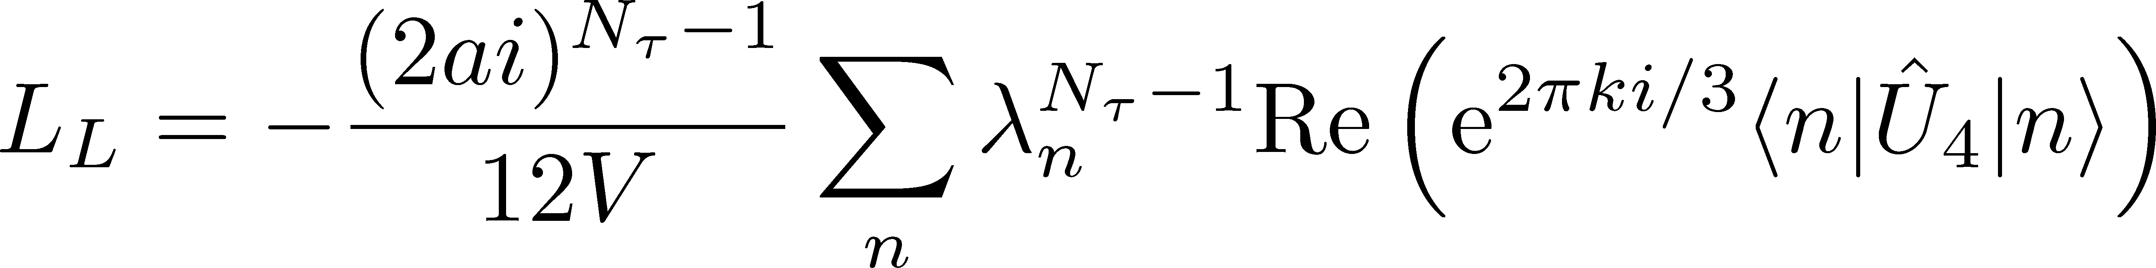
  Dirac spectrum representation of the Polyakov loop fluctuations
TMD, K. Redlich, C. Sasaki and H. Suganuma, Phys. Rev. D92, 094004 (2015).
Definition of the Polyakov loop fluctuations
Dirac spectrum representation of the Polyakov loop
・Polyakov loop:
・Z3 rotated Polyakov loop:
Polyakov loop :
・longitudinal Polyakov loop:
Dirac eigenmode :
・Transverse Polyakov loop:
link variable operator :
・Polyakov loop susceptibilities:
combine
Dirac spectrum representation
of the Polyakov loop fluctuations
For example,
・Ratios of Polyakov loop susceptibilities:
and...

Slide 24
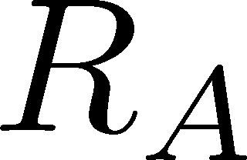
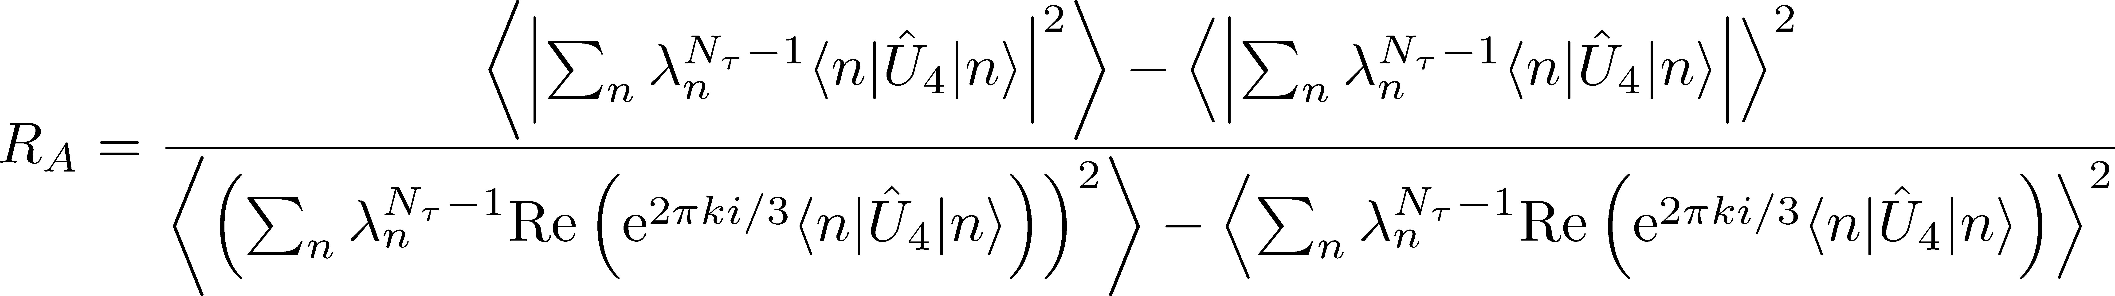
  Dirac spectrum representation of the Polyakov loop fluctuations
TMD, K. Redlich, C. Sasaki and H. Suganuma, Phys. Rev. D92, 094004 (2015).
In particular, the ratio can be represented using Dirac modes:
Note 1: The ratio is a good “order parameter” for deconfinement transition.

Slide 25
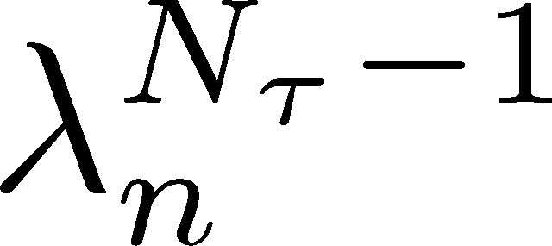
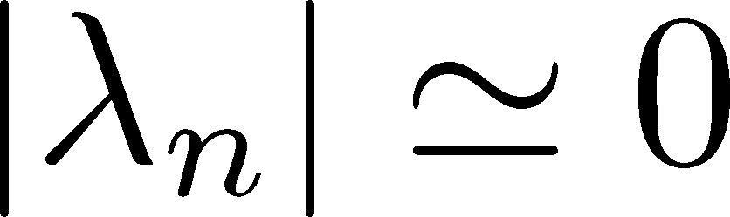
  Dirac spectrum representation of the Polyakov loop fluctuations
TMD, K. Redlich, C. Sasaki and H. Suganuma, Phys. Rev. D92, 094004 (2015).
In particular, the ratio can be represented using Dirac modes:
Note 1: The ratio is a good “order parameter” for deconfinement transition.
Note 2: Ｔhe damping factor is very small with small ,
then low-lying Dirac modes (with small ) are not important for ,
while these modes are important modes for chiral symmetry breaking.

Slide 26
  Dirac spectrum representation of the Polyakov loop fluctuations
TMD, K. Redlich, C. Sasaki and H. Suganuma, Phys. Rev. D92, 094004 (2015).
In particular, the ratio can be represented using Dirac modes:
Note 1: The ratio is a good “order parameter” for deconfinement transition.
Note 2: Ｔhe damping factor is very small with small ,
then low-lying Dirac modes (with small ) are not important for ,
while these modes are important modes for chiral symmetry breaking.
Thus, the essential modes for chiral symmetry breaking in QCD
are not important to quantify the Polyakov loop fluctuations,
which are sensitive observables to confinement properties in QCD.

Slide 27
  Dirac spectrum representation of the Polyakov loop fluctuations
TMD, K. Redlich, C. Sasaki and H. Suganuma, Phys. Rev. D92, 094004 (2015).
In particular, the ratio can be represented using Dirac modes:
Note 1: The ratio is a good “order parameter” for deconfinement transition.
Note 2: Ｔhe damping factor is very small with small ,
then low-lying Dirac modes (with small ) are not important for ,
while these modes are important modes for chiral symmetry breaking.
Thus, the essential modes for chiral symmetry breaking in QCD
are not important to quantify the Polyakov loop fluctuations,
which are sensitive observables to confinement properties in QCD.
This result suggests that
there is no direct, one-to-one correspondence
between confinement and chiral symmetry breaking in QCD.

Slide 28
Contents
・Introduction
・Quark confinement, Polyakov loop and its fluctuations
・Chiral symmetry breaking and Dirac eigenmode
・Deconfinement transition and chiral restoration at finite temperature
・Our work
Analytical part
・Dirac spectrum representation of the Polyakov loop
・Dirac spectrum representation of the Polyakov loop fluctuations
Numerical part
・Numerical analysis for each Dirac-mode contribution
to the Polyakov loop fluctuations
・Recent progress
・The relation between Polyakov loop and overlap-Dirac modes

Slide 29

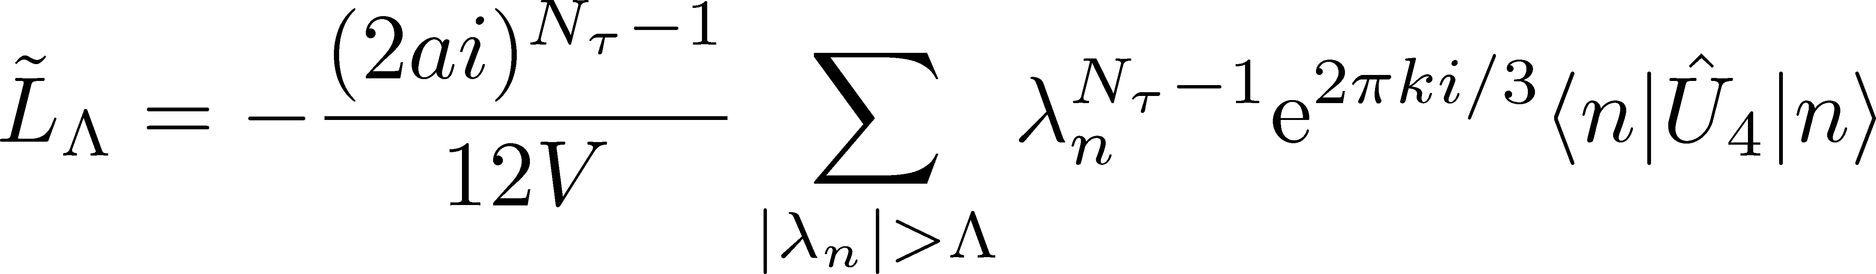
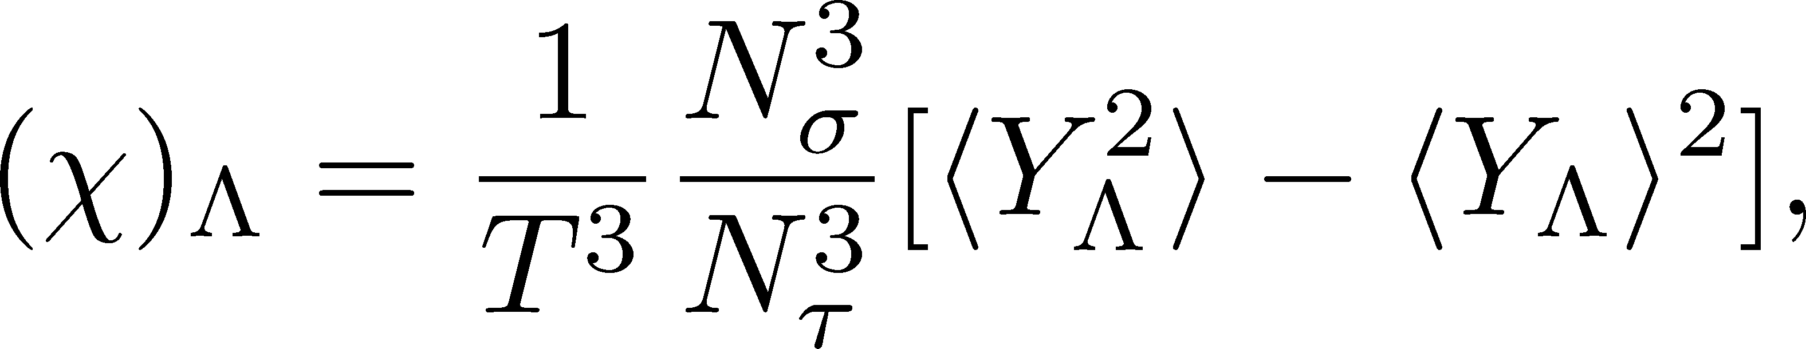
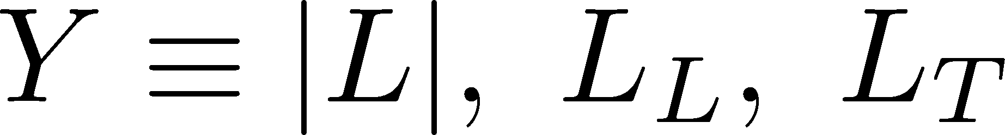
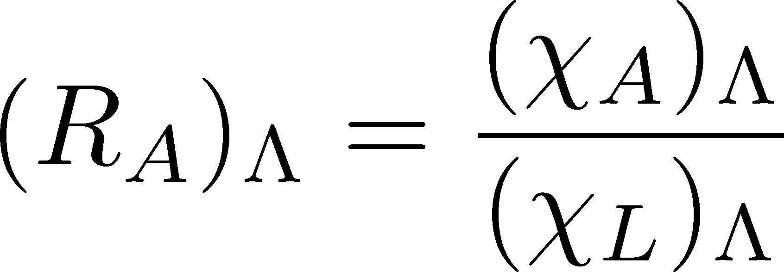
  Dirac spectrum representation of the Polyakov loop fluctuations
TMD, K. Redlich, C. Sasaki and H. Suganuma, Phys. Rev. D92, 094004 (2015).
Definition of the Polyakov loop fluctuations
Λ-dependent Polyakov loop fluctuations
・Polyakov loop:
Infrared cutoff of the Dirac eigenvalue:
・Z3 rotated Polyakov loop:
・Λ-dependent (IR-cut) Z3 rotated Polyakov loop:
・longitudinal Polyakov loop:
・Transverse Polyakov loop:
・Polyakov loop susceptibilities:
・Λ-dependent Polyakov loop susceptibilities:
・Ratios of Polyakov loop susceptibilities:
・Λ-dependent ratios of susceptibilities:

Slide 30
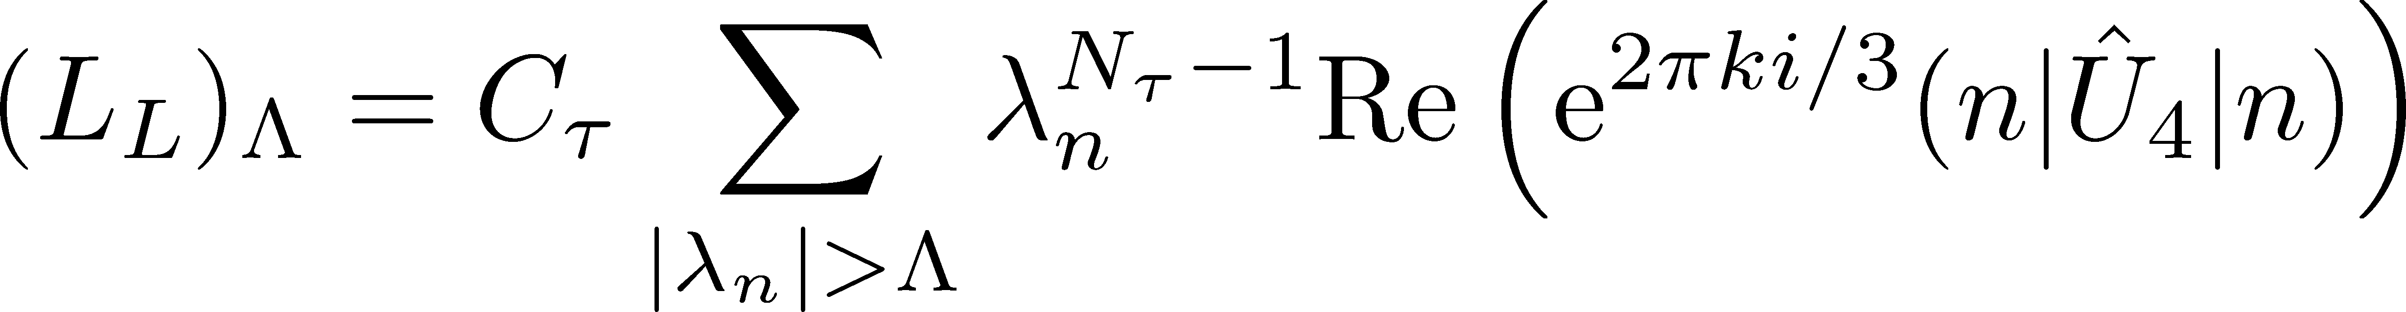
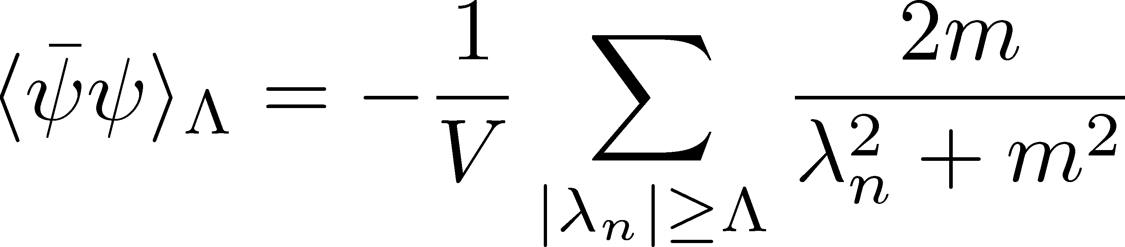
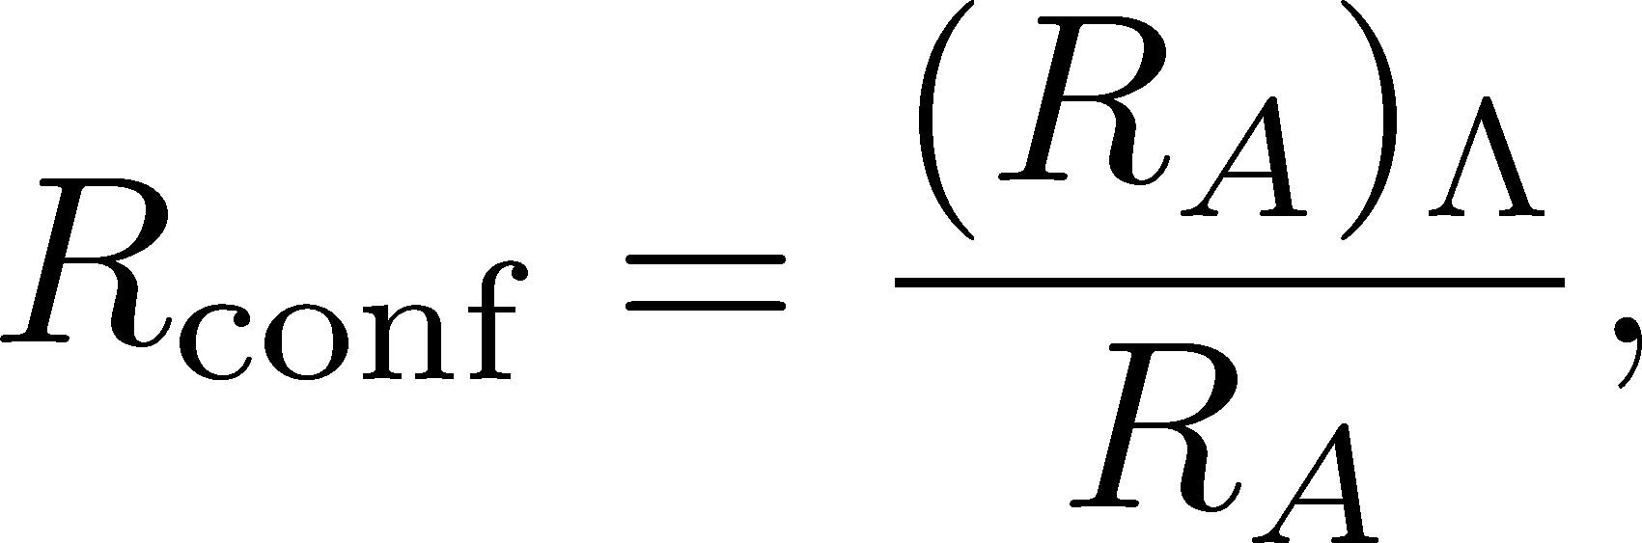

  Introduction of the Infrared cutoff for Dirac modes
TMD, K. Redlich, C. Sasaki and H. Suganuma, Phys. Rev. D92, 094004 (2015).
Define -dependent (IR-cut) susceptibilities:
where, for example,
Define -dependent (IR-cut) ratio of susceptibilities:
Define -dependent (IR-cut) chiral condensate:
Define the ratios, which indicate the influence of removing the low-lying Dirac modes:

Slide 31





  Numerical analysis
lattice setup:
・quenched SU(3) lattice QCD
・standard plaquette action
・gauge coupling:
・lattice size:
⇔
lattice spacing :
・periodic boundary condition
for link-variables and Dirac operator
・ is strongly reduced by removing the low-lying Dirac modes.
・ is almost unchanged.
It is also numerically confirmed that
low-lying Dirac modes are important for chiral symmetry breaking
and not important for quark confinement.

Slide 32
Contents
・Introduction
・Quark confinement, Polyakov loop and its fluctuations
・Chiral symmetry breaking and Dirac eigenmode
・Deconfinement transition and chiral restoration at finite temperature
・Our work
Analytical part
・Dirac spectrum representation of the Polyakov loop
・Dirac spectrum representation of the Polyakov loop fluctuations
Numerical part
・Numerical analysis for each Dirac-mode contribution
to the Polyakov loop fluctuations
・Recent progress
・The relation between Polyakov loop and overlap-Dirac modes

Slide 33

Fermion-doubling problem and chiral symmetry on the lattice
Naive Dirac operator
(So far)
･ include fermion doubler
・ exact chiral symmetry
Wilson-Dirac operator
(Example to avoid the fermion-doubling problem)
･ free from fermion-doubling problem
・ explicit breaking of chiral symmetry
e.g.) Nielsen-Ninomiya (1981)
Overlap-Dirac operator
H. Neuberger (1998)
･ free from fermion-doubling problem
・ exact chiral symmetry on the lattice

Slide 34




Recent progress: Overlap-Dirac operator
in preparation
Overlap-Dirac operator
H. Neuberger (1998)
(lattice unit)
・Wilson-Dirac operator with negative mass ( ):
・The overlap-Dirac operator satisfies the Ginsparg-Wilson relation:
⇒ the overlap-Dirac operator solves the fermion doubling problem
with the exact chiral symmetry on the lattice.
・The overlap-Dirac operator is non-local operator.
⇒ It is very difficult to directly derive the analytical relation
between the Polyakov loop and the overlap-Dirac modes.
⇒ However, we can discuss the relation between the Polyakov loop
and the overlap-Dirac modes. (next page~)
(The domain-wall-fermion formalism is also free from the doubling problem with the exact chiral symmetry on the lattice.)

Slide 35




Polyakov loop and overlap-Dirac modes
Strategy
We discuss the relation btw the Polyakov loop and overlap-Dirac modes
by showing the following facts:
① The low-lying overlap-Dirac modes are essential modes for chiral symmetry breaking.
② The low-lying eigenmodes of overlap-Dirac and Wilson-Dirac operators correspond.
③ The low-lying Wilson-Dirac modes have negligible contribution to the Polyakov loop.
②
Low-lying Wilson-Dirac modes
Low-lying overlap-Dirac modes
correspond
①
③
Essential modes for chiral symmetry breaking
Negligible contribution to the Polyakov loop

Slide 36





Polyakov loop and overlap-Dirac modes
① The low-lying overlap-Dirac modes are essential modes for chiral symmetry breaking.
② The low-lying eigenmodes of Wilson-Dirac and overlap-Dirac operators correspond.
③ The low-lying Wilson-Dirac modes have negligible contribution to the Polyakov loop.
① The low-lying overlap-Dirac modes are essential modes for chiral symmetry breaking.
The chiral condensate by the overlap-Dirac eigenvalues:
The low-lying overlap-Dirac modes
have the dominant contribution
to the chiral condensate .
(Recall the Banks-Casher relation)

Slide 37


Polyakov loop and overlap-Dirac modes
① The low-lying overlap-Dirac modes are essential modes for chiral symmetry breaking.
② The low-lying eigenmodes of Wilson-Dirac and overlap-Dirac operators correspond.
③ The low-lying Wilson-Dirac modes have negligible contribution to the Polyakov loop.
② The low-lying eigenmodes of Wilson-Dirac and overlap-Dirac operators correspond.

Slide 38

Polyakov loop and overlap-Dirac modes
① The low-lying overlap-Dirac modes are essential modes for chiral symmetry breaking.
② The low-lying eigenmodes of Wilson-Dirac and overlap-Dirac operators correspond.
③ The low-lying Wilson-Dirac modes have negligible contribution to the Polyakov loop.
② The low-lying eigenmodes of Wilson-Dirac and overlap-Dirac operators correspond.
Physical zero modes
Unphysical doubler modes

Slide 39



Polyakov loop and overlap-Dirac modes
① The low-lying overlap-Dirac modes are essential modes for chiral symmetry breaking.
② The low-lying eigenmodes of Wilson-Dirac and overlap-Dirac operators correspond.
③ The low-lying Wilson-Dirac modes have negligible contribution to the Polyakov loop.
③ The low-lying Wilson-Dirac modes have negligible contribution to the Polyakov loop.
The analytical relation btw the Polyakov loop and the Wilson-Dirac modes
Due to the damping factor ,
the low-lying Wilson-Dirac modes (with )
have negligible contribution to the Polyakov loop.
・ Derivation is shown in our paper:
TMD, H. Suganuma, T. Iritani, PRD90, 094505 (2014).
・ These low-lying modes also have negligible contribution
to Polyakov loop fluctuations and Wilson loop.

Slide 40
Polyakov loop and overlap-Dirac modes
① The low-lying overlap-Dirac modes are essential modes for chiral symmetry breaking.
② The low-lying eigenmodes of Wilson-Dirac and overlap-Dirac operators correspond.
③ The low-lying Wilson-Dirac modes have negligible contribution to the Polyakov loop.
②
correspond
①
③
Essential modes for chiral symmetry breaking
Negligible contribution to the Polyakov loop
Therefore, the presence or absence of the low-lying overlap-Dirac modes
is not related to the confinement properties such as the Polyakov loop
while the chiral condensate is sensitive to the density of the low-lying modes.

Slide 41

Summary
TMD, K. Redlich, C. Sasaki and H. Suganuma,
Phys. Rev. D92, 094004 (2015).
1.
We have derived the analytical relation between
Polyakov loop fluctuations and Dirac eigenmodes on temporally odd-number lattice:
e.g.)
Dirac eigenmode :
Link variable operator :
2.
We have analytically and numerically confirmed that
low-lying Dirac modes are not important to quantify the Polyakov loop fluctuation ratios,
which are sensitive observables to confinement properties in QCD.
3.
Our results suggest that there is
no direct one-to-one correspondence between
confinement and chiral symmetry breaking in QCD.
4.
We have shown the same results
within the overlap-fermion formalism,
which solves the fermion-doubling problem
with the exact chiral symmetry on the lattice.
Thank you very much for your attention!

Slide 42
Appendix

Slide 43
  An analytical relation between Polyakov loop and Dirac mode on temporally odd-number lattice
TMD, H. Suganuma, T. Iritani, Phys. Rev. D 90, 094505 (2014).
H. Suganuma, TMD, T. Iritani, Prog. Theor. Exp. Phys. 2016, 013B06 (2016).
on temporally odd number lattice:
・ Polyakov loop :
・ link variable operator :
notation:
with anti p.b.c. for time direction:
・ Dirac eigenmode :
Dirac operator :
・ This analytical formula is a general and mathematical identity.
・ valid in full QCD and at the quenched level.
・ holds for each gauge-configuration {U}
・ holds for arbitrary fermionic kernel K[U]
~from next page: Derivation

Slide 44


  An analytical relation between Polyakov loop and Dirac mode
  on temporally odd-number lattice
O
4
(time)
1,2,3
(spatial)
O
In this study, we use
・standard square lattice
・with ordinary periodic boundary condition for gluons,
・with the odd temporal length
( temporally odd-number lattice )

Slide 45

  An analytical relation between Polyakov loop and Dirac mode
  on temporally odd-number lattice
O
4
(time)
1,2,3
(spatial)
O
In this study, we use
・standard square lattice
・with ordinary periodic boundary condition for gluons,
・with the odd temporal length
( temporally odd-number lattice )
Note: in the continuum limit of a → 0, → ∞,
any number of large gives the same result.
Then, it is no problem to use the odd-number lattice.

Slide 46
  An analytical relation between Polyakov loop and Dirac mode
  on temporally odd-number lattice
O
4
(time)
1,2,3
(spatial)
O
In this study, we use
・standard square lattice
・with ordinary periodic boundary condition for gluons,
・with the odd temporal length
( temporally odd-number lattice )
For the simple notation,
we take the lattice unit a=1 hereafter.

Slide 47

  An analytical relation between Polyakov loop and Dirac mode
  on temporally odd-number lattice
Polyakov loop
In general, only gauge-invariant quantities
such as Closed Loops and the Polyakov loop
survive in QCD. (Elitzur’s Theorem)
4
O
Closed Loops
All the non-closed lines are gauge-variant
and their expectation values are zero.
4
e.g.
( =0 )
Nonclosed Lines
gauge-variant

Slide 48
  An analytical relation between Polyakov loop and Dirac mode
  on temporally odd-number lattice
Polyakov loop
In general, only gauge-invariant quantities
such as Closed Loops and the Polyakov loop
survive in QCD. (Elitzur’s Theorem)
4
O
Closed Loops
All the non-closed lines are gauge-variant
and their expectation values are zero.
4
e.g.
( =0 )
Nonclosed Lines
gauge-variant
Key point
Note: any closed loop needs even-number link-variables
on the square lattice.

Slide 49








  An analytical relation between Polyakov loop and Dirac mode
  on temporally odd-number lattice
We consider the functional trace on the temporally odd-number lattice:
definition:
Dirac operator :
site & color & spinor
is expressed as a sum of products of link-variable operators
because the Dirac operator includes one link-variable operator in each direction .
includes many trajectories on the square lattice.
case
4
length of trajectories:
odd !!

Slide 50
  An analytical relation between Polyakov loop and Dirac mode
  on temporally odd-number lattice
We consider the functional trace on the temporally odd-number lattice:
definition:
Dirac operator :
site & color & spinor
is expressed as a sum of products of link-variable operators
because the Dirac operator includes one link-variable operator in each direction .
includes many trajectories on the square lattice.
case
4
length of trajectories:
odd !!
Key point
Note: any closed loop needs even-number link-variables on the square lattice.

Slide 51


  An analytical relation between Polyakov loop and Dirac mode
  on temporally odd-number lattice
Dirac operator :
In this functional trace ,
it is impossible to form a closed loop on the square lattice,
because the length of the trajectories, , is odd.
Almost all trajectories are gauge-variant & give no contribution.
case
4
gauge variant
(no contribution)
Only the exception is the Polyakov loop.
case
is proportional to the Polyakov loop.
4
gauge invariant !!
: Polyakov loop

Slide 52








  An analytical relation between Polyakov loop and Dirac mode
  on temporally odd-number lattice
(∵ only gauge-invariant quantities survive)
(∵ : even, and )
(∵ only gauge-invariant quantities survive)
(∵ : Polyakov loop)
( : lattice volume)
Thus, is proportional to the Polyakov loop.

Slide 53





  An analytical relation between Polyakov loop and Dirac mode
  on temporally odd-number lattice
On the one hand,
・・・①
On the other hand, take the Dirac modes as the basis for functional trace
Dirac eigenmode
・・・②
from ①、②
Note 1: this relation holds gauge-independently. (No gauge-fixing)
Note 2: this relation does not depend on lattice fermion for sea quarks.

Slide 54







Analytical relation between Polyakov loop and Dirac modes with twisted boundary condition
C. Gattringer, Phys. Rev. Lett. 97 (2006) 032003.
twisted boundary condition:
: Eigenvalue of
: Eigenvalue of
: Wilson Dirac operator
The twisted boundary condition is not the periodic boundary condition.
However,
the temporal periodic boundary condition is physically important
for the imaginary-time formalism at finite temperature.
(The b.c. for link-variables is p.b.c., but the b.c. for Dirac operator is twisted b.c.)

Slide 55



  Why Polyakov loop fluctuations?
P.M. Lo, B. Friman, O. Kaczmarek, K. Redlich and C. Sasaki,
Phys. Rev. D88, 014506 (2013); Phys. Rev. D88, 074502 (2013)
Ans. 1: Avoiding ambiguities of the Polyakov loop renormalization
: renormalization function for the Polyakov loop, which is still unknown
Avoid the ambiguity of renormalization function
by considering the ratios of Polyakov loop susceptibilities:

Slide 56

















  v.s. ,
lattice size :
(confined phase)
Dirac eigenvalue:

Slide 57


  v.s. ,
lattice size :
(confined phase)
Dirac eigenvalue:
confined phase
is due to the symmetric distribution of positive/negative value of
Low-lying Dirac modes have little contribution to Polyakov loop.

Slide 58






  v.s. ,
lattice size :
(deconfined phase)
Dirac eigenvalue:
We mainly investigate the real Polyakov-loop vacuum, where the Polyakov loop is real,
so only real part is different from it in confined phase.

Slide 59


  v.s. ,
lattice size :
(deconfined phase)
Dirac eigenvalue:
In low-lying Dirac modes region,
has a large value,
but contribution of low-lying (IR) Dirac modes to Polyakov loop is very small
because of dumping factor

Slide 60


Polyakov loop and overlap-Dirac modes
① The low-lying overlap-Dirac modes are essential modes for chiral symmetry breaking.
② The low-lying eigenmodes of Wilson-Dirac and overlap-Dirac operators correspond.
③ The low-lying Wilson-Dirac modes have negligible contribution to the Polyakov loop.
② The low-lying eigenmodes of Wilson-Dirac and overlap-Dirac operators correspond.

