Slide 1
Experimental study of in-medium spectral change of vector mesons at J-PARC
φ
K. Aoki
KEK / J-PARC
Meson In Nucleus 2016

Slide 2
CONTENTS
Motivation
Probe: Vector meson → e⁺e⁻ decay
Results of KEK E325 experiment
J-PARC E16 experiment.
  Final goal
  The experimental setup
  Beam line status
  Simulation results w/ realistic background
  Status of detector construction.

Slide 3
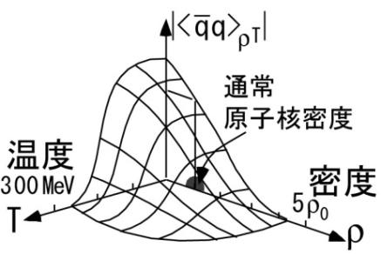
Physics motivation
E16 has been proposed to measure the spectral change of vector mesons in nuclear medium.
Spontaneously broken chiral symmetry and its (partial) restoration.
  Hadrons are excitations of QCD vacuum (ground state) and are affected by the vacuum property.
  Spectral change in nuclear medium provides information on the non-trivial structure of QCD vacuum at finite density.
Normal
nuclear density
Temperature
Density
Vacuum

Slide 4
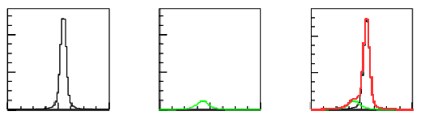
Probe: Vector meson→e⁺e⁻ invariant mass
Example: p + A → φ + X
Well-known
Inv. mass
In “vacuum”
Nucleus
e⁺
φ
e⁻
Proton
beam
＋
Mass
＋
Decays in “vacuum”
Without modification.
Modified mass
In nuclei.
Nucleus
e⁺
＝
Mass
＝
φ
e⁻
Observed
invariant
mass.
Proton
beam
Decays in nucleus.
With mass modified.
Mass
Lepton pair in the final state.
→ small final state interaction.

Slide 5
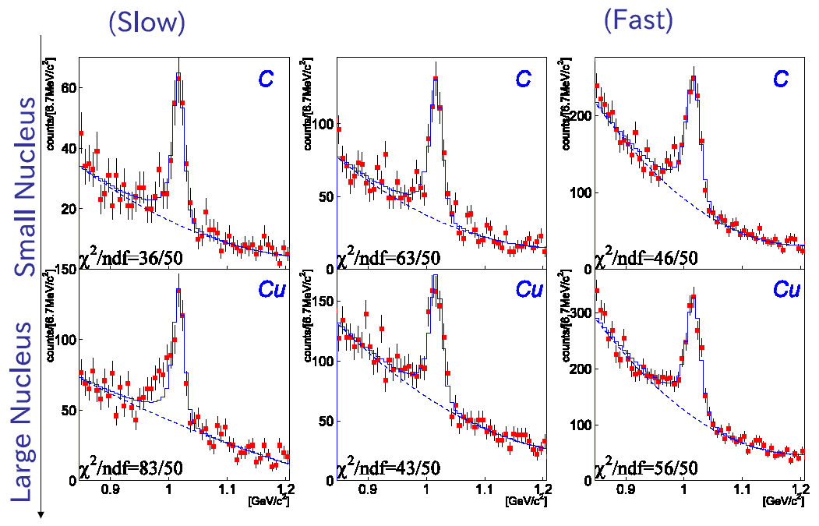
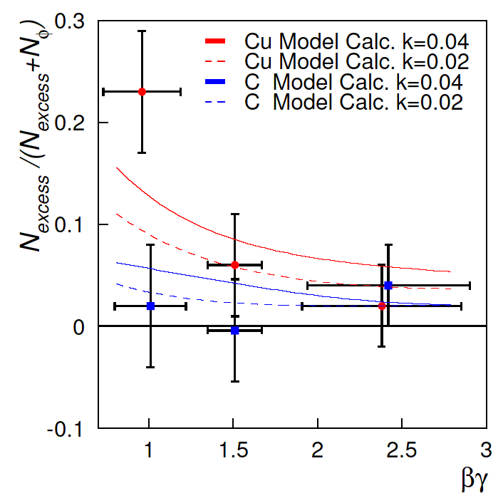
KEK-E325 results of φ meson
The world’s first results of φ modification.
βγ < 1.25
KEK-E325 results
Nuclear target
C, Cu
e⁺
φ meson
p + ⁶⁴Cu
φ
Red：⁶⁴Cu target
Blue: ¹²C target
e⁻
The fraction of Excess
12GeV (10⁹/spill)
Proton beam
Blue line represents
mass distribution
without mass modification.
Conclusion: Mass decreases in nuclei!!
  Under the assumption of linear dependence of mass and width on density.
    Mass: - 3.4 ^{+0.6}_{-0.7}% ↓
    Width: x 3.6^{+1.8}_{-1.2}
βγ = p/M of φ
At normal nuclear density

Slide 6
J-PARC E16 = 100 x KEK-E325
We decided to pursue this problem using
  The same reaction as KEK-E325 (p+A→φ X)
  with high stat x 100.
  with better resolution. σ < 10 MeV for φ
  J-PARC E16
    p + A → φ + X , φ → e+e-

Slide 7
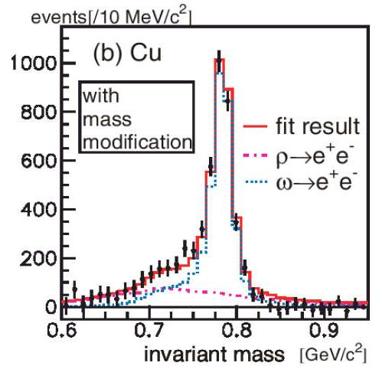
J-PARC E16 compared to other methods.
J-PARC E16
      p + A → φ + X , φ → e+e-
Other experiments
e+e- decay
  Small final state interactions
  Small branching ratio
φ meson
  Separated peak.
  Narrow (3.4 MeV)
  Lower stat.
Hadronic decay (π+π-, π⁰γ ,,)
  Suffer from final state interactions
  Large branching ratio.
ρ/ω mesons
  Overlapping peaks.
  Wide (ρ 150MeV)
  higher stat.
These disadvantages are
overcome by collecting
high statistics
ρ
ω

Slide 8
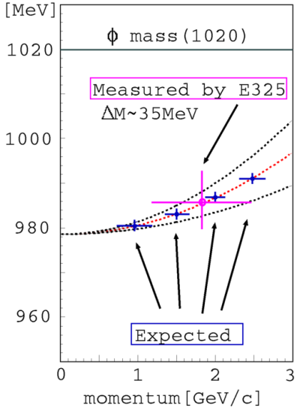
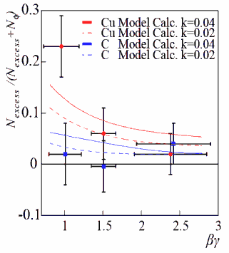
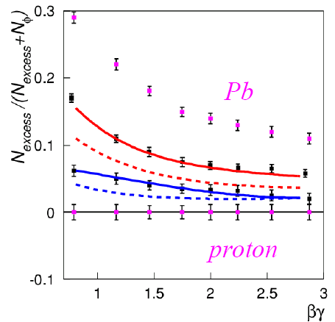
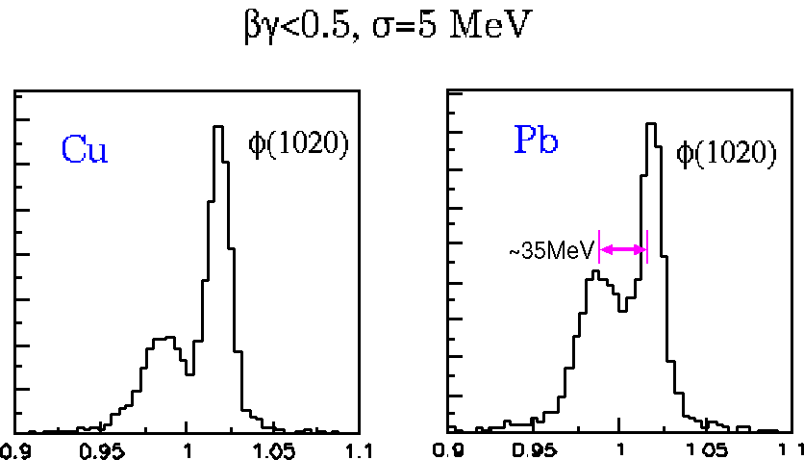
J-PARC E16 = 100 x KEK-E325
φ
KEK
J-PARC
KEK
Calc by S.H. Lee was
extrapolated to 3GeV/c
These three information can give further insights on this matter, thanks to High statistics in φ,
No peak near φ. Without complicated overlap.
Qualitatively new information can be obtained.

Slide 9
J-PARC E16 Collaboration
RIKEN
  S. Yokkaichi (spokesperson)
  H. En’yo
  Y. Komatsu
  F. Sakuma
  M. Sekimoto
KEK
  K. Aoki
  Y. Morino
  R. Muto
  K. Ozawa
  S. Sawada
RCNP
  H. Noumi
  T.N. Takahashi
Univ. of Tokyo
  K. Kanno
  S. Miyata
  H. Murakami
  W. Nakai
  Y. Obara
  T. Shibukawa
Kyoto Univ.
  M. Naruki
CNS (Univ. of Tokyo)
  Y.S. Watanabe
Hiroshima Univ.
  K. Shigaki
NiAS
  H. Hamagaki
JASRI
  A. Kiyomichi
Univ. Tsukuba
  T. Chujo
  S. Esumi
JAEA
  H. Sako
  S. Sato
  H.Sugimura
BNL
  T. Sakaguchi
Osaka Univ.
  R. Honda

Slide 10
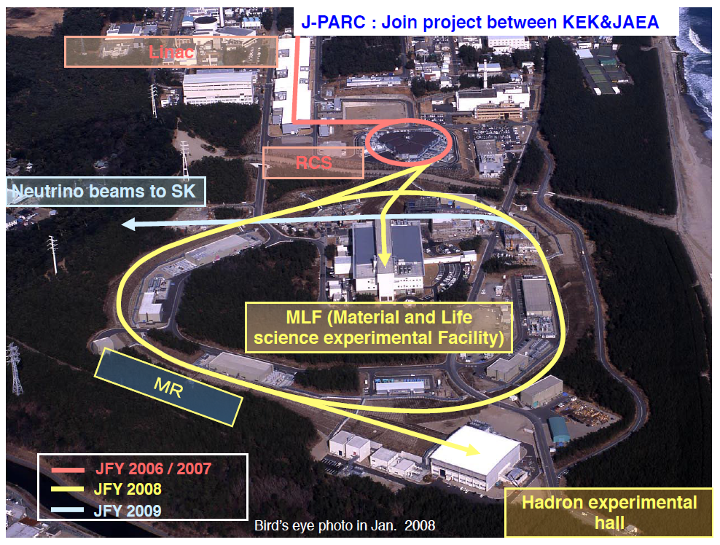
J-PARC (Proton Accelerator Research Complex)
Linac 400MeV
Neutrino beams
to Super K (T2K)
RCS 3GeV
MR 30 GeV
Switch Yard
30GeV proton
Slow extraction
Hadron Hall
Borrowed from Tadashi Koseki’s slide
Notes:
J-PARC: Japan Proton Accelerator Research Complex.
JAEA: Japan Atomic Energy Agency.
RCS: Rapid Cycling Synchrotron. 3GeV

Slide 11
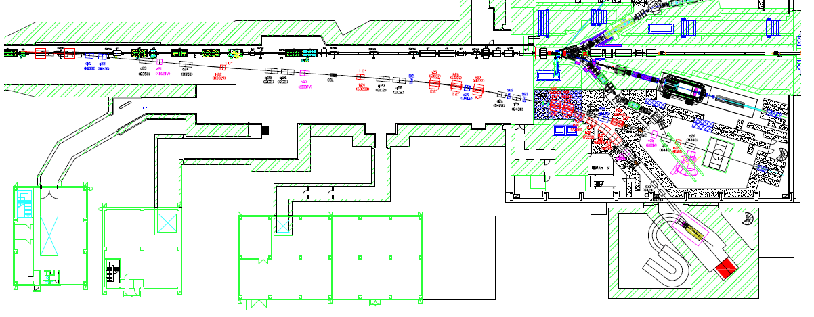
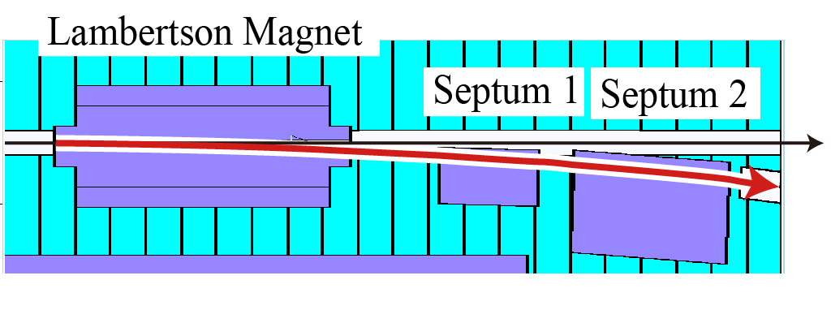
Beam Line at J-PARC Hadron Hall
30GeV proton --- 40 kW (5x10¹³ppp) as of 2016.
Switch Yard (SY)
Hadron Hall
K1.8BR
K1.8
Proton beam (30GeV) LINE-A
T1 target
K_{L}
High-p (LINE-B)
E16 spectrometer
~10¹⁰ ppp is stealed from LINE-A
To LINE-A
To LINE-B
LINE-B magnets at SY are placed except for LAMBERTSON/SEPTUMs.
They will be installed during 2017 summer shutdown.

Slide 12
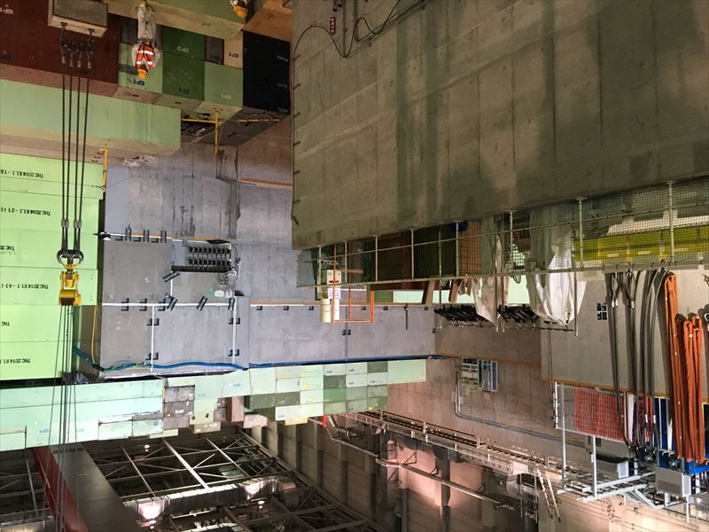
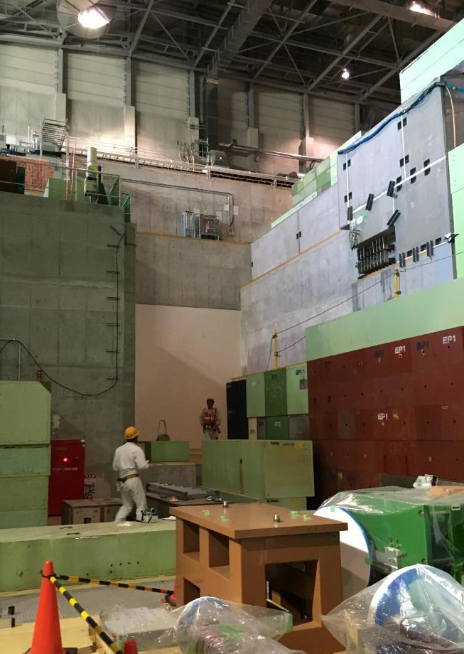
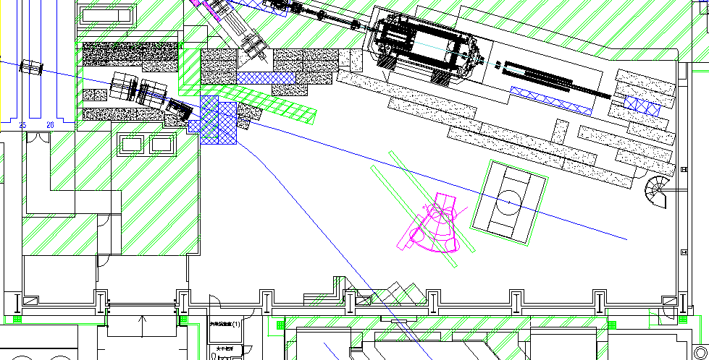
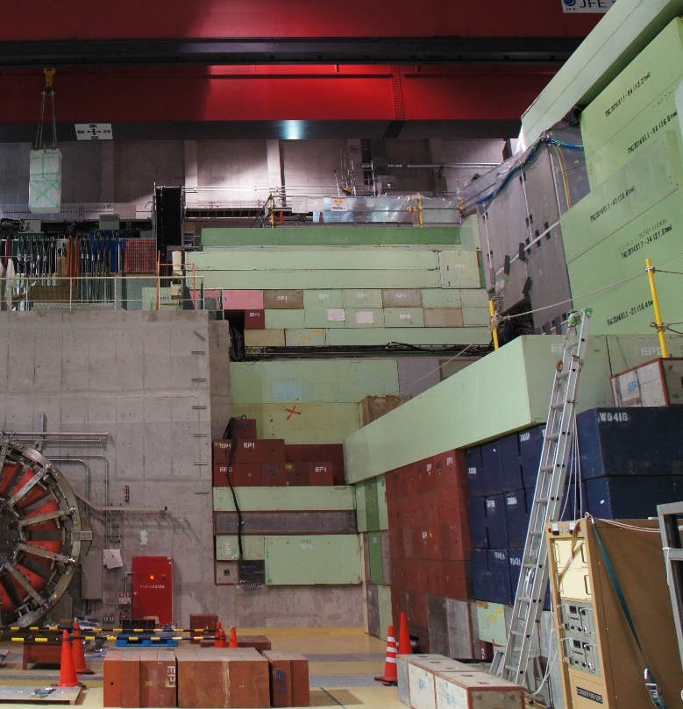
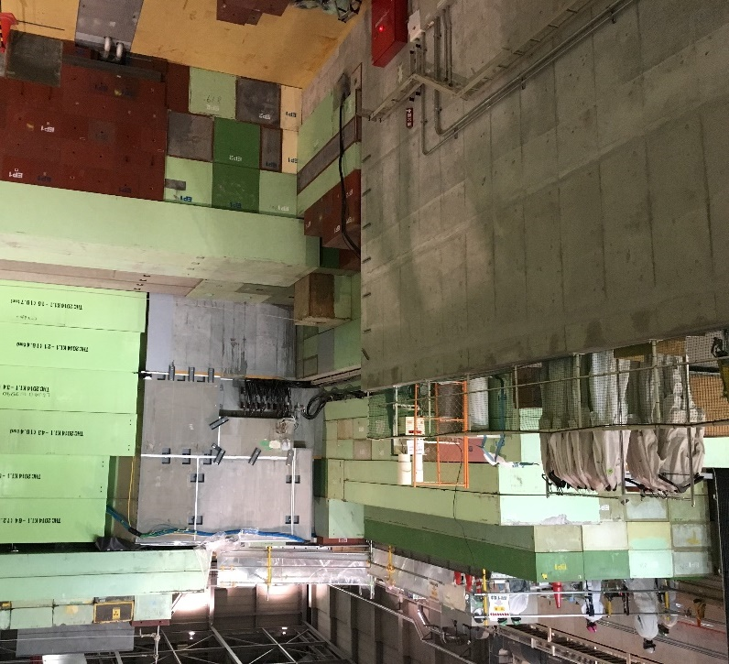
Beam line in Hadron hall
6.5m
10 m
GOAL of FY 2016
2016/Jul/19
2016/Mar

Slide 13
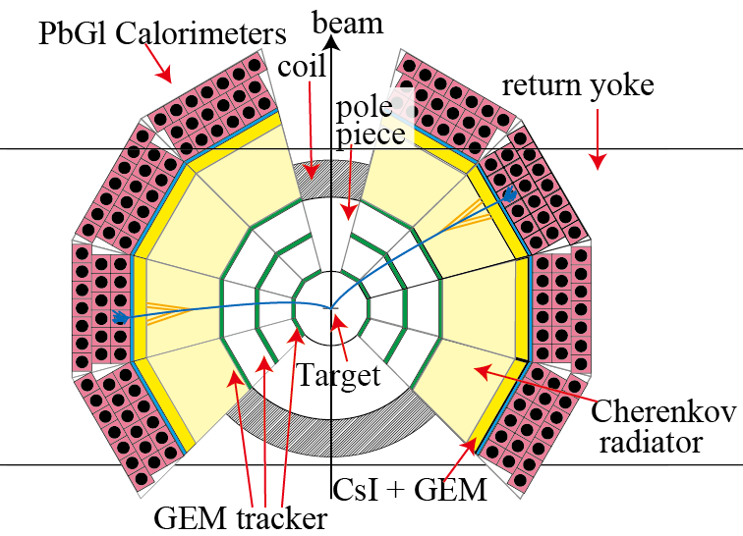
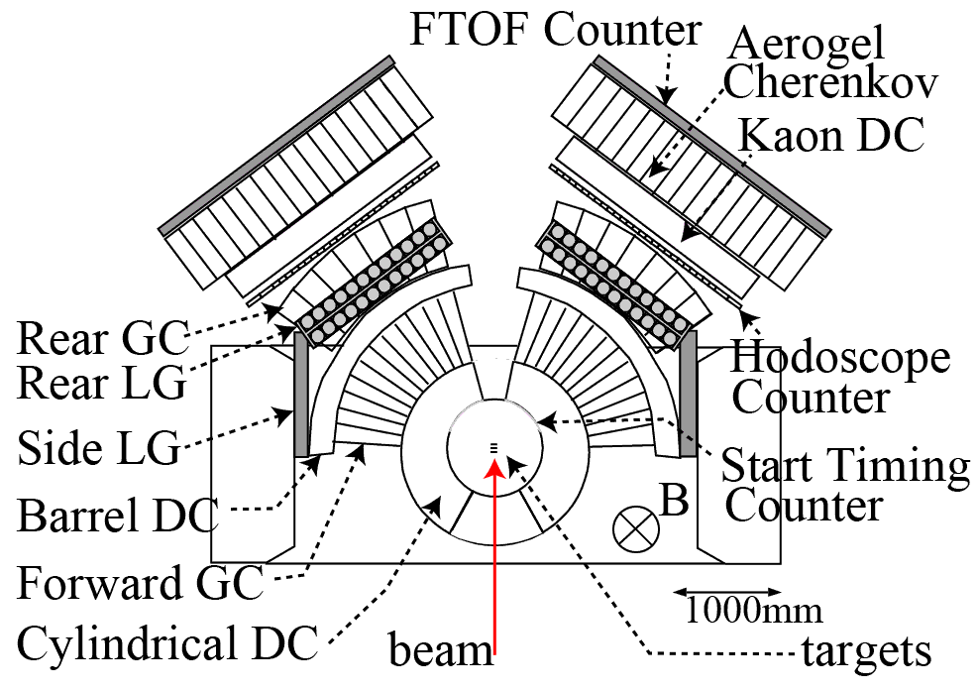
To achieve 100 times in statistics.
 | KEK- E325 | J-Parc E16
Proton beam | 10⁹ / spill 12GeV | 10¹⁰ / spill 30 GeV
Acceptance | (defined as) 1 | 5
Yield | ~2000 | ~ 2 x 10⁵
X １０
High rate capability
~5kHz/mm²
X ２（x-sec）
X ５
Large acceptance
spectrometer
yield x １００
KEK E325
J-PARC E16

Slide 14
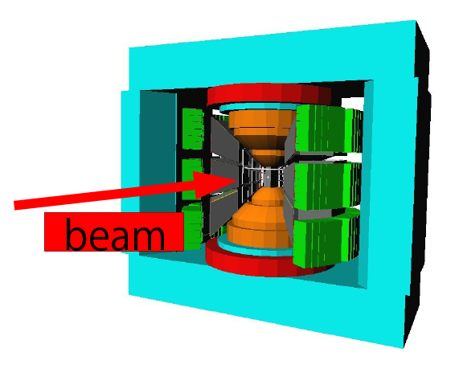
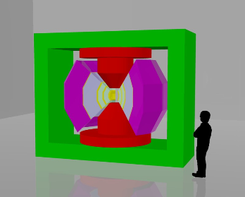
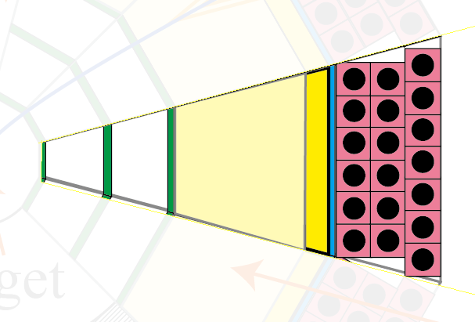
The J-PARC E16 spectrometer
Magnet (used for KEK E325)
A module
X 26
26 module in total.

Slide 15
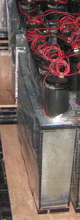
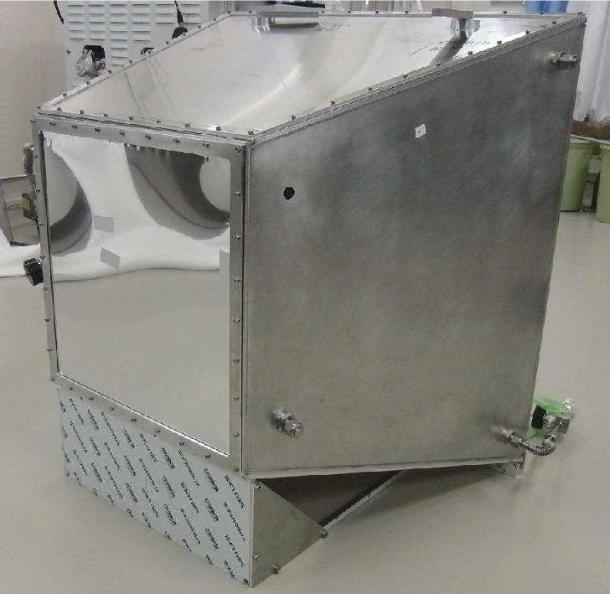
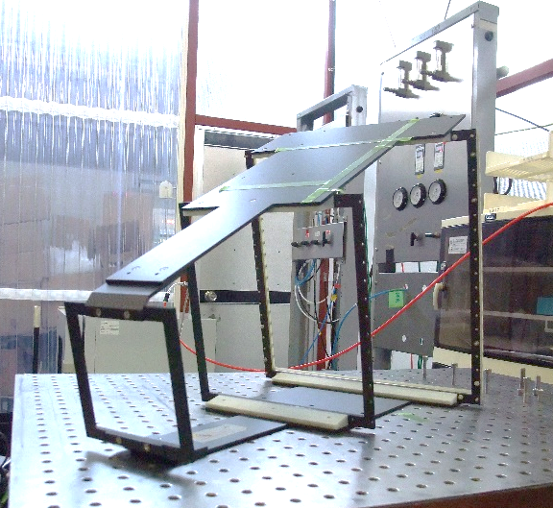
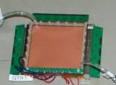
A module of the spectrometer
300 x 300
[mm²]
600 x 600
[mm²]
200 x 200
[mm²]
100 x 100
[mm²]
e⁻
Reuse from TRISTAN/TOPAZ
GEM tracker
Support frame
Hadron Blind Detector
(Cherenkov Detector.)
Pion rejection ~ 100
GTR (trackers)
・ 100 μm resolution
・ 5kHz/mm2 rate capability
PbGl Calorimeter
Pion rejection ~25
HBD

Slide 16
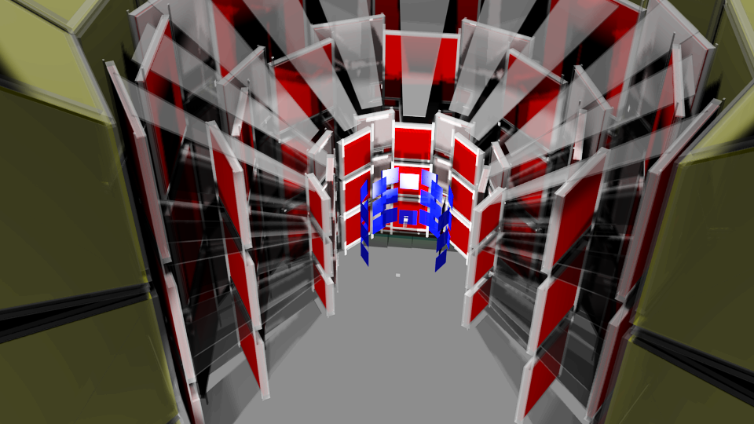
New subsystem : SSD
As explained later, the original design suffer from high rate environment.
We’ve decided to add new subsystem SSD.
  Fine segmented (80um) and fast detector adds robustness for high rate environment and reduces fake tracks.
  Adds redundancy for tracking. ( Four layers in total.)
The decision has been made very recently, so some simulation results are still GTR only configuration. Efforts on going.
SSD
GTR1
(HBD)
GTR3
GTR2

Slide 17
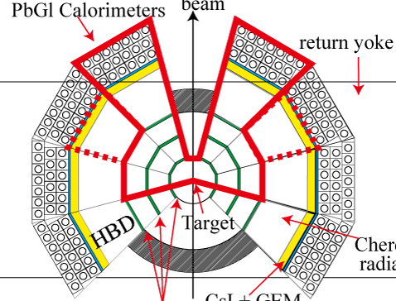
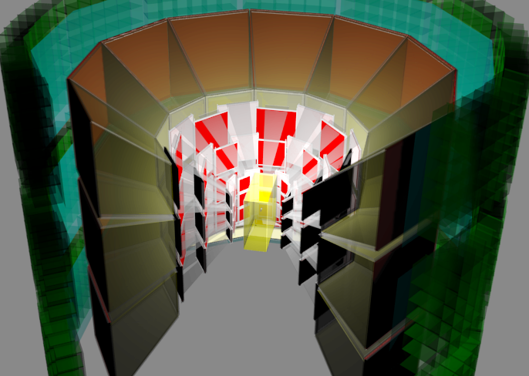
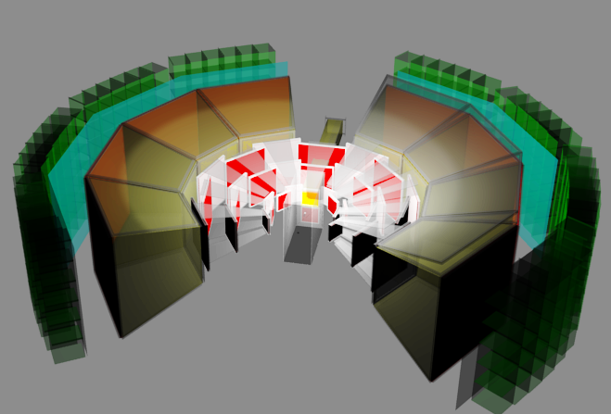
Strategy towards the final goal
Configuration for 1st physics run (2019?)
  Depending on the budget condition,
  We may start with a limited acceptance
    6 (SSD) + 6 (GTR) + 2 (HBD) + 2 (LG) (minimum setup) or
    8 (SSD) + 8 (GTR) + 8 (HBD) + 8 (LG) with additional budget.
Finally, we build 26 modules to obtain physics results which we’ve been advertising for long time!
Minimum setup
8 modules
Full setup (26 modules)

Slide 18
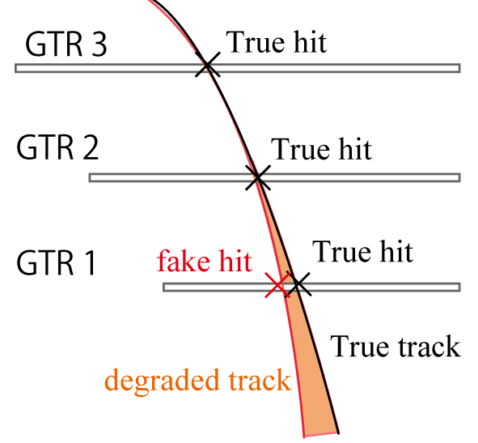

Simulation w/ realistic BG.
Simulation with realistic BG has been performed.
  Includes random hit BG. (5kHz/mm2)
    Shown at first.
  Includes Combinatorial BG.
    major BG
    Shown later
Effects of random hit BG
γ
dilepton??
π⁰
e⁺
e⁻
e⁺
π⁰
e⁻
γ

Slide 19
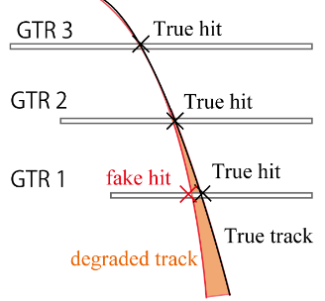
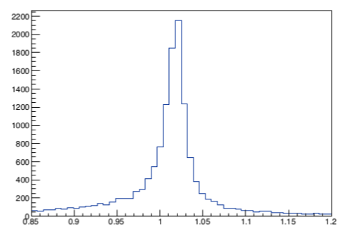
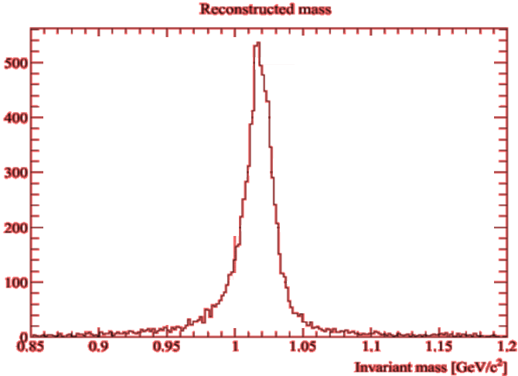
Simulation includes random hit BG.
Case 1: GTR only
  10¹⁰ /spill was turned out to be too high.
  “1 / 3 beam intensity”
    (0.33 x 10¹⁰ / spill. )
Case 2: GTR + SSD
  Full beam can be accepted.
    (1 x 10¹⁰ / spill. )
φ (1020)
w/o BG
σ = 8.0 MeV
for all βγ
φ (1020)
W/ “1/3” BG
σ = 9.0 MeV
for all βγ
φ (1020)
w/o BG
σ = 8 MeV
for all βγ
φ (1020)
SSD w/ BG
σ = 8.7 MeV
for all βγ
Tails on both sides are due to BG hits very close to the true hit.
case 1: Even with this configuration, we can do physics.
case 2: Tails greatly reduced. Better resolution.
We decided to go case 2. Evaluation ongoing.

Slide 20
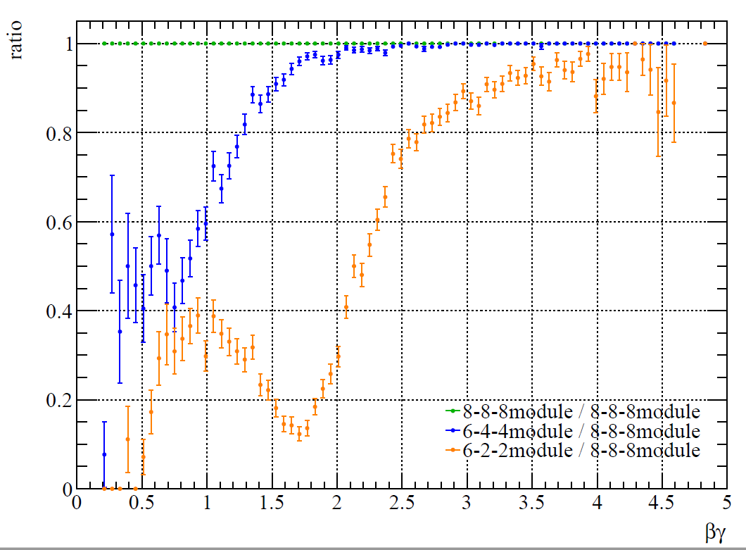
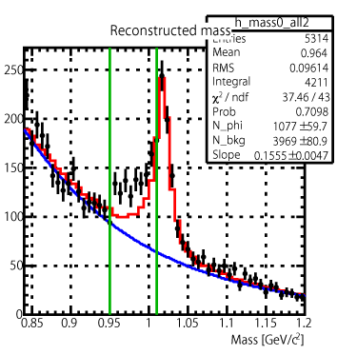
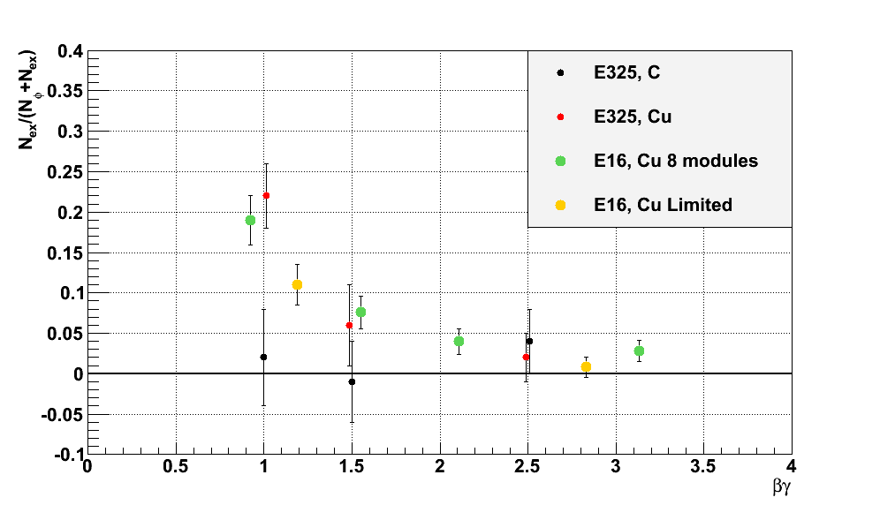
Expected from 1st RUN case 1 (GTR only)
1st physics RUN:
160 shifts (53 days)
1/3 beam intensity (0.33 x 10^10/spill)
8+8+8
βγ < 1.25
Fraction of excess
With the help of SSDs, we can accept full beam intensity,
We can collect 2 times more statistics w/ slightly better resolution.
Evaluation ongoing.

Slide 21
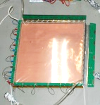
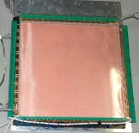
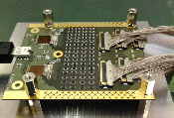
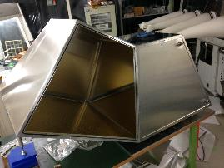
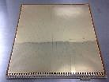
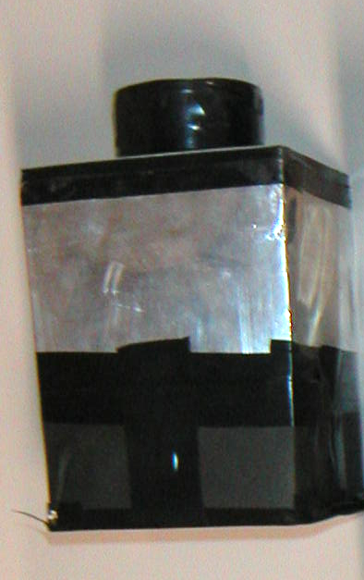
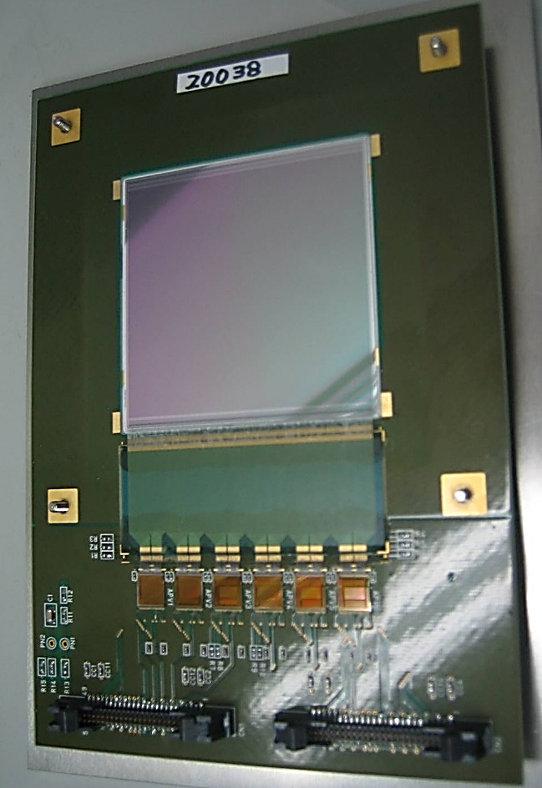
Preparation Status for 1st RUN
In a few words.
Each detector components (GTR/HBD/LG/SSD)
  R & D have finished.
  New subsystem SSD: K. Tanida’s
  Majority of the components are already delivered.
Readout electronics: almost finished.
  Preamp : R&D done. Already purchased.
  Trigger related electronics
    Under prototype test. If OK → mass production
DAQ :
  Most modules already purchased.
Support structure : in progress.
  GTR : good.
  SSD : will be started.
  HBD : in progress.
  LG : in progress.
ADC
FTSW
UT3

Slide 22
Summary
E16 use p+A→ρωφ → e+e- and measure the spectral change of vector meson in nuclear medium.
Final goal of E16 experiment is shown.
Beam line status is shown.
The detector configuration and its new subsystem SSD is introduced.
Detailed detector simulation with realistic background is shown.
  Expected results from 1st physics run with GTR is shown.
  With the help of SSD, factor of 2 more statistics is expected compared to GTR only case.
Evaluation of the new setup w/ SSD is ongoing.
Preparation status.

