Slide 1
Structure of light kaonic nuclei and kaon-nucleon interaction
Shota Ohnishi (Hokkaido Univ.)
In collaboration with
Wataru Horiuchi (Hokkaido Univ.)
Tsubasa Hoshino (Hokkaido Univ.)
Kenta Miyahara (Kyoto Univ.)
Tetsuo Hyodo (YITP, Kyoto Univ.)

Slide 2



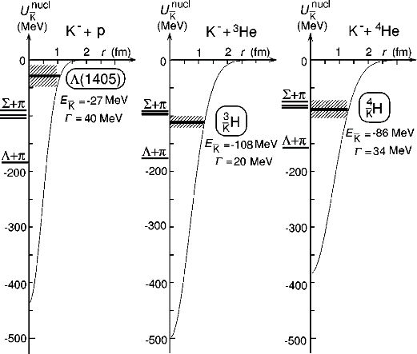
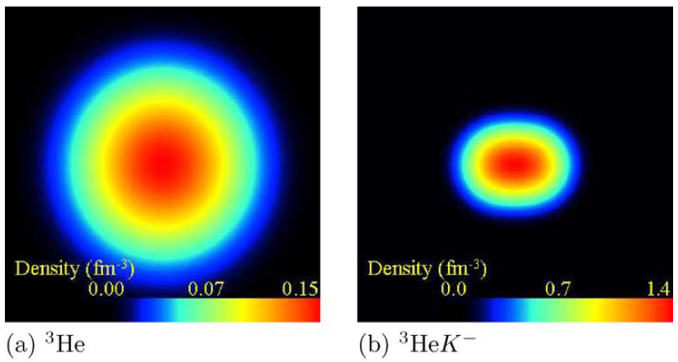
Kaonic nuclei
Λ(1405); J^{π}=1/2⁻, S= -1
  q^3(uds): P-wave excited state
    (much higher mass expected than experimental observation)
  unstable bound state
u
s
d
Isgur, Karl, PRD 18, 4187(1978).
  Dalitz, Wong, Tajasekaran, PR 153(1967)1617.
strongly attractive interaction in I=0, L=0
deeply bound and high density systems are proposed
- phenomenological potential and optical potential/ g-matrix approach
Dote, et. al., PLB590, 51(2004).
Y. Akaishi, T. Yamazaki, PRC 65, 044005 (2002).

Slide 3
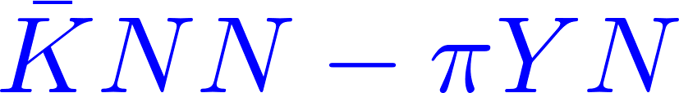
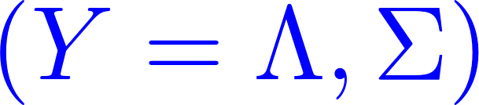
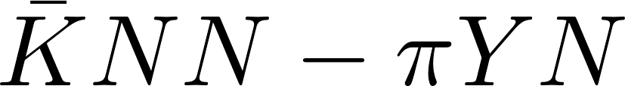



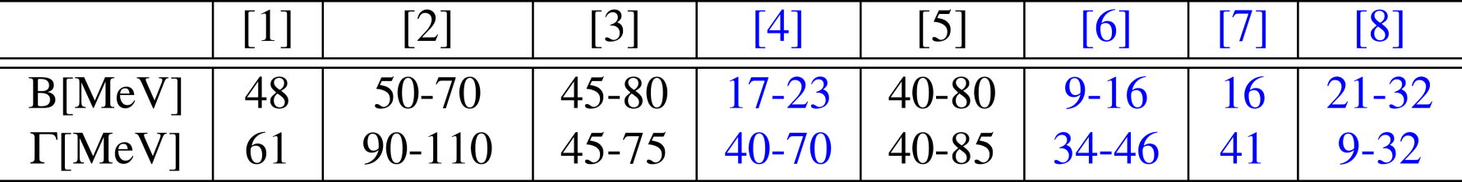
strange dibaryon
Deeply binding and compressed systems?
A test ground: three-body system (strange-dibaryon)
many particle dynamics can be examined accurately
theoretical investigations:
interactions | Phenomenological | Chiral SU(3)
Variational | Akaishi, Yamazaki[1] Wycech, Green[5] | Doté, Hyodo, Weise[4] Barnea, Gal, Liverts[7] Dote, Inoue, Myo[8]
Faddeev eqs. | Shevchenko, Gal , Mares[2] | Ikeda, Sato[3] Ikeda, Kamano, Sato[6]
Black；E-indep.
Blue；E-dep.
[1] Akaishi, Yamazaki, PRC 65, 044005 (2002).
[2] Shevchenko, Gal, Mares, PRL. 98, 082301 (2007).
[3] Ikeda, Sato, PRC 76, 035203 (2007).
[4] Dote, Hyodo and Weise, NPA 804, 197 (2008).
[5] Wycech and A. M. Green, PRC 79, 014001 (2009).
[6] Ikeda, Kamano, Sato, PTP 124, 533 (2010).
[7] Barnea, Gal, Liverts, PLB 712, 132(2012).
[8] Dote, Inoue, Myo, PTEP 2015, 043D02(2015).
This difference is enhanced in kaonic nuclei

Slide 4
Strategy of this work
Y. Akaishi, T. Yamazaki, PRC 65, 044005 (2002).
Dote, et. al., PLB590, 51(2004).
Many-body
approximation
Optical potential
g-matrix interaction
AY-potential
Phenomenological
Energy independent
Deeply binding and compressed systems
?
This works
How structure of light nuclei is changed by injected kaon?
SIDDHARTA pot.
Chiral SU(3) dynamics
Energy dependent
Few-body approach
Correlated Gaussian basis
Stochastic variational method
Three- to seven-body calc.
Miyahara, Hyodo,
PRC 93 (2016) 1, 015201.
Varga, Suzuki,
Phys. Rev C52 (1995) 2885.

Slide 5
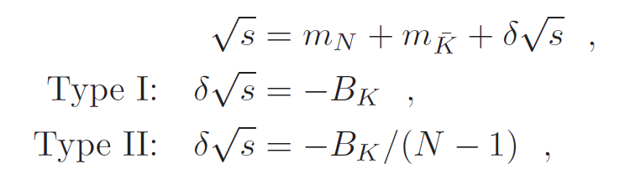



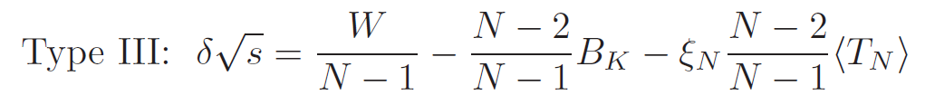
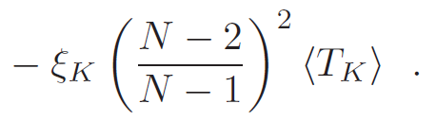

K^{bar}N interactions
  SIDDHARTA potential
  Energy-dependent K^{bar}N single-channel potential
  Reproduce the scattering amplitude by chiral SU(3) dynamics using driving
  interaction at NLO
  Pole energy: 1424 - 26i and 1381 – 81i MeV
  K^{bar}N two-body energy in N-body systems are determined as:
  We also use Akaishi-Yamazaki (AY) potential to investigate KN potential
  dependence
K.Miyahara, T.Hyodo, PRC 93 (2016) 1, 015201.
Y.Ikeda, T.Hyodo, W.Weise, NPA881 (2012) 98 .
for N-body
A. Dote, T. Hyodo, W. Weise, NPA804, 197 (2008).
N. Barnea, A. Gal, E. Liverts, PLB712, 132 (2012).
Akaishi, Yamazaki, PRC65, 04400(2002).

Slide 6

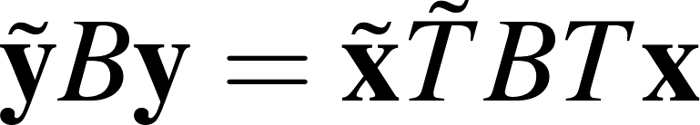
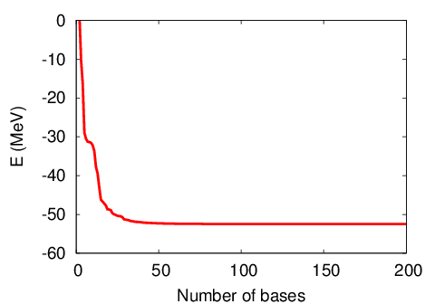
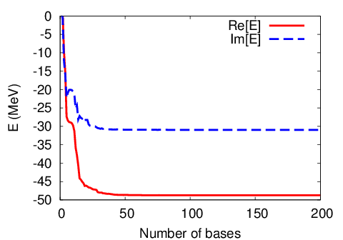
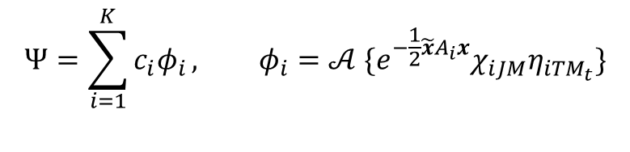
Correlated Gaussian basis
Varga, Suzuki, Phys. Rev C52 (1995) 2885.
Varga, Suzuki, Comp. Pnys. Com. 106 (1997) 157.
$$Ψ=\sum_{i=1}^{K}{c_{i}φ_{i}}, φ_{i}=𝒜 \{e^{−\frac{1}{2}\tilde{x}A_{i}x}χ_{iJM}η_{iTM_{t}}\}$$
$A_{i}:\left(N−1\right)×\left(N−1\right) matrix (paramaters of coordinates )$
for N-body
$x=\left\{x_{1}, x_{2},…, x_{N−1}\right\}$, $χ_{iJM}:spin function$, $η_{iTM_{t}}:isospin function$
Higher partial wave for each x_{i} are included by off-diagonal component of A_{i}.
Matrix elements are analytically calculable for N-body systems
Functional form of the correlated Gaussian remains unchanged
under the coordinate transformation
Stochastic variational method
To obtain the well variational
basis, we increase the basis
size one-by-one by searching
for the best variational
parameter A_{i} among many
random trials
Diagonalize full complex Hamiltonian
by using basis optimized for the
real part of the Hamiltonian
x₂
x₁
y₃
y₂
x₃
y₁
Energy convergence curve for KNN

Slide 7
Structure of kaonic nuclei (N=3-5)
Binding energies are similar values for Type I, II, and III
Width of Type II is 2-3 times larger than Type I and III
Binding energy for AY-potential is less than 100 MeV

Slide 8
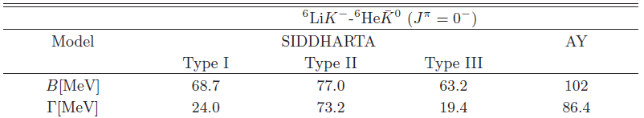

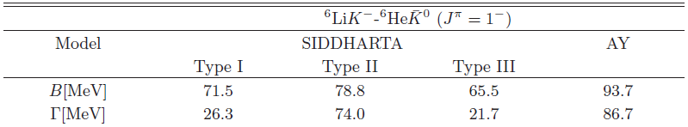
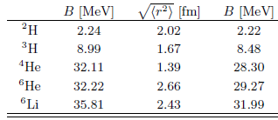
Structure of K^{bar}NNNNNN with J^{π}=0⁻ and 1⁻
(0)
(1)
Binding energy for SIDDHARTA potential is 63-77 MeV for 0⁻ and 66-79 MeV for 1⁻
Binding energy for AY-potential is about 102 MeV (0⁻) and 94 MeV (1⁻)
0⁻ and 1⁻ state are almost degenerate for SIDDHARTA potential, but the binding energy of 1⁻ state is smaller than 0⁻ state for AY potential
From the energy spectra of seven-body system, we may extract the information of KN interaction

Slide 9




Structure of K^{bar}NNNNNN with J^{π}=0⁻ and 1⁻
A=2
A=6
 | NN | KNN
J=0 | unbound | bound
J=1 | bound (d) | unbound
⁶Li
0⁺
1⁺
0⁻
1⁻
⁶Li K⁻
1⁻
0⁻
SIDDHARTA
AY
Binding energy for SIDDHARTA potential is 63-77 MeV for 0⁻ and 66-79 MeV for 1⁻
Binding energy for AY-potential is about 102 MeV (0⁻) and 94 MeV (1⁻)
0⁻ and 1⁻ state are almost degenerate for SIDDHARTA potential, but the binding energy of 1⁻ state is smaller than 0⁻ state for AY potential
From the energy spectra of seven-body system, we may extract the information of KN interaction

Slide 10
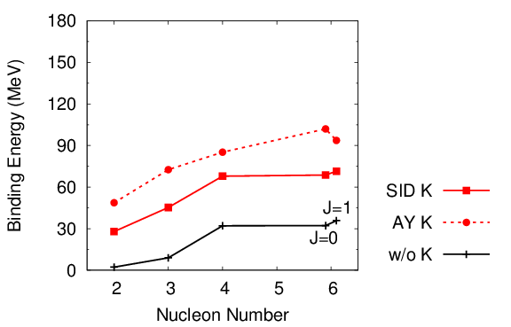



N number dependence of B.E.
(averaged value)
# KN pare = # N
× # K
How depends on Kaon number?

Slide 11
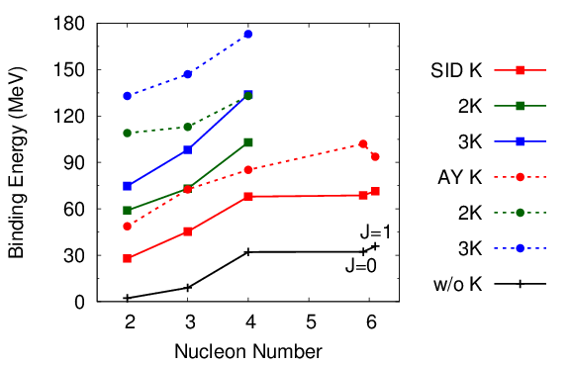







N and K number dependence of B.E.
Preliminary
(averaged value)
Difference of KN interaction
is enhanced in multi kaonic nuclei

Slide 12

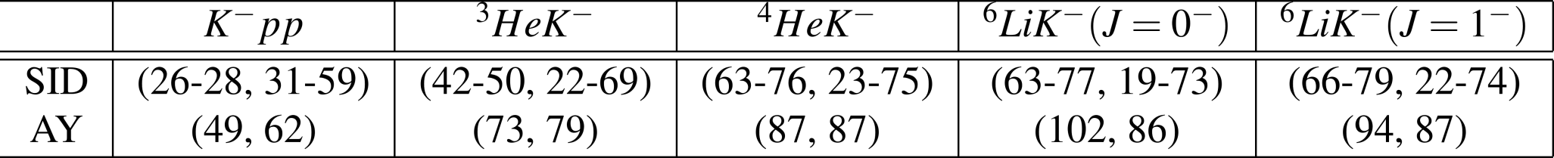

Summary
We have investigated the structure of light kaonic nuclei, K^{bar}NN, K^{bar}NNN, K^{bar}NNNN and K^{bar}NNNNNN
In the seven-body systems, J^{π}=1⁻ and 0⁻ states are degenerate for SIDDHARTA potential, but 0⁻ state is ground state for AY potential
Difference between B.E. for SIDDHARTA and AY is ,
, .
Future plan
Channel-coupling between K^{bar}N- πΣ
Kaonic atom (T. Hoshino, S.O, W. Horiuchi)

Slide 13
NN interaction
AV4’ potential: {1, σ.σ, τ.τ, σ.στ.τ}
R.B.Wiringa, S.C.Pieper, PRL89,182501 (2002).

Slide 14
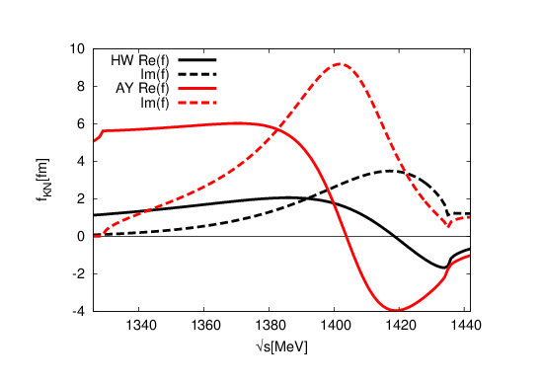
Pole position of Λ(1405) and energy dependence of potential
Hyodo, Weise, PRC77, 035204 (2008).
Phenomenological potential
Chiral SU(3) dynamics
Akaishi, Yamazaki, PRC65, 04400(2002).
Shevchenko, PRC85, 034001(2012).
Kaiser, Siegel, Weise, NPA594, 325(1995).
Oset, Ramos, NPA635, 99(1998).
Hyodo, Jido, PPNP67, 55(2012).
Λ(1405), one pole
Energy independent
Λ(1420), two pole
Energy dependent
This difference is enhanced in
kaon-nucleus quasi-bound states

Slide 15
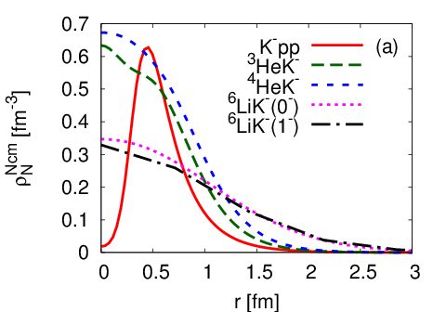
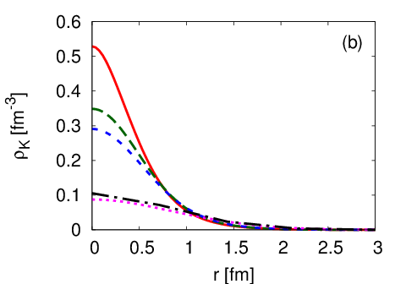
N and K distribution

Slide 16
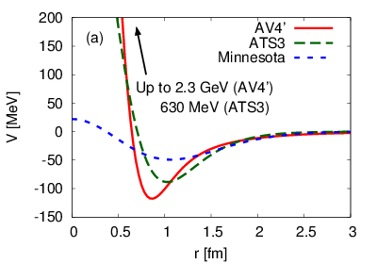
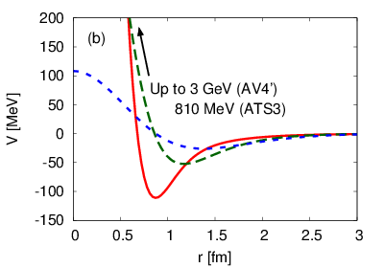
Dependence on NN interaction
³E
¹E
We investigate the NN interaction dependence by using
AV4’, ATS3, and Minnesota potential model,
which well reproduce the binding energy of s-shell nuclei

Slide 17
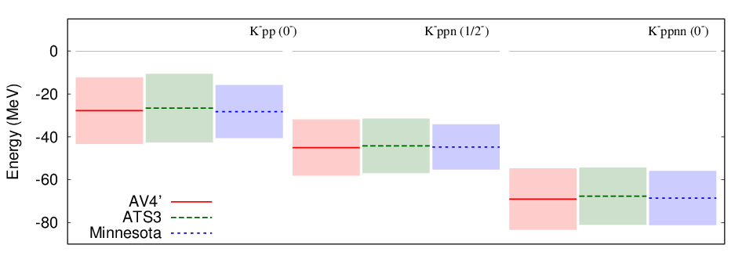
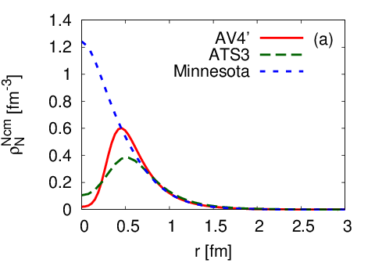
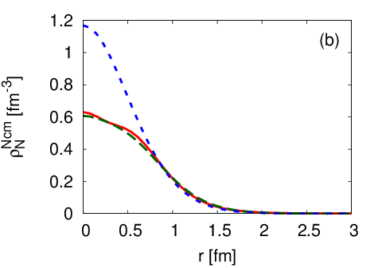
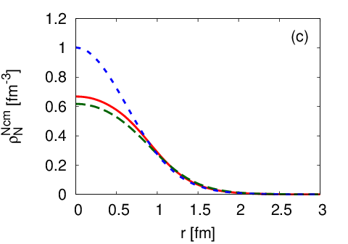
Dependence on NN interaction
Binding energy and decay width
Binding energy and
decay width are not
sensitive to NN
interaction model
Nucleon distribution
AV4’ and ATS3 potential with strong repulsive core produce similar density distribution,
but the central density for Minnesota potential with soft core become high.

Slide 18
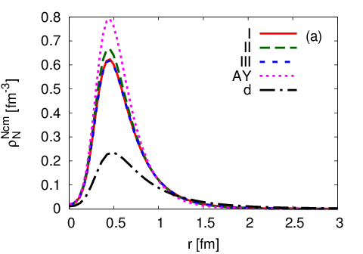
Density distribution of K⁻pp-K^{0bar}pn
Nucleon distribution from C.M. of NN
(deuteron is J=1)
Central density for SIDDHARTA potential is slightly smaller than density for AY-potential

Slide 19
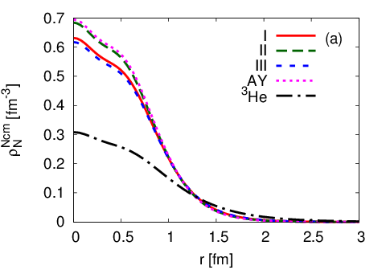
Density distribution of K⁻ppn-K^{0bar}pnn
Nucleon distribution from C.M. of NNN
Central nucleon density ρ(0)~0.6fm⁻³ is two times larger than ³He, but smaller than the density ρ(0)=1.4 fm⁻³ predicted by g-matrix effective KN and NN interactions
Dote, et. al., PLB590, 51(2004).

Slide 20
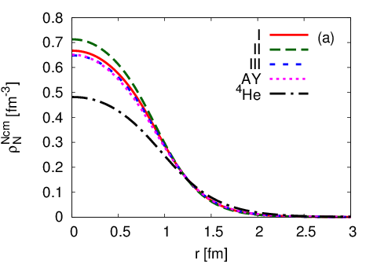
Density distribution of K⁻ppnn-K^{0bar}pnnn
Nucleon distribution from C.M. of NNNN
Central nucleon density ρ(0)~0.7fm⁻³ is 1.5 times larger than ⁴He

Slide 21
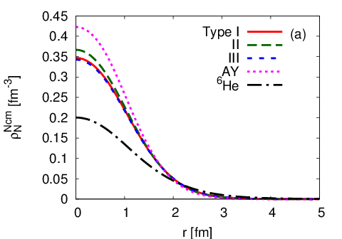
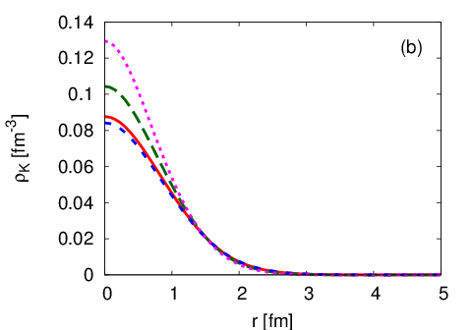
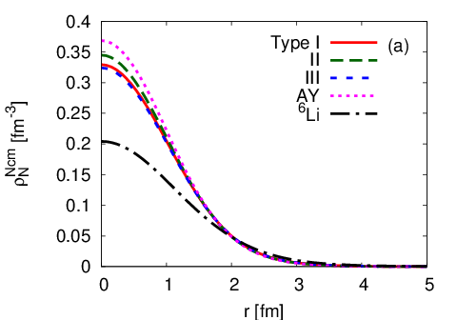
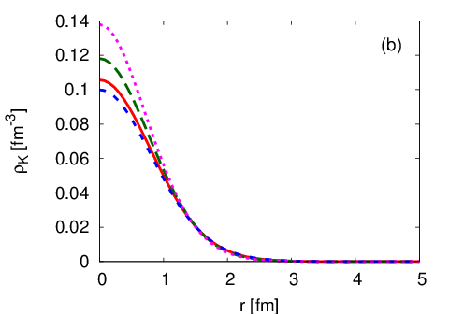
Density distribution of K⁻pppnnn-K^{0bar}ppnnnn
J^{π}=0-
J^{π}=1-

Slide 22
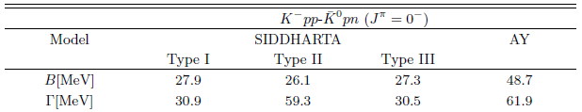



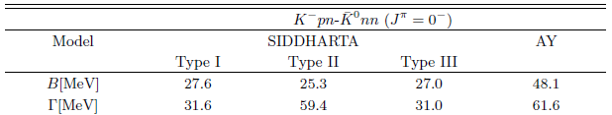


Structure of K^{bar}NN with J^{π}=0⁻
Coulomb splitting is small (~0.5MeV)
Binding energies are almost same between
Type I, II, and III, but width of Type II is two times larger than Type I and III
Binding energy for AY-potential is 48 MeV
The radii for AY-potential become smaller than SIDDHARTA potential

Slide 23
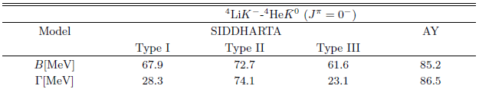

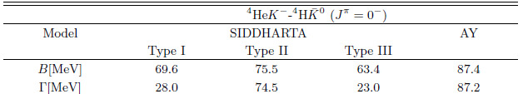

Structure of K^{bar}NNNN with J^{π}=0⁻
Coulomb splitting is large (~2 MeV), since Coulomb effect is repulsive for ⁴HeK⁰, but attractive for ⁴HeK⁻
Binding energy is about 60-75 MeV for SIDDHARTA potential
width of Type II is three times larger than Type I and III
Binding energy for AY-potential is about 86 MeV

Slide 24





Gamow vector

Slide 25
Correlated Gaussian basis
Varga, Suzuki, Phys. Rev C52 (1995) 2885.
Varga, Suzuki, Comp. Pnys. Com. 106 (1997) 157.
$$Ψ=\sum_{i=1}^{K}{c_{i}φ_{i}}, φ_{i}=𝒜 \{e^{−\frac{1}{2}\tilde{x}A_{i}x}χ_{iJM}η_{iTM_{t}}\}$$
$A_{i}:\left(N−1\right)×\left(N−1\right) matrix (paramaters of coordinates )$
$x=\left\{x_{1}, x_{2},…, x_{N−1}\right\}$, $χ_{iJM}:spin function$, $η_{iTM_{t}}:isospin function$
Correlated Gaussian basis represent the total angular momentum L=0,
but higher partial wave for each x_{i} are included by off-diagonal component of A_{i}.
Matrix elements are analytically calculable for N-body systems
Functional form of the correlated Gaussian remains unchanged
under the coordinate transformation
Stochastic variational method
To obtain the well variational
basis, we increase the basis
size one-by-one by searching
for the best variational
parameter A_{i} among many
random trials
Diagonalize full complex Hamiltonian
by using basis optimized for the
real part of the Hamiltonian
x₂
x₁
y₃
y₂
x₃
y₁
Energy convergence curve for KNN

Slide 26
Correlated Gaussian basis
Varga, Suzuki, Phys. Rev C52 (1995) 2885.
Varga, Suzuki, Comp. Pnys. Com. 106 (1997) 157.
$$Ψ=\sum_{i=1}^{K}{c_{i}φ_{i}}, φ_{i}=𝒜 \{e^{−\frac{1}{2}\tilde{x}A_{i}x}χ_{iJM}η_{iTM_{t}}\}$$
$A_{i}:\left(N−1\right)×\left(N−1\right) matrix (paramaters of coordinates )$
$x=\left\{x_{1}, x_{2},…, x_{N−1}\right\}$, $χ_{iJM}:spin function$, $η_{iTM_{t}}:isospin function$
Correlated Gaussian basis represent the total angular momentum L=0,
but higher partial wave for each x_{i} are included by off-diagonal component of A_{i}.
Matrix elements are analytically calculable for N-body systems
Functional form of the correlated Gaussian remains unchanged
under the coordinate transformation
Stochastic variational method
To obtain the well variational
basis, we increase the basis
size one-by-one by searching
for the best variational
parameter A_{i} among many
random trials
Diagonalize full complex Hamiltonian
by using basis optimized for the
real part of the Hamiltonian
x₂
x₁
y₃
y₂
x₃
y₁
Energy convergence curve for KNN

Slide 27




K^{bar}N interactions
  SIDDHARTA potential
  Reproduce the scattering amplitude by chiral SU(3) dynamics using driving
  interaction at NLO
K.Miyahara, T.Hyodo, PRC 93 (2016) 1, 015201.
Y.Ikeda, T.Hyodo, W.Weise, NPA881 (2012) 98 .
Chiral SU(3) dynamics
Description of S=-1, K^{bar}N s-wave scattering
Interaction ← chiral symmetry
Amplitude ← unitarity in coupled channel
Kaiser, Siegel, Weise, NPA594, 325(1995).
Oset, Ramos, NPA635, 99(1998).
Hyodo, Jido, PPNP67, 55(2012).

Slide 28
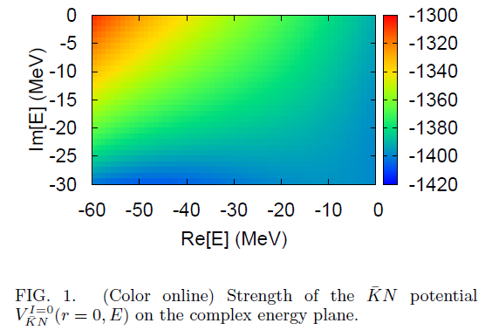

Slide 29
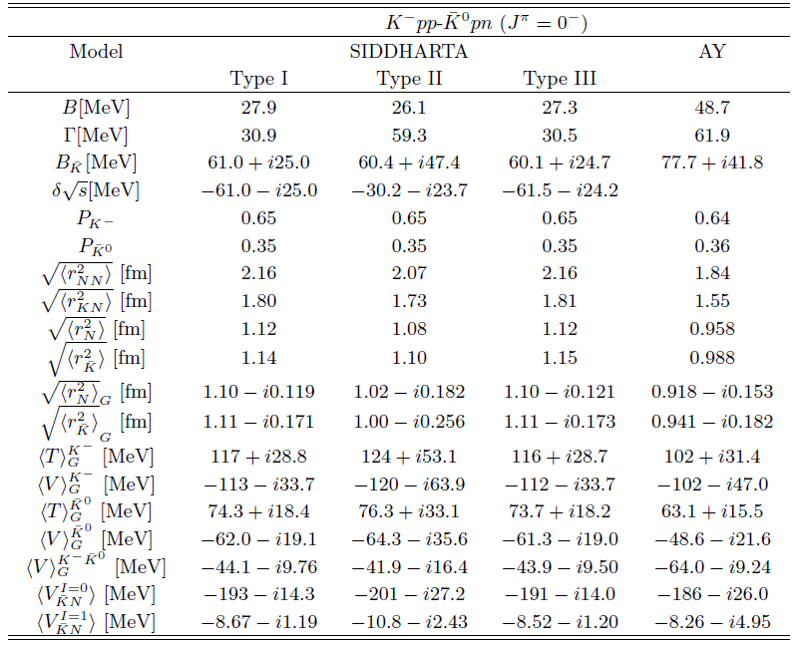

Slide 30
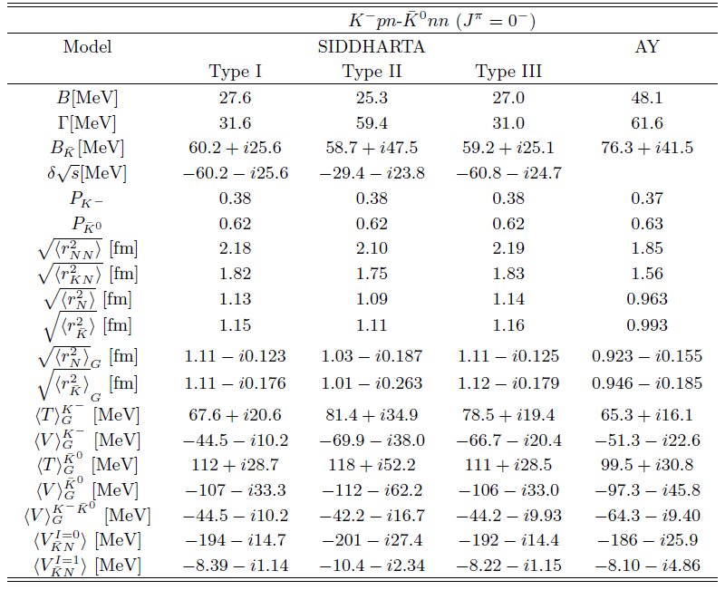

Slide 31
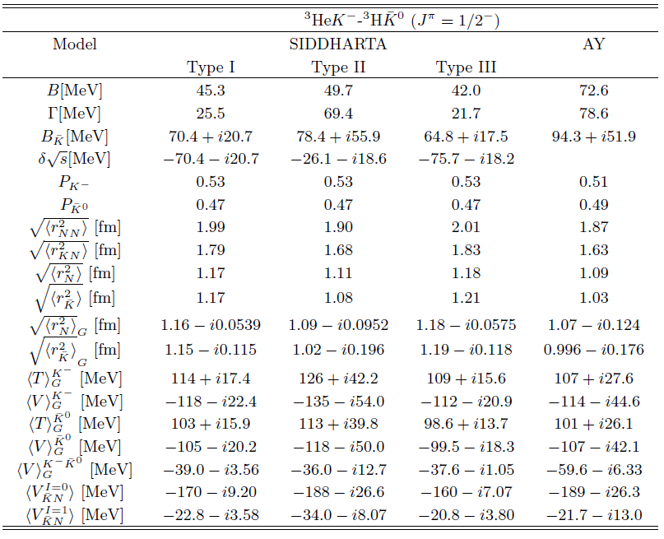

Slide 32
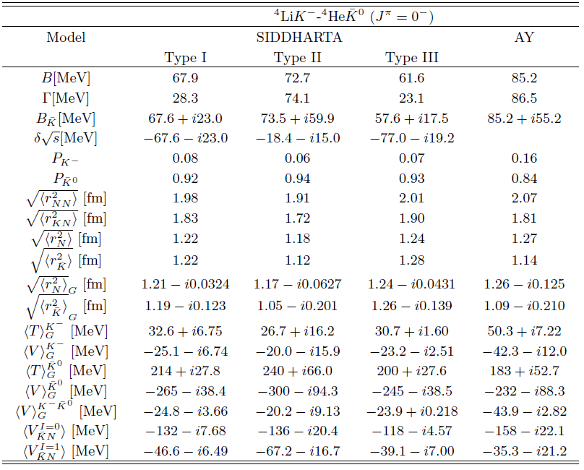

Slide 33
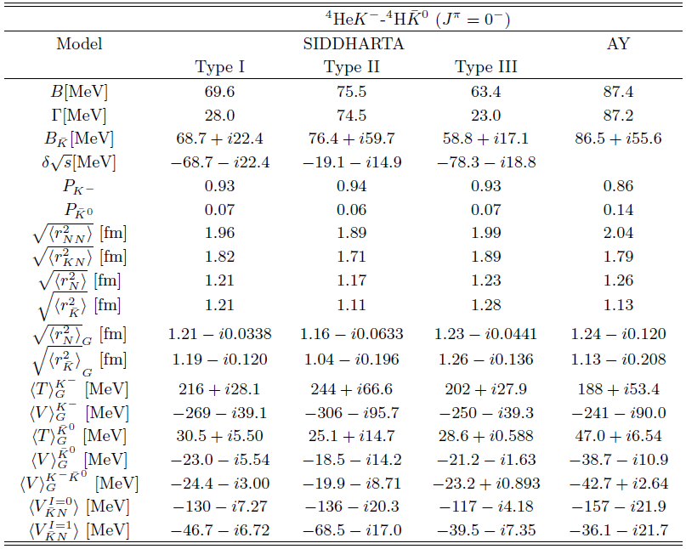

Slide 34
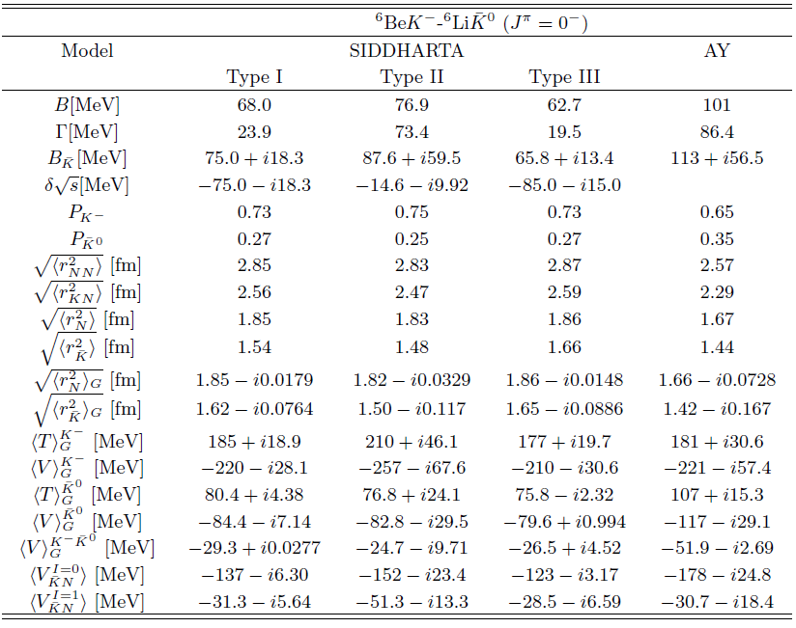

Slide 35
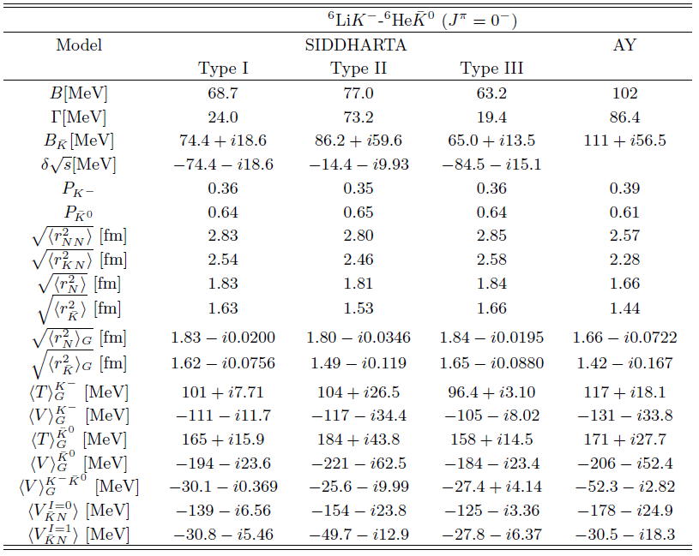

Slide 36
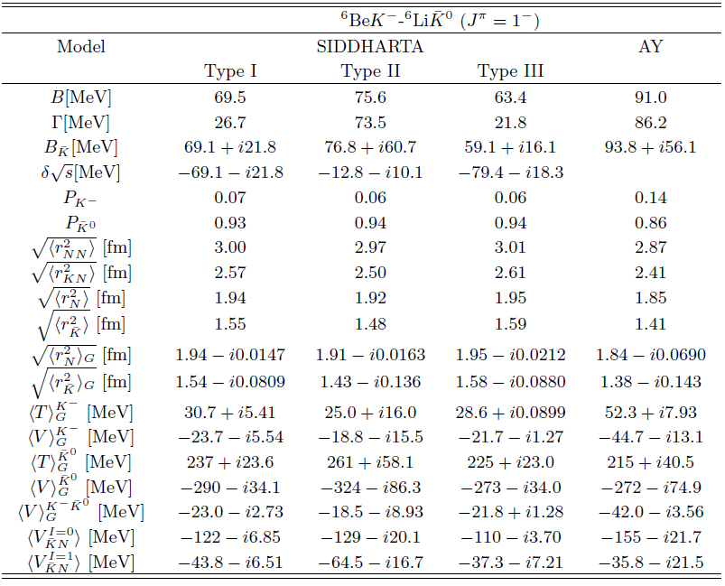

Slide 37
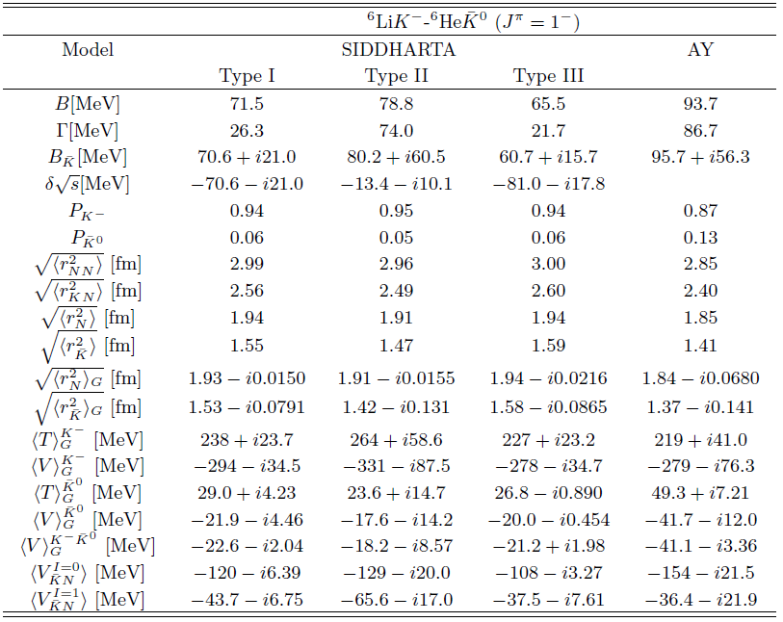

Slide 38
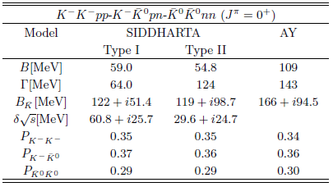



Slide 39




