Slide 1
Extracting η-neutron interaction from γ d → η n p data
Satoshi Nakamura (Osaka University)
Collaborators : H. Kamano (KEK), T. Ishikawa (Tohoku Univ.)

Slide 2
Introduction

Slide 3
η N scattering length (a_{ηN})
Fundamental quantity in hadron physics
Important relevance to the existence of η-mesic nuclei
But not well-known
Current status
Several combined analyses of π N → η N and γ N → η N data
Re[a_{ηN}] = − 0.4 ∼ − 1.1 fm
Im[a_{ηN}] ∼ − 0.26 fm (optical theorem)
pn → dη data (WASA/PROMICE@COSY) Eur. Phys. J. A 38, 209 (2008)
Re[a_{ηN}] = − 0.4 ∼ − 0.6 fm
a_{ηN} determined with indirect information → model dependence
Need process that sensitively probes η N → η N scattering but not contaminated by others

Slide 4
Proposed experiment at ELPH@Tohoku Univ.
γ d → η n p at Ε_{γ} ∼ 0.95 GeV and proton detected at 0º
An ideal kinematical setting for extracting η N scattering length
η is produced almost at rest → strong η n → η n rescattering is expected
π n → η n and NN rescatterings are expected to be suppressed
Data still need to be analyzed with reliable model to extract a_{ηN}

Slide 5
Dynamical Coupled-Channels (DCC) model for meson productions
Kamano, SXN, Lee, Sato, PRC 88, 035209 (2013)
Developed through fully combined analysis of γΝ, πΝ ➔ πΝ, ηΝ, ΚΛ, ΚΣ data, W < 2.1 GeV
This talk
Show DCC model meets requirements to extract a_{ηN} from ELPH data
Develop γ d → η n p reaction model with DCC model as building block
Demonstrate π n → η n and NN rescatterings are suppressed in ELPH exp.
Predict γ d → η n p reaction from the current DCC model
Study sensitivity of ELPH exp. to a_{ηN}

Slide 6
Dynamical Coupled-Channels model for meson productions

Slide 7
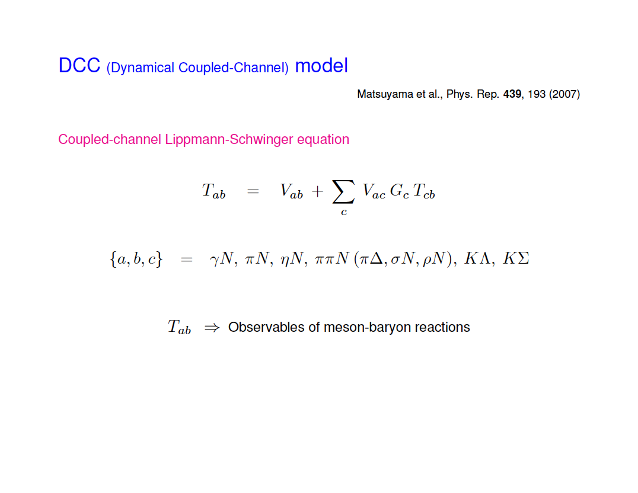
Kamano et al., PRC 88, 035209 (2013)
Coupled-channel Lippmann-Schwinger equation for meson-baryon scattering
,
By solving the LS equation, coupled-channel unitarity is fully taken into account
Both on- and off-shell amplitudes are calculated

Slide 8
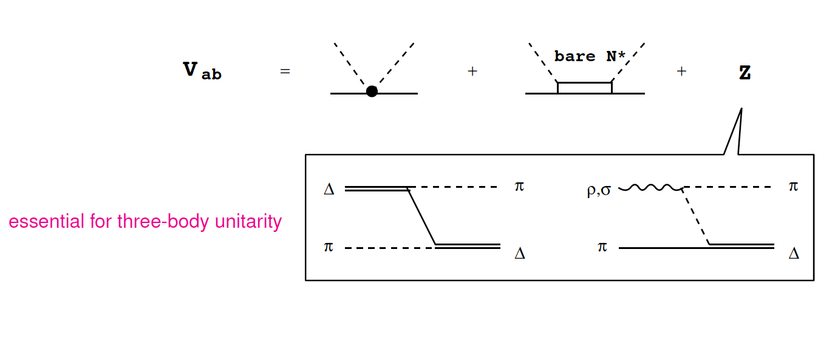
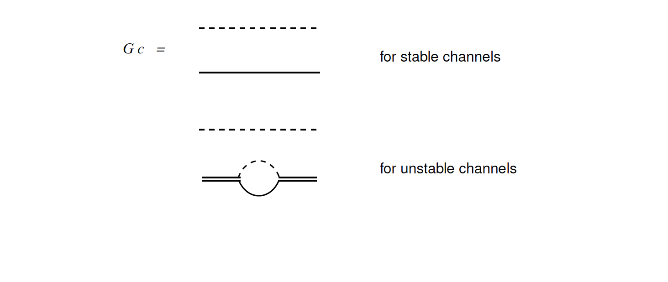
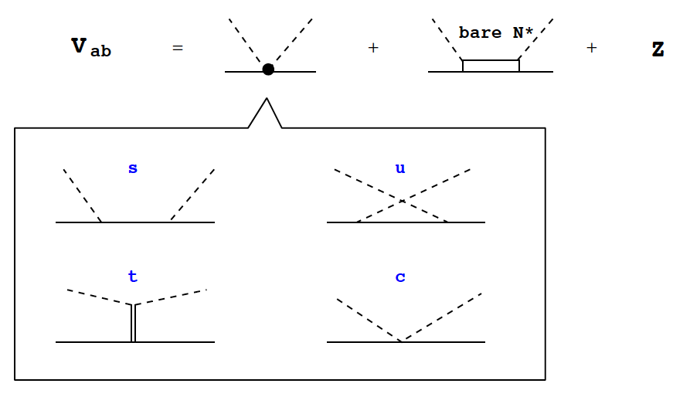
Kamano et al., PRC 88, 035209 (2013)
Coupled-channel Lippmann-Schwinger equation for meson-baryon scattering
1 or 2 bare N* in
each partial wave
,

Slide 9
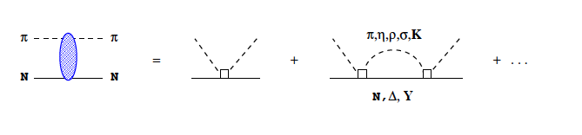
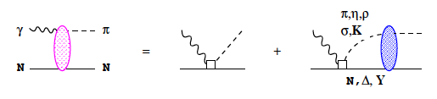
Kamano et al., PRC 88, 035209 (2013)
Coupled-channel Lippmann-Schwinger equation for meson-baryon scattering
,
T
V
V
V
By solving the LS equation, coupled-channel unitarity is fully taken into account
In addition, γΝ channels are included perturbatively
T

Slide 10
DCC analysis of γΝ, πΝ ➔ πΝ, ηΝ, ΚΛ, ΚΣ

Slide 11
DCC analysis of meson production data
Kamano, Nakamura, Lee, Sato, PRC 88 (2013)
Fully combined analysis of γΝ, πΝ ➔ πΝ, ηΝ, ΚΛ, ΚΣ data
and polarization observables
(W ≤ 2.1 GeV)
~ 23,000 data points are fitted
by adjusting parameters (N* mass, N* ➔ MB couplings, cutoffs)

Slide 12


Eta production reactions
Kamano, Nakamura, Lee, Sato, PRC 88 (2013)
Relevant to π n → η n rescattering
in γ d → η n p reaction

Slide 13
γp → π⁰p
dσ/dΩ for W < 2.1 GeV
Kamano, Nakamura, Lee, Sato, PRC 88 (2013)
Kamano, Nakamura, Lee, Sato, 2012
Relevant to π n → η n rescattering
in γ d → η n p reaction

Slide 14
γ p → η p
Kamano, Nakamura, Lee, Sato, PRC 88 (2013)
Tested important elementary amplitudes for γ d → η n p
relevant to impulse and η n → η n rescattering mechanisms

Slide 15
Application of DCC model to γ d reactions

Slide 16
Model for γ d → η n p
Impulse
ΝΝ rescattering
πΝ & ηN rescattering
η
N
N
T_{NN}
π, η
γ
d
d
d
γ N → π N, η N amplitude ⬅ DCC model
π N, η N → η N amplitude ⬅ DCC model
Τ_{ΝΝ} , deuteron w.f. ⬅ CD-Bonn potential (PRC 63, 024001 (2001) )
Off-shell effects are taken into account

Slide 17
Numerical results for γ d → η n p

Slide 18
γ d → η n p at proposed ELPH experiment
Kinematics : Ε_{γ} = 950 MeV, proton at 0º detected
M_{η n} is related to the proton momentum
Impulse current dominates
η n rescattering (mostly s-wave)
gives visible contribution
NN and πN → ηN rescattering are small
η production suppressed in intermediate M_{η n}
← deuteron wave function

Slide 19
γ d → η n p at proposed ELPH experiment
Kinematics : Ε_{γ} = 950 MeV, proton at 0º detected
p
n
η
η
n
d
γ (950 MeV)
ηn → ηn rescattering effect: −40% ∼ +20%

Slide 20
Re[a_{ηN}]-dependence of γ d → η n p at ELPH exp.
(DCC model)
a = – 0.7 – 0.3 i fm
r = –1.9 – 0.5 i fm
γ d → η n p at ELPH exp. kinematics has a good sensitivity to Re[a_{ηN}]
Well-tested elementary amplitude for γ p → η p is essential

Slide 21
Conclusion

Slide 22
Conclusion
Dynamical coupled-channels (DCC) model developed
← analysis of γ Ν, πΝ ➔ πΝ, ηΝ, ΚΛ, ΚΣ data
DCC model applied to photo-reactions on the deuteron
impulse, NN and meson-nucleon rescattering mechanisms
γ d → η n p at ELPH exp. kinematics studied with the DCC model
impulse dominates; γ p → η p elementary amplitude needs solid validation
η n → η n rescattering effect is visible (−40% ∼ +20%) at low M_{η n}
π n → η n and NN rescattering effects are small
γ d → η n p at ELPH setup has a good sensitivity to η n scattering length

Slide 23
BACKUP

Slide 24
Contents
Introduction
Dynamical coupled-channels (DCC) model
Analysis of γ Ν, πΝ ➔ πΝ, ηΝ, ΚΛ, ΚΣ data
DCC model applied to reactions on deuteron
Numerical results for γ d → η n p reactions
at kinematics of the proposed ELPH experiment
→ feasibility study to extract η n scattering length

Slide 25
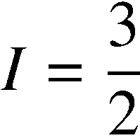
Partial wave amplitudes of π N scattering
Real part
Kamano, Nakamura, Lee, Sato, PRC 88 (2013)
Previous model
(fitted to πN → πN data only)
[PRC76 065201 (2007)]
Data: SAID πΝ amplitude
Imaginary part

Slide 26
γ d → π N N
Purpose : test the soundness of the model
Data: EPJA 6, 309 (1999)
Data: NPB 65, 158 (1973)
Model prediction is reasonably consistent with data
Large ΝΝ (small πΝ) rescattering effect for π⁰ production
orthogonality between deuteron and pn scattering wave functions
Small rescattering effect for π⁻ production

Slide 27
η n → η n s-wave amplitude
Definition
Im
Effective range expansion (ERE)
a : scattering length
r : effective range
Re
a = – 0.7 – 0.3 i fm
r = –1.9 – 0.5 i fm
(DCC model)
ERE is valid for W < 1550 MeV where η n rescattering is important
~

Slide 28
η n → η n s-wave amplitude
Definition
γ d → η n p
Effective range expansion (ERE)
a : scattering length
r : effective range
a = – 0.7 – 0.3 i fm
r = –1.9 – 0.5 i fm
(DCC model)
ERE is valid for W < 1550 MeV where η n rescattering is important
η n rescattering is well approximated by ERE in γ d → η n p for ELPH experiment kinematics
~

Slide 29
η n → η n s-wave amplitude
Re[a]-dependence of F_{ηN}
Im
Re
Q : Can we discriminate η n scattering length with γ d → η n p data from ELPH ?

Slide 30
Re[a_{ηN}]-dependence of γ d → η n p
γ d → η n p at FOREST exp. kinematics has a good sensitivity to Re[a_{ηN}]

Slide 31
Resonance region (single nucleon)
γΝ ➔ X
2nd
3rd
Δ
(MeV)
Multi-channel reaction
• 2π production is comparable to 1π
• η, Κ productions (ν case: background of proton decay exp.)

Slide 32
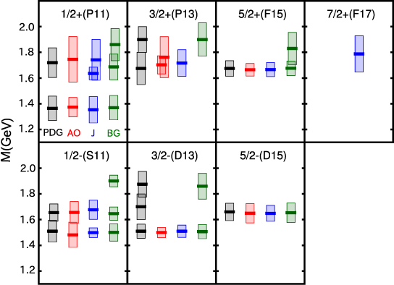
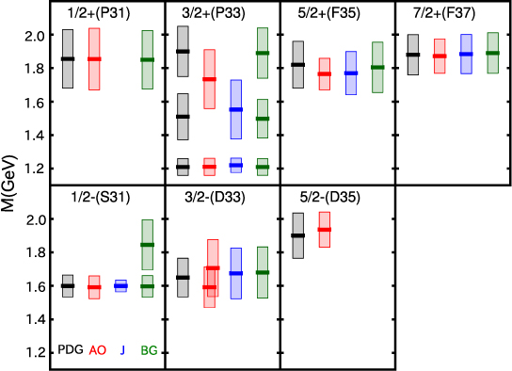
“N” resonances (I=1/2)
“Δ” resonances (I=3/2)
Kamano, Nakamura, Lee, Sato, PRC 88 (2013)
J^{P}(L_{2I 2J})
-2Im(M_{R})
(“width”)
Re(M_{R})
PDG: 4* & 3* states assigned by PDG2012
AO : ANL-Osaka
J : Juelich (DCC)
[EPJA49(2013)44, Model A]
BG : Bonn-Gatchina (K-matrix)
[EPJA48(2012)5]

Slide 33
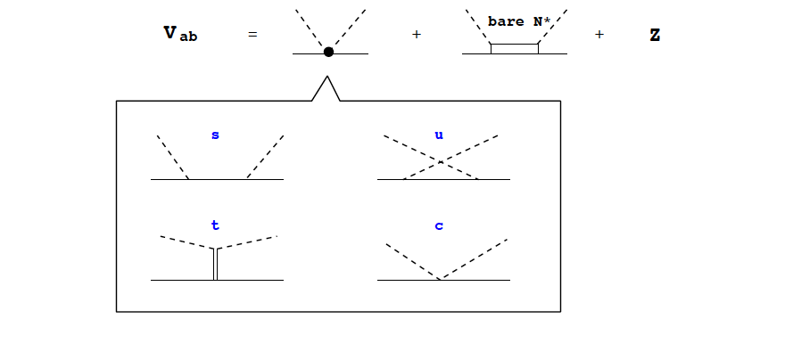
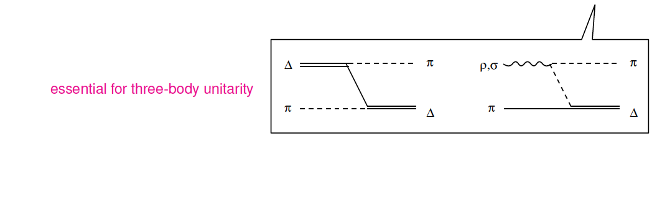
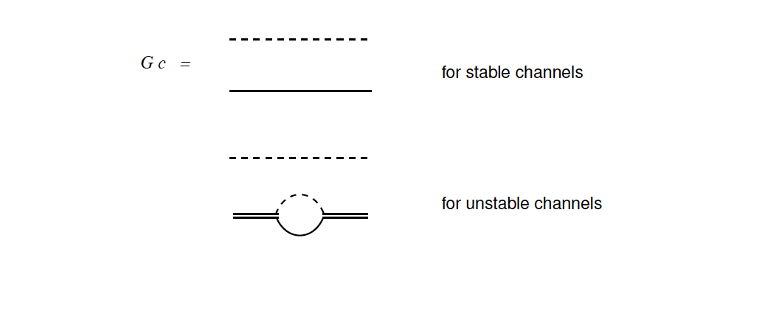


Slide 34




KY production reactions
Kamano, Nakamura, Lee, Sato, 2012
1732 MeV
1757 MeV
1792 MeV
1845 MeV
1879 MeV
1879 MeV
1985 MeV
1966 MeV
1966 MeV
2031 MeV
2059 MeV
2059 MeV

Slide 35
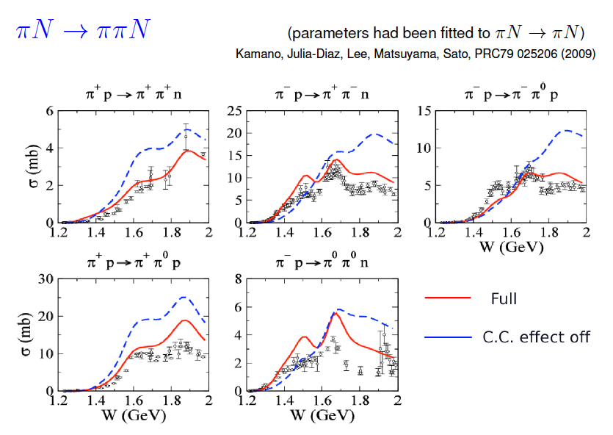

Slide 36
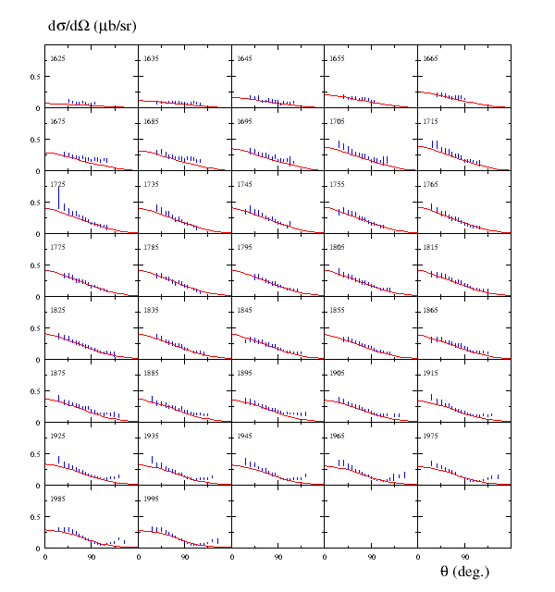

Kamano, Nakamura, Lee, Sato, arXiv:1305.4351
Vector current (Q²=0) for Κ
Production is well-tested by data

Slide 37
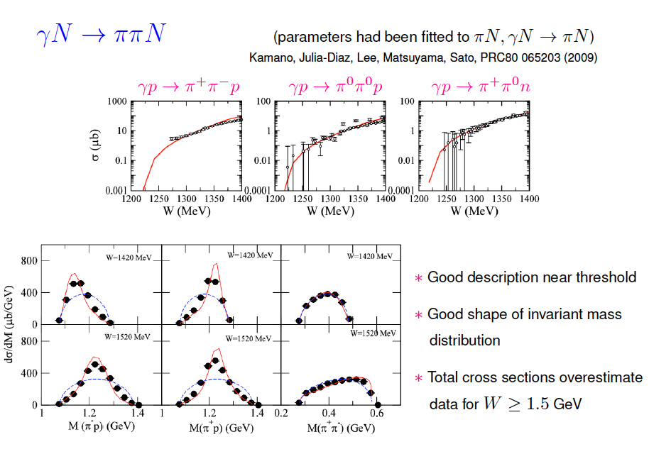

Slide 38
Analysis result (single π)
Q²=0
dσ / dΩ (γ n ➔ π⁻p) for W=1.1 – 2.0 GeV

Slide 39
Predicted πN → ππN total cross sections with our DCC model
π⁺p → π⁺π⁺n
π⁻p → π⁺π⁻n
π⁻p → π⁻π⁰p
π⁺p → π⁺π⁰p
π⁻p → π⁰π⁰n
Kamano, PRC88(2013)045208
Kamano, Julia-Diaz,
Lee, Matsuyama, Sato
PRC79(2008)025206

