Slide 1
U_{A}(1) symmetry and QCD sum rules in matter
Su Houng Lee
U_{A}(1) symmetry vs χ−symmetry breaking
- Correlation function:
- QCD sum rules
- Witten Veneziano formula
Conclusion
-Model independent statement on η’ mass and χ−symmetry
Ref: SHL, T. Hatsuda, PRD 54, R1871 (1996)
SHL, I. Zahed, PRC 63, 045204 (2001)
Y. Kwon, SHL, K. Morita, G. Wolf, PRD86,034014 (2012)
SHL, S. Cho, IJMP E 22 (2013) 1330008 + P. Gubler, P. Mohanty, SHL

Slide 2
UA(1) breaking and Chiral symmetry breaking
QCD Lagrangian
U_{A}(1) breaking
Chiral sym breaking
mass
a₁
?
η‘
ρ
?
π
Confinement

Slide 3
Correlation functions
Chiral symmetry breaking in Correlator
U_{A}(1) breaking effects in Correlators
Cohen 96
Hatsuda, Lee 96

Slide 4
Chiral symmetry breaking (m→0) : order parameter
Quark condensate
ν=0
→ Casher Banks formula: nontrivial zero mode ( λ =0) contribution
→ Chiral symmetry breaking order parameter : any operator that checks the existence of this link
ν=0

Slide 5
Other order parameters: σ − π correlator
ν=0
ν=0
Other order parameters: V - A correlator (mass difference)
ν=0

Slide 6
Meson with one heavy quark : S-P
ν=0
Baryon sector : Λ – Λ*
ν=0

Slide 7
Correlators and symmetry
Chiral symmetry breaking in Correlator
U_{A}(1) breaking effects in Correlators
Cohen 96
Hatsuda, Lee 96

Slide 8
U_{A}(1) effect : effective order parameter (Lee, Hatsuda 96)
Topologically nontrivial contributions
ν=0
ν=1

Slide 9
η ‘− π correlator : ν nonzero part
Lee, Hatsuda (96)
For SU(3) :
ν=1
For SU(2) : Always non zero
ν=1
For 2-point function: U(1)_{A} will be restored when chiral symmetry is restored for N_{F} =3
but always broken for N_{F} =2
But Non trivial to check because

Slide 10
QCD sum rules for η’ s
But what will happen to the mass ?
Unfortunately No model independent method
Try QCD sum rule

Slide 11
η ‘− π − S Correlators
Gubler, Mohanty, SHL
4 quark operators:
Vacuum Saturation

Slide 12
η ‘ correlator : to go beyond
Estimate disconnected contribution to 4 quark operators:
Or use PS gluonic correlation
1. Low energy theorem
2. Large Nc limit

Slide 13
Correlators and η’ meson mass
But what will happen to the mass ?
Unfortunately No model independent method
Try Large Nc → Witten Veneziano formula

Slide 14
η’ mass? Witten-Veneziano formula - I
Gluons only from low energy theorem
With quarks using
Large Nc argument
Need η‘ meson

Slide 15
Few Formula in Large Nc
Meson
Glueball
Baryon

Slide 16
Witten-Veneziano formula – III Nc counting and glueball
η‘ meson
η ‘ mass is a large 1/N_{c} correction
glueball

Slide 17
Witten-Veneziano formula – II
η‘ meson
Lee, Zahed (01)
Should be compared to
Modification in medium
Low energy theorem
New structure

Slide 18
Low energy theorem - Scalar
Novikov, Shifman, Vainshtein, Zhakarov
1) Note for any operator,
2) Left hand side can be obtained from

Slide 19
Low energy theorem - Pseudo Scalar
Novikov, Shifman, Vainshtein, Zhakarov
+ self dual field dominates
Lee, Zahed
+ introduce a heavy quark

Slide 20
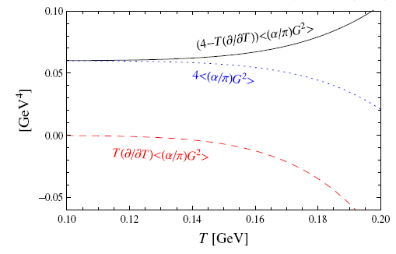
LET at finite temperature : Ellis, Kapusta, Tang (98)
Lee, Zahed (2001)

Slide 21
Linear density approximation : Lee,Zahed (01)
For gluon condensate: d= 4, and changes are smaller than
Changes by less than 2 % at nuclear matter

Slide 22
Any new structure?
Large N_{c} counting
At finite temperature, only gluonic effect is important
Glue N_{c}²
Quark N_{c}
Quark N_{c}² ?

Slide 23
Large Nc argument for Nucleon Scattering Term
Witten
That is, scattering terms are of order N_{c} and can be safely neglected

Slide 24
W-V formula at finite density:
Very small change
Therefore ,
→ In the large NC limit eta’ mass should decrease when chiral symmetry is restored

Slide 25
at finite temperature and density
Therefore, when chiral symmetry gets restored

Slide 26
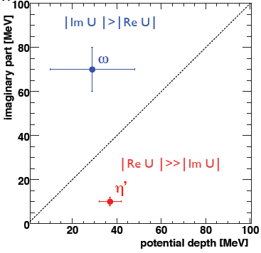
Experimental evidence of property change of η‘ in matter ?
CBELSA/TAPS coll
10 % reduction of mass from around 500 MeV from chiral symmetry breaking

Slide 27
Summary
Chiral symmetry breaking and in Correlator
U_{A}(1) breaking effects in Correlators
→ Restored in SU(3) and real world
In the large Nc limit, η ‘ mass reduces in medium and at finite temperature: due to Chiral symmetry restoration

Slide 28
Summary
η’ correlation functions should exhibit symmetry breaking from N-point function in SU(N) flavor even when chiral symmetry is restored.
→ For SU(2), UA(1) effect will be broken in the two point function
2. In W-V formula η’ mass is related to quark condensate and thus should reduce at finite temperature independent of flavor due to chiral symmetry restoration
→
a) Could serve as signature of chiral symmetry restoration
b) Dilepton in Heavy Ion collision
c) Measurements from nuclear targets seems to support it ?

Slide 29
UA(1) effect and η‘ mass : naïve picture
UA(1) current breaking:
ν=1
2. Index theorem
η ‘ mass
Disconnected diagrams
ν=1
ν=1

Slide 30
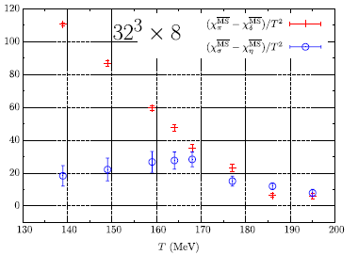
Recent Lattice results ?
S. Aoki et al. (PRD 86 11451) : no UA(1) effect above Tc
M. Buchoff et al. (PRD89 054514): UA(1) effect survives Tc in SU(2) in susceptibilities
chiral
UA(1)
Chiral symmetry restoration
UA(1) symmetry restoration ?
But what happens to the η‘ mass?
What is the relation to chrial symmetry

