Slide 1
Intense Coherent Emission in Relativistic Shocks
Masanori Iwamoto¹,
Takanobu Amano¹, Masahiro Hoshino¹, Yosuke Matsumoto²
[1]University of Tokyo; [2]Chiba University

Slide 2
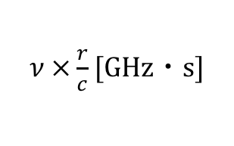


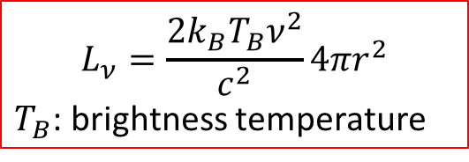
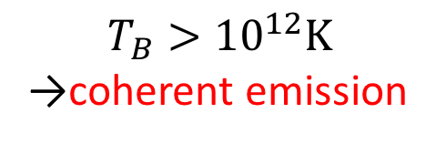
Coherent Emission
Black body radiation
Coherent Emission
[Pietka+ 2015]
$$L_{ν}=\frac{2k_{B}T_{B}ν^{2}}{c^{2}}4πr^{2}$$
$T_{B}$: brightness temperature
$$L_{ν}\text{[}\text{Jy}\text{・}\text{kpc}\text{2}\text{]}$$
$$T_{B}>{10}^{12}K$$
→coherent emission
${10}^{12}$K
$ν ×\frac{r}{c}$ [GHz・s]

Slide 3
Synchrotron Maser Instability
Coherent EM wave radiation by synchrotron maser instability is a common feature of 1D relativistic shocks (e.g., Gallant+ 1992)
Resonance between EM waves and relativistic cyclotron motion at the shock-transition region (Hoshino & Arons 1991)
downstream
shock front
upstream
$$y$$
$$B_{2}$$
$$B_{1}$$
$$e^{−}$$
$$z$$
$$x$$
Synchrotron maser instability is responsible for
Intense coherent emission
  Jupiter decametric (DAM) radio emission
  origin of fast radio burst? (Lyubarsky 2014)
Particle acceleration
  preferential positron acceleration (Hoshino+ 1992)
  wakefield acceleration (Lyubarsky 2006; Hoshino 2008)

Slide 4
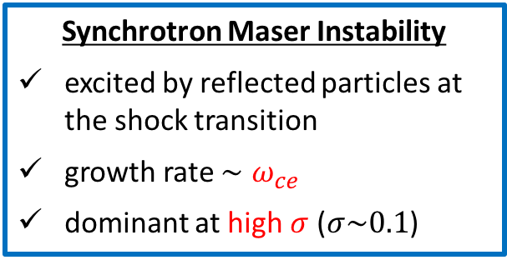

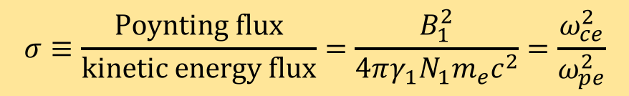
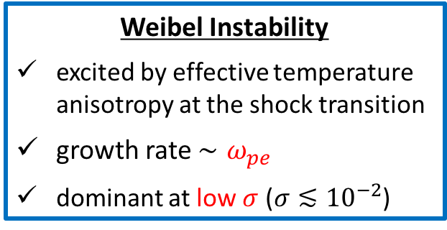
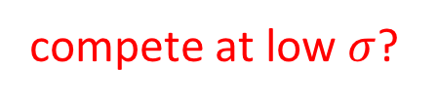
$σ$ Dependence of Shock Structure
$$σ≡\frac{Poynting flux}{kinetic energy flux}=\frac{B_{1}^{2}}{4πγ_{1}N_{1}m_{e}c^{2}}=\frac{ω_{ce}^{2}}{ω_{pe}^{2}}$$
still unknown in many astrophysical objects, depends on models
Synchrotron Maser Instability
excited by reflected particles at the shock transition
growth rate $∼ω_{ce}$
dominant at high $σ$ ($σ\sim 0.1$)
Weibel Instability
excited by effective temperature anisotropy at the shock transition
growth rate $∼ω_{pe}$
dominant at low $σ$ ($σ≲{10}^{−2}$)
compete at low $σ$?
Question
Can intense coherent emission be excited in multidimensional shocks?
Notes:
Considering shock-transition region, we can see the counter-streaming electrons in the x direction. A small seed magnetic field δBz in the z direction with wavevector pointing the y direction separates the counter-streaming particles, and induces net currents flowing in the x direction which reinforce the initial magnetic field. The mode is unstable for the wavevector perpendicular to the shock normal and thus appears only in multidimensional system.

Slide 5
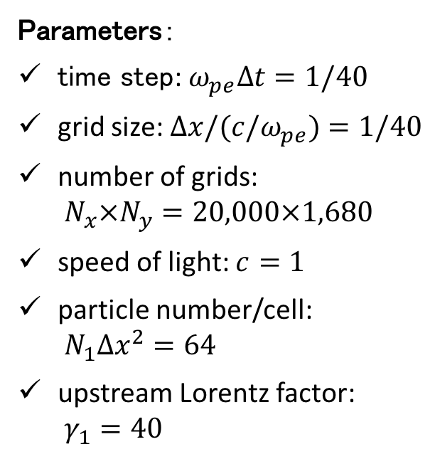
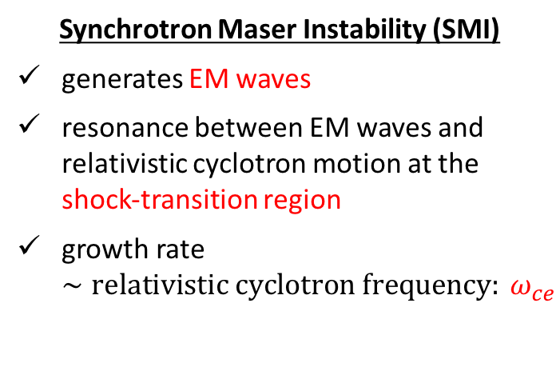


Simulation Setting
Parameters：
time step: $ω_{pe}∆t=1/40$
grid size: $∆x/(c/ω_{pe})=1/40$
number of grids:
$N_{x}×N_{y}=20,000×1,680$
speed of light: $c=1$
particle number/cell:
$N_{1}∆x^{2}=64$
upstream Lorentz factor:
$γ_{1}=40$
Coordinate system and geometry
$$e^{±}$$
$γ_{1}$
Variable：
$$σ_{e}≡\frac{Poynting flux}{electron kinetic energy flux}=\frac{B_{1}^{2}}{4πγ_{1}N_{1}m_{e}c^{2}}=\frac{{2u}_{1}^{2}}{M_{A}^{2}} \\ M_{A}: \text{Alfv}\text{é}\text{n} \text{Mach} \text{number}$$

Slide 6
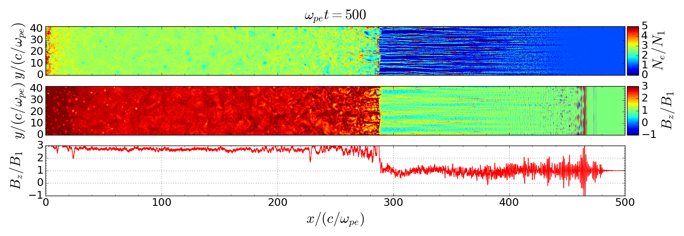



Global Shock Structure: High-$σ_{e}$ Case
$←$downstream
upstream$→$
filaments
plasma flow
EM waves
filaments → filamentation instability (Kaw+ 1973; Drake+ 1974)
evidence that the EM wave is intense and coherent

Slide 7
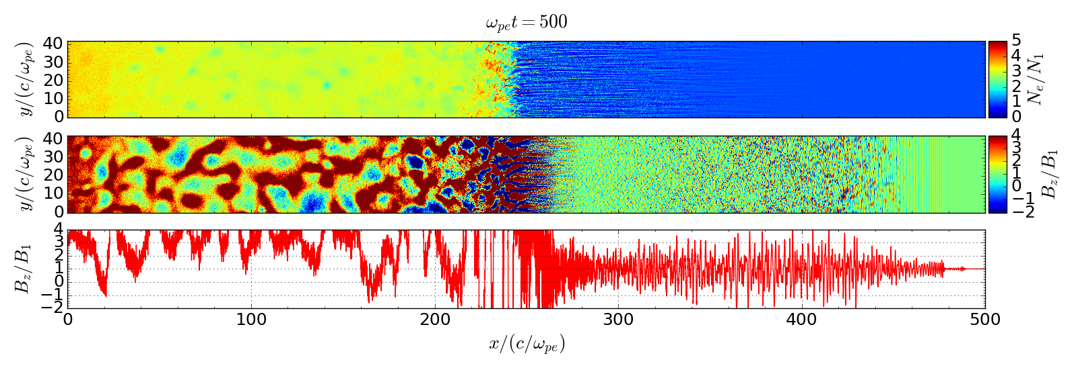






Global Shock Structure: Low-$σ_{e}$ Case
$←$downstream
upstream$→$
$$N_{e}$$
Weibel instability
plasma flow
$$B_{z}$$
$$B_{z}$$
EM wave
Filamentary structure → Weibel Instability
EM waves are excited and persist even in the Weibel-dominated regime

Slide 8


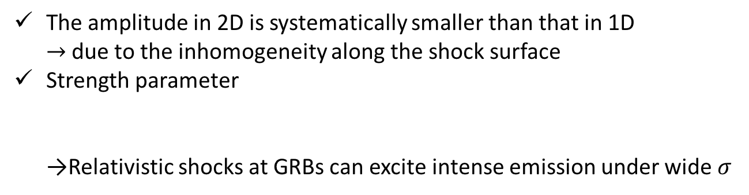
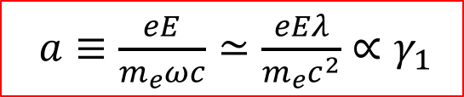
$σ$ Dependence of Wave Emission Efficiency
Weibel-dominated regime
$$a$$
intense emission
→wakefield acceleration?
The amplitude in 2D is systematically smaller than that in 1D
→ due to the inhomogeneity along the shock surface
Strength parameter
→Relativistic shocks at GRBs can excite intense emission under wide $σ$
$a≡\frac{eE}{m_{e}ωc}≃\frac{eEλ}{m_{e}c^{2}}∝γ_{1}$

Slide 9
Summary
We investigated EM wave emission efficiency in relativistic shocks via 2D PIC simulations.
The large-amplitude EM wave can be excited even in the Weibel-dominated regime
The intense coherent emission is expected for astrophysical objects such as GRBs
Reference
M. Iwamoto, T. Amano, M. Hoshino, Y. Matsumoto 2017, ApJ, 870, 52
doi: 10.3847/1538-4357/aa6d6f
arXiv:1704.0441
Notes:
The WFA needs a finite inertial difference between the positive and negative charges, we could not directly show the WFA
But, the precursor wave emission efficiency measured in a pair plasma shock will also give a good estimate for an ion–electron plasma
because the emission mechanism itself is identical between the pair and ion–electron plasmas,
the actual particle acceleration efficiency must be comprehensively examined by directly performing simulations for relativistic ion–electron shocks.

Slide 10
Convergence Study
high resolution
low resolution
Fine spatial resolution is required to estimate the EM wave emission efficiency accurately
To suppress a numerical instability in relativistic shocks…
Previous works → digital filtering (suppresses physical waves too)
Our simulation → Magic CFL number (Ikeya & Matsumoto 2016)

Slide 11







Filamentation Instability
Filamentation instability (Kaw+ 1973; Drake+ 1974) is induced by large-amplitude electromagnetic waves
Density filaments are generated
$$y$$
$$y$$
$$y$$
1
2
3
refraction
$$x$$
$$x$$
$$x$$
EM wave
$$δn$$
$$δn$$
$$δn$$
rays
ponderomotive force
dense region

Slide 12













Weibel instability
[Kato 2007]
The thermal anisotropy drives Weibel instability
Weibel instability can be induced near the shock front
Filament structures are generated
$$y$$
plasma flow
$$B_{z}$$
$$y$$
$$j_{x}$$
$$x$$
1
2
$$δB_{z}$$
3
$$y$$
$$y$$
$$y$$
$$e^{−}$$
$$e^{−}$$
$$δB_{z}$$
$$δj_{x}$$
$$e^{−}$$
$$e^{−}$$
$$z$$
$$x$$
$$z$$
$$x$$
$$z$$
$$x$$

