Slide 1
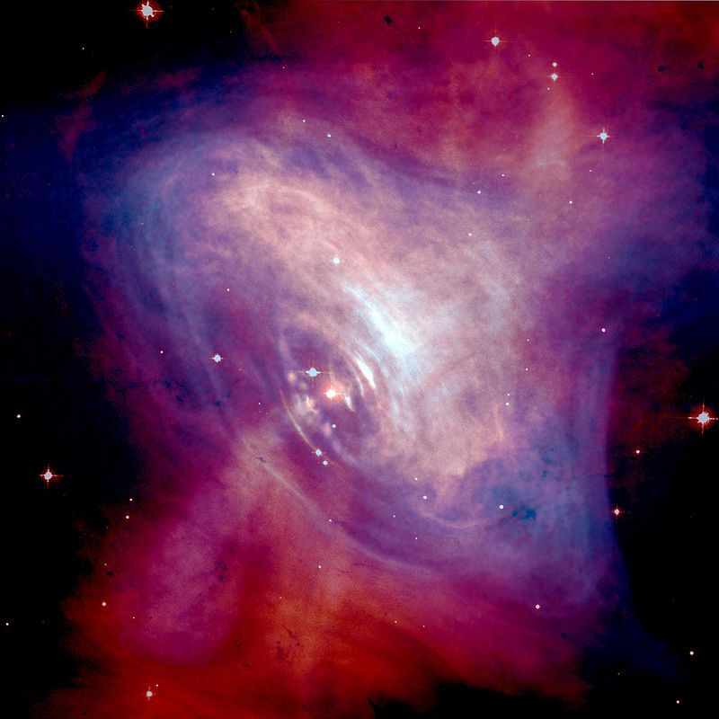
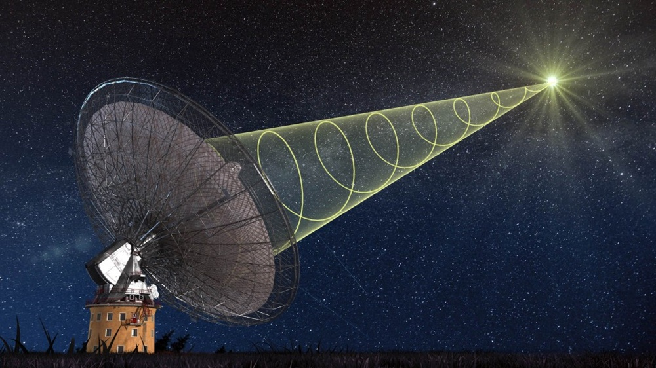
Fast Radio Bursts
Kazumi Kashiyama (U. of Tokyo)

Slide 2
Outline
What we know so far about FRB
A FRB in a bottle?
(Near) future prospects

Slide 3
1. What we know so far about FRB

Slide 4
Fast radio bursts
τ ~1-10 ms
S_{ν} ~ 0.1-1 Jy
ν ~ GHz
event rate ~ 10³ day⁻¹ sky⁻¹
δt_{ν} ~ ν ⁻²
DM ~ 500-1000 cm⁻³ pc
~ 20-30 events so far with Parkes, Arecibo, and GBT, but not with LOFAR
One is repeating (FRB121102)!
Lorimer et al. 2007; Keane et al. 2012; Thornton et al. 2013; Burke-Spolaor & Bannister 2014; Spitler et al. 2014;
Ravi, Shannon & Jameson 2015; Petroff et al. 2015; Masui et al. 2015; Champion et al. 2015 …

Slide 5
Basic properties
If DM_{FRB} is mainly from intergalactic propagation,
DM = 500-1000 cm⁻³ pc z ~ 0.5-1, d_{L} ~ 2-6 Gpc
Δt < 5 ms cΔt < 1500 (1+z)⁻¹ km
S_{ν}~ Jy E_{iso} ~ 10³⁸⁻⁴⁰ f_{b} erg
~10⁴ day⁻¹sky⁻¹ ~ 10⁻³ f_{b}⁻¹ yr⁻¹gal⁻¹ ~ 0.1 f_{b}⁻¹ R_{CCSN}
Coherent emission likely from relativistic outflows

Slide 6
Theoretical Challenges
Time scale ~1-10 ms → compact stars
Energetics ~10³⁸⁻⁴⁰ erg f_{b} d_{L,Gpc}² → easy peasy
Event rate ~10 % of CCSNe f_{b}⁻¹ d_{L,Gpc}⁻³ → not easy
Emission mechanism → super hard
Source environment → needs to be “clean”
Repeating → At least some are not totally cataclysmic.
wrt free-free absorption & induced Compton
but also “dirty” enough in some cases
wrt scattering

Slide 7
Proposed Scenarios
Galactic
Rotating radio transients
Flaring stars
Extragalactic
Giant pulses from young pulsars
Magnetar giant flares
Supernovae into nearby stars
Core-collapses of hypermassive NSs
Binary NS mergers
Binary WD mergers
Evaporations of BHs
Superconducting cosmic strings
Loeb+14; Maoz+15
Cordes&Wasserman 16; Connor+16; Lyutikov+16
Popov&Postnov 08; Thornton+13; Lyubarsky 14
Calgate+71,75; Egorov&Postnov 08
Falcke&Rezzolla 13; Zhang 13
cataclysmic
Hansen&Lyutikov+01; Totani 13
KK, Ioka, Meszaros 13
Rees 77; Blandford 77; Kavic+08; Keane+12
Cai+12
and more …
key diagnostics: other counterparts and host galaxy

Slide 8
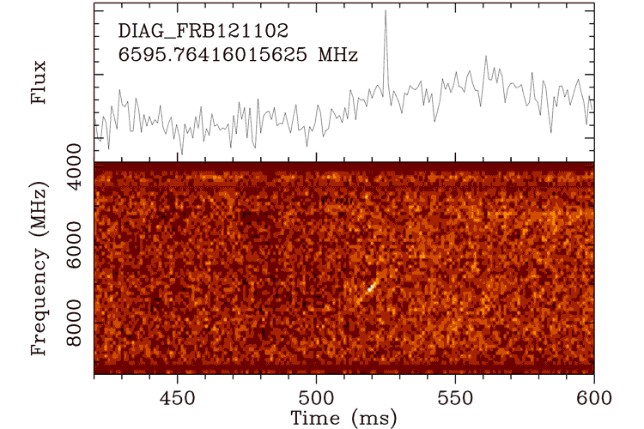
FRB 121102
Spitler+16, Chatterjee+17, Marcote+17, Tendulkar+17, …
The host is identified!
It repeats! e.g., ~10 times in ~3 hrs
a dwarf star-forming gal.
@ z = 0.19
A persistent radio counterpart!

Slide 9
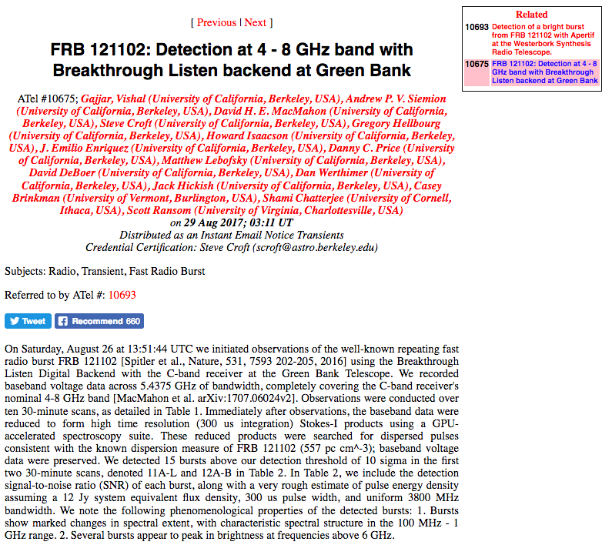

Slide 10

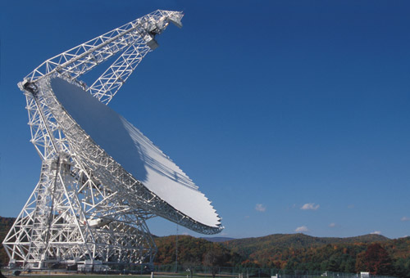
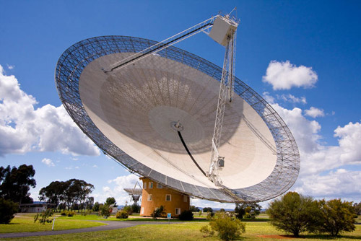
Breakthrough Listen
“A $100 million program of astronomical observations in search of evidence of intelligent life beyond Earth. It is by far the most comprehensive, intensive and sensitive search ever undertaken for artificial radio and optical signals. A complete survey of the 1,000,000 nearest stars, the plane and center of our galaxy, and the 100 nearest galaxies. All data will be open to the public.”

Slide 11
The Persistent Radio Counterpart
The source is localized within ~ 0.7 pc (!!)
& associated with a star forming region …
The spectrum is compatible with
the Crab pulsar-wind nebula …

Slide 12

Highly coherent ms radio bursts from a star-forming region? …
A Crab-PWN-like radio counterpart? …
smells like a young neutron star…
Cordes&Wasserman 16; Connor+16; Lyutikov+16
Popov&Postnov 08; Thornton+13; Lyubarsky 14

Slide 13
2. An FRB in a bottle?

Slide 14
An FRB in a bottle?
Or a bubble?
= pulsar wind nebula
& supernova remnant

Slide 15
A Very Young NS in a Bubble
~ a few months after the explosion
~ 1-100 yr after the explosion
The PWN emission is absorbed
and thermalized in the supernova ejecta,
powering a luminous supernova.
The non-thermal pulsar wind nebula (PWN) emission in
the radio bands starts to escape the supernova ejecta.
→ repeating FRBs and the persistent radio counterpart?
pulsar wind nebula
supernova ejecta

Slide 16
A Very Young NS in a Bubble
~ a few months after the explosion
~ 1-100 yr after the explosion
The PWN emission is absorbed
and thermalized in the supernova ejecta,
powering a luminous supernova.
The non-thermal pulsar wind nebula (PWN) emission in
the radio bands starts to escape the supernova ejecta.
→ repeating FRBs and the persistent radio counterpart?
pulsar wind nebula
supernova ejecta

Slide 17
GeV-TeV flares?
Lyubarsky 14
Murase, KK, Meszaros 16
total fluence in GeV-TeV (in the fast cooling case)
duration (sensitive to the Lorentz factor of the outflow)
→ can be detectable from ~ 10-100 Mpc by HAWC

Slide 18
A Very Young NS in a Bubble
~ a few months after the explosion
~ 1-100 yr after the explosion
The PWN emission is absorbed
and thermalized in the supernova ejecta,
powering a luminous supernova.
The non-thermal pulsar wind nebula (PWN) emission in
the radio bands starts to escape the supernova ejecta.
→ repeating FRBs and the persistent radio counterpart?
pulsar wind nebula
supernova ejecta

Slide 19
Very young, but not too young
The flux is much higher than
the Crab
Much younger and powerful
than the Crab pulsar.
In the early stage, radio waves
cannot escape the nebula ...
The NS is sufficiently old and/or
the SN ejecta mass is small.

Slide 20
Formation rate
The rate of repeating FRBs inferred from the survey
(Scholz+16)
which can be translated to the formation rate as
for τ_{FRB} ~ 10 yr & f_{b} ~ 1 → ~ 0.1 % of CCSNe
for τ_{FRB} ~ 100 yr & f_{b} ~ 1 → ~ 0.01 % of CCSNe
(though the uncertainty is huge)

Slide 21
Constraints on NS & SN
KK & Murase 17
PWNe with M_{ej} ~ a few M_{sun}, P₀ ~ ms, B_{dip} ~ 10¹³ G, & t_{age} ~ a few 10-100 yrs can explain the repeating FRB.
If t_{age} ~ 100 yrs, the formation rate is ~ 0.01 % of core-collapse SNe.

Slide 22
Constraints on NS & SN
KK & Murase 17
PWNe with M_{ej} ~ a few 0.1 M_{sun}, P₀ ~ ms, B_{dip} ~ 10¹²⁻¹³ G, & t_{age} ~ a few -10 yrs can explain the repeating FRB.
If t_{age} ~ 10 yrs, the formation rate is ~ 0.1 % of CCSNe.

Slide 23
A Very Young NS in a Bubble
~ a few months after the explosion
~ 1-100 yr after the explosion
The PWN emission is absorbed
and thermalized in the supernova ejecta,
powering a luminous supernova.
The non-thermal pulsar wind nebula (PWN) emission in
the radio bands starts to escape the supernova ejecta.
→ repeating FRBs and the persistent radio counterpart?
pulsar wind nebula
supernova ejecta

Slide 24
Superluminous Supernovae – FRBs?
KK+16
Murase, KK, Meszaros 16
See also e.g.,
Metzger+16,
Margalit+17
Ni powered
Pulsar-driven superluminous SNe: M_{ej} ~ a few M_{sun}, P₀ ~ ms, B_{dip} ~ 10¹³ G
→ consistent with the young NS model for FRB 121102
The event rate is consistent; ~ 0.01 % of core collapse SNe
The host gal. type is also consistent

Slide 25
Ultra-stripped SNe – BNSs ?
e.g.,Tauris et al. 15
e.g., PSR J0737-3039A/B
Proper motion of the system ~ 9 km/s
→ ultra-stripped 2nd exp. with M_{ej} ~ 0.1-0.2 M_{sun}?
M_{A} = 1.338±0.0007, M_{B} = 1.249±0.0007, P_{orb} = 0.102 day, e = 0.088
→ the progenitor of the 2nd NS is likely tidally locked
→ P₀ ~ ms
B_{A} = 10^{9.8} G, B_{B} = 10^{12.2} G (→ t_{sd,B} ~ 50 Myr)
Piran & Shaviv 05; Dall’Osso+14
Hotokezaka,KK,Murase 17
BNS merger
SNe at the birth of BNSs : M_{ej} ~ a few 0.1 M_{sun}, P₀ ~ ms, B_{dip} ~ 10¹²⁻¹³ G
→ also consistent with the young NS model for FRB 121102
KK & Murase 17

Slide 26
Luminous gap transients - FRBs - BNSs?
Hotokezaka,KK,Murase 17
Pulsar-driven ulta-stripped SNe: M_{ej} ~ a few 0.1 M_{sun}, P₀ ~ ms, B_{dip} ~ 10¹³ G
→ fast rise (= lower ejecta mass) & long tail (= longer energy injection)
→ luminous gap transients
The event rate is consistent; ~ 0.1 % of CCSNe
The host gal. type is also consistent (?)
Arcavi+16
Whitesides+17

Slide 27
FRB 121102 in a bottle?
If the persistent radio counterpart is a rotation-powered PWN,
NSs with M_{ej} ~ a few M_{sun}, P₀ ~ ms, B_{dip} <~ a few 10¹³ G, and t_{age} ~ 100 yrs, or
NSs with M_{ej} ~ a few 0.1 M_{sun}, P₀ ~ ms, B_{dip} <~ a few 10¹³ G, and t_{age} ~ 10 yrs
→ SLSN – FRB ?
→ Luminous gap transients – FRB – BNS ?
Multi-band followup obs. of SLSNe-I and luminous gap transients is the key to test the scenario.
GeV-TeV, MeV, keV, radio, …

Slide 28
3. (Near) future prospects

Slide 29
(Near) future prospects
Targeted FRB (and counterpart) searches
and powerful blind surveys
followed up by long-base-line facilities
What can “we" do?

Slide 30
FRB121102-like radio sources
Ofek 17
The galaxy sample:
~ 30% of the total galaxy g-band luminosity
within < 108 Mpc
Picking up persistent sources with
radio luminosities < 10 % of FRB 121102
Rejecting AGN-like sources
11 candidates
implying a birth rate of < 500 Gpc⁻³ yr⁻¹
(assuming t_{age} = 100 yrs)
Followup FRB searches are encouraged!

Slide 31
Radio PWNe of SLSN remnants
Omand,KK,Murase 17
1GHz
100 GHz
Detectable with ALMA from ~ 1 Gpc
<~ a few yrs after the explosion
Detectable with VLA from ~ 1 Gpc
~ few 10 yrs after the explosion, and
consistent with FRB121102
Our VLA/ALMA proposals have been approved.
We will observe some of them in this autumn.

Slide 32
PWNe of a newborn BNS candidate
Murase, KK, Hotokezaka in prep
PTF 10iam
@~500 Mpc
~ 7 yrs old
detectable (even) with VERA
An observation with VERA has been done
with a huge help from Terasawa san, Homma san,
Aoki san, and other VERA people.

Slide 33
FRBs from a newborn BNS candidate
Searched by Terasawa san and Takeuchi san

Slide 34
FRBs from a newborn BNS candidate
Searched by Terasawa san and Takeuchi san

Slide 35
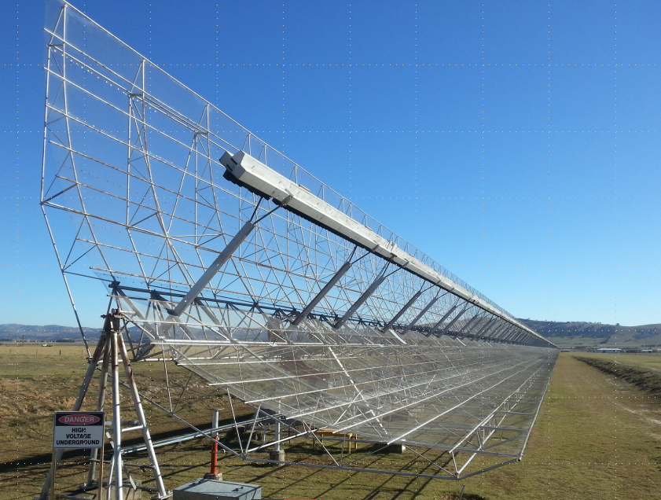
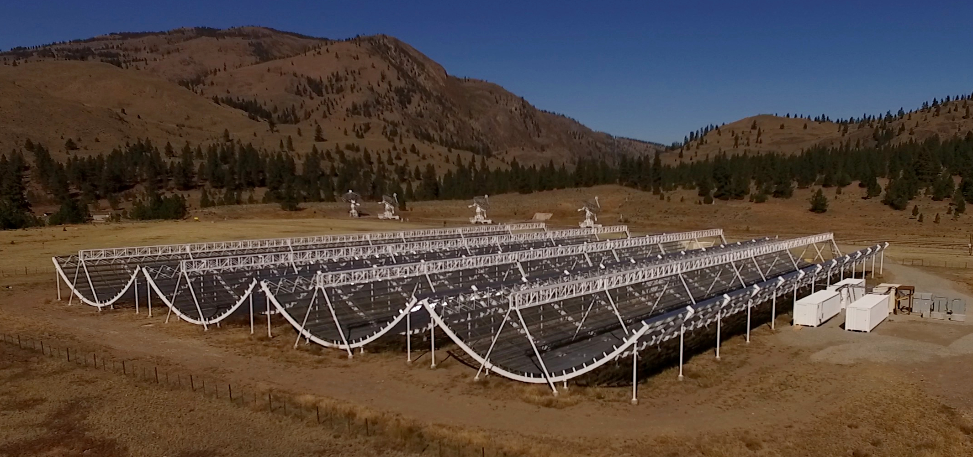
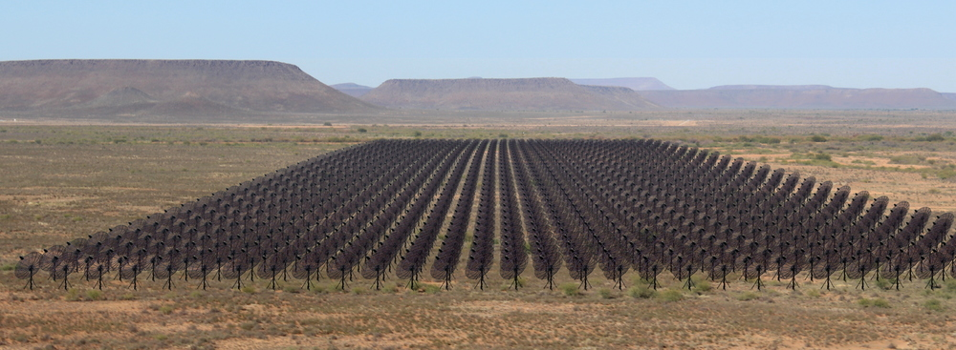
Powerful survey facilities online
UTMOST
an upgrade of the Molonglo Observatory
Synthesis Telescope (MOST)
CHIME
The Canadian Hydrogen Intensity Mapping Experiment
HIRAX
The Hydrogen Intensity and Real-time Analysis eXperiment

Slide 36
~10,000 FRBs in the coming decade(?)
Chawla+ 17
A large statistics → cosmological tool
Some should be very nearby, say ~ 10 Mpc → source identification

Slide 37
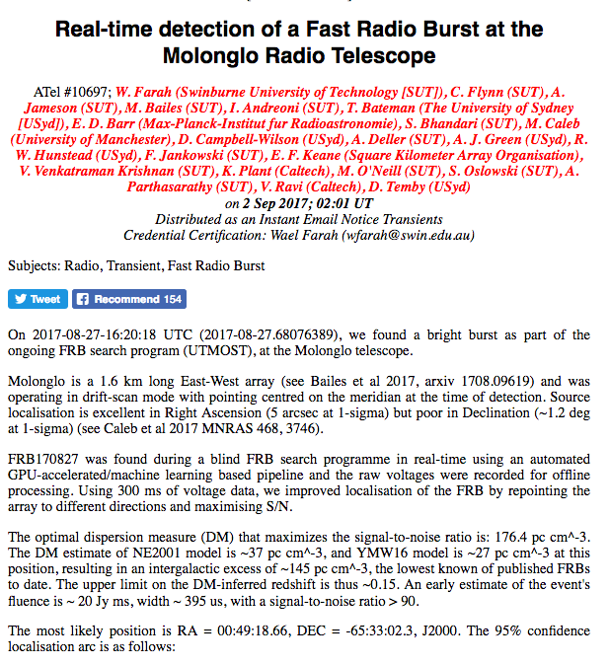
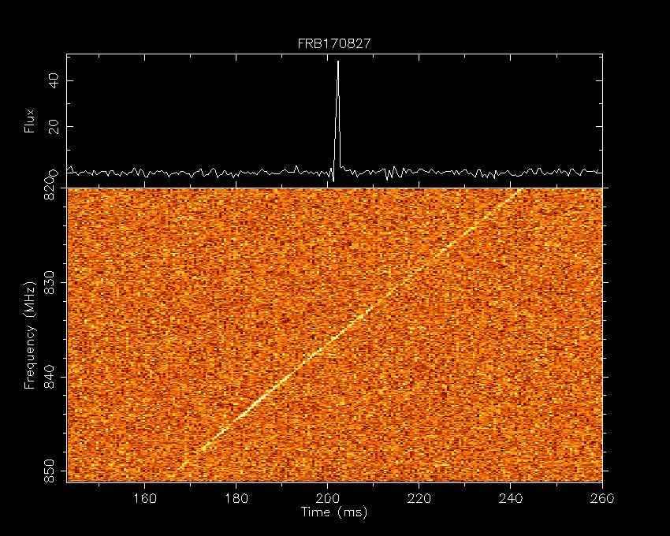
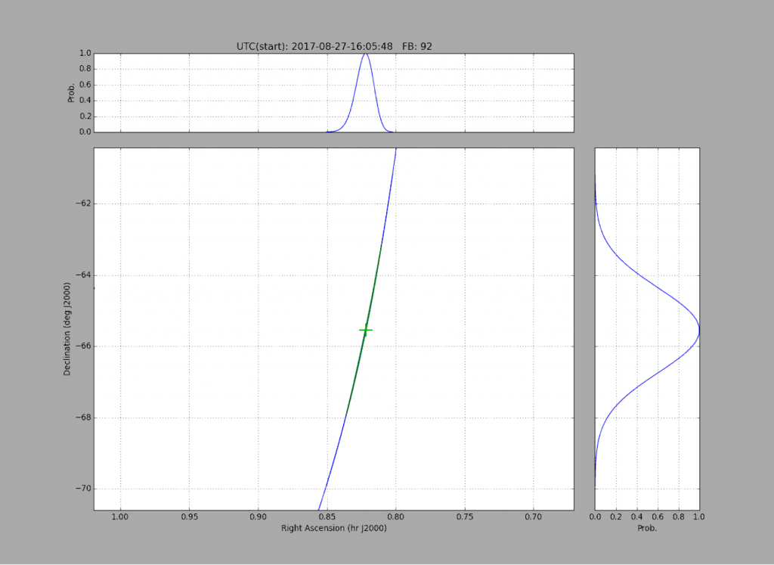
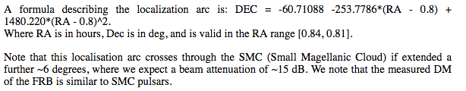
!?

Slide 38

Closer is better
A larger S/N → more detailed LC and spectrum
Non-radio counterpart too? (e.g., X rays)

Slide 39
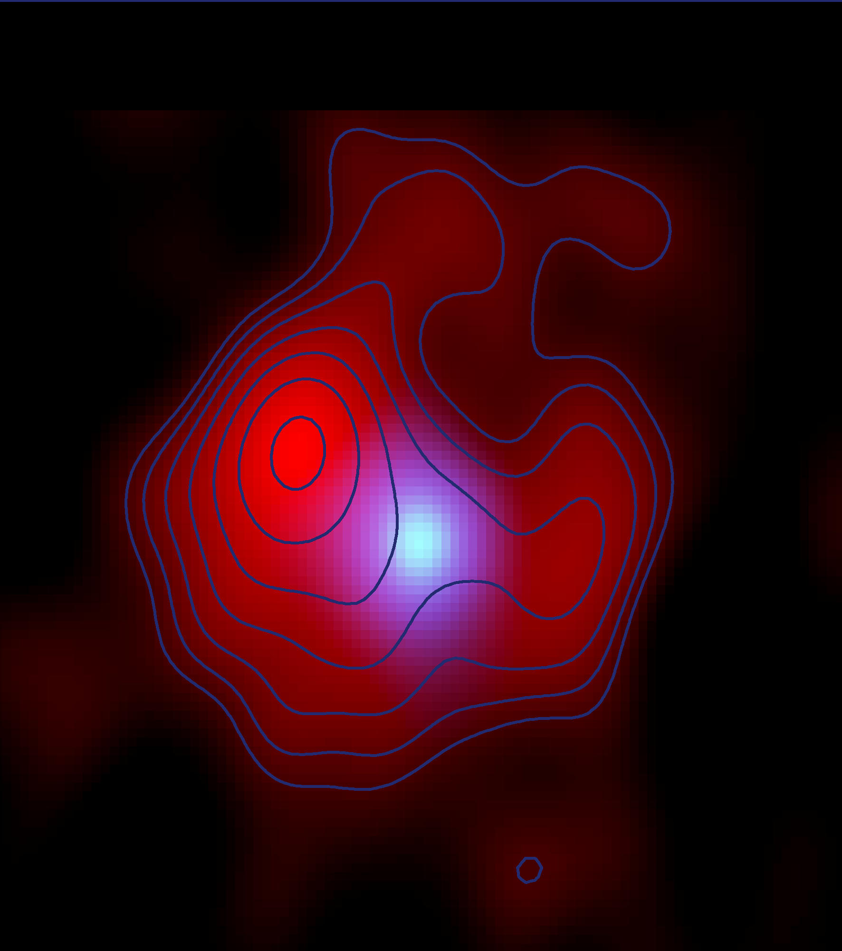
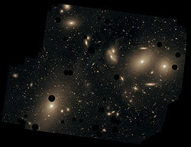
Watching Virgo Project (?)
e.g., 1986J
~ 10 deg x 10 deg
~ 15 Mpc to the center
~ 250 large galaxies
~ a few core-collapse SNe in 1 yr
~ a few ~1 yr old NSs
~ a few 10 of ~10 yrs old NSs
~ a few 100 of ~100 yrs old NSs
~ a few 1000 of ~ kyrs old NSs
…
@ ~ 10Mpc
possible PSR signatures
Something in-between Crab GP and FRB may be there and could be detected
→ Unveiling the population of extragalactic coherent radio bursts

Slide 40
Summary
Fast radio bursts so far
Emission mechanism? – unknown
Source? – unknown, but smells like young NSs
Two classes (repeat or not)? – not sure
My bets
The source(s) will be identified in the coming decade.
Also their population will be revealed somehow.

