Slide 1
Long GRB rate in the binary merger model
Tomoya Kinugawa
Collaborator : Katsuaki Asano
arXiv: 1706.07692

Slide 2
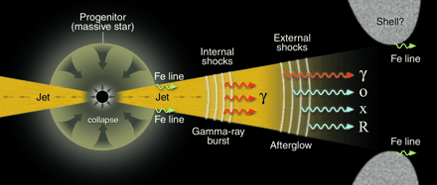
Long GRB
T90>2 s
Some long GRBs associate a supernova
Long GRBs may arise from the core collapse of massive stars. But do not follow the SFR…
GRB rate
N
SFR
redshift

Slide 3
Progenitor models

Slide 4
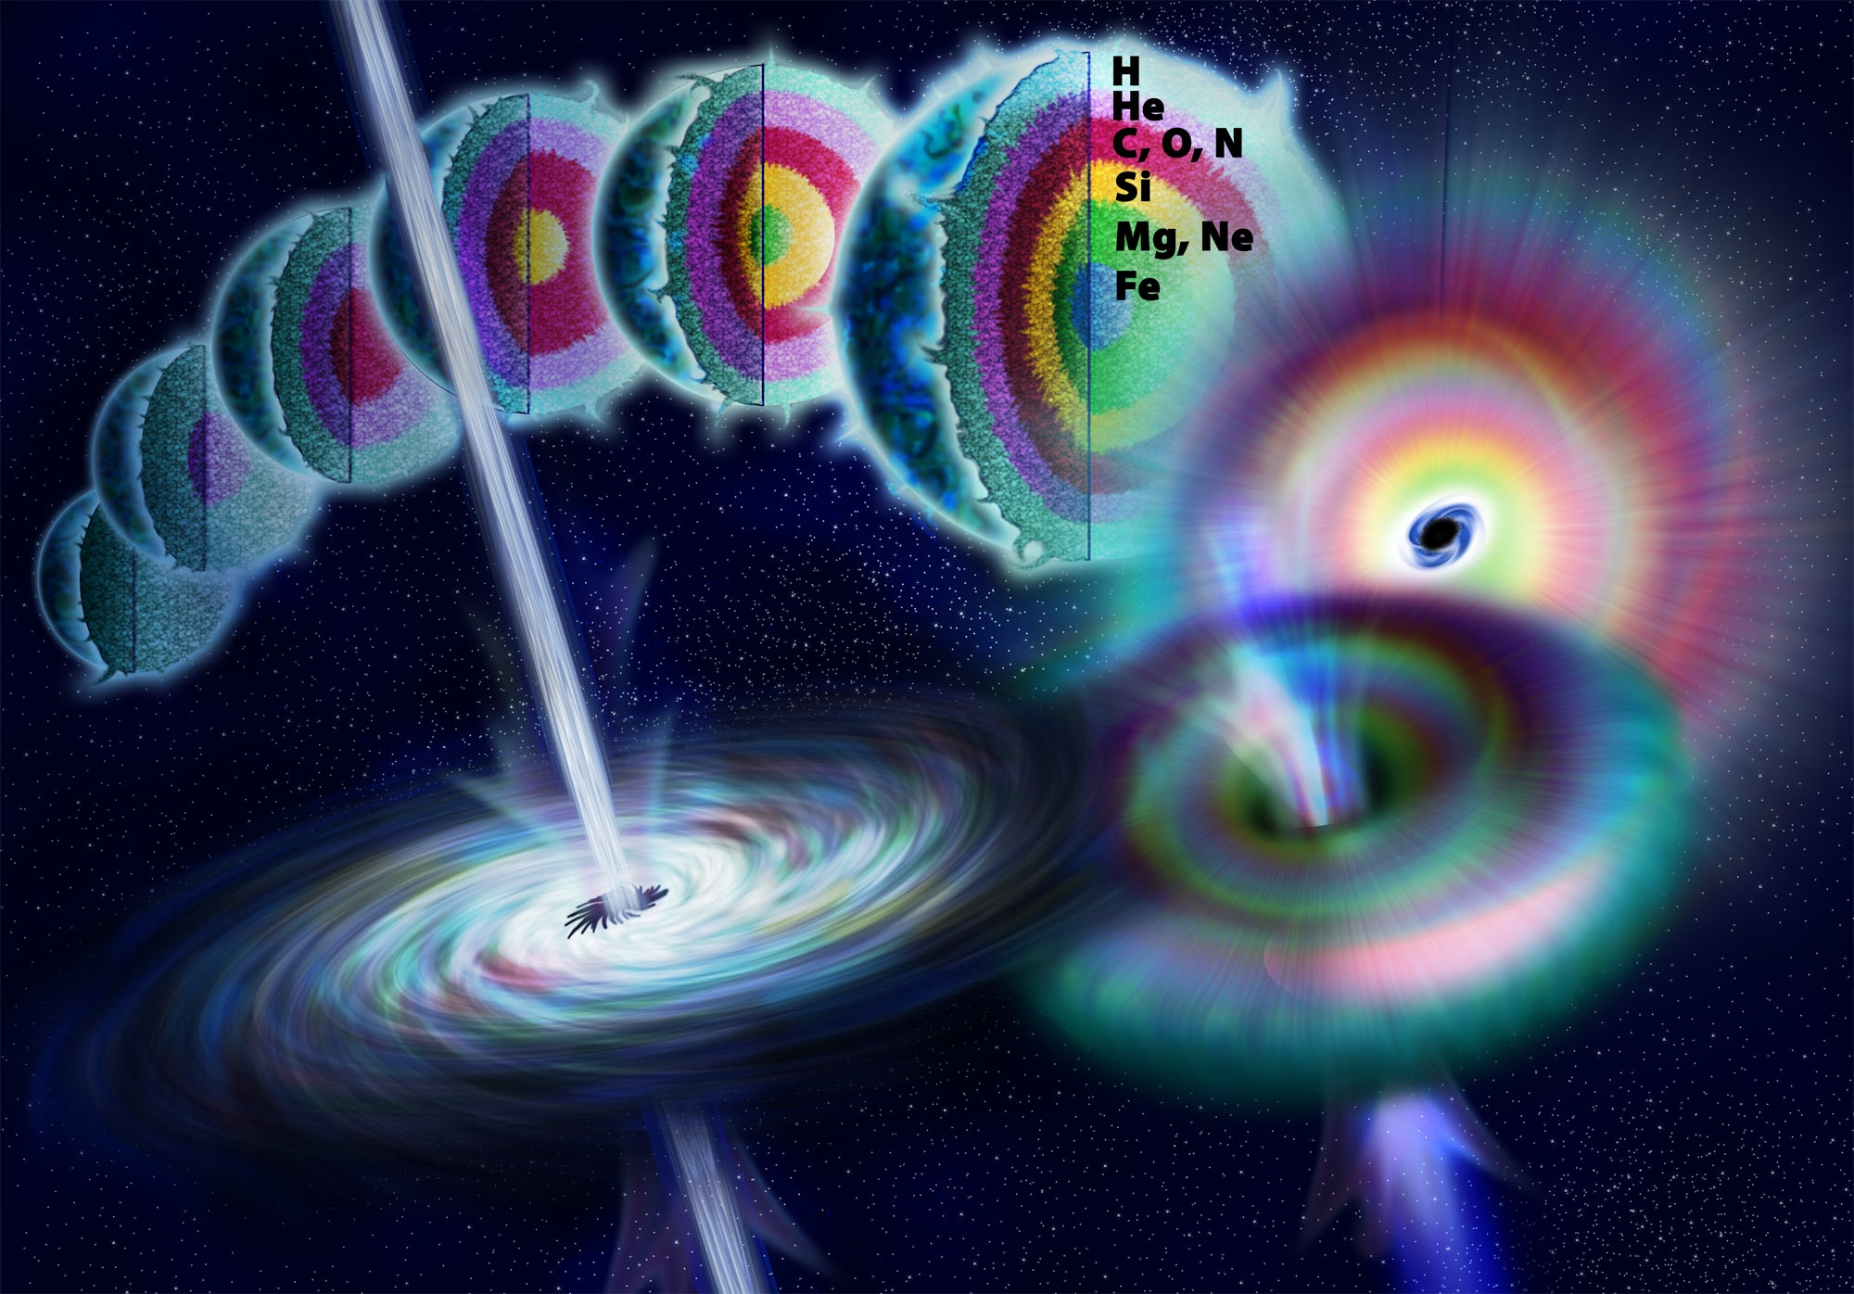
Recipe to make a long GRB
Collapsar Scenario (Woosley, 1993)
Massive core (enough to produce a BH)
no H envelope
(Jet cannot penetrate large envelope and observed GRB-SNe are Ic)
Rapidly rotating
(to produce an accretion disk around the BH)

Slide 5
The “angular momentum” issue
Generally, the star loses the mass due to stellar wind mass loss
It is possible to remove the envelope (WR winds) but too much angular momentum is lost during the RSG and WR phases (magnetic torques)
Possible solutions
Low metallicity model
Binary merger model

Slide 6
Low metallicity model
Stellar wind of low metallicity stars is weaker than that of high metallicity
Low metallicity stars do not lose the angular momentum due to the wind mass loss.
But, the H envelope remains
Need the initially high spin and the chemically homogeneous evolution?

Slide 7
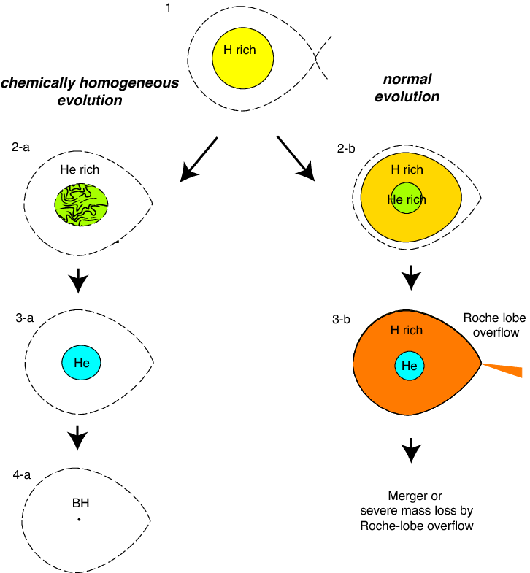
Chemically homogeneous evolution
Star rotates with near the Kepler velocity
Inside of star is entirely mixed
All Hydrogen can be used to burn.
Star will be He star.(➝CO star?)
They have no H envelope
But, What is make such a high rotating
initial condition?

Slide 8
Binary merger model
The binary consists of post main sequence stars
Wolf-Rayet+ giant or giant+ giant
They become the common envelope phase
Lose H envelope and He cores merge
After merge, they become the highly rotating Helium star.
Fryer&Heger 2005

Slide 9
Binary merger + low metallicity
If the wind mass loss is weak,
Binary can evolve as close binary.
The binary evolution is different.
High metal
They tend to become CE phase
at HG+MS
Low metal
They tend to become CE phase
at Post MS stars.

Slide 10
Binary evolution calculation

Slide 11
Calculation models
Z=Z, 10^{-0.5}Z, 10⁻¹Z, 10^{-0.5}Z, 10⁻²Z, 10^{-2.5}Z, 10⁻³Z
We calculate 10⁶ binaries for each metallicity
Initial condition
IMF: Salpeter (∝M^{-2.35}, 5Msun<M1<100Msun)
Mass ratio : q^{-0.1} (0.1/M₁<q<1)
Period: (logP)^{-0.55} (Pmin<P<Pmax)
Eccentricity: ∝e^{-0.5} (0<e<1)
Common envelope parameters
αλ＝0.1，1

Slide 12
GRB criterion
We assume following criterions
Binary merger remnants
(He core of giant +wolf-rayet or He core + He core of two giants)
M_{preSN}>3M
cJ_{preSN}/GM²>1

Slide 13
The fraction of long GRB for each metallicity

Slide 14
Binary merger + low metallicity
If the wind mass loss is weak,
Binary can evolve as close binary.
The binary evolution is different.
High metal
They tend to become CE phase
at HG+MS
Low metal
They tend to become CE phase
at Post MS stars.

Slide 15
GRB rate calculation
We need the metallicity evolution and SFR
Madou SFR
Galaxy mass distribution function (depends on redshift)
Galaxy mass-metallicity relation
The metallicity fraction

Slide 16
Long GRB rate and SFR
0 5 10

Slide 17
Conclution
The Low metallicity binaries are easier to become GRB progenitor than those of high metallicity.
The GRB rate of binary merger model is roughly consistent with the GRB rate from observation, in spite of simple assumptions.

