Slide 1
中性子星連星合体からの Rプロセス元素宇宙線 R-process Element Cosmic Rays from Neutron Star Mergers
高エネルギー宇宙物理学研究会
2017/09/06
@京大基研
Komiya, Yutaka
小宮 悠 ,
(東京大学RESCEU)
Collaborator: T. Shigeyama

Slide 2
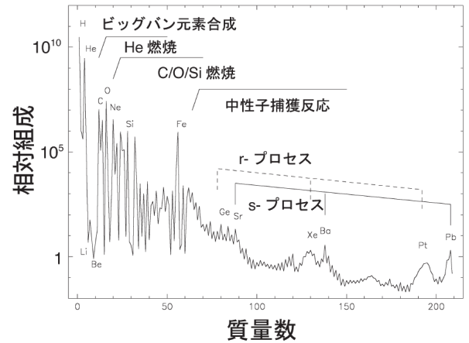
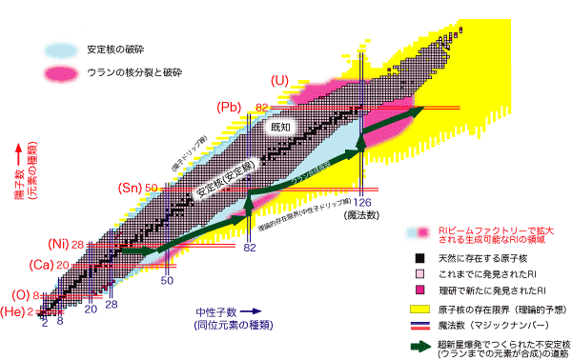
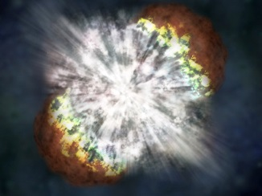
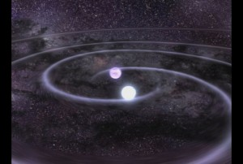
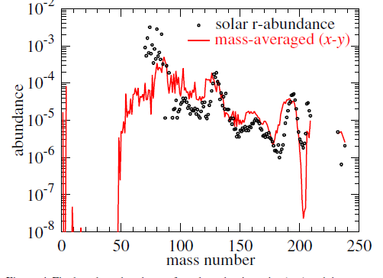
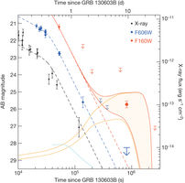
R-process elements
R-process
(Rapid neutron capture process)
processe to synthesize elements heavier than iron
Core collapse Supernova (CCSN)
Neutron Star Merger (NSM) e.g. Lattimer & Schramm (1974)
Komiya+ 2016
–
Successfully reproduce the abundance pattern
Chemical evolution
×（Argast+ 04）
OK (Komiya+ 2016, Hirai+ 2015)
Recent nucleosynthes studies shows that element at or above the 2nd r-process peak are hard to be synthesized (e.g. Wanajo 2011)

Slide 3
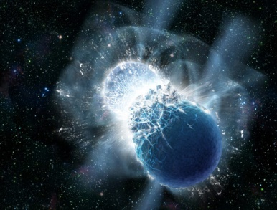
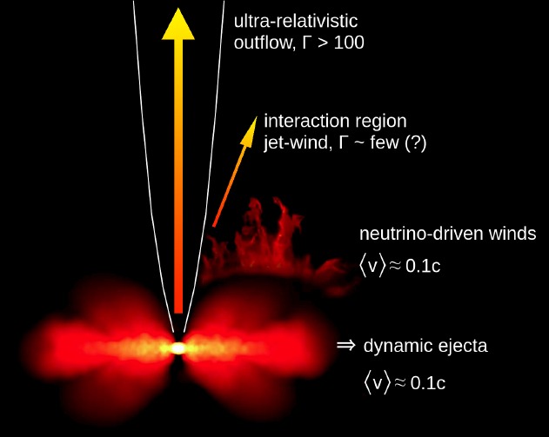
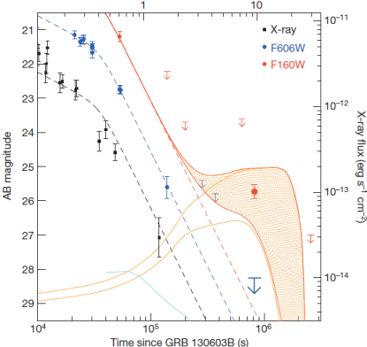
Neutron star mergers (NSMs)
Mass ejection from coalescence of NS-NS or NS-BH binary
Dynamic ejecta
Tidally disrupted
Shock heated
Disk wind
Neutrino driven wind
Mass: 0.0001 – 0.1M_{ʘ}
Velocity: ~ 0.2c
R-process elements
⇒ Ultra heavy element cosmic rays?

Slide 4
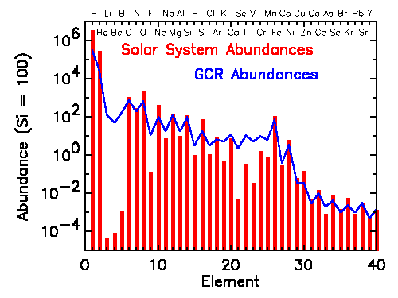
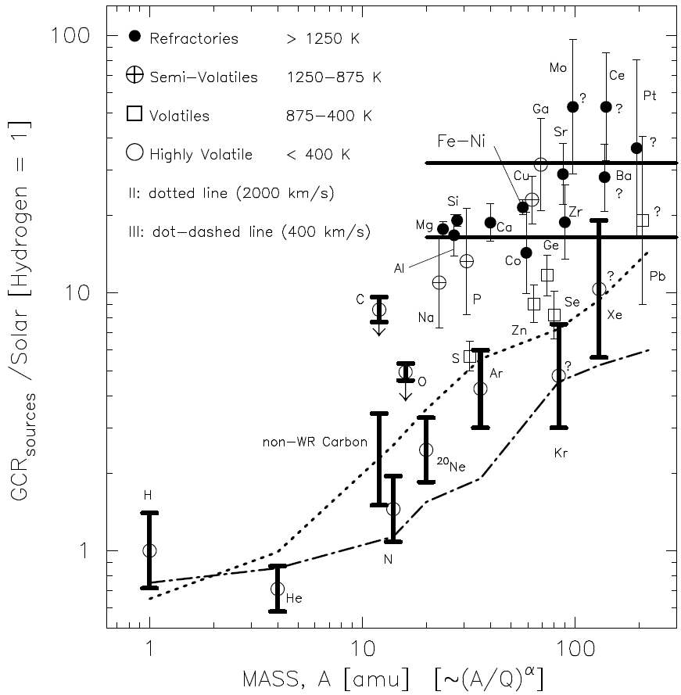
Chemical composition of cosmic rays
Overall trend is similar to the solar abundance
Spallation products
Li, Be, B
Weak “odd-even”
Relatively weak H, He ⇒ Acceleration bias
First Ionization Potential
Volatility, mass (Meyer 1997)

Slide 5
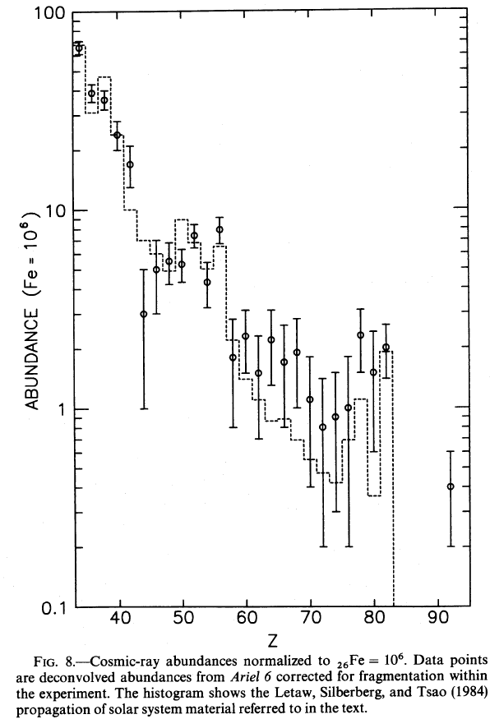
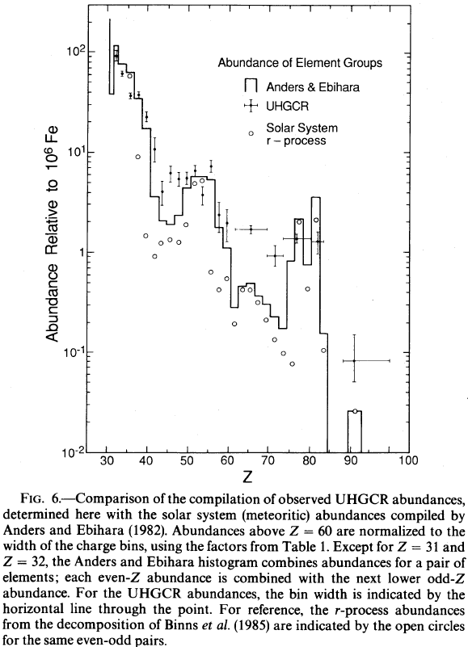
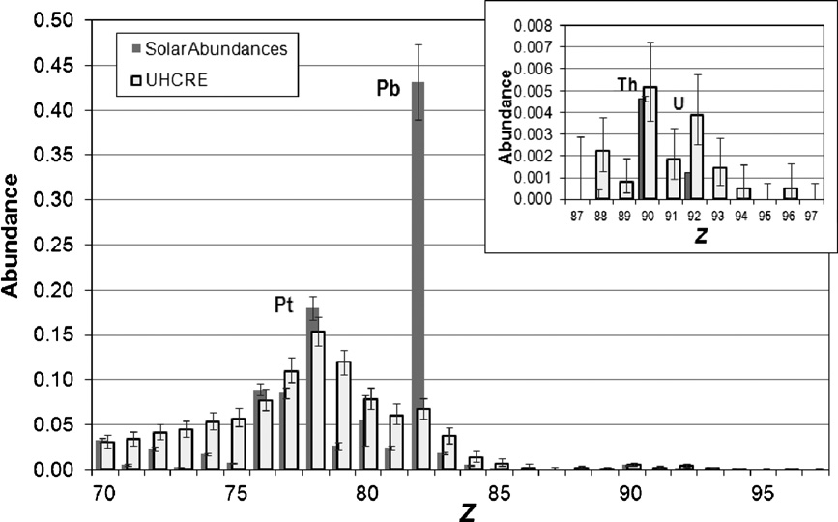
Observations of Ultra Heavy element Cosmic Rays (UHCRs)
Fowler et al.(1987)
( not Ultra High Energy Cosmic Ray)
UHCR (ultra heavy element cosmic ray) = cosmic ray nuclei of elements heavier than the iron group
Satellite experiments
Ariel-6 (Fowler et al.1987)
HEAO-3 (Binns et al.1989)
UHCRE (Donnelly et al. 2012)
Composition
UHCR/Fe ~ solar abundance ratio
60 < Z < 82: overabundant
Pt(r-process)/Pb(s-process)
Volatility biased acceleration?
Histogram: solar
● : cosmic ray
Donnelly et al. (2012)

Slide 6
UHCRs from NSMs?
Kyutoku & Ioka (2016)
Energy injection rate from NSMs to UHCRs
All the NSM ejecta is r-process elements
The ejecta velocity is very high
⇒ Large enhancement of r-process/Fe in cosmic-rays
They conclude either
the neutron star mergers is NOT the main source of the r-process elements in the universe, or
the CR acceleration efficiency at the reverse shock in NSM ejecta is very small (<0.003%)
But, spallation and energy loss processes are not considered
Forward shock of SNRs ⇒ solar r/Fe
Reverse shock of SNRs
Reverse shock NSMs
Because of the high ejecta velocity, larger enhancement of r/Fe is predicted if energy conversion rate is the same
Observationally, r-process/Fe ~ solar
(acceleration of ISM)
}
⇒
Enhancement of r-process elements
If NSMs are the dominant source of r-process elements in the universe and the CR acceleration efficiency at reverse shock in NSM ejecta is not very small,

Slide 7
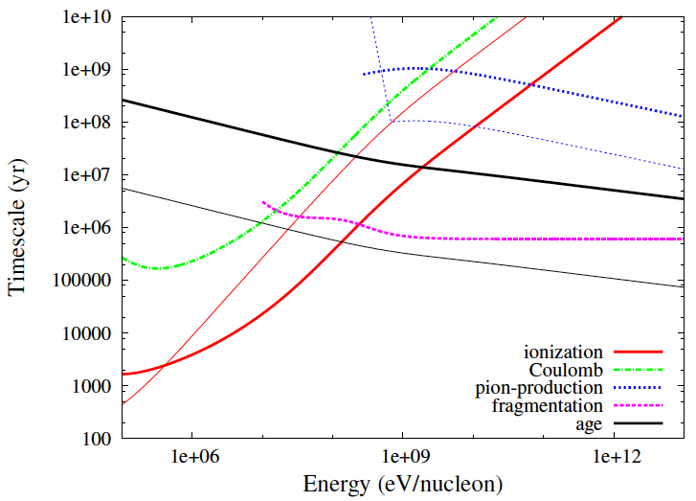
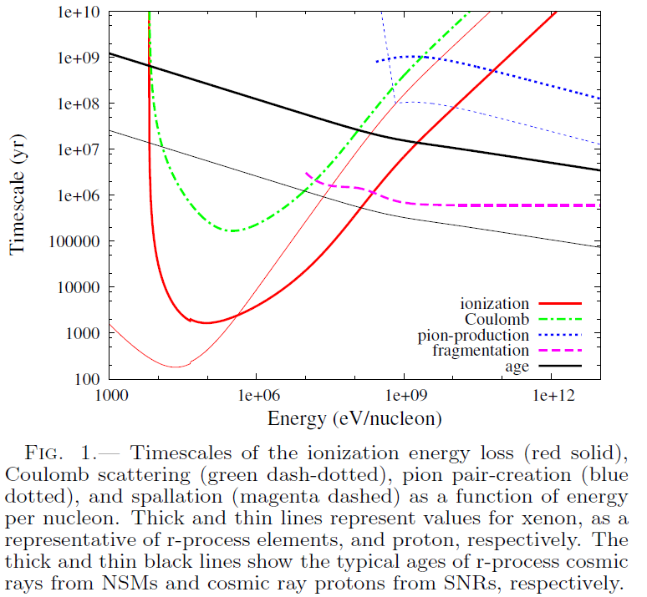
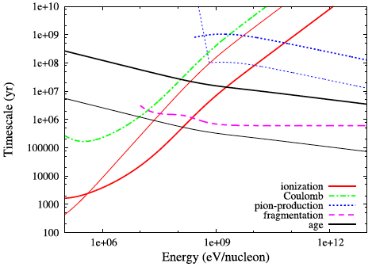



Energy loss, spallation
Energy loss
Ionization
Coulomb scattering
Pion pair-production
Spallation
Timescale from the most recent event which contributes to CR observations
Diffusion timescale
Event rate
Typical timescale
NSM
SN
UHCRs from NSMs suffer ionization energy loss and/or spallation
(Cosmic ray protons from SNe are almost free from decay processes excepting at < 20 MeV)

Slide 8
Numerical model

Slide 9
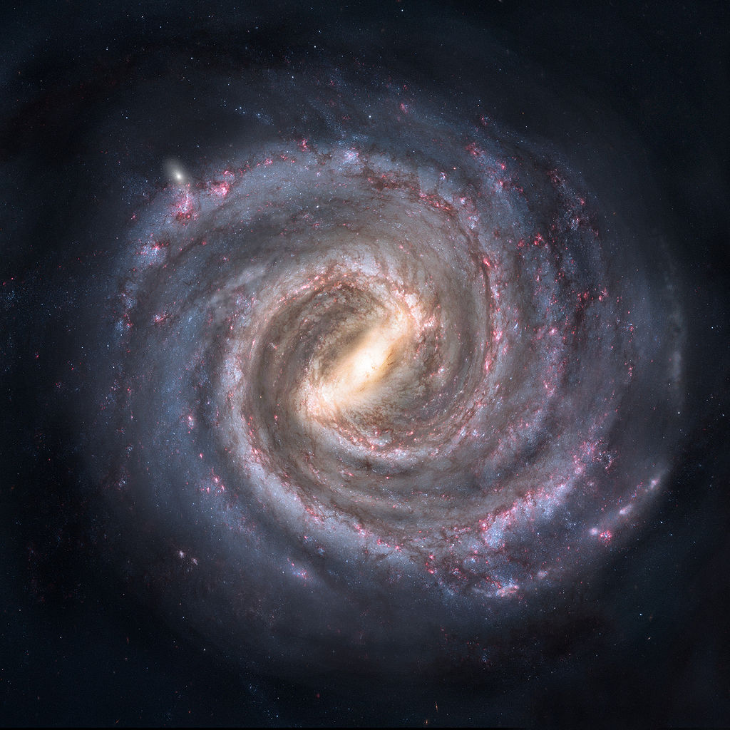
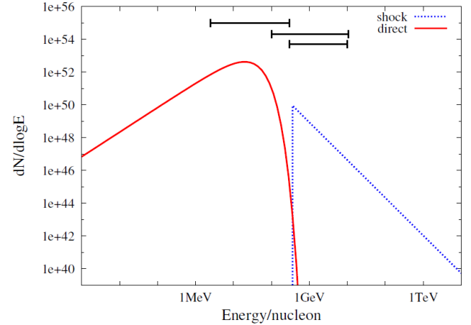



Model
Event rate
R_{SN} ~ 3×10⁴ /Myr/MW
R_{NSM} ~ 10 /Myr/MW
Spatial distribution
∝ exp(r/3kpc) (Exponential disk)
θ: random
NSM ejecta: M = 0.01M_{ʘ}, v = 0.2 c
Propagation (diffusion equation)
diffusion coefficient (Thoudam+ 2016)
Spallation
Energy loss
Ionization
Coulomb, pion-creation
（2次生成物は無視）

Slide 10
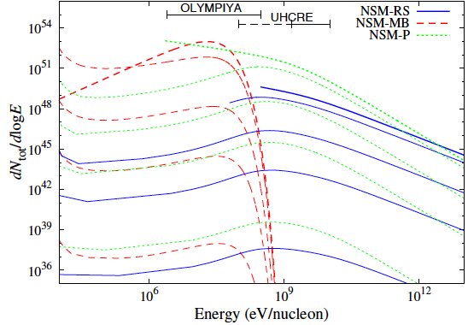


Injection of UHCRs from NSMs
Energy spectra
Reverse shock (NSM-RS)
ε_{CR} = 0.03
Q(p)∝p ^{-2.3}
p_{min} = 300 MeV
Unshocked (Tsujimoto & Shigeyama 2014)
Nuclei in NSM ejecta have large velocity (~ 20MeV/nucleon) ⇒ Stopping length = 2.6kpc
⇒ propagate without energy dissipation by reverse shock
Maxwell-Boltzmann (NSM-MB)
Power law (NSM-P)
Radice et al. (2016)
Q(v) ∝ v ⁻²
(Nagakura et al. 2014)

Slide 11
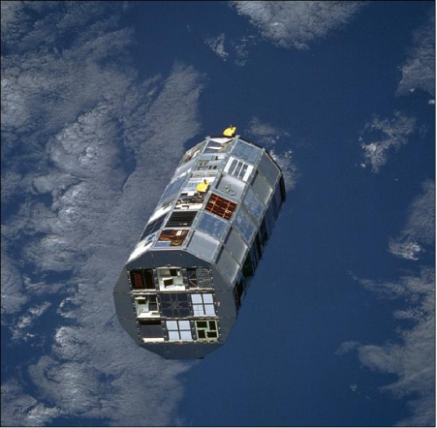
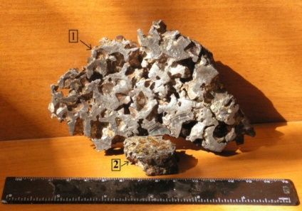
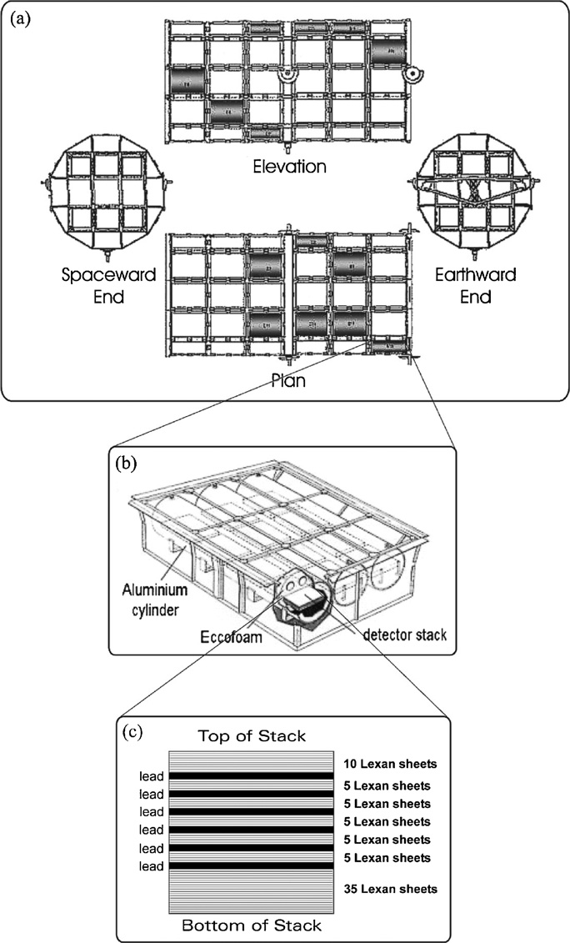
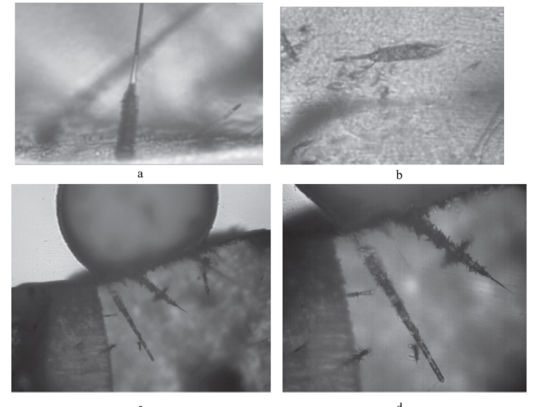
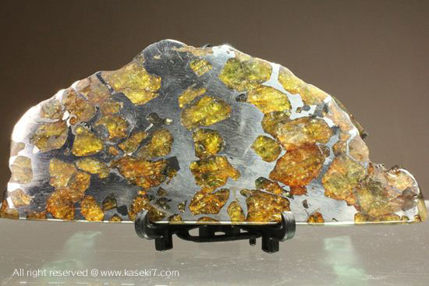



Observations of UHCRs
Energy range
Satellite
E_{low} = 1.5 GeV
E_{upp} = 10.6 GeV (UHCRE, Donnelly et al. 2012)
Meteorite
In olivine crystals in stony iron meteorites, UHCRs create tracks due to induced structure transformations. (Z ≳ 50).
[E_{low}, E_{upp}] = [2.5 MeV, 300 MeV]
Solar modulation
Detection rete

Slide 12
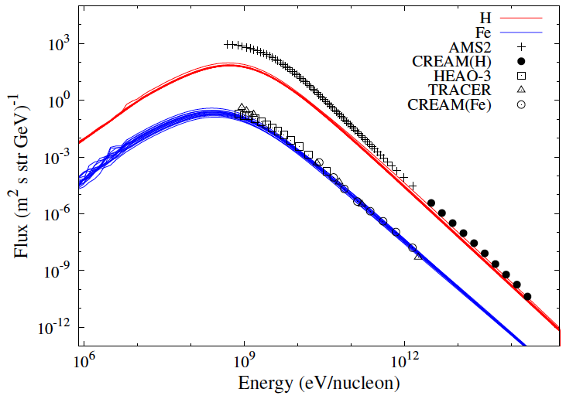
Model calibration
SN forward shock
E = 10⁵⁰ erg
Proton
Iron
Bias: b=200
OK
(Re-acceleration
Thoudam+ 2016)

Slide 13
Results

Slide 14
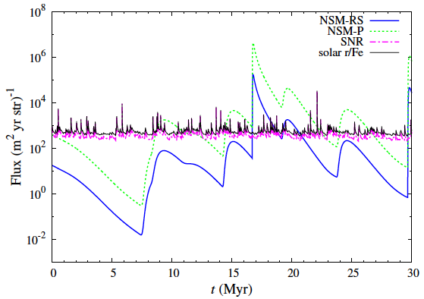
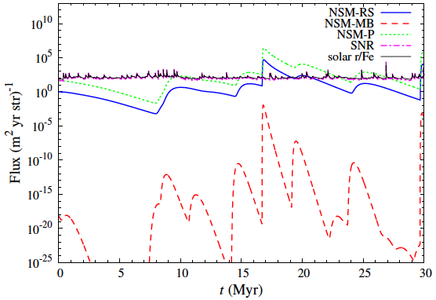
UHCR Flux
Satellite [1.5 – 10 GeV]
Meteorite [2.5 – 300 MeV]
8 dex
25 dex
Very large fluctuation
Many orders of magnitude. Timescale of millions of years.
NSMs are very rare events. Spallation, ionization energy loss
NSM-UHCRs occasionally overwhelms SNR-UHCRs
can be consistent with the solar r-process/Fe

Slide 15
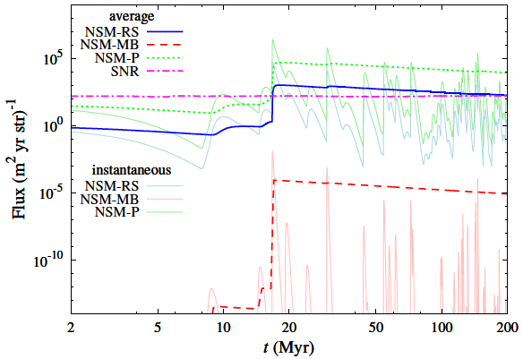
Averaged flux
Meteorites record the cumulative flux with very long exposure time of 3 – 200 Myr
⇒ we may find the evidence of the time variation
The NSM-UHCR flux averaged with very long exposure time overwhelms the SNR-UHCR flux
If NSMs are the main source of UHCR, meteorites with different age show different flux
Dependent on the event history at solar vicinity

Slide 16
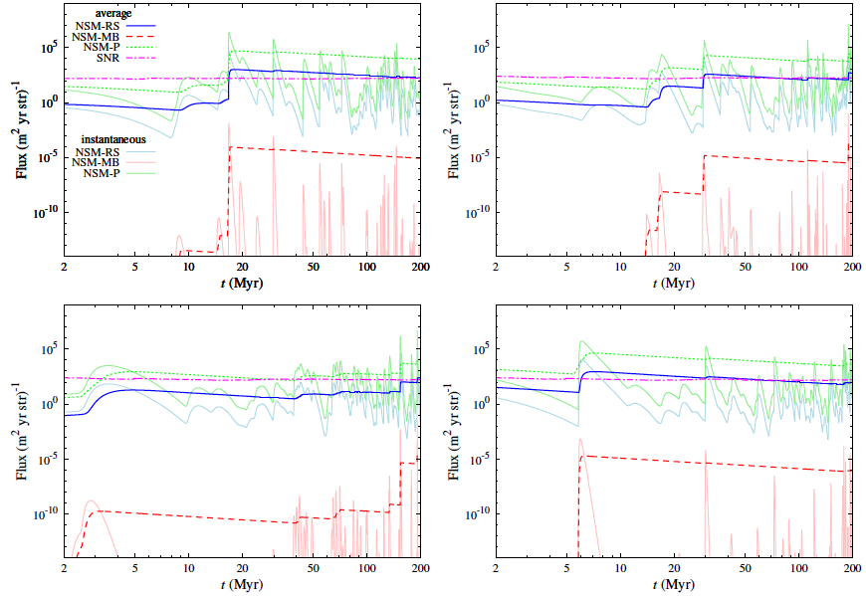

Slide 17
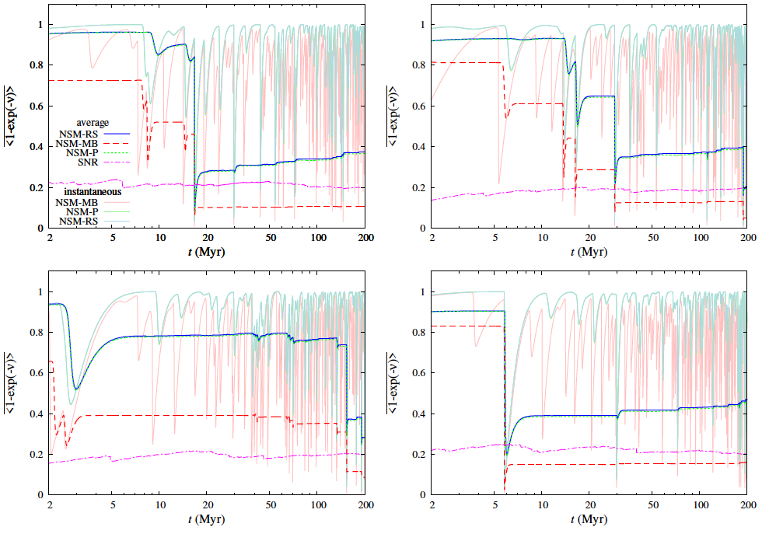

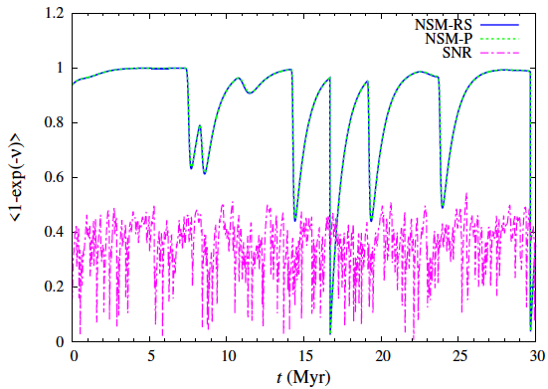
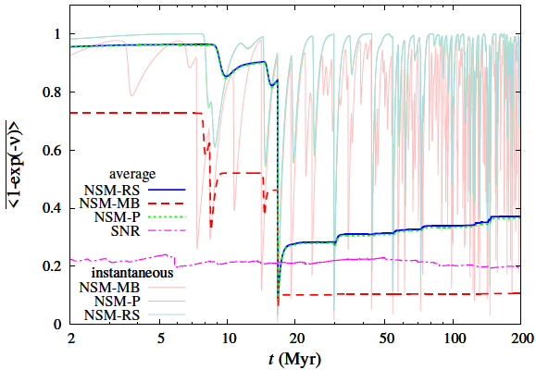
Secondary elements by spallation
Satellite observation
Meteorite observation
and event history of NSM around the sun
secondary/primary ratio also fluctuate with time
secondary/primary ratio is dependent on age of meteorites
secondary/primary ratio observed by satellite and by meteorite can be different

Slide 18

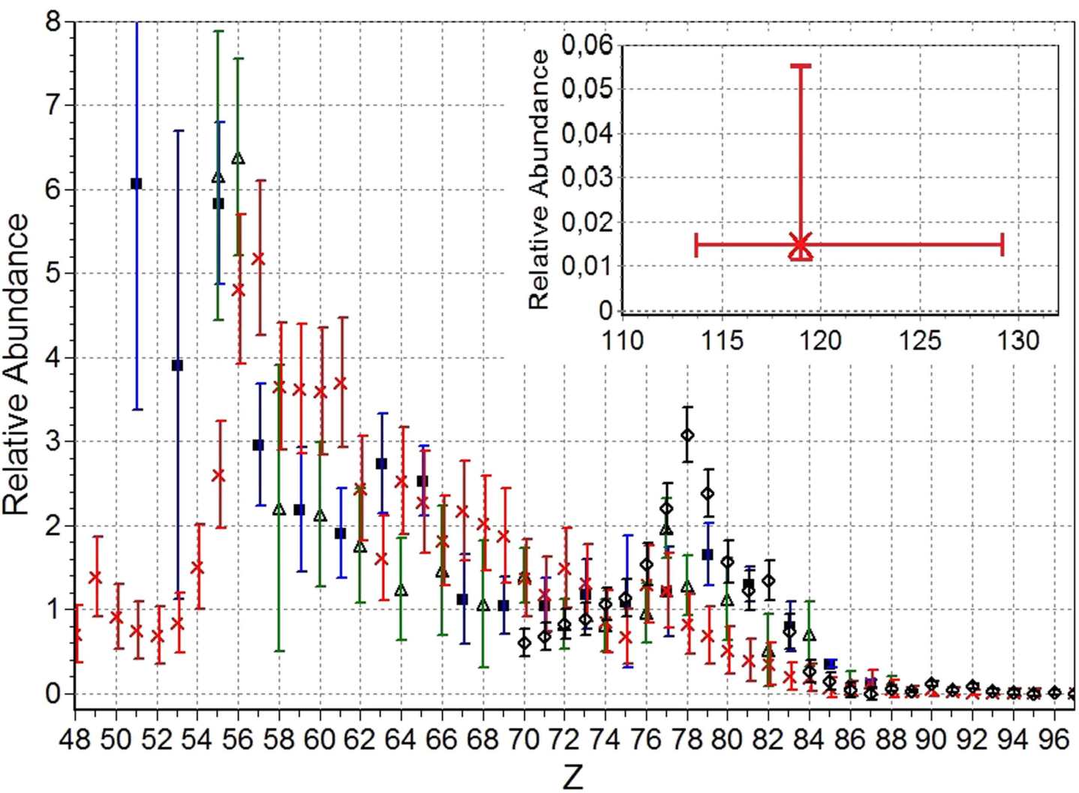
Meteorite experiment
OLIMPIYA experiment (Alexeev et al. 2016)
using two meteorites with ages of 70 Myr and 200 Myr
but they do not show result of each meteorite
The abundance pattern is somewhat different from the result of UHCRE experiment using a satellite.
can be explained by the NSM scenario
but error bars are very large
There are also disagreement between satellite experiments
×: OLYMPIYA
◇: UHCRE
△: Ariel-6
■: HEAO-3

Slide 19
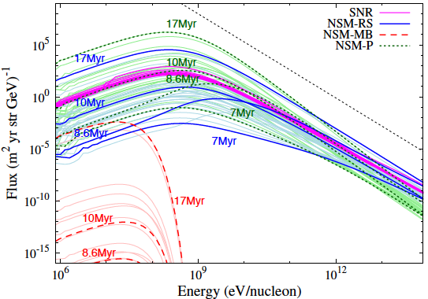
Spectrum
spec

Slide 20
Conclusions
NSMs can be the dominant source of UHCRs
The NSM-UHCR flux wildly fluctuate with time
Timescale: millions of years
Spallation, ionization energy loss
We have possibility to detect the fluctuation using stony iron meteorites
reconstruct the event history of NSMs in the solar vicinity
The proportion of secondary elements also fluctuates
Current observations are not conclusive. Future experiments using meteorites of various age will reveal the origin of UHCRs.
arXiv: 1708.05638

