Slide 1
超新星残骸からの陽子起源ガンマ線
放射スペクトルの変調機構
名古屋大学 理学研究科
井上剛志

Slide 2
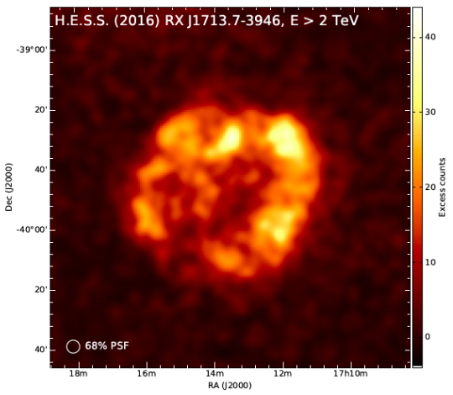
Introduction to RX J1713.7-3946
SNR: RX J1713.7-3946: the brightest TeV γ-ray SNR.
Young and associates strong shock (t_{age} ~ 1000 yr, R ~ 8 pc, v_{sh} ~ 5000 km/s).
Show bright shell-like synchrotron x-ray emissions
(at least electrons are accelerated by 1st order Fermi mechanism at shock).
H.E.S.S. collaboration 16
See also similar young SNRs: Vela Jr., RX J1731

Slide 3
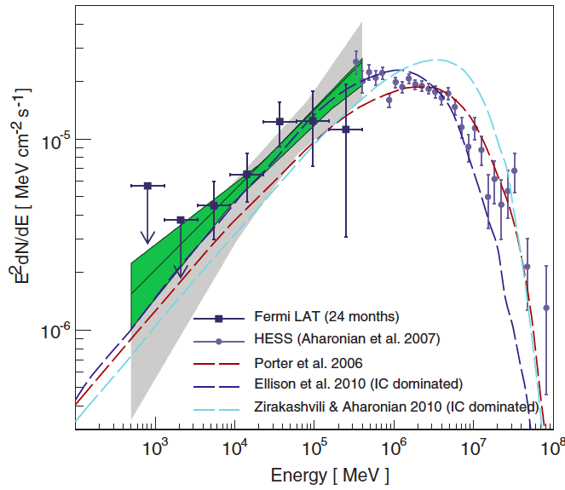
γ-ray Emissions from SNR
Two candidates of γ-ray emission mechanism:
Leptonic emission: e_{acc} + CMB → γ (inverse Compton)
hv ∝ E_{e}² → vF_{v} ∝ v^{(3-p)/2} = v^{1/2} for DSA spectrum: p=2
Hadronic emission: p_{acc} + p_{ISM} → π⁰ → γ (pion decay)
hv ~ 0.1 E_{p} → vF_{v} ∝ v^{2-p} = v⁰ for DSA, if p_{ISM} is distributed uniformly.
If the latter is the case, we can learn CR acceleration efficiency, maximum energy etc…
Recent γ-ray observation of RXJ1713 by Fermi space telescope:
Abdo+11
The Leptonic origin of γ-ray （vF_{v}∝ v^{1/2})
is favored by SNR community.

Slide 4
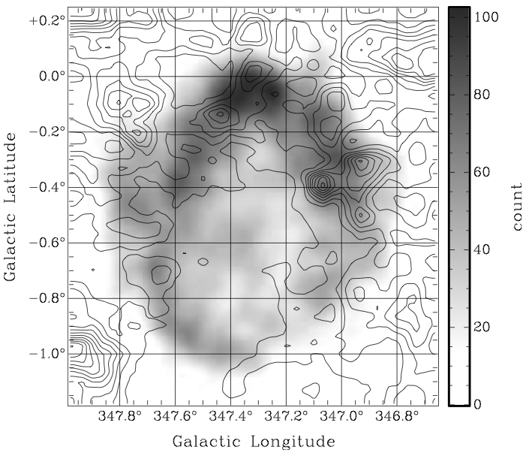
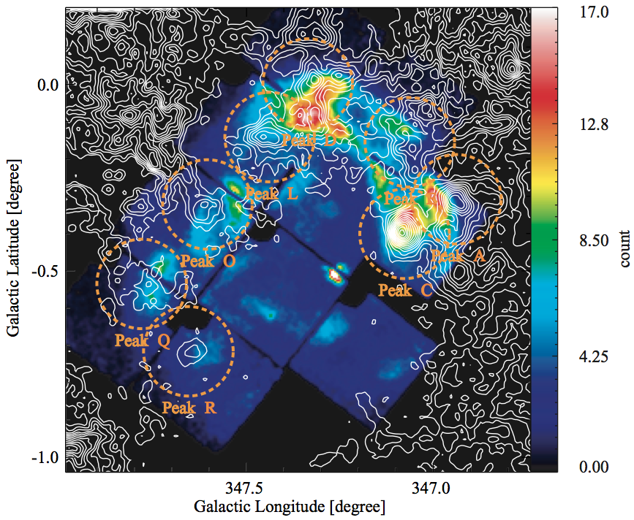
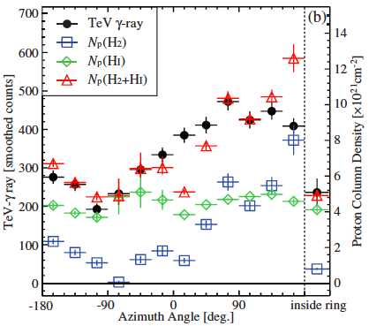
Good Correlation of Gas & Γ-rays
RXJ1713 is well correlated with dense gas (Fukui+03, Moriguchi+05, Fukui+12).
Fukui+12
contour: CO line
gray scale: TeV γ-ray
contour: CO line
color: X-ray
Azimuthal distribution of both γ-ray and n_{ISM} correlate very well （Fukui+12）.
Strong B field amplification up to 1mG supports hadronic γ-rays as well
(Uchiyama+07, Inoue+09, 12 )

Slide 5
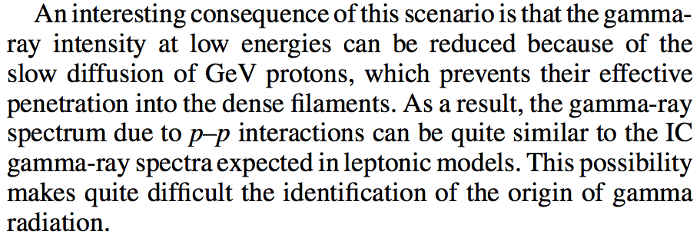
陽子起源スペクトルの変調 1/2
Flat な vF_{v} スペクトルはどのエネルギーの加速陽子も同じ量のISMと相互作用
するという大きな仮定が入っている
Zirakashvili & Aharonian 10: スペクトル変調の可能性の定性的議論
低エネルギーCR
高エネルギーCR
δρ

Slide 6




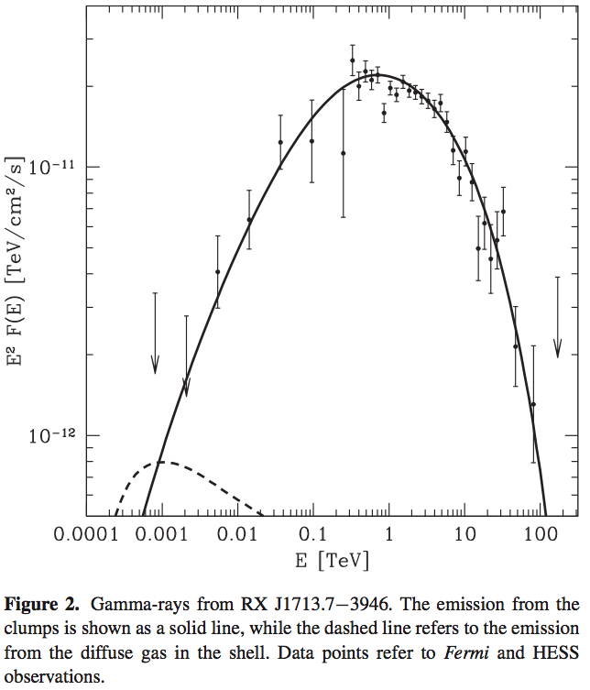
陽子起源スペクトルの変調 2/2
Inoue+12: Bohm-like diffusion ならば GeV-TeV のスペクトル vF_{v} ∝ v^{1/2} が再現
←→ vF_{v} ∝ E² N(E) ∝ (hv)^{1/2}
Gabici & Aharonian 14:
Inoue+12 の設定で実際に拡散浸透させて
観測データと合わせた
For RXJ1713
e_{CR,max} ~ 200 TeV
E_{CR} ~ 0.1 E_{SN}
Total mass of clumps ~ 500 Ms
Clump volume filling factor ~ 0.01
雲内部で Bohm-like な拡散係数は実現されるの？？？

Slide 7
Clumps Irradiated by CRs
Inoue+12
In clumpy ISM, dense clumps are externally irradiated by CRs.
If CRs freely penetrate into cloud, we get conventional flat vF_{v} spectrum.
However, if the stream of CR （current） can induce B-field fluctuation in cloud,
CR propagation is suppressed depending on energy of CR.
Diffusion coefficient of CRs:
high-energy γ
vF_{v}
high-energy CRs
B
low-energy CRs
hv
1 GeV 1TeV
low-energy γ

Slide 8
Clumps Irradiated by CRs
Inoue+12
In clumpy ISM, dense clumps are externally irradiated by CRs.
If CRs freely penetrate into cloud, we get conventional flat vF_{v} spectrum.
However, if the stream of CR （current） can induce B-field fluctuation in cloud,
CR propagation is suppressed depending on energy of CR.
Diffusion coefficient of CRs:
high-energy γ
vF_{v}
high-energy CRs
B
low-energy CRs
hv
1 GeV 1TeV
low-energy γ

Slide 9
Mechanism of Bell Instability
When CRs (mostly protons) diffuse into a clump, thermal electrons follow CRs to keep
charge neutrality (return current).
The return current induces additional Lorentz force to fluid.
Circularly polarized Alfven waves are excited.
B
J_{return} = −J_{CR}
J_{CR}
Bell 04

Slide 10
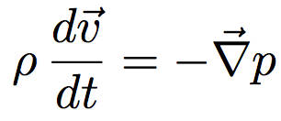

Basic Equations and Δt (1)
Inoue+17 in prep.
Basic equations for CR streaming into cloud.
Return current to keep charge neutrality
Bell MHD eqs. for fluid + B-field dynamics:
CR diffusion due to
pitch angle scatterings
Diffusion convection eq. for CR streaming:
Required resolution Δx and timestep Δt.
the most unstable scale of Bell instability is L_{Bell}~ 5×10¹⁴ cm
→ Δx < L_{Bell} /50 ~ 10¹³ cm, while L_{cloud} ~ 1pc ~ 10¹⁸ cm → N_{cell} > 10⁵

Slide 11
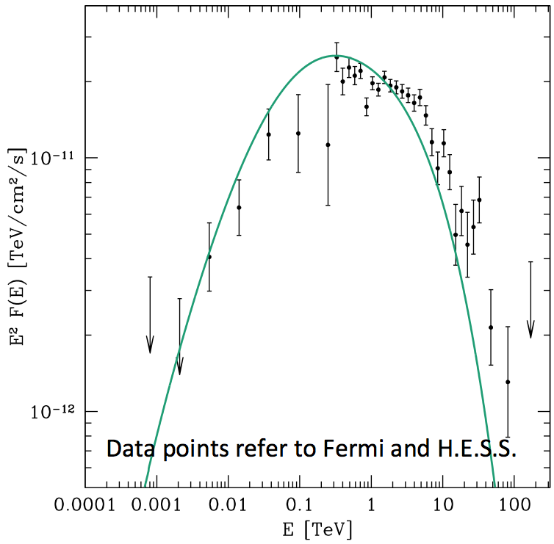
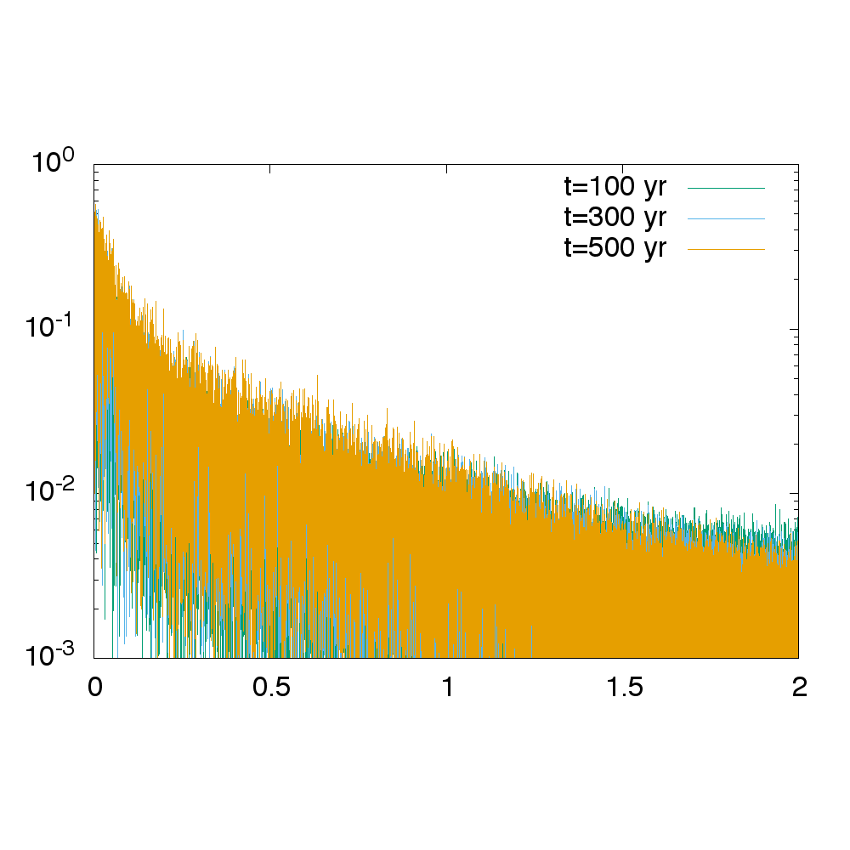
δB Generation by Bell Instability
Inoue+17 in prep.
Result of simulation of cloud irradiated by CRs (N_{x}=10⁵, N_{p}=128, 4th order MUSCL scheme).
Set CRs with f (p) = F₀ p⁻⁴ exp(-cp/300TeV) (for p > 0.1 GeV/c) at x=0 (surface of cloud).
At beginning, high-energy CRs freely penetrate into cloud, which induce current in cloud
The induced current generates δB and prevent low-energy CR penetration.
Synthesized γ-ray spectrum
vF_{v}
v^{0.5}
δB/B
distance from cloud surface : x [pc]
photon energy : log(E [GeV])
← 10万 cellsで分解 →

Slide 12
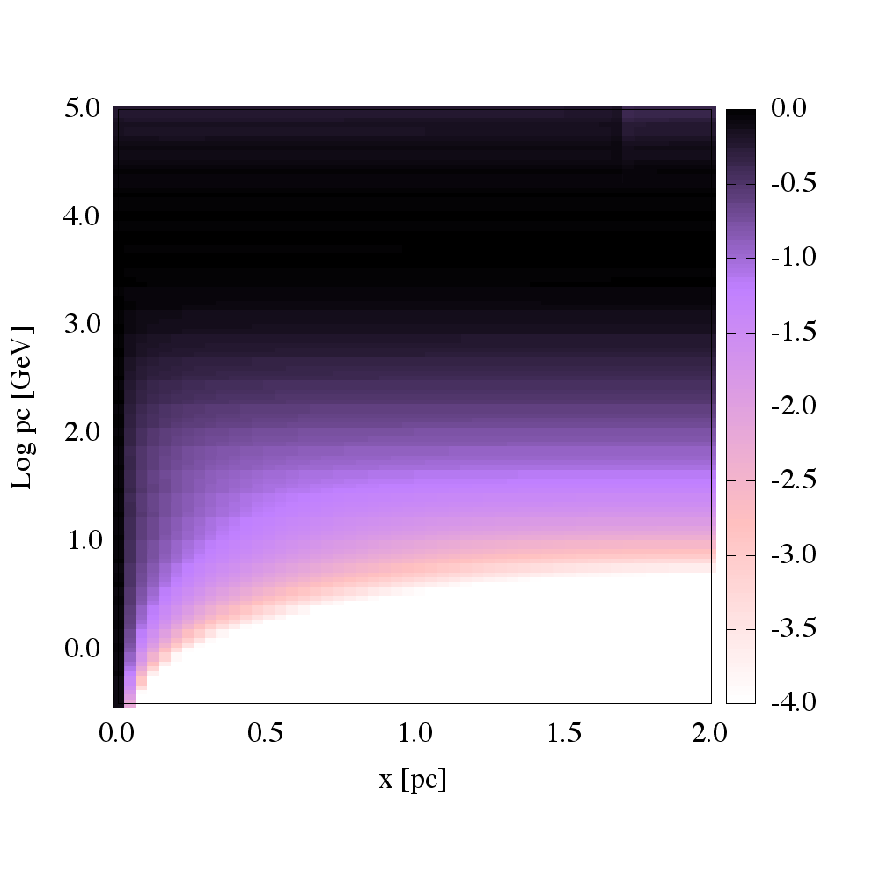
Spatial Variation of Spectrum
γ-ray spectrum varies with emission region in cloud.
More flattened in surface region because of easier penetration for GeV CRs.
CR abundance normalized by cloud surface abundance
Synthesized γ-ray spectrum
CR energy : log(E [GeV])
distance from cloud surface : x [pc]
photon energy : log(E [GeV])

Slide 13
Summary
RXJ1713 からのガンマ線放射は電子起源であると言われているが…
Clumpy な ISM を考慮すると陽子起源の放射でも hardening の可能性が可能
＊分子雲は熱的不安定性の影響で必ず clumpy
Inoue+12, Inoue & Inutsuka 12
過去の研究では分子雲に浸透する宇宙線の拡散係数を都合良く仮定していた
Inoue+12, Gabici & Aharonian 14
宇宙線を分子雲クランプに流し込む超高分解能数値実験を Bell MHD+拡散輸送
方程式を解くことで行った
宇宙線の伝搬に起因する Bell 不安定によって磁気乱流が生成され、乱流による
宇宙線拡散の抑制で実際に観測と無矛盾なスペクトル変調が発生することを確認
クラウド表面からよりフラットなスペクトルを持つガンマ線放射が観測されると予言
Inoue+17 in prep.

