Slide 1
Particle-In-Cell Simulation of Relativistic Shocks Propagating into the Inhomogeneous Media
Sara Tomita and Yutaka Ohira
(Aoyama Gakuin University)
高エネルギー宇宙物理学研究会2017, 9/5 ~ 9/7 in 京都大学
Notes:
My name is Sara Tomita. I am a graduate student in Aoyama University.
I will be talking about Relativistic Unmagnetized Collisionless Shocks Propagating into the Inhomogeneous Media.

Slide 2


Amplified B-field in GRBs afterglows
GRB afterglow observations suggest that magnetic fields are strongly amplified in large emission regions.
$ε_{B}=\frac{{B^{2}}/{8π}}{Γmnc^{2}}\sim {10}^{−8}−$ ${10}^{−3}$ Average: ${10}^{−5}$
→Post-shock magnetic fields are amplified to about 100 times the shock-compressed value.
(Santana et al. 2014)
25
20
Percentage of GRBs
(out of 35)
15
10
5
0
Kumar et al. 2015
-8.0
-7.0
-6.0
-5.0
-4.0
-3.0
$$\log_{10}{ε_{B}}$$
Notes:
The observation of GRB afterglow suggests that the magnetic fields are amplified in the large downstream region.
According to the recent study, the ratio of the magnetic field energy density to the shock kinetic energy density $epsilon_{B} has a large range,
and the mean value is about ten to the minus five.
This means that post-shock magnetic fields are amplified to about one hundred times the shock-compressed value.

Slide 3
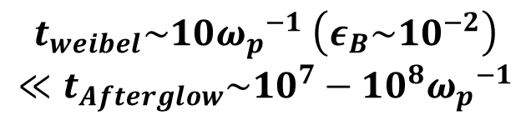


B-field amplification by theWeibel instability
Weibel instability
is a possible generation process of magnetic fields.
occurs in an anisotropic temperature plasma.
Previous PIC simulations :
Magnetic fields produced by
the Weibel instability cannot
occupy large downstream regions
because of the rapid decay.
Spitkovsky et al. 2008
Density
$ε_{B}$
Averaged density
$$ε_{B}$$
$$t_{weibel}\sim 10{ω_{p}}^{−1} \left(ε_{B}\sim {10}^{−2}\right)$$
$$≪t_{Afterglow}\sim {10}^{7}−{10}^{8}{ω_{p}}^{−1}$$
Notes:
The Weibel instability is thought to be important for the particle acceleration and generation of magnetic fields.
It is excited by plasma with anisotropic velocity distribution existing around shock front.
However, pic simulations show that the magnetic field by the Weibel instability rapidly decay.
So, the simulation results cannot explain the GRB observations.
------------------------------------------------------------------------------
Picシミュレーションを初めて見た人用。
This figures show particle-in-cell simulation results of a relativistic collisionless shock.
The shock is located at around this region.
As you can see, the magnetic field generated by the Weibel instability decays rapidly in the downstream region.
So, the simulation results cannot explain the GRB observations.

Slide 4
Purpose of our study
Previous studies :
Nonlinear evolution of the Weibel instability for shocks in uniform plasmas → B-fields rapidly decay.
However, there must be some density fluctuations in the interstellar and circumstellar media.
In this study :
We investigate a magnetic field amplification in the downstream region of the relativistic collissionless shock propagating to the inhomogeneous ISM,
by using two-dimensional PIC simulations.
今回の話：非一様な場合では、GRB残光の観測が示唆するように、
衝撃波下流の広範囲で、磁場が増幅される可能性が見られた！
Notes:
So far, nonlinear evolution of the Weibel instability has been investigated for shocks in uniform plasmas.
(In this case, the Weibel mode decay rapidly.)
However, there really must be density fluctuations in the interstellar medium.
In this study, by means of two-dimensional PIC simulation, we investigate the evolution of magnetic fields in relativistic collisionless shocks propagating to an inhomogeneous media.

Slide 5
Generation of a Temperature Anisotropy
: high-density region
As clumps are convected downstream, high-velocity particles escape from the clump in the shock normal direction.
Shock rest fame
Upstream region Downstream region
upstream rest frame
Shock front
Clumps are
shock-compressed and heated.
Weibel instability
=> B-field generation
Upstream clumps are deformed by Lorentz contraction (in the
downstream frame).
Notes:
Before talking about the PIC simulation, let me explain what we can expect from this study.
We consider an unmagnetized shock propagating to an inhomogeneous plasma, which contains high-density clumps.
The blue circle represents a high density region.
These circles writend with dashed lines are upstream isotropic density clumps in the upstream rest frame.
whose velocity distribution is cold and almost isotropically.
In the downstream rest frame,
The upstream clumps are deformed by Lorentz contraction in the upstream region.
After the clump passes thorough the shock front,
clumps are shock-compressed and heated.
For unmagnetized shocks, the Weibel instability generates magnetic field fluctuations in the shock transition region.
As clumps are convected downstream region, high velocity particles escape from the clump in the shock normal direction.

Slide 6
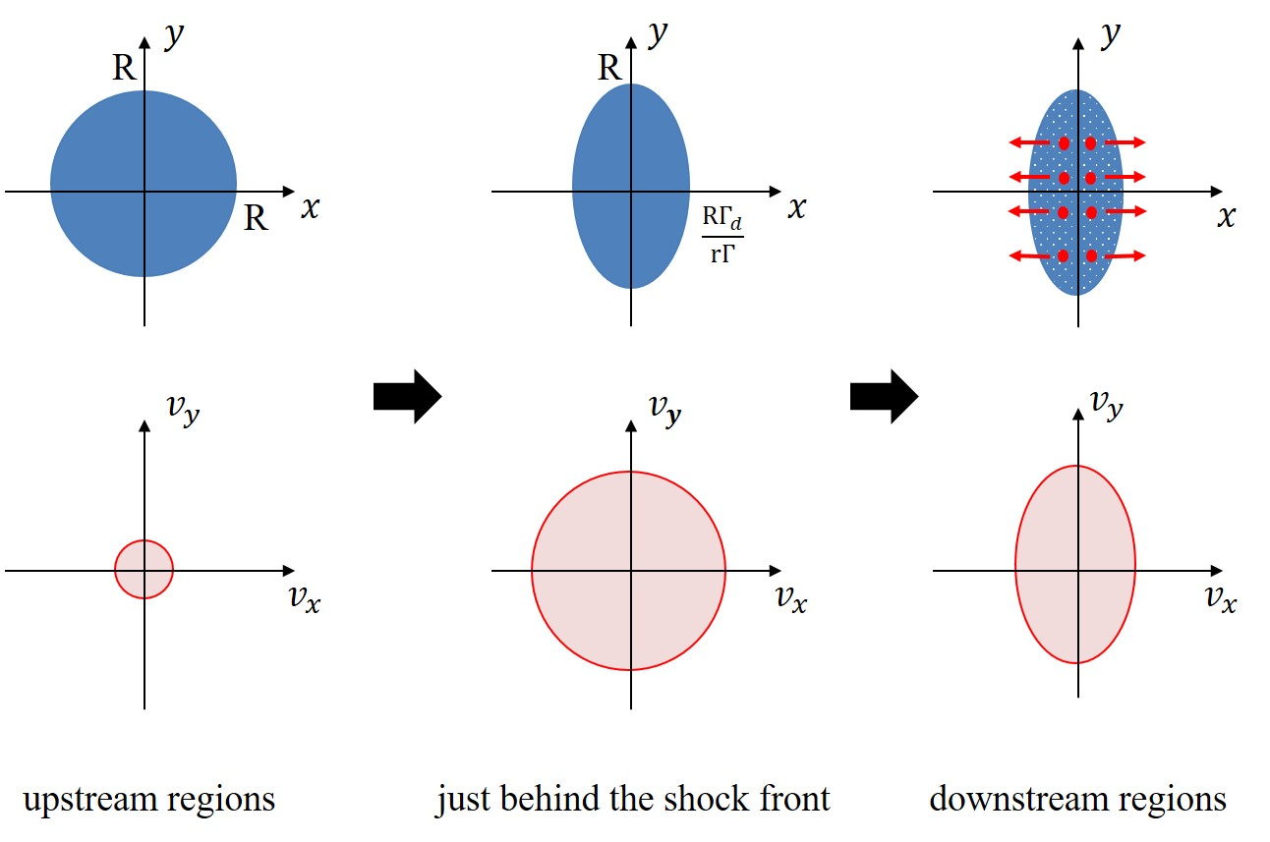
Generation of a Temperature Anisotropy
As a result, a temperature anisotropy appears at the density clump in the downstream region.
=> 2nd Weibel instability.
: high-density region
Shock rest frame
Upstream Downstream
Shock front
Clumps are
shock-compressed and heated.
Upstream clumps are deformed by Lorentz contraction (in the
downstream frame).
Notes:
As a result, a temperature anisotropy would appear at the density clump in the downstream region like this.
And the temperature anisotropy would generate the magnetic field by the weibel instability.
So we can expect that the upstream density fluctuations generate the magnetic field in the downstream region.

Slide 7




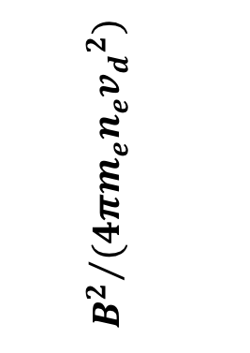

Generation of a Temperature Anisotropy
we solved only the shock downstream region, instead of solving the whole shock structure.
S. Tomita &Y. Ohira ApJ 2016
: high-density region
The time evolution of B-field
downstream rest frame
$${10}^{−1}$$
The 1st Weibel instability
Upstream Downstream
No-uniform
$${10}^{−2}$$
The 2nd Weibel instability !
$${10}^{−3}$$
$${B^{2}}/{(4πm_{e}n_{e}{v_{d}}^{2})}$$
Uniform
$${10}^{−4}$$
0
50
100
150
200
250
300
$$tω_{p}$$
Shock front
Clumps are
shock-compressed and heated.
Upstream clumps are deformed by Lorentz contraction (in the
downstream frame).
Notes:
Then, In order to confirm whether an anisotropic density fluctuations actually generate the temperature anisotropy and magnetic fields or not,
we solve only the shock downstream region, instead of solving the whole shock structure.
As a result, the magnetic field is generated by the Weibel instability after the 1st saturation, because temperature anisotropy is produced by anisotropic density structures in collisonless plasmas.

Slide 8






Simulation Set Up
Two-dimensional electromagnetic PIC code (pCANS)*
(We modify the original code* to suppress numerical Cherenkov instability)
Calculator: Cray XC30 (1000 core) @NAOJ
X-Y plane with periodic boundary condition in the y-direction.
Box Size: $L_{x}=4×{10}^{3}c/{ω_{p}},L_{y}=8×{10}^{2}c/{ω_{p}}$ , Cell Size: ΔX=ΔY=0.1$c/{ω_{p}}$
Unmagnetized $e^{±}$ plasmas ($n_{e^{+}}=n_{e^{−}}$) with Lorentz factor Γ = 2, $v_{th}$=0.1c.
Initial spatial distribution of $e^{±}:$
$$n\left(x,y\right)=n_{0}\left\{1+0.5\sin{(2π(kx})sin(2π(ky)\right\}$$
Downstream region rest frame
$$y=L_{y}$$
Upstream region
Downstream
region
Unmagnetized $e^{±}$ plasma
Injection boundary
Conducting Wall
Γ＝２
Shock front
$$x=L_{x}$$
$$y=0$$
$$x=0$$
Notes:
Then, in order to investigate whether our model actually works, we performed PIC simulation of relativistic collisionless shock propagating to an inhomogeneous electron-positron plasma.We used two-dimensional electromagnetic PIC code, pCANS. To suppress numerical Cherenkov instability, we modified the original code of PCANS.
We set the two dimensional simulation box in the x-y plane with periodic boundary condition in the y-direction.
The simulation box size is 4 thousands times skindepth in the x-direction and 8 hundreds times skindepth in y-direction.
The unmagnetized upstream electron-positron plasma has a Lorentz factor of γ = 2 and thermal velocity of v_th = 0.1c. They are injected at the left boundary and reflected at the right boundary.
In this boundary condition, a collisionless shock propagates to the upstream region with a shock velocity of v≈ −c/3, that is, the simulation is performed in shock the downstream rest frame.
Also we set the initial spatial distribution of the electron-positron plasma in the upstream region like this. These are simulation setup.

Slide 9
Simulation Set Up
Two-dimensional electromagnetic PIC code (pCANS)*
(We modify the original code* to suppress numerical Cherenkov instability)
Calculator: Cray XC30 (1000 core) @NAOJ
X-Y plane with periodic boundary condition in the y-direction.
Box Size: $L_{x}=4×{10}^{3}c/{ω_{p}},L_{y}=8×{10}^{2}c/{ω_{p}}$ , Cell Size: ΔX=ΔY=0.1$c/{ω_{p}}$
Unmagnetized $e^{±}$ plasmas ($n_{e^{+}}=n_{e^{−}}$) with Lorentz factor Γ = 2, $v_{th}$=0.1c.
Initial spatial distribution of $e^{±}:$
$$n\left(x,y\right)=n_{0}\left\{1+0.5\sin{(2π(kx})sin(2π(ky)\right\}$$
Downstream region rest frame
$$y=L_{y}$$
Upstream region
Downstream
region
Unmagnetized $e^{±}$ plasma
Injection boundary
Conducting Wall
Γ＝２
Shock front
$$x=L_{x}$$
$$y=0$$
$$x=0$$
Notes:
Then, in order to investigate whether our model actually works, we performed PIC simulation of relativistic collisionless shock propagating to an inhomogeneous electron-positron plasma.We used two-dimensional electromagnetic PIC code, pCANS. To suppress numerical Cherenkov instability, we modified the original code of PCANS.
We set the two dimensional simulation box in the x-y plane with periodic boundary condition in the y-direction.
The simulation box size is 4 thousands times skindepth in the x-direction and 8 hundreds times skindepth in y-direction.
The unmagnetized upstream electron-positron plasma has a Lorentz factor of γ = 2 and thermal velocity of v_th = 0.1c. They are injected at the left boundary and reflected at the right boundary.
In this boundary condition, a collisionless shock propagates to the upstream region with a shock velocity of v≈ −c/3, that is, the simulation is performed in shock the downstream rest frame.
Also we set the initial spatial distribution of the electron-positron plasma in the upstream region like this. These are simulation setup.

Slide 10
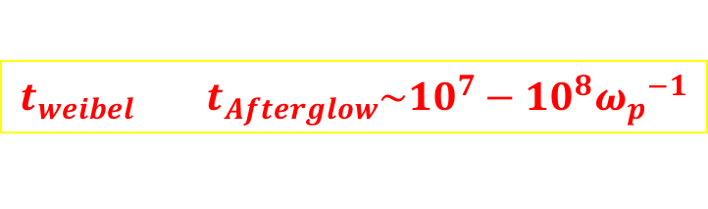
Discussion
Why the be-field is amplified although the temperature anisotropy is generated in the downstream ?
→ Our simulation time
The b-field amplification would take for longer time.
Could the temperature anisotropy explain the b-field suggested by the observation of the GRB afterglow ?
→
The growth time of
the Weibel instability
(the maximum growth rate
for the temperature anisotropy )
$${t_{weibel} t}_{Afterglow}\sim {10}^{7}−{10}^{8}{ω_{p}}^{−1}$$
A: the temperature anisotropy
the temperature anisotropy in the downstream region could explain the observation of the GRB afterglow!
より
Notes:
温度非等方性 5*10^-2が持つエネルギー密度の、
0.1%が磁場のエネルギー密度に変換されれば、
観測¥epsilon_B~10^-5を説明できるかもしれない。

Slide 11
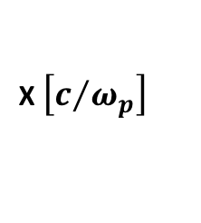

Summary
We have performed the two-dimensional PIC simulation to investigate the b-field generation in the downstream region of collisionless shocks propagating to the inhomogeneous media.
The downstream region keeps the high temperature anisotropy for the inhomogeneous case!
The observed temperature anisotropy is of the order of ${10}^{−2}$.
⇒ It is large enough to generate the magnetic field expected from
observations of GRB afterglows !!
However the magnetic field seems to decay simply
in the downstream region.
we need the larger simulation for a longer time, $ω_{p}t\sim {10}^{4}$.
Notes:
In summary, we found that there is a larger temperature anisotropy in the far downstream region compared with a uniform case, although the magnetic field simply decays.
However the observed temperature anisotropy is sufficiently large to generate the required magnetic field.
So, in order to see the generation of magnetic field by the Weibel instability, we need to perform the larger simulation.
That’s all. thank you.

Slide 12




Weibel instability
The Weibel instability occurs in plasmas with anisotropic velocity distributions.
Ex.) T_{x} > T_{y} , counter streaming plasmas
J
δB
δB
×
×
×
$$e^{−}$$
$$e^{−}$$
$$e^{−}$$
×
×
$$e^{−}$$
J
●
●
●
δB
δB
●
●
J
Counter streaming plasma
+
Magnetic field perturbations, δB
The streaming plasmas are deflected by δB, so that currents are generated.
The currents amplify δB → unstable
The Weibel instability makes magnetic fields.
Notes:
At first, I’ll explain the physical mechanism of the Weibel instability.
The Weibel instability occurs in plasmas with anisotropic velocity distributions.
For example, anisotropic temperature plasma or counter-streaming plasma.
If there are perturbations of magnetic field in the counter-streaming plasma,
the streaming plasmas are deflected by magnetic field perturbations δB, so that currents are generated and
the currents amplify the initial perturbation of magnetic fields δB.
So, the Weibel instability makes magnetic fields.

