Slide 1
Vector and axial-vector mesons in nuclear matter – recent results
Philipp Gubler, Yonsei University, Seoul
Keio University, Tokyo
P. Gubler and K. Ohtani, Phys. Rev. D 90, 094002 (2014). P. Gubler and W. Weise, Phys. Lett. B 751, 396 (2015).
P. Gubler and W. Weise, Nucl. Phys. A 954, 125 (2016).
H.J. Kim, P. Gubler and S.H. Lee, arXiv:1703.04848 [hep-ph].
P. Gubler, S.H. Lee and T. Kunihiro, Phys. Lett. B 767, 336 (2017).
Talk at the YITP Kyoto University
Kyoto, Japan
18. May, 2017
Collaborators:
Keisuke Ohtani (Tokyo Tech), Wolfram Weise (TUM), Hyung Joo Kim (Yonsei), Su Houng Lee (Yonsei), Teiji Kunihiro (Kyoto)

Slide 2








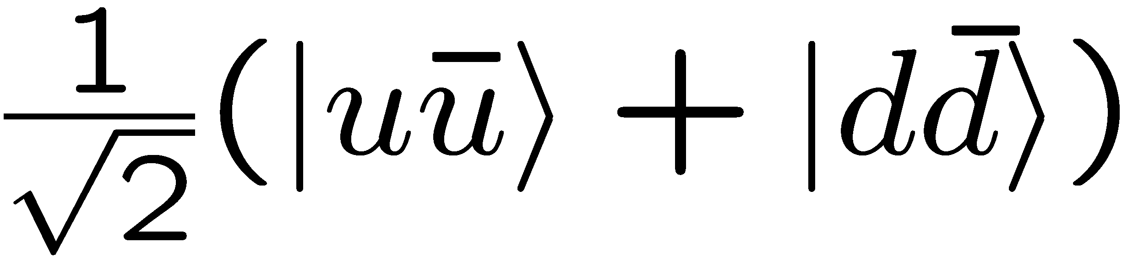
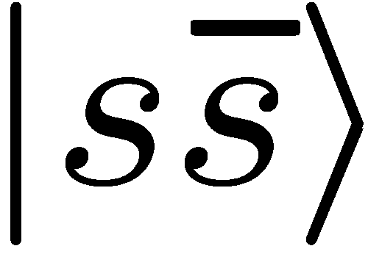
Introduction
Vector mesons
Axial-vector mesons
chiral partners
ρ
a₁
degenerate
degenerate
ω
φ
chiral partners?
f₁
f₁
ideally mixed
ideally mixed?

Slide 3
Introduction
P
P
Axial-vector mesons
Vector mesons
Ｎ
Ｎ
P
chiral partners
P
Ｎ
ρ
Ｎ
a₁
P
Ｎ
degenerate
degenerate
P
P
Ｎ
Ｎ
P
P
Ｎ
P
P
Ｎ
φ
chiral partners?
f₁
f₁
ω
P
Ｎ
Ｎ
Ｎ
P
P
P
P
Ｎ
Ｎ
ideally mixed
ideally mixed?

Slide 4




Introduction
Object of study:
Interest:
φ meson
m_{φ} = 1019 MeV
Γ_{φ} = 4.3 MeV

Slide 5
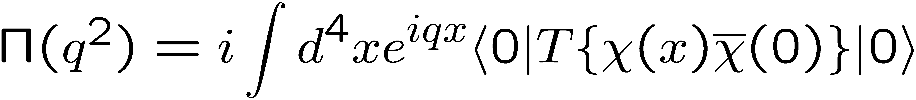
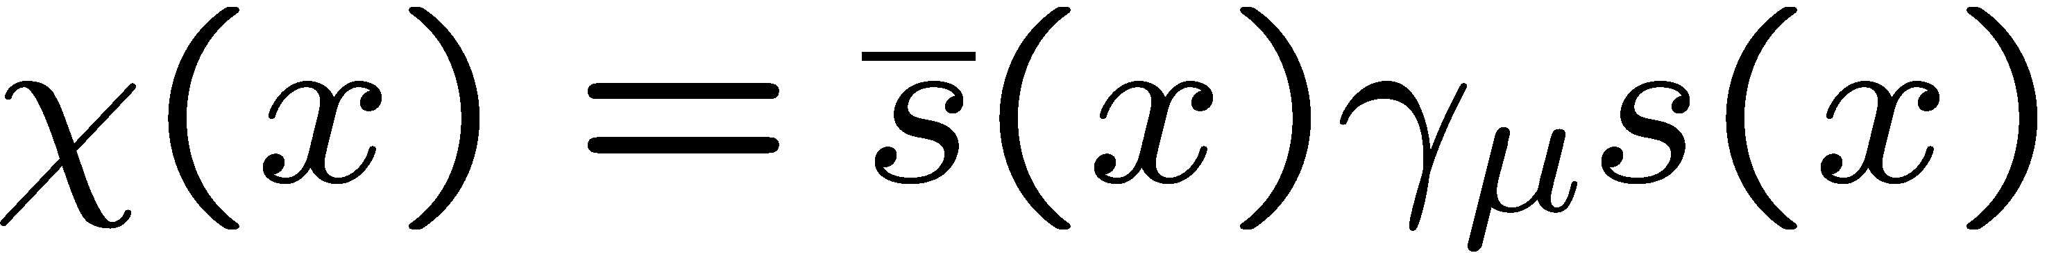
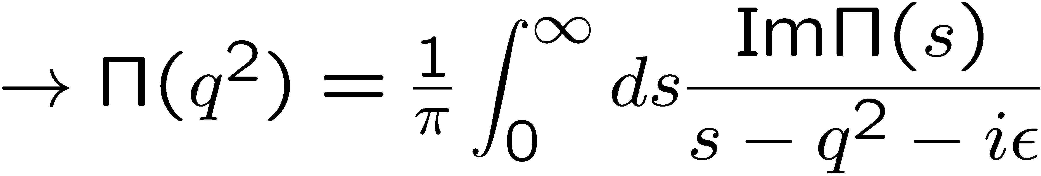
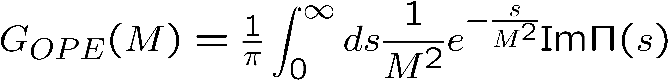
QCD sum rules
M.A. Shifman, A.I. Vainshtein and V.I. Zakharov, Nucl. Phys. B147, 385 (1979); B147, 448 (1979).
Makes use of the analytic properties of the correlation function:
q²
is calculated
“perturbatively”,
using OPE
spectral function
of the operator χ
After the Borel transformation:

Slide 6
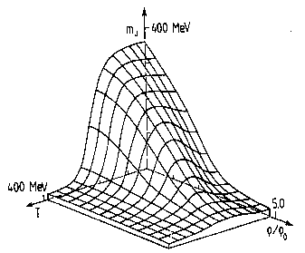
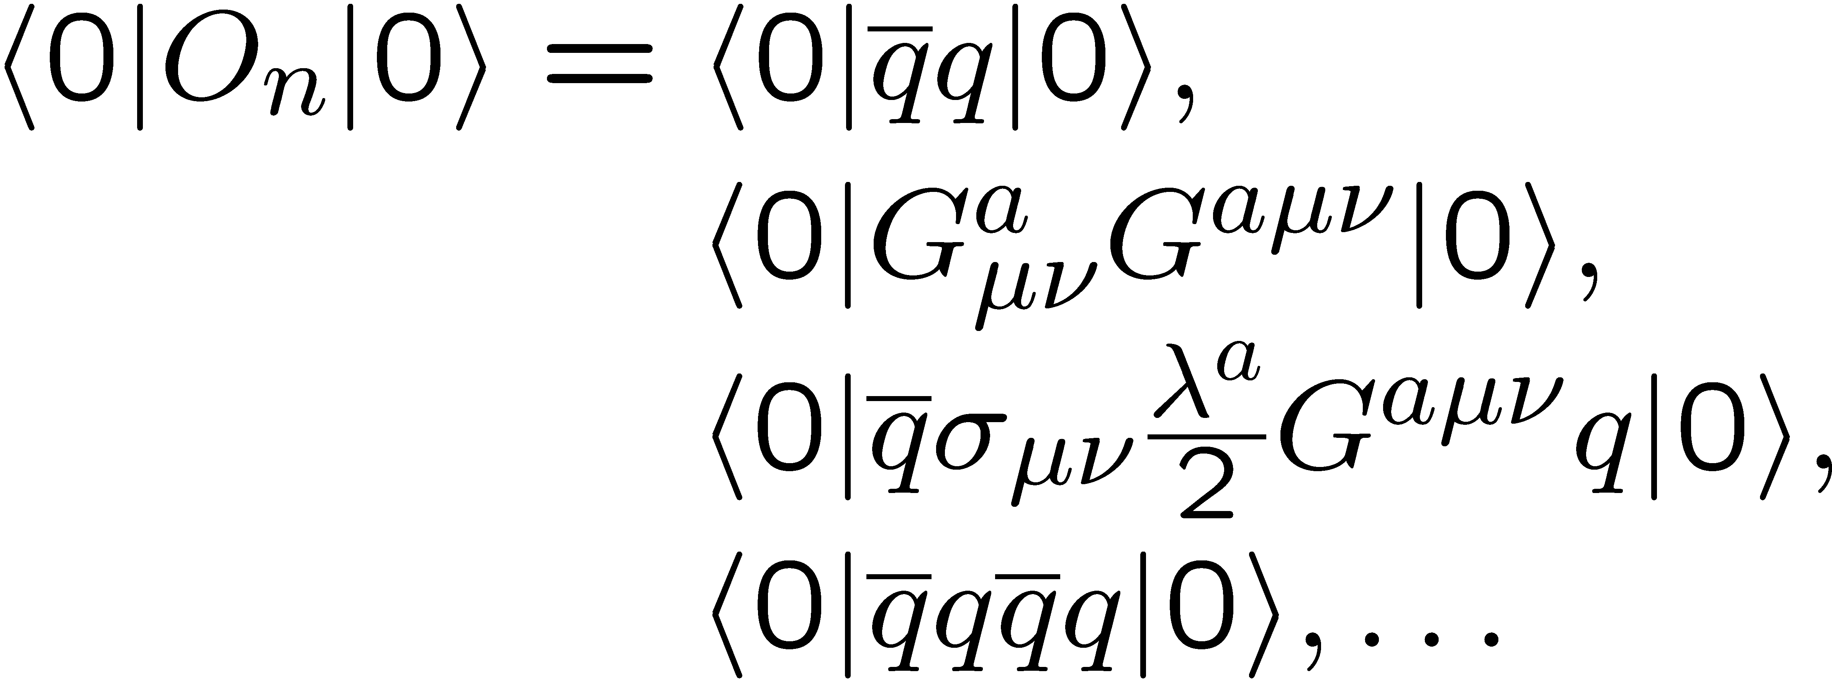
More on the OPE in matter
non-perturbative condensates
perturbative Wilson coefficients
Change in hot or dense matter!

Slide 7
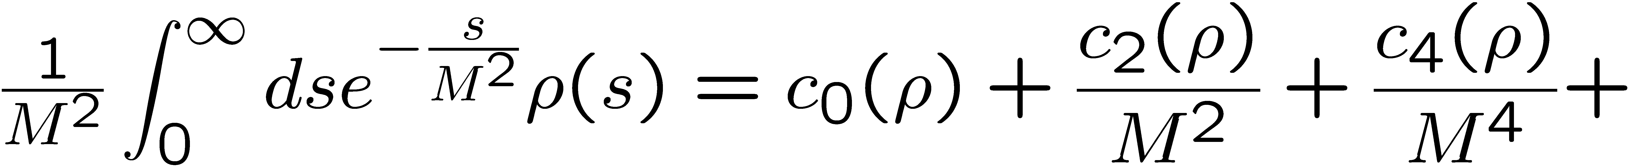
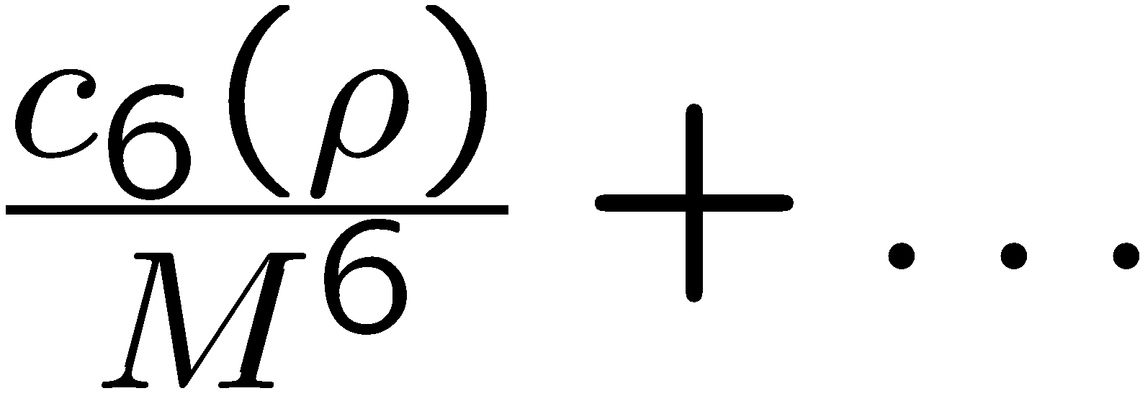
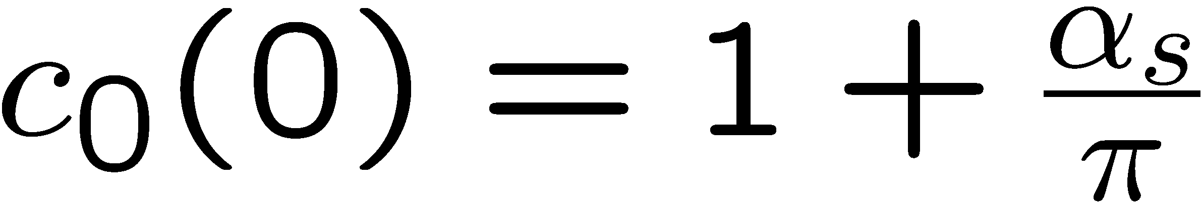
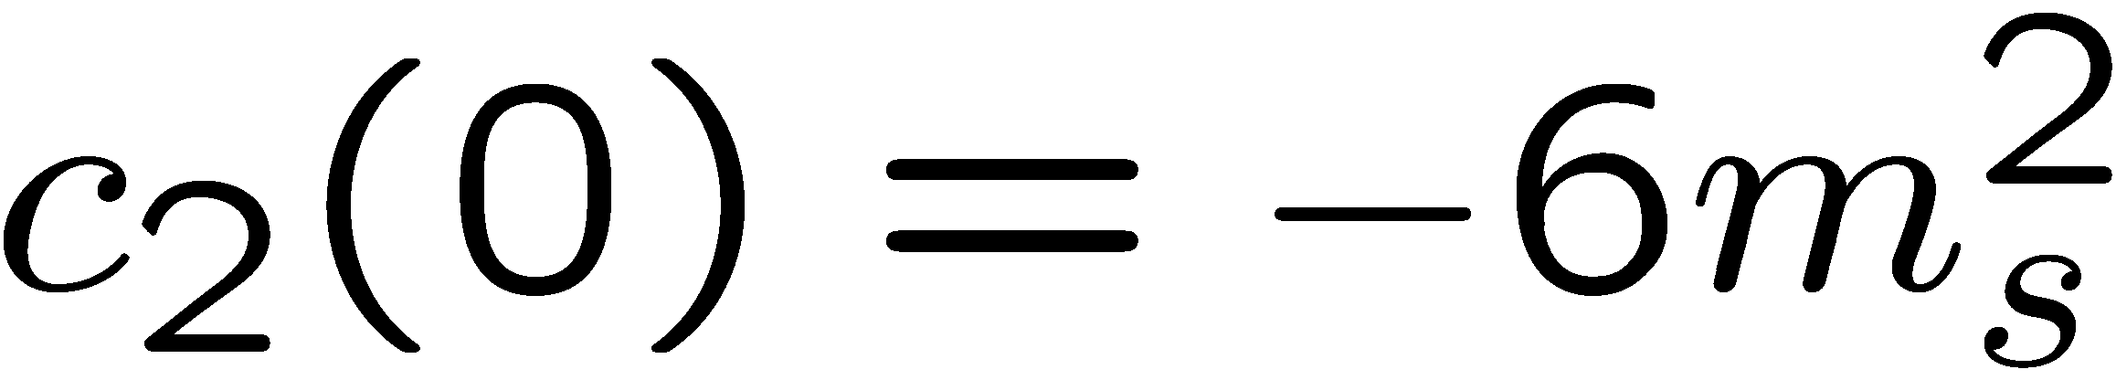
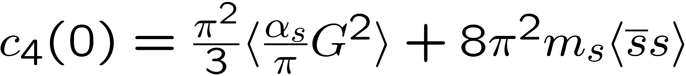
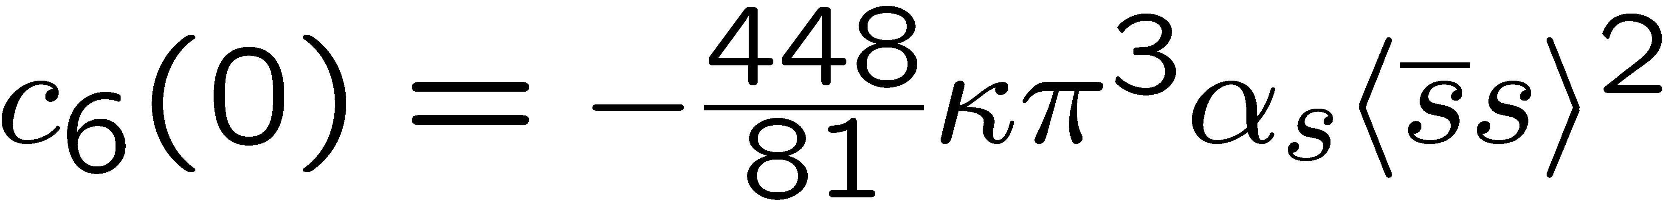
Structure of QCD sum rules for the phi meson
In Vacuum
Dim. 0:
Dim. 2:
Dim. 4:
Dim. 6:

Slide 8
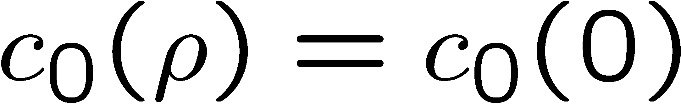
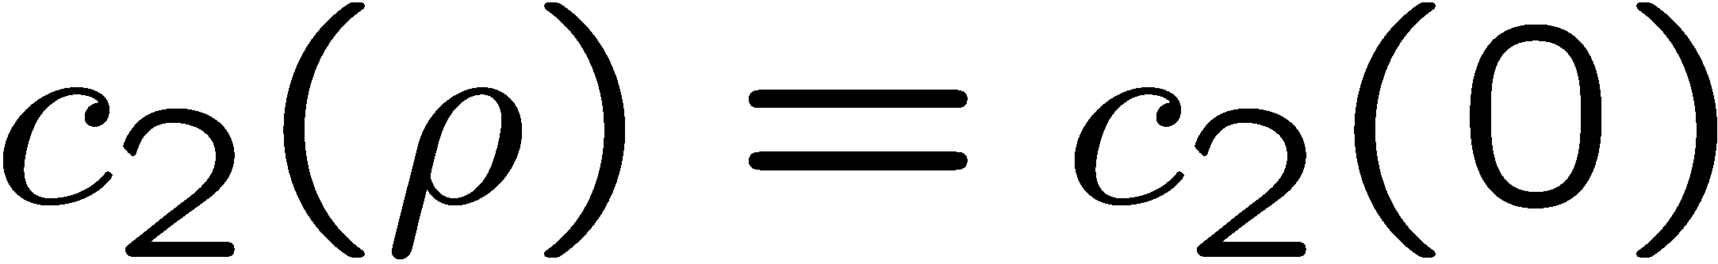
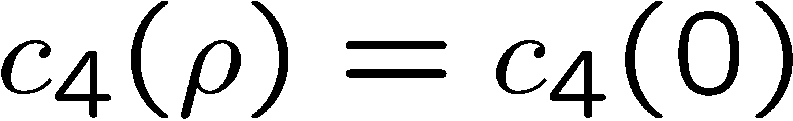
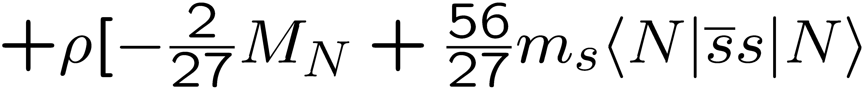
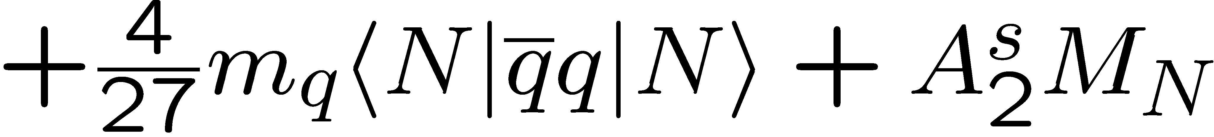
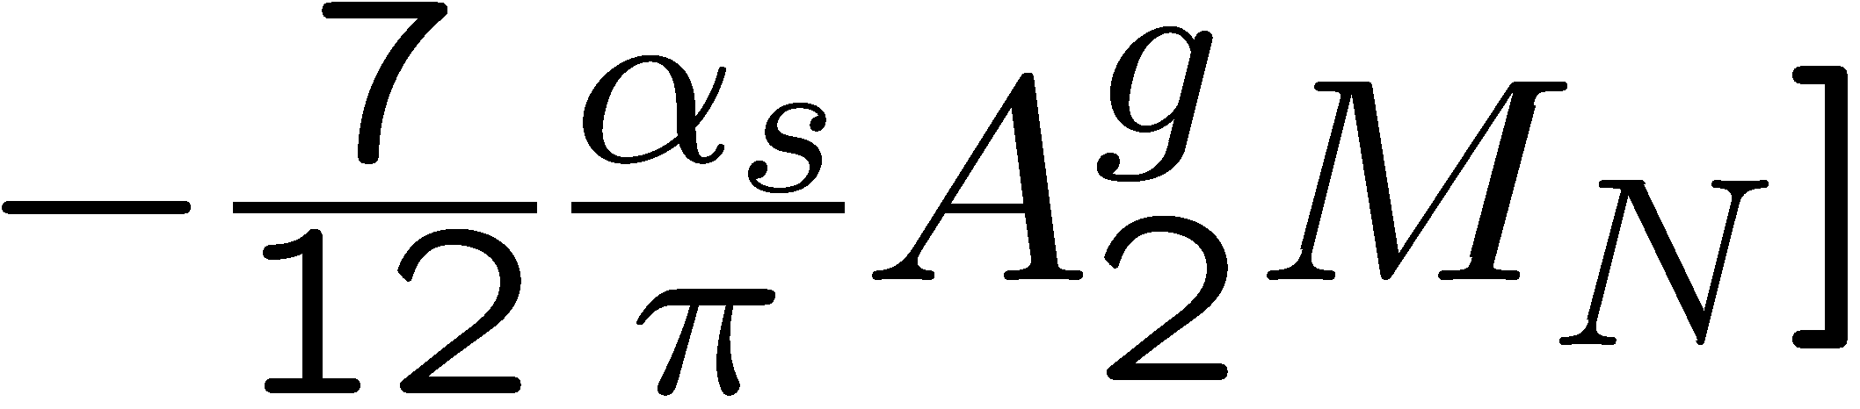
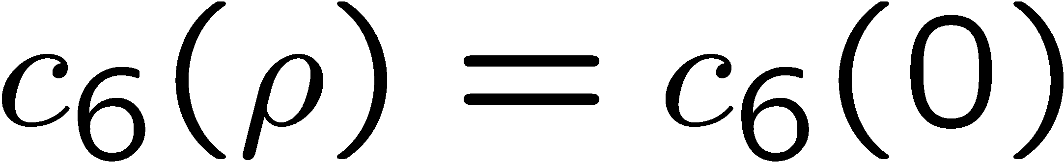
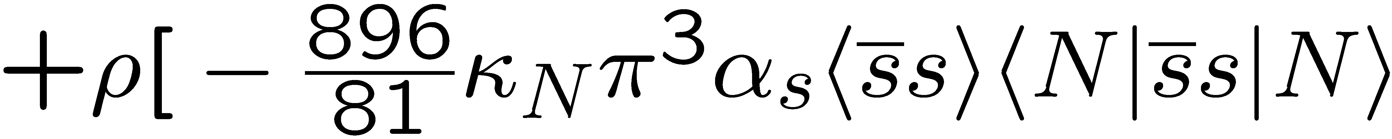
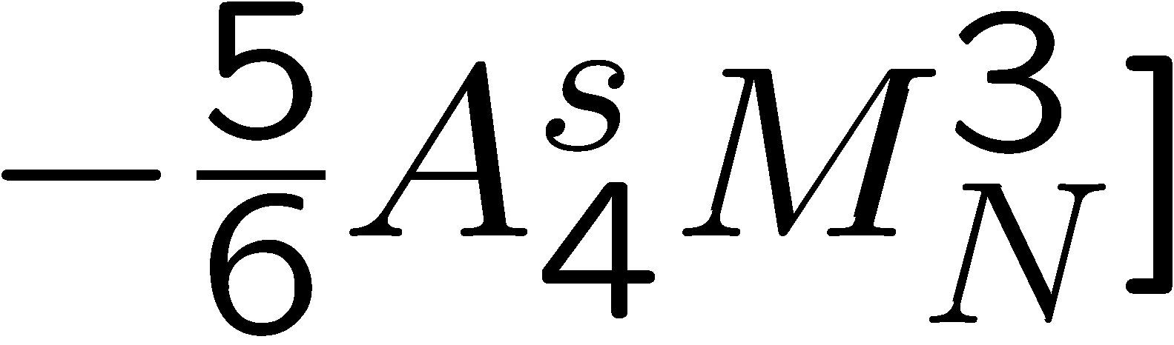
Structure of QCD sum rules for the phi meson
In Nuclear Matter
Dim. 0:
Dim. 2:
Dim. 4:
Dim. 6:

Slide 9
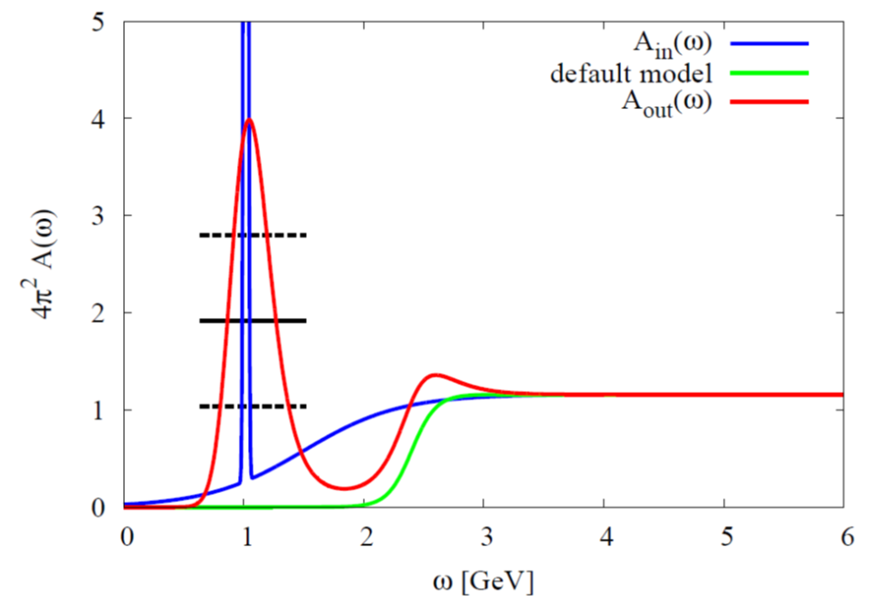
Results of test-analysis (using MEM)
Peak position can be extracted, but not the width!
P. Gubler and K. Ohtani, Phys. Rev. D 90, 094002 (2014).

Slide 10
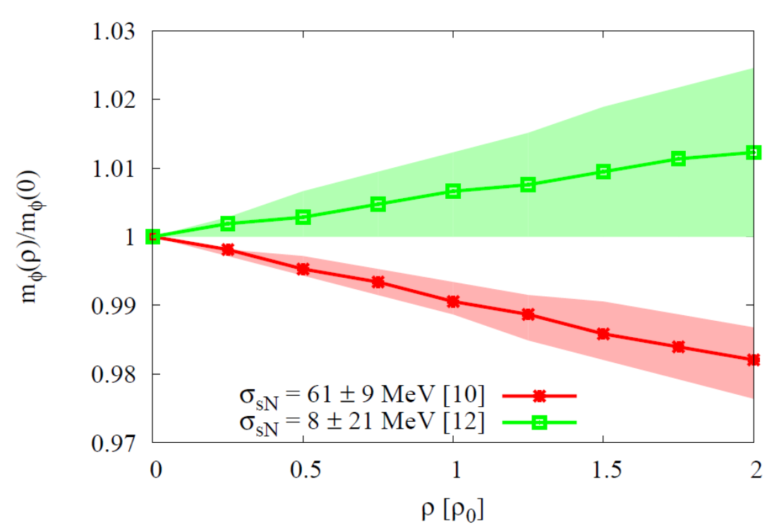
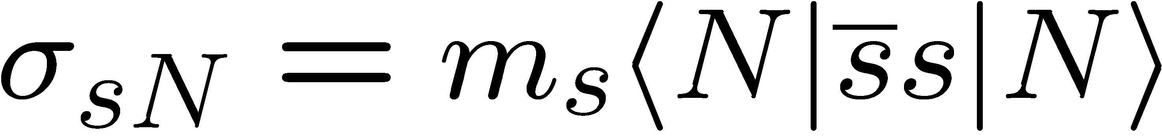
Results for the φ meson mass
Most important parameter, that
determines the behavior of the φ meson mass at finite density:
Strangeness content of the nucleon
P. Gubler and K. Ohtani, Phys. Rev. D 90, 094002 (2014).

Slide 11
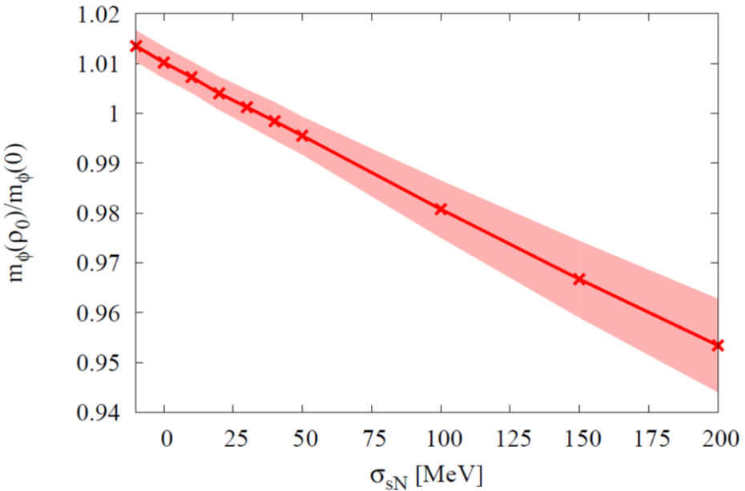
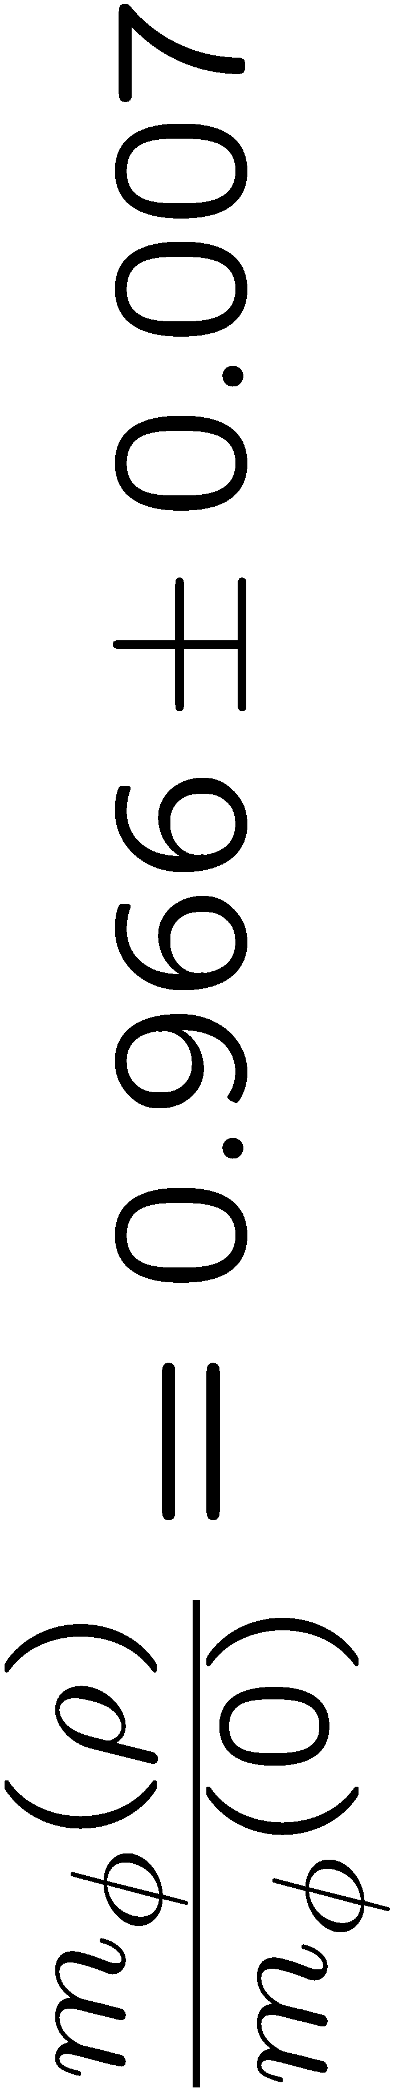
Compare Theory with Experiment
Sum Rules + Experiment
Not consistent?
Experiment
Lattice QCD

Slide 12
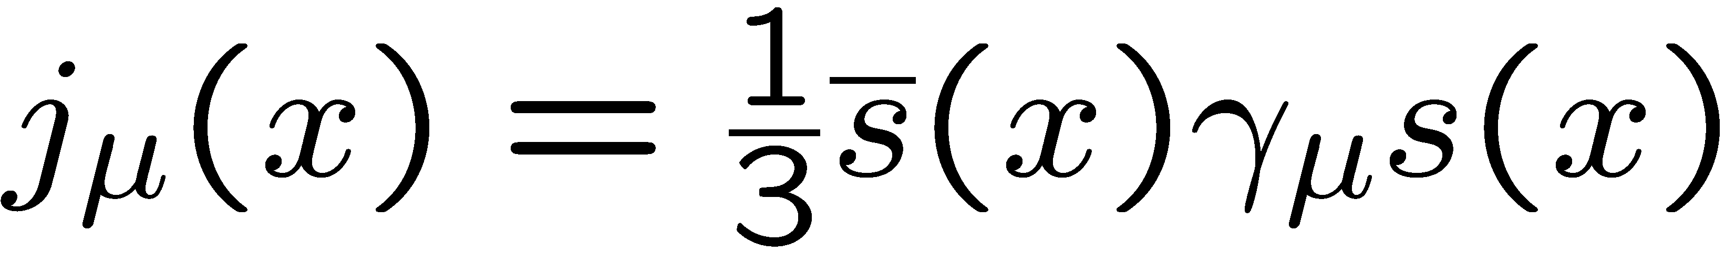
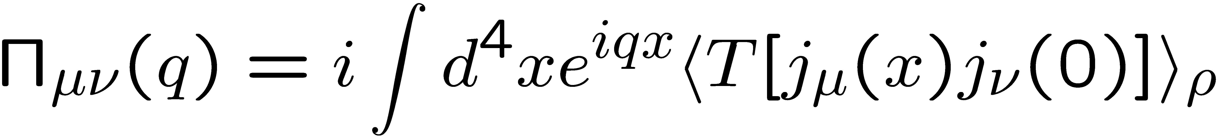

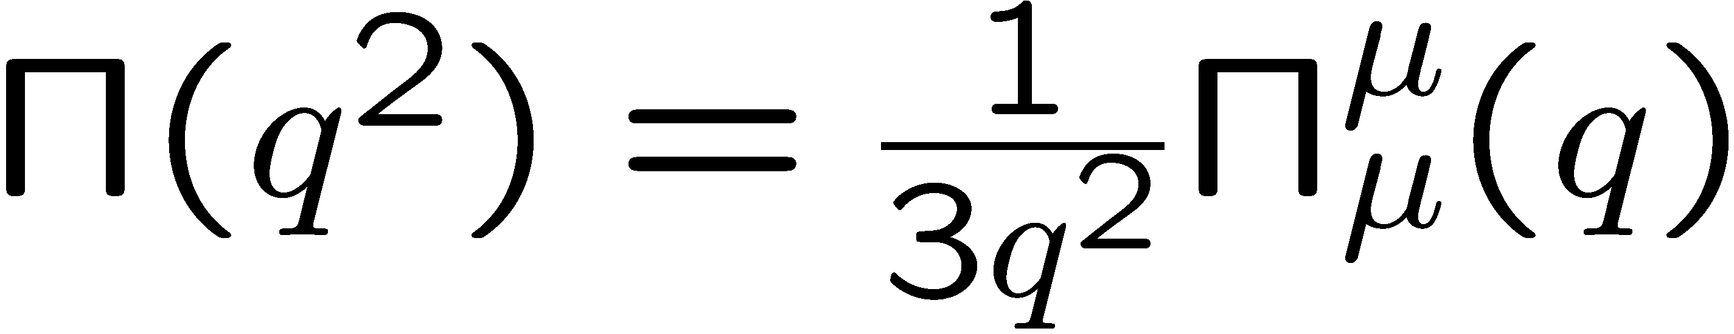
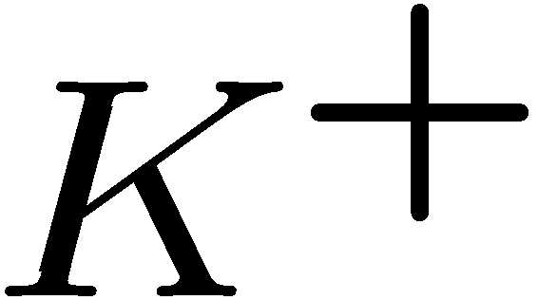
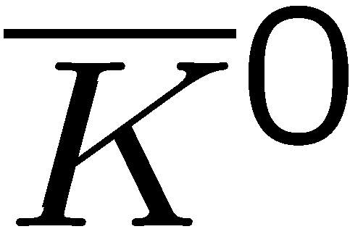
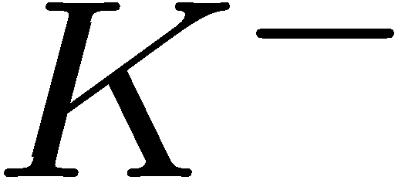
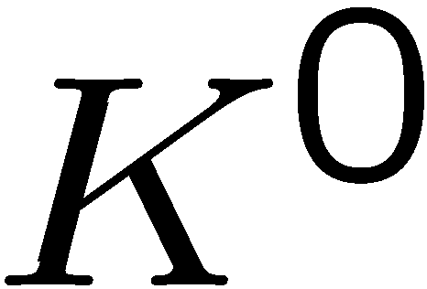
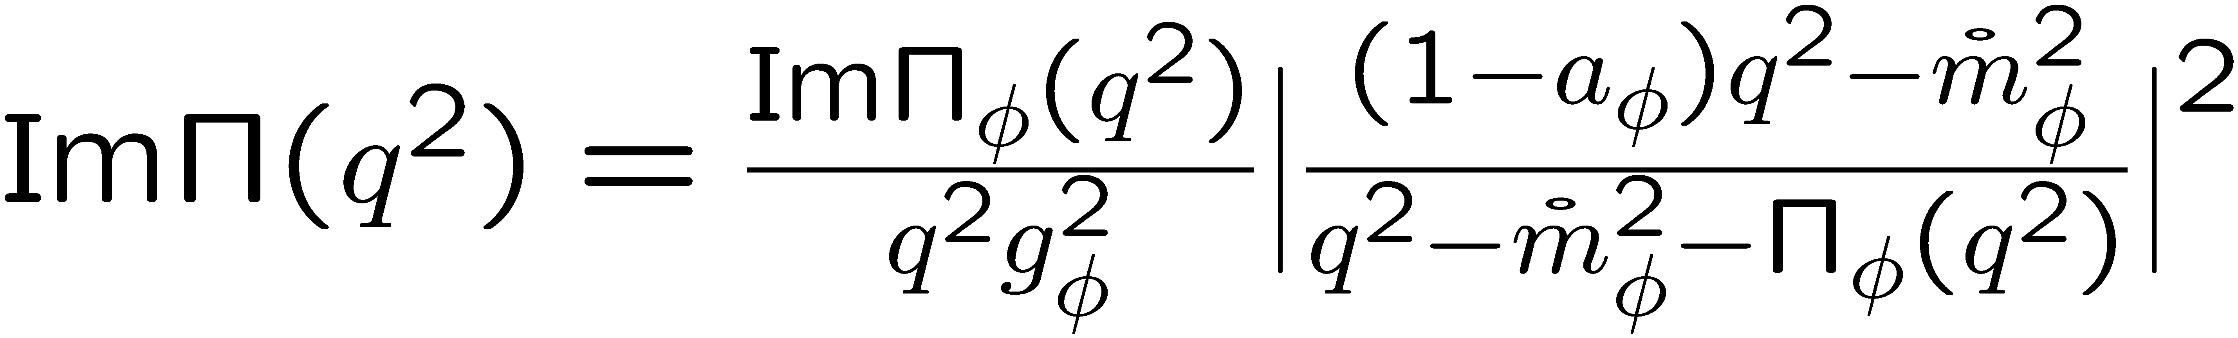
Starting point
Rewrite using hadronic degrees of freedom
(vector dominance model)
Kaon loops

Slide 13
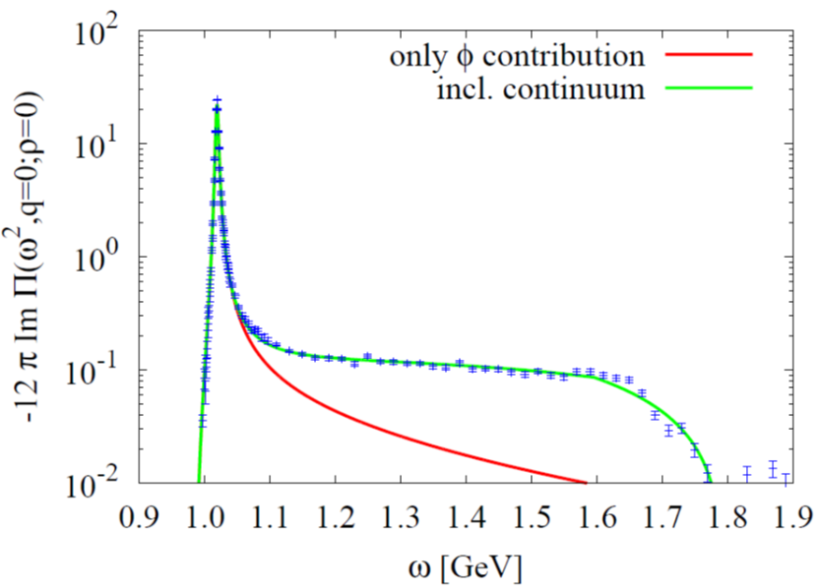
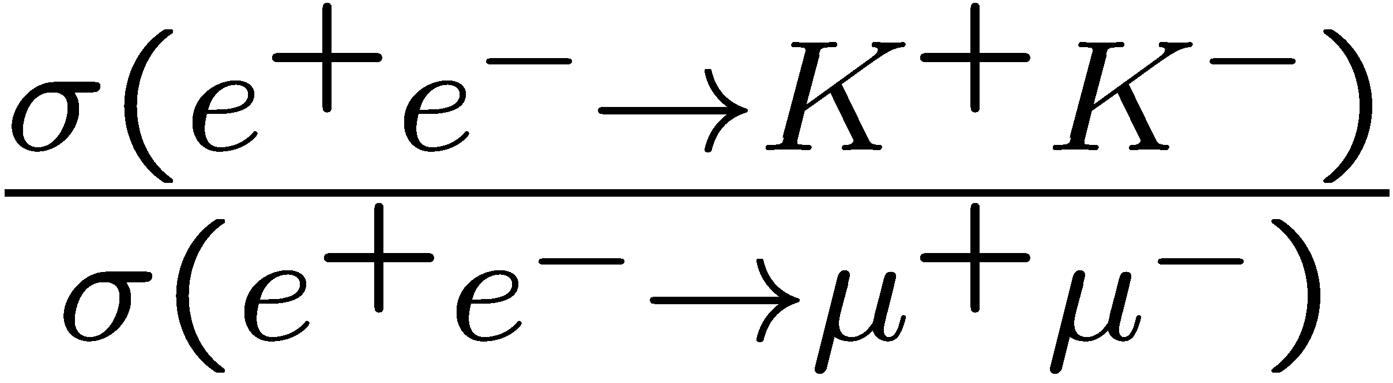
Vacuum spectrum
(Vacuum)
How is this spectrum modified in nuclear matter?
Is the (modified) spectral function consistent with QCD sum rules?
Data from
J.P. Lees et al. (BABAR Collaboration), Phys. Rev. D 88, 032013 (2013).

Slide 14
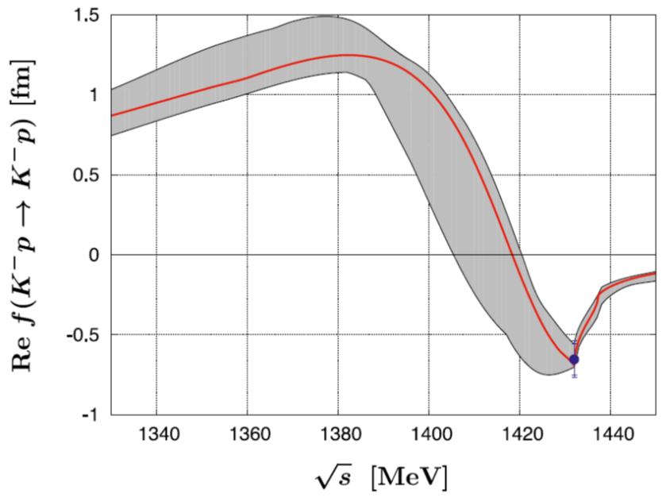
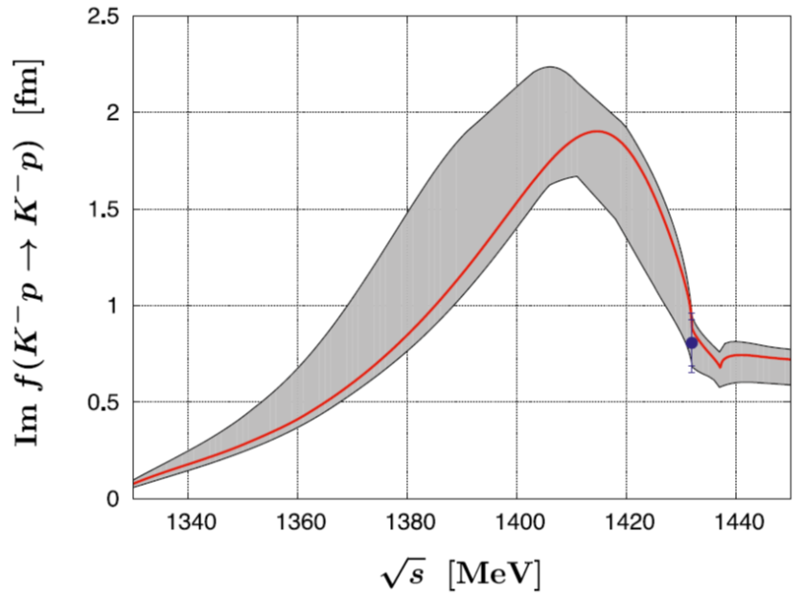
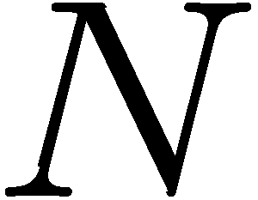
What happens in nuclear matter?
P
N
N
P
Recent fit based on SU(3) chiral effective field theory
Forward KN (or KN) scattering amplitude
If working at linear order in density, the free scattering amplitudes can be used
Y. Ikeda, T. Hyodo and W. Weise, Nucl. Phys. A 881, 98 (2012).

Slide 15
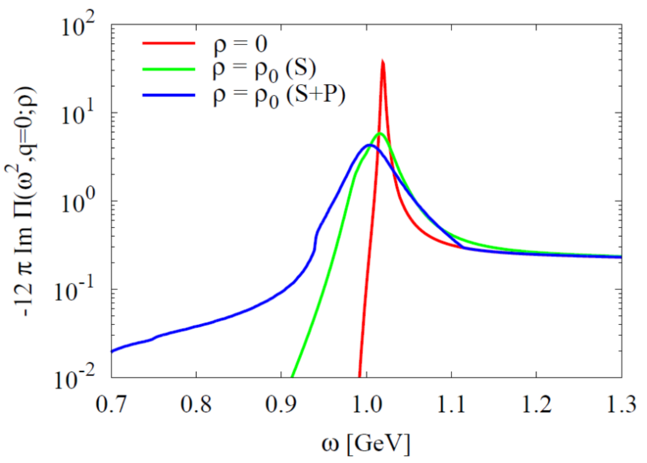
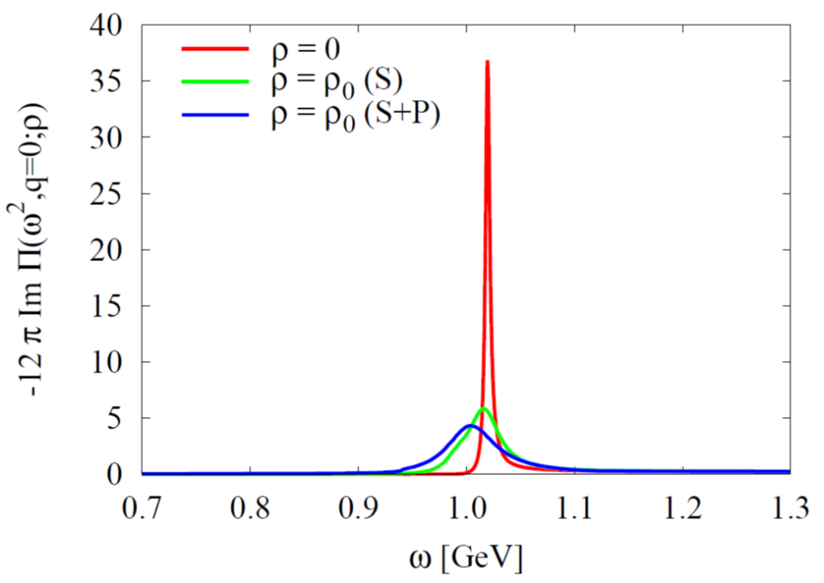
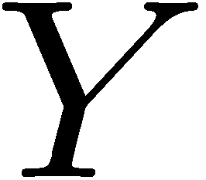
Results (Spectral Density)
Asymmetric modification of the spectrum. → Not necessarily parametrizable by a simple Breit-Wigner peak!
→ Important message for future E16 experiment at J-PARC
Takes into account further KN-interactions with intermediate hyperons, such as:

Slide 16
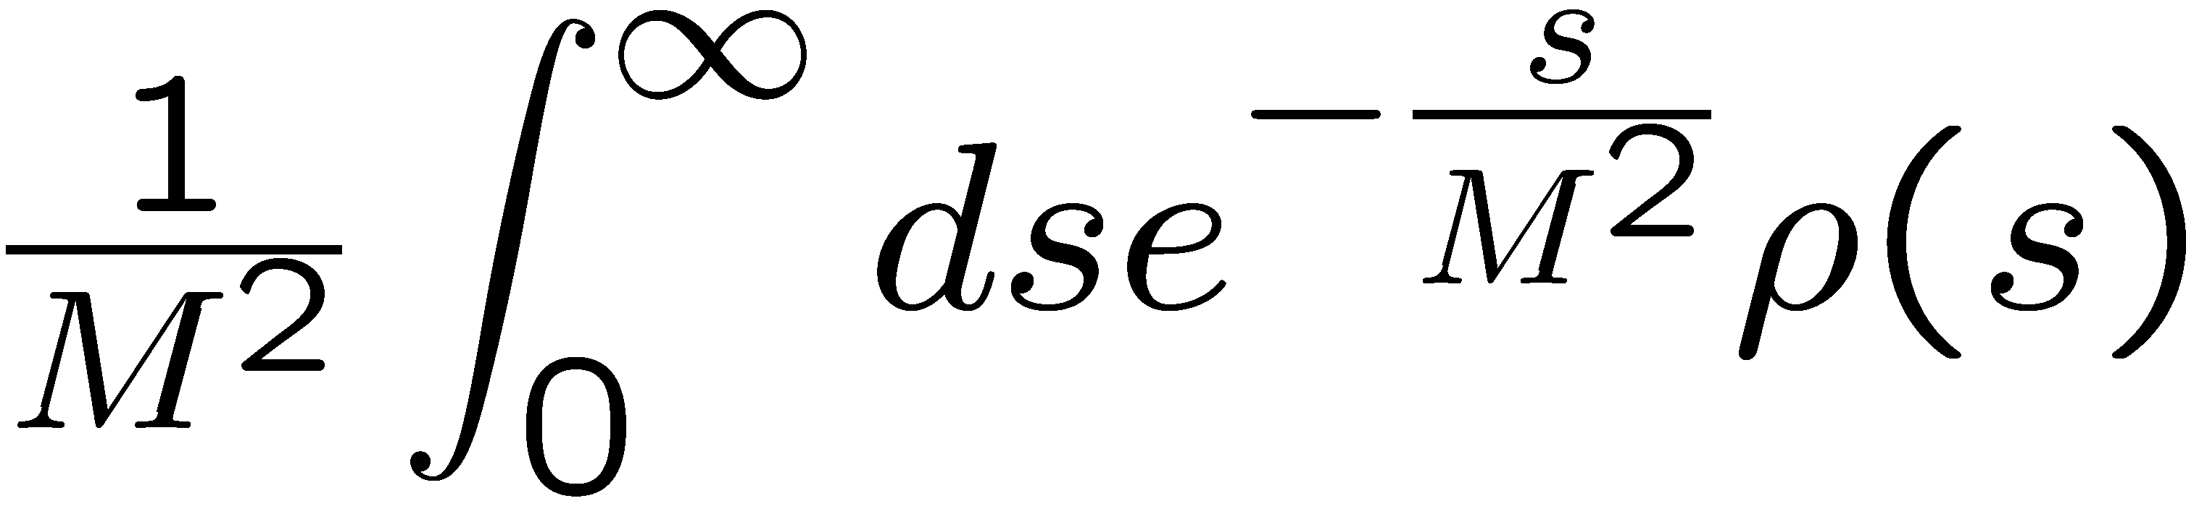
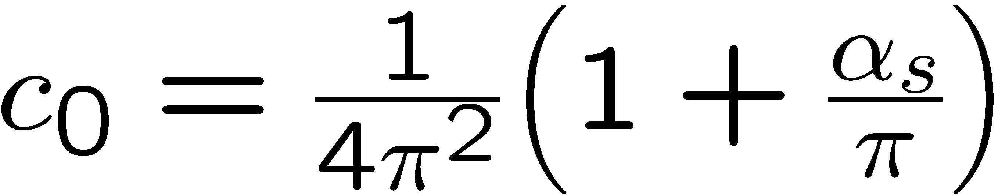
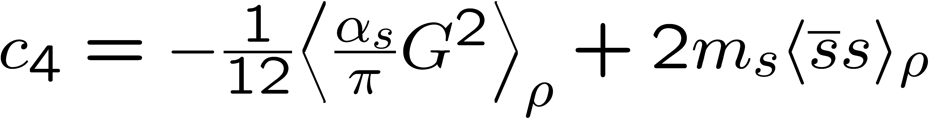
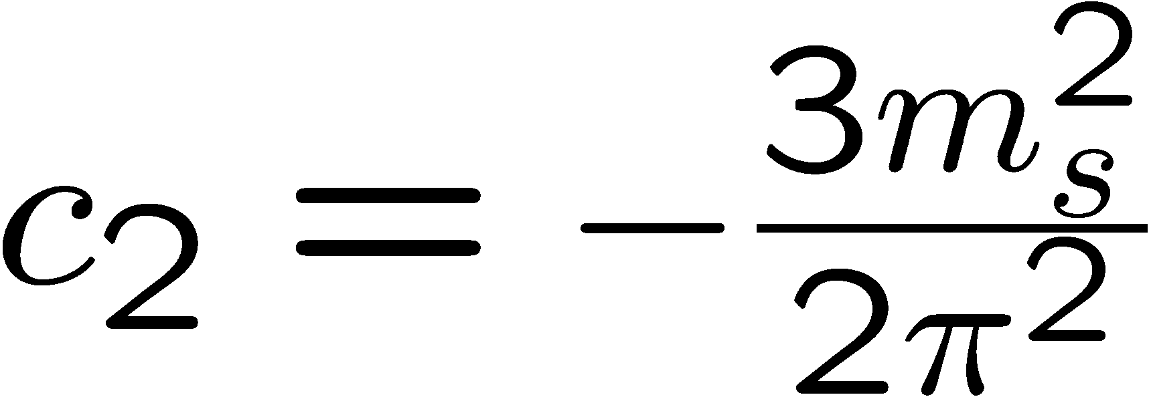
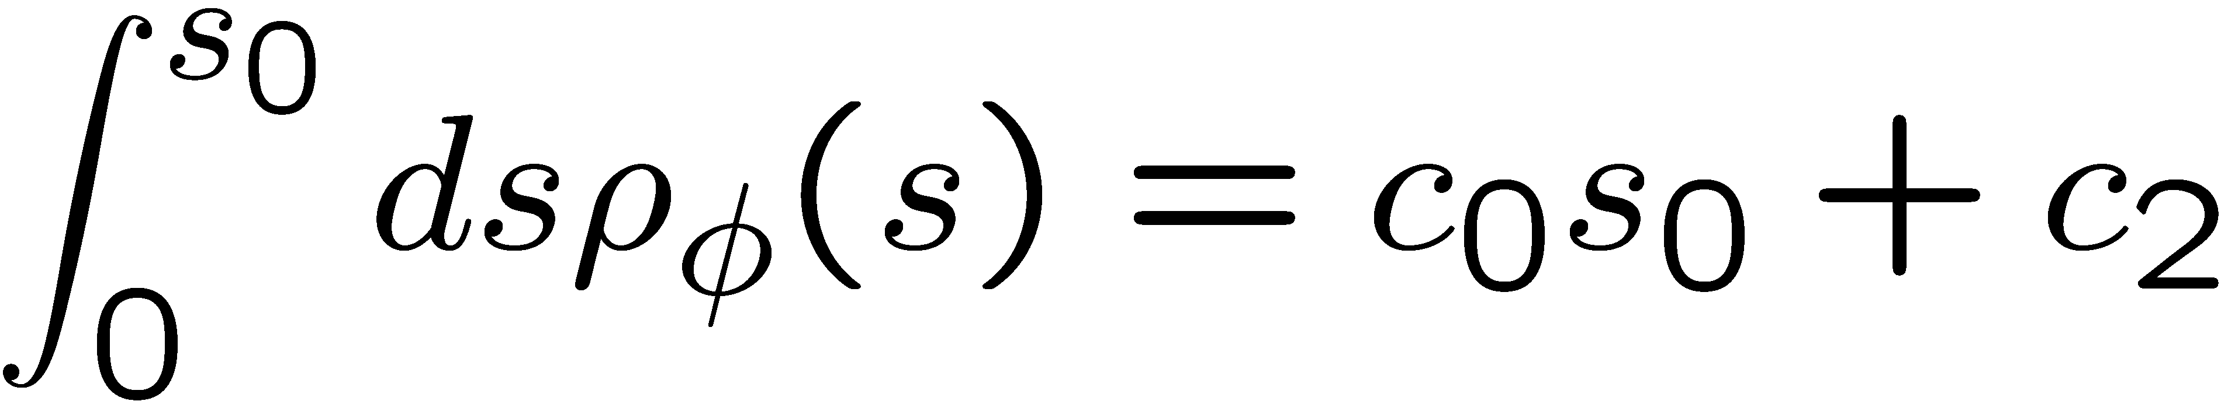
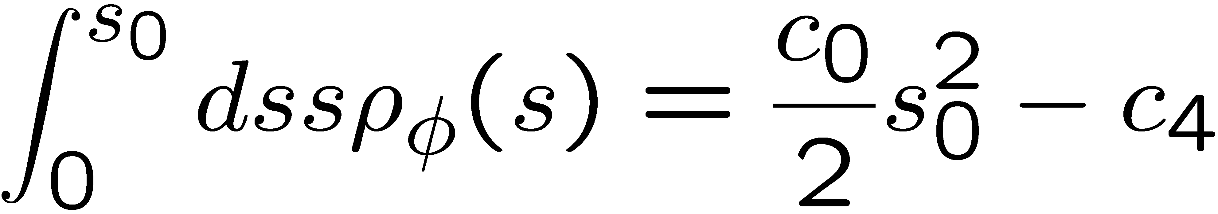

Moment analysis of obtained spectral functions
Starting point: Borel-type QCD sum rules
Large M limit
Finite-energy sum rules

Slide 17

Outlook
Spectrum at finite momentum
Target of the E16 experiment at J-PARC
Non-trivial dispersion relation?
Non-scalar operators in OPE
(non-zero only in a Lorentz violating environment)

Slide 18







Non-scalar operators
scalar
non-scalar
OPE not yet available
For ρ, ω:
For φ:

Slide 19



OPE calculation
Mass singularities in chiral limit!
Subtract corresponding quark condensate contribution
S. Kim and S.H. Lee, Nucl. Phys. 679, 517 (2001).
H.J. Kim, P. Gubler and S.H. Lee, arXiv:1703.04848 [hep-ph].

Slide 20



OPE result
H.J. Kim, P. Gubler and S.H. Lee, arXiv:1703.04848 [hep-ph].

Slide 21
Next
Do numerical analysis and make predictions for the E16 experiment at J-PARC
?
What condensate is most important for determining the momentum dependence?
?

Slide 22
f₁(1285) in nuclear matter
P. Gubler, T. Kunihiro and S.H. Lee, Phys. Lett. B 767, 336 (2017).

Slide 23


Slide 24


Slide 25






What is the f₁(1285)?
Not a completely settled issue
A tightly bound q-q state, almost ideally mixed with the f₁(1410)?
A tetraquark?
A KK* molecule?
K
K*

Slide 26







Recent experimental results

Slide 27




What about tetraquarks?
Actual measurement:
u and d contributions dominate!
Tetraquark structure is disfavored
Aaij et al. (LHCb Collaboration), Phys. Rev. Lett. 112, 091802 (2014).

Slide 28


Results from lattice QCD

Slide 29

Results
J.J. Dudek et al. (Hadron Spectrum Collaboration), Phys. Rev. D 88, 094505 (2013).

Slide 30






Results
almost perfect ideal mixing
approximate ideal mixing
small, but non-negligible disconnected diagrams
vanishing disconnected diagrams
J.J. Dudek et al. (Hadron Spectrum Collaboration), Phys. Rev. D 88, 094505 (2013).

Slide 31



Results from QCD sum rules
in qualitative agreement with experiment, but too high
good quantitative agreement with experiment

Slide 32
What happens at finite density?
Ｎ
Ｎ
P
P
f₁
Ｎ
Ｎ
Ｎ
P
P
Study
with

Slide 33





OPE
scalar part
38 MeV
S. Durr et al., (BMW Collaboration),
Phys. Rev. Lett. 116, 172001 (2016).
60 MeV
M. Hoferichter, et al.,
Phys. Rev. Lett. 115, 092301 (2015).
non-scalar part
Still large systematic uncertainty!
P. Gubler, T. Kunihiro and S.H. Lee, Phys. Lett. B 767, 336 (2017).

Slide 34



Results
100 MeV reduction!
uncertainty due to not well determined sigma term
However:
Broadening is ignored in this simple estimate. Taking it into account can lead to a smaller mass shift.
Factorization is assumed for the four-quark condensates. Violation of this assumption could change the results

Slide 35











What is the relation to chiral symmetry?
SU(2) chiral rotation
ρ and a₁ mix → chiral partners
SU(2) chiral rotation
No mixing → Not chiral partners [SU(3) chiral rotations are needed]

Slide 36
Ignoring disconnected diagrams
ingore
chiral partners
exactly true for OPE with factorized 4-quark condensates

Slide 37


Conclusions
The φ-meson mass shift in nuclear matter constrains the strangeness content of the nucleon:
  Increasing φ-meson mass in nuclear matter
  Decreasing φ-meson mass in nuclear matter
We have computed the φ meson spectral density in vacuum and nuclear matter based on an effective vector dominance model and the latest experimental constraints
Non-symmetric behavior of peak in nuclear matter
Moments provide direct links between QCD condensates and experimentally measurable quantities
We have estimated the potential modification of the f₁(1285) in nuclear matter
Strong modification of the peak is possible (e.g. 100 MeV negative mass shift)
For vanishing disconnected diagrams, the f₁(1285) will become degenerate with the ω once chiral symmetry is restored

Slide 38
Backup slides

Slide 39


Consistency check
(Vacuum)
Are the zeroth and first momentum sum rules consistent with our phenomenological spectral density?
Zeroth Moment
First Moment
Consistent!

Slide 40




Consistency check
(Nuclear matter)
Are the zeroth and first momentum sum rules consistent with our phenomenological spectral density?
Zeroth Moment
First Moment
Consistent!

Slide 41



Second moment sum rule
Factorization hypothesis
Strongly violated?
Should be tested on the lattice!

Slide 42



The basic problem to be solved
given
?
“Kernel”
(but only incomplete and with error)
This is an ill-posed problem.
But, one may have additional information on ρ(ω), which can help to constrain the problem:
- Positivity:
- Asymptotic values:

Slide 43



The Maximum Entropy Method
How can one include this additional information and find the most probable image of ρ(ω)?
→ Bayes’ Theorem
likelihood function
prior probability

Slide 44






likelihood function
prior probability
Corresponds to ordinary χ²-fitting.
(Shannon-Jaynes entropy)
“default model”
M. Jarrel and J.E. Gubernatis, Phys. Rep. 269, 133 (1996).
M.Asakawa, T.Hatsuda and Y.Nakahara, Prog. Part. Nucl. Phys. 46, 459 (2001).

Slide 45



The strangeness content of the nucleon: results from lattice QCD
Two methods
Direct measurement
Feynman-Hellmann theorem
A. Abdel-Rehim et al. (ETM Collaboration), Phys. Rev. Lett. 116, 252001 (2016).
S. Durr et al. (BMW Collaboration), Phys. Rev. Lett. 116, 172001 (2016).

Slide 46



Recent results
S. Durr et al. (BMW Collaboration), Phys. Rev. Lett. 116, 172001 (2016).
(Feynman-Hellmann)
Y.-B. Yang et al. (χQCD Collaboration), Phys. Rev. D 94, 054503 (2016).
(Direct)
A. Abdel-Rehim et al. (ETM Collaboration), Phys. Rev. Lett. 116, 252001 (2016).
(Direct)
G.S. Bali et al. (RQCD Collaboration), Phys. Rev. D 93, 094504 (2016).
(Direct)

Slide 47
QCD sum rules
M.A. Shifman, A.I. Vainshtein and V.I. Zakharov, Nucl. Phys. B147, 385 (1979); B147, 448 (1979).
Makes use of the analytic properties of the correlation function:
q²
is calculated
“perturbatively”,
using OPE
spectral function
of the operator ｊ
After the Borel transformation:

Slide 48
More on the OPE in matter
non-perturbative condensates
perturbative Wilson coefficients
Change in hot or dense matter!

Slide 49

Introduction
Spectral functions at finite density
How is this complicated behavior related to QCD condensates?
modification at finite density
coupling to nucleon resonances?
broadening?
mass/threshold shifts?

Slide 50


Experimental developments
The E325 Experiment (KEK)
Slowly moving φ mesons are produced in 12 GeV p+A reactions and are measured through di-leptons.
e
e
p
e
p
φ
φ
e
outside decay
inside decay
No effect (only vacuum)
Di-lepton spectrum reflects the modified φ-meson
Y. Morino et. al. (J-PARC E16 Collaboration), JPS Conf. Proc. 8, 022009 (2015).

Slide 51

Fitting Results
βγ<1.25 (Slow)
1.25<βγ<1.75
1.75<βγ (Fast)
Small Nucleus
Large Nucleus

Slide 52




Experimental Conclusions
R. Muto et al, Phys. Rev. Lett. 98, 042501 (2007).
Pole mass:
35 MeV negative mass shift at normal nuclear matter density
Pole width:
Increased width to 15 MeV at normal nuclear matter density
Caution!
Fit to experimental data is performed with a simple Breit-Wigner parametrization
Too simple??

Slide 53
The traditional analysis method
The spectral function is approximated by a “pole + continuum” ansatz:
pert. QCD limit
m
s_{th}
Even though this ansatz is very crude, it works quite well in cases for which it is phenomenologically known to be close to reality.
e.g. -charmonium (J/ψ)

Slide 54







Other experimental results
There are some more experimental results on the φ-meson width in nuclear matter, based on the measurement of the transparency ratio T:
Measured at SPring-8 (LEPS)
Measured at COSY-ANKE
T. Ishikawa et al, Phys. Lett. B 608, 215 (2005).
A. Polyanskiy et al, Phys. Lett. B 695, 74 (2011).

Slide 55




The strangeness content of the nucleon:
Important parameter for dark-matter searches:
Neutralino: Linear superposition of the Super-partners of the Higgs, the photon and the Z-boson
Adapted from: W. Freeman and D. Toussaint (MILC Collaboration), Phys. Rev. D 88, 054503 (2013).
most important contribution
dominates
A. Bottino, F. Donato, N. Fornengo and S. Scopel, Asropart. Phys. 18, 205 (2002).

Slide 56

In-nucleus decay fractions for E325 kinematics
Taken from: R.S. Hayano and T. Hatsuda, Rev. Mod. Phys. 82, 2949 (2010).

Slide 57







How can this result be understood?
Let us examine the OPE at finite density more closely:
Dimension 4 terms governs the behavior of the φ meson

Slide 58

More on the free KN and KN scattering amplitudes
For KN:
Approximate by a real constant (↔ repulsion)
T. Waas, N. Kaiser and W. Weise, Phys. Lett. B 379, 34 (1996).
For KN:
Use the latest fit based on SU(3) chiral effective field theory, coupled channels and recent experimental results (↔ attraction)
Y. Ikeda, T. Hyodo and W. Weise, Nucl. Phys. A 881, 98 (2012).
K⁻p scattering length obtained from kaonic hydrogen (SIDDHARTA Collaboration)

Slide 59

Results of test-analysis (using MEM)
P. Gubler and K. Ohtani, Phys. Rev. D 90, 094002 (2014).

Slide 60

Dependence on continuum onset?
Ansatz used so far:
However, experiments give us a different picture:

Slide 61




New trial: ramp function
Mimics the experimental behavior of the 2K + nπ states
Will this new ansatz significantly change the behavior of our results?

Slide 62








New trial: ramp function
→ modified sum rules

Slide 63

Results of ramp-function analysis
(Vacuum)
→ Consistent, if W’ is not too small

Slide 64

Results of ramp-function analysis
(Nuclear matter)
→ Also consistent, if W’ is not too small

