Slide 1
“QCD Kondo effect” in dense quark matter
Koichi Hattori
Fudan University
“Strangeness and charm in hadrons and dense matter” @ YITP, May 15, 2017

Slide 2
Table of contents
1-1
“QCD Kondo effect: dense quark matter with heavy-flavor impurities”,
KH, K. Itakura, S. Ozaki, S. Yasui, PRD, arXiv:1504.07619 [hep-ph]
1-2
“QCD Kondo effect in two-flavor superconducting phase,”
KH, X.-G. Huang, R. Pisarski, very preliminary.
S. Yasui, Next week. Kondo effect in hadronic matter,
Heavy-light condensates, etc, etc.
S. Ozaki, Next week.
“Magnetically Induced QCD Kondo Effect”
2-1
“Dimensional reduction” in systems at high density and in strong magnetic field
KH, K. Itakura, S. Ozaki, To appear in Prog. Part. Nucl. Phys.
2-2
Heavy Quark Diffusion Dynamics in QGP under strong B
K. Fukushima (Tokyo), KH, H.-U. Yee (UIC), Yi Yin (BNL→MIT),
PRD, [arXiv:1512.03689 [hep-ph]]
Cf.) KH and Xu-Guang Huang (Fudan), arXiv:1609.00747 [nucl-th]

Slide 3
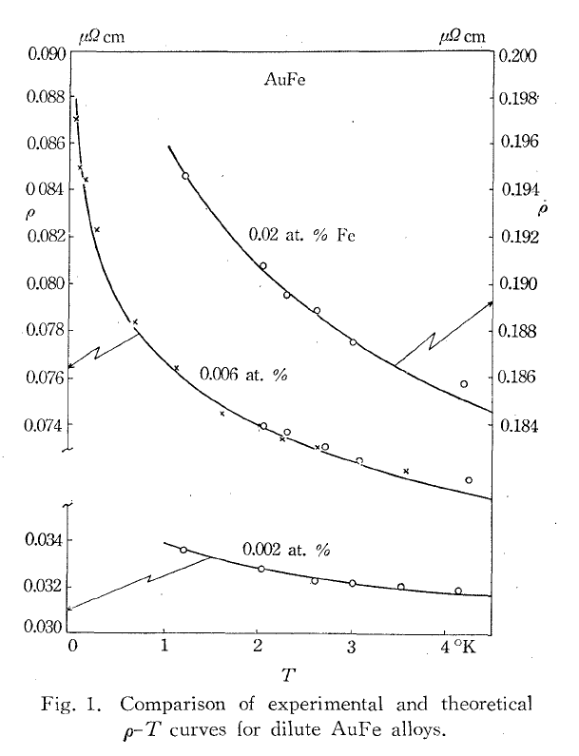
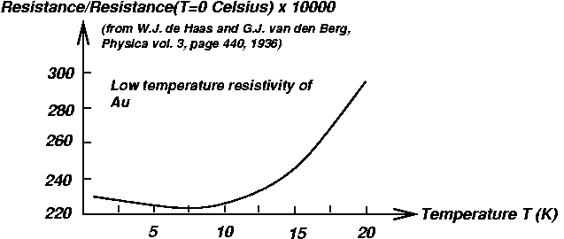
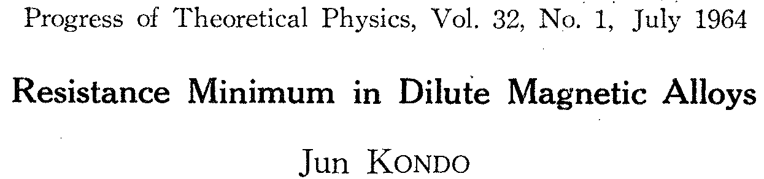
Brief Introduction to Kondo effect
Log T/T_{K}
(quantum)
Lattice vibration
Electron scatterings (classical)
GTT
T (K)
electron
+
+
T_{K}: Kondo Temp. (Location of the minima)
Classical
Quantum
hole

Slide 4
Heavy-light scatterings near Fermi surface
Dilute impurities (heavy quarks)
without their mutual correlations.
Q
Q
How does the coupling evolve
with the energy scale, Λ --> 0,
on the basis of Wilsonian RG?
Q
Nothing special in the LO.
[Nevertheless, important
(Talk by Sho)]
q
Q
But, logarithmic quantum corrections arise
in special kinematics and circumstances.
→ BCS, Kondo effect, etc.
Large Fermi sphere

Slide 5
“Dimensional reduction” in dense systems
-- (1+1)-dimensional low-energy effective theory
+ Low energy excitation along radius [(1+1) D]
+ Degenerated states in the tangential plane [2D]
Phase space volume ~ p^{D-1} dp
Enhanced IR dynamics induces nonperturbative physics,
such as superconductivity and Kondo effect.

Slide 6
IR scaling dimensions
Kinetic term
Four-Fermi operators for superconductivity
Polchinski (1992)
In general momentum config.
In the BCS config.

Slide 7
IR scaling dimension for Kondo effect
Heavy-quark Kinetic term
Heavy-light four-Fermi operator
Marginal !! Let us proceed to diagrams.

Slide 8
Scattering in the NLO
-- Renormalizaiton in the low energy dynamics
Large Fermi sphere
Wilsonian RG
Large Fermi sphere
Large Fermi sphere

Slide 9
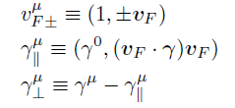

High-Density Effective Theory (LO)
Expansion around the large Fermi momentum
The LO Fermion propagator near the Fermi surface
(1+1)-dimensional dispersion relation
Large Fermi sphere
Spin flip suppressed
when the mass is small m << μ.
Interaction vertex in the LO

Slide 10
Heavy-Quark Effective Theory (LO)
HQ-momentum decomposition
HQ velocity
Q
Dispersion relation
Nonrelativistic magnetic moment suppressed by 1/m_{Q}
The LO HQ propagator

Slide 11

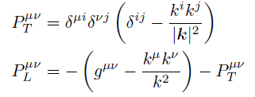
Gluon propagator in dense matter
Screening of the <A⁰A⁰> from HDL
q
In RG, screening properties can be included through the LO diagram,
Which results in additional terms in the RG equation.
Cf., Son, Schaefer, Wilczek, Hsu, Schwetz, Pisarski, Rischke, ……,
showed that unscreened magnetic gluons play a role in the cooper paring.
Q

Slide 12
Logs from the longitudinal integrals

Slide 13
Important ingredients for Kondo effect
1. Quantum corrections
Particle
hole
2. Log enhancements from the IR dynamics
0
Λ-dΛ
Λ

Slide 14
Color-matrix structures
3. Incomplete cancellation due to non-Abelian interactions
Particle contribution
Hole contribution

Slide 15
RG analysis for “QCD Kondo effect”
G(Λ-dΛ)
=
G(Λ)
+
+
RG equation
Effective coupling: G(Λ)
Asymptotic-free solution
Strong coupling
Λ
E = 0
Fermi energy
Landau pole (“Kondo scale”)

Slide 16
Short summary for Kondo effect in quark matter
1. Non-Ablelian interaction (QCD)
2. Dimensional reduction near Fermi surface
3. Continuous spectra near Fermi surface,
and heavy impurities (gapped spectra).
Impurity state

Slide 17
Emergent QCD Kondo Effect in 2-flavor color superconductor
-- Interaction btw gapped and ungapped excitations
Very preliminary results
KH, X.-G. Huang, R. Pisarski, In progress.

Slide 18
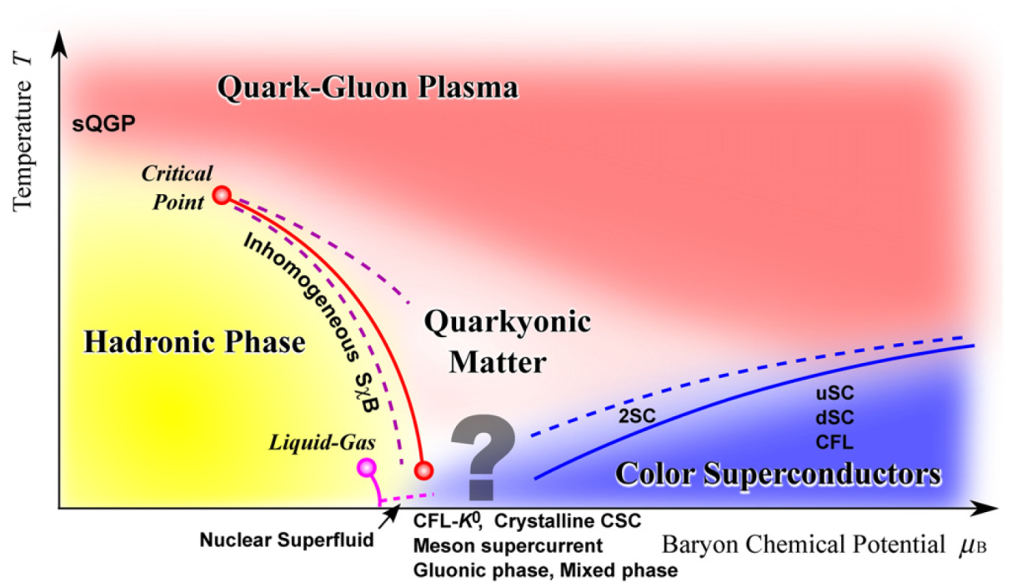
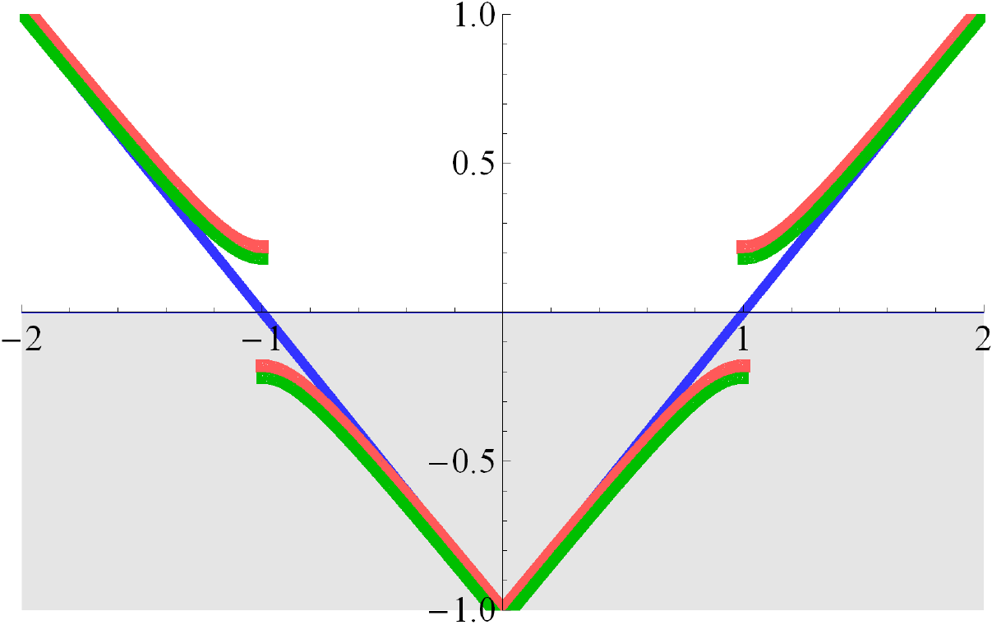
Gapped and ungapped quasiparticles in 2SC phase
Attraction in color 3
S-wave
Spin-0
Flavor antisymmetric

Slide 19
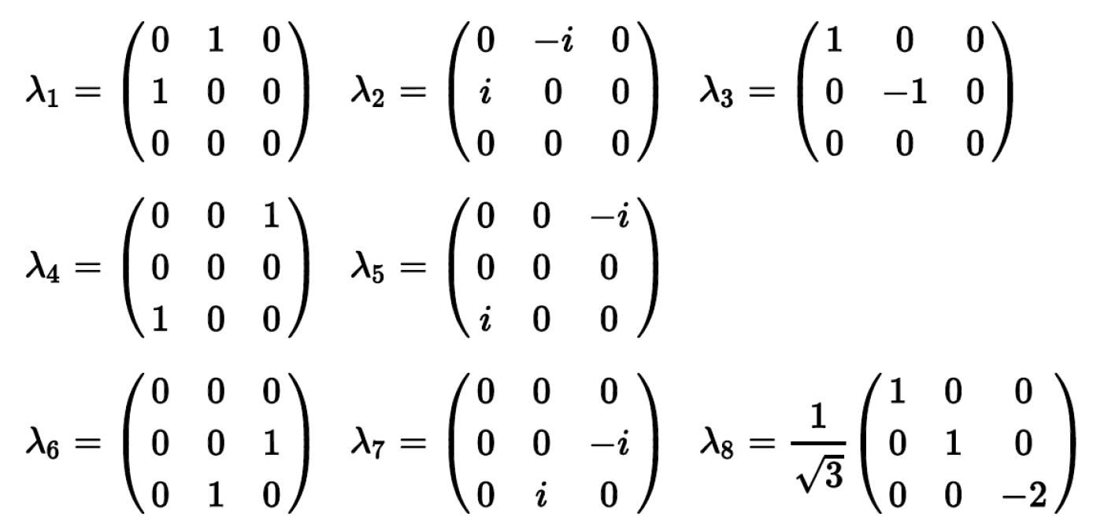
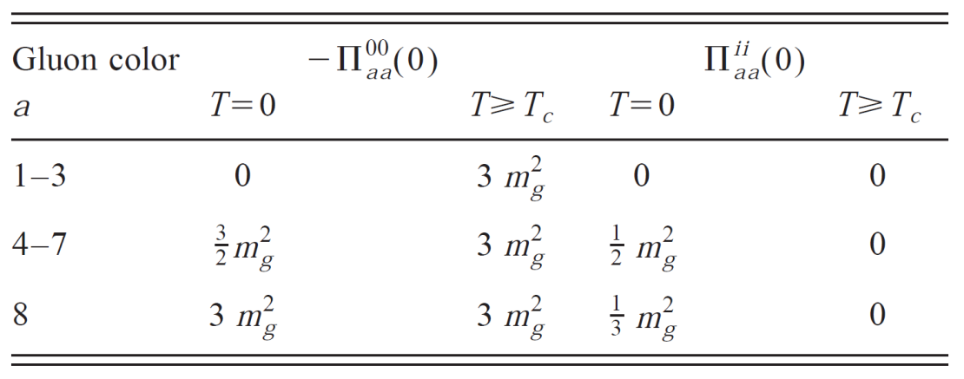
Debye and Meissner masses in 2SC phase
Pure gluodynamics
Rischke, Son, Stephanov
Rischke

Slide 20
Possible diagrams for the scattering btw Color 1 and 3
Some more if one includes interactions with the condensate
by Nambu Gorkov formalism.

Slide 21
Propagator for the gapped quasiparticles and quasiholes
Rischke, Pisarski, ...
LO expansion by 1/μ

Slide 22
Strong coupling between gapped and ungapped excitations
Effective coupling: G(Λ)
Strong coupling
Λ
E = 0
Fermi energy
Landau pole (“Kondo scale”)

Slide 23
An analogy between the dimensional reductions
in high-density matter and in strong magnetic field
Cf. S. Ozaki, K. Itakura, Y. Kuramoto, “Magnetically Induced QCD Kondo Effect ”, arXiv:1509.06966 [hep-ph]
KH, K. Itakura, S. Ozaki, To appear in Prog. Part. Nucl. Phys.

Slide 24
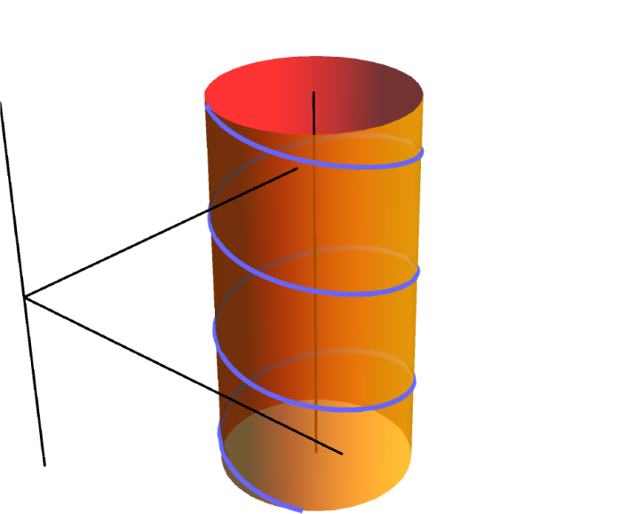
Landau level discretization due to the cyclotron motion
B
“Harmonic oscillator” in the transverse plane
Nonrelativistic:
Cyclotron frequency
Relativistic:
In addition, there is the Zeeman effect.

Slide 25
Schematic picture of the lowest Landau levels
(1+1)-D dispersion relation
Squeezed wave function
Large Fermi sphere
Strong B

Slide 26
Scaling dimensions in the LLL
(1+1)-D dispersion relation → d_{ψ} = - 1/2
Four-light-Fermi operator
Always marginal thanks to the dimensional reduction in the LLL.
→ Magnetic catalysis of chiral condensate (Chiral symmetry is broken even in QED.)
Gusynin, Miransky, and Shovkovy. Lattice QCD data also available (Bali et al.).
Heavy-light four-Fermi operator
Marginal !! Just the same as in dense matter.

Slide 27
Important ingredients of Kondo effect
-- Revisited with strong B fields
1. Quantum corrections (loop effects)
2. Log enhancement from the IR dynamics
due to the dimensional reduction in the strong B.
3. Incomplete cancellation due to non-Abelian
color-exchange interactions
“QCD Kondo Effect”
KH, K. Itakura, S. Ozaki, S. Yasui, arXiv:1504.07619 [hep-ph]
“Magnetically Induced QCD Kondo Effect”
S. Ozaki, K. Itakura, Y. Kuramoto, “Magnetically Induced QCD Kondo Effect ”, arXiv:1509.06966 [hep-ph]

Slide 28
Heavy-quark diffusion dynamics at finite T
under strong magnetic field
-- Perturbative diffusion constant at the LO
K. Fukushima, KH, H.-U. Yee, Y. Yin,
Phys. Rev. D 93 (2016) 074028. arXiv:1512.03689 [hep-ph]
Cf.) KH and Xu-Guang Huang (Fudan), arXiv:1609.00747 [nucl-th]

Slide 29
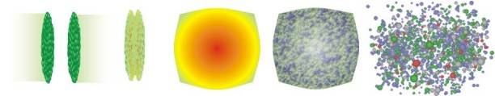
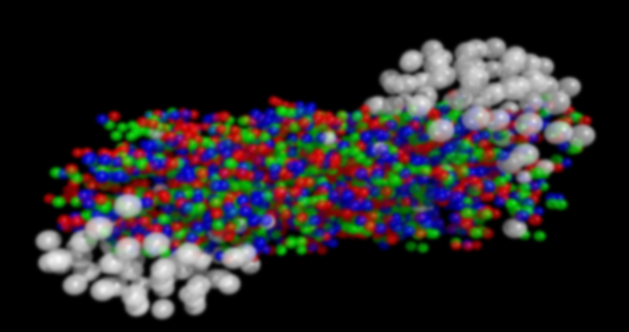
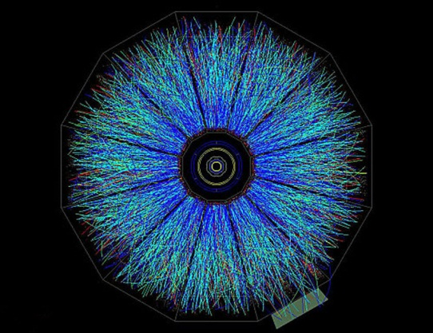
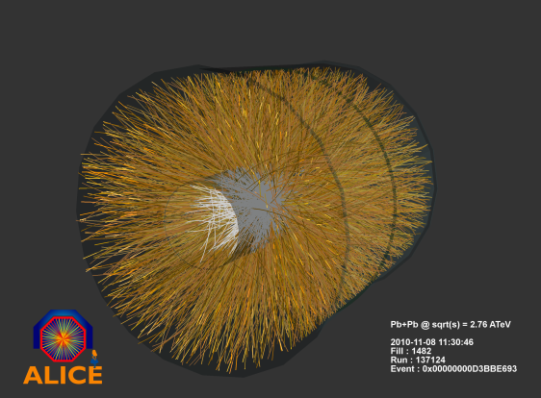
Heavy quarks as a probe of QGP
g
g
B
Thermal Quark-Gluon Plasma (QGP)
Hadrons
RHIC
Non-thermal heavy-quark production in hard scatterings
Momentum distribution of HQs in log scale
Initial distribution (τ = 0)
from pQCD
LHC
Thermal (τ = ∞)
Relaxation time is controlled by transport coefficients (Drag force, diffusion constant)

Slide 30
Heavy quark (HQ) dynamics in the QPG
-- In soft regime
Langevin equation
Random kick (white noise)
Einstein relation
Drag force coefficient: η_{D}
Diffusion constant: κ
Perturbative calculation by finite-T field theory (Hard Thermal Loop resummation)
LO and NLO without B are known (Moore & Teaney, Caron-Huot & Moore).

Slide 31



Perturbative computation of momentum diffusion constant
Momentum transfer rate in the LO Coulomb scatterings
2
2
2
2
+
+
HQ
HQ
HQ
Thermal quarks
HQ
Thermal gluons
Thermal quarks
Thermal gluons
c.f.) LO and NLO without B (Moore & Teaney, Caron-Huot & Moore)
Effects of a strong magnetic field: T² << eB << m_{Q}²
1. Modification of the dispersion relation of thermal quarks
2. Modification of the Debye screening mass

Slide 32
Schematic picture in the strong field limit
Gluon self-energy
Schwinger model
Strong B
+ There is no T or μ correction in massless Schwinger model
+ Mass correction is small ~ m/T

Slide 33

Prohibition of the longitudinal momentum transfer
Massless limit
Linear dispersion relation
Energy and momentum transfers in the direction of B
From the chirality conservation
In the static limit (or HQ limit)
HQ
Light quark

Slide 34
Transverse diffusion constant in massless limit
Distribution of the quark scatterers
Screened Coulomb scattering amplitude (squared)
Spectral density

Slide 35
Longitudinal diffusion constant
1. Quark contribution to the longitudinal diffusion constant
2. Gluon contribution to the longitudinal diffusion constant
Same as Moore & Teaney up to constants

Slide 36
Anisotropic momentum diffusion constant
Remember the density of states in B-field,
In the strong field limit,

Slide 37
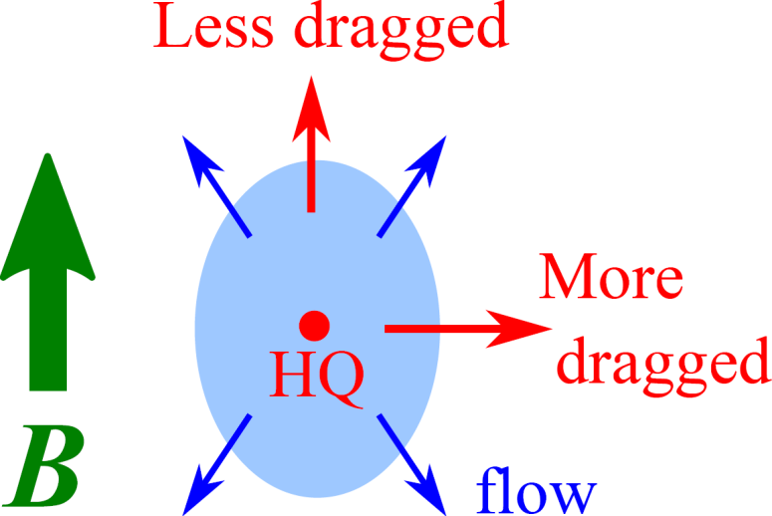
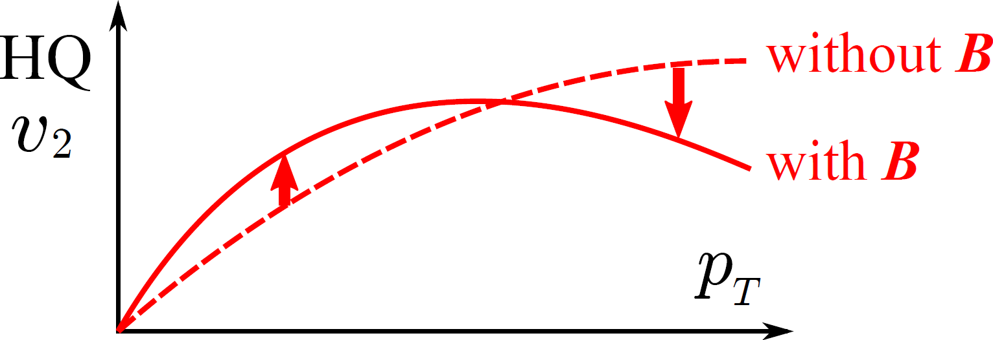
Implication for v2 of heavy flavors
Magnetic anisotropy gives rise to v2 of HQs
even without the v2 of medium.
→ Possible to generate v2 of HQs in the early QGP stage.
Kondo effect may occur in the NLO!

Slide 38
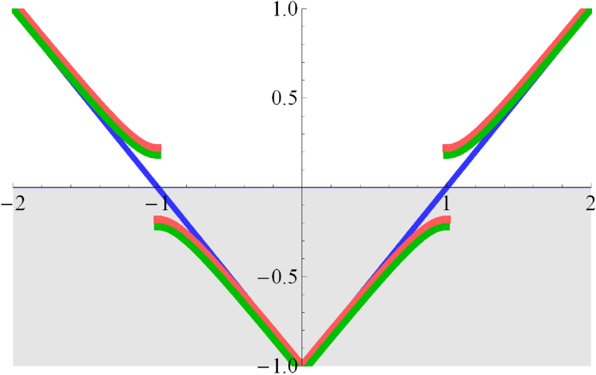
Summary
QCD Kondo effects occur in various systems.
Necessary ingredients
1) Non-Abelian interactions (QCD)
3) Gapped and ungapped spectra
-- Heavy-quark impurities
-- Gapped states in 2SC
2) Dimensional reductions
-- In dense quark matter
-- In strong B fields
Large Fermi sphere
Prospects
- Effects on specific transport coefficients, e.g., heavy-quark
diffusion dynamics, electrical and thermal conductivities.
- Observable consequences for FAIR, J-PARC as well as RHIC, LHC.

Slide 40
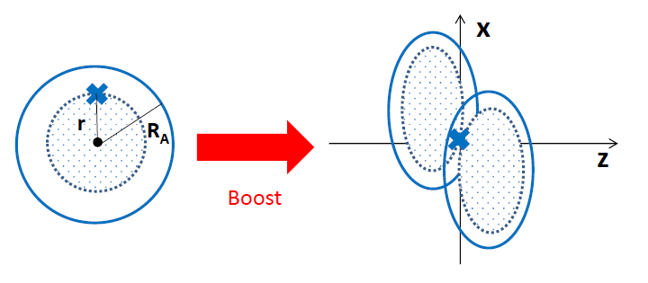
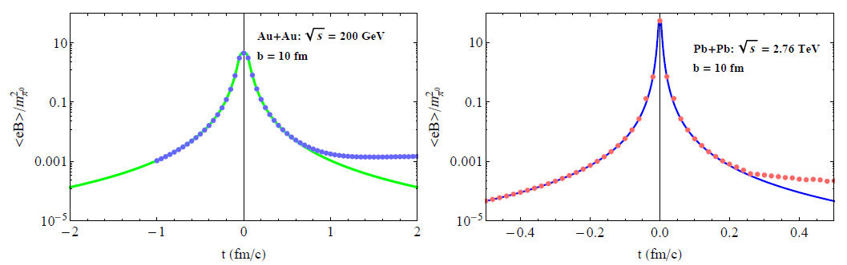
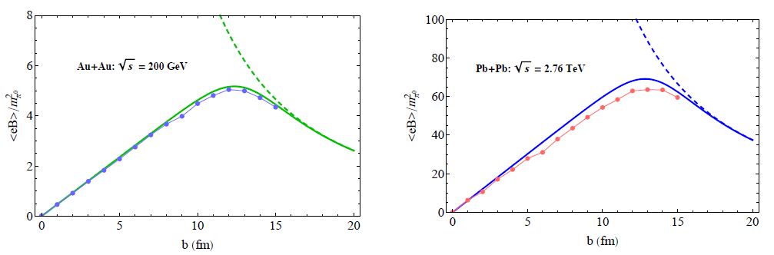
Liu, C. Greiner, and C. M. Ko
KH, X.-G. Huang

Slide 41
Transverse diffusion constant in massless limit
Screened Coulomb scattering amplitude (squared)
Spectral density
Distribution of the scatterers

