Slide 1
Character change and tachyonic instability
of the soft mode at QCD critical point
based on Functional renormalization-group method
Takeru Yokota (Dept. of Physics, Kyoto University)
Collaborators
Teiji Kunihiro (Dept. of Physics, Kyoto University)
Kenji Morita (YITP, Kyoto University)
Strangeness and charm in hadrons and dense matter, YITP, May 15, 2017

Slide 2
Contents
● Introduction
● Formulation
● Results
Notes:
目次

Slide 3
Contents
● Introduction
● Formulation
● Results
Notes:
目次

Slide 4
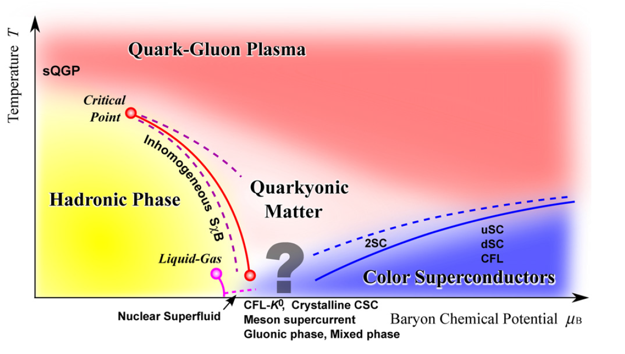
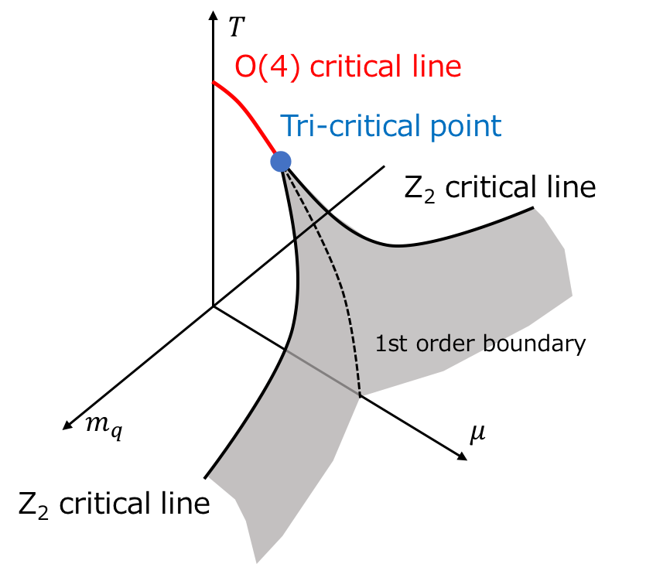


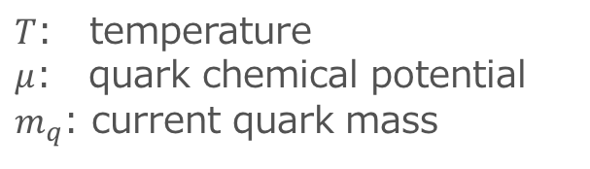
QCD critical point in ($T, μ,m_{q}$)-space
K. Fukushima, T. Hatsuda, RPP (2011)
Wing structure
$$σ∼0$$
$$σ≠0$$
$T$: temperature
$μ$: quark chemical potential
$m_{q}$: current quark mass
● We consider 2-flavor, isospin symmetric, no anomaly case.
● Wing structure in ($T, μ,m_{q}$)-space: O(4) critical line bifurcates into two
Z₂ critical lines in the positive $m_{q}$ and fictitious negative $m_{q}$.
Notes:
Quark chemical potential

Slide 5



Critical behavior of modes around a critical point
$$\text{I}\text{m}ω$$
System approaches
$$\text{Re}ω$$
●
CP
●
Pole of
Soft mode
$$T, μ, ⋯$$
● One of the features of critical points (CPs) is the existence
of Soft modes. At a CP, there is at least one soft mode.
● Critical slowing down:
Soft mode becomes massless and a long-lived.
Notes:
QCD critical point

Slide 6

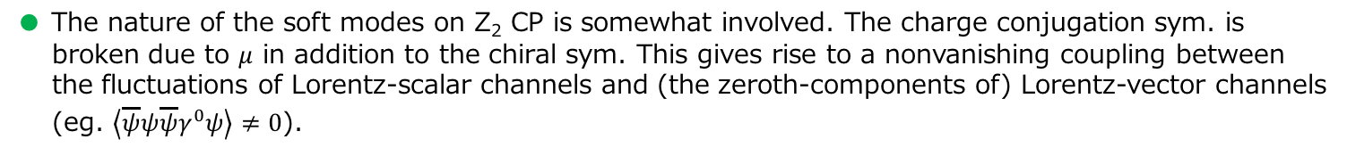



Soft modes at the QCD critical points
Soft modes at O(4) CP: $σ$ and $\vec{π}$ (meson quartet)
$$ω$$
$$\left|\vec{p}\right|$$
Soft modes at Z₂ CP: particle-hole modes?
(hydrodynamical modes, such as baryon number fluctuation, ...)
●
$$ω$$
●
Fermi sphere
$$\left|\vec{p}\right|$$
● The nature of the soft modes on Z₂ CP is somewhat involved. The charge conjugation sym. is
broken due to $μ$ in addition to the chiral sym. This gives rise to a nonvanishing coupling between
the fluctuations of Lorentz-scalar channels and (the zeroth-components of) Lorentz-vector channels
(eg. $\left\langle \overline{ψ}ψ\overline{ψ}γ^{0}ψ\right\rangle ≠0$).
● According to RPA for NJL model, Time-dependent GL [H. Fujii, M. Ohtani, PRD (2004)] and
Langevin eq. [D. T. Son, M. A. Stephanov, PRD (2004)], the soft modes are the particle-hole modes.

Slide 7
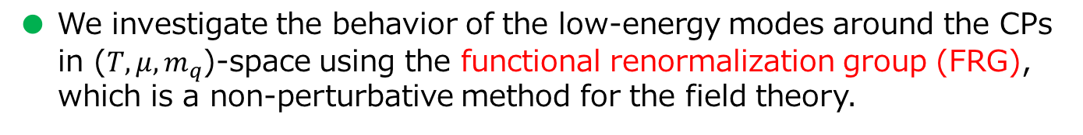
Purpose of this research
● We investigate the behavior of the low-energy modes around the CPs
in ($T, μ,m_{q}$)-space using the functional renormalization group (FRG),
which is a non-perturbative method for the field theory.
● We calculate the thermodynamic quantities and the spectral functions
in the mesonic channels with 2-flavor quark-meson model to investigate
the behavior of modes.
● We find a non-trivial behavior in the sigma meson channel.
Therefore we mainly show the result of the spectral functions in the
sigma meson channel.

Slide 8
Contents
● Introduction
● Formulation
● Results
Notes:
目次

Slide 9

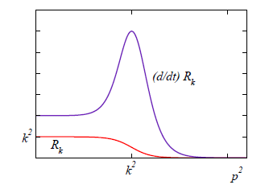



Functional renormalization group and 2-point function
Functional renormalization group
C. Wetterich, PLB (1993)
$R_{k}$: regulator
Wetterich eq.
●
● Fluctuations are incorporated as $k→0$.
Flow eq. for 2-point function
Expectation value
in the ground state
● The second derivatives of Wetterich eq. around the expectation value of the field
in the ground state becomes the flow eq. for (inverse) 2-point function.

Slide 10


Model and approximation
2-flavor quark-meson model
Finite temperature $T$ and quark chemical potential $μ$.
Having $N_{f}=2$ chiral symmetry except for $−cσ$ (effect of current quark mass).
Approximation for flow eqs. for meson 2-point functions
K. Kamikado, N. Strodthoff, L. Smekal, J. Wambach, EPJ C (2014)
R. Tripolt, N. Strodthoff, L. Smekal, J. Wambach, PRD (2014)
R. Tripolt, L. Smekal, J. Wambach, PRD (2014)
Propagators, vertices, $Φ_{0}$
$k$-dependent effective potential
● We use “LPA” ansatz to evaluate the RHS of the flow eq. of meson 2-point function.
● $U_{k}$ is also calculated in the FRG framework [B.-J. Schaefer, J. Wambach, NPA, 2005].
● We assume uniform chiral condensate and no pion condensate.

Slide 11
Analytic continuation
Temperature Green’s fcn.
Retarded Green’s fcn.
Analytic continuation
Spectral fcn.
● The analytic continuation of the Green's function can be performed
in the flow equation by making use of 3D regulators.
S. Floerchinger, JHEP (2012)
K. Kamikado, N. Strodthoff, L. Smekal, J. Wambach, EPJ C (2014)
R. Tripolt, N. Strodthoff, L. Smekal, J. Wambach, PRD (2014)
Litim type 3D regulators [D. F. Litim, PRD (2001)]

Slide 12
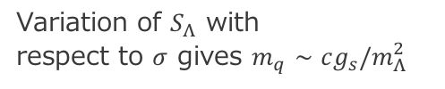
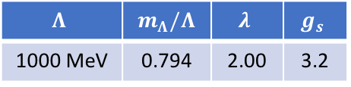
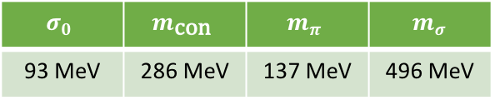



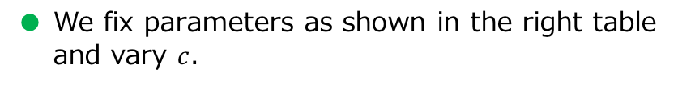

Parameters
Initial condition for the effective potential
Parameter setting at physical point
R. Tripolt, N. Strodthoff, L. Smekal, J. Wambach, PRD (2014)
● We fix parameters as shown in the right table
and vary $c$.
$$Λ$$ | $m_{Λ}/Λ$ | $$λ$$ | $$g_{s}$$
1000 MeV | 0.794 | 2.00 | 3.2
● Varying $c$ corresponds to varying $m_{q}$.
Chiral limit
Physical point
Maximum in our calc.
●
●
●
$m_{q}$ [MeV]
0
8.88
15.23
Variation of $S_{Λ}$ with
respect to $σ$ gives $m_{q}∼cg_{s}/m_{Λ}^{2}$
($c/Λ^{3}=0$)
($c/Λ^{3}=0.00175$)
($c/Λ^{3}=0.003$)
Vacuum values of physical quantities
$$σ_{0}$$ | $$m_{\text{con}}$$ | $$m_{π}$$ | $m_{σ}$
93 MeV | 286 MeV | 137 MeV | 496 MeV
Constituent quark mass, screening masses

Slide 13
Contents
● Introduction
● Formulation
● Results
Notes:
目次

Slide 14
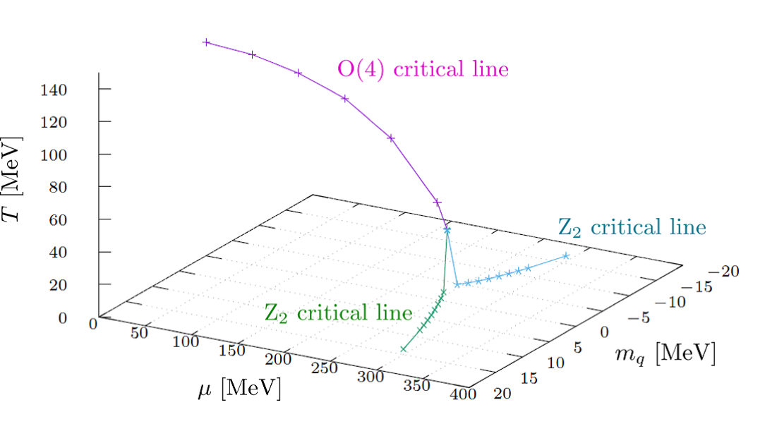
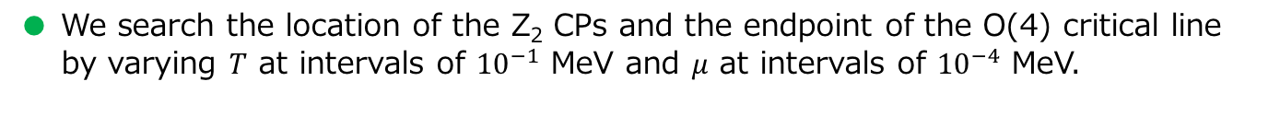
Locations of CPs
● To locate the critical points, we examine whether the gap in $σ_{0}$ appears or not
to distinguish the order of the phase transition.
● We also check that the inverse of the chiral susceptibility $m_{σ}^{2}$ becomes close to zero
at the CPs.
● We search the location of the Z₂ CPs and the endpoint of the O(4) critical line
by varying $T$ at intervals of ${10}^{−1}$ MeV and $μ$ at intervals of ${10}^{−4}$ MeV.

Slide 15
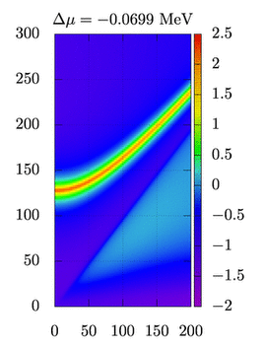
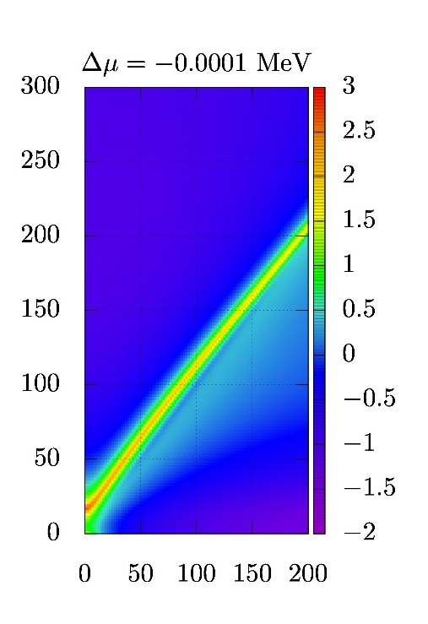
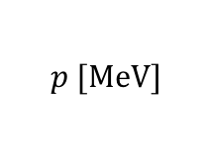
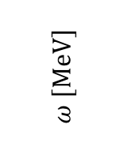
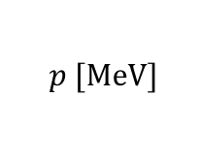
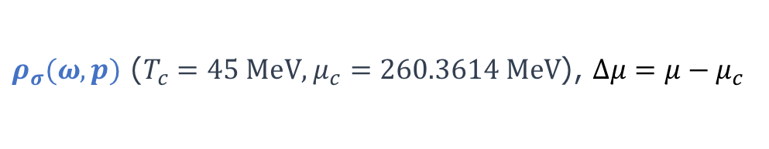




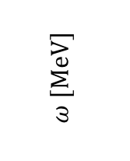
$ρ_{σ}$ around an O(4) CP
$$T$$
$ρ_{σ}(ω, p)$ ($T_{c}=45 \text{MeV}$, $μ_{c}=260.3614 \text{MeV}$), $Δμ=μ−μ_{c}$
System approaches
$$T_{c}$$
● CP
$$μ$$
Closest point in our calc.
$$μ_{c}$$
Dispersion curve
of the sigma
mesonic mode
$$ω [\text{MeV}]$$
$$ω [\text{MeV}]$$
light-like line
$$p [\text{MeV}]$$
$$p [\text{MeV}]$$
● The system approaches the CP at fixed temperature $T=T_{c}(m_{q})$.
● We calculate in $μ<μ_{c}$ because numerical instability occurs in $μ>μ_{c}$.
● The peak of the sigma mesonic mode moves down toward zero energy, strongly
in the lower-momentum region. This shows that the sigma mesonic mode is a
soft mode of the O(4) CP.

Slide 16
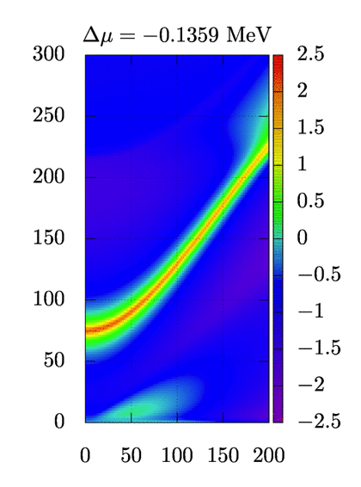
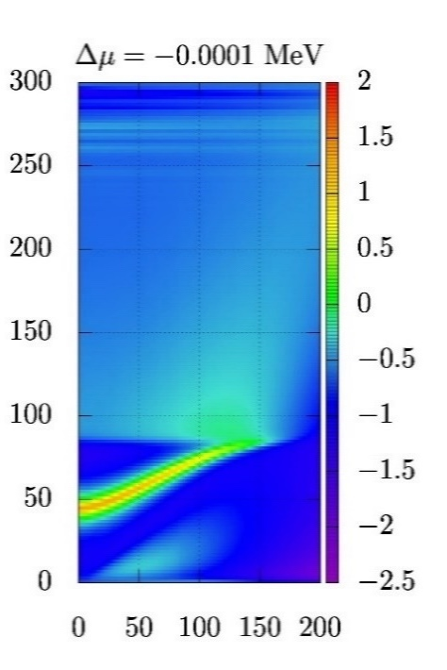
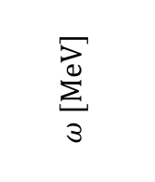
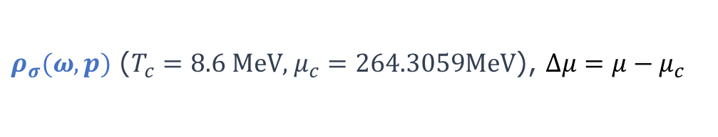
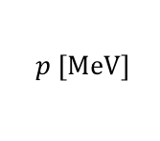
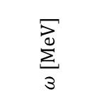
$ρ_{σ}$ around Z₂ CP (at $m_{q}=1.27$ MeV)
$ρ_{σ}(ω, p)$ ($T_{c}=8.6 \text{MeV}$, $μ_{c}=264.3059\text{MeV}$), $Δμ=μ−μ_{c}$
Closest point in our calc.
$$ω [\text{MeV}]$$
$$ω [\text{MeV}]$$
particle-hole mode
$$p [\text{MeV}]$$
$$p [\text{MeV}]$$
● $ρ_{π}$ does not show critical behavior at Z₂ CPs. We focus on $ρ_{σ}$ below.
● There appears a bump of particle-hole excitations in the space-like momentum
region ($ω<p$) in contrast to the case of the O(4) critical line.
● The sigma mesonic mode moves down. However, the down shift of the energy
of the peak is not so complete as in the chiral limit.

Slide 17
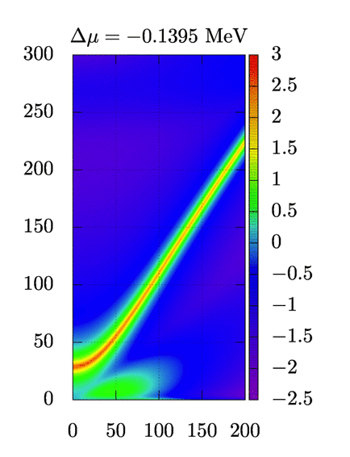
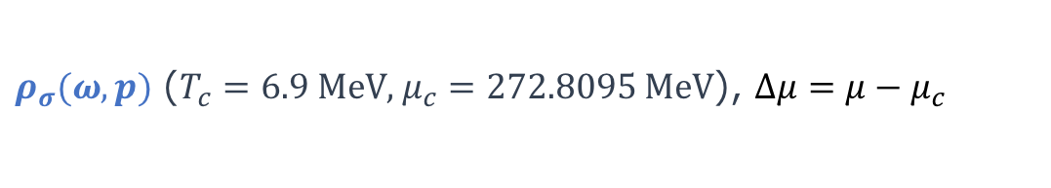
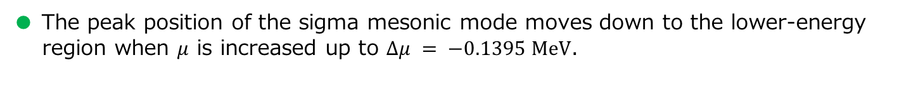
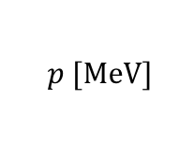
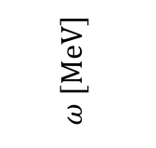
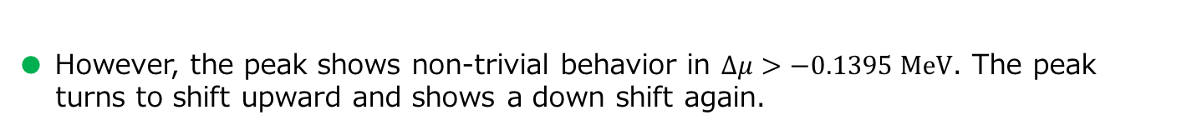
$ρ_{σ}$ around Z₂ CP (at $m_{q}=3.81$ MeV)
$ρ_{σ}(ω, p)$ ($T_{c}=6.9 \text{MeV}$, $μ_{c}=272.8095 \text{MeV}$), $Δμ=μ−μ_{c}$
$$ω [\text{MeV}]$$
$$p [\text{MeV}]$$
● The peak position of the sigma mesonic mode moves down to the lower-energy
region when $μ$ is increased up to $Δμ = −0.1395 \text{MeV}$.
● However, the peak shows non-trivial behavior in $Δμ>−0.1395 \text{MeV}$. The peak
turns to shift upward and shows a down shift again.

Slide 18
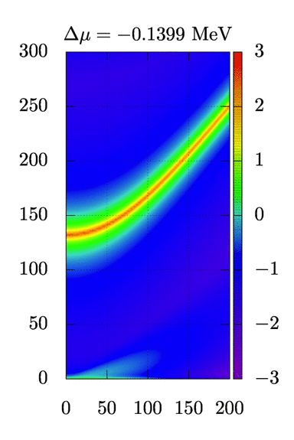
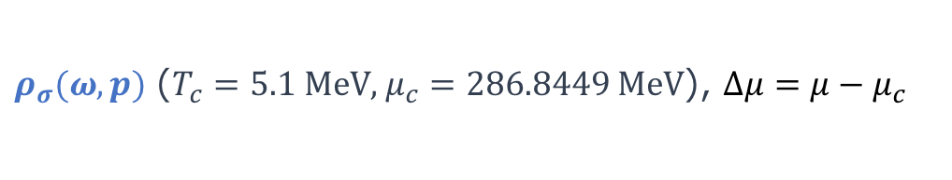
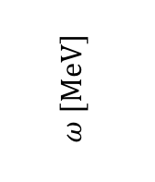
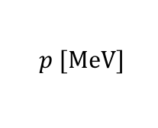
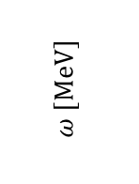
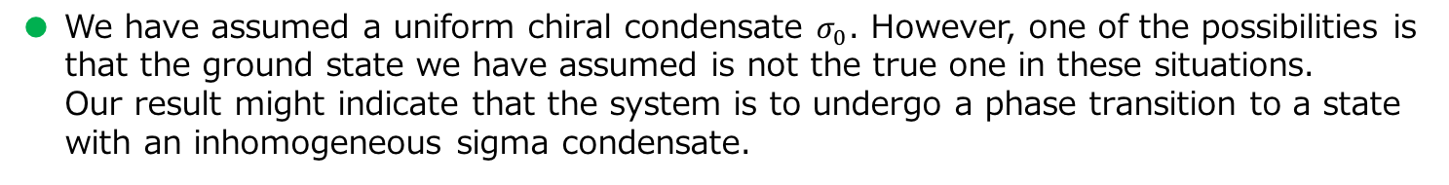
$ρ_{σ}$ around Z₂ CP (at physical point $m_{q}=8.88$ MeV)
$ρ_{σ}(ω, p)$ ($T_{c}=5.1 \text{MeV}$, $μ_{c}=286.8449 \text{MeV}$), $Δμ=μ−μ_{c}$
$$ω [\text{MeV}]$$
$$ω [\text{MeV}]$$
$$p [\text{MeV}]$$
tachyonic mode
● The dispersion curve of the sigma mesonic mode is further pushed down to be
mixed with the bump of the particle-hole mode in the space-like region.
● Tachyonic mode appears at finite momentum.
● We have assumed a uniform chiral condensate $σ_{0}$. However, one of the possibilities is
that the ground state we have assumed is not the true one in these situations.
Our result might indicate that the system is to undergo a phase transition to a state
with an inhomogeneous sigma condensate.

Slide 19
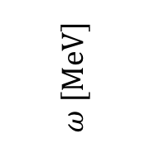

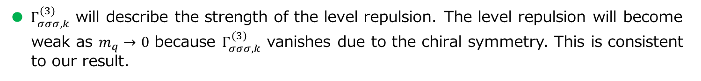

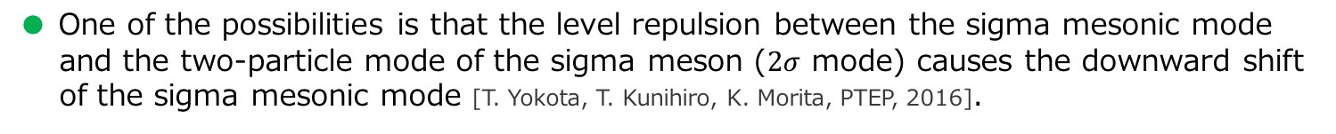





Effect of level repulsion
Peak of the sigma mesonic mode at $p=0$ MeV
Level repulsion
$2σ$ mode
Energy
sigma mesonic mode
$$\sim Γ_{σσσ,k}^{(3)}$$
particle-hole mode
$$ω [\text{MeV}]$$
$Γ_{σσσ,k}^{(3)}$ on Z₂ critical line
$$m_{q}$$
$$0$$
$$μ−μ_{c}(m_{q}) [\text{MeV}]$$
$∵$ chiral symmetry
● The downward shift of the peak of the sigma mesonic mode before turning
to shift upward is more drastic for the larger $m_{q}$.
● One of the possibilities is that the level repulsion between the sigma mesonic mode
and the two-particle mode of the sigma meson ($2σ$ mode) causes the downward shift
of the sigma mesonic mode [T. Yokota, T. Kunihiro, K. Morita, PTEP, 2016].
● $Γ_{σσσ,k}^{(3)}$ will describe the strength of the level repulsion. The level repulsion will become
weak as $m_{q}→0$ because $Γ_{σσσ,k}^{(3)}$ vanishes due to the chiral symmetry. This is consistent
to our result.

Slide 20

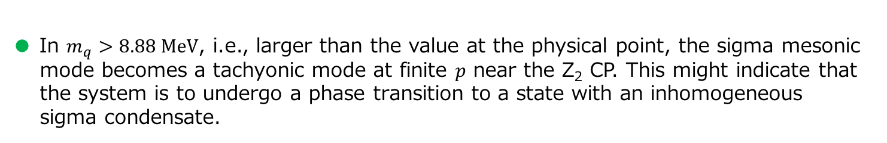
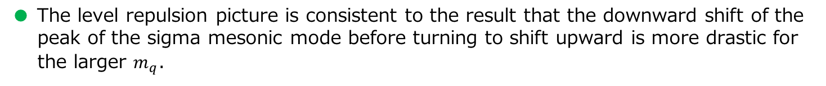
Summary
● We have investigated the behavior of the low-energy modes around the O(4) and
Z₂ CPs using the functional renormalization group (FRG).
● Modes in the pion channels have not shown critical behavior on the Z₂ critical line.
● The sigma mesonic mode becomes soft on the O(4) critical line but not on
the Z₂ critical line in small $m_{q}$.
● In $m_{q}>3.81 \text{MeV}$, the peak of the sigma mesonic mode shows behavior that it turns
to shift to higher-energy and shows a down shift again.
● In $m_{q}>8.88 \text{MeV}$, i.e., larger than the value at the physical point, the sigma mesonic
mode becomes a tachyonic mode at finite $p$ near the Z₂ CP. This might indicate that
the system is to undergo a phase transition to a state with an inhomogeneous
sigma condensate.
● The level repulsion picture is consistent to the result that the downward shift of the
peak of the sigma mesonic mode before turning to shift upward is more drastic for
the larger $m_{q}$.
Outlook
● Is the analysis with FRG under the inhomogeneous phase possible?

