Slide 1
Self-propelled motion of a fluid droplet under chemical reaction
Shunsuke Yabunaka¹, Takao Ohta¹,
Natsuhiko Yoshinaga² 1)Department of physics, Kyoto University. 2) WPI-AIMR, Tohoku University.
arXiv:1203.0593v1 [nlin.PS]
J. Chem. Phys. 136, 074904 (2012)

Slide 2
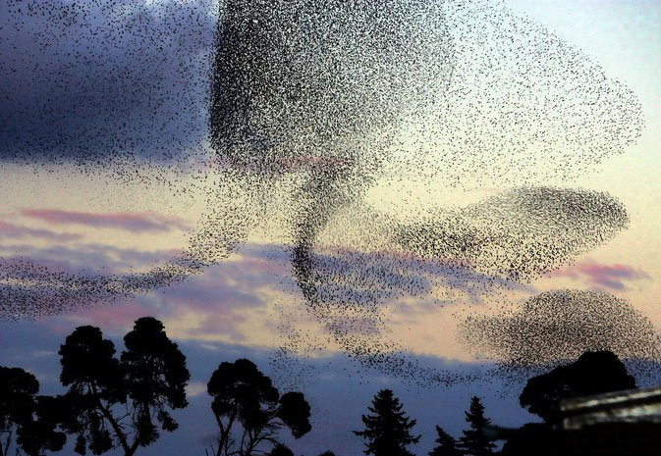
ACTIVE MATTER
Active matter is a new field in non-equilibrium physics and describes systems whose elements are consuming energy and moving without external force. Example includes collections of cells and flocks of animals.
single Dictyostelium(15 mm), Li et al, 2008.
Collective motion of a flock of birds.
In this talk, however, we will focus on dynamics of a single non-biological particle as a first step to understand the mechanism of self-propulsion.

Slide 3
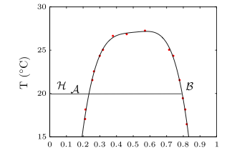
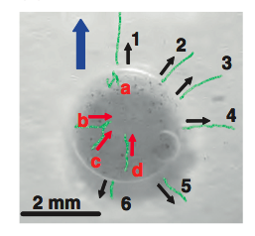
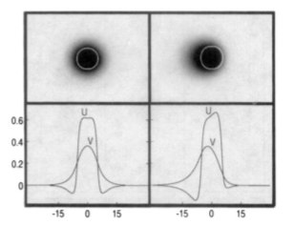
SELF-PROPELLED MOTION OF A NON-EQUILIBRIUM DROPLET
Self-propelled motion of a droplet with out-of-equilibrium concentration induced by Korteweg force (Binary mixture system).
A. Shioi, T. Ban, and Y. Morimune, Entropy 12, 2308 (2010)
Flow patterns around a self-propelling droplet. The blue line represents the direction of self-propelled motion.
Bifurcation from a motionless state to a propagating state in a numerical simulation of reaction-diffusion equations
How can we theoretically describe this spontaneous symmetry breaking under non-equilibrium condition?
K. Krischer and A. Mikhailov, Phys. Rev. Lett. 73, 3165 (1994). )

Slide 4
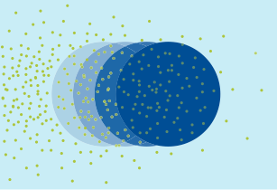
AIM OF OUR STUDY
To construct a theoretical model of self-propelled motion induced by hydrodynamic effects under non-equilibrium environment.
To derive the equation of the velocity of center of a droplet by analyzing the model.
A Set of continuous field equations

Slide 5
OUR MODEL SYSTEM
We consider a phase separated binary mixture.
We assume the existence of the third dilute component which influences the interfacial tension (a Marangoni effect). The third component is generated inside the droplet, diffuses away from the droplet and is decomposed due to chemical reactions.
Yellow points represent
the third Dilute component
B rich
A rich

Slide 6
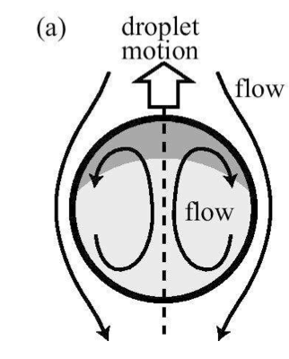
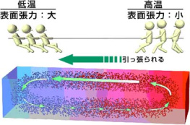
MARANGONI EFFECT
If there are concentration variations of the third dilute component on the surface of the droplet, the flow field will be generated around the droplet and the droplet will be transported by this flow field.
(We assume .)
When we assume the profile as
, the velocity field becomes
Flow field around the droplet in the system which is moving with the droplet

Slide 7
FORMULATION
We consider phase separated binary mixture where a chemical reaction takes place inside a droplet.
is a free energy density such that phase separation occurs.
is composition of the dilute third component whose translational entropy is given by .
The coefficient is assumed to depend linearly on .
The free energy density such that
phase separation occurs.
The density of the third
dilute component

Slide 8
DYNAMIC EQUATIONS
We neglect deformations of the droplet.
The pressure is determined from the incompressibility condition .
Concentration of the dilute component
Diffusion constant
Decomposition rate
Generation rate

Slide 9
OUTLINE OF OUR ANALYSIS ON THE DROPLET VELOCITY
Concentration profile of the third dilute component on the interface
Interface tension and its gradient
Interface
Flow field around a droplet
Marangoni effect
The velocity of the droplet center
We will obtain the expression of the droplet velocity in terms of the profile of the third dilute component.

Slide 10
THE VELOCITY OF THE CENTER OF A DROPLET
We ignore the migration of the droplet due to the diffusion of .
From geometrical consideration, the velocity of the center of a droplet is given as
Normal vector at the interface
Normal component of the flow field on the surface of a droplet.

Slide 11
THE DROPLET VELOCOTY IN TERMS OF CONCENTRATION OF THE THIRD COMPONENT
Here we can derive the following equation for the velocity of the center of a droplet by substituting the equation for in terms of the concentration profile .
When we assume the profile as
, we obtain the well-known results in hydrodynamics
z

Slide 12
ANALYSIS ON THE PROFILE OF THE DILUTE COMPONENT
In terms of the Fourier transform, the compositional field satisfies
.
Here we dropped the convective term, assuming that it does not change the essential bifurcation behavior. We will later consider this point.

Slide 13
SHORT TIME EXPANSION NEAR THE BIFURCATION THRESHOLD
By assuming that the relaxation of the third component is sufficiently rapid compared with the motion of interface, we can solve the equation in the last slide in terms of the time derivative as
We can evaluate the velocity of the center of mass of the droplet using this concentration profile of .

Slide 14
DETERMINATION OF THE DROPLET VELOCITY
The concentration profile of
The droplet velocity
The droplet velocity
and its time derivatives
The concentration profile of

Slide 15
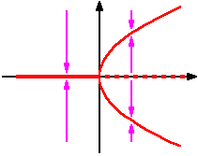
SCALED EQUATION OF MOTION FOR A DROPLET
This equation indicates that there is a bifurcation from a motionless state to a uniformly moving state by changing the strength of the Marangoni effect!

Slide 16
DISCUSSION
The mechanism of self-propulsion
Assume that a droplet was initially motionless, and is shifted slightly now.
Then, the concentration of the third component becomes higher on the rear of the droplet, and the interface tension also becomes higher on the rear!
Before
After
Shifted slightly

Slide 17
DISCUSSION
The effect of convective term
The correction for profile of to the first order is given as .
This changes as .
However, this correction does not change the essential bifurcation behavior.

Slide 18
CONCLUSION
We have constructed a theoretical model of self-propelled motion induced by hydrodynamic effects under non-equilibrium environment.
We have derived the equation of the velocity of center of mass of a droplet, and found that it indicates a bifurcation from a motionless state to a uniformly propagating state.

Slide 19
FLOW FIELD AROUND A DROPLET
Oseen Tensor
interface
high
low

Slide 20
PROFILE OF THE THIRD COMPONENT
By performing inverse Fourier transformation, we obtain the profile of the third component as
where

Slide 21
EQUATION OF MOTION FOR A DROPLET
By substituing of the profile of into the equation of the velocity of the center of the mass, we obtain the closed equaition for the velocity of the center of the mass of a droplet
,
where the coefficients are given as
.

Slide 22
DEFINITION OF THE SCALED PARAMETERS
When ,

Slide 23
INTRODUCTION
And simpler systems which show self-propelled motion are also proposed. As a first step to understand mechanism of self-propulsion, we would like to consider

