Slide 1
Neutrino oscillations with the T2K experiment
Phillip Litchfield, Kyoto University

Slide 2
Neutrinos
t
electron
tau
charm
muon
τ
up u
C
e
μ
top
b
neutrinos
s
d down
strange
Leptons
Quarks
bottom

Slide 3
Mass and flavour
The weak nuclear force connects the leptons together, and the quarks together. Neutrinos don’t have electric charge or strong colour, so the only way they can be detected is through their weak interactions.
We can’t see the neutrinos directly, so we usually label neutrinos by what lepton they couple to in weak interactions (‘flavour’): $ν_{e}$, $ν_{μ}$, $ν_{τ}$
But we can also order them by mass $ν_{1}$, $ν_{2}$, $ν_{3}$. How do the labels match up? Does $ν_{e}≡ν_{1}$?

Slide 4
Mixing
It turns out that there is no simple connection between neutrino mass states ($ν_{1}$, $ν_{2}$, $ν_{3}$) and flavour states ($ν_{e}$, $ν_{μ}$, $ν_{τ}$)
Instead they act as independent eigenstates for a general neutrino. So for any neutrino state:
$$\left|\left.ν\right\rangle \right.=k_{1}\left|\left.ν_{1}\right\rangle \right.+k_{2}\left|\left.ν_{2}\right\rangle \right.+k_{3}\left|\left.ν_{3}\right\rangle \right.=k_{e}\left|\left.ν_{e}\right\rangle \right.+k_{μ}\left|\left.ν_{μ}\right\rangle \right.+k_{τ}\left|\left.ν_{τ}\right\rangle \right.$$
Conservation of probability requires that the two bases are related by a unitary transformation (“mixing matrix”):
$$\left|\left.ν_{α}\right\rangle \right.=\sum_{i=1}^{3}{U_{αi}^{}}\left|\left.ν_{i}\right\rangle \right.$$

Slide 5
How to observe mixing
The mixing is pure quantum mechanics:
Prepare a pure neutrino mass eigenstate $ν_{i}$and the probability to observe it as $ν_{α}$is ${\left|U_{αi}\right|}^{2}$
The problem:
Neutrinos interact only through the weak force, so we have no way to prepare or observe mass states
Instead:
Start with a flavour eigenstate
Allow it to propagate (i.e. act as a superposition of mass eigenstates)
Measure the flavour state at later (proper) time.

Slide 6
Oscillations
The flavourmassflavour method for observing mixing gives a distinctive signature: Neutrino oscillations
A simple treatment is to treat the mass states as plane waves and use the fact $m_{ν}≪m_{e}≤E_{ν}$: $$\left|\left.ν_{i}\left(t\right)\right\rangle =\right. e^{−ip_{i}∙x}\left|\left.ν_{i}\left(t=0\right)\right\rangle \right.$$
Expand out $p_{i}∙x \sim E\left(1−\frac{m_{i}^{2}}{2E^{2}}+…\right)L \sim LE+\frac{m_{i}^{2}L}{2E}$
Phase difference between $ν_{i}.$ Looks like ${\sim mcτ}/{γ }$
Phase advancement shared by all $ν_{i}$

Slide 7
Phase advancement
Mass states start in phase
Different phase advancement
Mass states now in anti-phase
A simple 2 neutrino picture:
$\left.\left|ν_{μ}\right.\right\rangle =\frac{1}{√2}\left[\left.\left|ν_{1}\right.\right\rangle +\left.\left|ν_{2}\right.\right\rangle \right]$; $\left.\left|ν_{τ}\right.\right\rangle =\frac{1}{√2}\left[\left.\left|ν_{1}\right.\right\rangle −\left.\left|ν_{2}\right.\right\rangle \right]$
When the mass states have shifted phase by π, the flavour has completely changed.

Slide 8
With three neutrinos…
In general, amplitudes can be different:
1st flavour state: 2 free amplitudes
2nd flavour state: 1 free amplitude
3rd flavour state: 0 free amplitudes
For any particular flavour state: can’t force mass states to be in phase.
Cannot avoid a (1) phase parameter
Therefore 3 magnitude parameters and 1 complex phase
For antineutrinos: phase advancement is opposite.
Therefore phase parameter can cause CP violation.

Slide 9
Putting it all together
Relative phase of mass eigenstates is proportional to mass-squared. Therefore phase differences depend on only on splittings ${∆m}_{ij}^{2}=m_{i}^{2}−m_{j}^{2}$
Transitions involve the mixing matrix four times: $A_{ij;αβ}=U_{βi}U_{αi}^{∗}U_{βj}^{∗}U_{αj}$
$$P\left(ν_{α}→ν_{β}\right)=δ_{αβ}+\sum_{i>j}{2Im\left[A_{ij;αβ}\right]\sin\left(\frac{{∆m}_{ij}^{2}L}{2E_{ν}}\right)−4Re\left[A_{ij;αβ}\right]\sin^{2}\left(\frac{{∆m}_{ij}^{2}L}{4E_{ν}}\right)}$$
Survival probability: For $β=α$, $A_{ij;αα}={\left|U_{αi}\right|}^{2}{\left|U_{αj}\right|}^{2}$
2
α
$$U_{αi}$$
$$ν_{i}$$
$$U_{βi}^{∗}$$
β
breaks CP

Slide 10
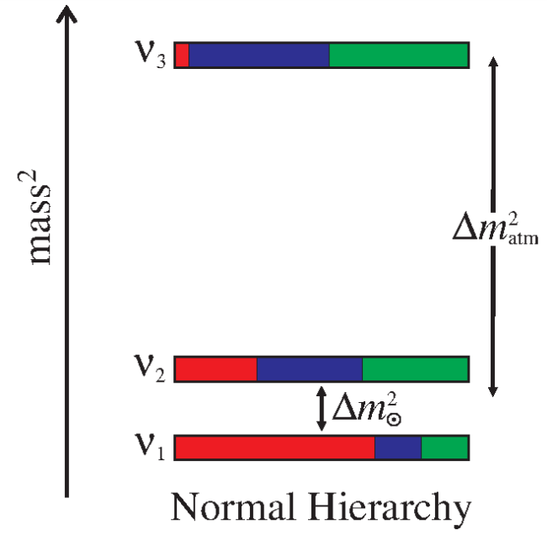
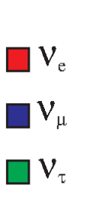
Parameters before T2K
Neutrino mixing matrix is:
$$\left(\begin{matrix}ν_{e} \\ ν_{μ} \\ ν_{τ}\end{matrix}\right)=\left(\begin{matrix}U_{e1} & U_{e2} & U_{e3} \\ U_{μ1} & U_{μ2} & U_{μ3} \\ U_{τ1} & U_{τ2} & U_{τ3}\end{matrix}\right)\left(\begin{matrix}ν_{1} \\ ν_{2} \\ ν_{3}\end{matrix}\right)$$
4 independent parameters: 3 rotations + 1 phase
T2K measurements primarily sensitive to $U_{μ3}$and $U_{e3}$
*Plotted for $U_{e3}±\sqrt{0.05}i$
$$0$$
$$\sqrt{1/6}$$
$$\sqrt{1/3}$$
$$\sqrt{1/2}$$
$$\sqrt{2/3}$$
$$1$$

Slide 11
Angle parameterisation
The mixing matrix is commonly parameterised as the product of two rotations and a unitary transformation. Writing $s_{ij}=sinθ_{ij}$, and $c_{ij}=cosθ_{ij}$:
$$\left(\begin{matrix}{ c}_{12} & s_{12} & 0 \\ {−s}_{12} & c_{12} & 0 \\ 0 & 0 & 1\end{matrix}\right)\left(\begin{matrix}{ c}_{13} & 0 & s_{13}e^{iδ} \\ 0 & 1 & 0 \\ {−s}_{13}e^{−iδ} & 0 & c_{13}\end{matrix}\right)\left(\begin{matrix}1 & 0 & 0 \\ 0 & { c}_{23} & s_{23} \\ 0 & {−s}_{23} & c_{23}\end{matrix}\right)$$
Original solar and atmospheric disappearance amplitudes are approximately functions of $θ_{12}$ and $θ_{23}$. (Works if the third angle $θ_{13}$ is small.)
Phase parameter δ is placed with $θ_{13}$.

Slide 12
The T2K experiment
Uses the high power ‘Main Ring’ accelerator at JPARC in Tokai-mura to produce muon neutrinos .
The neutrino beam is directed toward Kamioka, where the Super-Kamiokande detector looks for oscillation signals.
A suite of near detectors characterise the beam at creation point to eliminate systematic errors.
Beam energy is tuned to maximum of atmospheric oscillation probability.

Slide 13
Oscillation signals at T2K
Disappearance mode
Measure $P\left(ν_{μ}→ν_{μ}\right)$
Since $\left|{∆m}_{21}^{2}\right|≪\left|{∆m}_{31}^{2}\right|$ and $\cos^{2}{θ_{13}}≅1$, can approximate amplitude as:
$$4\sin^{2}{θ_{23}}\cos^{2}{θ_{23}} \\ (=\sin^{2}{{2θ}_{23}})$$
Current measurements are consistent with $\sin^{2}{θ_{23}}=\frac{1}{2}$
Recent results have hinted at deviation. T2K may be able to see evidence of this.
Appearance mode
Measure $P\left(ν_{μ}→ν_{e}\right)$
First direct evidence of appearance mode.
Dominant term of probability is:
$$4\sin^{2}{θ_{23}}\sin^{2}{θ_{13}}\cos^{2}{θ_{13}} \\ \left(=2\sin^{2}{θ_{23}}\sin^{2}{{2θ}_{13}}\right)$$ but other terms are significant
Disappearance experiments with reactors can measure $\sin^{2}{2θ_{13}}$. Using these constraints T2K can investigate sub-dominant terms

Slide 14
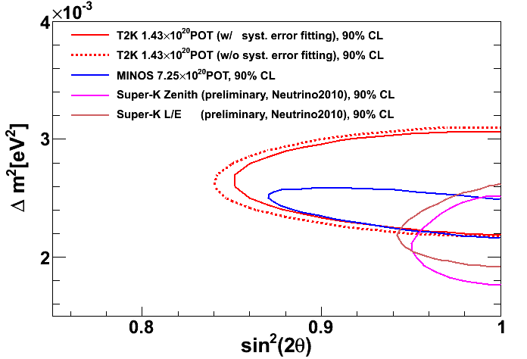
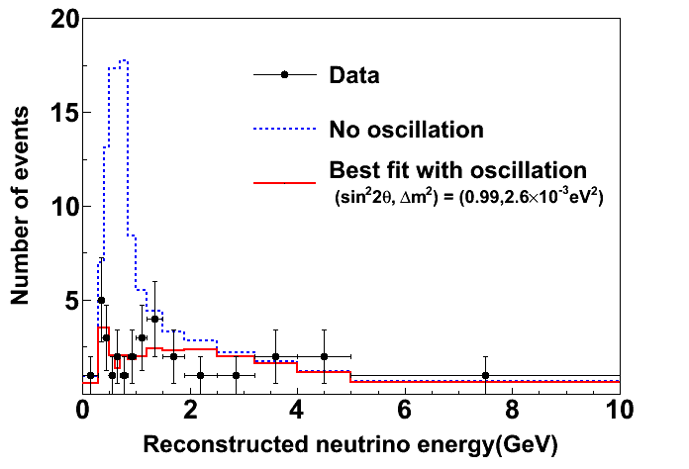
$ν_{μ}$ disappearance
Use reaction kinematics to reconstruct neutrino energy.
Dip shape is characteristic of oscillations.
New results coming soon!
Long-term goal is an order of magnitude higher.

Slide 15
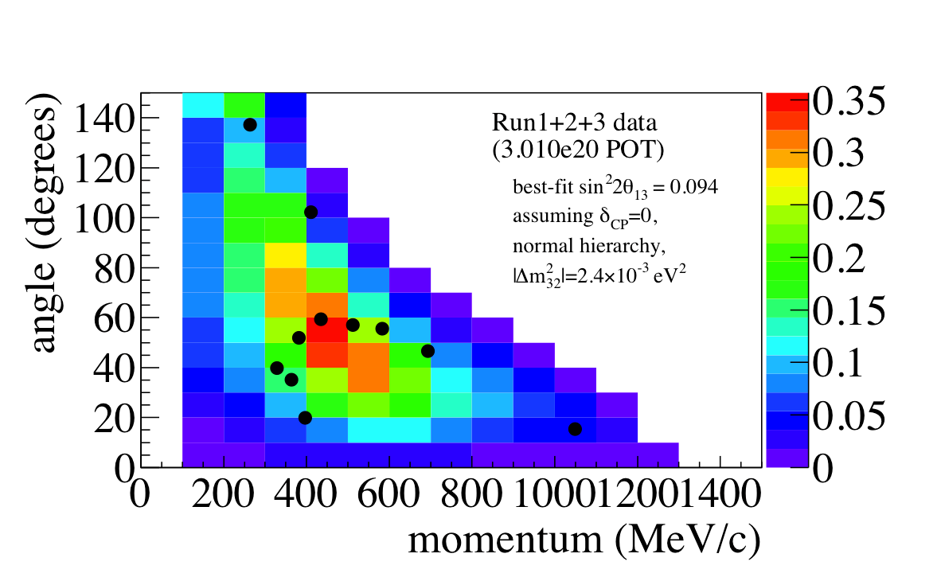
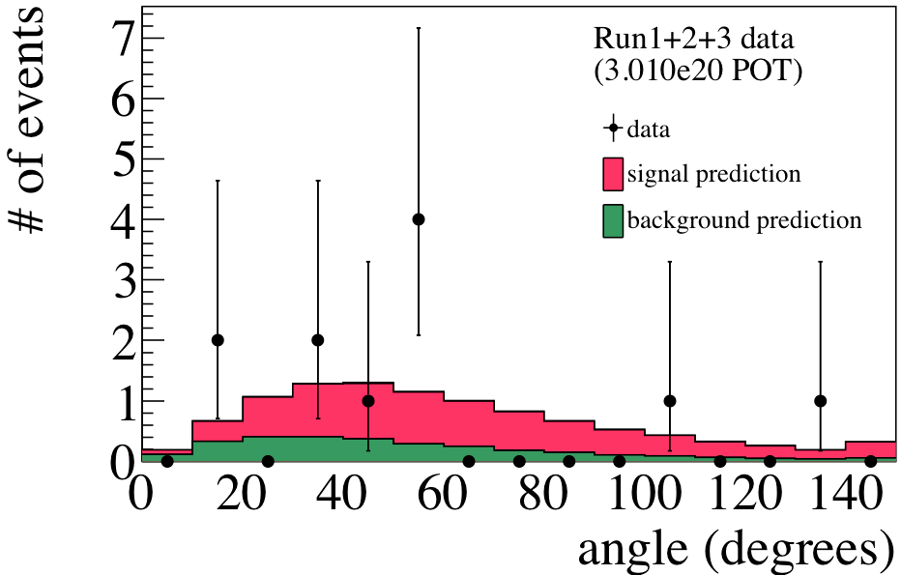
$ν_{e}$ appearance*
*T2K $3.010×{10}^{20}$ POT, first shown at ICHEP 2012
Fit ($p_{e}$, $θ_{e,ν}$) distribution in two dimensions
Reject $U_{e3}=0$ at 3.2σ
For these parameters:
$\left|∆m_{32}^{2}\right|=2.4×{10}^{−3}{eV}^{2}$,
$\sin^{2}2θ_{23}=1$,
$δ=0$,
Normal hierarchy,
Best fit $\sin^{2}2θ_{13}=0.094$

Slide 16
Going further
Expand $ν_{e}$ appearance probability up to terms quadratic in the parameters $α={∆m_{21}^{2}}/{∆m_{31}^{2}}≈1/{32}$, and $\sin{2θ_{13}}$:
$P\left(ν_{μ}→ν_{e}\right)≈$ $T_{θθ}\sin^{2}2θ_{13}\frac{\sin^{2}\left(\left[1−A\right]∆\right)}{{\left[1−A\right]}^{2}}+ T_{αα}α^{2}\frac{\sin^{2}\left(A∆\right)}{A^{2}}$ $+ T_{αθ}α\sin{2θ_{13}}\frac{sin\left(\left[1−A\right]∆\right)}{\left(1−A\right)}\frac{\sin\left(A∆\right)}{A}\cos\left(δ+∆\right)$
where
${T_{θθ}=sin}^{2}θ_{23}$, $T_{αα}=\cos^{2}{θ_{23}}\sin^{2}2θ_{12}$, $$T_{αθ}=\cos{θ_{13}}\sin{{2θ}_{12}}\sin{2θ_{23}}$$
and $∆=\frac{∆m_{31}^{2}L}{4E}$ $\sim \frac{π}{2}$ at 1st osc. maximum.
$A\left(=±{{2\sqrt{2}G}_{F}n_{e}E }/{∆m_{31}^{2}}\right)$ is the matter density parameter. For T2K, $\left|A\right|\sim 0.07$

Slide 17
New measurements
$P\left(ν_{μ}→ν_{e}\right)≈$ $T_{θθ}\sin^{2}2θ_{13}\frac{\sin^{2}\left(\left[1−A\right]∆\right)}{{\left[1−A\right]}^{2}}+ T_{αα}α^{2}\frac{\sin^{2}\left(A∆\right)}{A^{2}}$ $+ T_{αθ}α\sin{2θ_{13}}\frac{sin\left(\left[1−A\right]∆\right)}{\left(1−A\right)}\frac{\sin\left(A∆\right)}{A}\cos\left(δ+∆\right)$
The dominant 1st term depends on ${T_{θθ}=sin}^{2}θ_{23}$
If we observe $\sin^{2}{θ_{23}}≠\frac{1}{2}$ it can give information on the sign of $\sin^{2}{θ_{23}}−\frac{1}{2}$
Physical interpretation: is $ν_{3}$ mostly $ν_{μ}$ or mostly $ν_{τ}$?

Slide 18
New measurements
$P\left(ν_{μ}→ν_{e}\right)≈$ $T_{θθ}\sin^{2}2θ_{13}\frac{\sin^{2}\left(\left[1−A\right]∆\right)}{{\left[1−A\right]}^{2}}+ T_{αα}α^{2}\frac{\sin^{2}\left(A∆\right)}{A^{2}}$ $+ T_{αθ}α\sin{2θ_{13}}\frac{sin\left(\left[1−A\right]∆\right)}{\left(1−A\right)}\frac{\sin\left(A∆\right)}{A}\cos\left(δ+∆\right)$
The 3rd term depends on the last remaining unknown parameter, the phase δ.
In the equivalent probability for anti-neutrinos it enters with opposite sign  Charge-Parity asymmetry.
Possible origin of observed matter-antimatter asymmetry (Leptogenisis)

Slide 19
New measurements
$P\left(ν_{μ}→ν_{e}\right)≈$ $T_{θθ}\sin^{2}2θ_{13}\frac{\sin^{2}\left(\left[1−A\right]∆\right)}{{\left[1−A\right]}^{2}}+ T_{αα}α^{2}\frac{\sin^{2}\left(A∆\right)}{A^{2}}$ $+ T_{αθ}α\sin{2θ_{13}}\frac{sin\left(\left[1−A\right]∆\right)}{\left(1−A\right)}\frac{\sin\left(A∆\right)}{A}\cos\left(δ+∆\right)$
All terms have dependence on A, which can determine the (as yet unknown) sign of $∆m_{31}^{2}$
If $∆m_{31}^{2}>0$, then $m_{3}^{2}>m_{2}^{2}>m_{1}^{2},$ “Normal hierarchy” If $∆m_{31}^{2}<0$, then $m_{2}^{2}>m_{1}^{2}>m_{3}^{2},$ “Inverse hierarchy”
This dependence is weak in T2K, but must be taken into account

Slide 20
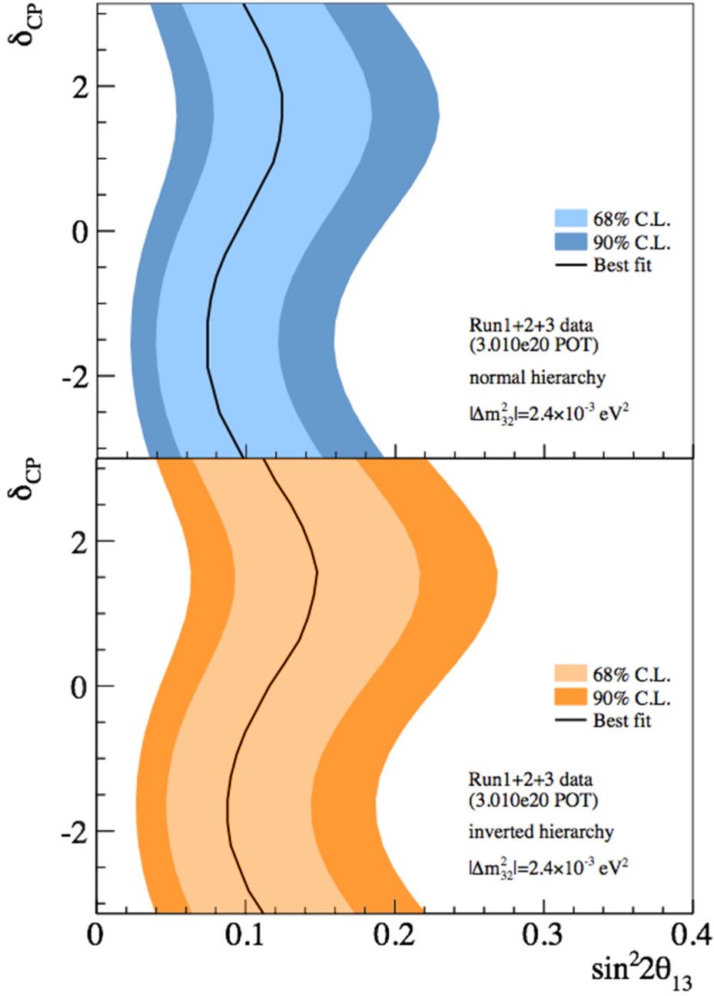
Dependence on δ and hierarchy
Leave $\left|∆m_{31}^{2}\right|$and $θ_{23}$ fixed, but allow the unknown CP phase and hierarchy to vary.
Plots show allowed regions of $\sin^{2}2θ_{13}$ for each value of CP phase and hierarchy.
In combination with other results, can start to constrain δ, $θ_{23}$
This is just the first step!
T2K preliminary
Normal hierarchy
Inverted hierarchy

Slide 21
Summary
T2K is already very successful
First appearance paper made 500+ citations yesterday
Previous experiments have been able to ignore second-order corrections, but T2K is sensitive enough that this is not possible
More sophisticated analyses to come in the future.
We have a chance to make qualitatively new discoveries.
Please see talk by Tsuyoshi Nakaya tomorrow.

