Slide 1
Three-body calculation for
Kaonic deuterium
Tsubasa Hoshino,
Shota Ohnishi, Wataru Horiuchi
(Hokkaido Univ.)
Computational Advances in Nuclear and Hadron Physics (CANHP 2015)
October 14, 2015
Yuakawa Institute for Theoretical Physics, Kyoto, Japan

Slide 2
Outline
Introduction
𝚲(𝟏𝟒𝟎𝟓)
Method
Kaonic hydrogen
Kaonic atom
Results
Kaonic deuterium
Summary
$\overline{K}$N interaction
K ̅N interaction
Three-body calculation

Slide 3
Introduction

Slide 4
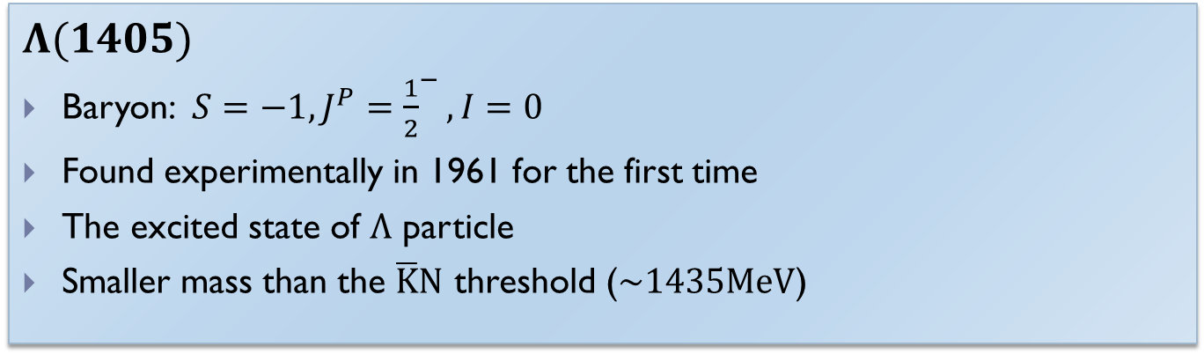
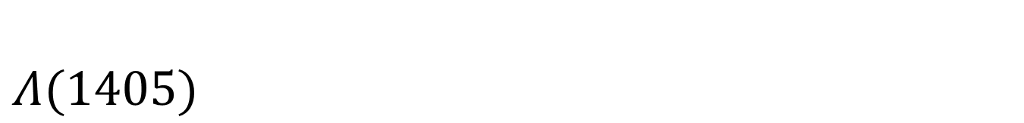
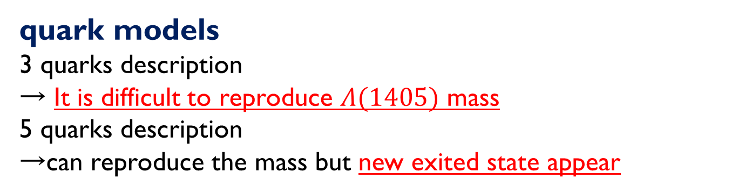
$$Λ(1405)$$
$$Λ(1405)$$
Baryon: $S=−1, J^{P}={\frac{1}{2}}^{−},I=0$
Found experimentally in 1961 for the first time
The excited state of $Λ$ particle
Smaller mass than the $\overline{K}N$ threshold ($\sim 1435MeV$)
quark models
3 quarks description
→ It is difficult to reproduce $Λ(1405)$ mass
5 quarks description
→can reproduce the mass but new exited state appear

Slide 5
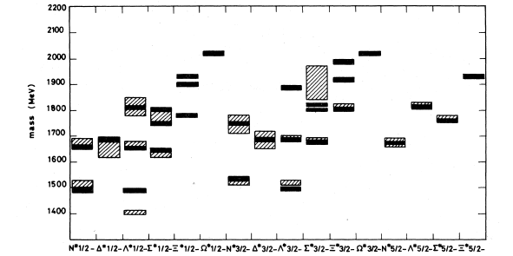

Three-body quarks model
Calculation of Hadron mass from three-body quarks model
$$Λ(1405)$$
N.Isgur and G.Karl, PRD18 (1978)

Slide 6
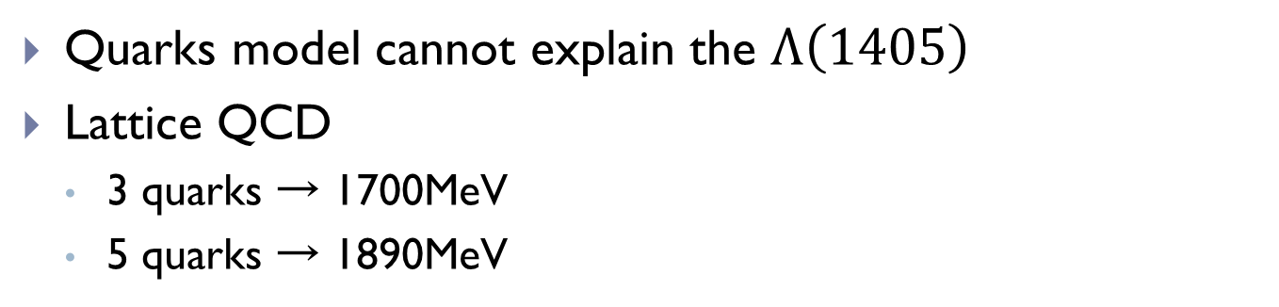
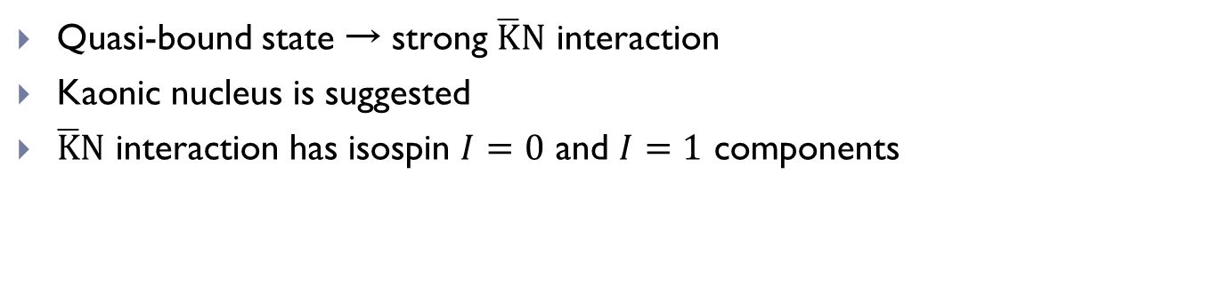
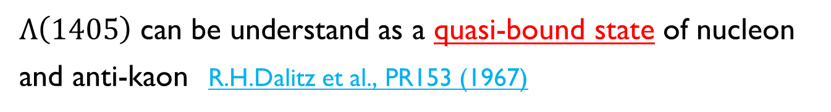
Meson-Baryon description
Quarks model cannot explain the $Λ\left(1405\right)$
Lattice QCD
  3 quarks → 1700MeV
  5 quarks → 1890MeV
Y.Nemoto et al., PRD68 (2003)
N.Ishii et al., PTP168 (2007)
Meson-Baryon description
$Λ\left(1405\right)$ can be understand as a quasi-bound state of nucleon and anti-kaon R.H.Dalitz et al., PR153 (1967)
Quasi-bound state → strong $\overline{K}N$ interaction
Kaonic nucleus is suggested
$\overline{K}N$ interaction has isospin $I=0$ and $I=1$ components

Slide 7
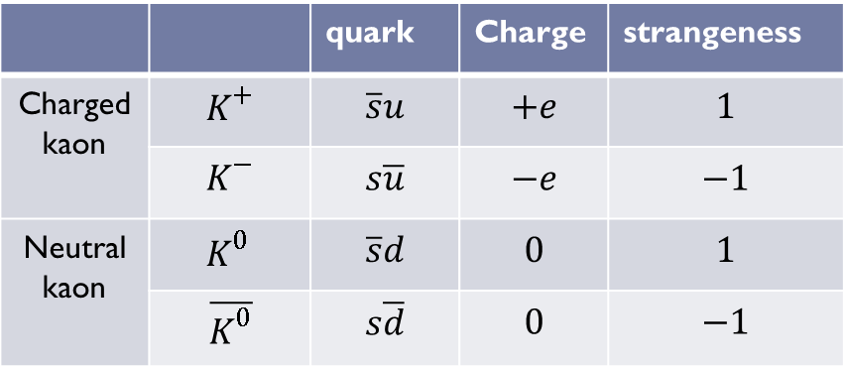
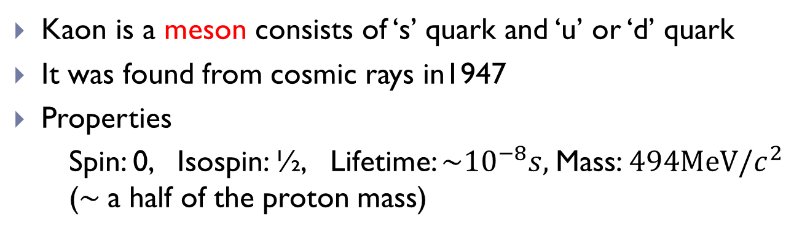





Kaon(meson having strangeness)
Kaon is a meson consists of ‘s’ quark and ‘u’ or ‘d’ quark
It was found from cosmic rays in1947
Properties
    Spin: 0, Isospin: ½, Lifetime: $\sim {10}^{−8}s,$Mass: $494MeV/c^{2}$ ($\sim$a half of the proton mass)
 |  | quark | Charge | strangeness
Charged kaon | $$K^{+}$$ | $$\overline{s}u$$ | $$+e$$ | $$1$$
 | $$K^{−}$$ | $$s\overline{u}$$ | $$−e$$ | $$−1$$
Neutral kaon | $$K^{0 }$$ | $$\overline{s}d$$ | $$0$$ | $$1$$
 | $$\overline{K^{0}}$$ | $$s\overline{d}$$ | $$0$$ | $$−1$$
Anti particle
$$K^{+}$$
$$K^{−}$$
Anti particle
$$K^{0}$$
$$\overline{K^{0}}$$
$$\overline{K}$$

Slide 8

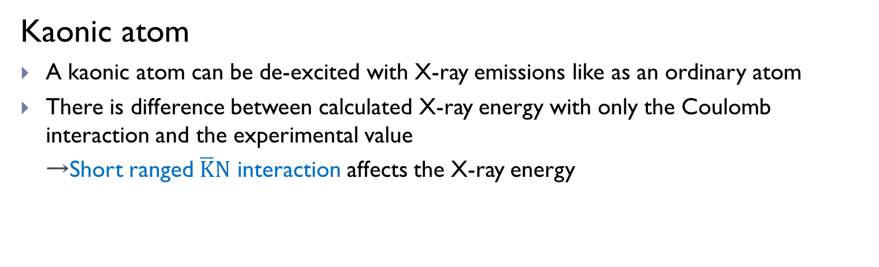

Kaonic atom
Kaonic atom
A kaonic atom can be de-excited with X-ray emissions like as an ordinary atom
There is difference between calculated X-ray energy with only the Coulomb interaction and the experimental value
  →Short ranged $\overline{K}N$ interaction affects the X-ray energy
X-ray
Coulomb
Coulomb + $\overline{K}N$
2p
p
1s
$$K^{−}$$
1s level shift
Kaonic hydrogen

Slide 9
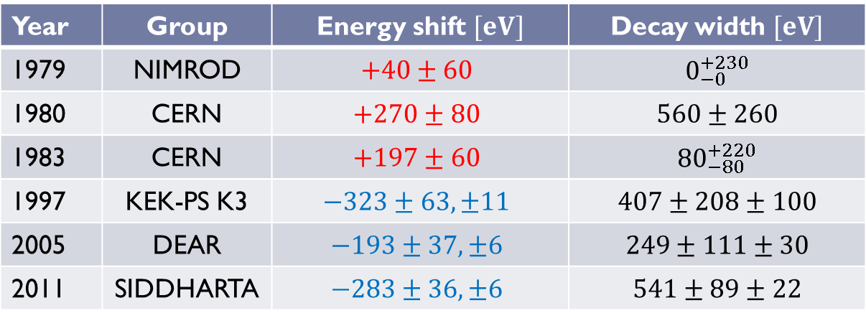
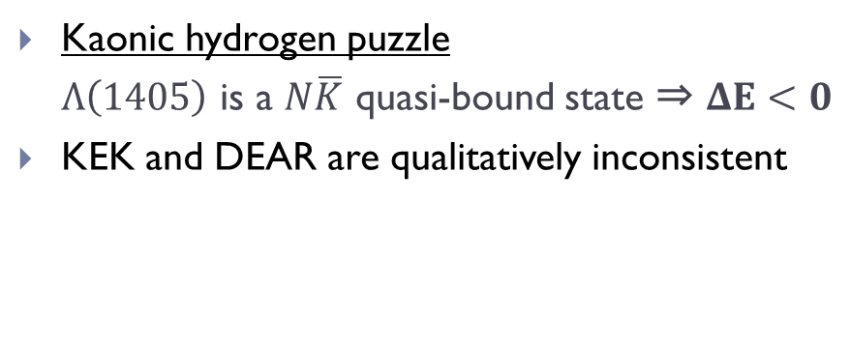
Studies for kaonic hydrogen
Year | Group | Energy shift $[eV]$ | Decay width $[eV]$
1979 | NIMROD | $$+40±60$$ | $$0_{−0}^{+230}$$
1980 | CERN | $$+270±80$$ | $$560±260$$
1983 | CERN | $$+197±60$$ | $${80}_{−80}^{+220}$$
1997 | KEK-PS K3 | $$−323±63,±11$$ | $$407±208±100$$
2005 | DEAR | $$−193±37,±6$$ | $$249±111±30$$
2011 | SIDDHARTA | $$−283±36,±6$$ | $$541±89±22$$
Kaonic hydrogen puzzle
  $Λ\left(1405\right)$ is a $N\overline{K}$ quasi-bound state ⇒ $ΔE<0$
KEK and DEAR are qualitatively inconsistent
J. Davies et al., PLB83 (1979).
M. Izycki et al., ZPA297 (1980)
P. Bird et al., NPA404 (1983)
M. Iwasaki et al., PRL78 (1997)
G. Beer et al., PRL94 (2005)
Bazzi et al., NPA881 (2012)
SIDDHARTA experiment

Slide 10



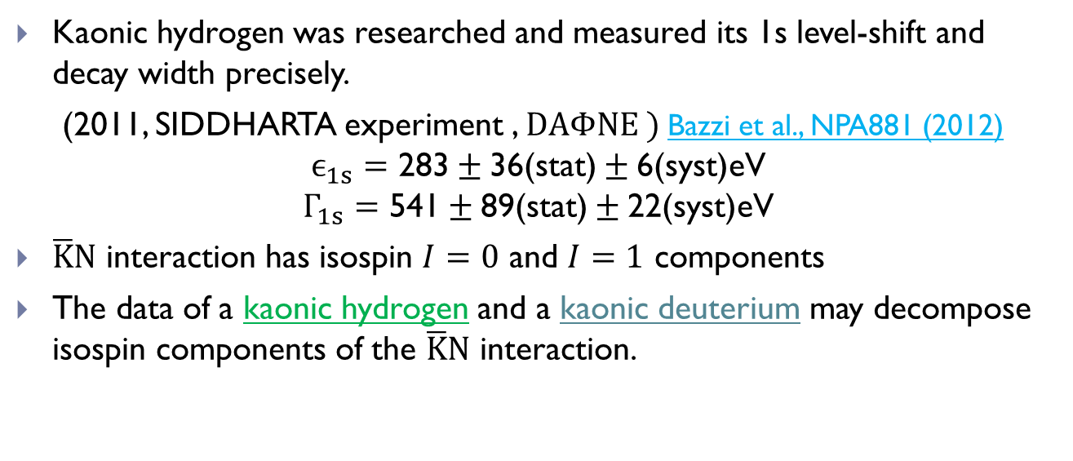
Studies for kaonic atoms
Kaonic hydrogen was researched and measured its 1s level-shift and decay width precisely.
(2011, SIDDHARTA experiment , $DAΦNE )$ Bazzi et al., NPA881 (2012)
$$ϵ_{1s}=\text{283}±\text{36(}\text{stat}\text{)}±\text{6(}\text{syst}\text{)}\text{eV}$$
$$Γ_{1s}=\text{541}±\text{89}\text{(}\text{stat}\text{)}±\text{22(}\text{syst}\text{)}\text{eV}$$
$\overline{K}N$ interaction has isospin $I=0$ and $I=1$ components
The data of a kaonic hydrogen and a kaonic deuterium may decompose isospin components of the $\overline{K}N$ interaction.
$$\left|K^{−}p\right\rangle =\left|↑↓\right\rangle \\ =|I=0⟩+|I=1⟩$$
p
n
$$\left|K^{−}n\right\rangle =\left|↑↑\right\rangle \\ =\left|I=1\right\rangle$$
$$K^{−}$$
Kaonic deuterium

Slide 11
Method

Slide 12




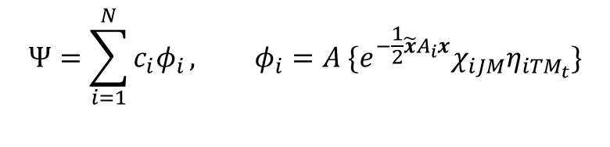


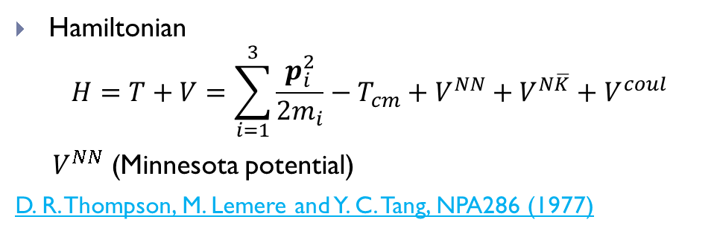

Three body calculation
$$x_{1}$$
Hamiltonian
  $$H=T+V=\sum_{i=1}^{3}{\frac{p_{i}^{2}}{2m_{i}}}−T_{cm}+V^{NN}+V^{N\overline{K}}+V^{coul}$$
  $V^{NN}$ (Minnesota potential)
D. R. Thompson, M. Lemere and Y. C. Tang, NPA286 (1977)
$$\overline{K}$$
N
$$x_{2}$$
N
Wave function
    Correlated Gaussian basis
$x=\left\{x_{1}, x_{2}\right\}$, total angular momentum $L=0$
$χ_{iJM}:spin function$, $η_{iTM_{t}}:isospin function$
Configuration,1
$$Ψ=\sum_{i=1}^{N}{c_{i}φ_{i}}, φ_{i}=A \{e^{−\frac{1}{2}\tilde{x}A_{i}x}χ_{iJM}η_{iTM_{t}}\}$$
$$\overline{K}$$
N
$$y_{2}$$
$A_{i}:2×2 matrix( paramaters of coordinates )$
$$y_{1}$$
N
Configuration,2

Slide 13
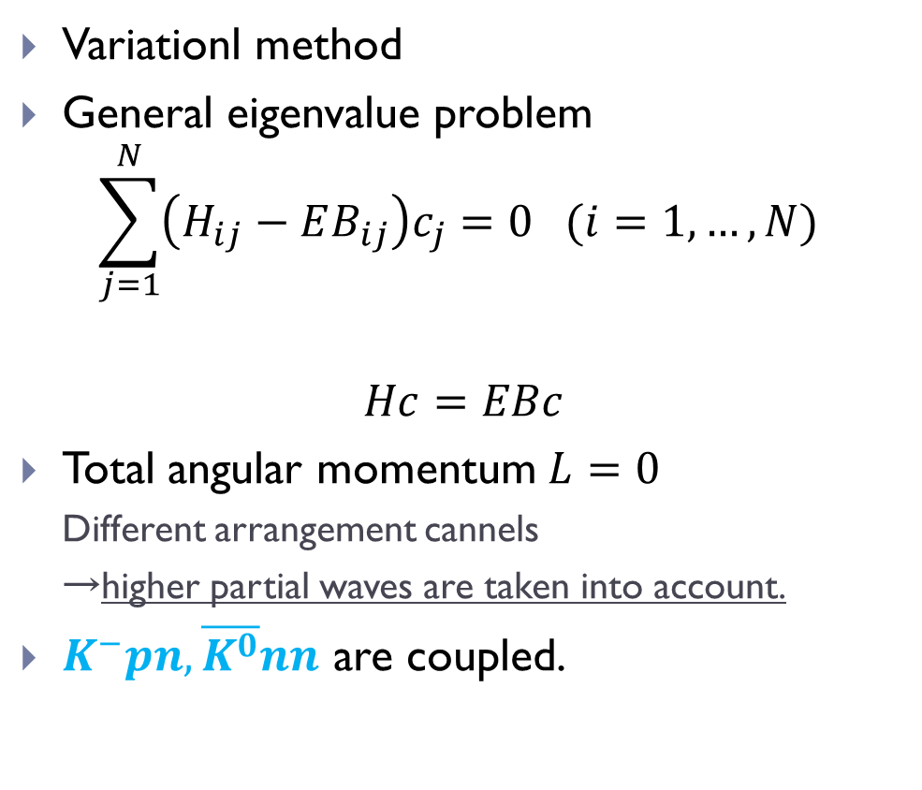
Three body calculation
$$x_{1}$$
Variationl method
General eigenvalue problem
$$\sum_{j=1}^{N}{\left(H_{ij}−EB_{ij}\right)c_{j}=0 (i=1,…,N) }$$
$$Hc=EBc$$
Total angular momentum $L=0$
  Different arrangement cannels
  →higher partial waves are taken into account.
$K^{−}pn, \overline{K^{0}}nn$ are coupled.
$$\overline{K}$$
N
$$x_{2}$$
N
Configuration,1
$$\overline{K}$$
N
$$y_{2}$$
$$y_{1}$$
N
Configuration,2

Slide 14
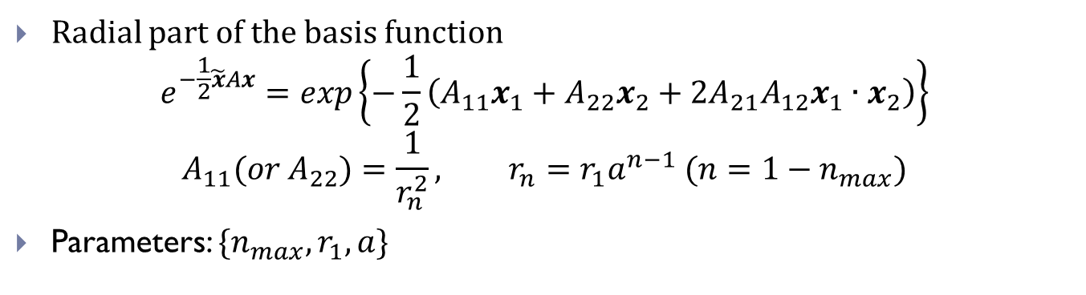
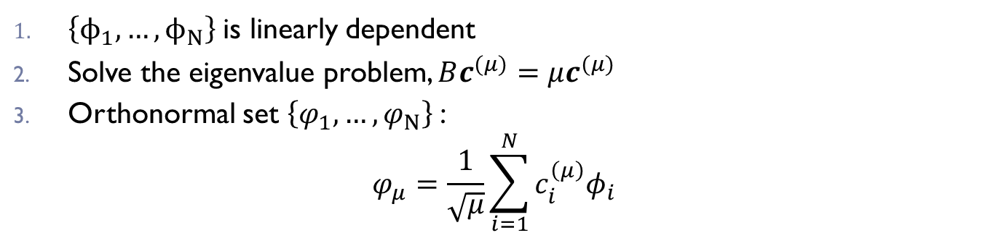
Geometric progression
Radial part of the basis function
$$e^{−\frac{1}{2}\tilde{x}Ax}=\exp\left\{−\frac{1}{2}\left(A_{11}x_{1}+A_{22}x_{2}+{2A}_{21}A_{12}x_{1}∙x_{2}\right)\right\}$$
$$A_{11}({or A}_{22})=\frac{1}{r_{n}^{2}}, r_{n}=r_{1}a^{n−1} (n=1−n_{max})$$
Parameters: ${\{n}_{max}, r_{1}, a\}$
E. Hiyama Y. Kino and M. Kamimura, PPNP51 (2003)
Making the orthonormal set
$\left\{ϕ_{1},…,ϕ_{N}\right\}$is linearly dependent
Solve the eigenvalue problem, $Bc^{(μ)}=μc^{(μ)}$
Orthonormal set $\left\{φ_{1},…,φ_{N}\right\}$:
$$φ_{μ}=\frac{1}{\sqrt{μ}}\sum_{i=1}^{N}{c_{i}^{\left(μ\right)}φ_{i}}$$

Slide 15

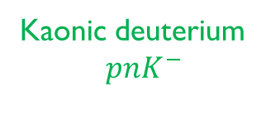


Geometric progression
Energy eigenvalues with AY
$$p+n+K^{−}$$
0
-2.20
$$pn+K^{−}$$
Kaonic deuterium
$$pnK^{−}$$
B.E. (MeV)
continuum
$$Λ(1405)+n$$
-29.6
It is difficult to use the random selection and optimization
  Existence of the continuum state
  The scales of the states are extremely different.

Slide 16
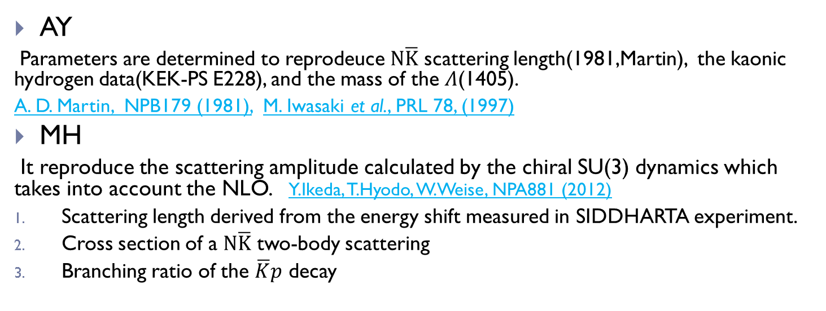
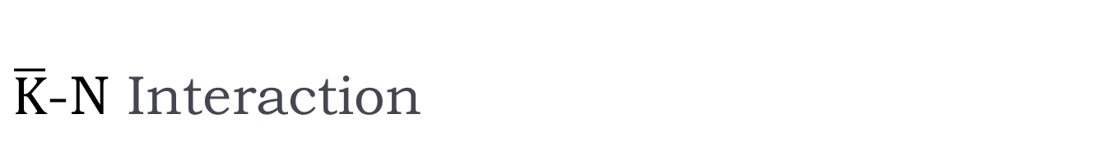
$\overline{K}$-N Interaction
 | Akaishi, Yamazaki | Miyahara, Hyodo
Theory | phenomenological | Chiral SU(3)
Energy dependence | × | ○
Y. Akaishi, T.Yamazaki, PRC65 (2002)
T.Yamazaki, Y. Akaishi, PRC76 (2007)
K.Miyahara, T.Hyodo, arXiv:1506.05724 [nucl-th]
AY
Parameters are determined to reprodeuce $N\overline{K}$ scattering length(1981,Martin), the kaonic hydrogen data(KEK-PS E228), and the mass of the $Λ$(1405).
A. D. Martin, NPB179 (1981), M. Iwasaki et al., PRL 78, (1997)
MH
It reproduce the scattering amplitude calculated by the chiral SU(3) dynamics which takes into account the NLO. Y.Ikeda, T.Hyodo, W.Weise, NPA881 (2012)
Scattering length derived from the energy shift measured in SIDDHARTA experiment.
Cross section of a $N\overline{K}$ two-body scattering
Branching ratio of the $\overline{K}p$ decay

Slide 17
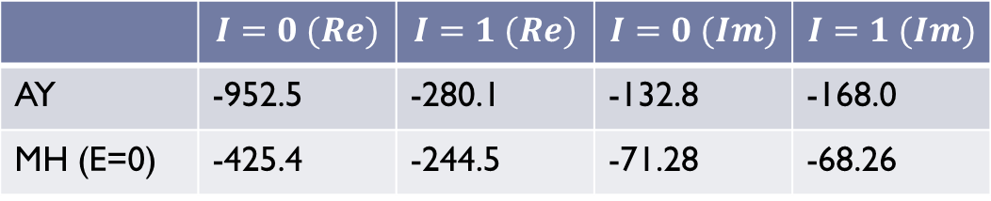

Comparison of potentials
AY
MH
(E=0)
Volume integral of potentials ($MeV∙fm^{3}$)
 | $$I=0 (Re)$$ | $$I=1 (Re)$$ | $$I=0 (Im)$$ | $$I=1 (Im)$$
AY | -952.5 | -280.1 | -132.8 | -168.0
MH (E=0) | -425.4 | -244.5 | -71.28 | -68.26

Slide 18
Results

Slide 19
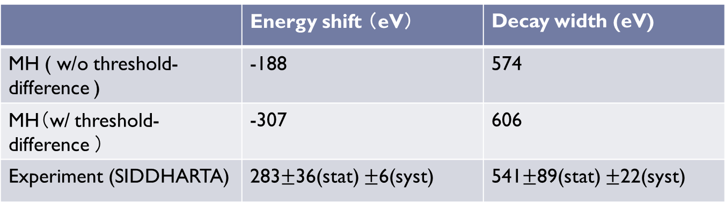
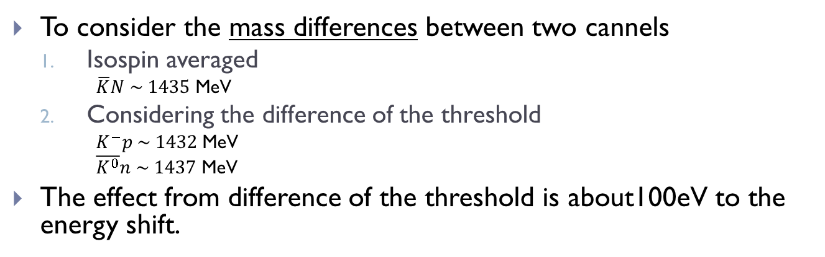
The effect of the mass difference
 | Energy shift （eV） | Decay width (eV)
MH ( w/o threshold-difference ) | -188 | 574
MH（w/ threshold-difference ） | -307 | 606
Experiment (SIDDHARTA) | 283$±$36(stat) $±$6(syst) | 541$±$89(stat) $±$22(syst)
To consider the mass differences between two cannels
  Isospin averaged
      $\overline{K}N \sim 1435$ MeV
  Considering the difference of the threshold
      $K^{−}p \sim 1432$ MeV
      $\overline{K^{0}}n \sim 1437$ MeV
The effect from difference of the threshold is about100eV to the energy shift.

Slide 20
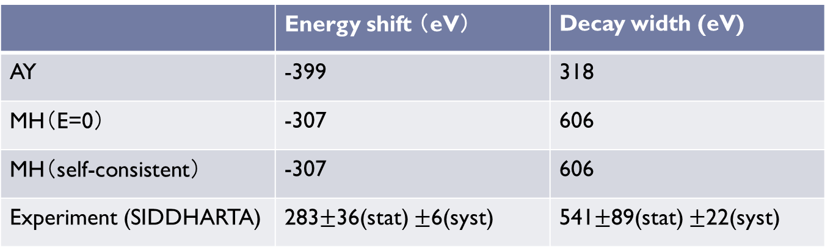



Results ($N\overline{K}$ two-body)
 | Energy shift （eV） | Decay width (eV)
AY | -399 | 318
MH（E=0） | -307 | 606
MH（self-consistent） | -307 | 606
Experiment (SIDDHARTA) | 283$±$36(stat) $±$6(syst) | 541$±$89(stat) $±$22(syst)
The effect of the self-consistency in the MH potential is negligible.
MH interaction well reproduced the SIDDHARTA experiment.
AY interaction failed to reproduce the experimental value.
$$x_{1}$$
$$\overline{K}$$
N
0.1~300 fm

Slide 21
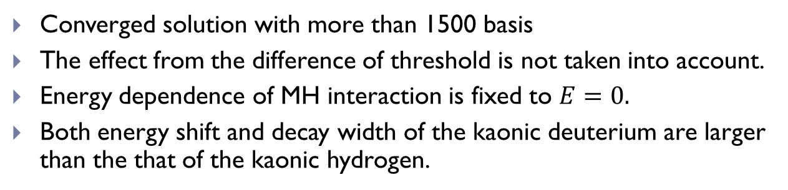
Results (three-body)
Kaonic deuterium | Energy shift (eV) | Decay width (eV)
AY | -778 | 624
MH | -669 | 1030
Kaonic hydrogen | Energy shift （eV） | Decay width (eV)
AY | -399 | 318
MH | -307 | 606
Converged solution with more than 1500 basis
The effect from the difference of threshold is not taken into account.
Energy dependence of MH interaction is fixed to $E=0.$
Both energy shift and decay width of the kaonic deuterium are larger than the that of the kaonic hydrogen.

Slide 22
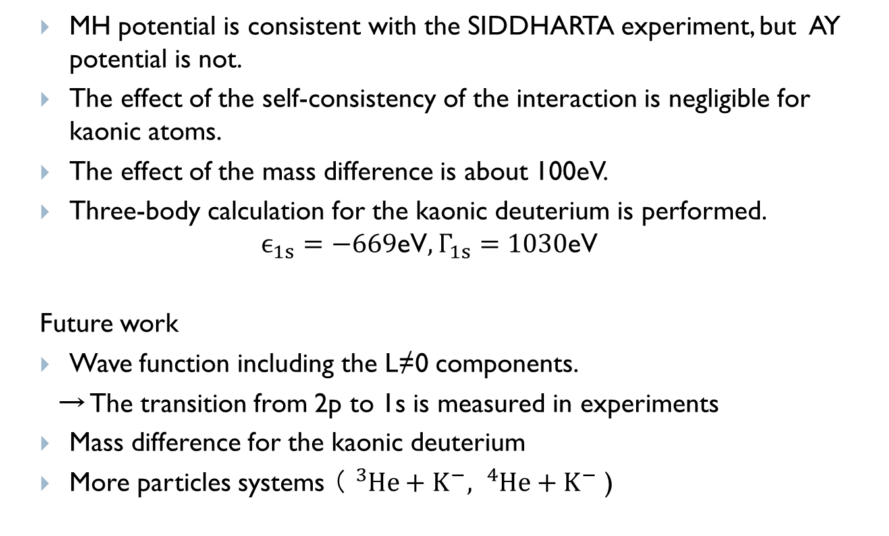
Summary
  MH potential is consistent with the SIDDHARTA experiment, but AY potential is not.
  The effect of the self-consistency of the interaction is negligible for kaonic atoms.
  The effect of the mass difference is about 100eV.
  Three-body calculation for the kaonic deuterium is performed.
  $$ϵ_{1s}=\text{−669}\text{eV}, Γ_{1s}=\text{1030}\text{eV}$$
  Future work
  Wave function including the L≠0 components.
  → The transition from 2p to 1s is measured in experiments
  Mass difference for the kaonic deuterium
  More particles systems （ ${}_{}^{3}{He}+K^{−}, {}_{}^{4}{He}+K^{−}$ )

Slide 23
Thank you for your attention.

Slide 24

Spectra of the system
Energy eigenvalues with AY
$$p+n+K^{−}$$
0
-2.20
$$pn+K^{−}$$
Kaonic deuterium
$$pnK^{−}$$
B.E. (MeV)
continuum
$$Λ(1405)+n$$
-29.6

