Slide 1
M87からの広帯域放射の解釈
浅野勝晃, Daniel Mazin (東大宇宙線研),
Elina Lindfors (トゥルク大), Fabrizio Tavecchio (ブレラ天文台), Julian Sitarek (ウッジ大), Elisa Prandini (パドヴァ大), 窪秀利, 増田周(京大), 西嶋恭司, 櫛田淳子, 辻本晋平, 神本匠(東海大), 手嶋政廣, 齋藤隆之, 中嶋大輔, 林田将明, Daniela Hadasch, 井上進, 高橋光成, 永吉勤, 深見哲志, 稲田知大, 岩村由樹(東大宇宙線研), 折戸玲子(徳島大) ほか MAGIC collaboration

Slide 2
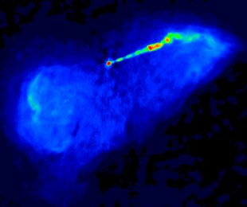
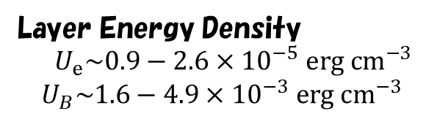
M87
電波イメージ
Other BL Lac
Spine-Layer Model
Tavecchio & Ghisellini 2008
Layer Energy Density
$U_{e}\sim 0.9−2.6×{10}^{−5} erg cm^{−3}$
$$U_{B}\sim 1.6−4.9×{10}^{−3} erg cm^{−3}$$
H.E.S.S. obs.

Slide 3


Fermi Paper
Abdo+ 2009
Large Error
Slight tension
$$Γ=2.3$$
Source radius: $R=1.4×{10}^{16}$cm.
Magnetic Field $B=55mG$
Viewing angle: 10 degree.
For Electrons, $γ_{min}=1$, $γ_{br}=4000$, $γ_{max}={10}^{7}$, and index $p_{1}=1.6, p_{2}=3.6.$
Electron Luminosity: $7×{10}^{42} erg s^{−1}$, Magnetic Luminosity: $2×{10}^{40} erg s^{−1}$

Slide 4

Poynting Flux Dominated?
$∼{10}^{16}cm$ scale
Kino+ 2015
with EHT@230GHz

Slide 5
MAGIC Monitoring
99.9% CF circle
～0.04deg～11.5kpc
Preliminary
Preliminary
Skymap
VLA image

Slide 6
Fermi and others
Preliminary

Slide 7
HE-VHE Spectrum
MAGIC Spectrum
Fermi-MAGIC Spectrum
Preliminary

Slide 8
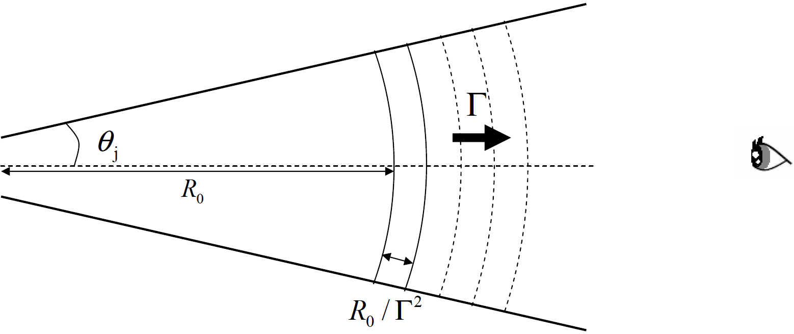

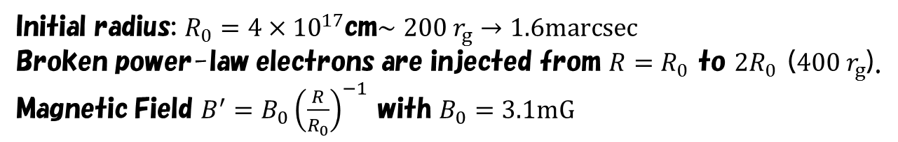




Off-axis Calculation
1-D steady model
$$θ_{j}=1/Γ$$
For $Γ=3$, $θ_{j}={19}^{o}$
$$θ_{obs}$$
$$Γ=3$$
Initial radius: $R_{0}=4×{10}^{17}$cm$∼200 r_{g}→1.6marcsec$
Broken power-law electrons are injected from $R=R_{0}$ to $2R_{0}$ ($400 r_{g}$).
Magnetic Field $B^{′}=B_{0}{\left(\frac{R}{R_{0}}\right)}^{−1}$ with $B_{0}=3.1mG$
For Electrons, $γ_{min}=500$, $γ_{br}={1.4×10}^{4}$, $γ_{max}=3×{10}^{7}$, and index $p_{1}=1.9, p_{2}=3.2.$
Isotropic Electron Luminosity: $4.5×{10}^{45} erg s^{−1}∼{5.4×10}^{−3}L_{Edd}$
→$L_{j,e}=1.2×{10}^{44}erg s^{−1}$

Slide 9
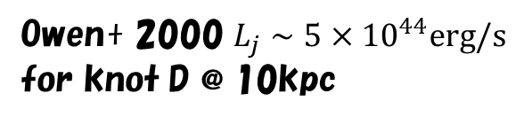
Large Scale Jet Power
VLA 90cm
Owen+ 2000 $L_{j}∼{5×10}^{44}erg/s$
for knot D @ 10kpc

Slide 10
Evolution of Electron and Photon Spectra
Comoving Frame
For $R_{0}<R<2R_{0}$, electrons are continuously injected.

Slide 11
Spectrum & Radial Evolution of the energy densities.
The viewing angle is assumed as 15 degree.
Preliminary
Radio data: 5/10 mas Gaussian beam for 5/1.7GHz (European VLBI Network),
1.2mas for 43GHz (VLBA).

Slide 12
Summary
GeV-TeVはSingle Componentと考えるのが自然。
SSCでFitするには、低い磁場が要求
電波観測による磁場の制限とは矛盾
何か別なものを見ている？
天文月報2017年9月号 EUREKA(林田)より
David Meierの図から改変。

