Slide 1
TeV 宇宙線電子スペクトルの解釈
- HESS の結果について少し -
Norita Kawanaka
Hakubi center / Department of Astronomy, Kyoto U
高エネルギー宇宙物理学研究会 9/5/2017

Slide 2
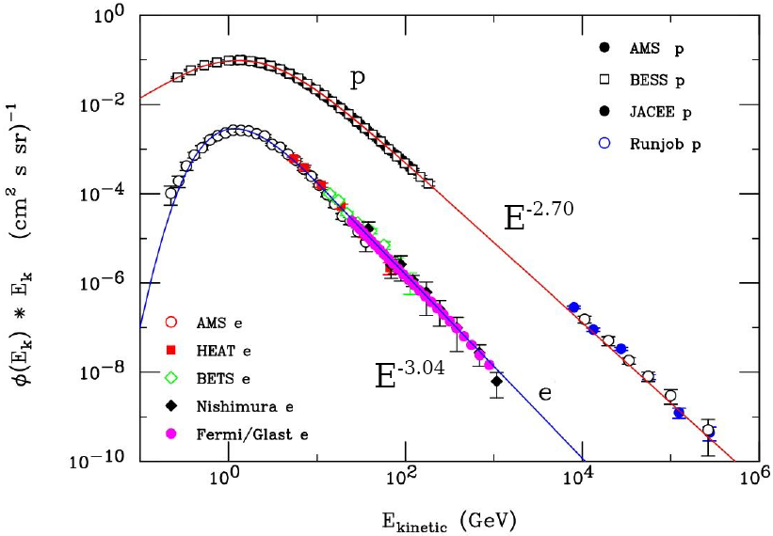
Cosmic-ray Electrons (e⁻)
flux ~ 1% of p
(partly) accelerated in SNRs
significant energy loss during propagation (synchrotron & inverse Compton scattering)
the spectrum is softer than that of nuclei
cannot propagate farther than ~ 1-2 kpc due to the energy loss

Slide 3
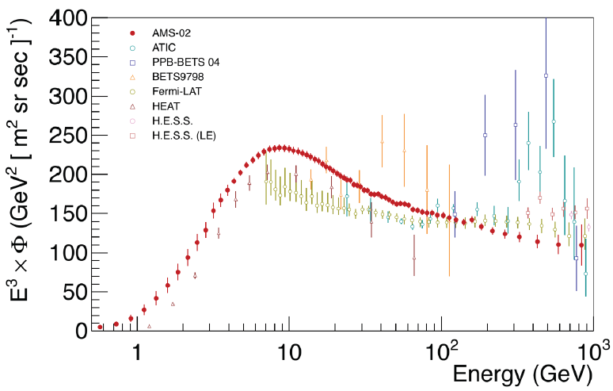
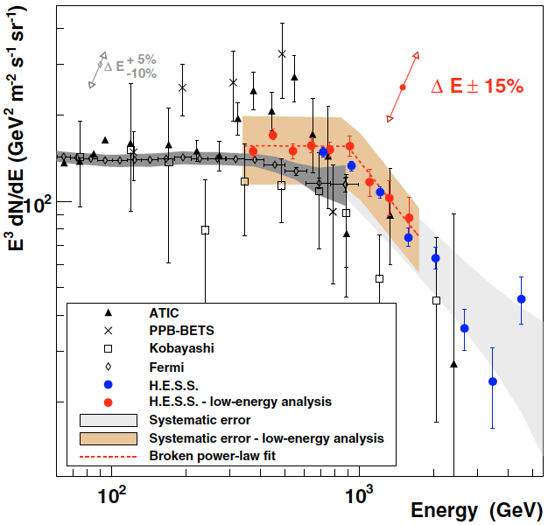
Cosmic-ray Electron Flux
Excess from the conventional model?
Positron fraction also exceeds the prediction (PAMELA / AMS-02)
→ Primary CR e± sources?
drop above ~TeV? (HESS 2008, 2017 ← new!)
H.E.S.S. (2008)
Fermi/AMS-02 etc.
(Aguilar et al. 2014)
(Aharonian et al. 2008)

Slide 4
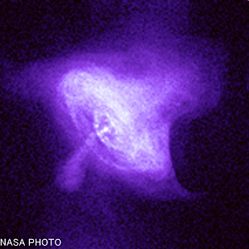
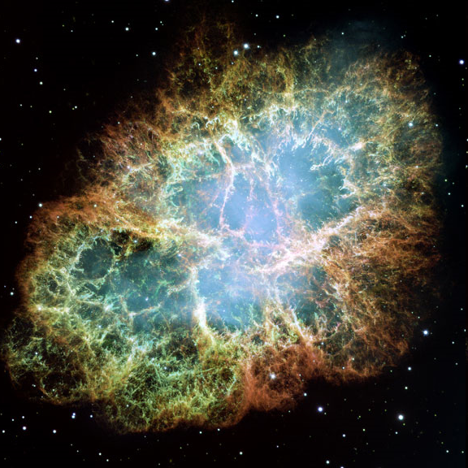
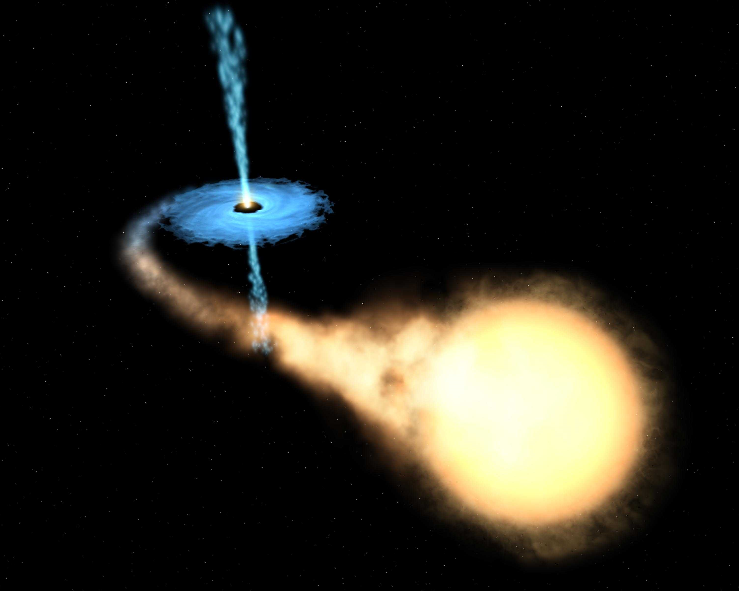
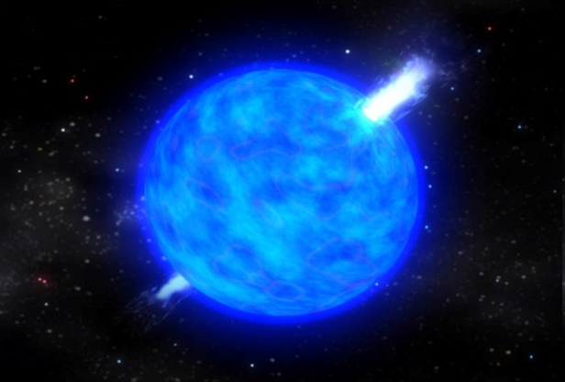
Astrophysical Origin
Pulsars (including MSPs)
Atoyan et al. 95; Chi+ 96; Zhang & Cheng 01; Yuksel+ 08; Buesching+ 08; Hooper+ 08; Profumo 08; Malyshev+09; Grasso+ 09; NK, Ioka & Nojiri 10; NK, Ioka, Ohira & Kashiyama 11; Kisaka & NK 12 etc.
Supernova Remnants
Pohl & Esposito 98; Kobayashi+ 04; Shaviv+ 09; Hu+ 09; Fujita+ 09; Blasi 09; Blasi & Serpico 09; Mertsch & Sarkar 09; Biermann+ 09; Ahlers+ 09; NK 12 etc.
Microquasars (Galactic BHs)
Heinz & Sunyaev 02
Gamma-Ray Burst Ioka 10
White Dwarfs Kashiyama, Ioka & NK 11

Slide 5
CR e± propagation equation
Diffusion equation for CR e± distribution function, f :
diffusion
injection
energy loss (not negligible)
diffusion coefficient：
K(ε_{e}) ~ 2×10²⁸cm²s⁻¹(ε_{e}/1GeV)^{δ}, δ = 1/3 – 1/2
energy loss rate：
P(ε_{e}) = P_{syn}(ε_{e}) + P_{IC}(ε_{e})
P_{syn}: synchrotron cooling (Galactic magnetic field ~1-3 μG)
P_{IC}: inverse Compton scattering (starlight, dust, CMB)
Thomson approx. P(ε_{e}) ~ bε_{e}², b ~10⁻¹⁶ GeV⁻¹s⁻¹
t_{cool} ~ 1/bε_{e} ~ 10⁶ yr (ε_{e}/300GeV)⁻¹

Slide 6
Simplest Solution (a single source)
Atoyan+ 1995
Point-like, instantaneous injection Q∝δ(r) δ(t – t₀)
N_{e} (ε_{e}, t): total number of injected particles
:energy of a particle at its injection
：diffusion length
Thomson approx.
cutoff: ε_{e}~1/bt_{age}
(α: spectral index of e±)

Slide 7
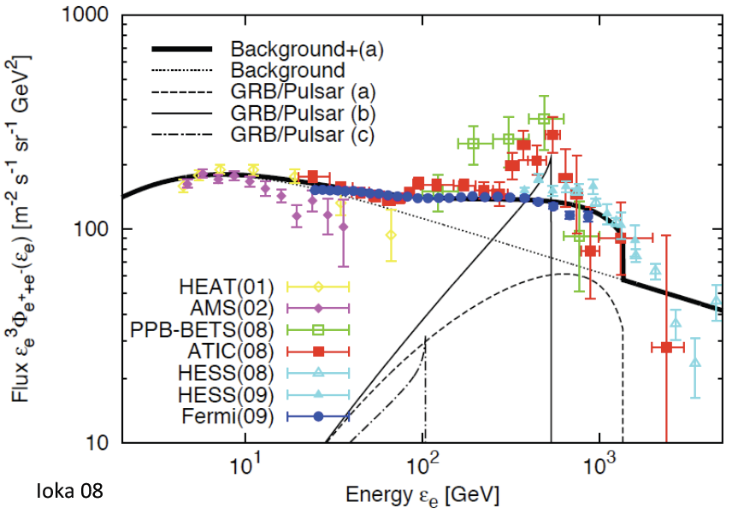
The case of transient source: e± spectrum
The cutoff energy corresponds to the age of the source.
d=1kpc
(a)
E=0.9x10⁵⁰erg
age=2x10⁵yr
α=2.5
(b)
E=0.8x10⁵⁰erg
age=5.6x10⁵yr
α=1.8
(c)
E=3x10⁵⁰erg
age=3x10⁶yr
α=1.8
Ioka 2011
Notes:
.

Slide 8
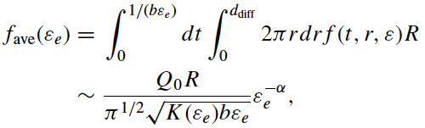
e± flux from multiple sources
NK+ 2010; Kashiyama, Ioka & NK 2011
Average flux from multiple sources with a birth rate of R (per unit surface area per unit time):
Flux per source
In the Thomson regime (t_{cool} ~ 1/bε_{e}),

Slide 9
Dispersion of the e± flux
Number of sources which contribute to the energy bin of ε_{e}
typical birth rate of pulsars in the vicinity of the Earth
Assuming the Poisson statistics of the source distribution,
ε_{e}↑ or R ↓⇒ Δf / f ↑ i.e. higher energy/lower birth rate would make the spectrum wiggled

Slide 10
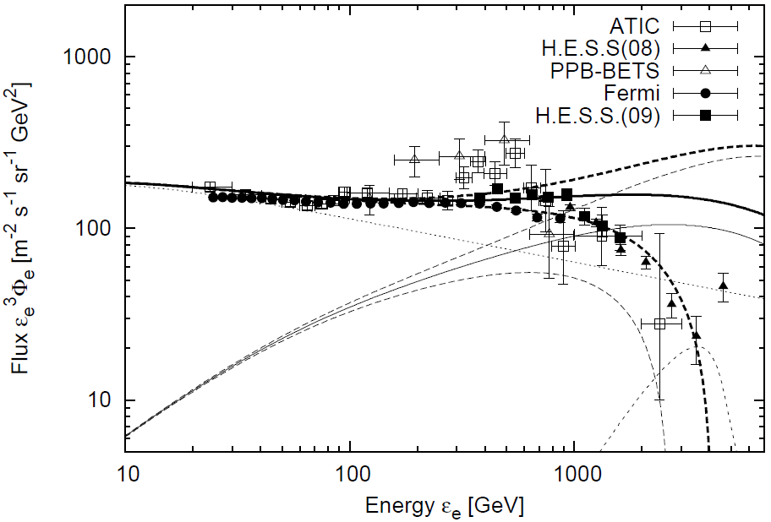
solid lines： f_{ave}(ε_{e})
dashed lines： f_{ave}(ε_{e}) ±Δf_{ave}
e⁺ fraction
Average spectra are consistent with PAMELA, Fermi & H.E.S.S.
ATIC/PPB-BETS peak is largely separated from the average flux. → Such a peak is hard to produce by the sum of multiple pulsars.
Large dispersion in the TeV range due to the small N(ε_{e}) → possible explanation for the cutoff inferred by H.E.S.S. (2008)
R~0.7x10⁻⁵/yr/kpc²
E_{e+}=E_{e-}~10⁴⁸erg
α~1.9
e±spectrum

Slide 11
Other candidates
White dwarf pulsars
R ~ 10⁻⁷ yr ⁻¹ kpc⁻²
τ_{WD} ~ 10⁹ yr
Kashiyama, Ioka & NK 2011
Millisecond pulsars
R ~ 3×10⁻⁹ yr ⁻¹ kpc⁻²
τ_{MSP} ~ 5×10¹⁰ yr > t_{cos}
Kisaka & NK 2011

Slide 12
ε_{e}>TeV spectrum is interesting!
Will be explored by CALET, DAMPE, ISS-CREAM, etc.
Large theoretical dispersion → We can expect to observe the contributions from a single young and nearby source.
Vela pulsar (age~10⁴year, distance~290pc), Cygnus loop, or undiscovered compact objects
?
10TeV
100TeV

Slide 13
e± spectrum > TeV by HESS (ICRC 2017)

Slide 14
Featureless spectrum up to ~ 10 TeV

Slide 15
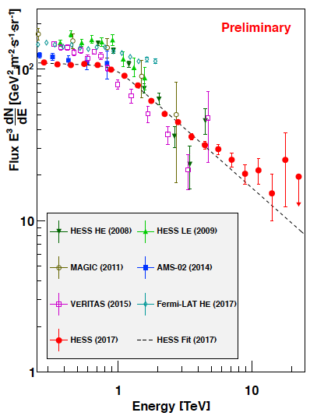
What is interesting in the HESS e± spectrum?
no features of young, nearby sources (e.g. Vela)
power-law-like cutoff (?)
smoothly connected with the lower energy part
→ e±s are still confined?
→ Not expected from cooling
~ 0.78

Slide 16
More nearby sources than expected?
When the disk thickness can be ignored,
2-dim
However, if there are sufficiently many sources within r <~ H ~ 200-500 pc, this integral should be
3-dim
When d_{diff} ~ [4K(ε_{e})t_{cool}]^{1/2} < H, the average spectrum would become softer by d_{diff}¹ ~ ε_{e}^{(δ-1)/2}

Slide 17
Recent results (AMS-02)
B/C ratio
Power-law index
B/C ~ escape time of CR particles ~ 1/K(ε_{e})
δ >~ 1/3

Slide 18
Then…
The steepening above ~ TeV may not be due to the cooling or the 3-dim effect.
Too smooth → Single source contribution is not likely
another component of multiple sources? (NS pulsars and MSP/WD etc.?)

Slide 19
Example
NS pulsars
(~ 10⁻⁵ yr⁻¹ kpc⁻², cutoff ~ TeV)
+ WD pulsars
(~ 10⁻⁷ yr⁻¹ kpc⁻², long-lived, cutoff ~ 10 TeV)
fine tuning is needed…
A higher energy cutoff may exist (>~ 30 TeV)

Slide 20
Summary
The origin of GeV - TeV cosmic-ray electrons is still uncertain.
If the origin is Galactic sources (e.g. pulsars), the contribution from a few young, nearby sources above ~ TeV is expected.
HESS results: broken-power-law (ε_{b} ~ TeV), there is no contribution from nearby sources such as Vela
very smooth spectrum: multiple sources are contributing?
3-dim effect: probably no
double-component effect?

