Slide 1
Interaction of η and ή meson
with nucleons
Paweł Moskal
Jagiellonian University, Cracow, Poland
Abstract:
„We will review experiments and phenomenology
of the near threshold production of the η and ή mesons
in the proton-proton and proton-deuteron collision”
P.M., Few Body Syst. 55 (2014) 667-674
Hadrons and Hadron Interaction in QCD 2015
Kyoto, YITP, 1-6 March 2015

Slide 2

experimental aspects
natural width of the ή meson
ή -proton interaction
production dynamics
η-proton-proton interaction
Borromean-states?
η-nucleus interaction
mesic-nuclei ?
challenges to theory

Slide 3
threshold as a spin filter
in the laboratory
P
3 GeV/c
η
P
before reaction:
after reaction:
in the centre of mass system
1 GeV/c
P
η
P
1 GeV/c
L = 1, S = 1
L = 0, l=0
⇒ Reaction parameter b ∼ 0.2 fm
³P₀→¹S₀s

Slide 4
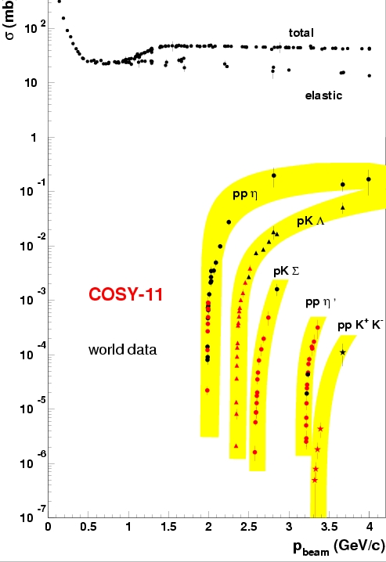
experimental challenge !

Slide 5
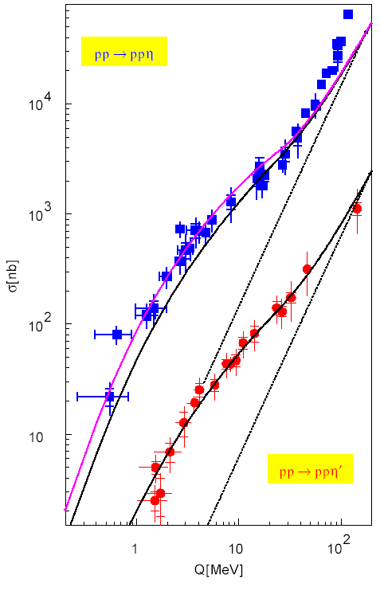
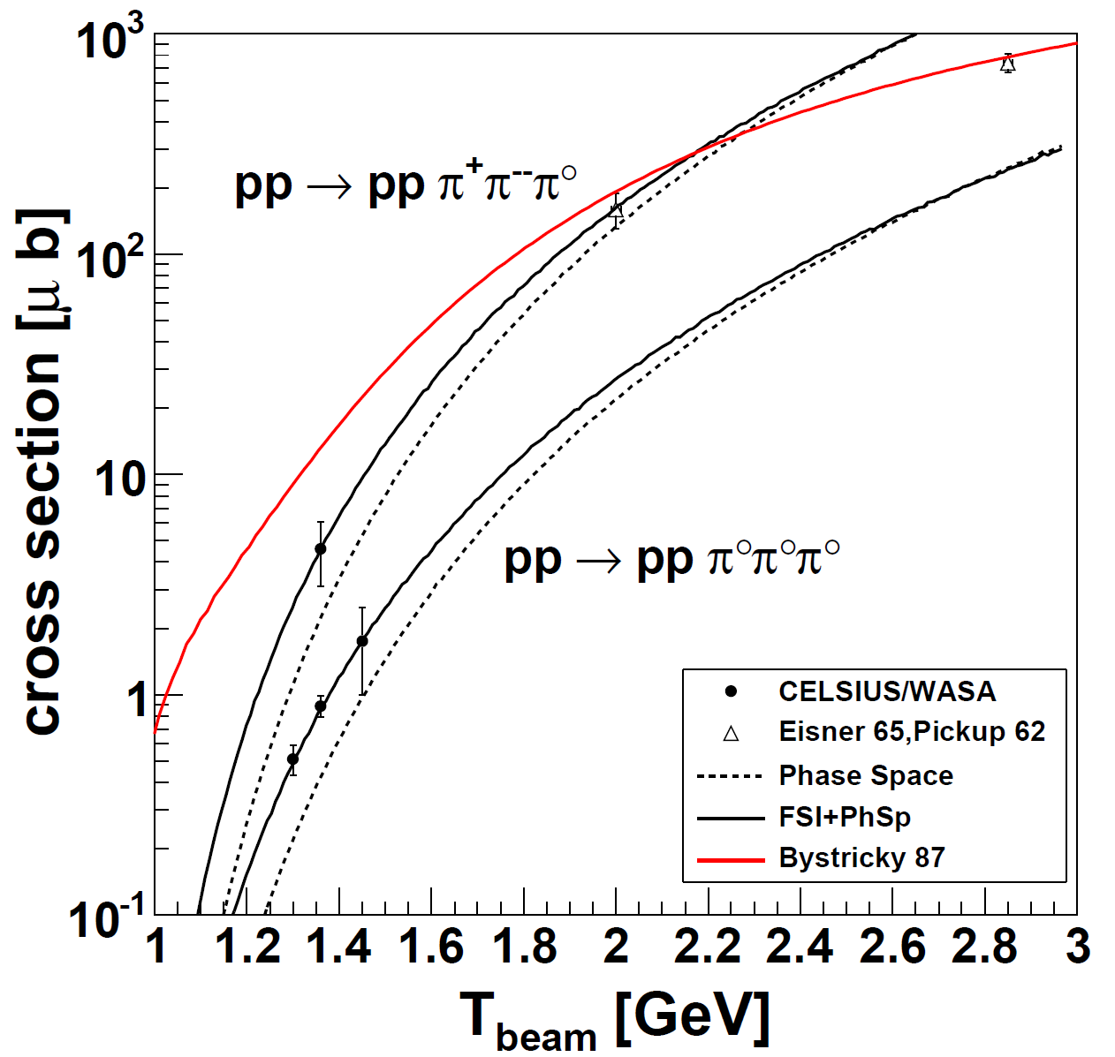
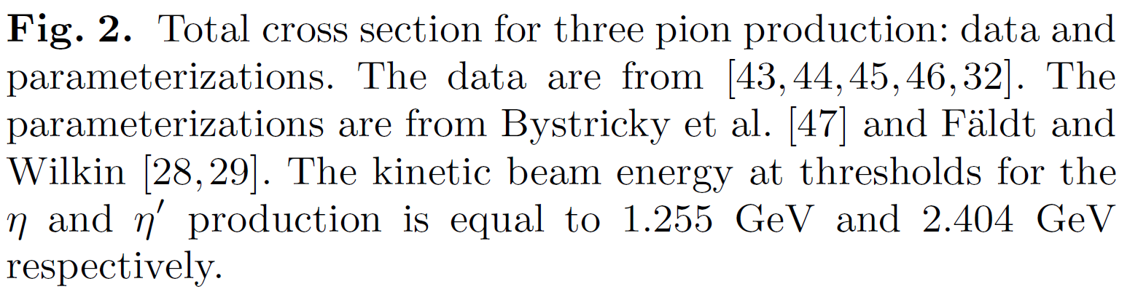
experimental challenge !
M. Zieliński, P. M., A. Kupść,
Eur.Phys.J. A47 (2011) 93

Slide 6
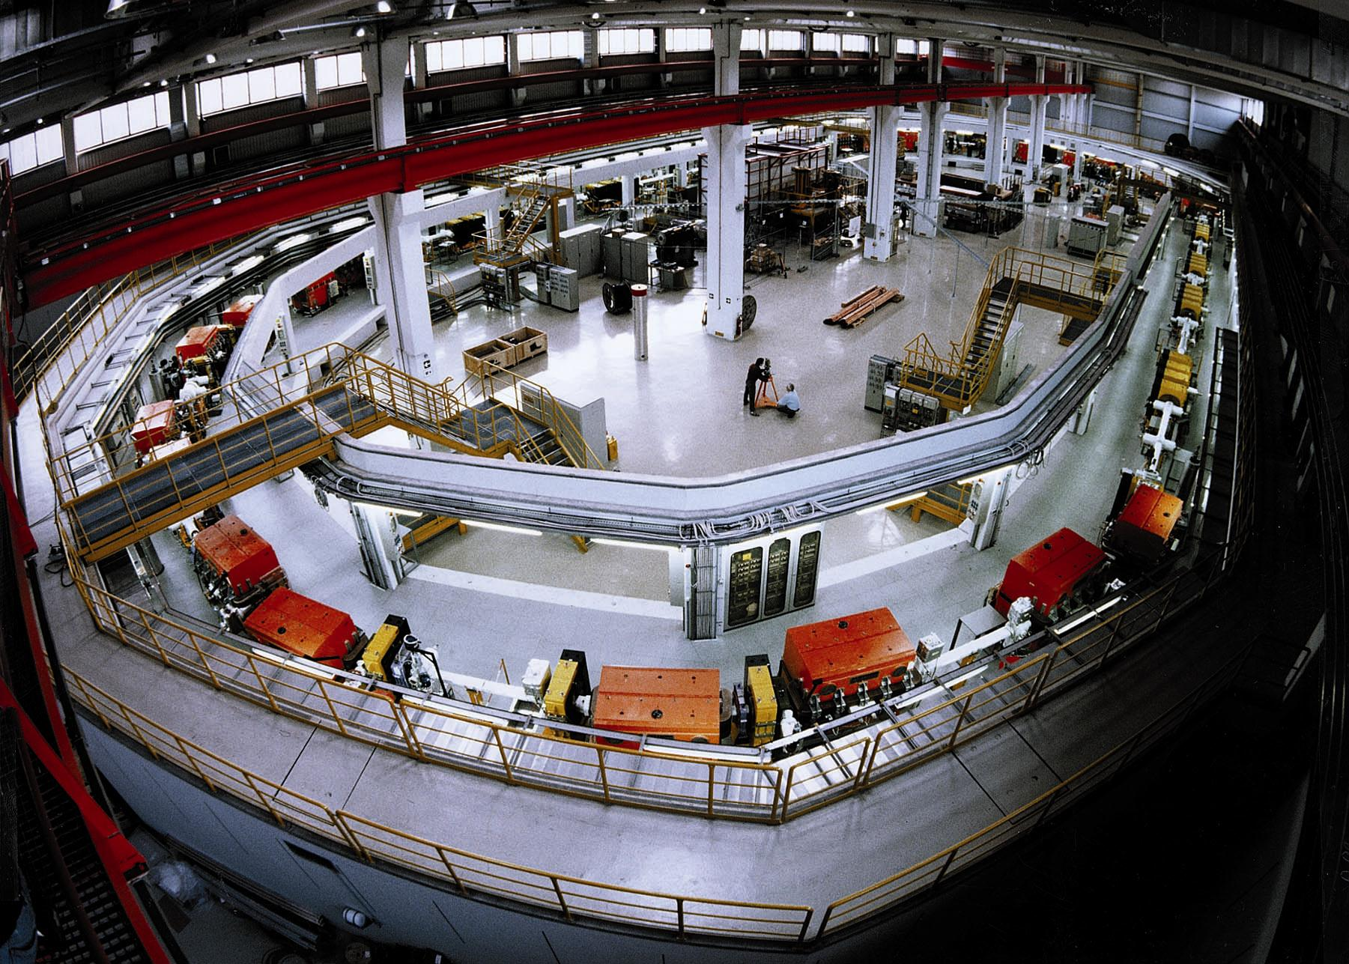
spolaryzowana lub niespolaryzowana
wiązka protonów i deuteronów
polarised and unpolarised proton
and deuteron beams
chłodzenie stochasyczne i elektronowe
stochastic and electron cooling
zakres pędu: 600 – 3700 MeV/c
momentum range: 600 – 3700 MeV/c
produkcja mezonów do φ(1020) włącznie
meson production up to φ(1020)‏
COoler SYnchrotron COSY
Notes:
6
6

Slide 7

The natural width of the ή meson
experimental aspects
natural width of the ή meson
ή -proton interaction
production dynamics
η-proton-proton interaction
Borromean-states?
η-nucleus interaction
mesic-nuclei ?
challenges to theory
η
I thought… the scientific theories were not the digest of observation,
but that they were inventions-conjectures boldly put forward for trial
to be eliminated if they clashed with observation …
David Hume
Transition Form-Factors: J. Zdebik PhD JU (2013); M.Hodana PhD JU (2012)
R. Pohl et al., The size of the proton, Nature 466, 213 (2010)

Slide 8
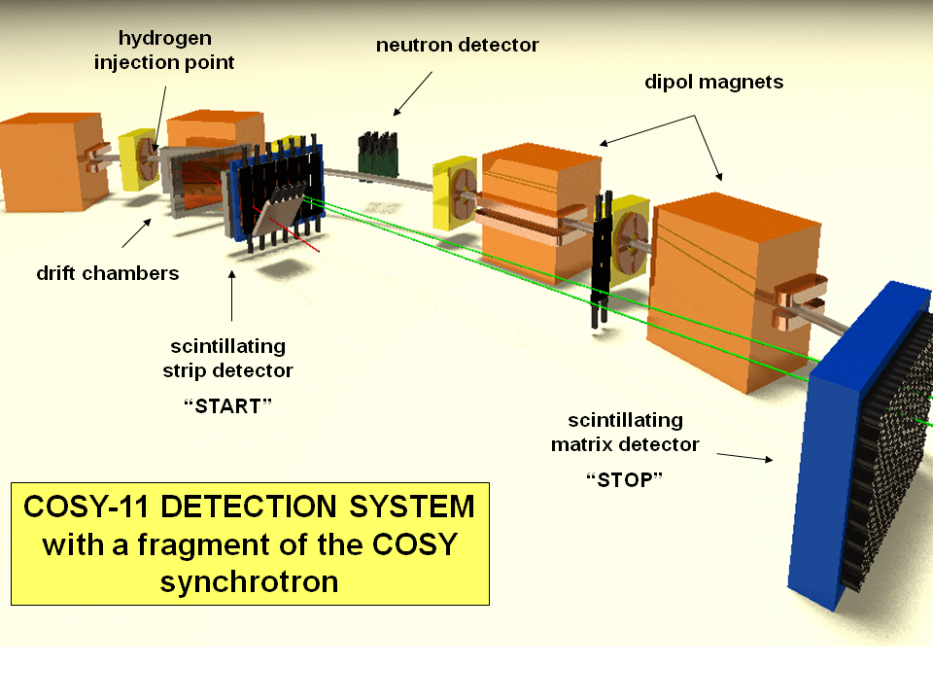
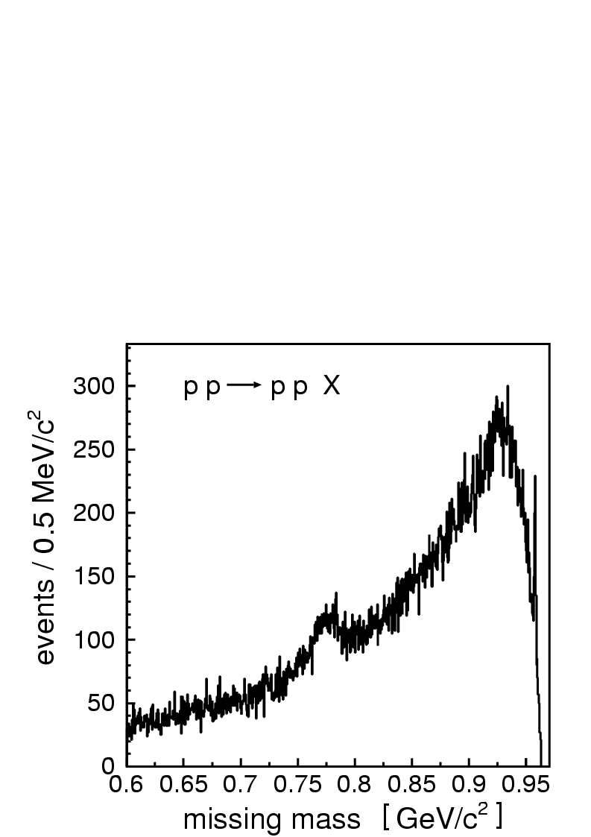
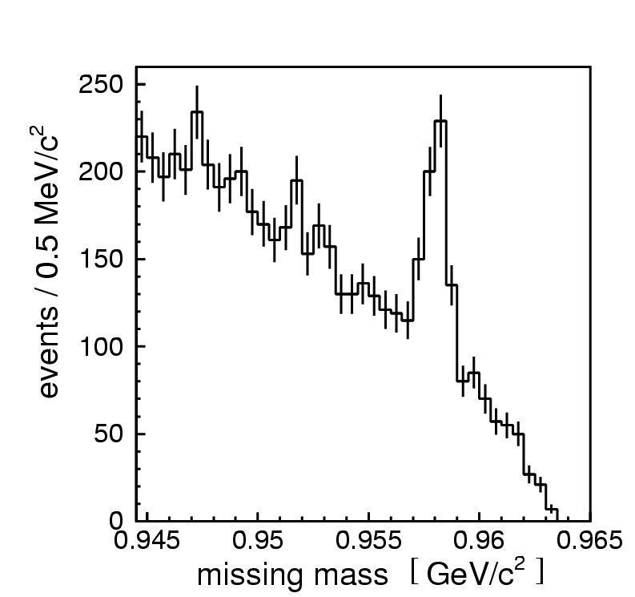
COSY-11
cluster target
scintillators
drift chambers
scintillator
Notes:
8
8
8

Slide 9
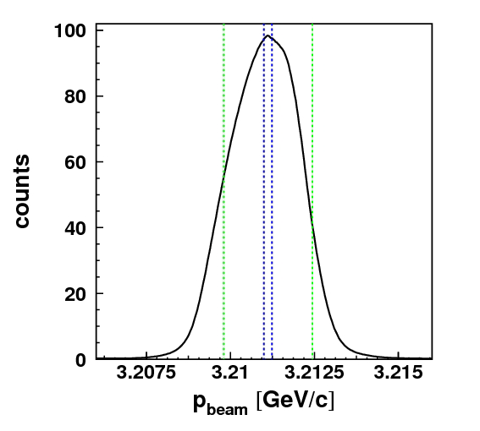
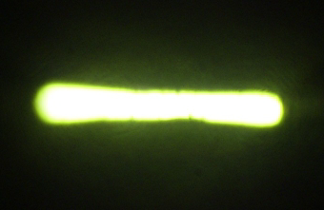
COSY-11
Notes:
9
9
9

Slide 10
threshold as a spin filter
in the laboratory
P
3 GeV/c
η
P
before reaction:
after reaction:
in the centre of mass system
1 GeV/c
P
η
P
1 GeV/c
L = 1, S = 1
L = 0, l=0
⇒ Reaction parameter b ∼ 0.2 fm
³P₀→¹S₀s

Slide 11
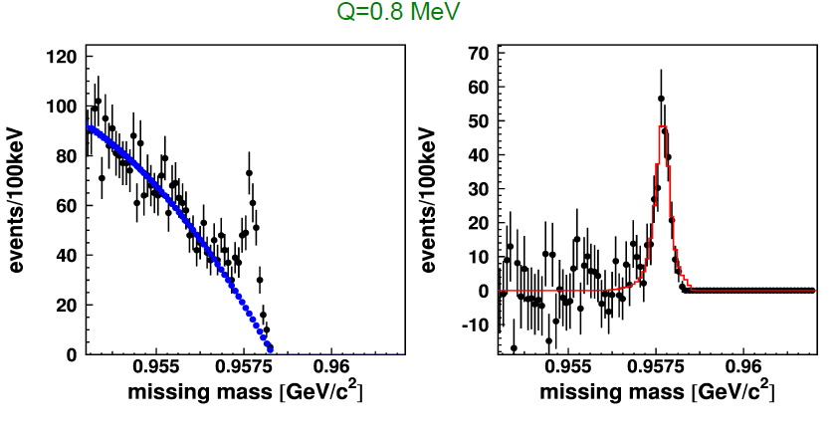

COSY-11
COSY-11: Phys. Rev. Lett. 105 (2010) 122001

Slide 12
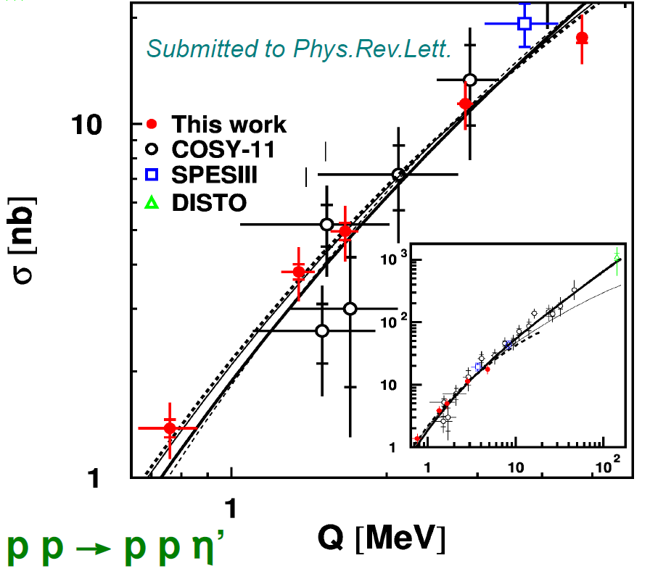
The ή - proton hadronic interaction
p
η'
COSY-11: Phys. Rev. Lett. 113 (2014) 062004
CBELSA/TAPS: Vreal(ρ0) =−37±10(stat.)±10(syst.)
Phys. Lett. B727, 417 (2013); Phys. Lett. B710, 600 (2012)

Slide 13
Production mechanism
experimental aspects
natural width of the ή meson
ή -proton interaction
production dynamics
η-proton-proton interaction
Borromean-states?
η-nucleus interaction
mesic-nuclei ?
challenges to theory
η
I thought… the scientific theories were not the digest of observation,
but that they were inventions-conjectures boldly put forward for trial
to be eliminated if they clashed with observation …
David Hume
Transition Form-Factors: J. Zdebik PhD JU (2013); M.Hodana PhD JU (2012)
R. Pohl et al., The size of the proton, Nature 466, 213 (2010)

Slide 14
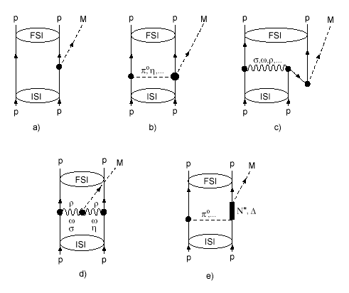
production dynamics e.g. meson η
σ = dV_{ps} |M|²
What would the first experimental physicists tell us?
|M|² ~ |M₀|² |M_{FSI}|²
Salviati. But if, of many computations,
not even two came out in agreement,
what would you think of that?
Simplicio. If that is how the matters stand,
it is truly a serious defect
GALILEO GALILEI
”Dialogue concerning the two chief world systems”
dynamics → |M₀|²
What would the best student
of the Jagellonian University tell us?
He is encouraging us to continue:
For what is determinate
cannot have innumerable explanations
NICOLAUS COPERNICUS
”Minor Works III, Letter against Wagner”
1 GeV/c
P
η
P
1 GeV/c
ONE NUMBER and MANY GRAPHS

Slide 15
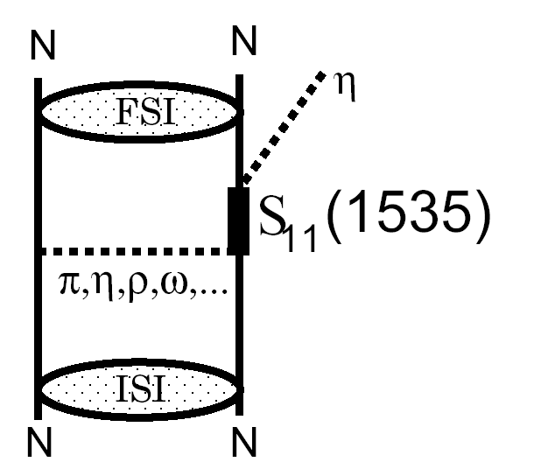
dynamics → |M₀|²
LARGE → RESONANSE
CELSIUS
COSY
SATURNE

Slide 16
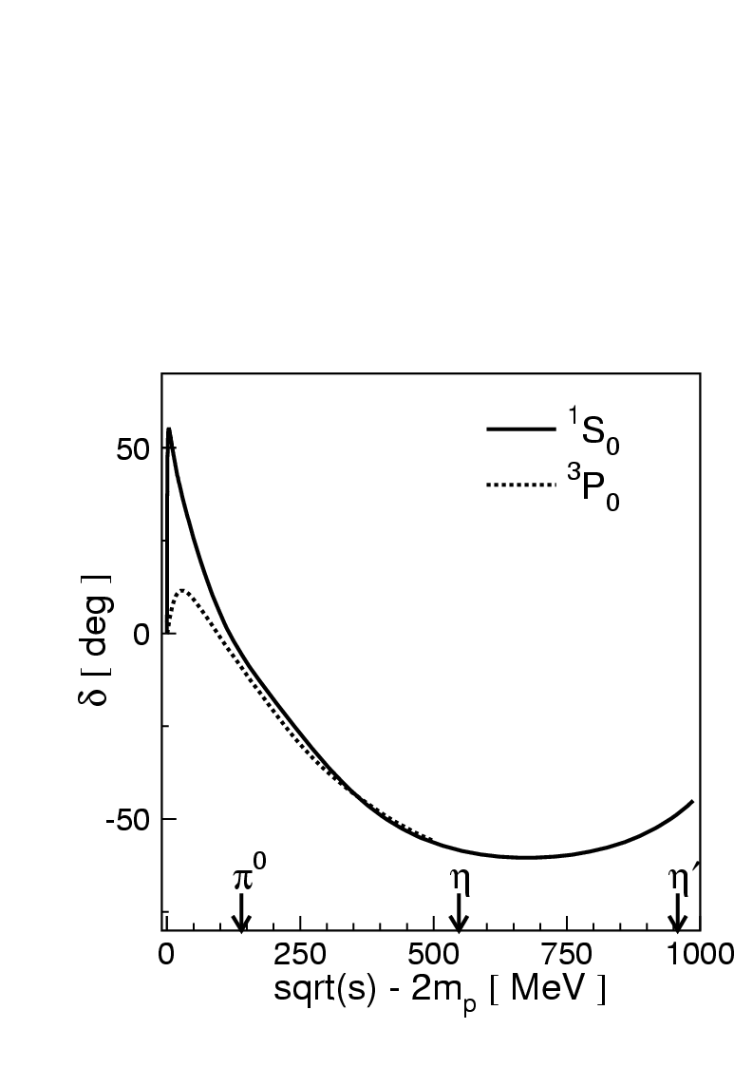

Slide 17
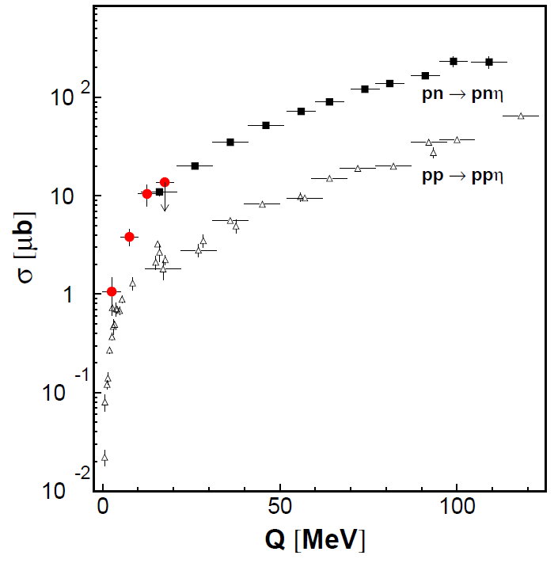
X
X
X
  STRONG ISOSPIN DEPENDENCE
  Eta meson is by factor of 12
  more coupiously produced
  when the total isospin of nucleons
  is equal to 0
  than when it is equal to 1
  Strong evidence of isovector meson
  exchange in production mechanism
CELSIUS
COSY
SATURNE

Slide 18
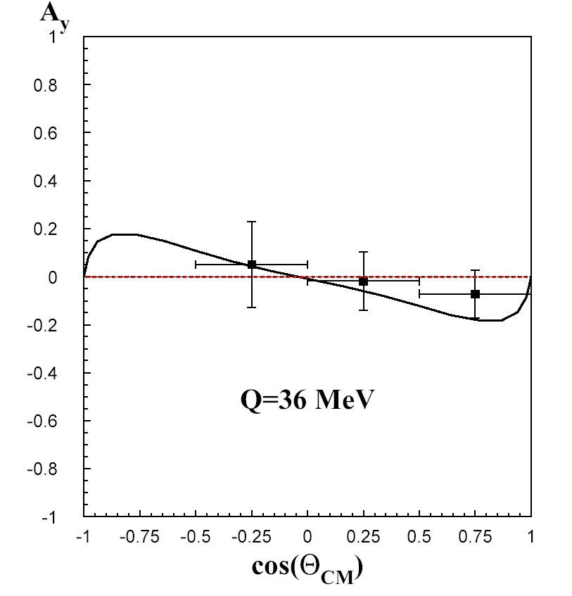
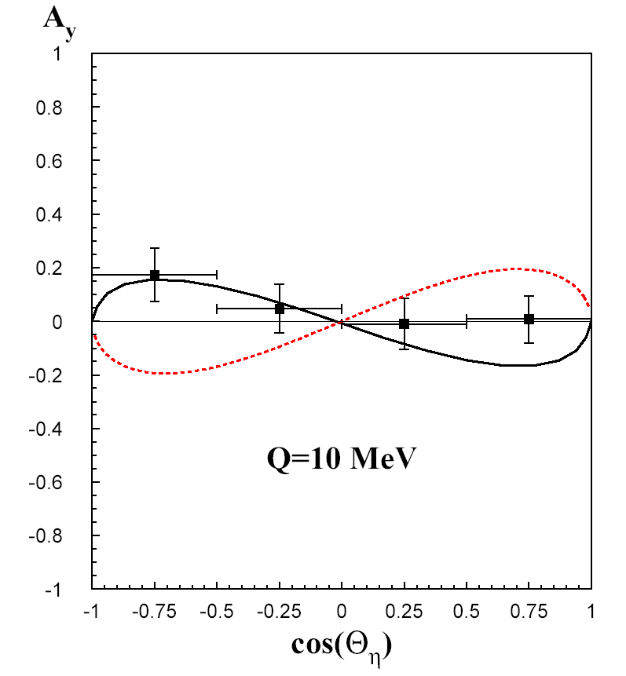
This was PREDICTED already about 2500 years ago
by the very first physicists
Thus, it is suggested that among created beings
there must be some basic agent which will move
things and bring them together
ARISTOTLE
“Metaphysics”
X
X
X
X
π
ρ
COSY-11: Phys. Rev. Lett. 98 (2007) 122003

Slide 19
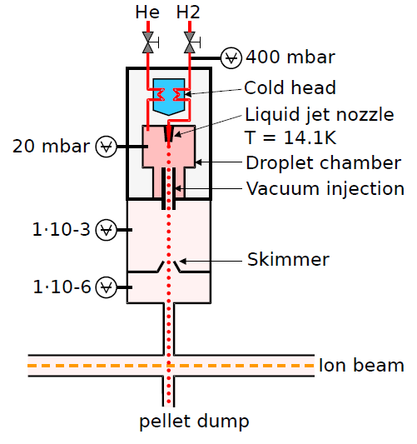
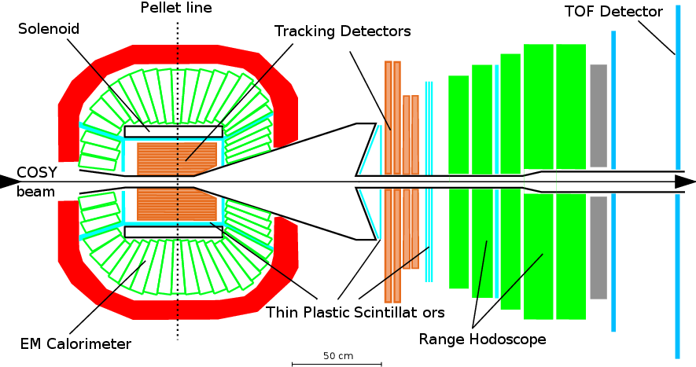
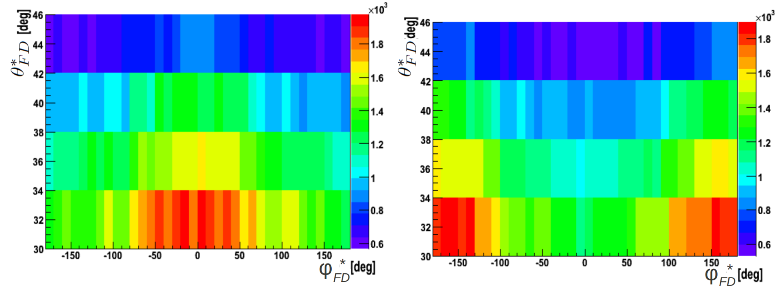
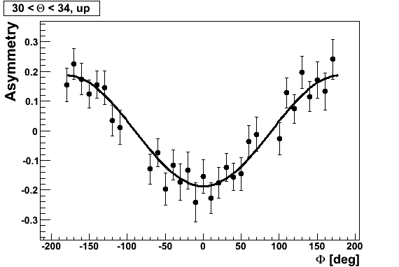
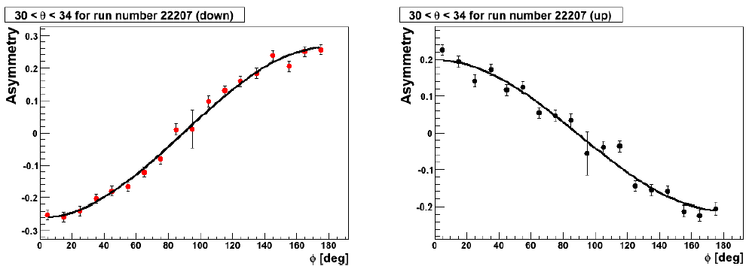
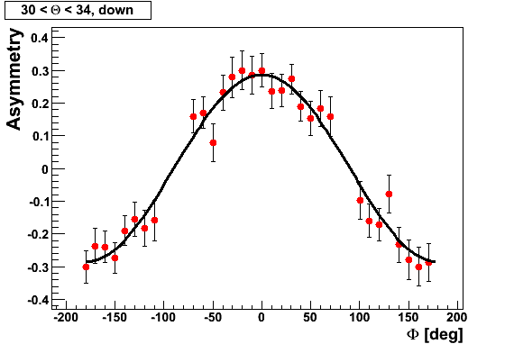
WASA-at-COSY
p p → p p M 10⁹ η and 10¹¹ π⁰ on discs
p p → p p η 10⁶ η mesons on discs ; Polarization of about 70%
more than factor of 100 larger statistics
I. Ozerianska, P.M., M. Zieliński, Acta Phys. Pol. B 46 (2015) 153
→
SPIN UP SPIN DOWN

Slide 20
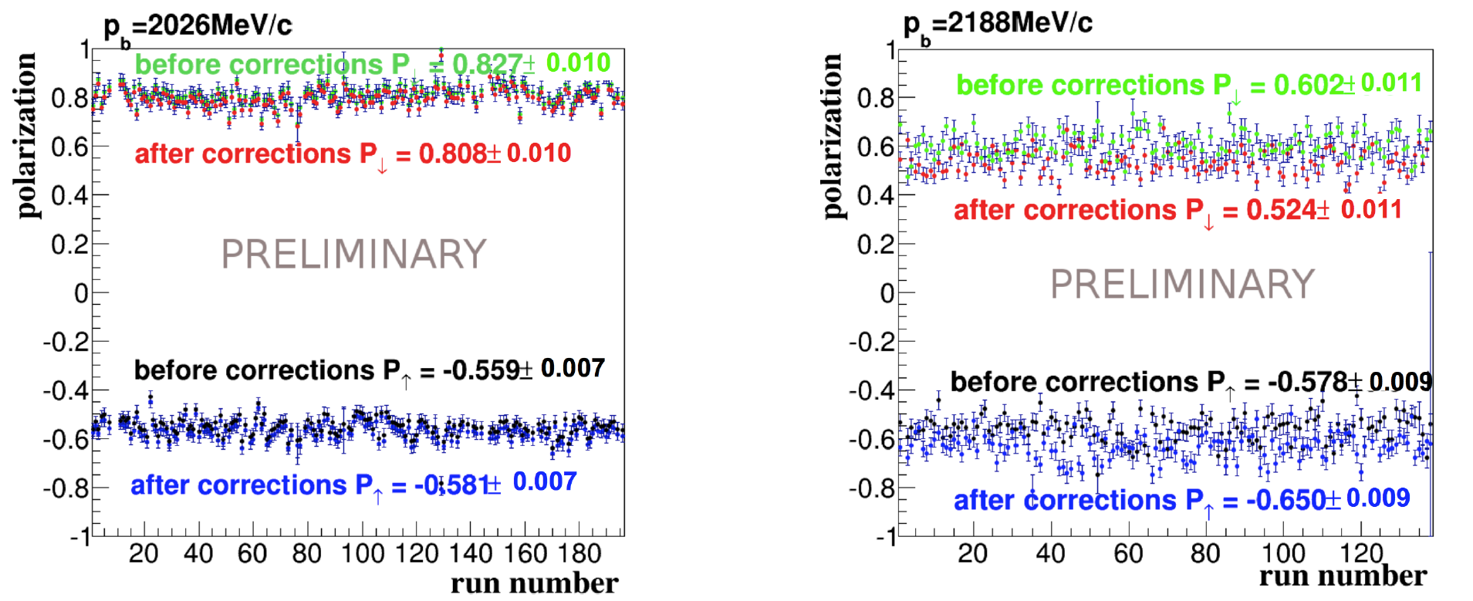
WASA-at-COSY
p p → p p M 10⁹ η and 10¹¹ π⁰ on discs
p p → p p η 10⁶ η mesons on discs ; Polarization of about 70%
more than factor of 100 larger statistics
I. Ozerianska, P.M., M. Zieliński, Acta Phys. Pol. B 46 (2015) 153
→

Slide 21
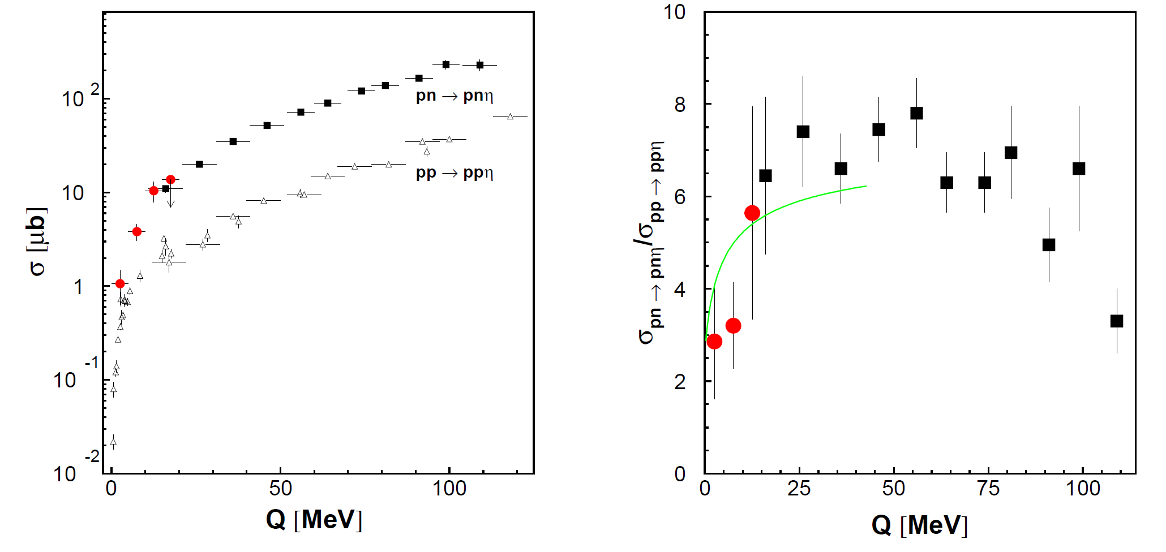
COSY-11: Phys.Rev. C79 (2009) 015208

Slide 22
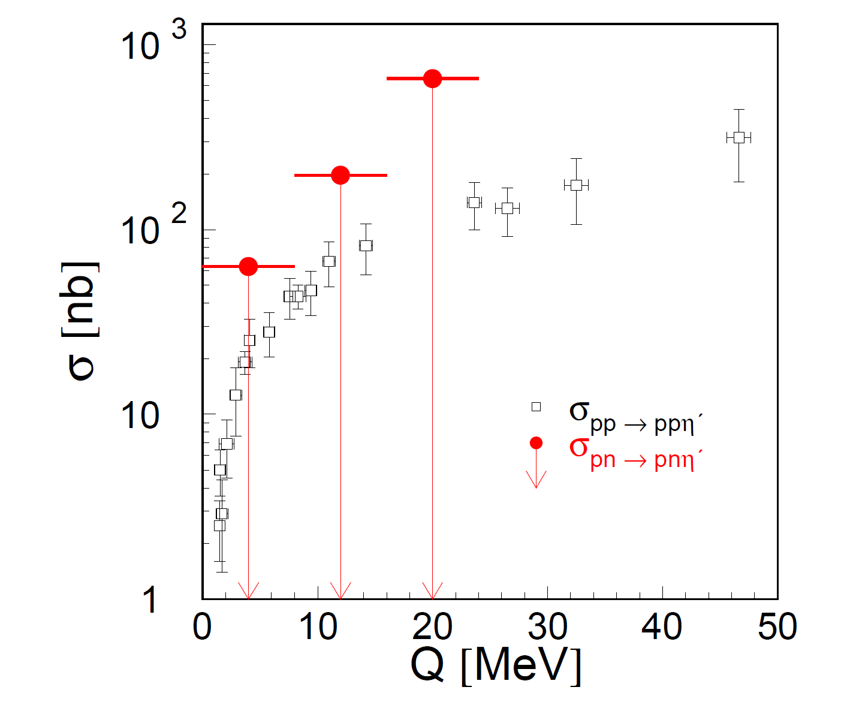
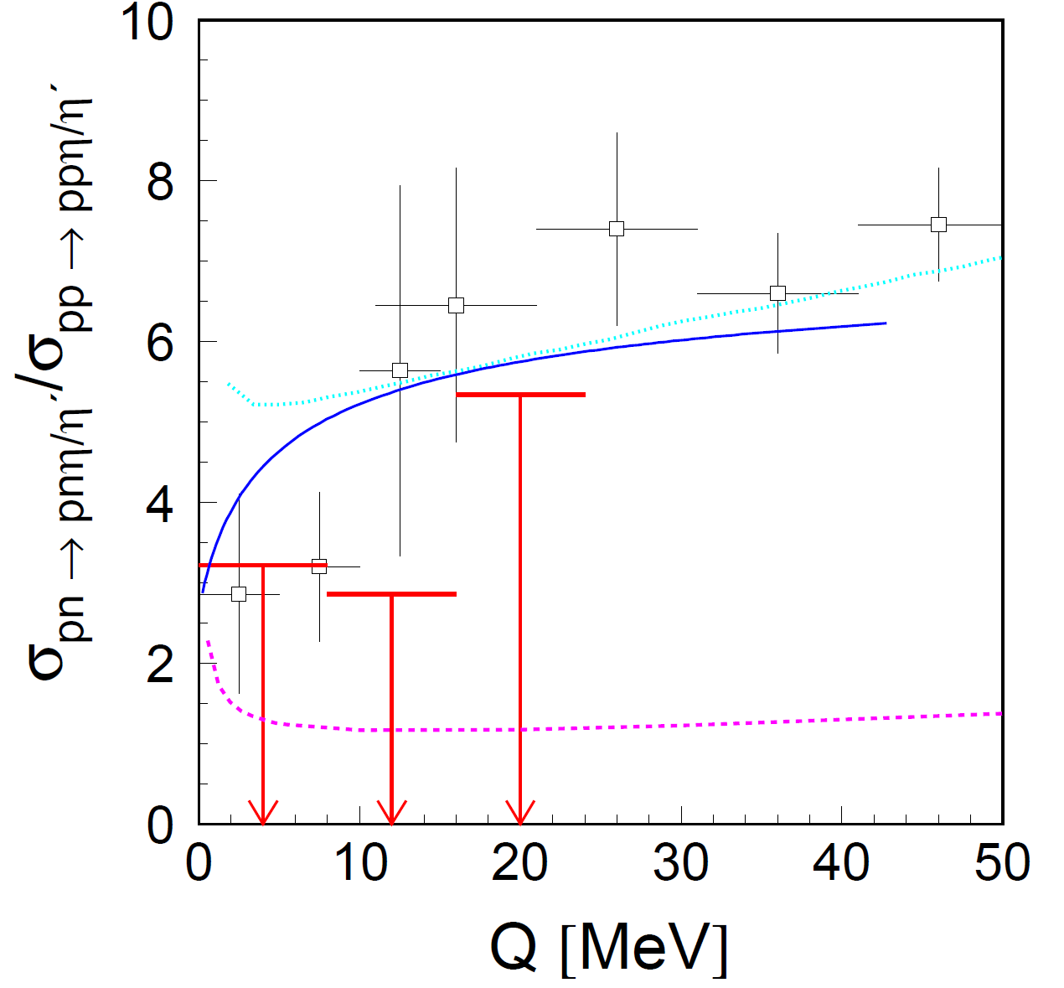
COSY-11: Phys. Rev. C81 (2010) 035209

Slide 23
Borromean state ?
experimental aspects
natural width of the ή meson
ή -proton interaction
production dynamics
η-proton-proton interaction
Borromean-states?
η-nucleus interaction
mesic-nuclei ?
challenges to theory
η
I thought… the scientific theories were not the digest of observation,
but that they were inventions-conjectures boldly put forward for trial
to be eliminated if they clashed with observation …
David Hume
Transition Form-Factors: J. Zdebik PhD JU (2013); M.Hodana PhD JU (2012)
R. Pohl et al., The size of the proton, Nature 466, 213 (2010)

Slide 24
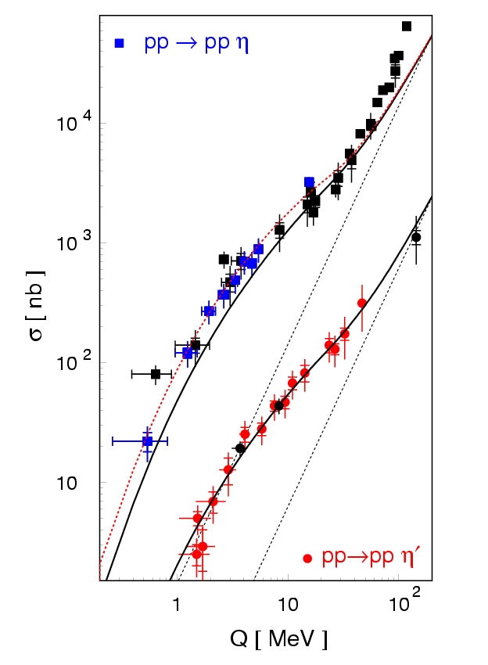
σ = dV_{ps} |M|²
|M|² ~ |M₀|² |M_{FSI}|²
|M_{FSI}|² ~ |M_{pp}|² |M_{p1η}|² |M_{p2η}|²
dynamics → |M₀|²
interaction → σ (Q)
CELSIUS, COSY, SATURNE
+
+
η
S. Wycech, Acta Phys. Polon. B 27 (1996) 2981

Slide 25
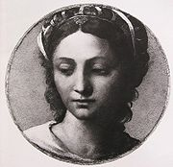
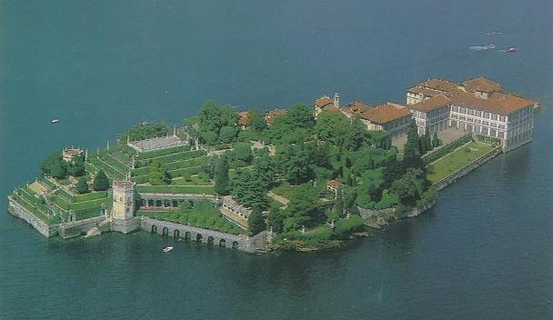
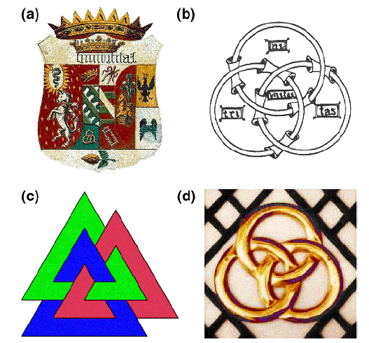
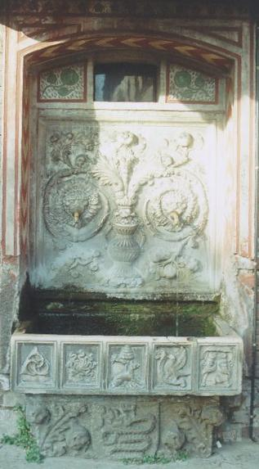
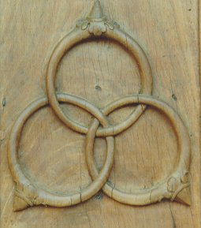
Isola Bella
Baroque Borromeo Palace, Lake Magiorre in Italy
Borromeo, Sforza, Visconti
The most famous of the islands, Isola Bella, is crowned by the princely
Borromeo Palace with its formal Italian-style gardens laid out on ten terraces.
The Baroque palace contains a wealth of artefacts: original furnishings,
gold and silk Flemish tapestries, period weapons, sculptures, paintings
and frescoes from the 16th to the 19th centuries.

Slide 26
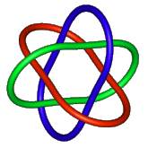
Borromean rings from nucleons
⁶He
+
+
Borromean nuclei: ⁶He, ¹¹Li, ¹⁴Be

Slide 27
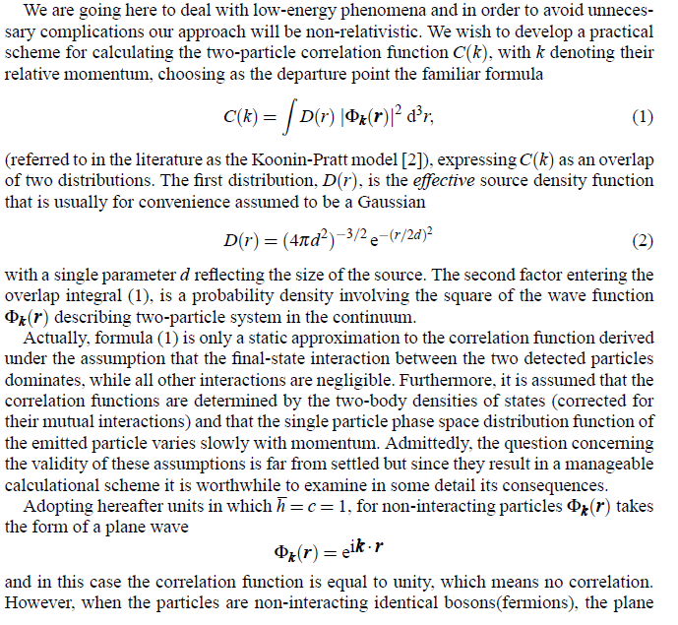
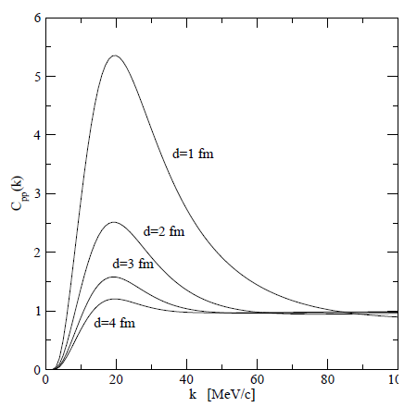
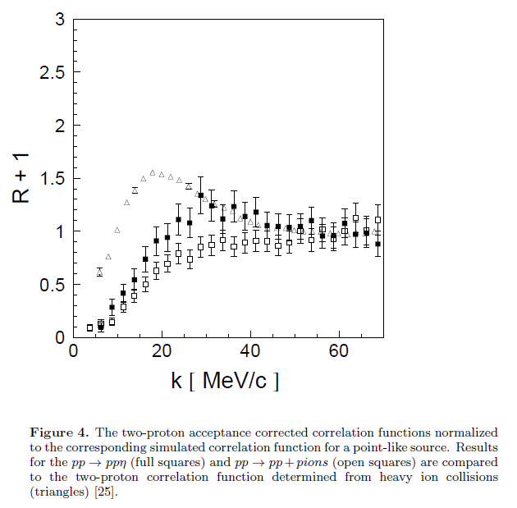


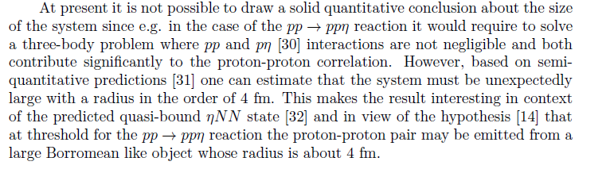
A. Deloff, AIP Conf. Proc. 950 (2007) 150
„At present it is not possible to draw a solid quantitative
conclusion about the size of the system since e.g. in the
case of the pp → pp reaction it would require to solve
a three-body problem where pp and p-eta interactions
are not negligible and both contribute significantly
to the proton-proton correlation. However, based on
semiquantitative predictions one can estimate that the
system must be unexpectedly large with a radius
in the order of 4 fm”
+
COSY-11: J. Phys. G 37 (2010) 055003
+
η
Correlation femtoscopy
Koonin-Pratt model [2]

Slide 28
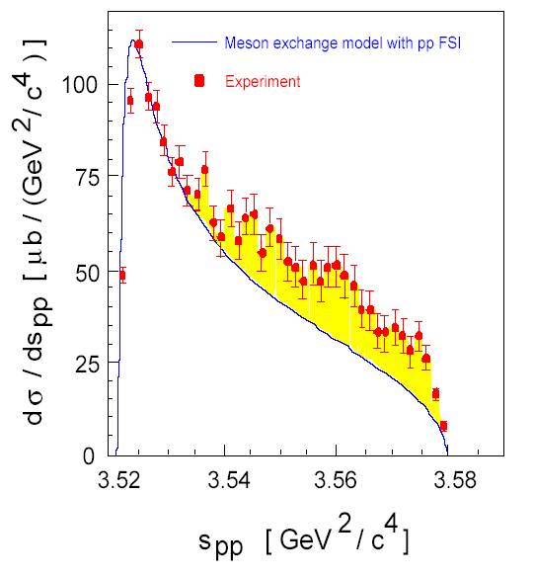
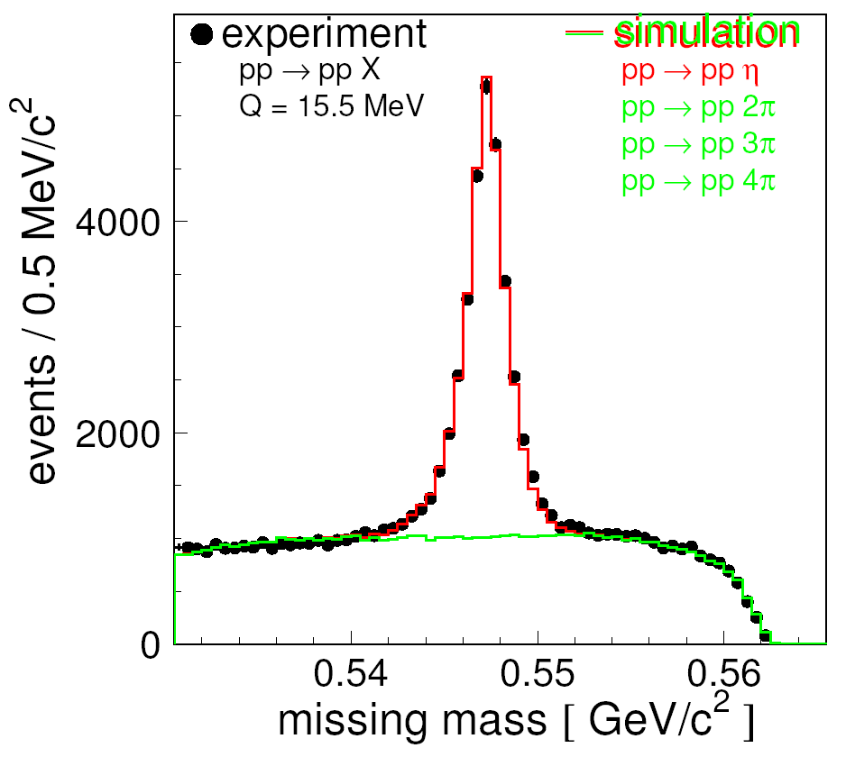
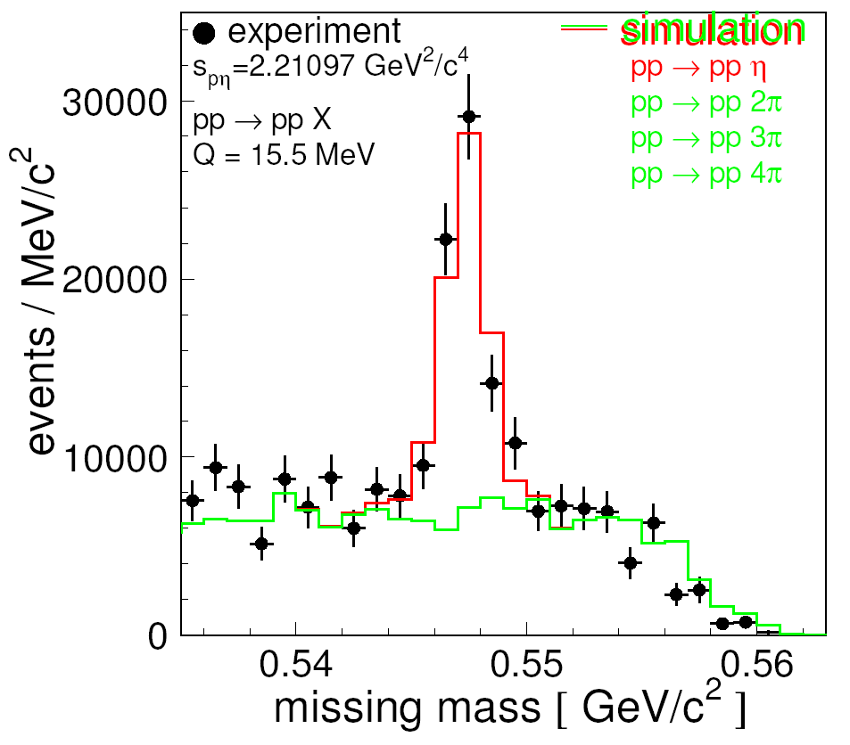
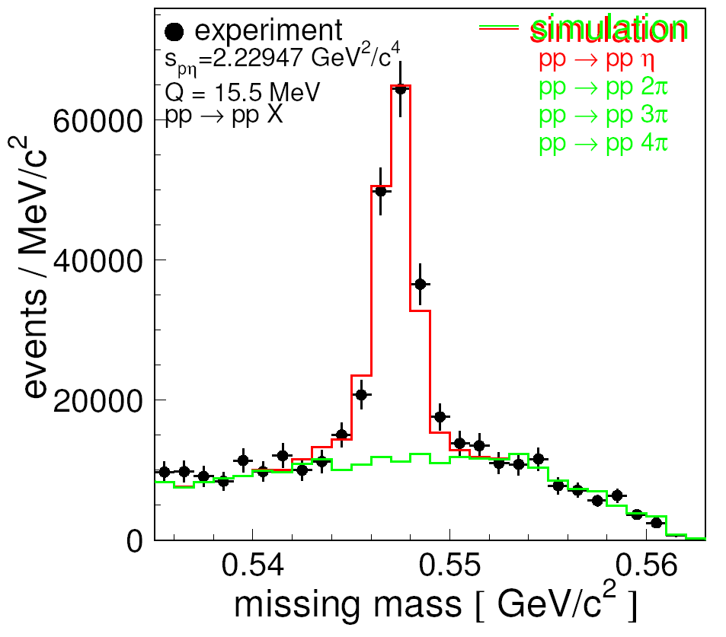
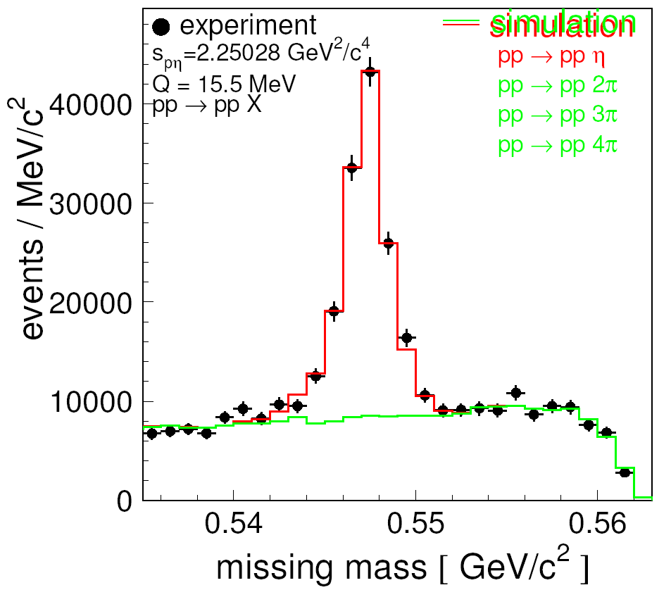

Slide 29
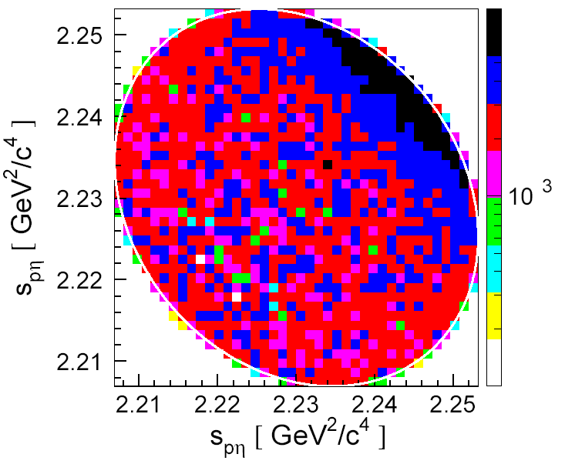
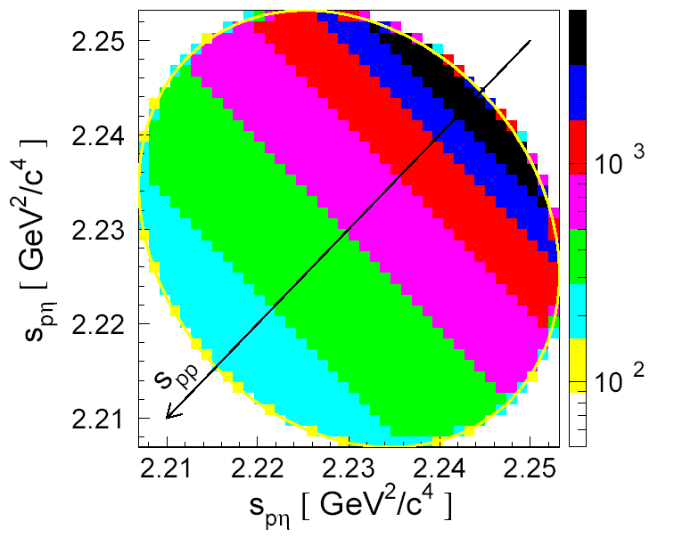
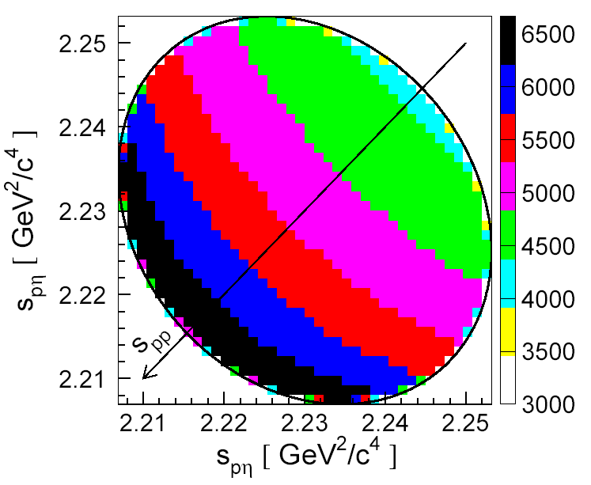
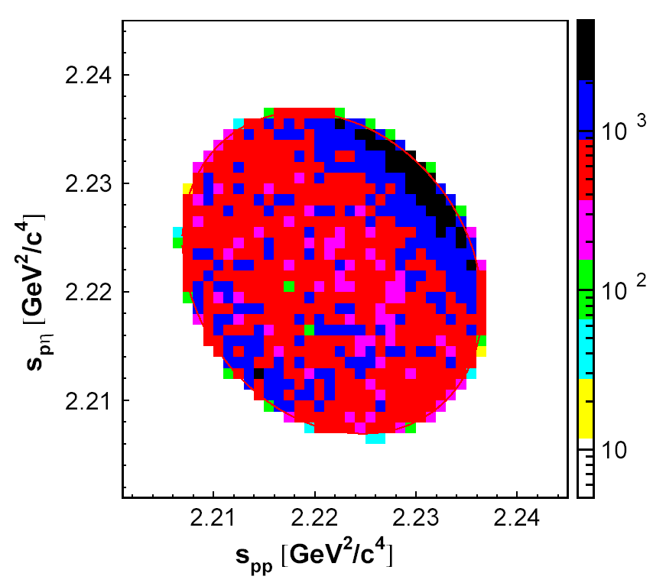
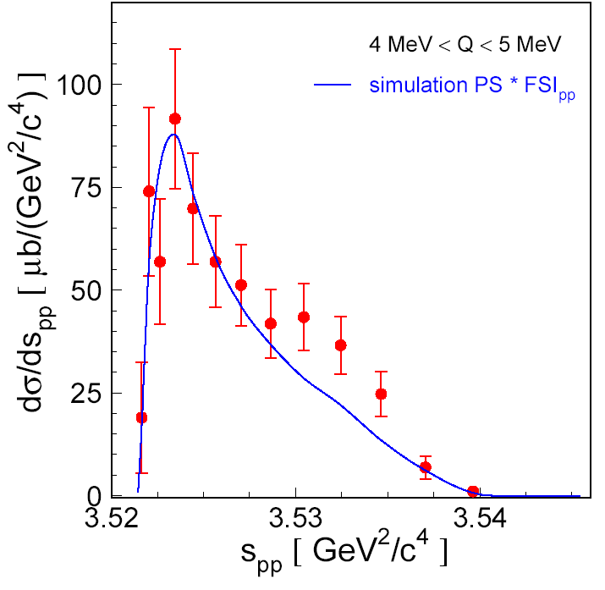
EXPERIMENT Q = 15.5 MeV
SIMULATION
SIMULATION
Phys. Rev. C 69 (2004) 025203
EXPERIMENT Q = 15.5 MeV
EXPERIMENT Q = 10 MeV
EXPERIMENT Q = 4.5 MeV

Slide 30
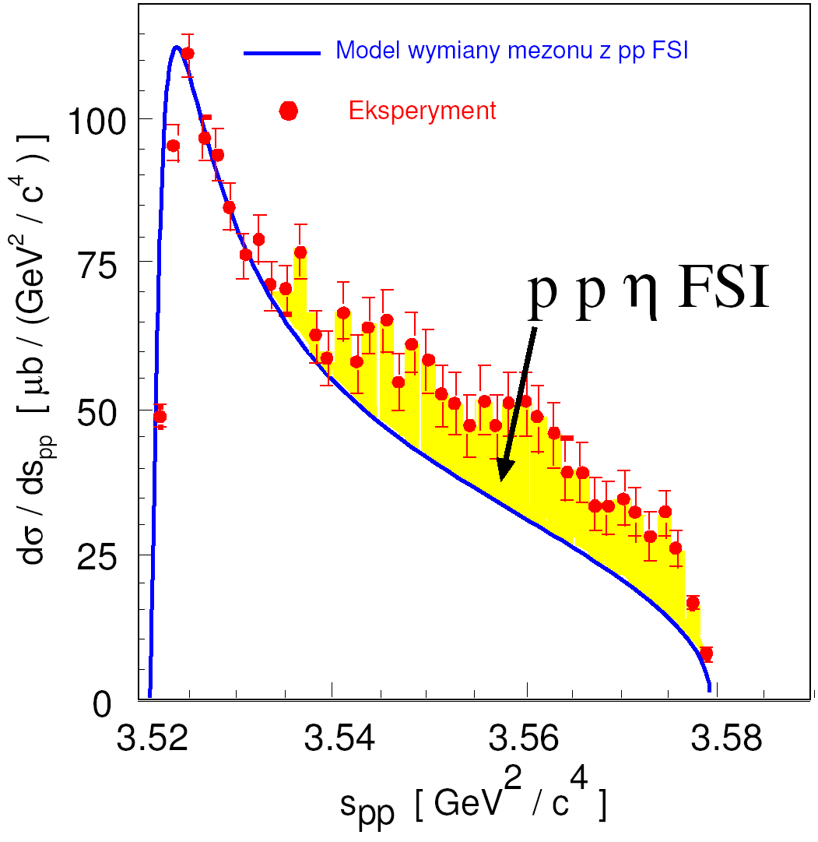

V. Baru et al., PRC 67
(2003) 024002
COSY TOF, COSY-11, WASA/CELSIUS

Slide 31


COSY-11 STILL ALIVE
PRELIMINARY
COSY-11: Phys. Rev. Lett. 113 (2014) 062004
COSY-11: Phys. Lett. B 684 (2010) 11
Rysunek 3. Widmo masy niezmienniczej podukładu proton-proton dla układu ppη (zielone punkty) oraz ppη’ (czerwone punkty)
wyznaczone dla energii wzbudzenia wynoszącej 15.5 MeV. W celu umożliwienia porównania kształtu
widm dane dla mezonu η’ zostały unormowane do danych otrzymanych dla mezonu η.

Slide 32
WASA-at-COSY
p p → p p M 10⁹ η and 10¹¹ π⁰ on discs
p p → p p η 10⁶ η mesons on discs ; Polarization of about 70%
more than factor of 100 larger statistics
I. Ozerianska, P.M., M. Zieliński, Acta Phys. Pol. B 46 (2015) 153
→
SPIN UP SPIN DOWN

Slide 33
Mesic nuclei ?
experimental aspects
natural width of the ή meson
ή -proton interaction
production dynamics
η-proton-proton interaction
Borromean-states?
η-nucleus interaction
mesic-nuclei ?
challenges to theory
η
I thought… the scientific theories were not the digest of observation,
but that they were inventions-conjectures boldly put forward for trial
to be eliminated if they clashed with observation …
David Hume
Transition Form-Factors: J. Zdebik PhD JU (2013); M.Hodana PhD JU (2012)
R. Pohl et al., The size of the proton, Nature 466, 213 (2010)

Slide 34


³He η interaction (pd → ³He η)
+
π
η
+
η
Notes:
W TYM OPISIE DOŁOŻYC TAKŻE WIDMA TAKŻE Z FOTOPRODUKCJI …. !!!!!!

Slide 35



+
η - ³He
+
dp→ ³Heη γ ³He → ³Heη
COSY
MAMI
η
MAMI:
M. Pfeiffer et al., Phys. Rev. Lett. 92 252001 (2004)
F. Pheron et al., Phys. Lett. B709 21 (2012)
ANKE: T. Mersmann et al., Phys. Rev. Lett. 98 242301 (2007)
COSY-11: J. Smyrski et al., Phys. Lett B 649 258-262 (2007)
T. Mersmann et al., Phys. Rev. Lett. 98, 242301 (2007)

Slide 36



+
η - ³He
+
η
COSY-ANKE
Phys. Lett. B734 (2014) 333
C.Wilkin et al., Phys. Lett. B654 (2007) 92‏

Slide 37
THE ETA-MESIC NUCLEUS
η meson bound with nucleus via
STRONG INTERACTION
+
+
N*
π‾
+
η
N*
COSY, J-PARC, MAMI, GSI, LPI/JINR
Talk by Wojciech Krzemień at this conference …
G. A, Sokol et al., arXiv:nucl-ex/0106005

Slide 38
THE ETA-MESIC NUCLEUS
η meson bound with nucleus via
STRONG INTERACTION
γ
+
+
η
γ
COSY, J-PARC, MAMI, GSI, LPI/JINR
Talk by Wojciech Krzemień at this conference …
G. A, Sokol et al., arXiv:nucl-ex/0106005

Slide 39
η - ⁴He
~25nb -- Present experimental upper limit .
WASA-at-COSY: Phys. Rev. C87(2013) 035204
~ 4 nb -- Theoretical estimation .
S. Wycech, W. Krzemien , Acta. Phys. Pol. B45 (2014) 745
~ few nb -- WASA-at-COSY data collected in 2010 .
η - ³He
~270 nb -- Present experimental upper limit pppπ⁻
COSY-11: Acta Phys. Pol B41 (2010) 21
~80 nb -- Theoretical estimation .
C. Wilkin, Acta. Phys. Pol. B45 (2014) 603
~ 10nb -- expected from New WASA-at-COSY data
collected in May 2014

Slide 40
THANK YOU
FOR YOUR ATTENTION

Slide 41
Challanges
experimental aspects
natural width of the ή meson
ή -proton interaction
production dynamics
η-proton-proton interaction
Borromean-states?
η-nucleus interaction
mesic-nuclei ?
challenges to theory
η
I thought… the scientific theories were not the digest of observation,
but that they were inventions-conjectures boldly put forward for trial
to be eliminated if they clashed with observation …
David Hume
Transition Form-Factors: J. Zdebik PhD JU (2013); M.Hodana PhD JU (2012)
R. Pohl et al., The size of the proton, Nature 466, 213 (2010)

Slide 42
Challanges for theortists
Using many-body formalism try to determine:
Total cross section for the pp→ppη (pp→ppM)
Total cross section for the production of mesic nucleus
Distribution of N* momentum in the (³He-N*) helium
BR of mesic-nucleus decays via „N*” and „orbiting”
Correlation function for the ppη system
…
HINT: It is very simple to do !

Slide 43
THANK YOU
FOR YOUR ATTENTION

