Slide 1


Discontinuous shear-thickening in Brownian suspensions
Rheology of disordered particles - suspensions, glassy and granular materials; part I
Department of Physics, Nagoya University
Takeshi Kawasaki
（Collaborator）
Université de Montpellier, CNRS, Ludovic Berthier
T. Kawasaki, A. Ikeda, and L. Berthier, EPL 107, 28009 (2014).
T. Kawasaki and L. Berthier, arXiv:1804.06800.
Notes:
Thank you so much for giving me an opportunity to give a seminar today.

Slide 2
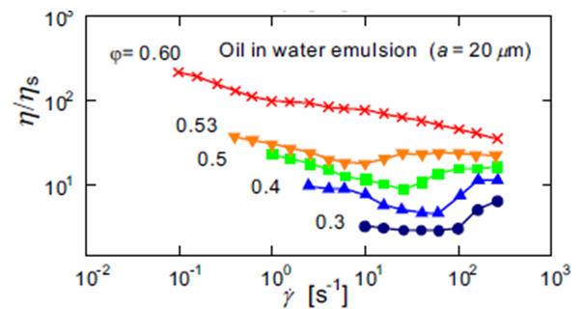


Suspension rheology
✓Suspension rheology → complicated flow behaviours.
Flow curve:
$$η(\dot{γ})=σ(\dot{γ})/\dot{γ }$$
cf: Oil in water emulsion (diameter = 20 μm)
$$η_{s}=ξ/3πa$$
Y. Otsubo and R. K. Prud’homme, Rheol. Acta 33, 29 (1994)
The flow curves show non-monotonic bahaviour -- there are several flow regimes.
Notes:
In this study I will focus on the suspension rheology, which show very complicated behaviours.
To investigate the flow behaviours we measure the flow curves.
Flow curves is a relation between viscousity eta and shear rate gammadot.
This is the flow curves of oil in water emulsions as a function of packing fraction.
Here we see that especially in the middle density as shear rate is increased the viscosity shows non-monotonic behaviour.

Slide 3
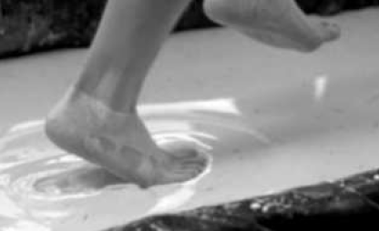
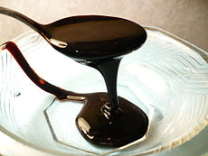


Elements of flow curve
$$η(\dot{γ})$$
Shear thickening
E. Brown and H. M. Jaeger, Rep. Prog. Phys. 77, 046602 (2014).
Newtonian
http://ja.wikipedia.org/wiki/%E7%B3%96%E8%9C%9C
Shear thinning
$$\dot{γ}$$
Elements of flow curve
Notes:
Flow curves are composed of roughly speaking three elements, thickening, thinning , and Newtonian.
If the viscosity is constant as shear rate changed it is Newtonian – which is like a simple liquid behavior.
The viscosity decreasing with gammadot means shear thinning, which is very familiar in our daily life.
For instance, spreading butter, jam, syrup on a bread we experience shear thinning.
On the other hand, thickening is not so familiar. This picture is an example of thickening, one can walk on the fluid.
歩みを止めると沈む。。。

Slide 4
Flow curves of suspensions
Y. Otsubo and R. K. Prud’homme, Rheol. Acta 33, 29 (1994)
H. M. Laun, Angew. Makromol. Chem. 123, 335 (1984).
Full range of the flow curves are deserved to be understood.
Notes:
Until recently, full range of the flow curve had not understood well even in recently.

Slide 5
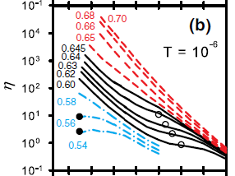




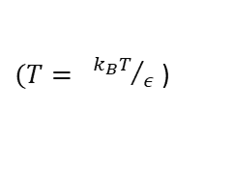

Recent progress: physical origins of the two Newtonians
✓ Numerical simulations on overdamped frictionless sheared Brownian particles.
✓ Time scale for thermal motions
→ Glass transition
Characterized by thermal fluctuation
$(T= {k_{B}T}/ε$ )
✓ Time scale for dissipation
→ Jamming transition
Characterized by interaction energy
$$\dot{γ}$$
$$\dot{γ}τ_{T}^{}=Pe=1$$
$$\dot{γ}τ_{0}^{}=1$$
A. Ikeda, L. Berthier, and P. Sollich, Phys. Rev. Lett. 109, 018301 (2012)
Notes:
Recently by using very simple model, understanding of some of the rheological regimes has been obtained.

Slide 6

Two yieldings
The intersection:
The intersection:
$$\dot{γ}$$
The intersection:
Green Kubo formula:

Slide 7

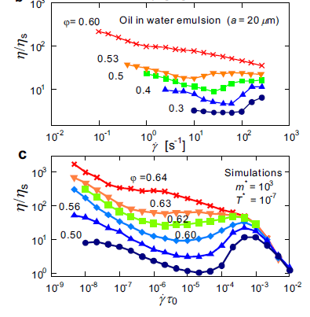
Adding inertia to the simple model
✓ Adding inertia to Ikeda et al., PRL (2012)
Experiments
Our numerical simulations
T. Kawasaki, A. Ikeda, and L. Berthier, EPL 107, 28009 (2014).

Slide 8
Discontinuous shear thickening by experiments
✓Latex dispersion (experiment)
H. M. Laun, Angew. Makromol. Chem. 123, 335 (1984).
Discontinuous shear thickening is not reproduced by our earlier model [T. K, A. Ikeda, and L. Berthier, EPL 107, 28009 (2014)].
Notes:
Discontinuous shear thickening cannot be reproduced by just adding inertia.

Slide 9
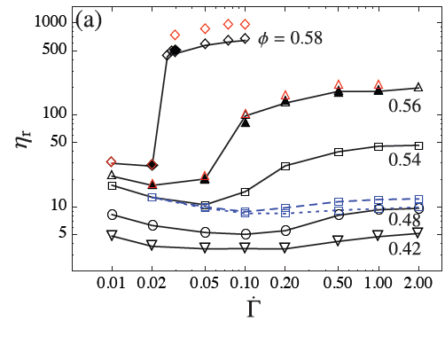
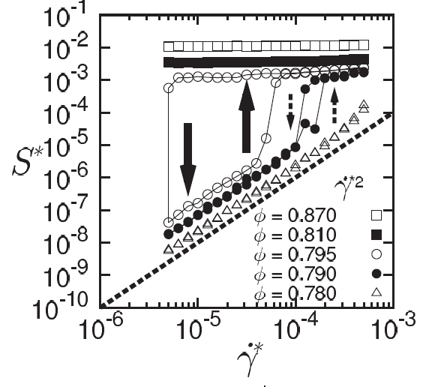
Discontinuous shear thickening by computer simulations
✓Recent observations (Numerical simulations)
Non-Brownian colloidal model
Granular model
Bagnold law
viscosity
stress
Shear rate
Shear rate
R. Seto et al., PRL 111, 218301 (2013).
M. Otsuki and H. Hayakawa, PRE 83, 051301 (2011).
・inertia ×
・tangential friction ○
・contact repulsive force○
・electro static force○
・hydrodynamic lubrication force○
・inertia○
・tangential friction○
・contact repulsive force○
Yet, most experiments study soft colloidal particles subject to thermal fluctuations.

Slide 10
Purpose of the present study
We propose minimal model for colloidal suspensions, which reproduces experiments for discontinuous shear thickening (DST).
-- We show that the model with following forces is enough to reproduce many of the experiments.
inertia ×
Contact friction ○
Contact repulsion (softness) ○
Thermal fluctuation○
We intentionally neglect hydrodynamics, electrostatics, lubrication, and inertia, but can nevertheless achieve quantitative agreement with experimental findings.

Slide 11
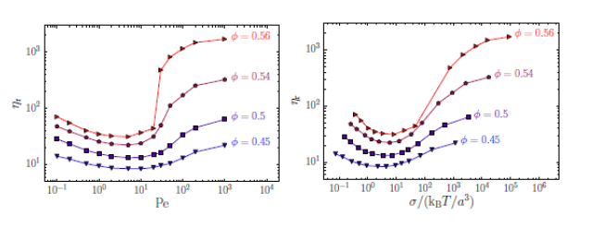

Note: Recent work by Mari et al.
R. Mari, R. Seto, J. F. Morris, and M. M. Denn, PNAS 112, 15326 (2015).
$$Pe= \dot{γ}τ_{T}^{}$$
The thickening is scaled with the Péclet number.
We have obtained different conclusions: if we change softness, the flow curve will not be scaled with Péclet number.

Slide 12

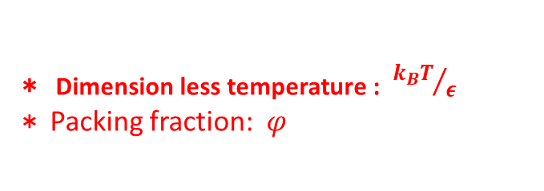
Numerical methods
Molecular dynamics simulation
✓Eq. of motions:
✓Tangential friction:
＊Distinct Element method（DEM）．
P. A. Cundall, O. D. L. Strack, Geotechnique 29 47-65 (1979).
＊Friction coefficient: $μ_{C}=0, 1.0$
✓Binary mixtures:
＊ 50:50 bidisperse. Size ratio 1:1.4.
＊ Particle number N = 1000 (10000)
✓Control parameters:
＊ Dimension less temperature : ${k_{B}T}/ε$
＊ Packing fraction: $φ$

Slide 13
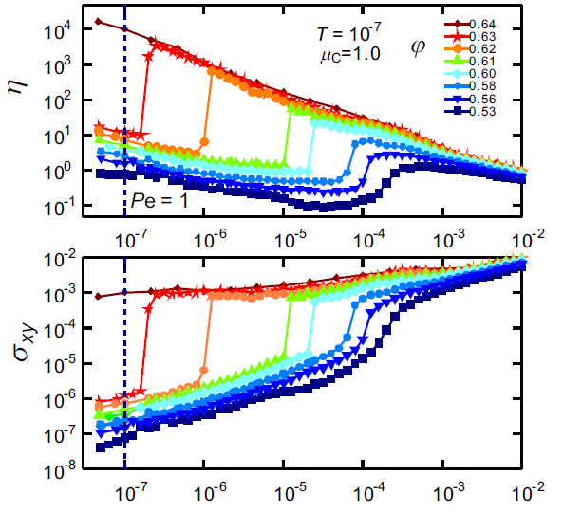



Density dependence of the flow curve with frictional Brownian particles
$$μ_{C}=1.0,T={10}^{−7}$$
$${η=σ}_{xy}/ \dot{γ}$$
$$\dot{γ}$$

Slide 14
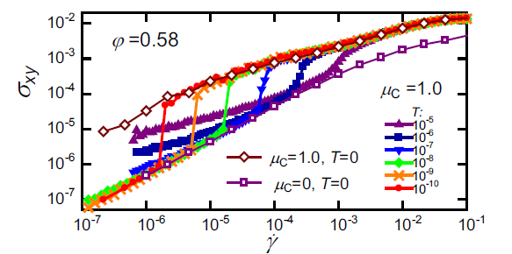
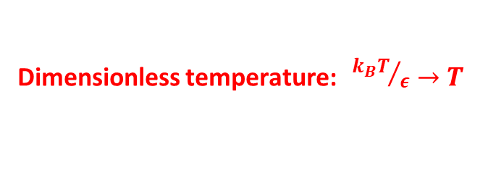
Changing dimensionless temperature
Dimensionless temperature: ${{ k}_{B}T}/ε→T$
Tangential friction with thermal fluctuation lead discontinuous thickening.

Slide 15
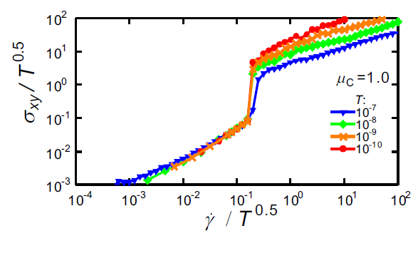

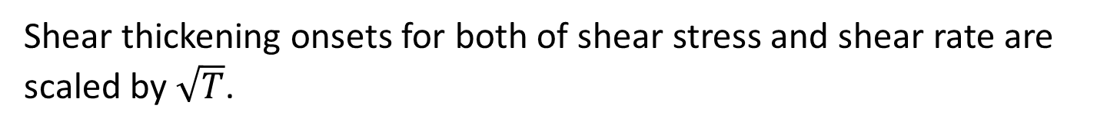

Scaling law
$${{ k}_{B}T}/ε→T$$
Shear thickening onsets for both of shear stress and shear rate are scaled by$\sqrt{T}$.

Slide 16
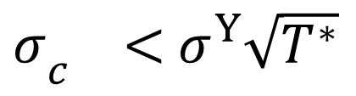
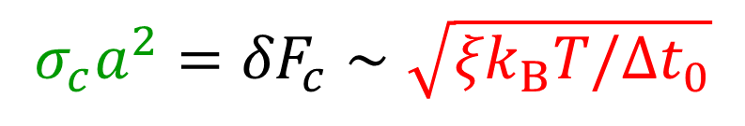
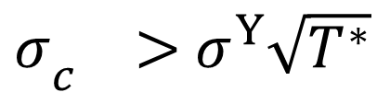

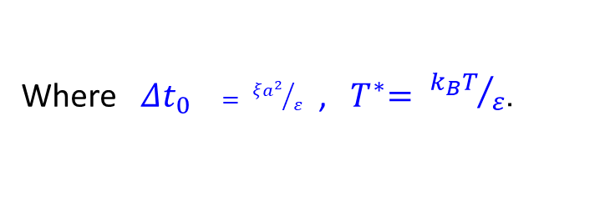

Discussion
Onset stress $σ_{c}$is determined by the interplay between the instantaneous thermal fluctuation and frictional force.
$$σ_{c}a^{2}={δF}_{c}∼\sqrt{{ξk}_{B}T/{Δt}_{0}}$$
(due to FDT)
Frictional force
Instantaneous thermal fluctuations
Where${{ Δt}_{0}}_{}= {ξa^{2}}/ε$ , ${ T}^{∗}= {k_{B}T}/ε$．
$$σ_{c}=\frac{1}{a^{2}}\sqrt{{ξk}_{B}Tε/ξa^{2}}=\frac{ε}{a^{3}}\sqrt{T^{∗}}=σ^{Y}\sqrt{T^{∗}}$$
$$\dot{γ}$$
$σ_{c }>$ $σ^{Y}\sqrt{T^{∗}}$
Friction is dominant
Discontinuous thickening
$σ_{c }<$ $σ^{Y}\sqrt{T^{∗}}$
Friction is not dominant

Slide 17
DST in Brownian suspensions
Sketch:

Slide 18
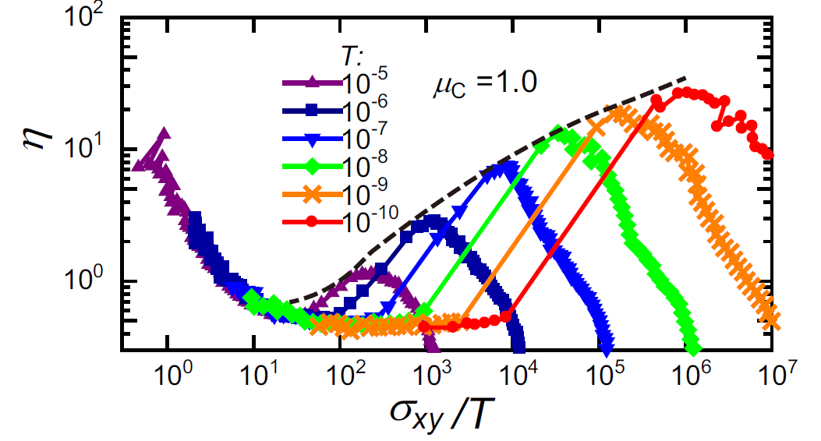
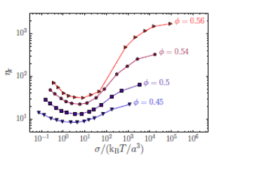
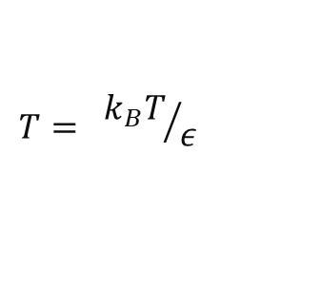
Discontinuous shear thickening for different temperatures
$$T= {k_{B}T}/ε$$
envelope
R. Mari, R. Seto, J. F. Morris, and M. M. Denn, PNAS 112, 15326 (2015).

Slide 19
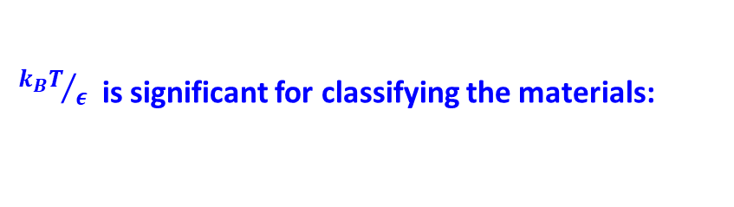
Comparisons to experiments
Experimental data:
[3] N. J. Wagner and J. F. Brady, Phys. Today 62, 27 (2009).
[4] B. J. Maranzano and N. J. Wagner, J. Chem. Phys. 114, 10514 (2001).
[8] N. Fernandez, et al., Phys. Rev. Lett. 111, 108301 (2014).
[9] B. M. Guy, M. Hermes, and W. C. K. Poon, Phys. Rev. Lett. 115, 088304 (2015).
${k_{B}T}/ε$ is significant for classifying the materials:
Notes:
Here, we compare to the actual experimental values. According to the literatures we can obtain the shear thickening onset stress.
From this onset value we can obtain the dimensionless temperature. These are very close to what we use in our simulations.
Note that Mari’s estimated onset value 5kT/a^3 are very different from experimental ones.
In fact, this dimensionless temperatures is significant for classifying the materials.

Slide 20
Experiments vs simulations
Scaled viscosity
Scaled shear rate
Simulation
( )
Experiment
( )
( )
The factor 10 we find suggests that the viscosity of the experimental suspensions is about 10 times larger than the corresponding one in the simulations.

Slide 21
Hydrodynamic interaction is dominant in low density
R. Mari, R. Seto, J. F. Morris, and M. M. Denn, PNAS 112, 15326 (2015).

Slide 22
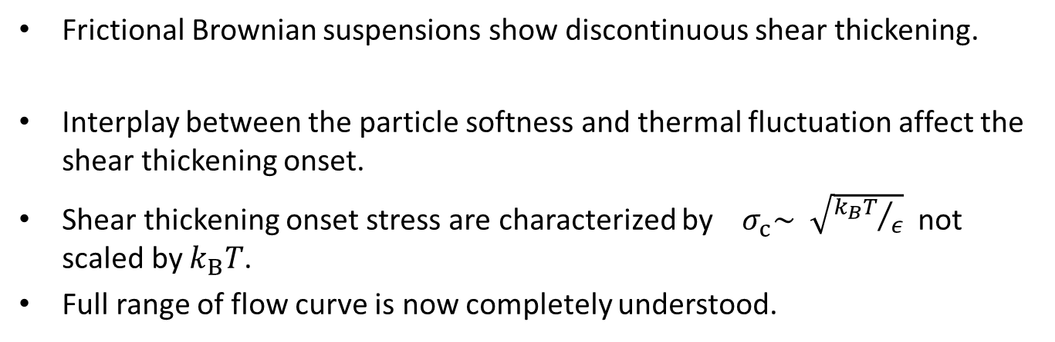
Conclusion
Frictional Brownian suspensions show discontinuous shear thickening.
Interplay between the particle softness and thermal fluctuation affect the shear thickening onset.
Shear thickening onset stress are characterized by $σ_{c}\sim \sqrt{{k_{B}T}/ε}$ not scaled by $k_{B}T$.
Full range of flow curve is now completely understood.
T. Kawasaki and L. Berthier, submitted

