Slide 1
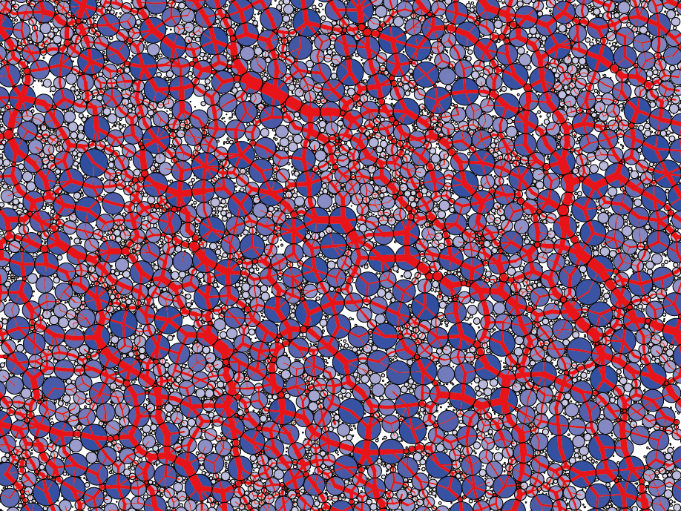
"Rheology of disordered particles – suspensions, glassy and granular materials", 22nd June, 2018
Kyoto University, Kyoto, Japan
Microscopic theory for discontinuous shear thickening of frictional granular disks
Kuniyasu Saitoh^{1, 2} and Hisao Hayakawa³
¹RACMaS, ²WPI-AIMR, Tohoku University
³YITP, Kyoto University

Slide 2
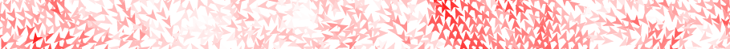
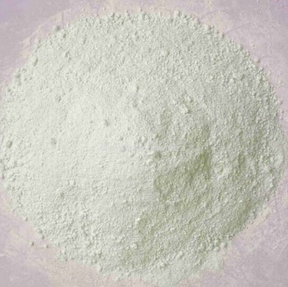
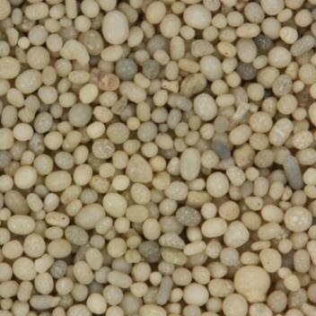
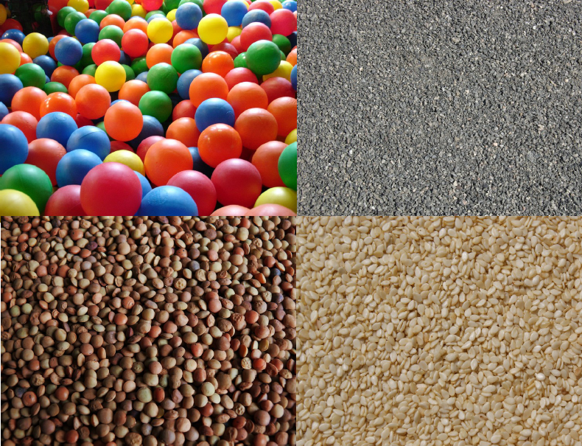
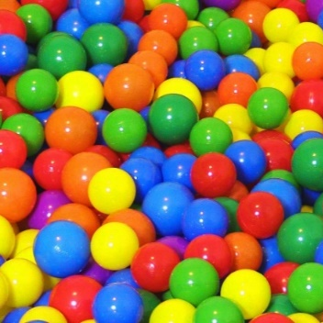
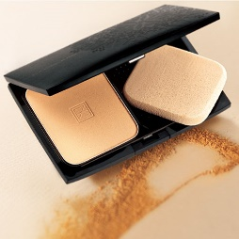
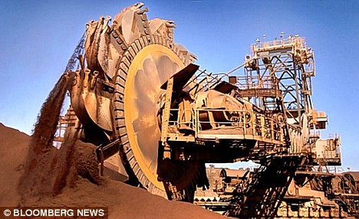
Granular materials
ceramic powders
stones/rocks
Macro-sized “particles” (few μm ~ mm).
Energy dissipation due to inelasticity.
A wide variety of contact force.
Thermal fluctuations are negligible.
Mostly in disordered configurations.
sesame/seeds
balls
Applications
Manufacturing of food and medicine.
Geo-hazards, e.g. earthquakes.
Astronomy, e.g. planetary rings.
Chemical & civil engineering, geophysics.
cosmetics
mining industry
Understanding of their macroscopic flow behavior/mechanical response is crucial.

Slide 3
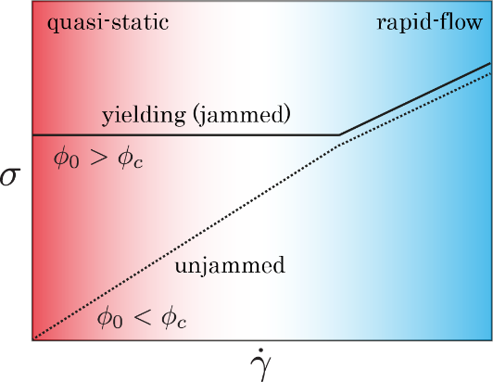
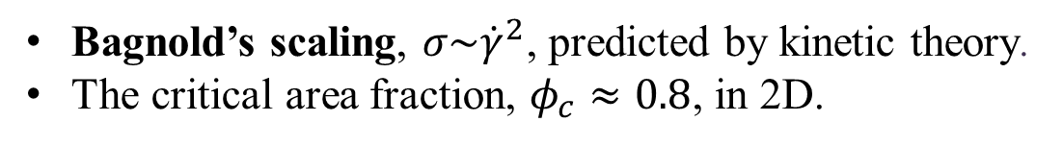
Rheology of frictionless granular particles
Liquid-like unjammed state
Bagnold’s scaling, $σ\sim {\dot{γ}}^{2}$, predicted by kinetic theory.
The critical area fraction, $φ_{c}≈0.8$, in 2D.
Solid-like jammed (or yielding) state
The rate-independent “critical state”.
Finite yield stress in a quasi-static limit.

Slide 4
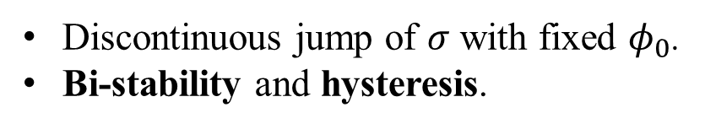
Rheology of frictional granular particles
Discontinuous shear thickening (DST)
Discontinuous jump of $σ$ with fixed $φ_{0}$.
Bi-stability and hysteresis.
M. Otsuki and H. Hayakawa, Phys. Rev. E 83 (2011) 051301 (2011)
R. Seto, R. Mari, J.F. Morris, and M.M. Denn, Phys. Rev. Lett. 111 (2013) 218301
M. Grob, C. Heussinger, and A. Zippelius, Phys. Rev. E 89 (2014) 050201(R)
Microscopic theory for the DST?

Slide 5
I. General framework

Slide 6
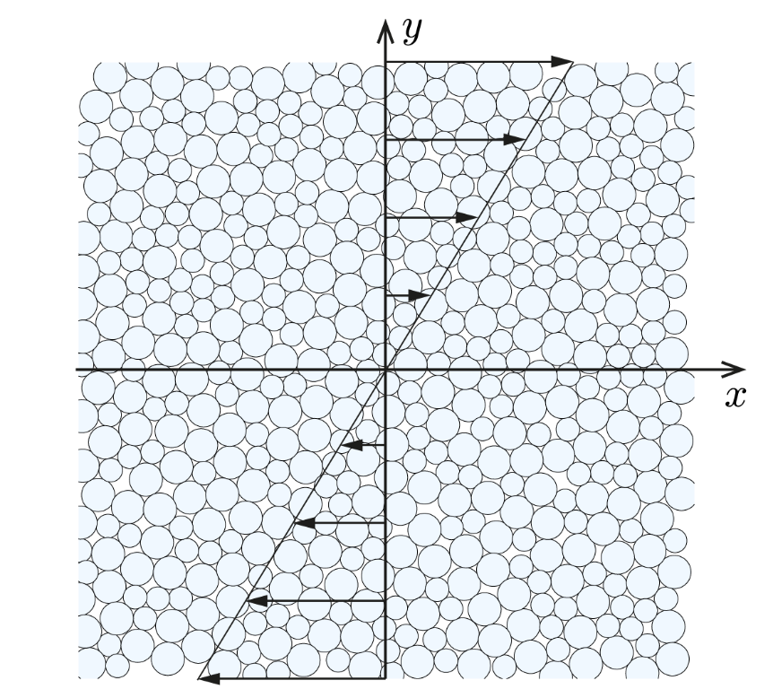

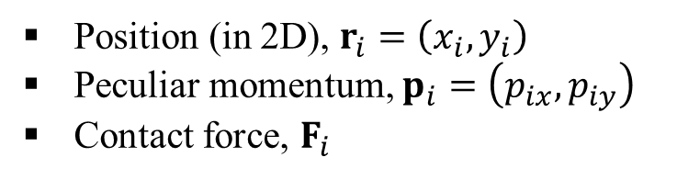



Equations of motions
The SLLOD equation
$${\dot{r}}_{i}=\frac{p_{i}}{m}+\dot{γ}y_{i}e_{x}$$
$${\dot{p}}_{i}=F_{i}−\dot{γ}p_{iy}e_{x}$$
Position (in 2D), $r_{i}=\left(x_{i},y_{i}\right)$
Peculiar momentum, $p_{i}=\left(p_{ix},p_{iy}\right)$
Contact force, $F_{i}$
The Euler equation
$$I_{i}{\dot{ω}}_{i}=M_{i}$$
Frictional disks under shear
The Lees-Edwards boundaries
Angular velocity, $ω_{i}$, and torque, $M_{i}$

Slide 7
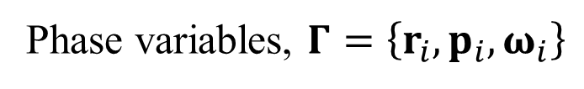
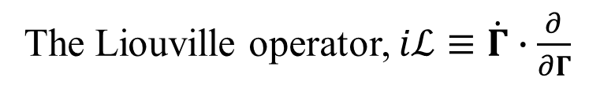

Liouville operator
Effects of shear and friction
Phase variables, $Γ=\left\{r_{i},p_{i}, ω_{i}\right\}$
The Liouville operator, $iℒ≡\dot{Γ}∙\frac{∂}{∂Γ}$
$$iℒ=\sum_{i=1}^{N}{\left\{\frac{p_{i}}{m}∙\frac{∂}{∂r_{i}}+F_{i}∙\frac{∂}{∂p_{i}}+I_{i}^{−1}M_{i}∙\frac{∂}{∂ω_{i}}\right\}}$$
$$+\dot{γ}\sum_{i=1}^{N}{\left(y_{i}\frac{∂}{∂x_{i}}−p_{iy}\frac{∂}{∂p_{ix}}\right)}$$
The SLLOD equation and Euler equation have been used.

Slide 8


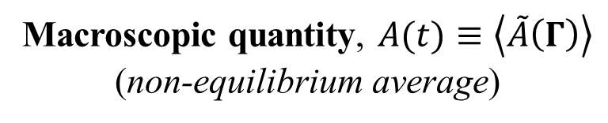
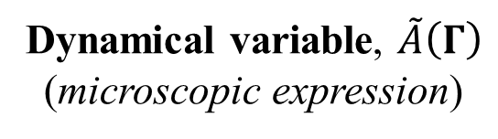

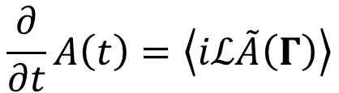
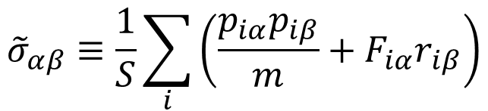
Dynamical equation
Dynamical variable, $\tilde{A}\left(Γ\right)$
(microscopic expression)
Macroscopic quantity, $A(t)≡\left\langle \tilde{A}\left(Γ\right)\right\rangle$
(non-equilibrium average)
$$\frac{∂}{∂t}A\left(t\right)=\left\langle iℒ\tilde{A}\left(Γ\right)\right\rangle$$
D.J. Evans and G. Morriss, “Statistical Mechanics of Nonequilibrium Liquids”, 2nd ed. (2008)
Stress tensor/granular temperature
$${\tilde{σ}}_{αβ}≡\frac{1}{S}\sum_{i}{\left(\frac{p_{iα}p_{iβ}}{m}+F_{iα}r_{iβ}\right)}$$
$$\tilde{T}≡\frac{1}{N}\sum_{i}{\frac{p_{i}^{2}}{2m}}$$
$$\tilde{A}\left(Γ\right)→$$
$$\left(α,β=x,y\right)$$

Slide 9

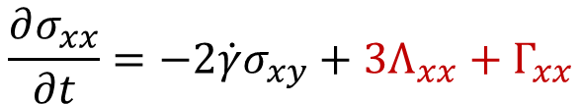
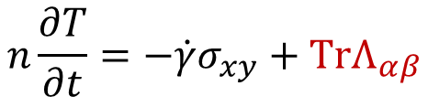
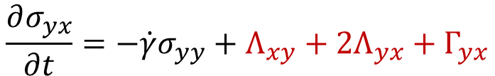
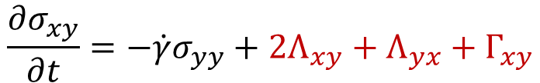
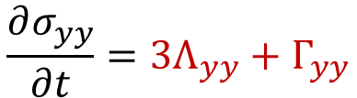
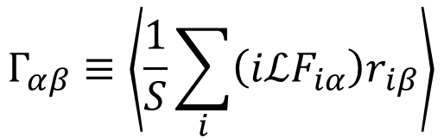
Dynamical equations
$$n\frac{∂T}{∂t}=−\dot{γ}σ_{xy}+TrΛ_{αβ}$$
$$\frac{∂σ_{xx}}{∂t}=−2\dot{γ}σ_{xy}+3Λ_{xx}+Γ_{xx}$$
$$\frac{∂σ_{xy}}{∂t}=−\dot{γ}σ_{yy}+2Λ_{xy}+Λ_{yx}+Γ_{xy}$$
$$\frac{∂σ_{yx}}{∂t}=−\dot{γ}σ_{yy}+Λ_{xy}+2Λ_{yx}+Γ_{yx}$$
$$\frac{∂σ_{yy}}{∂t}=3Λ_{yy}+Γ_{yy}$$
Non-equilibrium averages
$$Λ_{αβ}≡\left\langle \frac{1}{S}\sum_{i}{F_{iα}{\dot{r}}_{iβ}}\right\rangle$$
$$Γ_{αβ}≡\left\langle \frac{1}{S}\sum_{i}{\left(iℒF_{iα}\right)r_{iβ}}\right\rangle$$

Slide 10
II. Contact model

Slide 11





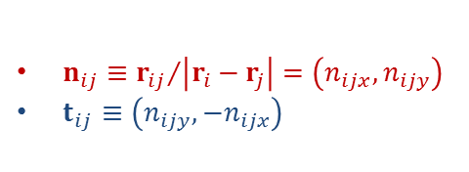


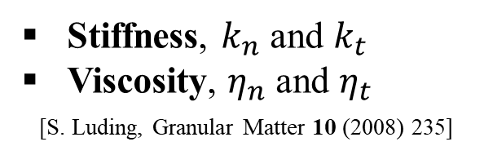
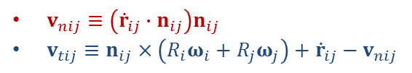


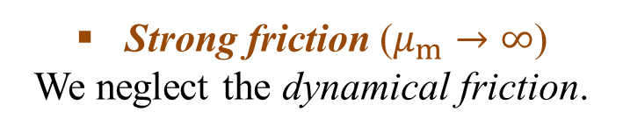





Frictional contact model
Normal/tangential force
Particle overlap, $ξ_{ij}≡R_{i}+R_{j}−\left|r_{i}−r_{j}\right|$
$$f_{ij}=f_{ijn}+f_{ijt}$$
$$r_{i}$$
$$t_{ij}$$
$$r_{j}$$
$$R_{i}$$
$$n_{ij}$$
$$R_{j}$$
$$f_{ijn}=k_{n}ξ_{ij}n_{ij}−η_{n}v_{nij}$$
$$f_{ijt}=k_{t}ζ_{ij}t_{ij}−η_{t}v_{tij}$$
$n_{ij}≡{r_{ij}}/{\left|r_{i}−r_{j}\right|}=\left(n_{ijx},n_{ijy}\right)$
$t_{ij}≡\left(n_{ijy},−n_{ijx}\right)$
Stiffness, $k_{n}$ and $k_{t}$
Viscosity, $η_{n}$ and $η_{t}$
[S. Luding, Granular Matter 10 (2008) 235]
$${\dot{r}}_{i}$$
$$ω_{j}$$
$$ω_{i}$$
$${\dot{r}}_{j}$$
Strong friction ($μ_{m}→∞$)
We neglect the dynamical friction.
$v_{nij}≡\left({\dot{r}}_{ij}∙n_{ij}\right)n_{ij}$
$v_{tij}≡n_{ij}×\left(R_{i}ω_{i}+R_{j}ω_{j}\right)+{\dot{r}}_{ij}−v_{nij}$

Slide 12
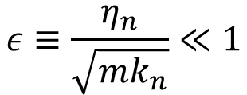
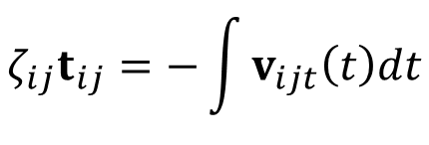
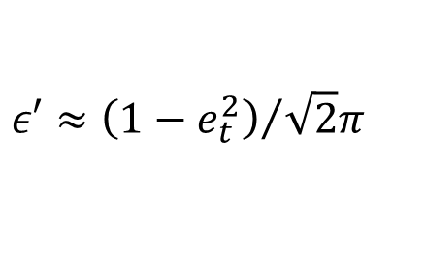
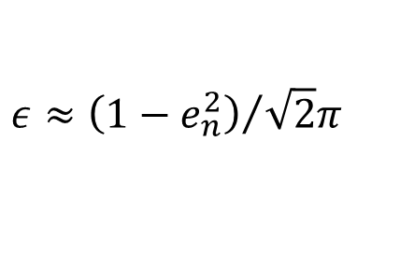
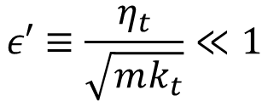

Frictional contact model
Restitution coefficients
Dimensionless parameters
(weakly inelastic)
$$ε≡\frac{η_{n}}{\sqrt{mk_{n}}}≪1$$
$$ε′≡\frac{η_{t}}{\sqrt{mk_{t}}}≪1$$
$$ε≈{\left(1−e_{n}^{2}\right)}/{\sqrt{2}π}$$
$$ε′≈{\left(1−e_{t}^{2}\right)}/{\sqrt{2}π}$$
Tangential displacement
$$ζ_{ij}t_{ij}=−\int{v_{ijt}\left(t\right)dt}$$
Difficult to deal with the
time integral analytically…
We assume that $ζ_{ij}$ is determined by $ξ_{ij}$, i.e. $ζ_{ij}=ζ_{ij}\left(ξ_{ij}\right)$.
$$ξ_{ij}≪d$$
$$∴ζ_{ij}\left(ξ_{ij}\right)=ζ_{ij}\left(0\right)+{ζ′}_{ij}\left(0\right)ξ_{ij}+⋯≈{ζ′}_{ij}\left(0\right)ξ_{ij}$$

Slide 13
III. Grad’s-like approximation

Slide 14
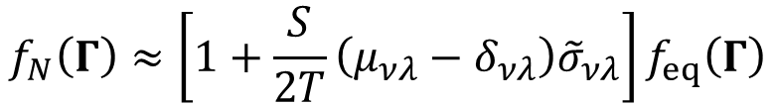
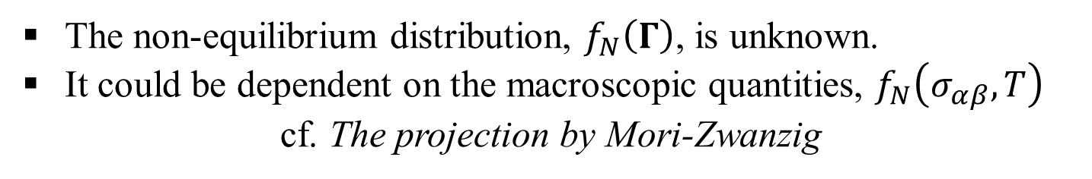
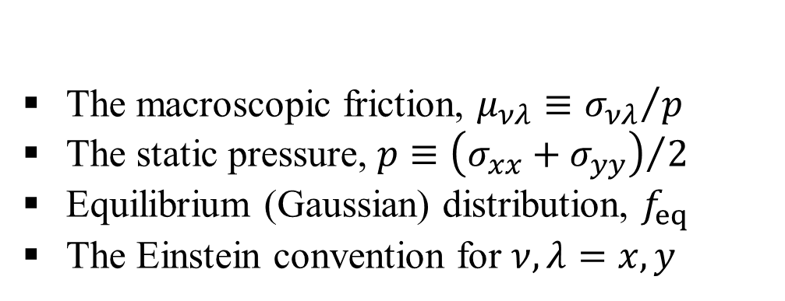
Non-equilibrium distribution function
Motivation
The non-equilibrium distribution, $f_{N}\left(Γ\right)$, is unknown.
It could be dependent on the macroscopic quantities, $f_{N}\left(σ_{αβ},T\right)$
cf. The projection by Mori-Zwanzig
Grad’s-like expansion as a candidate
$$f_{N}\left(Γ\right)≈\left[1+\frac{S}{2T}\left(μ_{νλ}−δ_{νλ}\right){\tilde{σ}}_{νλ}\right]f_{eq}\left(Γ\right)$$
The macroscopic friction, $μ_{νλ}≡{σ_{νλ}}/p$
The static pressure, $p≡{\left(σ_{xx}+σ_{yy}\right)}/2$
Equilibrium (Gaussian) distribution, $f_{eq}$
The Einstein convention for $ν,λ=x,y$
See also H. Hayakawa, S. Takada, and V. Garzo, Phys. Rev. E 96 (2017) 042903.

Slide 15
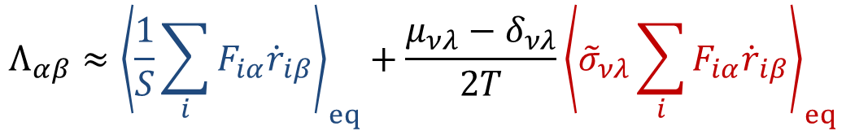
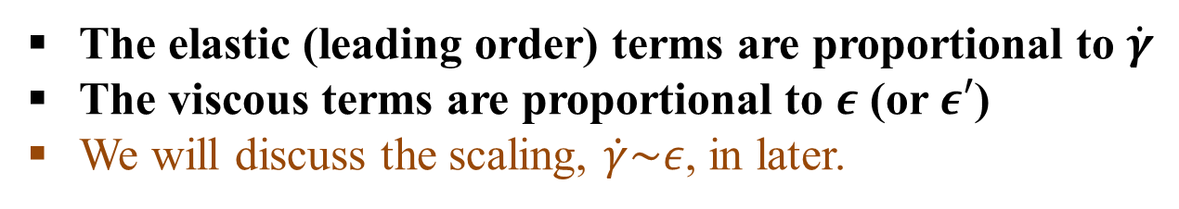
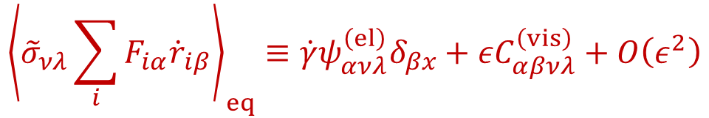
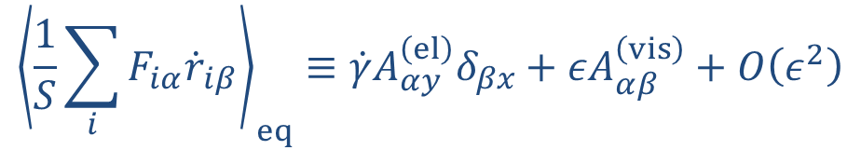
Non-equilibrium average 1
$$Λ_{αβ}≈{\left\langle \frac{1}{S}\sum_{i}{F_{iα}{\dot{r}}_{iβ}}\right\rangle }_{eq}+\frac{μ_{νλ}−δ_{νλ}}{2T}{\left\langle {\tilde{σ}}_{νλ}\sum_{i}{F_{iα}{\dot{r}}_{iβ}}\right\rangle }_{eq}$$
$${\left\langle \frac{1}{S}\sum_{i}{F_{iα}{\dot{r}}_{iβ}}\right\rangle }_{eq}≡\dot{γ}A_{αy}^{\left(el\right)}δ_{βx}+εA_{αβ}^{\left(vis\right)}+O\left(ε^{2}\right)$$
$${\left\langle {\tilde{σ}}_{νλ}\sum_{i}{F_{iα}{\dot{r}}_{iβ}}\right\rangle }_{eq}≡\dot{γ}ψ_{ανλ}^{\left(el\right)}δ_{βx}+εC_{αβνλ}^{\left(vis\right)}+O\left(ε^{2}\right)$$
The elastic (leading order) terms are proportional to $\dot{γ}$
The viscous terms are proportional to $ε$ (or $ε′$)
We will discuss the scaling, $\dot{γ}\sim ε$, in later.

Slide 16
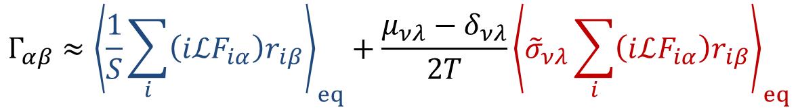
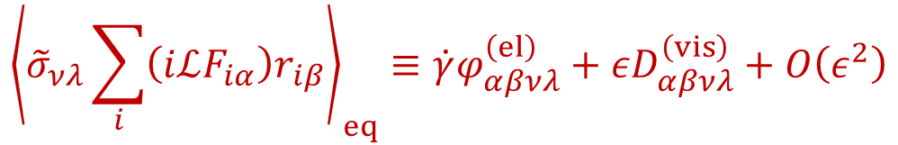
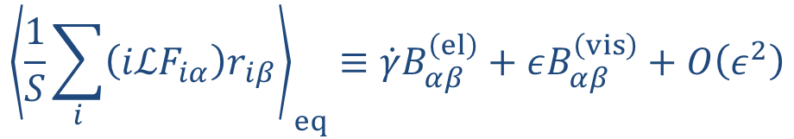
Non-equilibrium average 2
$$Γ_{αβ}≈{\left\langle \frac{1}{S}\sum_{i}{\left(iℒF_{iα}\right)r_{iβ}}\right\rangle }_{eq}+\frac{μ_{νλ}−δ_{νλ}}{2T}{\left\langle {\tilde{σ}}_{νλ}\sum_{i}{\left(iℒF_{iα}\right)r_{iβ}}\right\rangle }_{eq}$$
$${\left\langle \frac{1}{S}\sum_{i}{\left(iℒF_{iα}\right)r_{iβ}}\right\rangle }_{eq}≡\dot{γ}B_{αβ}^{\left(el\right)}+εB_{αβ}^{\left(vis\right)}+O\left(ε^{2}\right)$$
$${\left\langle {\tilde{σ}}_{νλ}\sum_{i}{\left(iℒF_{iα}\right)r_{iβ}}\right\rangle }_{eq}≡\dot{γ}φ_{αβνλ}^{\left(el\right)}+εD_{αβνλ}^{\left(vis\right)}+O\left(ε^{2}\right)$$
The elastic (leading order) terms are proportional to $\dot{γ}$
The viscous terms are proportional to $ε$ (or $ε′$)
We will discuss the scaling, $\dot{γ}\sim ε$, in later.

Slide 17
IV. Equilibrium averages

Slide 18
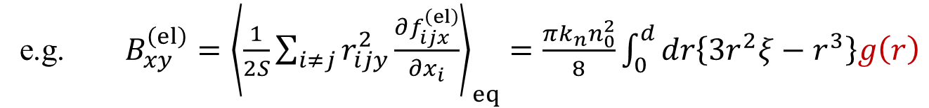
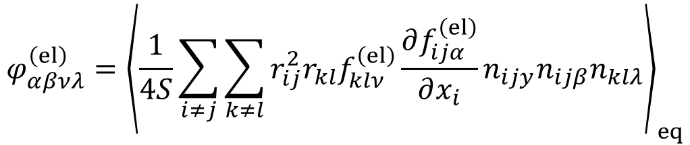
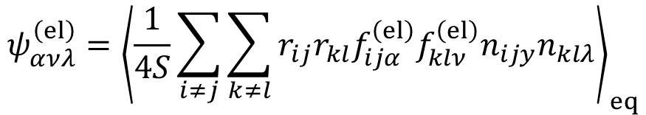
Equilibrium averages
Two-body correlations
radial distribution function
e.g. $A_{yy}^{\left(el\right)}={\left\langle \frac{πk_{n}}{2S}\sum_{i≠j}{Θ\left(ξ_{ij}\right)r_{ij}ξ_{ij}}\right\rangle }_{eq}=\frac{πk_{n}n_{0}^{2}}{2}\int_{0}^{d}{dr\left\{r^{2}ξ\right\}g\left(r\right)}$
e.g. $B_{xy}^{\left(el\right)}={\left\langle \frac{1}{2S}\sum_{i≠j}{r_{ijy}^{2}\frac{∂f_{ijx}^{\left(el\right)}}{∂x_{i}}}\right\rangle }_{eq}=\frac{πk_{n}n_{0}^{2}}{8}\int_{0}^{d}{dr\left\{3r^{2}ξ−r^{3}\right\}g\left(r\right)}$
Three- and four-body correlations
$$ψ_{ανλ}^{\left(el\right)}={\left\langle \frac{1}{4S}\sum_{i≠j}{\sum_{k≠l}{r_{ij}r_{kl}f_{ijα}^{\left(el\right)}f_{klν}^{\left(el\right)}n_{ijy}n_{klλ}}}\right\rangle }_{eq}$$
$$φ_{αβνλ}^{\left(el\right)}={\left\langle \frac{1}{4S}\sum_{i≠j}{\sum_{k≠l}{r_{ij}^{2}r_{kl}f_{klν}^{\left(el\right)}\frac{∂f_{ijα}^{\left(el\right)}}{∂x_{i}}n_{ijy}n_{ijβ}n_{klλ}}}\right\rangle }_{eq}$$

Slide 19


Kirkwood’s superposition approximation
Three-body correlations
$$\frac{1}{S}\iiint{dr_{i}dr_{j}dr_{l}g_{3}\left(r_{i},r_{j},r_{l}\right)⋯}$$
$$≈\iint{drdr^{′}g\left(r\right)g\left(r^{′}\right)g\left(\left|r−r′\right|\right)⋯}$$
Average over the relative angle, $π/3≤θ_{r}≤{5π}/3$
[J.-P. Hansen and I.R. McDonald, “Theory of Simple Liquids”, 4th ed. (2013)]
Four-body correlations
$$\frac{1}{S}\iiint{dr_{i}dr_{j}dr_{k}dr_{l}g_{4}\left(r_{i},r_{j},r_{k},r_{l}\right)⋯}$$
$$≈\iint{drdr^{′}dr^{′}′g\left(r\right)g\left(r^{′}\right)g\left(r^{′}′\right)g\left(\left|r−r′\right|\right)g\left(\left|r−r′′\right|\right)g\left(\left|r′−r′′\right|\right)⋯}$$
[K. Suzuki and H. Hayakawa, Phys. Rev. Lett. 115 (2015) 098001]

Slide 20







Hard-core limit
$$u(r)$$
$$u\left(r\right)=\frac{k_{n}}{2}{\left(d−r\right)}^{2}→\left\{\begin{matrix}∞ & \left(r≤d\right) \\ 0 & \left(r>d\right)\end{matrix}\right.$$
$$0$$
$$r$$
$$d$$
Examples
$$a_{n}=\int_{0}^{∞}{dr\left\{k_{n}ξr^{n}g\left(r\right)\right\}}→d^{n}g_{0}T$$
$$b_{n}=\int_{0}^{∞}{dr\left\{r^{n}g\left(r\right)\right\}}→d^{n}g_{0}\sqrt{\frac{T}{k_{n}}}$$

Slide 21

Results
$$φ_{αβνλ}^{\left(el\right)}$$

Slide 22
V. Steady state solutions

Slide 23



Equations of stress
Steady state, ${∂σ_{αβ}}/{∂t}=0$
$$0=\dot{γ}\left\{−2σ_{xy}+3A_{xy}^{\left(el\right)}+B_{xx}^{\left(el\right)}+\frac{μ_{νλ}−δ_{νλ}}{2T}\left(3ψ_{xνλ}^{\left(el\right)}+φ_{xxνλ}^{\left(el\right)}\right)\right\}+O\left(ε\right)$$
$$0=\dot{γ}\left\{−σ_{yy}+A_{yy}^{\left(el\right)}+B_{xy}^{\left(el\right)}+\frac{μ_{νλ}−δ_{νλ}}{2T}\left(ψ_{yνλ}^{\left(el\right)}+φ_{xyνλ}^{\left(el\right)}\right)\right\}+O\left(ε\right)$$
$$0=\dot{γ}\left\{−σ_{yy}+2A_{yy}^{\left(el\right)}+B_{yx}^{\left(el\right)}+\frac{μ_{νλ}−δ_{νλ}}{2T}\left(2ψ_{yνλ}^{\left(el\right)}+φ_{yxνλ}^{\left(el\right)}\right)\right\}+O\left(ε\right)$$
$$0=\dot{γ}\left\{B_{yy}^{\left(el\right)}+\frac{μ_{νλ}−δ_{νλ}}{2T}φ_{yyνλ}^{\left(el\right)}\right\}+O\left(ε\right)$$
$A_{αβ}^{\left(el\right)}$, $B_{αβ}^{\left(el\right)}$, $ψ_{ανλ}^{\left(el\right)}$, and $φ_{αβνλ}^{\left(el\right)}$ are the functions of $T$, e.g. $B_{αβ}^{\left(el\right)}\left(T\right)$.
If we neglect the viscous terms, $O\left(ε\right)$, $\dot{γ}$ is canceled.
The stress is given by the function of $T$, i.e. $σ_{αβ}\left(T\right)$.

Slide 24





Equations of granular temperature
Energy balance, ${∂T}/{∂t}=0$
energy dissipation
$$\dot{γ}σ_{xy}=\dot{γ}\left\{A_{xx}^{\left(el\right)}+\frac{μ_{νλ}−δ_{νλ}}{2T}ψ_{xνλ}^{\left(el\right)}\right\}+ε\left\{TrA_{αβ}^{\left(vis\right)}+\frac{μ_{νλ}−δ_{νλ}}{2T}TrC_{αβνλ}^{\left(vis\right)}\right\}$$
$$+O\left(ε^{2}\right)$$
$$TrA_{αβ}^{\left(vis\right)}\sim T^{3/2}$$
$$∴\dot{γ}\left(T\right)≈ε\frac{TrA_{αβ}^{\left(vis\right)}+\frac{μ_{νλ}−δ_{νλ}}{2T}TrC_{αβνλ}^{\left(vis\right)}}{σ_{xy}−A_{xx}^{\left(el\right)}−\frac{1}{2T}\left\{μ_{xy}ψ_{xxy}^{\left(el\right)}+μ_{yx}ψ_{xyx}^{\left(el\right)}\right\}}$$
We substitute the steady state solutions, $σ_{αβ}\left(T\right)$ and $μ_{αβ}\left(T\right)$.
Then, the shear rate is given by the function of $T$, i.e. $\dot{γ}\left(T\right)$.
Even if $σ_{αβ}=σ_{αβ}^{\left(el\right)}+εσ_{αβ}^{\left(vis\right)}$, the viscous part contributes to $O\left(ε^{2}\right)$.

Slide 25



Flow-curves
Parametric plots
$σ_{xy}\left(T\right)$ vs. $\dot{γ}\left(T\right)$
Approach to jamming
$$g_{0}\sim {\left(φ_{J}−φ_{0}\right)}^{−1}$$

Slide 26





Previous studies
DST of pressure
Quantitatively same with $σ_{xy}$
$$p\sim σ_{xy}$$
If $\dot{γ}≪1$, the macroscopic friction
$$μ_{xy}={σ_{xy}}/p\sim const.$$
[M. Otsuki and H. Hayakawa, Phys. Rev. E 83 (2011) 051301]
Normal stress difference
$$∆N≡σ_{xx}−σ_{yy}$$
Significant increase around DST
Off-diagonals
$$σ_{yx}≠σ_{xy}$$
because of friction
[C.D. Cwalina and N.J. Wagner, J. Rheol. 58 (2014) 949]

Slide 27




Summary & Discussion
We derived dynamical equations of granular temperature and stress tensor of two-dimensional frictional disks under shear, where all the coefficients are given by microscopic expressions. Then, we provided a theoretical prediction of DST near the jamming transition, $g_{0}→∞$.
Tangential displacement, $ζ_{ij}$, can be improved.
Scaling relation, $\dot{γ}\sim ε$.
Grad’s-like approximation.
Phenomenology of DST
M. Wyart and M. Cates, Phys. Rev. Lett. 112 (2014) 098302
Interpolation of pressure-dependent jamming density
Pressure
$$p=λ\dot{γ}{\left\{φ_{J}\left(p\right)−φ\right\}}^{−2}$$
Jamming density
$$φ_{J}\left(p\right)=φ_{m}f+φ_{0}\left(1−f\right)$$

Slide 28



Summary & Discussion
Phenomenology of DST
M. Grob, C. Heussinger, and A. Zippelius, Phys. Rev. E 89 (2014) 050201(R)
Van der Waals type flow-curve
Shear rate
$$\dot{γ}\left(σ\right)=aσ^{1/2}−bσ+cσ^{2}$$
Formal but exact theory
Kawasaki-Gunton, Phys. Rev. A 8 (1973) 2048
Conjugate field of $\tilde{A}\left(Γ\right)$
(macroscopic variables)
Dynamical equation with local equilibrium
$$\frac{∂}{∂t}A\left(t\right)={\left\langle iℒ\tilde{A}\left(Γ\right)\right\rangle }_{eq}−\int_{0}^{t}{ds{\left\langle \left\{\left[1−℘\left(t\right)\right]iℒ\tilde{A}\left(Γ\right)\right\}f_{eq}^{−1}\left(t\right)U\left(ts\right)f_{eq}\left(s\right)\left\{\left[1−℘\left(s\right)\right]iℒ\tilde{A}\left(Γ\right)\right\}\right\rangle }_{eq}b(s)}$$
Anisotropy
M. Zhang and G. Szamel, Phys. Rev. E 83 (2011) 061407
$$g\left(r,θ\right)=g_{0}\left(r\right)+g_{+}\left(r\right)n_{x}n_{y}+⋯$$

Slide 29


Thank you very much!

Slide 30











Micropolar fluids – energy equation
Internal energy, E
$$ρ\frac{D}{Dt}E=−∇∙q+σ:∇u+τ:∇ω−σ_{x}∙ω$$
$$σ_{x}≡ε_{ijk}σ_{jk}$$
($ε_{ijk}$; Levi-Civita)
In 2 dimensions
$$σ_{x}=\left(0,0,σ_{xy}−σ_{yx}\right)$$
$$ω=\left(0,0,ω\right)$$
$σ_{xy}≠σ_{yx}$ for frictional particles
Stress tensor, $σ=σ^{(s)}+σ^{(a)}$
Couple stress tensor, $τ_{ij}=δ_{ij}c_{0}∇_{k}ω_{k}+c_{d}\left(∇_{j}ω_{i}+∇_{i}ω_{j}\right)+c_{a}\left(∇_{i}ω_{j}−∇_{j}ω_{i}\right)$
Homogeneous field
$$ρ\frac{D}{Dt}E=ρ\frac{∂}{∂t}E$$
$$u_{x}=\dot{γ}y$$
$$u_{y}=0$$
$$ω=?$$

Slide 31




Liouville operator
Dissipative systems
Shrink of phase volume (energy non-conserving)
Phase variables, $Γ=\left\{r_{i},p_{i},φ_{i},ω_{i}\right\}$
The Liouville operator, $iℒ≡\dot{Γ}∙\frac{∂}{∂Γ}$
The adjoint, $iℒ^{†}≡\dot{Γ}∙\frac{∂}{∂Γ}+\frac{∂}{∂Γ}∙\dot{Γ}$
$$Γ\left(0\right)$$
$$Γ\left(t\right)$$
Non-Hermitian, $iℒ≠iℒ^{†}$, because of the compression factor, $Λ≡\frac{∂}{∂Γ}∙\dot{Γ}$
$Λ=0$ for energy conserving systems (but not in general)
The time development of N-body distribution function,
$$\frac{∂}{∂t}f_{N}\left(t\right)=−iℒ^{†}f_{N}\left(t\right)$$
[D.J. Evans and G. Morriss, “Statistical Mechanics of Nonequilibrium Liquids”, 2nd ed. (2008)]

Slide 32


Rotational temperature
Microscopic expression
$${\tilde{T}}_{r}=\frac{1}{N}\sum_{i}{I_{i}ω_{i}^{2}}$$
$$\frac{∂}{∂t}T_{r}={\left\langle iℒ{\tilde{T}}_{r}\right\rangle }_{eq}−\frac{S}{2T}\left(μ_{αβ}+δ_{αβ}\right)\left\{{\left\langle {\tilde{σ}}_{αβ}^{(kin)}iℒ{\tilde{T}}_{r}\right\rangle }_{eq}+{\left\langle {\tilde{σ}}_{αβ}^{(con)}iℒ{\tilde{T}}_{r}\right\rangle }_{eq}\right\}$$
Equilibrium average, ${\left\langle iℒ{\tilde{T}}_{r}\right\rangle }_{eq}=−\frac{4ζ_{t}z}{m}T_{r}$
Kinetic contribution, ${\left\langle σ_{αβ}^{(kin)}iℒ{\tilde{T}}_{r}\right\rangle }_{eq}=−δ_{αβ}\frac{4ζ_{t}n_{0}z}{m}TT_{r}$
Contact contributions, e.g. ${\left\langle σ_{xy}^{(con)}iℒ\tilde{T}\right\rangle }_{eq}=\dot{γ}\frac{πζ_{t}\left(η_{n}+ζ_{t}\right)n_{0}^{2}z}{2m}\left\{\int_{0}^{d}{drr^{3}g(r)}\right\}T_{r}$
Hard-core limit
$$\frac{∂}{∂t}T_{r}=−\dot{γ}\frac{ζ_{t}S{\left(φ_{0}g_{0}\right)}^{2}}{4πmk_{n}}\left[\left(η_{n}+ζ_{t}\right)μ_{xy}+\left(η_{n}−ζ_{t}\right)μ_{yx}\right]n_{0}T_{r}−\frac{4dn_{0}g_{0}}{m\sqrt{k_{n}}}ζ_{t}T^{1/2}T_{r}$$

