Slide 1
Wave-Particle Interaction in Blazar
Katsuaki Asano
(ICRR, U. Tokyo)
M. Hayashida, Y. Teraki

Slide 2
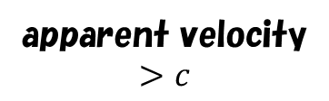

Open Problems in Blazar Emission
1. Index harder than 2 for the electron injection spectrum.
2. Lower maximum energy
Mrk 421：
B=38mG
If $η=1,$even for $β_{sh}=0.1,$
$E_{max}=7 TeV$.
But actual Max. Energy $50 GeV$
The Bohm factor should be $∼{10}^{4}$
Inoue & Takahara 2002
3. Too sharp break in the electron
spectrum.
Kino, Takahara, Kusunose 2002
Compared to the cooling break,
the difference in the indices
seems large.

Slide 3
Electron Index in Fermi BL Lacs
Yan+

Slide 4
Emission Region
Mrk 421 Spectral Fit
Phenomenological model requires many parameters.

Slide 5
Difficulties in Shock Acceleration
Angle of B-field: 30 degree
Subluminal
Magnetic Field
Sironi+ 2015

Slide 6
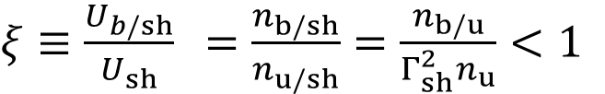

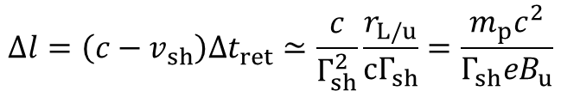
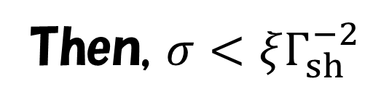
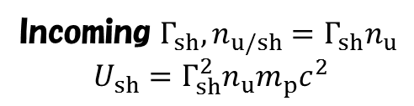

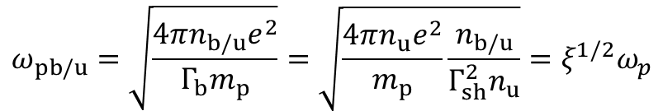
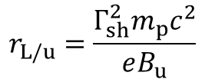

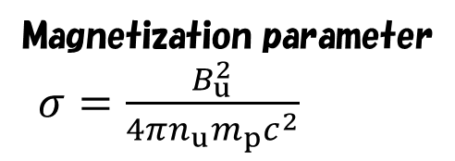
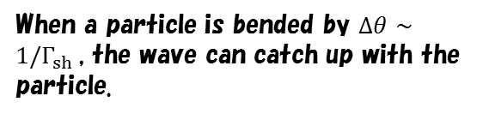
Suppresion of Turbulence in the upstream
Reflected particles
Larmor radius in the upstream
Shock wave rest frame
Reflected$Γ_{sh},n_{b/sh},U_{b/sh}=Γ_{sh}n_{b/sh}m_{p}c^{2}$
$$r_{L/u}=\frac{Γ_{sh}^{2}m_{p}c^{2}}{eB_{u}}$$
Residence time in the upstream
Precursor Scale
When a particle is bended by $Δθ∼1/Γ_{sh}$, the wave can catch up with the particle.
$$Δt_{ret}≃\frac{r_{L/u}}{{cΓ}_{sh}}$$
Incoming $Γ_{sh}, n_{u/sh}=Γ_{sh}n_{u}$
$$U_{sh}=Γ_{sh}^{2}n_{u}m_{p}c^{2}$$
Precursor Scale in the upstream
$$Δl=\left(c−v_{sh}\right)Δt_{ret}≃\frac{c}{Γ_{sh}^{2}}\frac{r_{L/u}}{{cΓ}_{sh}}=\frac{m_{p}c^{2}}{Γ_{sh}eB_{u}}$$
$ξ≡\frac{U_{b/sh}}{U_{sh}}$ $=\frac{n_{b/sh}}{n_{u/sh}}=\frac{n_{b/u}}{Γ_{sh}^{2}n_{u}}<1$
Plasma frequency in the upstream
Magnetization parameter
$σ=\frac{B_{u}^{2}}{4πn_{u}m_{p}c^{2}}$
$$ω_{pb/u}=\sqrt{\frac{4πn_{b/u}e^{2}}{Γ_{b}m_{p}}}=\sqrt{\frac{4πn_{u}e^{2}}{m_{p}}\frac{n_{b/u}}{Γ_{sh}^{2}n_{u}}}={ξ^{1/2}ω}_{p}$$
should be larger than $c/Δl$.
Then, $σ<ξΓ_{sh}^{−2}$

Slide 7
Alternative: Magnetic Recconection
Sironi+ 2015
Equipartition
But in Mrk 421,
Magnetic Energy is 3-10% of Electrons’

Slide 8
Very Hard Spectrum in 3C 279
Broken power-law
Parameters

Slide 9
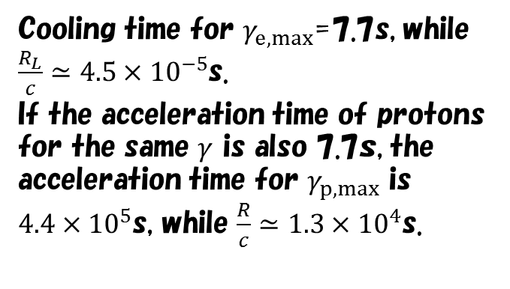
Hadronic?
Mrk 421
Blue：muon synchro
Red：Proton synchro
Cooling time for $γ_{e,max}$=7.7s, while
$\frac{R_{L}}{c}≃4.5×{10}^{−5}$s.
If the acceleration time of protons for the same $γ$ is also 7.7ｓ, the acceleration time for $γ_{p,max}$ is
$4.4×{10}^{5}$s, while $\frac{R}{c}≃1.3×{10}^{4}$s.
Fast cooling: Electron synchrotron becomes soft.
Low energy cutoff is required in Electron spectrum.
Why we have no X-ray flare in 3C 279 case?

Slide 10
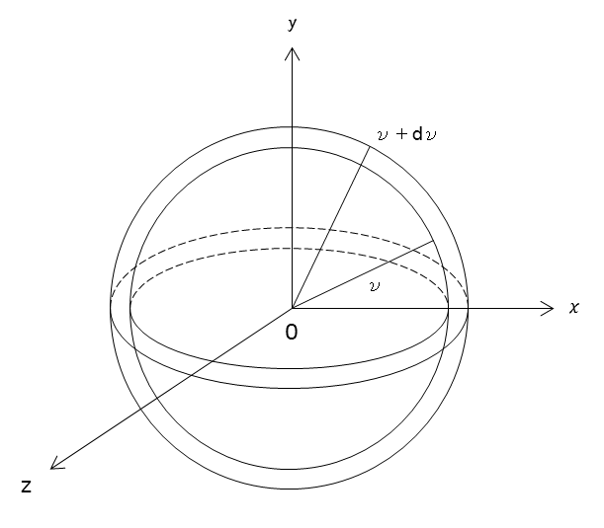






Alternative: stochastic acceleration by turbulece
$$p_{y}$$
$$p+dp$$
$$p$$
$$p_{x}$$
$$p_{z}$$
Energy=const.
Outer: larger volume $→$ Higher acceleration
$$\frac{∂N_{e}(ε,t)}{∂t}=\frac{∂}{∂E}\left[D_{EE}\frac{∂N_{e}\left(E,t\right)}{∂E}\right]−\frac{∂}{∂E}\left[\left(\frac{2D_{EE}}{E}−\left\langle {\dot{E}}_{cool}\right\rangle \right)N_{e}\left(E,t\right)\right]+{\dot{N}}_{e,inj}(E,t)$$
Diffusion
Acceleration
Cooling
Injection

Slide 11



Mrk421+Kolmogorov
$$t_{coll}^{−1}=$$
$$δB^{2}\left(k\right)∝k^{−q}→ν∝k^{2−q}∝E^{q−2}$$
$$D_{EE}∝νE^{2}∝E^{q}$$
Kolmogorov case $q=5/3$
The spectrum becomes too hard.
Asano+ 14

Slide 12
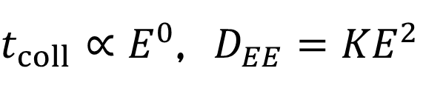
Mrk421+Hard Sphere
$$Γ=15, B_{0}=0.16G, W^{′}=\frac{R_{0}}{Γ}={10}^{16}cm, ΔT_{inj}^{′}=\frac{W^{′}}{c}, K=3.7×{10}^{−6}s^{−1}, \dot{N}=9.8×{10}^{46}s^{−1}$$
See also Kakuwa+ 2015
$t_{coll}∝E^{0}$, $D_{EE}{=KE}^{2}$

Slide 13


3C 279 +Hard Sphere
Model for the Steady State
Asano & Hayashida 2015
Hayashida+2012
SSC Component constrains
the emission radius
$$q=2$$
$${T_{UV}^{′}=10ΓeV, U}_{UV}^{′}=8{\left(\frac{Γ}{15}\right)}^{2}erg cm^{−3}$$

Slide 14
Hard Sphere

Slide 15
Evolution of Energy Densities

Slide 16

Flare Model
The same radius, Lorentz factor, and UV field as those in the steady model.
$$q=2$$

Slide 17
Light curve

Slide 18


Energy Density
Very Weak Magnetic Field.
Negative for
the magnetic reconnection,
and
the jet acceleration by magnetic
dissipation.
Drenkhahn 2002
$$Γ∼$$
$$<15$$
Assumed Values

Slide 19
Excitation of Turbulence
Rayleigh-Taylor
(Toma+ 2017)
Kelvin-Helmholtz
(Beckwith+ 2011)
Kink
(Bromberg & Tchekhovskoy)
2016

Slide 20
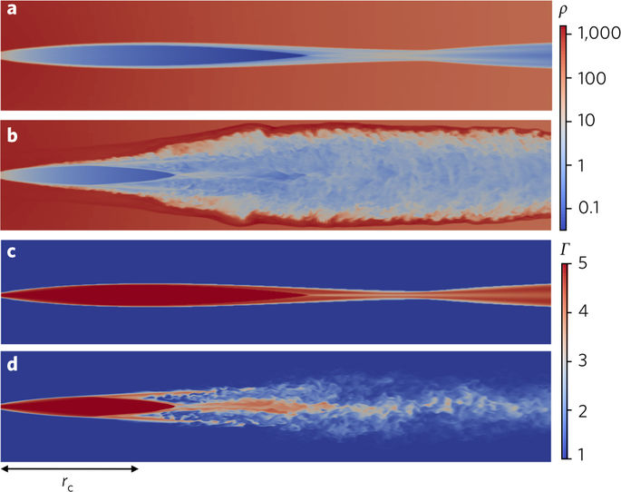
Instability 2
Reconfinement induced one.
Star-jet interaction
Gourgouliatos & Komissarov 2018
Perucho+ 2017

Slide 21
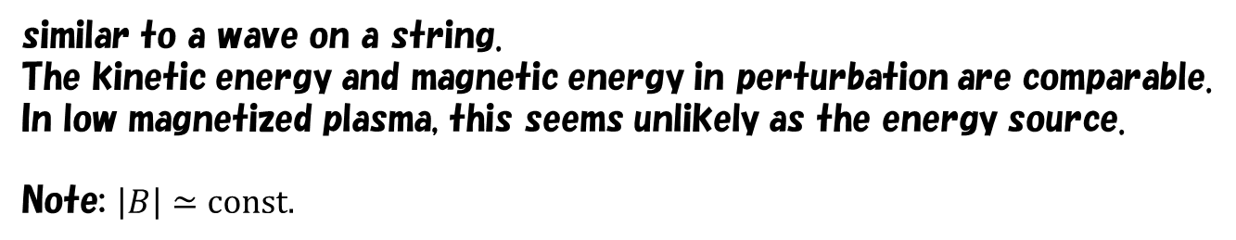
Wave Mode
High-energy particles interact with macroscopic E-M waves.
Hereafter, we consider waves in MHD approximation.
Alfven mode:
similar to a wave on a string.
The kinetic energy and magnetic energy in perturbation are comparable.
In low magnetized plasma, this seems unlikely as the energy source.
Note: $\left|B\right|≃const.$

Slide 22
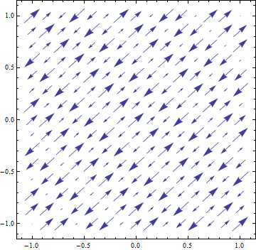
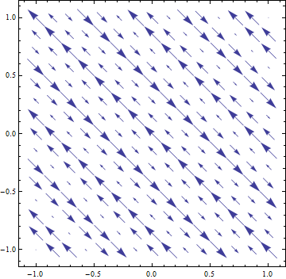
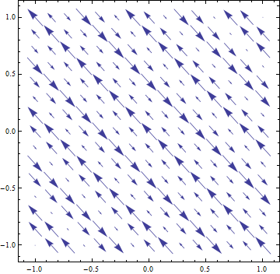
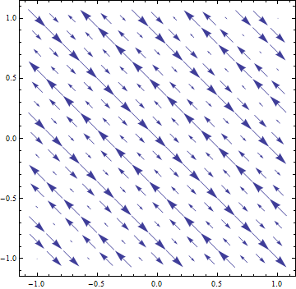
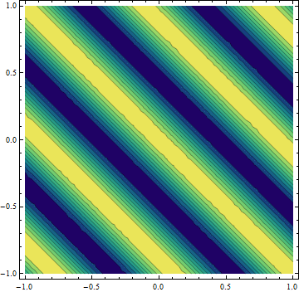
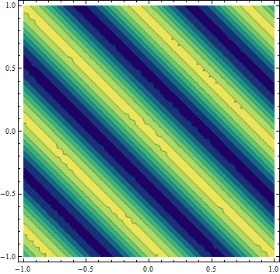

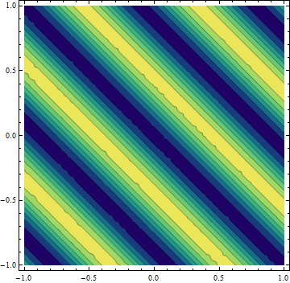

























Fast & Slow Waves
$$α=10, k=10,θ=π/4,$$
Fast
Slow
$$z$$
$$v$$
$$z$$
$$δB$$
$$z$$
$$v$$
$$z$$
$$δB$$
$$x$$
$$x$$
$$x$$
$$x$$
$$z$$
$${δP}_{gas}∝k⋅v$$
$$z$$
$${δP}_{B}∝∼B_{0}δB_{z}$$
$$z$$
$${δP}_{gas}∝k⋅v$$
$$z$$
$${δP}_{B}∝∼B_{0}δB_{z}$$
$$x$$
$$x$$
$$x$$
x5 speed
$$x$$
$cE=v×B$ accelerate particles so that only oblique waves do work.

Slide 23


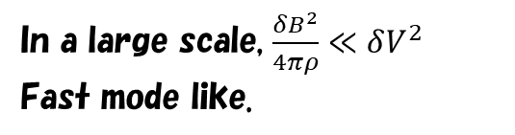



Fast mode is dominant?
Simulation （Inoue+ 2011）
As for the magnetic field fluctuation,
$$b=\frac{k}{ω}×\left(B_{0}×V\right)=B_{0}\frac{V}{V_{ph}}\left(cosθ_{v}e_{B}−cosθe_{v}\right)$$
$$δv^{2}(k)$$
In the gas pressure dominant case,
$\frac{δB^{2}}{4πρ}∼V^{2}$ for slow mode.
$$δB^{2}(k)$$
$\frac{δB^{2}}{4πρ}≪V^{2}$ for fast mode.
In a large scale, $\frac{δB^{2}}{4πρ}≪δV^{2}$
Fast mode like.

Slide 24
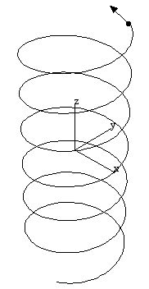

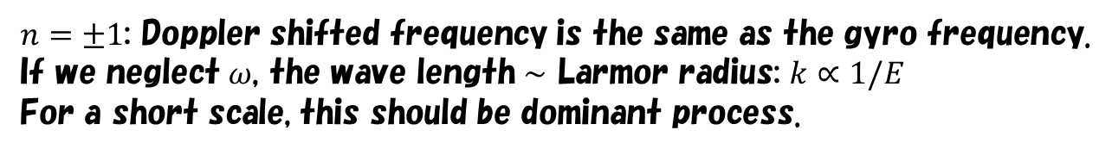


Gyro Resonance
$$B$$
$$k^{−1}$$
$$δB$$
$n=±1$: Doppler shifted frequency is the same as the gyro frequency.
If we neglect $ω$, the wave length $∼$ Larmor radius: $k∝1/E$
For a short scale, this should be dominant process.
Electric Field rotates with the particle.
Accelerate particles efficiently.
Possible for Alfven, fast, and slow.
Considering fast wave, such a short wave is obtainable?

Slide 25

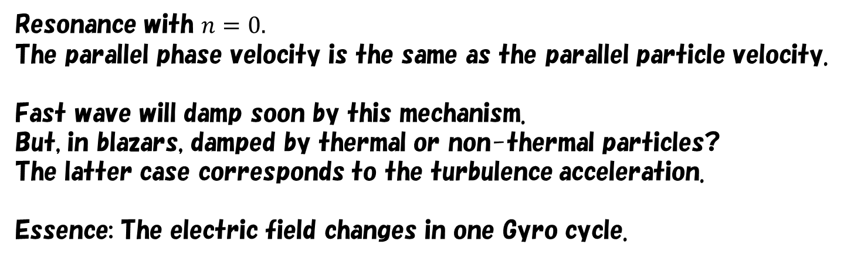
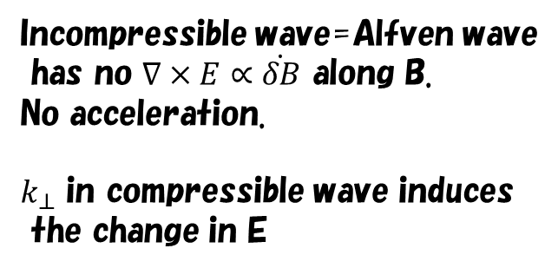
Transit Time Damping
Resonance with $n=0.$
The parallel phase velocity is the same as the parallel particle velocity.
Fast wave will damp soon by this mechanism.
But, in blazars, damped by thermal or non-thermal particles?
The latter case corresponds to the turbulence acceleration.
Essence: The electric field changes in one Gyro cycle.
Incompressible wave=Alfven wave
has no $∇×E∝\dot{δB}$ along B.
No acceleration.
$k_{⊥}$ in compressible wave induces
the change in E
$$E$$
Accelerate
Decelerate

Slide 26








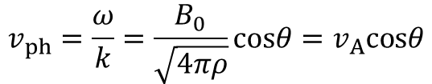
Lorentz Transformation
$$β$$
$$θ$$
$$ε_{f}=γε^{′}\left(1+β\left(μ^{′}+Δμ^{′}\right)\right)$$
$=γ^{2}ε(1−βμ)$ $\left(1+β\left(μ^{′}+Δμ^{′}\right)\right)$
Non-rela
particle
$$cosθ≡μ$$
$$\overline{ε_{f}}≃ε(1+βΔμ)$$
$$ε′=γε(1−βμ)$$
$$\overline{\frac{Δε}{ε}}=βΔμ$$
$$μ^{′}=\frac{−β+μ}{1−μβ}→Δμ^{′}≃Δμ$$
$$D_{εε}≡\frac{\left\langle ΔεΔε\right\rangle }{2Δt}=β^{2}ε^{2}\frac{\left\langle ΔμΔμ\right\rangle }{2Δt}$$
Pitch angle diffusion induces the energy diffusion.
It does not depend on the magnetic field.
Correct?

Slide 27


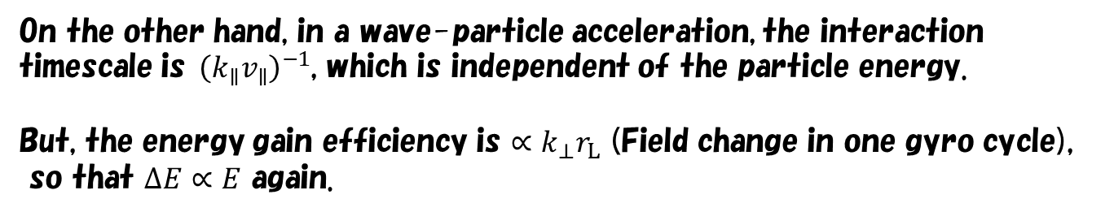
Energy Gain
Magnetic Field does not change the particle energy.
In Shock Acceleration,
$$ΔE∝E$$
$$E$$
Motional Electric Field
High energy particle
Low energy particle
On the other hand, in a wave-particle acceleration, the interaction timescale is${\left(k_{∥}v_{∥}\right)}^{−1}$, which is independent of the particle energy.
But, the energy gain efficiency is $∝k_{⊥}r_{L}$ (Field change in one gyro cycle),
so that $ΔE∝E$ again.

Slide 28


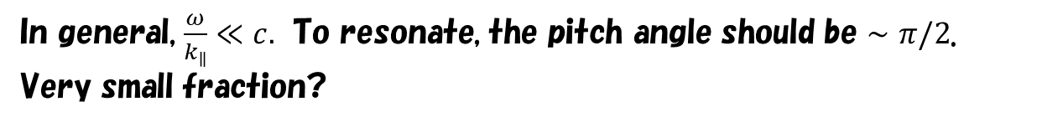



Fraction of particles in resonant
In general, $\frac{ω}{k_{∥}}≪c.$ To resonate, the pitch angle should be $∼π/2$.
Very small fraction?
Resonance broadening by Mirror Force
$$2p_{∥}\dot{p_{∥}}=−\frac{p_{⊥}^{2}}{B}\dot{B}$$
$$θ_{min}$$
$$ξ≡\frac{B_{0}^{2}}{δB^{2}}>1$$
$$B_{0}$$
$$\cos^{2}{θ_{min}}=\frac{1}{1+ξ^{1/2}}$$
Let’s verify with a simulation.

Slide 29

Test Particle Simulation
Lynn+ 2014
Particle injection in MHD simulations,
where the slow-mode is dominant (?).
$$D_{EE}=KE^{2}$$
Multiple Wave modes in MHD simulations.
Physically ambiguous.

Slide 30
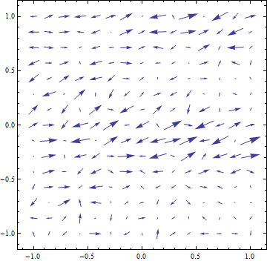
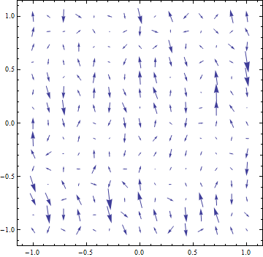
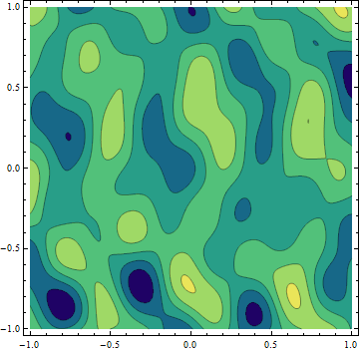
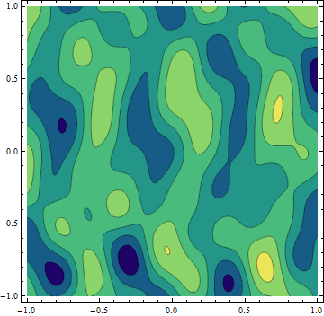











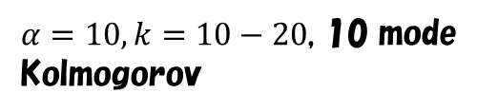

Test particle simulation in pure linear Waves
Fast
$$z$$
$$v$$
$$z$$
$$δB$$
High-beta plasma
Projection
$$x$$
$$x$$
$$z$$
$${δP}_{gas}∝k⋅v$$
$$z$$
$${δP}_{B}∝∼B_{0}δB_{z}$$
Teraki & Asano in prep.
$α=10, k=10−20$, 10 mode
Kolmogorov
$$x$$
$$x$$

Slide 31




Wave Description in Simulation with linear waves.
Fast and Slow waves
Fluid Velocity
Dispersion relation
$$≫1$$
$$\hat{z}$$
Alfven wave
$$\hat{k}$$
$$\hat{θ}$$

Slide 32
Field Description
Induction eq.

Slide 33
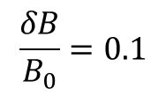


Pitch angle diffusion
Due to Mirror Force
$$\frac{δB}{B_{0}}=0.1$$
$$μ=1/\sqrt{1+ξ^{1/2}}$$
$$μ=V_{ph}/c$$

Slide 34
Enrgy diffusion
Energy gain by the TTD resonance

Slide 35
Energy Diffusion
Significant fraction of particles diffuses in the energy space.

Slide 36


Diffusion coefficient
Diffusion by mirror force
$$P_{B}∝k^{−ν}$$
$$D_{μμ}=\frac{{\left(Δμ\right)}^{2}}{δt}∼$$

Slide 37

Hard Sphere-like diffusion
$v_{F}=0.1c, δV={10}^{−3}$(weak turb.)

Slide 38
Dependence on Parameters

Slide 39
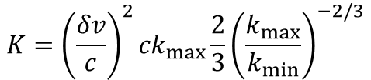

Consistent with Blazar model?
Mrk 421
$$B_{0}=0.16G→r_{L}=2.1×{10}^{10}cm@TeV$$
$$D_{EE}=KE^{2}, K=3.7×{10}^{−6}s^{−1}$$
For $ν=5/3$
$$K={\left(\frac{δv}{c}\right)}^{2}{ck}_{max}\frac{2}{3}{\left(\frac{k_{max}}{k_{min}}\right)}^{−2/3}$$

Slide 40
Summary
Hard-sphere acceleration is favorable to reproduce blazar spectra.
Particles interacting compressible waves are accelerated via TTD resonance.
A significant fraction of particles are accelerated by the resonance broadening due to mildly relativistic phase speed and pitch angle diffusion by mirror force.
Hard-sphere-like acceleration is realized via the above mechanism.

