Slide 1
Distinguishing black hole-neutron star binaries and binary neutron star from electromagnetic transients
Koutarou Kyutoku
High Energy Accelerator Research Organization (KEK), Institute of Particle and Nuclear Studies

Slide 2
Plan of the session
Introduction (gravitational waves)
Mass ejection and gamma-ray burst
Compact binary merger remnant (or afterglow)
Kilonova/macronova
Summary

Slide 3
1. Introduction

Slide 4
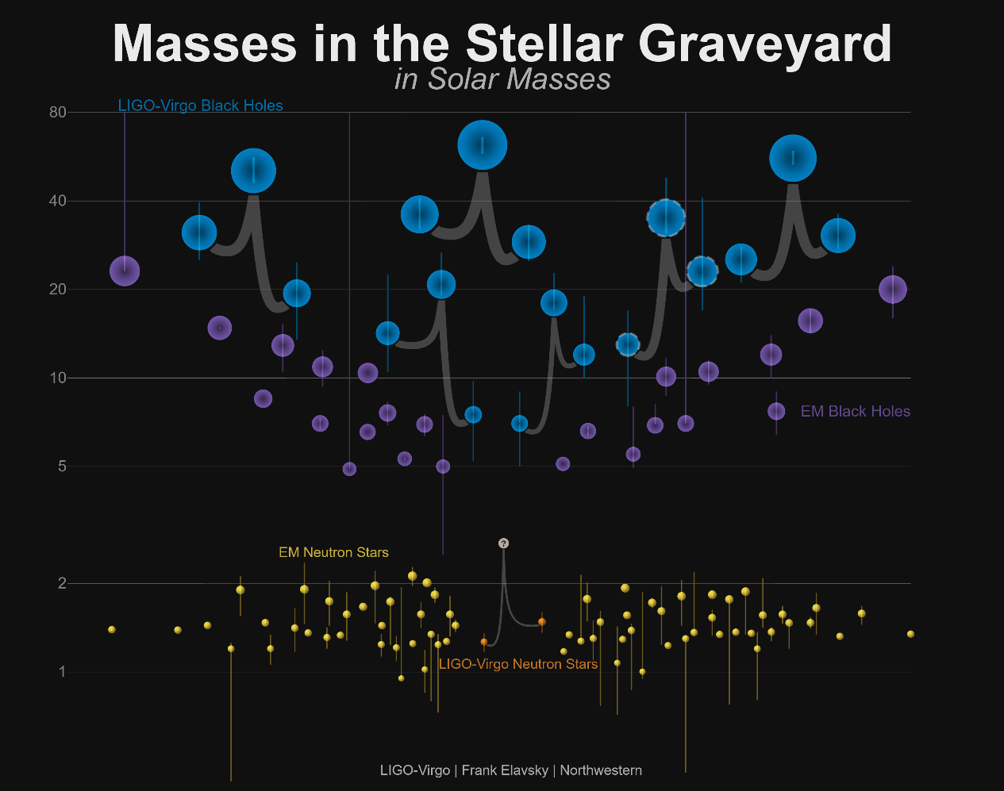
Black hole-neutron star merger
The last frontier of compact binary coalescences
https://www.ligo.org/detections/GW170608/images-GW170608/BH_NSmassplot_error_bars.png

Slide 5

GW170817
Can we declare that
this was not caused by
black hole-neutron star
“without believing that
low-mass objects must
not be black holes?”
We have $\tilde{Λ}≤800$ from LVC
LIGO-Virgo (2017)

Slide 6

Tidal deformability?
NS-NS each with $Λ$ <-> BH-NS latter with $2Λ$
($Λ=0$ for black holes)
NS-NS and $Λ≤800$?
- approx. <13-13.5km
BH-NS and $Λ≤1600$?
- approx. <14.5-15km
… cannot even reject
binary black holes
Kawaguchi+KK+
(2018)
GW170817

Slide 7

Caution on credible intervals
$Λ≥0$ for normal objects: (say) [5%:95%] intervals always reject $Λ=0$ in an uninteresting manner
The same situation also occurs for the mass ratio, and it further distorts inferences of individual $Λ$
De+ (2018)

Slide 8
Stronger indication of a neutron star
LIGO, Virgo… (2017)

Slide 9
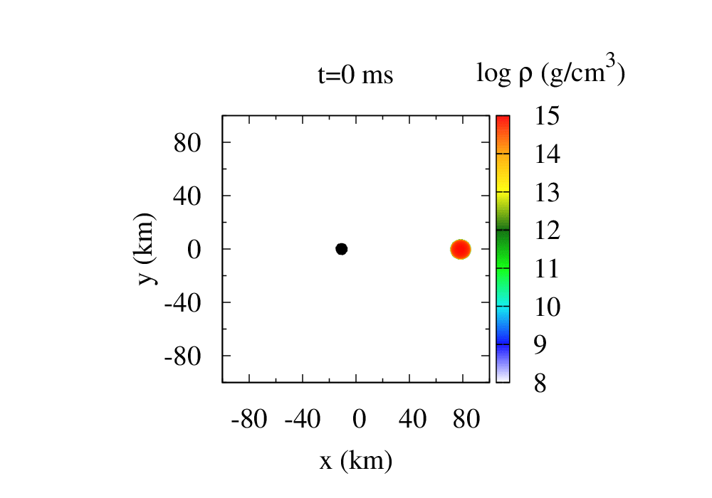
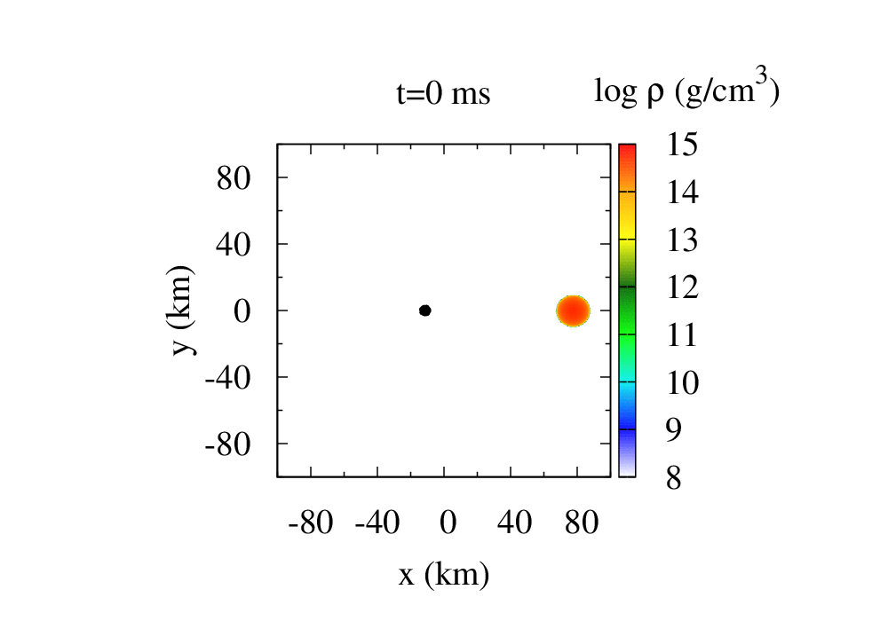
Yet black hole-neutron star binaries
NS radius 11.1km NS radius 13.6km
BH spin 0.5 BH spin 0.75
No disruption
Tidal disruption
From Kyutoku+ (2015)

Slide 10
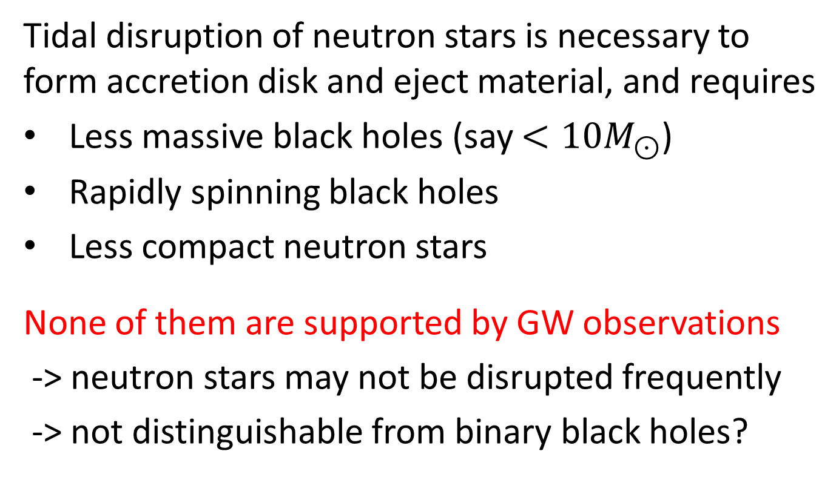
Headwind for tidal disruption
Tidal disruption of neutron stars is necessary to form accretion disk and eject material, and requires
Less massive black holes (say $<10M_{⊙}$)
Rapidly spinning black holes
Less compact neutron stars
None of them are supported by GW observations
-> neutron stars may not be disrupted frequently
-> not distinguishable from binary black holes?

Slide 11
Purpose of this session
Consider possible differences of electromagnetic counterparts between black hole-neutron star binaries and binary neutron stars
What I do not discuss here:
- precursor type emission
- late-time energy injection model
(magnetar models indicate binary neutron stars?)

Slide 12
2. Mass ejection and gamma-ray burst

Slide 13
Channel of mass ejection
Dynamical mass ejection [Kyutoku+ 2013,2015,2018]
gravity+pure hydrodynamics may be sufficient
- except for determining chemical composition
sometimes obviously dominates disk activity
Postmerger activity: wind from the accretion disk
- neutrino-driven wind: found to be subdomoinant
- viscously-driven wind (likely from MRI)
- nuclear heating, magnetically-driven, etc…

Slide 14
Multiple components seem essential
AT 2017gfo is likely to be “fast blue” + “slow red”
Tanaka+ (2017)

Slide 15
Multiple components seem essential
Dynamical ejection + postmerger activity?
- the red may be heavy r-process elements
- the blue may be light ones … under debate
Kasen+ (2017)
Shibata+KK+ (2017)

Slide 16
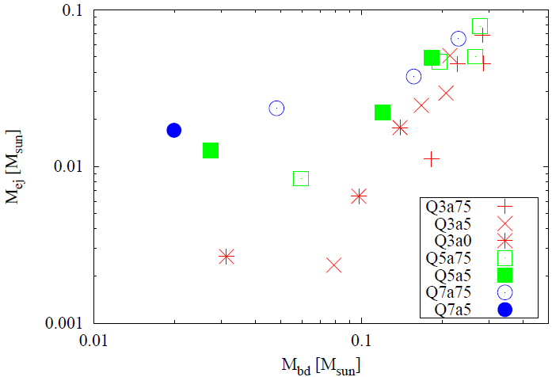
These components in BH-NS
Dynamical ejecta can be as massive as the disk
-> disk activity cannot dominate dynamical ejection
Dynamical ejecta
Kyutoku+ (2015)
Disk(+fallback) material

Slide 17
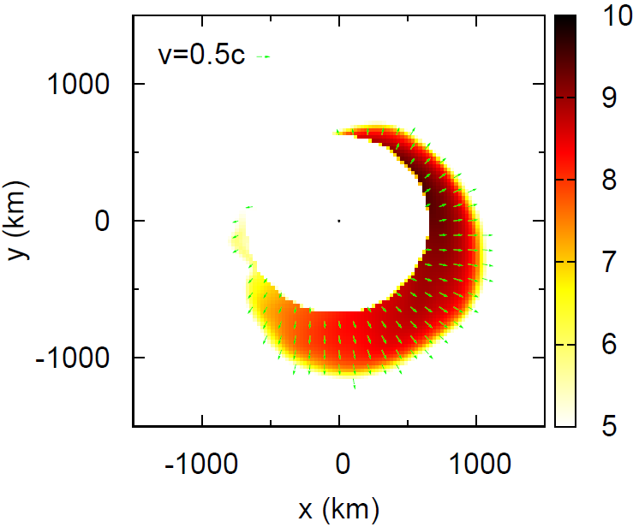

BH-NS dynamical mass ejection
The ejecta mass and kinetic energy can be large
Anisotropic ejection due to tidal torque (<-> NS-NS)
ejecta mass
$(0\sim )0.08M_{⊙}$
kinetic energy
$\left(0\sim \right)5×{10}^{51}\text{erg}$
“bulk” velocity
$v_{\text{ej}}\sim 0.2c$
Kyutoku+ (2013)
$$v_{\text{ej}}\sim {P_{\text{ej}}}/{M_{\text{ej}}}$$
Only unbound material

Slide 18
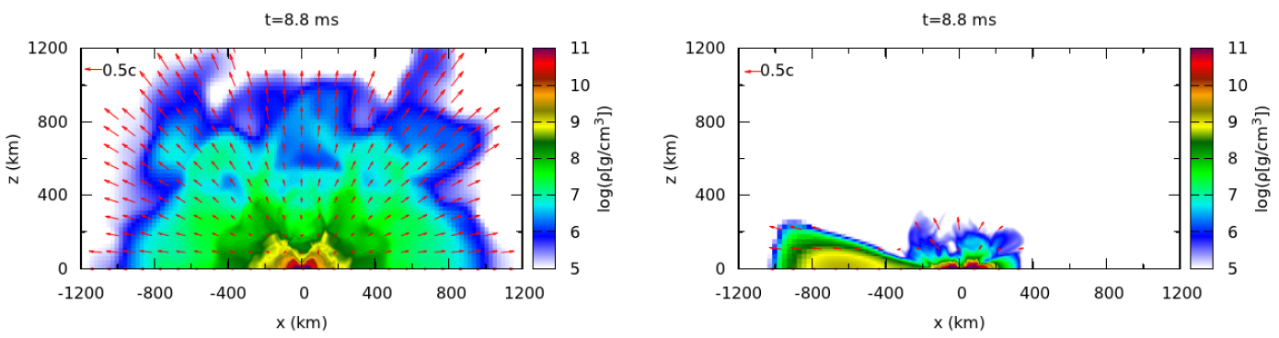
Morphology difference
Density profile on the meridional plane
NS-NS: massive NS BH-NS: BH-disk
Hotokezaka, KK+ (2013)
Devoid of material
in the polar region

Slide 19
But the wind?
Density profile on the meridional plane
NS-NS: massive NS BH-NS: BH-disk
Hotokezaka, KK+ (2013)

Slide 20
And the jet?
Density profile on the meridional plane
NS-NS: massive NS BH-NS: BH-disk
Hotokezaka, KK+ (2013)

Slide 21
Role of the ejecta surrounding a jet
Jet confinement? Cocoon production?
Crucial for short GRBs
and also GRB 170817A?
Nagakura+ (2014)
Gottlieb+ (2018)

Slide 22
Time order of the jet and wind launch
Both the jet and wind are powered by accretion
The accretion time scale is at most 100-300ms
- the viscosity only (likely) shortens this time scale
The jet cannot
be delayed by
>~100ms
than the wind?
Kyutoku+ (2018)

Slide 23
Note on the fallback material
Continue to late times, but not very substantial
- this rate may not be equal to the accretion rate
Brege+ (2018)
Kyutoku+ (2015)

Slide 24
Case 1: jet launch~wind launch
The wind is not likely to catch up and confine the jet
(extremely) rough idea of observational feature:
quasi-isotropic, low-luminosity, leptonic fireball?
The initial temperature may be ~0.1-1MeV
It becomes transparent at
around 1,000-10,000km
Photospheric emission
may be expected
Kyutoku+ (2018)

Slide 25
Case 1: jet launch~wind launch
The wind is not likely to catch up and confine the jet
(extremely) rough idea of observational feature:
quasi-isotropic, low-luminosity, leptonic fireball?
The initial temperature may be ~0.1-1MeV
It becomes transparent at
around 1,000-10,000km
Photospheric emission
may be expected
Kyutoku+ (2018)

Slide 26
Viscous thickening
Viscosity due to MRI can inflate the disk to a torus and this could help the jet collimation
- preferable geometry for
launching a pair-annihilation jet
- requirement for producing
a coherent poloidal field?
- also advantageous to launch
the wind from the outer part

Slide 27
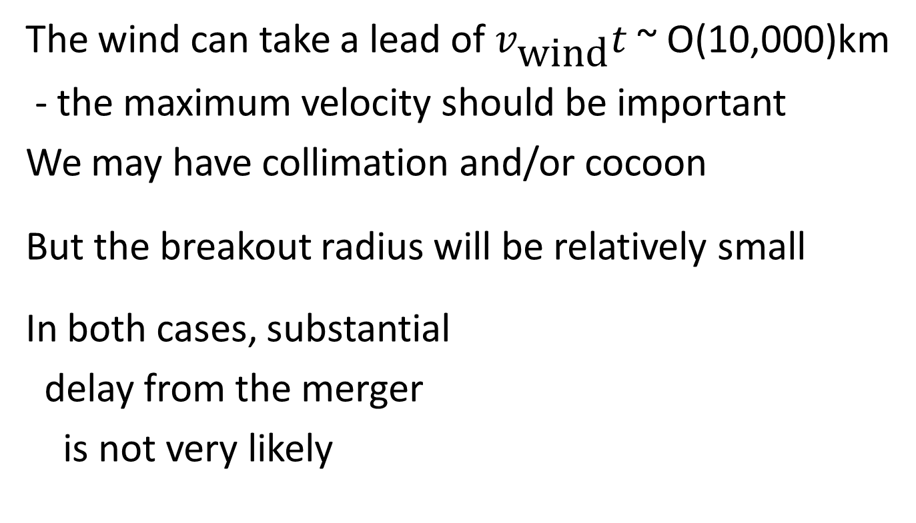
Case 2: wind launch -> jet launch
The wind can take a lead of $v_{\text{wind}}t$ ~ O(10,000)km
- the maximum velocity should be important
We may have collimation and/or cocoon
But the breakout radius will be relatively small
In both cases, substantial
delay from the merger
is not very likely
Kyutoku+ (2018)

Slide 28
Case 2: wind launch -> jet launch
The wind can take a lead of $v_{\text{wind}}t$ ~ O(10,000)km
- the maximum velocity should be important
We may have collimation and/or cocoon
But the breakout radius will be relatively small
In both cases, substantial
delay from the merger
is not very likely
Kyutoku+ (2018)

Slide 29

Viscously-driven wind
~20% of disk material can be ejected
Low velocity of $\sim 0.1c$ is expected on average
what is the maximum? limitation of $α$ viscosity?
Fernandez+ (2015)

Slide 30
Magnetic field as viscosity
Confirming the basic picture in a realistic setting
(but no neutrino absorption, with low resolution)
Siegel-Metzger (2017)

Slide 31
Thermally-driven wind in MHD
Faster winds could come from inner regions with higher resolutions (but no neutrino physics here)
Kiuchi+KK+ (2015)
Kiuchi+KK+ (2015)
10ms
20ms
30ms
40ms
50ms
60ms
Dynamical ejecta

Slide 32
3. Compact binary merger remnant (or afterglow)

Slide 33
“Compact binary merger remnant”
Blast-wave interaction between the ejecta and the interstellar medium (that may not be very dense)
Magnetic-field amplification + electron acceleration
-> synchrotron radio emission (SNR, GRB afterglow)

Slide 34

Velocity distribution
The maximum velocity is likely to be low, $\sim 0.4c$, and the energy distribution may not be very steep
Brege+ (2018)
Kyutoku+ (2015)

Slide 35

Compared to binary neutron stars
Fast components up to $v∼0.7c$ may be ejected particularly for equal-mass binary neutron stars
(+ ultra relativistic shock-breakout components?)
Hotokezaka+ (2018)

Slide 36
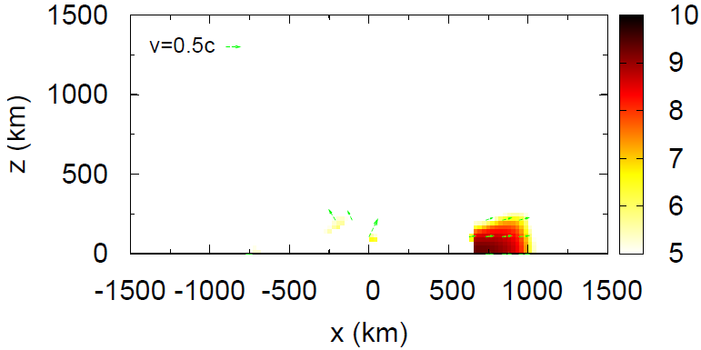




Crescent-like ejecta anisotropy
Only unbound material
Kyutoku+ (2013)
$φ_{\text{ej}}≈180°$
$θ_{\text{ej}}≈10°−20°$
$$φ_{\text{ej}}$$
Brege+ (2018)
$$\log{ρ}\left(\text{g}/\text{c}{\text{m}}^{\text{3}}\right)$$
Kyutoku+ (2013)
$$θ_{\text{ej}}$$

Slide 37
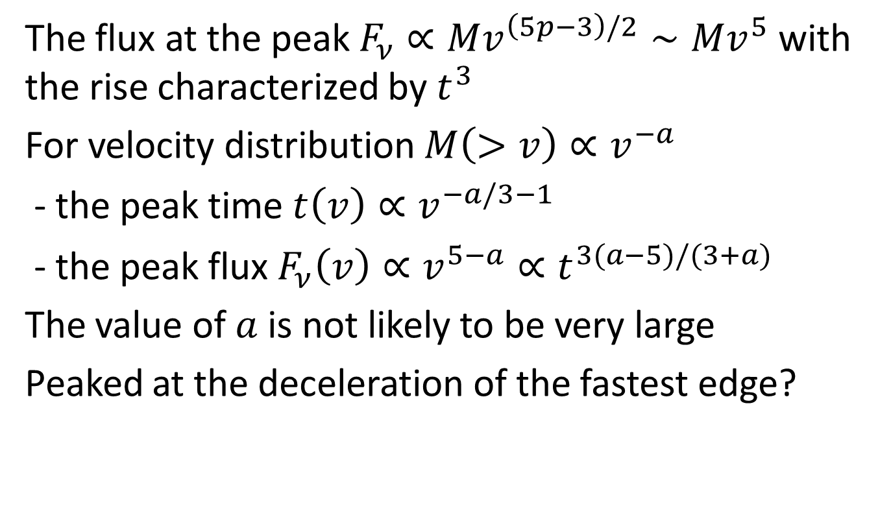
Time evolution
The flux at the peak $F_{ν}∝Mv^{\left(5p−3\right)/2}∼Mv^{5}$ with the rise characterized by $t^{3}$
For velocity distribution $M\left(>v\right)∝v^{−a}$
- the peak time $t\left(v\right)∝v^{−a/3−1}$
- the peak flux $F_{ν}\left(v\right)∝v^{5−a}∝t^{3(a−5)/(3+a)}$
The value of $a$ is not likely to be very large
Peaked at the deceleration of the fastest edge?

Slide 38

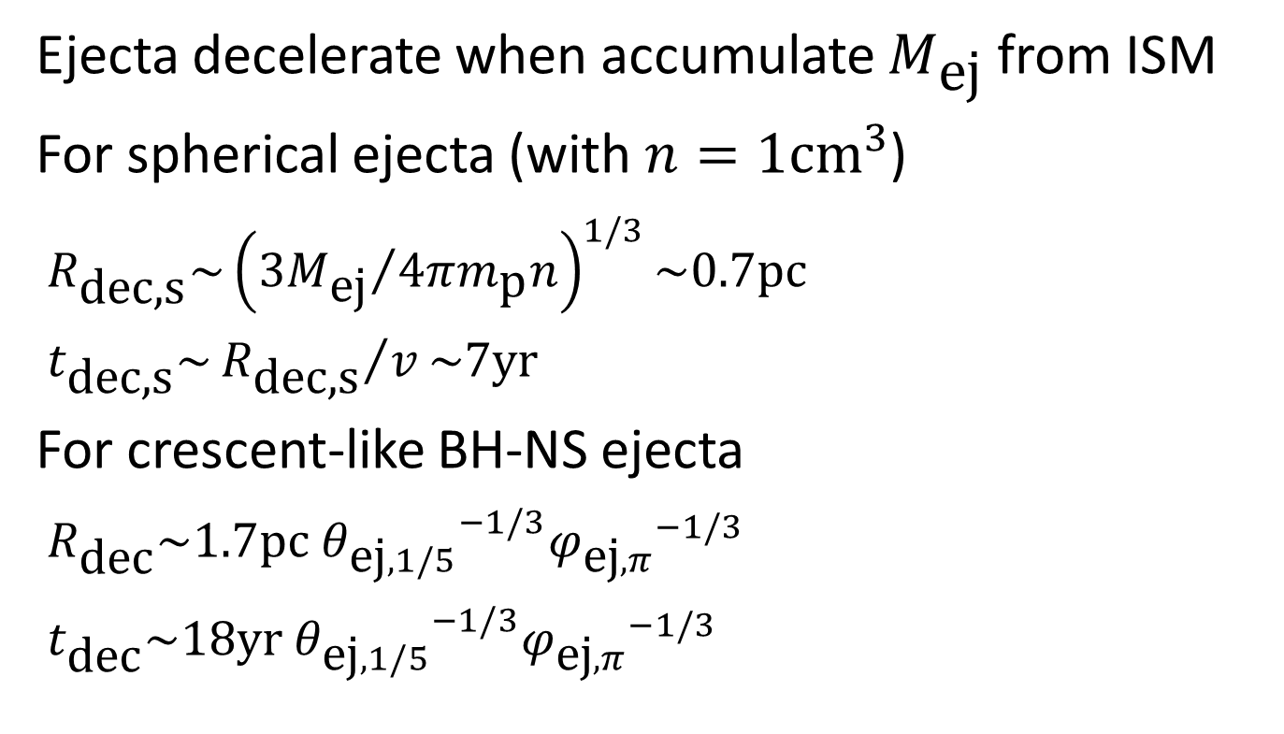

BH-NS: longer Sedov length/time
Ejecta decelerate when accumulate $M_{\text{ej}}$ from ISM
For spherical ejecta (with $n=1{\text{cm}}^{3}$)
$R_{\text{dec}\text{,}\text{s}}\sim {\left({3M_{\text{ej}}}/{4πm_{\text{p}}n}\right)}^{1/3}\sim 0.7\text{pc}$
$t_{\text{dec}\text{,}\text{s}}\sim {R_{\text{dec}\text{,}\text{s}}}/v\sim 7\text{yr}$
For crescent-like BH-NS ejecta
$R_{\text{dec}}\sim 1.7\text{pc} {θ_{\text{ej},1/5}}^{−1/3}{φ_{\text{ej},π}}^{−1/3}$
$t_{\text{dec}}\sim 18\text{yr} {θ_{\text{ej},1/5}}^{−1/3}{φ_{\text{ej},π}}^{−1/3}$
$$R_{\text{dec}\text{,}\text{s}}$$
$$R_{\text{dec}}$$

Slide 39
Lateral expansion
Difficult to model beyond the deceleration radius
each “shell” expands ballistically
before significant deceleration
i.e., up to its own Sedov length
beyond the Sedov length,
lateral expansion sets in…
how to model evolution?
BH
Dynamical ejecta as shells with different velocity

Slide 40
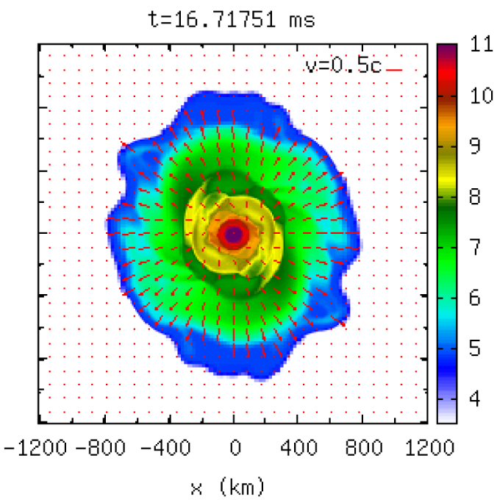
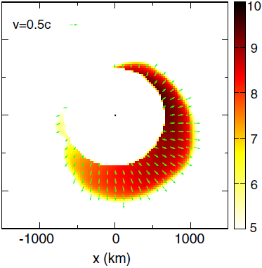

Proper motion of radio images
Typical proper motion in terms of the angle
$${v_{\text{ej}}t_{\text{dec}}}/D\sim {1\text{pc}}/{100\text{Mpc}}\sim 1\text{mas}$$
resolvable by radio instruments?
both images
expand in time
but only BH-NS
moves in time
Kyutoku+ (2013)
Hotokezaka+KK+ (2013)

Slide 41
Within the reach
This method has already been applied to long GRBs and also could be useful for GRB 170817A
Taylor+ (2004)
Hallinan+ (2017)

Slide 42
4. Kilonova/macronova

Slide 43
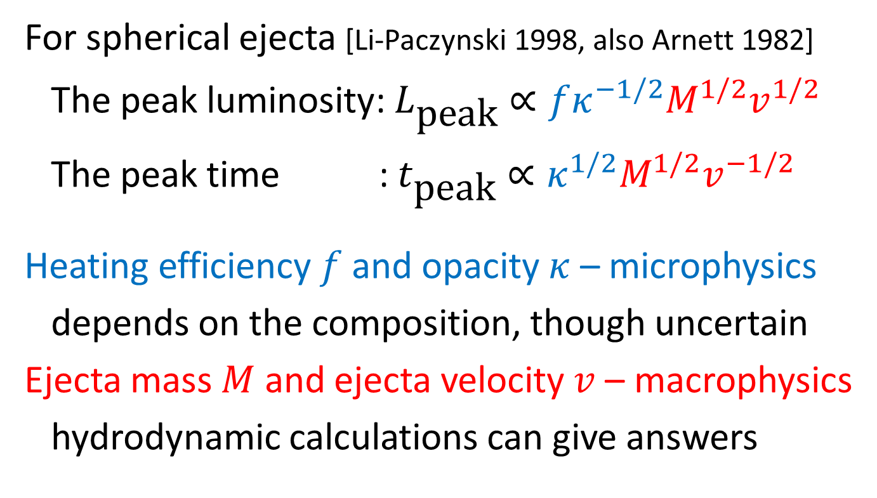
Macronova/kilonova characteristics
For spherical ejecta [Li-Paczynski 1998, also Arnett 1982]
The peak luminosity: $L_{\text{peak}}∝fκ^{−1/2}M^{1/2}v^{1/2}$
The peak time : $t_{\text{peak}}∝κ^{1/2}M^{1/2}v^{−1/2}$
Heating efficiency $f$ and opacity $κ$ – microphysics
depends on the composition, though uncertain
Ejecta mass $M$ and ejecta velocity $v$ – macrophysics
hydrodynamic calculations can give answers

Slide 44
Opacity
Lanthanides (in particular, open f-shell elements) affect the opacity by orders of magnitude
Nucleosynthetic yields are critically important
Tanaka+ (2017)
Tanaka+ (2018)
lanthanide
actinide

Slide 45
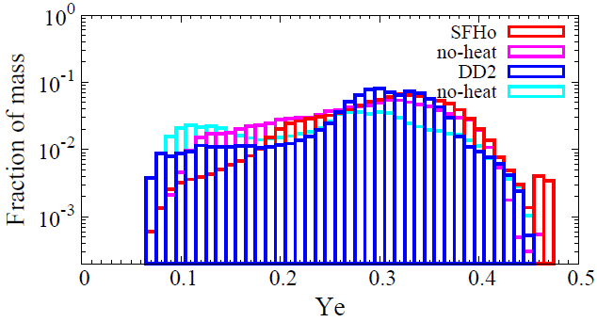
NS-NS dynamical ejecta
The electron fraction, #electron/#baryon, can be increased by shock heating (+ neutrino irradiation)
Still, a copious amount of lanthanides are formed
Sekiguchi+KK+ (2015)
Wanajo+KK+ (2014)

Slide 46


BH-NS dynamical ejecta
Strongly peaked below $Y_{e}=0.1$ for all the models
i.e., original composition of neutron stars is kept
No shock heating, negligible neutrino irradiation
Foucart+ (2017)
No significant high $Y_{e}$
Kyutoku+ (2018)

Slide 47
Expected BH-NS nucleosynthetic yield
Significant fission cycling -> 2nd/3rd peak formation
Even larger amount of lanthanides (say, ~10%)
Roberts+ (2017)

Slide 48
Postmerger ejecta in NS-NS
The electron fraction
tends to become high
except for those near
the equatorial plane
Lanthanide production
may be avoided over
the wide angle
-> blue fast kilonova
Fujibayashi+ (2017)

Slide 49
Postmerger ejecta in BH-NS
They could also suppress
lanthanide production
Detailed study with realistic
initial conditions are required
Just+ (2015)
Wu+ (2016)

Slide 50
Heating rate: consideration
R-process elements decay back to beta-stability
- beta decay: releases about ~90% of energy
goes to electron -> totally thermalize the ejecta
neutrino -> totally escape
gamma-ray -> escape at the late epoch
- (spontaneous) fission: releases about ~10%
nearly all the energy thermalize the material
This ratio is determined by the precise microphysics

Slide 51

Thermalization efficiency
Once the ejecta becomes transparent to $γ$-rays, energy deposition becomes difficult unless fission dominates heating … does it occur?
Value adopted
in earlier studies
BH-NS?
NS-NS?
Hotokezaka+ (2016)

Slide 52

Dependence on nuclear models
Some models predict no fission after ~1day irrespective of $Y_{e}$, rather alpha decay
Hotokezaka+ (2016)
Barnes+ (2016)

Slide 53
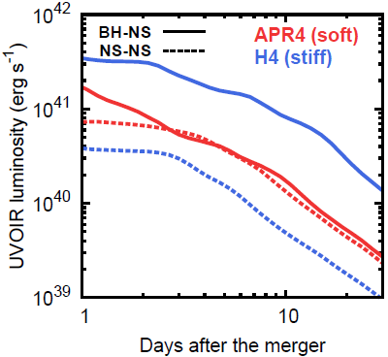

Effect of anisotropic dynamical ejecta
Geometry determines the photon-diffusion direction
sphericial ejecta BH-NS crescent-like ejecta
aspect ratio: ${v_{∥}}/{v_{⊥}\sim 1/{θ_{\text{ej}}\sim 5}}$
NS-NS: $t_{\text{peak}\text{,}\text{s}}\sim {\left({3κ{\text{M}}_{\text{ej}}}/{4πcv}\right)}^{1/2}\sim 8\text{day}$
BH-NS: $t_{\text{peak}}\sim {\left({κM_{\text{ej}}θ_{\text{ej}}}/{cφ_{\text{ej}}v}\right)}^{1/2}\sim \text{4}\text{day}$
diffusion
diffusion
Slow, cool, dim
Rapid, hot, bright
Tanaka+KK+ (2014)

Slide 54
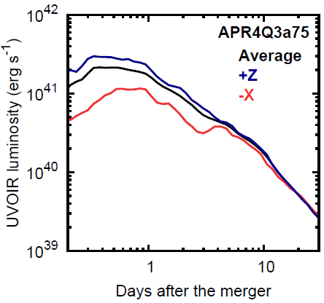

Viewing-angle dependence
High luminosity $L_{\text{peak}}\sim {fM_{\text{ej}}}/{t_{\text{peak}}}\sim {10}^{41}{\text{erg}}/{\text{s}}$
low luminosity
$\sim θ_{\text{ej}}L_{\text{peak}}$
polarization?
Kyutoku+ (2013)
deformed photosphere
radiation transfer
(3D Monte Carlo)
Tanaka+KK+ (2014)

Slide 55
AT 2017gfo unpolarized
Consistent with polarization due to galactic dusts
This is expected for
quasispherical ejecta of
binary neutron stars
In addition,
Thomson scattering <<
bound-bound transition
Covino+ (2017)

Slide 56
5. Summary

Slide 57
Summary
Depending on time ordering of jet and wind launches, we may see weak and spherical fireball from black hole-neutron star binaries.
Synchrotron radio emission from the remnant will take long to reach the peak brightness, while the lateral expansion must be modeled.
The kilonova/macronova may be bright particularly at late times, and the polarization may be determined by multi-component nature.

Slide 59
Appendix

Slide 60
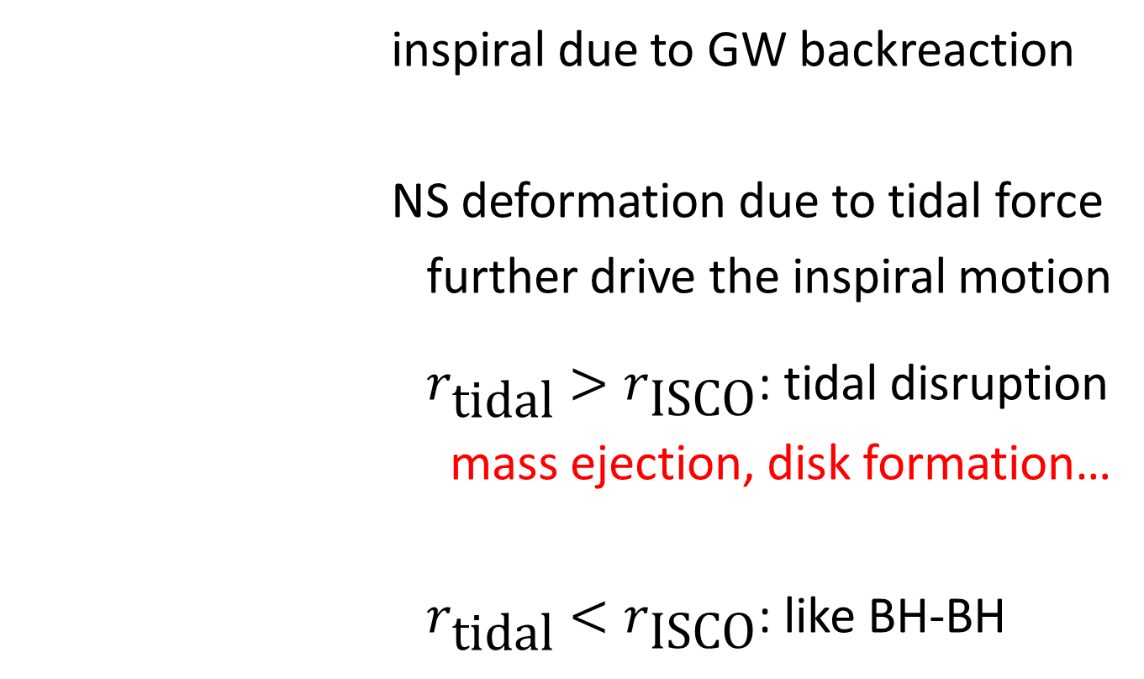
Merger dynamics
inspiral due to GW backreaction
NS deformation due to tidal force
further drive the inspiral motion
$r_{\text{tidal}}>r_{\text{ISCO}}$: tidal disruption
mass ejection, disk formation…
$r_{\text{tidal}}<r_{\text{ISCO}}$: like BH-BH

Slide 61


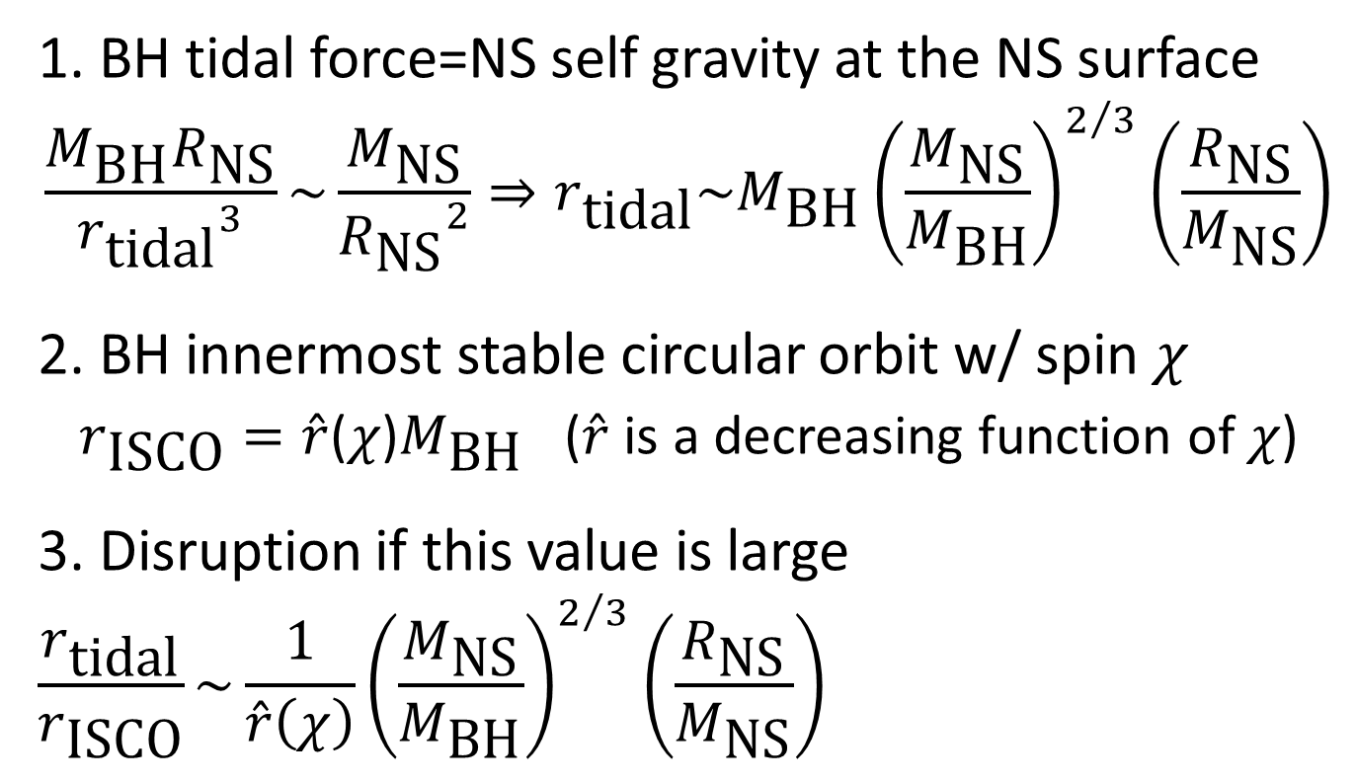



Mass shedding condition
1. BH tidal force=NS self gravity at the NS surface
$$\frac{M_{\text{BH}}R_{\text{NS}}}{{r_{\text{tidal}}}^{3}}\sim \frac{M_{\text{NS}}}{{R_{\text{NS}}}^{2}}⇒r_{\text{tidal}}\sim M_{\text{BH}}{\left(\frac{M_{\text{NS}}}{M_{\text{BH}}}\right)}^{2/3}\left(\frac{R_{\text{NS}}}{M_{\text{NS}}}\right)$$
2. BH innermost stable circular orbit w/ spin $χ$
$r_{\text{ISCO}}=\hat{r}$($χ$)$M_{\text{BH}}$ ($\hat{r}$ is a decreasing function of $χ$)
3. Disruption if this value is large
$$\frac{r_{\text{tidal}}}{r_{\text{ISCO}}}\sim \frac{1}{\hat{r}\left(χ\right)}{\left(\frac{M_{\text{NS}}}{M_{\text{BH}}}\right)}^{2/3}\left(\frac{R_{\text{NS}}}{M_{\text{NS}}}\right)$$
$$r_{\text{ISCO}}$$
$$R_{\text{NS}}$$
$$r_{\text{tidal}}$$
$$M_{\text{BH}}, χ$$
$$M_{\text{NS}}$$

Slide 62
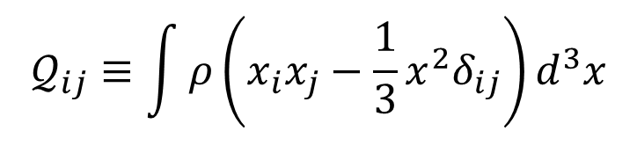
Quadrupolar tidal deformability
Leading-order finite-size effect on orbital evolution (strongly correlated with the neutron-star radius)
$$Λ=Gλ{\left(\frac{c^{2}}{GM}\right)}^{5}=\frac{2}{3}k{\left(\frac{c^{2}R}{GM}\right)}^{5}∝R^{5}$$
$k\sim 0.1$: (second/electric) tidal Love number
External field
deformed
$$𝒬_{ij}=−λℰ_{ij}$$
$$𝒬_{ij}≡\int{ρ\left(x_{i}x_{j}−\frac{1}{3}x^{2}δ_{ij}\right)d^{3}x}$$
$$ℰ_{ij}≡\frac{∂^{2}Φ_{ext}}{∂x^{i}∂x^{j}}$$

Slide 63
Neutron star equation of state
Note: not need to observe the radius, and other quantities may be fine
We want to know the realistic equation of state, that uniquely determines the mass-radius relation
Equation of state: Nuclear physics
Mass-Radius relation: Astrophysics
Özel-Freire
(2016)
Özel-Freire (2016)

Slide 64

Representative example of EOSs
$$R\left(1.35M_{⊙}\right), Λ\left(1.35M_{⊙}\right)$$
13.7km, 1211
13.0km, 863
12.3km, 607
11.6km, 422
11.0km, 289

Slide 65
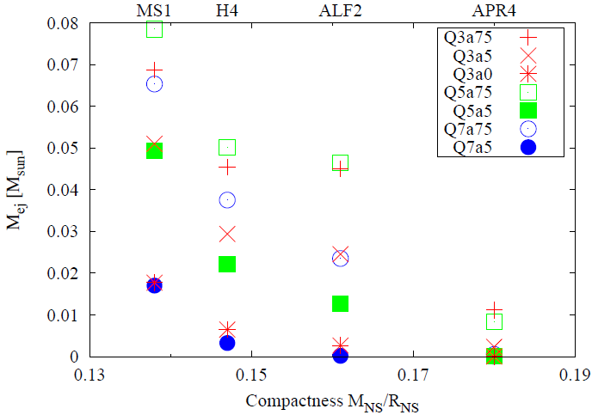
Dynamical ejecta mass
The ejecta mass is large when the NS radius is large
Kyutoku+ (2015)
NS-NS
range
Large radius
Small radius

Slide 66
Misaligned black-hole spin
Spin inclination decreases the ejecta mass
Inclined spin
Kawaguchi, KK+ (2015)
Aligned spin
Large radius
Small radius

Slide 67
Possible magnetar injection
Similar story as in the supernova literature
Gao+ (2013)

Slide 68
Possible gamma-ray detection
Gamma-ray detection may serve as a magnetar test
Takami, KK+ (2014)

Slide 69
Too many lines of lanthanoid
A bunch of energy levels -> complex line structures
-> very high opacity
Kasen+ (2013)

Slide 70
Magnitude evolution in each band
Redder bands are suitable for followup searches
Tanaka+KK+ (2014)

Slide 71
Color evolution
Much redder than supernova explosions
Tanaka+KK+ (2014)

